Slide 1
Mechanical Injuries-III
Dr Filza ali & Dr Gulzaib
Forensic Medicine & Toxicology

Slide 2
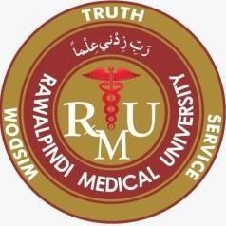

Slide 3
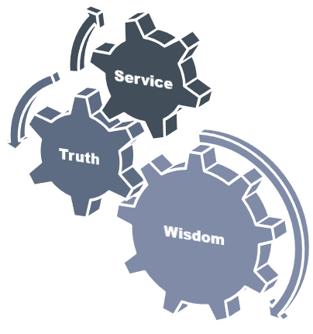
Motto of RMU

Slide 4
Vision of Rawalpindi Medical University The Dream/ Tomorrow
To impart evidence based research oriented medical education
To provide best possible patient care
To inculcate the values of mutual respect and ethical practice of medicine

Slide 5
Umar’s LGIS Model
Prof

Slide 6
SEQUENCE OF LGIS
Learning Objectives
Core concept 70 %
Horizontal integration related to Pathology and Pharmacology 15 %(if applicable)
Relevant clinical concepts and medico legal application of core knowledge / Vertical integration 10%
Research article relevant to the topic 3%
Ethics and family medicine 2%

Slide 7
Describe the different types of punctured wound with calculation of age of a punctured wound.
Briefly describe the features of Stab wound
State the medico-legal importance of Punctured and Stab
wound.
LEARNING OBJECTIVES:

Slide 8
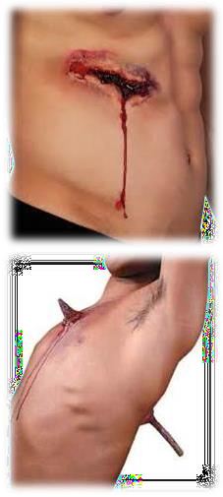
STAB WOUNDS:
Core Concept
“Injury caused by pointed object when it is
driven in through skin
and its depth is the greatest
dimension”
weapons used; knife, dagger, needle, spear,
arrow, scissors, ice pick
Types:
Penetrating stab wound:
when weapon enters a body
cavity such as
thorax or abdomen
ii) only entry wound present

Slide 9
STAB WOUNDS:
Core Concept
Perforating stab wound:
when a weapon after penetrating the
tissues,comes out from the other side making an
exit wound
both entry and exit wound is present
2. Punctured stab wound:
made by pins,needles
M/L importance in Infanticide
fontanelle,nape of neck,axilla.

Slide 10
Characteristics:
Core Concept
Wound of Entry:
Bigger than exit wound
Shape corresponds to the weapon used
Knife ( single edge) چاقو ……………… Wedge shape
Dagger( double edge) خنجر..................elliptical shaped
Size of wound
Smaller than breadth of weapon.
In drawing out, due to Rocking movement than it becomes larger
Margins clear cut and inverted.
In rusty weapon ..………… edges everted & bruised

Slide 11
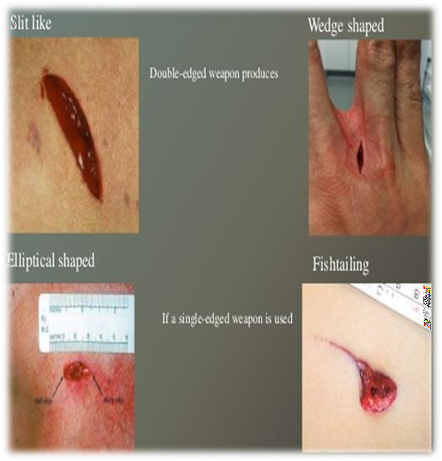
Core Concept
Wound of EXIT:
SMALLER than entry wound
Margins everted
Depth
is greater than its length and breadth

Slide 12
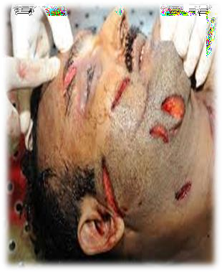
MEDICOLEGAL ASPECTS OF STAB WOUND:
Vertical Integration
Nature & dimensions of the weapon used.
Position of victim and assailant from direction of wound.
Nature of injury and intention
i.e Homicide,
Accident Suicide
Stab wound is converging wound whereas firearm
is diverging wound.

Slide 13
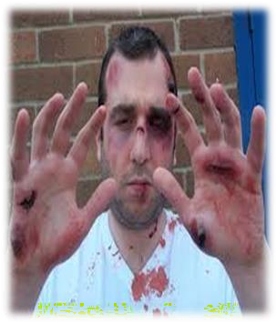
DEFENCE WOUNDS:
Core Concept
“Injuries sustained by a person as a result of his spontaneous
reaction
to protect himself when attacked”
Common site:
grasping surface of hands
ulnar borders of forearms
dorsum of hand
lower limbs in sexual assault
Back
Characteristics:
May be superficial or deep Corresponds to the weapon used
Tells about victim’s awareness , consciousness & ability to resist
e.g. not seen if hands are tied

Slide 14
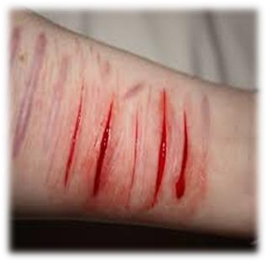
SELF-INFLICTED WOUNDS:
Core Concept
Injuries produced by a person on his body himself (self inflicted) or caused by other acting in agreement with him ( friendly hand
injury).”
Also known as FABRICATED, FACTITIOUS,FORGED or
INVENTED INJURIES
Common sites: easily accessible parts of body e.g top of head, forehead,front and outer side of thighs
Characteristics:
parallel,multiple & superficial
non-involvement of clothes & vital organs
hestation marks may be present
Objects:
a) To support a false charge
b) To avert suspicion

Slide 15
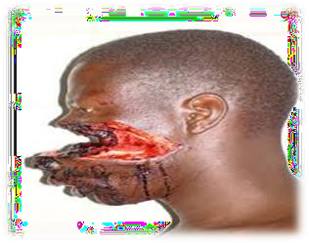
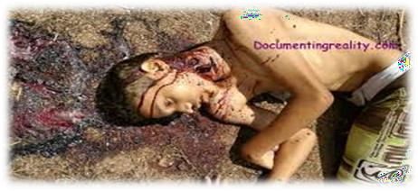
CAUSE OF DEATH FROM WOUNDS:
Core Concept
PRIMARY OR IMMEDIATE CAUSES
excessive bleeding
injury to vital organs
neurogenic shock
Embolism
Crush syndrome
SECONDARY OR INDIRECT CAUSES
infection
thrombosis
sepsis
supervening of new disease
exacerbation of pre-existing disease
neglect of patient
EWING POSTULATE

Slide 16
Core Concept
FEATURES | LACERATION | INCISED WOUND | STAB WOUND
Type of weapon | Blunt weapon | Sharp weapon | Pointed weapon
Shape | Irregular | Linear/Spindle | Depends on type of weapon
Site | Usually over bony prominences | Anywhere | Usually on chest and abdomen
Surrounding | Burised | Normal | Abraded/Bruised
Margins | Irregular | Clean cut and everted | Entry wound inverted
Dimensions | Variable | Length > Depth | Length < Depth
Hair & Blood Vessels | Crushed | Clean cut | Variable
Hemorrhage | Less | Profuse | Variable
Foreign body | + | _ | +/-

Slide 17
RESEARCH
https://www.ncbi.nlm.nih.gov/pmc/articles/PMC1720275/
https://www.ncbi.nlm.nih.gov/pmc/articles/PMC5771278/
https://www.ncbi.nlm.nih.gov/books/NBK554465/
https://my.clevelandclinic.org/health/diseases/25079-abrasion
RESEARCH

Slide 18
The 4 basic ethical principles of
ETHICS
Beneficence
Non-Maleficence
Respect for autonomy
Justice
https://www.ncbi.nlm.nih.gov/pmc/articles/PMC2967260/
BIOMEDICAL ETHICS

Slide 19
Family Medicine
Patients attending an emergency department (ED) are entitled to assume that they will be treated in accordance with the best available evidence. The emergency physician (EP) has a responsibility to expand the fund of knowledge that underpins best evidence by means of clinical studies of new technologies and interventions:
NSAIDs , such as ibuprofen, help decrease swelling, pain, and fever. This medicine is available with or without a doctor's order. NSAIDs can cause stomach bleeding or kidney problems in certain people. If you take blood thinner medicine, always ask if NSAIDs are safe for you.
FAMILY MEDICINE

Slide 20
How To Access Digital Library
1. Go to the website of HEC National Digital Library.
2. On Home Page, click on the INSTITUTES.
3. A page will appear showing the universities from Public and Private Sector and other Institutes which have access to HEC National Digital Library HNDL.
4. Select your desired Institute.
5. A page will appear showing the resources of the institution
6. Journals and Researches will appear
7. You can find a Journal by clicking on JOURNALS AND DATABASE and enter a keyword to search for your desired journal.

Slide 21
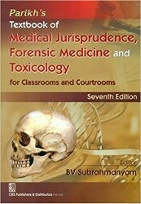
TEXT BOOKS & PRACTICAL NOTEBOOK:
Principles & Practice of Forensic Medicine.
by Nasib R. Awan
Parikh’s Textbook of Medical Jurisprudence,
Forensic Medicine & Toxicology.
Practical Manual Of Forensic Medicine
& Toxicology

Slide 22
THANK YOU

