Slide 1
Mechanical Injuries-II
Dr Filza ali &Dr Shahida Forensic Medicine & Toxicology

Slide 2
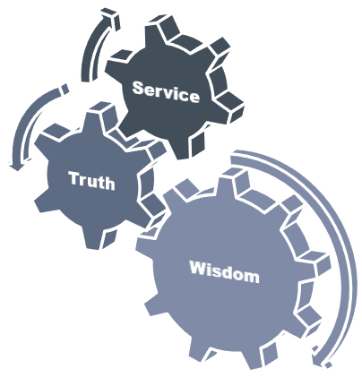
Motto of RMU

Slide 3
Vision of Rawalpindi Medical University The Dream/ Tomorrow
To impart evidence based research oriented medical education
To provide best possible patient care
To inculcate the values of mutual respect and ethical practice of medicine

Slide 4
Umar’s LGIS Model
Prof

Slide 5
SEQUENCE OF LGIS
Learning Objectives
Core concept 70 %
Horizontal integration related to Pathology and Pharmacology 15 %(if applicable)
Relevant clinical concepts and medico legal application of core knowledge / Vertical integration 10%
Research article relevant to the topic 3%
Ethics and family medicine 2%

Slide 6
Describe and differentiate between the features of lacerated wound and incised wound
Briefly describe the types of laceration.
Differentiate between incised & lacerated wounds.
State the medico-legal importance of both incised and lacerated
wound.
LEARNING OBJECTIVES:

Slide 7
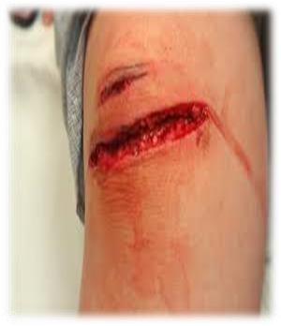
LACERATION:
Core Concept
“It is a wound with rupture of the skin or tears of the underlying tissues as a result of the application of blunt force”
The offending object and amount of force determines the type & degree of laceration
There is no relation between shape and size of wound and the weapon producing it.
Lacerations are more commonly produced on the areas of the body where underlying structure is a rigid structure e.g bone
So if blow over cheek bone………Laceration. an identical blow on cheek ……... only bruise

Slide 8
Characteristics of Laceration:
Core Concept
Edges/Margin….........................irregular, swollen, torn, inverted
Angles ………...………………….….....irregular
Deeper tissues ………..…….…..…..unevenly divided (tissue bridging)
Surrounding tissue ………….……..contused and swollen
Bleeding ………..………………….…..scanty (blood vessels
crushed)
Leaves a Scar

Slide 9
Core Concept

Slide 10
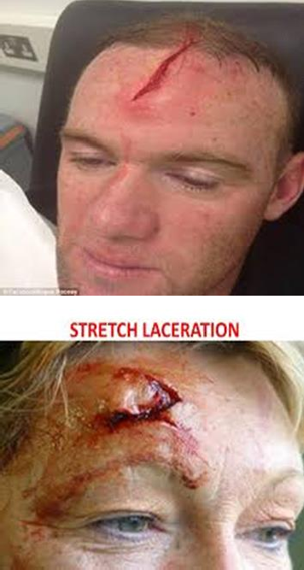
Core Concept
SPLIT LACERATION:
“Lacerations produced due to crushing of skin between two
hard objects i.e underlying bone and object responsible for
injury’’
Caused By: blunt perpendicular impact
Results in linear split in the skin, which simulates an incised
wound
Common Site: scalp,face,hands and lower legs

Slide 11
Core Concept
STRETCH LACERATION:
“Laceration produced due to overstretching of the skin till it splits and produces a flap ”
Caused by: Blunt tangential impact
Flap produced indicates the Direction of the force
Examples: i) Glancing kicks with a boot
ii) head strikes with motorcar wind screen
during accident

Slide 12
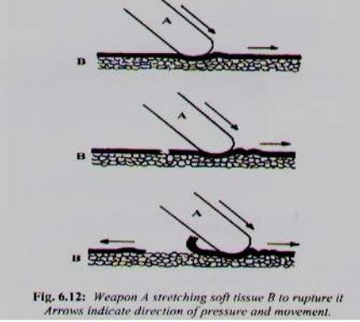
Core Concept

Slide 13
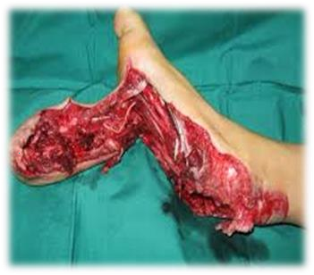
3. Avulsions: ( Grind Laceration)
Core Concept
“Laceration caused by grinding compression of
tissues,causing degloving of skin and crushing
of underlying
muscles”
Caused by: Horizontal impact
Examples: crushing injuries by machinery
Vehicle wheel passing over a limb

Slide 14
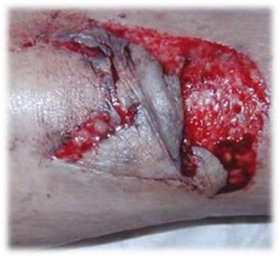
4. TEARS:
Core Concept
“LACERATION CAUSED BY IMPACT AGAINST IRREGULAR OR SHARP OBJECTS”
Caused by: irregularly directed impact
Examples: i) blows from broken bottles
ii) fall on earthen-ware pots

Slide 15
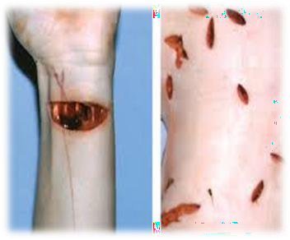
INCISED WOUND:
Core Concept
“Injury caused by a weapon with a sharp cutting
edge when it is drawn across the skin”
The long axis of these wounds is their length rather than depth. The weapons include knives, razors, broken pieces of glasses.
Caused by: Sharp edged weapon

Slide 16
Characteristics of Incised wound:
Core Concept
Edges…………………………………….smooth, clean cut, even , everted
Angles ………………………………… everted
Deeper tissues……………………..clean, evenly divided
Surrounding tissues…….……….free from bruising
Bleeding……………………………….freely and profusely
Measurements …………………..Length of wound is greater than depth
Clothes involved…………………..cut marks present on the clothes
Shape…………………………………...spindle shape or linear

Slide 17
Hesitation / Tentative Cuts:
Core Concept
“These are preliminary cuts made by a person intending to commit suicide by a cutting instrument before gathering sufficient courage to make a final deep
incision”
Common site: wrist and cut throat
Characteristics:
Small, multiple, parallel and superficial cuts
Seen at the commencement of the incised wound and
merge with the main incision
*TAILING:
Tailing may determine handedness of person

Slide 18
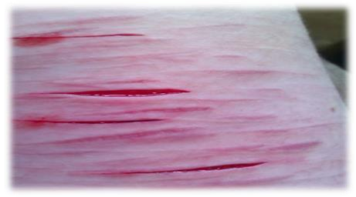
Tailing :
Core Concept
Towards the end of the cut, the wound becomes increasingly shallow,
known as the tailing of the wound. It indicates the direction.

Slide 19
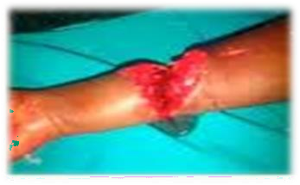
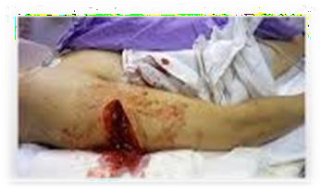
Chop Wounds:
Core Concept
“ INJURIES due to sharp edge of a heavy cutting weapon”
Example: Axe, Cleaver, Sabre, Sword

Slide 20
MEDICOLEGAL SIGNIFANCE OF INCISED WOUND:
Core Concept
HOMICIDAL INCISED WOUNDS: i) deep
associated with defense injuries
on any part of the body
common site: face,neck,genitals
SUICIDAL INCISED WOUNDS: i) multiple, superimposed, varying depth
Self inflicted
accessible parts of the body
common site: elbows,wrist,throat,groin
ACCIDENTAL INCISED WOUNDS: i) on any part of the body
irregular, clean cut and everted margins
commonly in traffic injuries, fall on broken glass bottles

Slide 21
Difference between Incision & Split Laceration:
Core Concept
Character | Incision | Split Laceration
Margins | Straight | Ragged
Wound bed | Clean out | Bridging
Bleeding | Profuse | Scanty
Blood vessels | Cut | Crushed
Hair bulbs | Cut | Crushed
Trace evidence (Foreign body) | Mostly absent | Mostly present
Infection | Less | More

Slide 22
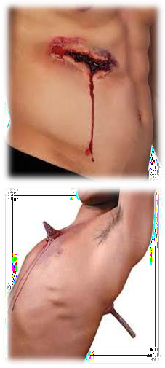
STAB WOUNDS:
Core Concept
“Injury caused by pointed object when it is
driven in through skin
and its depth is the greatest
dimension”
weapons used; knife, dagger, needle, spear,
arrow, scissors, ice pick
Types:
Penetrating stab wound:
when weapon enters a body
cavity such as
thorax or abdomen
only entry wound present

Slide 23
STAB WOUNDS:
Core Concept
Perforating stab wound:
when a weapon after penetrating the
tissues,comes out from the other side making an
exit wound
both entry and exit wound is present
Punctured stab wound:
made by pins,needles
M/L importance in Infanticide
fontanelle,nape of neck,axilla.

Slide 24
Characteristics:
Core Concept
Wound of Entry:
Bigger than exit wound
Shape corresponds to the weapon used
Knife ( single edge) وقاچ ……………… Wedge shape
Dagger( double edge) رجنخ ..................elliptical shaped
Size of wound
Smaller than breadth of weapon.
In drawing out, due to Rocking movement than it becomes larger
Margins clear cut and inverted.
In rusty weapon ..………… edges everted & bruised

Slide 25
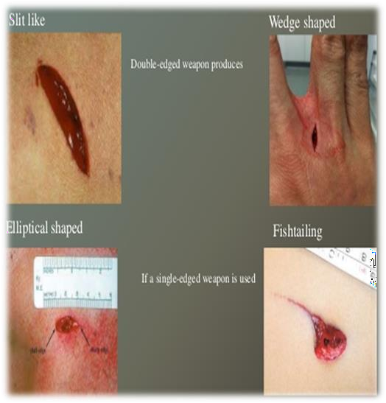
Core Concept
Wound of EXIT:
SMALLER than entry wound
Margins everted
Depth
is greater than its length and breadth

Slide 26
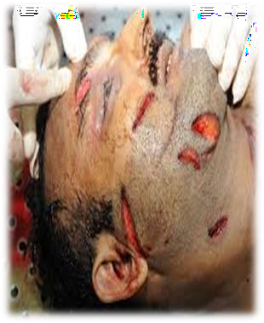
MEDICOLEGAL ASPECTS OF STAB WOUND:
Core Concept
Nature & dimensions of the weapon used.
Position of victim and assailant from direction of wound.
Nature of injury and intention
i.e Homicide, Accident Suicide
Stab wound is converging wound whereas firearm is diverging wound.

Slide 27
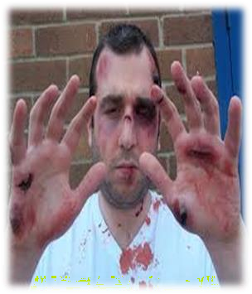
DEFENCE WOUNDS:
Core Concept
“Injuries sustained by a person as a result of his spontaneous reaction
to protect himself when attacked”
Common site:
grasping surface of hands
ulnar borders of forearms
dorsum of hand
lower limbs in sexual assault
Back
Characteristics:
May be superficial or deep Corresponds to the weapon used
Tells about victim’s awareness , consciousness & ability to resist
e.g. not seen if hands are tied

Slide 28
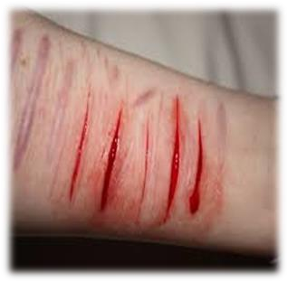
SELF-INFLICTED WOUNDS:
Core Concept
Injuries produced by a person on his body himself (self inflicted) or caused by other acting in agreement with him ( friendly hand
injury).”
Also known as FABRICATED, FACTITIOUS,FORGED or
INVENTED INJURIES
Common sites: easily accessible parts of body e.g top of head, forehead,front and outer side of thighs
Characteristics:
parallel,multiple & superficial
non-involvement of clothes & vital organs
hestation marks may be present
Objects:
a) To support a false charge
b) To avert suspicion

Slide 29
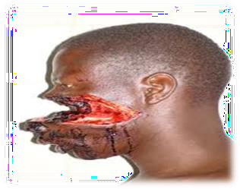
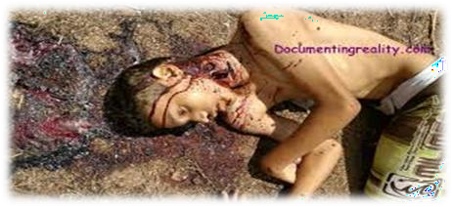
CAUSE OF DEATH FROM WOUNDS:
Core Concept
PRIMARY OR IMMEDIATE CAUSES
excessive bleeding
injury to vital organs
neurogenic shock
Embolism
Crush syndrome
SECONDARY OR INDIRECT CAUSES
infection
thrombosis
sepsis
supervening of new disease
exacerbation of pre-existing disease
neglect of patient
EWING POSTULATE

Slide 30
Core Concept
FEATURES | LACERATION | INCISED WOUND | STAB WOUND
Type of weapon | Blunt weapon | Sharp weapon | Pointed weapon
Shape | Irregular | Linear/Spindle | Depends on type of weapon
Site | Usually over bony prominences | Anywhere | Usually on chest and abdomen
Surrounding | Burised | Normal | Abraded/Bruised
Margins | Irregular | Clean cut and everted | Entry wound inverted
Dimensions | Variable | Length > Depth | Length < Depth
Hair & Blood Vessels | Crushed | Clean cut | Variable
Hemorrhage | Less | Profuse | Variable
Foreign body | + | _ | +/-

Slide 31
RESEARCH
https://www.ncbi.nlm.nih.gov/pmc/articles/PMC1720275/
https://www.ncbi.nlm.nih.gov/pmc/articles/PMC5771278/
https://www.ncbi.nlm.nih.gov/books/NBK554465/
https://my.clevelandclinic.org/health/diseases/25079-abrasion
RESEARCH

Slide 32
The 4 basic ethical principles of
ETHICS
Beneficence
Non-Maleficence
Respect for autonomy
Justice
https://www.ncbi.nlm.nih.gov/pmc/articles/PMC2967260/
BIOMEDICAL ETHICS

Slide 33
FAMILY MEDICINE
Patients attending an emergency department (ED) are entitled to assume that they will be treated in accordance with the best available evidence. The emergency physician (EP) has a responsibility to expand the fund of knowledge that underpins best evidence by means of clinical studies of new technologies and interventions:
NSAIDs , such as ibuprofen, help decrease swelling, pain, and fever. This medicine is available with or without a doctor's order. NSAIDs can cause stomach bleeding or kidney problems in certain people. If you take blood thinner medicine, always ask if NSAIDs are safe for you.
FAMILY MEDICINE

Slide 34
How To Access Digital Library
1. Go to the website of HEC National Digital Library.
2. On Home Page, click on the INSTITUTES.
3. A page will appear showing the universities from Public and Private Sector and other Institutes which have access to HEC National Digital Library HNDL.
4. Select your desired Institute.
5. A page will appear showing the resources of the institution
6. Journals and Researches will appear
7. You can find a Journal by clicking on JOURNALS AND DATABASE and enter a keyword to search for your desired journal.

Slide 35
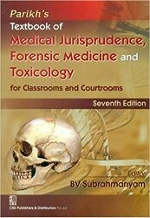
TEXT BOOKS & PRACTICAL NOTEBOOK:
Principles & Practice of Forensic Medicine.
by Nasib R. Awan
Parikh’s Textbook of Medical Jurisprudence,
Forensic Medicine & Toxicology.
Practical Manual Of Forensic Medicine
& Toxicology

Slide 36
THANK YOU

