Slide 1
Mechanical Injuries-I
Dr Filza ali &Dr Urooj
Forensic Medicine & Toxicology

Slide 3
Motto of RMU

Slide 4
Vision of Rawalpindi Medical University The Dream/ Tomorrow
To impart evidence based research oriented medical education
To provide best possible patient care
To inculcate the values of mutual respect and ethical practice of medicine

Slide 5
Umar’s LGIS Model
Prof

Slide 6
SEQUENCE OF LGIS
Learning Objectives
Core concept 70 %
Horizontal integration related to Pathology and Pharmacology 15 %(if applicable)
Relevant clinical concepts and medico legal application of core knowledge / Vertical integration 10%
Research article relevant to the topic 3%
Ethics and family medicine 2%

Slide 7
Define mechanical injury and describe the classification of mechanical injuries
Briefly describe the mechanism of production of a mechanical injury.
Explain the different types of Abrasions and Bruise\ contusion.
Briefly state the method of duration or age estimation of an injury with respect to type of injury.
Describe the medicolegal importance of age estimation of an injury.
LEARNING OBJECTIVES:

Slide 8
MECHANICAL INJURY:
Injury where transfer of kinetic energy occurs
Core Concept
TRAUMATOLOGY:
Science which deals with all aspects of mechanical injury
FORENSIC TRAUMATOLOGY:
It deals with interpretation and certification of trauma in the light of law

Slide 9
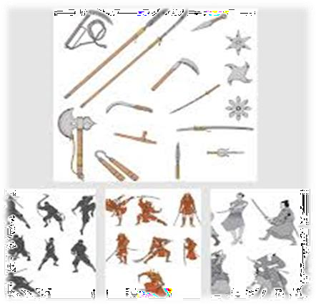
Factors affecting Wound Production Or Mechanism of Injury
Core Concept
Weapons:
Type of weapon
Mechanical force
Direct force
Indirect force
Weight and velocity of weapon
Type of tissues
Resistance of the tissues
Motion of the body part

Slide 10
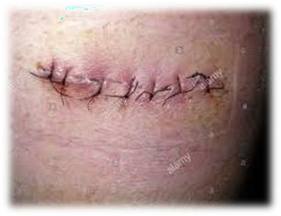
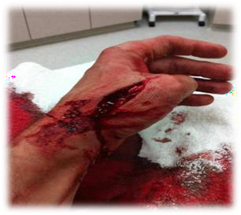
Disruption of the anatomical continuity of tissues of the body
Core Concept
WOUND:(not a legal term)
INJURY:(legal term Sec 44PPC)
It is harm illegally caused to any person in body, mind, reputation and property
HURT:
“In law it means causing of pain, harm, disease, infirmity,
injury, impairing, cause disabling, dismembering any organ of the body or part thereof without causing death.”
*All wounds are injuries, all injuries are not wound

Slide 11
Types of body injuries:
Core Concept
Mechanical injuries
Firearm injuries
Road Traffic injuries
Thermal injuries
Mechanical Injuries: --------------> according to weapon used
Abrasion -------------------------> blunt force trauma
ii. Bruises ------------------------------>
blunt force trauma blunt force trauma sharp force trauma sharp force trauma firearm trauma
Lacerations --------------------------->
Incised wounds --------------------->
Stab wounds ------------------------>
Firearm injuries ------------------->
Other injuries: --------------------> irrespective of weapon used
Defense wounds
Self-inflicting wounds

Slide 12
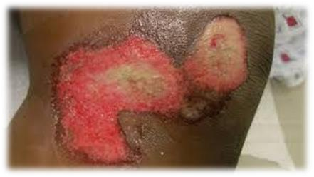
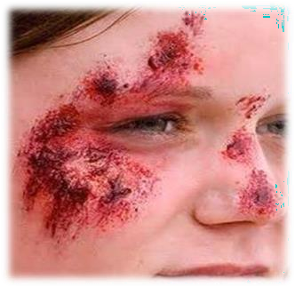
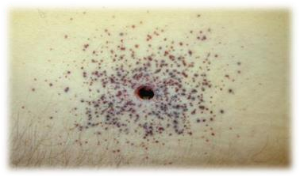
Core Concept

Slide 13
1. Abrasions:
Core Concept
A superficial injury involving only the superficial layer of skin due to a mechanical force
Caused by:
Friction between skin and rough object.
Characteristics:
Bleeds slightly
Heels rapidly
Leaves no scar
Classification of Abrasion:
Scratch
Graze
Imprint/pressure/contact

Slide 14
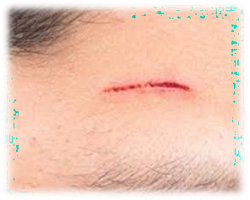
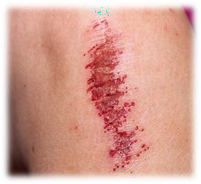
1. Scratch:
Core Concept
Linear injuries produced by rough object running across the skin.
e.g. Rough stone, pin, thorn, finger nail.
Direction of injury is indicated by
sharp edge initially --------------> heaped up epithelium at the end
Graze: (brush, friction burn)
Injury is produced when broad surface of the skin slides against a rough surface:
It resembles a burn produced by friction, therefore known as a friction burn.
Commonly seen in traffic accidents, when the body is dragged
Contaminated with grit
Direction of injury is indicated by
serrated border initially -------------> heaped up epithelium at the
end

Slide 15
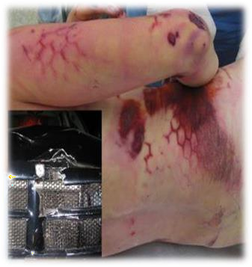
3. IMPRINT:
Core Concept
PRESSURE,CONTACT , PATTERNED ABRASION
Injury produced by direct impact, pressure, contact with some object which stamps its shape upon the skin.
Ligature mark in hanging
Nail and thumb marks in manual strangulation
Teeth marks in biting
Whip mark in beating
Radiator or tyre marks in accidents
Muzzle mark in gunshot injuries

Slide 16
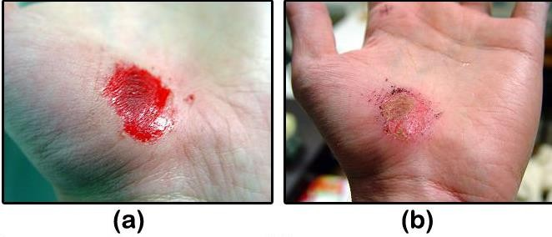
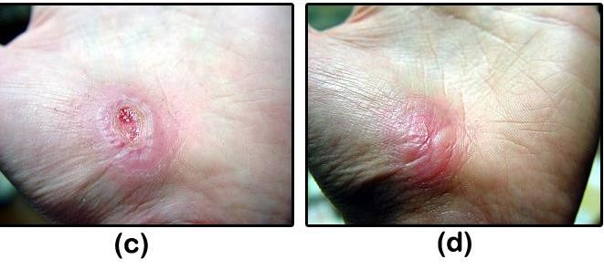
AGE OF ABRASION
Core Concept
Bright red………………………….. Fresh abrasion
Red Scab formation………………......12-24 hours
Reddish brown scab …………….........2-3 days
Peripheral growth of epithelium………….4-7days
Complete healing (scab separation)……10days
Medico-legal aspects:
Site of impact
Identification of object
Cause of injury
Direction of injury
Time of injury
Any infection
Confusion with burns

Slide 17
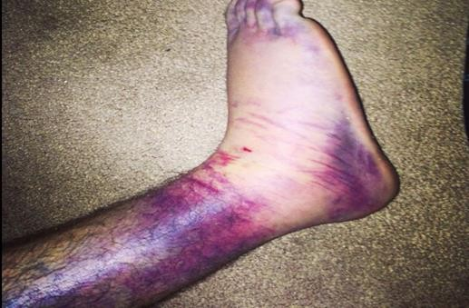
2. BRUISES:
Core Concept
Also known as contusions
“It is an infilteration or extravasation of blood into the tissues,due to rupture of small vessels as a result of blunt force”
Bruise is visible through the skin
Contusion is bleeding in the viscera's e.g. spleen, liver and not visible externally also known as
Deep Bruise.
Classification of bruise:
Intra-Dermal Bruise
Subcutaneous Bruise (usual)
small pin-head
Hematoma
Deep Bruise

Slide 18
Colour changes/ Age of Bruise:
Core Concept
Red | (Hemoglobin) | Fresh bruise
Blue | (deoxygenated Hb) | 1 day
Bluish black or brown | (hemosiderin, iron present) | 2-4 days
Green | (hemotoidin, iron not present) | 5-7days
Yellow | (Bilirubin) | 7-10 days
Normal skin | (phagocytes remove pigments) | 14-15 days

Slide 19
Factors modifying appearance of a bruise:
Core Concept
Site of the injury
Vascularity of the part
Age
Sex
Color of skin
Natural disease
Gravitational shift of the blood

Slide 20
Gravitational Shift
Core Concept
The facial planes at the site of impact may prevent blood from reaching the surface.
The bruise may not appear at the site of injury and obeys law of gravity and therefore known as ectopic bruise
e.g :
1. Head
Bruise around the eye (spectacle hematoma/black eye/Racoon’s eye)
Bruise behind the ear (Battles sign ) Bruise on outer aspect of lower thigh Bruising around the knee
Vertex of head
Fracture femur Head
Blow on the thigh
Blow to the calf muscles Bruise around the ankle

Slide 21
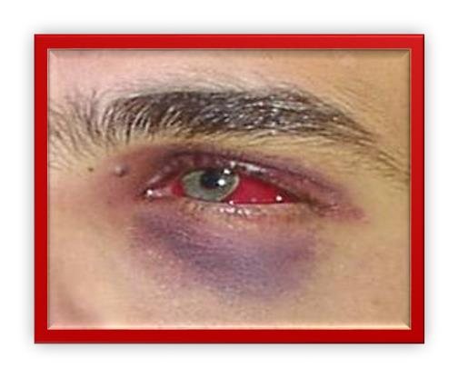
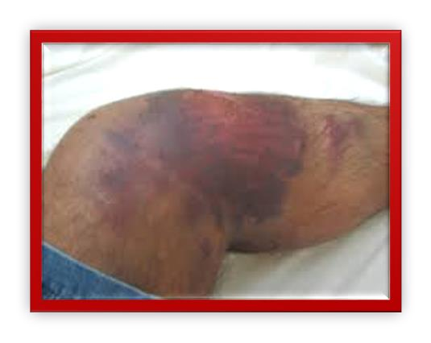
Core Concept
(Spectacle hematoma
black eye/Racoon’s eye

Slide 22
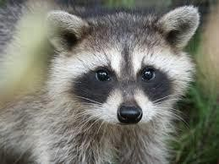
Core Concept
What is RACCON EYES?????
What is a Raccoon????

Slide 23
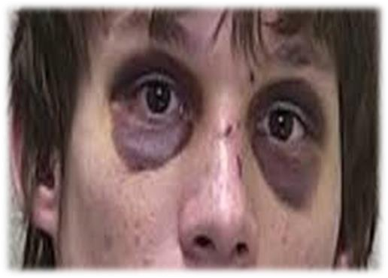
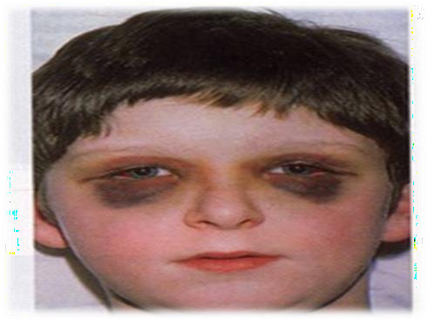
Core Concept

Slide 24
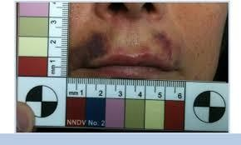
Medico-legal Aspects of Bruise:
Core Concept
Identification of object
Degree of violence
Cause of injury
Time of injury
Possibility of infection

Slide 25
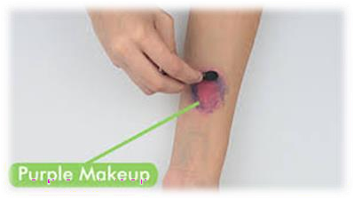
ARTIFICAL/FALSE BRUISE/PSEUDO BRUISES:
Core Concept
To substantiate a false charge of an assault
Artificial bruises are sometimes formed by the application of irritant
substances e.g.
marking nut juice
calotropis
root of plumbago

Slide 26
Core Concept
TRUE BRUISE | FALSE BRUISE
Colour changes are present | No Colour changes are seen
Margins are much defined | Margins are not much defined
Swelling is seen | No swelling is seen
Extravasation of blood is present | No extravasation is present
Blood coagulation is present | No blood coagulation
On any part of body | Only at accessible part
No itching | Itching is present
Area is not corroded | Signs of irritation or corrosion are seen
Chemical tests are negative | Chemical tests are positive
Blood is present in true bruise | Serum is present in false bruise

Slide 27
RESEARCH
https://www.ncbi.nlm.nih.gov/pmc/articles/PMC1720275/
https://www.ncbi.nlm.nih.gov/pmc/articles/PMC5771278/
https://www.ncbi.nlm.nih.gov/books/NBK554465/
https://my.clevelandclinic.org/health/diseases/25079-abrasion
RESEARCH

Slide 28
The 4 basic ethical principles of
ETHICS
Beneficence
Non-Maleficence
Respect for autonomy
Justice
https://www.ncbi.nlm.nih.gov/pmc/articles/PMC2967260/
BIOMEDICAL ETHICS

Slide 29
FAMILY MEDICINE
Patients attending an emergency department (ED) are entitled to assume that they will be treated in accordance with the best available evidence. The emergency physician (EP) has a responsibility to expand the fund of knowledge that underpins best evidence by means of clinical studies of new technologies and interventions:
NSAIDs , such as ibuprofen, help decrease swelling, pain, and fever. This medicine is available with or without a doctor's order. NSAIDs can cause stomach bleeding or kidney problems in certain people. If you take blood thinner medicine, always ask if NSAIDs are safe for you.
FAMILY MEDICINE

Slide 30
How To Access Digital Library
1. Go to the website of HEC National Digital Library.
2. On Home Page, click on the INSTITUTES.
3. A page will appear showing the universities from Public and Private Sector and other Institutes which have access to HEC National Digital Library HNDL.
4. Select your desired Institute.
5. A page will appear showing the resources of the institution
6. Journals and Researches will appear
7. You can find a Journal by clicking on JOURNALS AND DATABASE and enter a keyword to search for your desired journal.

Slide 31
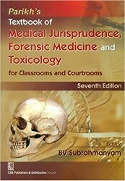
TEXT BOOKS & PRACTICAL NOTEBOOK:
Principles & Practice of Forensic Medicine.
by Nasib R. Awan
Parikh’s Textbook of Medical Jurisprudence,
Forensic Medicine & Toxicology.
Practical Manual Of Forensic Medicine
& Toxicology

Slide 32
THANK YOU

