Slide 2
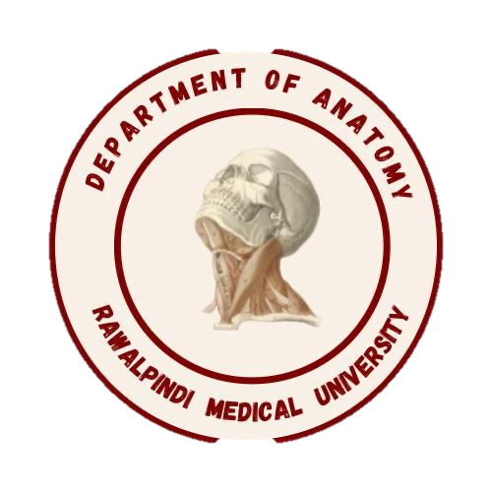
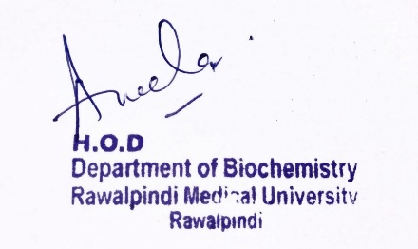
MSKII Module 1st Year MBBS(LGIS)Elastin
Presenter: Dr Uzma Zafar Date: 01-02-25
Dept of Biochemistry
RMU

Slide 3
Motto, Vision, Dream
To impart evidence based research oriented medical education
To provide best possible patient care
To inculcate the values of mutual respect and ethical practice of medicine
Wisdom
Truth
Service

Slide 4
Professor Umar Model of Integrated Lecture

Slide 5
Learning Objectives
At the end of this session students should be able to
Understand elastin structure
Differentiate between elastin and collagen
Associate clinicopathological conditions

Slide 6
Elastin
Core Knowledge
Elastin is a fibrous protein that resembles a rubber band — it can stretch out (extend) and shrink back (recoil). It's a major component of tissues in your body that require stretchiness, like your lungs, bladder, large blood vessels and some ligaments

Slide 7
Core Knowledge
Incontrast to collagen, which forms fibers that are tough and have high tensile strength, elastin is a connective tissue protein with rubber-like properties
Elastic fibers composed of elastin and glycoprotein microfibrils
They can be stretched to several times their normal length but recoil to their original shape when the stretching force is relaxed

Slide 8
Core Knowledge
Elastin
fibers

Slide 9
Core Knowledge
Structure
Nonpolar (for example, glycine, alanine, and valine). Elastin is also rich in proline and lysine but contains scant hydroxyproline and hydroxylysine
Amino acid
sequence

Slide 10
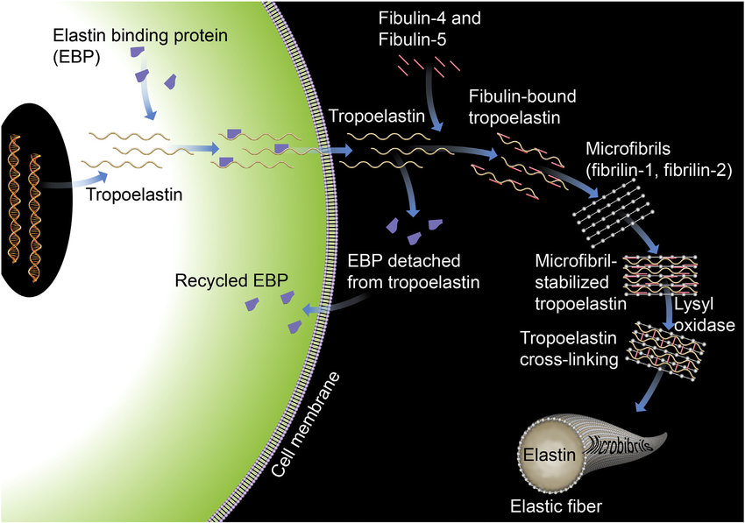
Core Knowledge
Biosynthesis

Slide 11
Core Knowledge
Elastin is an insoluble protein polymer synthesized from a precursor, tropoelastin. Tropoelastin is secreted by the cell into the extracellular space. There, it interacts with specific glycoprotein microfibrils, such as fibrillin, which function as a scaffold onto which tropoelastin is deposited. Some of the lysyl side chains of the tropoelastin polypeptides are oxidatively deaminated by lysyl oxidase, forming allysine residues.
Three of the allysyl side chains plus one unaltered Lysyl side chain from the same or neighbouring polypeptides form a desmosine cross-link
This produces elastin, an extensively interconnected, rubbery network that can stretch and bend in any direction when stressed, giving connective tissue elasticity

Slide 12
Core Knowledge
Tropoelastin polypeptides are oxidatively deaminated

Slide 13
Core Knowledge
Desmosine
cross-link

Slide 14
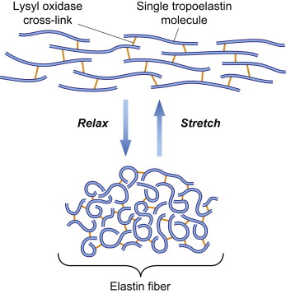
Core Knowledge
Desmosine
cross-link

Slide 15
Core Knowledge
Difference between collagen and elastin
Properties | Collagen | Elastin
Structure | Triple helix | Random coiled
Function | Strength | Elasticity
Colour | White colour | Yellow colour
Location | Cartilage, bones, tendons | Blood vessels, alveoli, bladder wall
Flexibility | Flexible | 100 times flexible then collagen
Abundance | Most abundant protein in body | Less abundant then collagen
Diseases | OI, EDS | COPD, Marfan syndrome

Slide 16
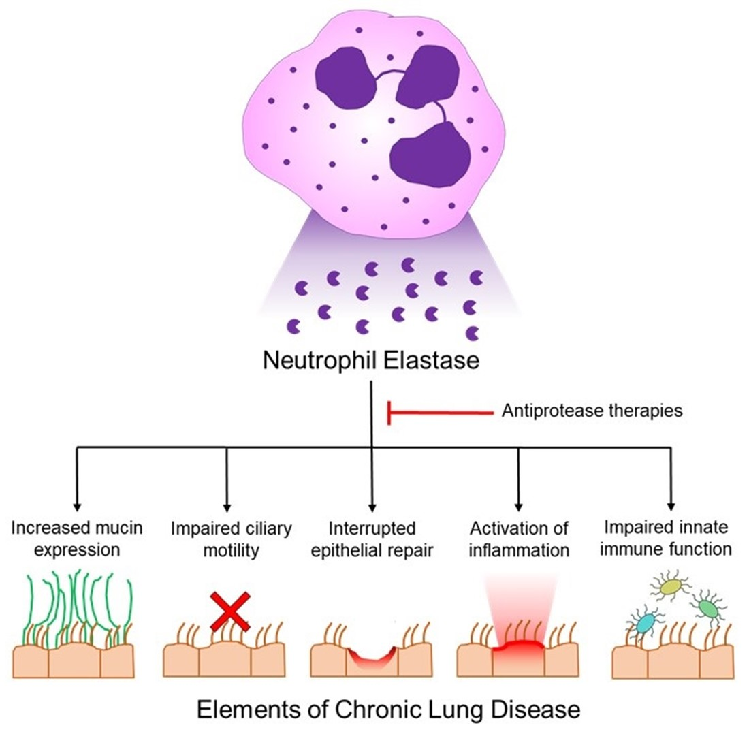
Core Knowledge
α1-Antitrypsin (ATT)
Alpha-1 antitrypsin is a protease inhibitor produced primarily in the liver. It inhibits the neutrophil elastase activity in the lung and hence can protect it from proteolytic damage

Slide 17
Vertical Integration
Marfan syndrome
Mutations in the fibrillin-1 protein are responsible for Marfan syndrome, a connective tissue disorder characterized by impaired structural integrity in the skeleton, the eye, blood vessels and the CVS. With this disease, abnormal fibrillin protein is incorporated into microfibrils along with normal fibrillin, inhibiting the formation of functional microfibrils

Slide 18
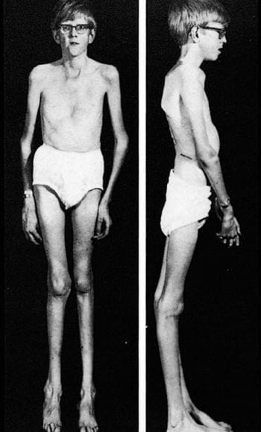
Vertical Integration
Marfan syndrome
Tall and slender build
Disproportionate long arms, legs and fingers
A breastbone that protrudes outward or dips inward
A high, arched palate and crowded teeth
Heart murmurs
An abnormally curved spine
Flat feet

Slide 19
Suggested Research Article
Spiral Integration

Slide 20
Spiral Integration
Family Medicine
Family Medicine plays important role in following manner:
Diagnosis
Education & Counselling
Dietary Guidance
Monitoring

Slide 21
Spiral Integration
Bioethics
Ethical Considerations
From an ethical standpoint, the scenario raises considerations regarding patient autonomy, informed consent, and confidentiality
The physician must ensure that patient fully understands her diagnosis, treatment options, and potential implications
Discuss the necessity of a healthy lifestyle & treatment plan. This requires clear communication and understanding of risks and benefits.
Additionally, the physician must respect patient’s privacy and confidentiality throughout the diagnostic and treatment process

Slide 22
Spiral Integration
Artificial Intelligence
Role of AI in Management
AI can potentially aid in enhancing diagnostic accuracy and efficiency.
AI-powered decision support systems can also help clinicians in selecting appropriate treatment modalities
AI-driven predictive models may help anticipate the risk of complications of the Disease in susceptible populations

Slide 23
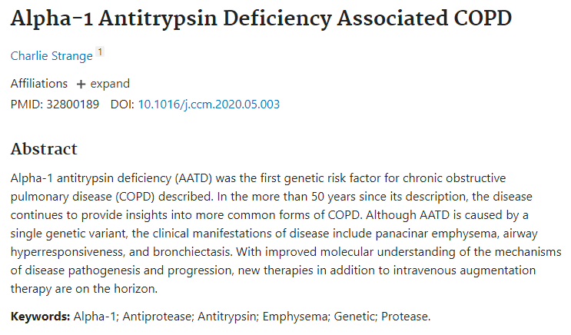
Suggested research article
Spiral Integration
Research Article
https://doi.org/10.1016/j.ccm.2020.05.003

Slide 24
How To Access Digital Library
Steps to Access HEC Digital Library
Go to the website of HEC National Digital Library
On Home Page, click on the INSTITUTES
A page will appear showing the universities from Public and Private Sector and other Institutes which have access to HEC National Digital Library HNDL
Select your desired Institute
A page will appear showing the resources of the institution
Journals and Researches will appear
You can find a Journal by clicking on JOURNALS AND DATABASE and enter a keyword to search for your desired journal

Slide 25
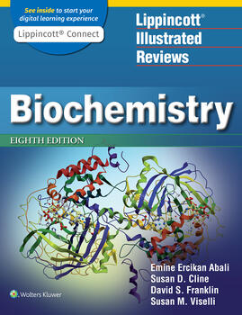
Learning Resources
Lippincott Illustrated Review,
Biochemistry, (Eighth edition,
chapter 4, Pages 49 and 50)
Related articles
Google images

Slide 26
THANK YOU

