Slide 1


Slide 2


1st Year MBBS
MSK-1 Module
Small Group Discussion (SGD)
Minerals
Presenter: Dr Uzma Zafar Date: 01-02-25
Deptt of Biochemistry
RMU

Slide 3
Motto, Vision, Dream
To impart evidence based research oriented medical education
To provide best possible patient care
To inculcate the values of mutual respect and ethical practice of medicine
Wisdom
Truth
Service

Slide 4
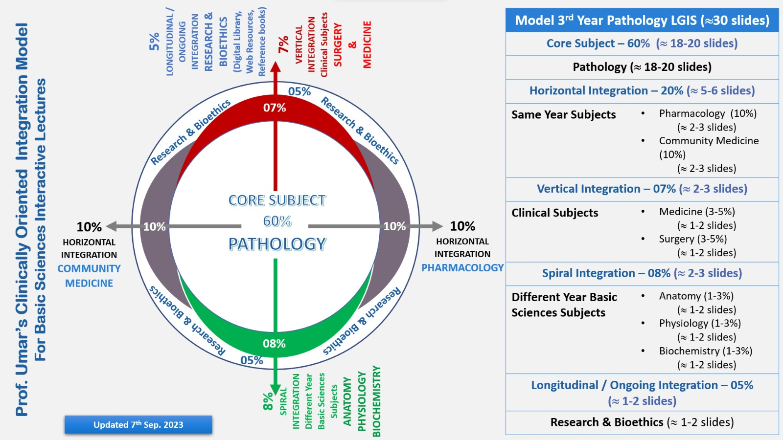
Professor Umar Model of Integrated Lecture

Slide 5
Learning Objectives
At the end of the SGD, students will be able to:
Classify the minerals into macro and micro minerals
Describe the role of minerals in the body as a cofactor for various enzymes.
Differentiate between Trace minerals and ultra trace minerals.

Slide 6
Minerals
Core Knowledge
Minerals are inorganic in nature.
They are essential for vital processes. Minerals can be classified as
Macro minerals
Daily requirement > 100 mg
It forms 60-80 % of body’s inorganic material e.g. Calcium, Phosphorous, Magnesium, Sodium, Potassium, Chloride, Sulfur.
Micro minerals
Daily requirement < 100 mg, also known as Trace elements
Micro minerals are divided into
Essential trace elements
Additional trace elements
Toxic trace elements

Slide 7
Calcium
Core Knowledge
Introduction:
Calcium is a macro mineral.
Daily requirement > 100 mg/day
It is the most abundant mineral
It takes part in structural formation
Total body calcium:
1-1.4kg, 1-2% of body weight
(99% is present in bones and teeth)
(1% is present in remaining parts of the body)
Normal Plasma Calcium level: 9-11 mg/dl

Slide 8
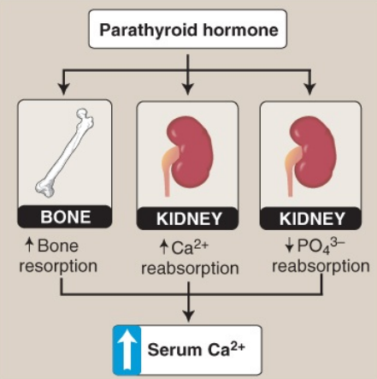
Effect of parathyroid hormone on serum calcium (Ca 2+ ). PO4 3– = phosphate
Core Knowledge

Slide 9
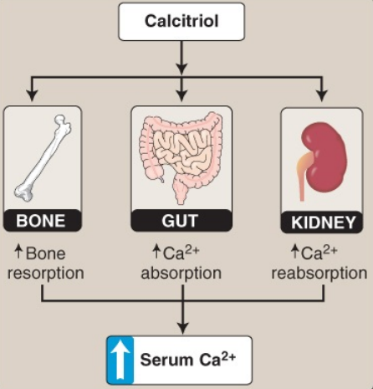
Effect of Calcitriol on Serum Calcium
Core Knowledge

Slide 10
Phosphorus
Core Knowledge
It is a macro mineral
Total body phosphorous 700 grams
85% in skeleton
10% in muscles
05% in others
Normal levels
Whole blood level 48 mg /dl as
Inorganic phosphate esters
Lipid phosphorous

Slide 11
Copper
Core Knowledge
Copper Cu is a key component of several enzymes that play critical functions in the body.
These include ferroxidases such as the ceruloplasmin and hephaestin involved in the oxidation of ferrous iron (Fe 2+ ) to the ferric form (Fe 3+ ) that is required for its intracellular storage or transport through blood.
Meat, shellfish, nuts, and whole grains are good dietary sources of Cu. Dietary deficiency is uncommon.
Menkes syndrome and Wilson disease are genetic causes of Cu deficiency and Cu overload, respectively.

Slide 12
Zinc
Core Knowledge
Zn plays important structural and catalytic functions in the body.
Zinc fingers are super secondary structures in proteins (e.g., transcription factors) that bind to DNA and regulate gene expression.
Hundreds of enzymes require Zn for activity. Examples include alcohol dehydrogenase, which oxidizes ethanol to acetaldehyde; carbonic anhydrase, which is important in the bicarbonate buffer system;

Slide 13
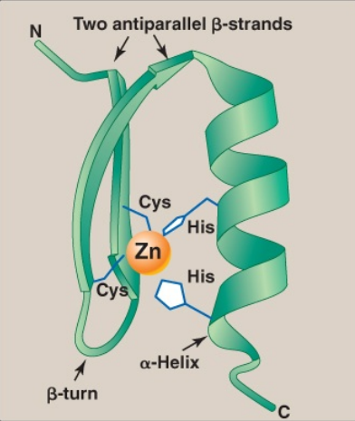
Zinc Finger
Core Knowledge
Zinc (Zn) finger is a common motif in proteins that bind DNA. Cys = cysteine; His = histidine.

Slide 14
Other Microminerals
Core Knowledge
Chromium (Cr) and fluorine (F) also play roles in the body.
Cr potentiates the action of insulin by an unknown mechanism.
It is found in fruits, vegetables, dairy products, and meat.
F (as fluoride [F − ]) is added to water in many parts of the world to reduce the incidence of dental caries.
F − replaces the hydroxyl group of hydroxylapatite, forming fluoroapatite that is more resistant to the enamel-dissolving acid produced by mouth bacteria.

Slide 15
Ultra Trace Minerals
Core Knowledge
The ultra trace minerals include
iodine (I)
selenium (Se)
molybdenum (Mo)

Slide 16
Iodine
Core Knowledge
Iodine is utilized in the synthesis of the thyroid hormones triiodothyronine (T3 ) and thyroxine (T4 ) that are required for development, growth, and metabolism.
Circulating iodide (I − ) is taken up (“trapped”) and concentrated in the epithelial follicular cells of the thyroid gland.
It then is sent into the colloid of the follicular lumen where it is oxidized to iodine (I₂ ) by thyroperoxidase (TPO).
The coupling of two DIT on Tg gives T4 , whereas coupling one MIT and one DIT gives T3.

Slide 17
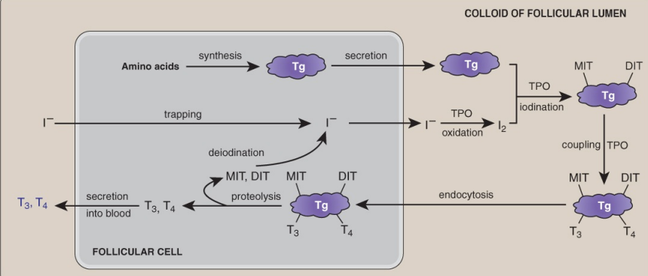
Iodine
Core Knowledge

Slide 18
Selenium
Core Knowledge
Selenium (Se) is present in approximately 25 human proteins (selenoproteins) as a constituent of the amino acid selenocysteine, which is derived from serine.
Selenoproteins include glutathione peroxidase that oxidizes glutathione in the reduction of hydrogen peroxide, a ROS, to water; thioredoxin reductase that reduces thioredoxin, a coenzyme of ribonucleotide reductase; and deiodinases that remove iodine from thyroid hormones.
Meat, dairy products, and grains are important dietary sources. Keshan disease, first identified in China, is a cardiomyopathy caused by eating foods produced from Se-deficient soil.

Slide 19
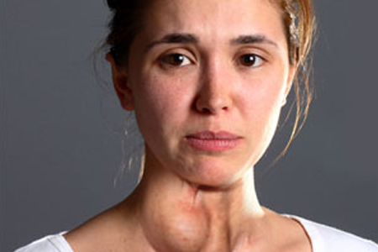
Vertical Integration
Clinical Correlates

Slide 20
Spiral Integration
Family Medicine
Family Medicine plays important role in following manner:
Diagnosis
Education
Dietary Guidance
Monitoring
Refer to Specialists

Slide 21
Spiral Integration
Bioethics
Ethical Considerations
From an ethical standpoint, the scenario raises considerations regarding patient autonomy, informed consent, and confidentiality
The physician must ensure that patient fully understands her diagnosis, treatment options, and potential implications
Discuss the necessity of a healthy lifestyle & treatment plan. This requires clear communication and understanding of risks and benefits.
Additionally, the physician must respect patient’s privacy and confidentiality throughout the diagnostic and treatment process

Slide 22
Spiral Integration
Artificial Intelligence
Role of AI in (The Disease) Management
AI can potentially aid in enhancing diagnostic accuracy and efficiency.
AI-powered decision support systems can also help clinicians in selecting appropriate treatment modalities
AI-driven predictive models may help anticipate the risk of complications of the Disease in susceptible populations

Slide 23
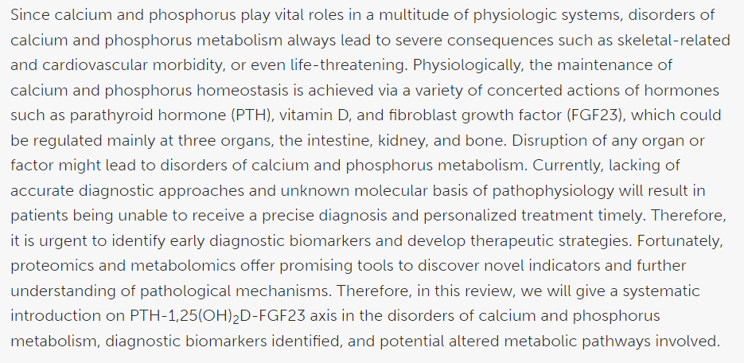
Spiral Integration
Research Article
Link:
https://www.frontiersin.org/articles/10.3389/fcell.2020.576110/full
Journal Name:
frontiers
Title:
Disorders of Calcium and Phosphorus Metabolism and the Proteomics/Metabolomics-Based Research
Author Name:
Meiheng Sun

Slide 24
How To Access Digital Library
Steps to Access HEC Digital Library
Go to the website of HEC National Digital Library
On Home Page, click on the INSTITUTES
A page will appear showing the universities from Public and Private Sector and other Institutes which have access to HEC National Digital Library HNDL
Select your desired Institute
A page will appear showing the resources of the institution
Journals and Researches will appear
You can find a Journal by clicking on JOURNALS AND DATABASE and enter a keyword to search for your desired journal

Slide 25
Learning Resources
Textbook of Biochemistry, Lippincott 8th edition, chapter no.29 , page no.446
Google scholar
Google images

Slide 26
THANK YOU

