Slide 1


Slide 2



MSK1 Module
O2 Dissociation Curve
1st Year MBBS(LGIS)
Presenter: Dr Uzma Zafar Date: 01-02-25
Deptt of Biochemistry
RMU

Slide 3
Motto, Vision, Dream
To impart evidence based research oriented medical education
To provide best possible patient care
To inculcate the values of mutual respect and ethical practice of medicine
Wisdom
Truth
Service

Slide 4
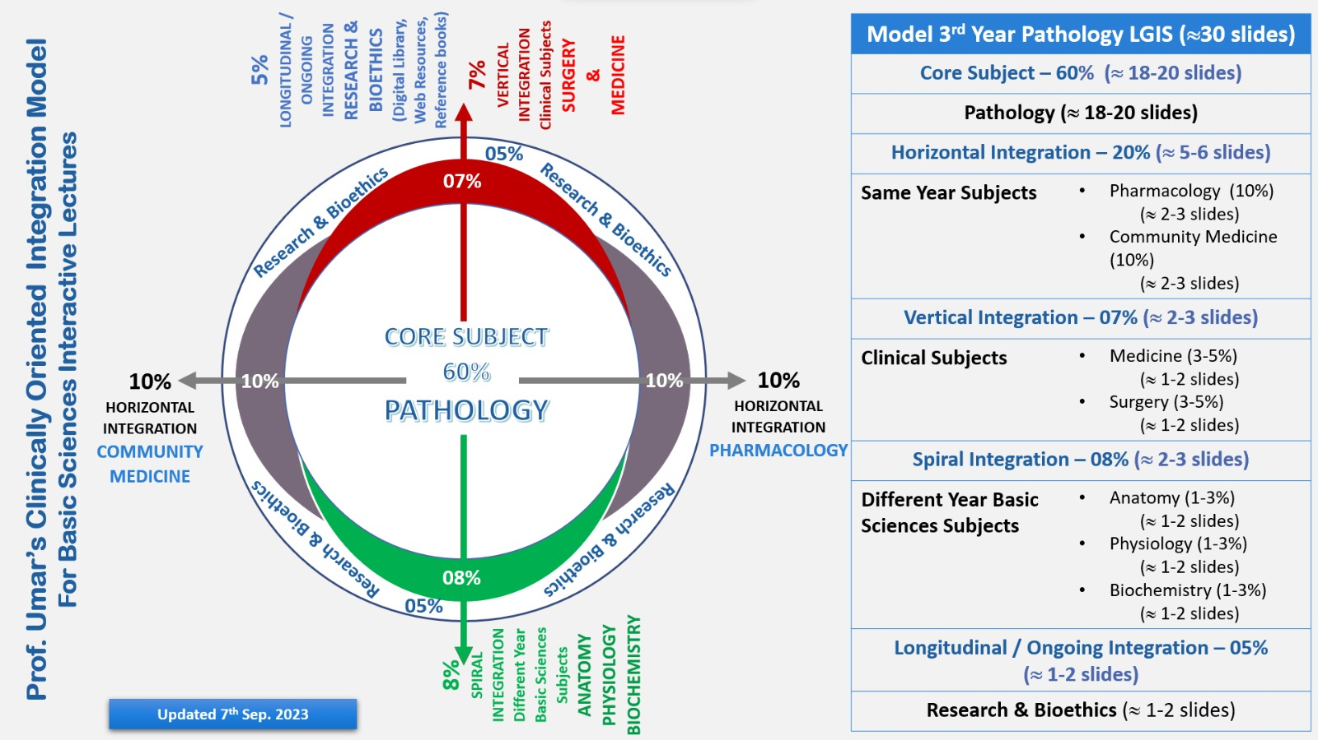
Professor Umar Model of Integrated Lecture

Slide 5
Learning Objectives
At the end of this session, students will be able to:
Learn about the structure of hemoglobin and myoglobin
Explain O2 binding to hemoglobin and myoglobin
Explain about the O2 dissociation curve for myoglobin and hemoglobin

Slide 6

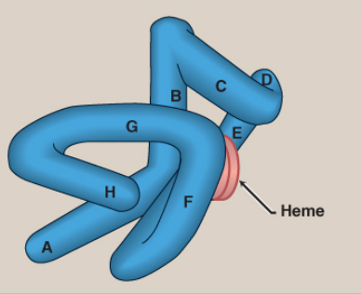
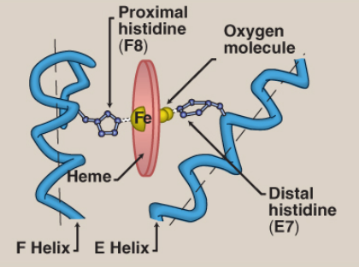
Structure of Myoglobin
Core Knowledge
Model of myoglobin showing α-helices A to H
Schematic diagram of the oxygen-binding site of myoglobin

Slide 7
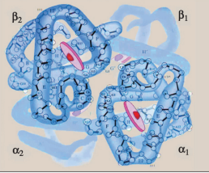
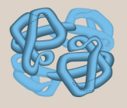
Core Knowledge
Structure of Hemoglobin
Structure of hemoglobin showing the polypeptide backbones.
Simplified drawing showing the α-helices.

Slide 8
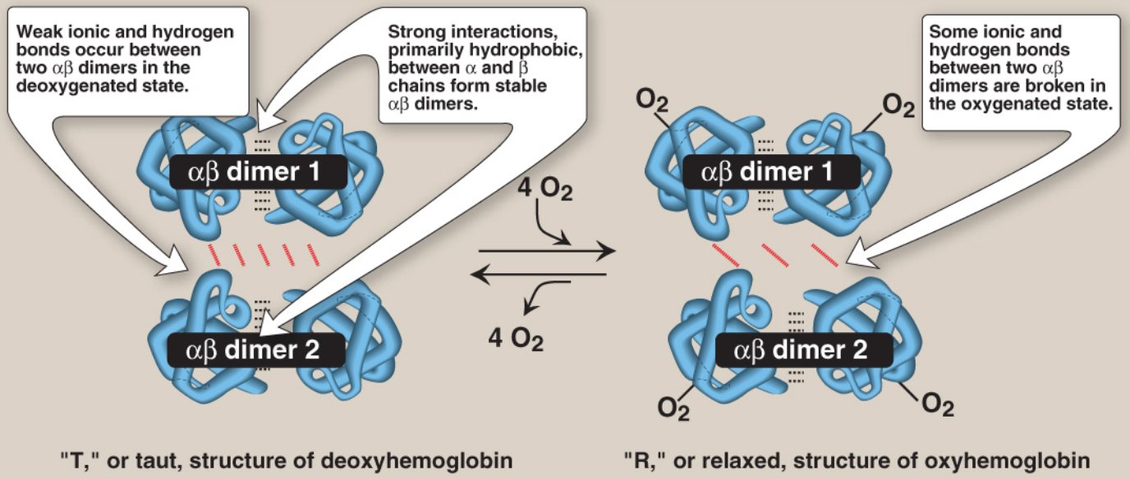
Core Knowledge
Schematic diagram showing structural changes resulting from oxygenation and deoxygenation of hemoglobin.

Slide 9
Oxygen binding to myoglobin and hemoglobin
Core Knowledge
Myoglobin can bind only one molecule of O2 , because it contains only one heme group.
In contrast, hemoglobin can bind four molecules of O2 , one at each of its four heme groups.
Myoglobin has 26 times more affinity for oxygen than hemoglobin.

Slide 10
Oxygen-dissociation curve
Core Knowledge
A plot of the degree of saturation (Y) measured at different partial pressures of oxygen (pO2 ) is called the oxygen-dissociation curve.
Myoglobin: The oxygen-dissociation curve for myoglobin has a hyperbolic shape.
This reflects the fact that myoglobin reversibly binds a single molecule of O2.
Thus, oxygenated (MbO2 ) and deoxygenated (Mb) myoglobin exists in a simple equilibrium:
Mb + O2 ⇄ MbO2
The equilibrium is shifted to the right or to the left as O2 is added to or removed from the system.

Slide 11
Core Knowledge
Oxygen-dissociation curve
b. Hemoglobin:
The oxygen-dissociation curve for hemoglobin is sigmoidal in shape, indicating that the subunits cooperate in binding O2.
Cooperative binding of O2 by the four subunits of hemoglobin means that the binding of an oxygen molecule at one subunit increases the oxygen affinity of the remaining subunits in the same hemoglobin tetramer.
Although it is more difficult for the first oxygen molecule to bind to hemoglobin, the subsequent binding of oxygen molecules occurs with high affinity.

Slide 12
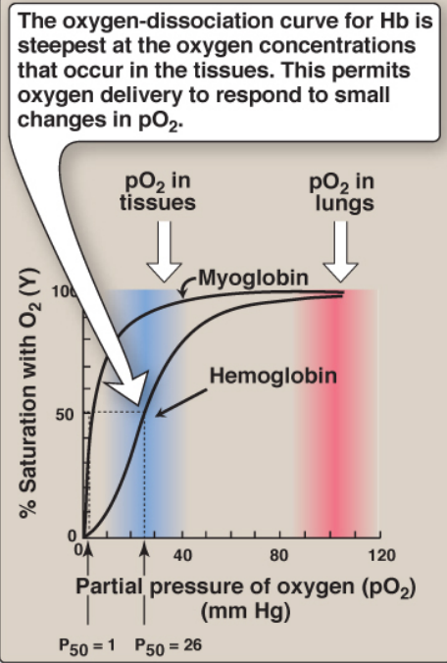
Core Knowledge
Oxygen-dissociation curves for myoglobin and hemoglobin (Hb)

Slide 13
Oxygen-dissociation curve
Core Knowledge
b. Significance of the sigmoidal oxygen-dissociation curve:
The steep slope of the oxygen-dissociation curve over the range of oxygen concentrations that occur between the lungs and the tissues permits hemoglobin to carry and deliver O2 efficiently from sites of high to sites of low pO2.
A molecule with a hyperbolic oxygen-dissociation curve, such as myoglobin, could not achieve the same degree of O2 release within this range of pO2 .
Instead, it would have maximum affinity for O2 throughout this oxygen pressure range and, therefore, would deliver no O2 to the tissues.

Slide 14
Core Knowledge
Oxygen-dissociation curve:
2. Bohr effect:
The release of O2 from hemoglobin is enhanced when the pH is lowered (proton concentration [H+ ] is increased) or when the hemoglobin is in the presence of an increased pCO2.
Both result in decreased oxygen affinity of hemoglobin and, therefore, a shift to the right in the oxygen-dissociation curve.
Both, then, 84 stabilize the T (deoxy) form.
This change in oxygen binding is called the Bohr effect.
Conversely, raising the pH or lowering the concentration of CO2 results in a greater oxygen affinity, a shift to the left in the oxygen-dissociation curve, and stabilization of the R (oxy) form.

Slide 15
Oxygen-dissociation curve
Core Knowledge
3. 2,3-BPG effect on oxygen affinity:
2,3-BPG is an important regulator of the binding of O2 to hemoglobin.
It is the most abundant organic phosphate in the RBCs, where its concentration is approximately that of hemoglobin.
2,3-BPG is synthesized from an intermediate of the glycolytic pathway

Slide 16
Oxygen-dissociation curve
Core Knowledge
2,3-BPG binding to deoxyhemoglobin:
2,3-BPG decreases the oxygen affinity of hemoglobin by binding to deoxyhemoglobin but 87 not to oxyhemoglobin.
This preferential binding stabilizes the T conformation of hemoglobin.
The effect of binding 2,3-BPG can be represented schematically as:
HbO2 + 2,3-BPG ⇄ Hb − 2,3-BPG + O2
Oxyhemoglobin Doxyhemoglobin

Slide 17
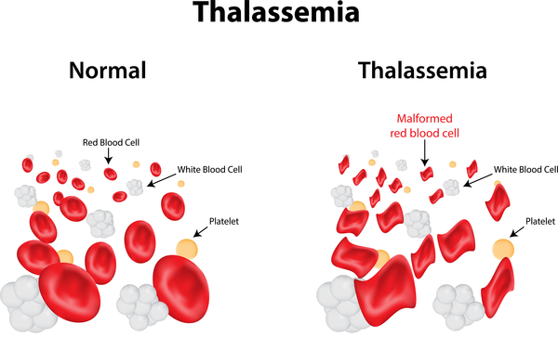
Vertical Integration

Slide 18
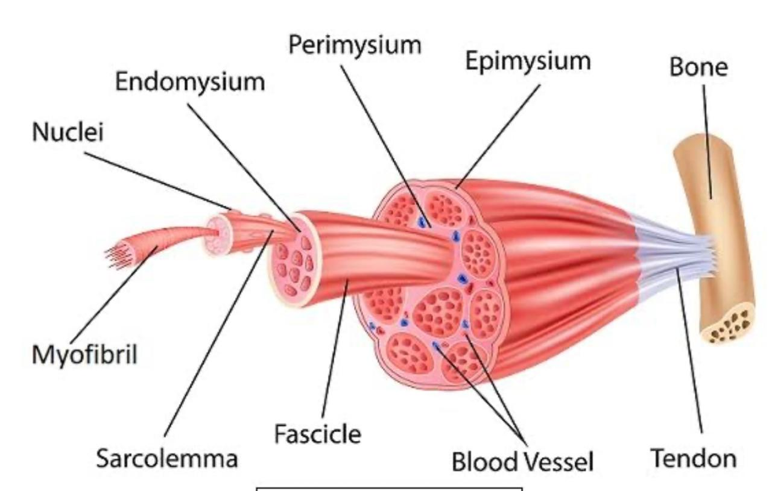
Anatomy of Skeletal Muscle
Horizontal Integration

Slide 19
Functions of Proteins
Horizontal Integration
Act as enzymes and hormones
Maintaining proper fluid and acid-base balance
Providing nutrient transport
Making antibodies
Enabling wound healing and tissue regeneration
Providing energy when carbohydrate and fat intake is inadequate.

Slide 20
Family Medicine
Spiral Integration
Family Medicine plays important role in following manner:
Diagnosis
Education
Dietary Guidance
Monitoring
Refer to Specialists

Slide 21
Artificial Intelligence
Spiral Integration
Artificial Intelligence plays role in following aspects:
Personalized Nutrition
Diagnostic Tools
Food Recommendations
Drug Development

Slide 22
Spiral Integration
Bioethics
Ethical Considerations
From an ethical standpoint, the scenario raises considerations regarding patient autonomy, informed consent, and confidentiality
The physician must ensure that patient fully understands her diagnosis, treatment options, and potential implications
Discuss the necessity of a healthy lifestyle & treatment plan. This requires clear communication and understanding of risks and benefits.
Additionally, the physician must respect patient’s privacy and confidentiality throughout the diagnostic and treatment process

Slide 23
Spiral Integration
Artificial Intelligence
Role of AI in Management
AI can potentially aid in enhancing diagnostic accuracy and efficiency.
AI-powered decision support systems can also help clinicians in selecting appropriate treatment modalities
AI-driven predictive models may help anticipate the risk of complications of the Disease in susceptible populations

Slide 24
Research Article
Introduction
Beta thalassemia is an inherited red blood cell disorder that results in the complete absence or decreased synthesis of the beta globin chains of hemoglobin. Individuals with beta thalassemia trait or beta thalassemia minor are heterozygous for beta thalassemia, or simply a carrier of beta thalassemia. Individuals with beta thalassemia major are homozygous for beta thalassemia, thus have two copies of defective beta-globin genes, and develop disease. The complete absence of beta-globin synthesis is denoted as 0 thalassemia and the reduced synthesis is denoted as + thalassemia. Unlike hemoglobinopathies, which cause disease through structural defects of hemoglobin, thalassemias cause disease due to an affect on the production of hemoglobin. The decrease in beta-globin leads to a relative excess of alpha-globin chains, causing disease.
Link:
https://dph.illinois.gov/content/dam/soi/en/web/idph/files/publications/factsheetpbetathal.pdf
Journal Name:
NEWBORN SCREENING OFFICE OF HEALTH PROMOTION
Title:
Beta Thalassemia Disease (Cooley’s Anemia)
Author Name:
IDPH

Slide 25
Reference
Lippincott Illustrated Reviews Biochemistry, 8th Edition, Chapter 29 , page no. 450
Google images
Textbook of Medical Biochemistry, 8th Edition MN Chatterjea Rana Shinde, page no 161

Slide 26
How To Access Digital Library
Steps to Access HEC Digital Library
Go to the website of HEC National Digital Library
On Home Page, click on the INSTITUTES
A page will appear showing the universities from Public and Private Sector and other Institutes which have access to HEC National Digital Library HNDL
Select your desired Institute
A page will appear showing the resources of the institution
Journals and Researches will appear
You can find a Journal by clicking on JOURNALS AND DATABASE and enter a keyword to search for your desired journal

Slide 27
Learning Resources
Lippincott Illustrated Reviews 8th Edition, Chap , pages -
Harper’s Illustrated Biochemistry 32nd Edition, Chap , pages –
Google images

Slide 28
THANK YOU

