Slide 1


Slide 2


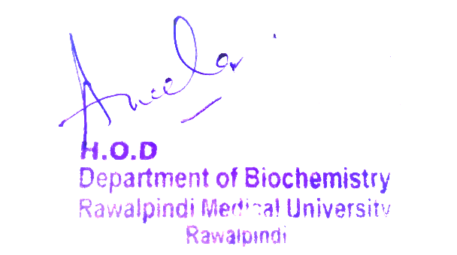
MSK1 Module
1st Year MBBS(LGIS)
Blood and Immunity Module
Iron, Transferrin and ferritin
Presenter: Dr Uzma Zafar Date: 01-02-25
Deptt of Biochemistry
RMU

Slide 3
Motto, Vision, Dream
To impart evidence based research oriented medical education
To provide best possible patient care
To inculcate the values of mutual respect and ethical practice of medicine
Wisdom
Truth
Service

Slide 4
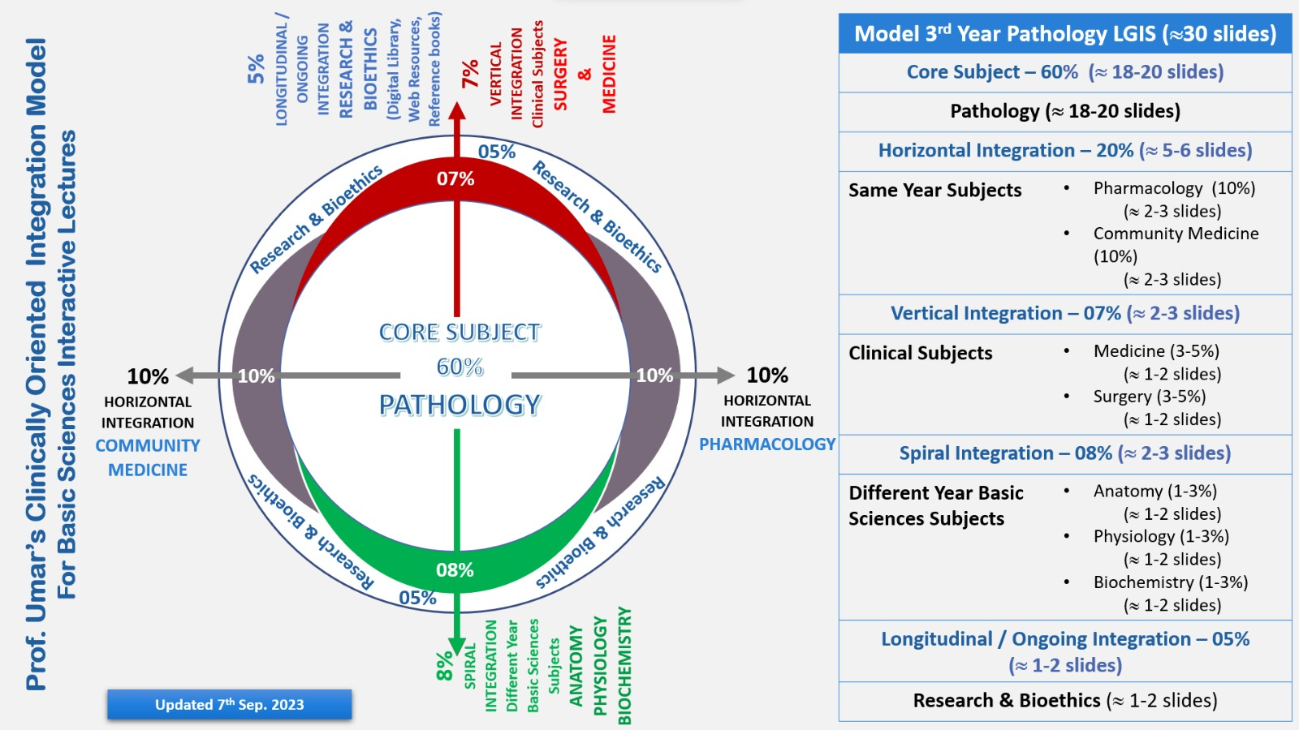
Professor Umar Model of Integrated Lecture

Slide 5
Learning Objectives
At the end of the lecture, Students will be able to
Discuss iron metabolism in body
Discuss regulation of transferrin and ferritin
Differentiate between hemochromatosis and hemosiderosis

Slide 6
Iron Overview
Core Knowledge
Core Knowledge
It is one of the micronutrient
Plasma level is 50-175 µg/ dl
About 70% of this occurs in the RBCs
as a constituent of haemoglobin
Iron from food comes in two forms:
Heme
Non-heme

Slide 7
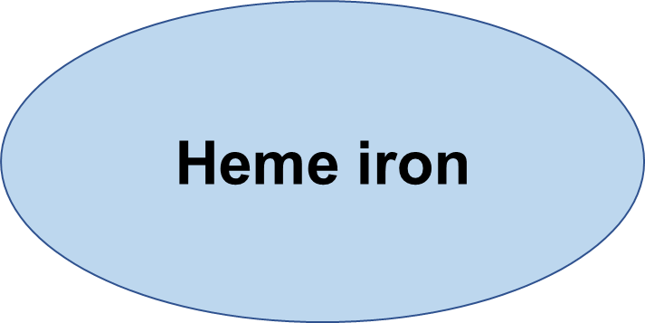
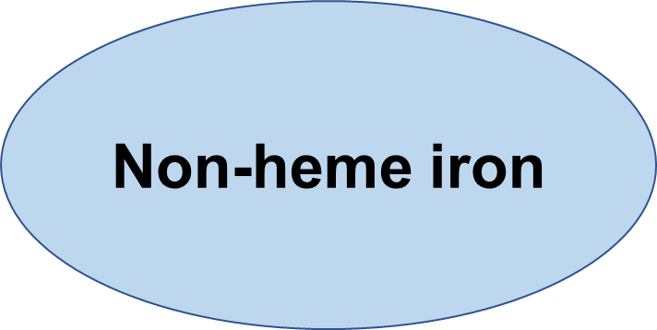
Core Knowledge
Hemoglobin
Myoglobin
Cytochromes
Xanthine oxidase
Catalase
Peroxidase
Transferrin
Ferritin
Hemosiderin

Slide 8
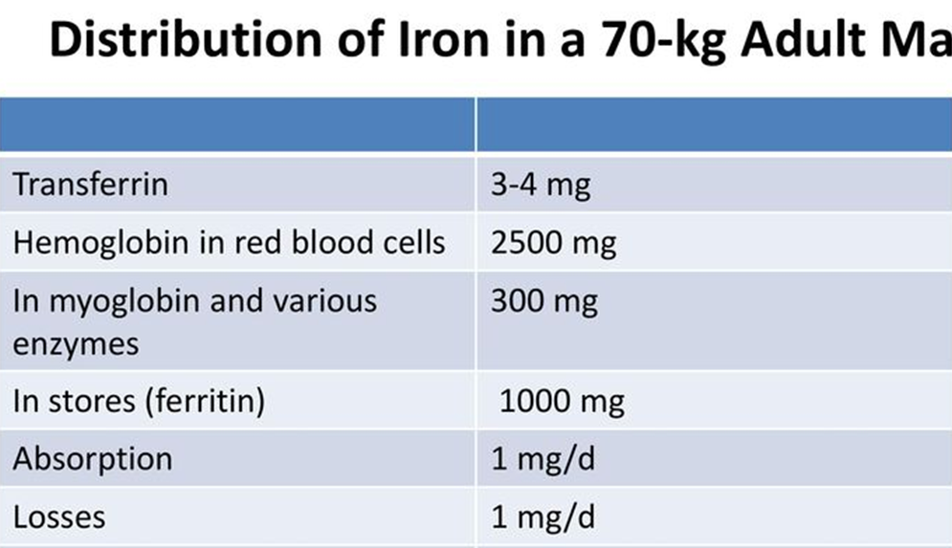
Core Knowledge
In the diet we ingest as heme and non heme iron
Different transport mechanism in intestine for both types
Body protects iron loss
1mg lost /day in normal Adult
Absorption is 1mg/day

Slide 9
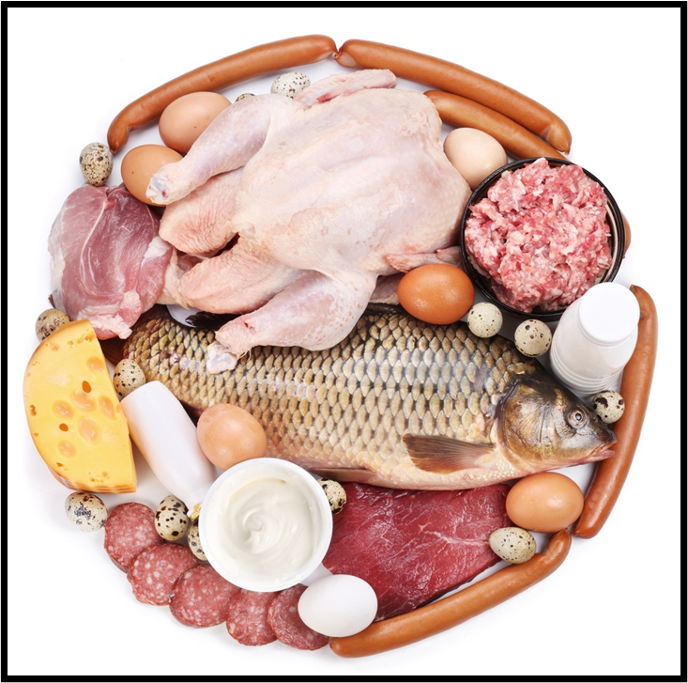
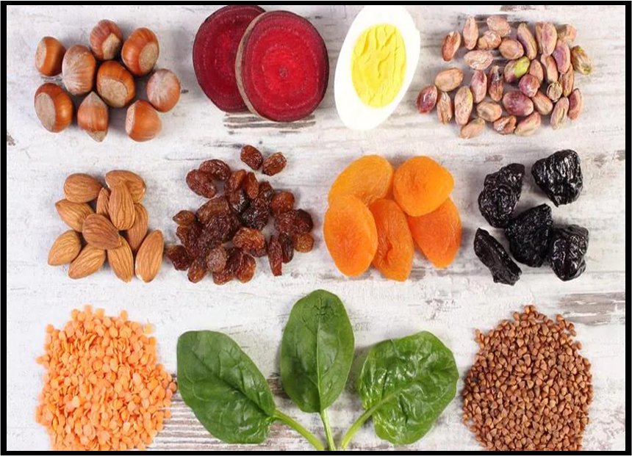
Sources of Iron
Core Knowledge
Non-heme iron
Heme iron

Slide 10
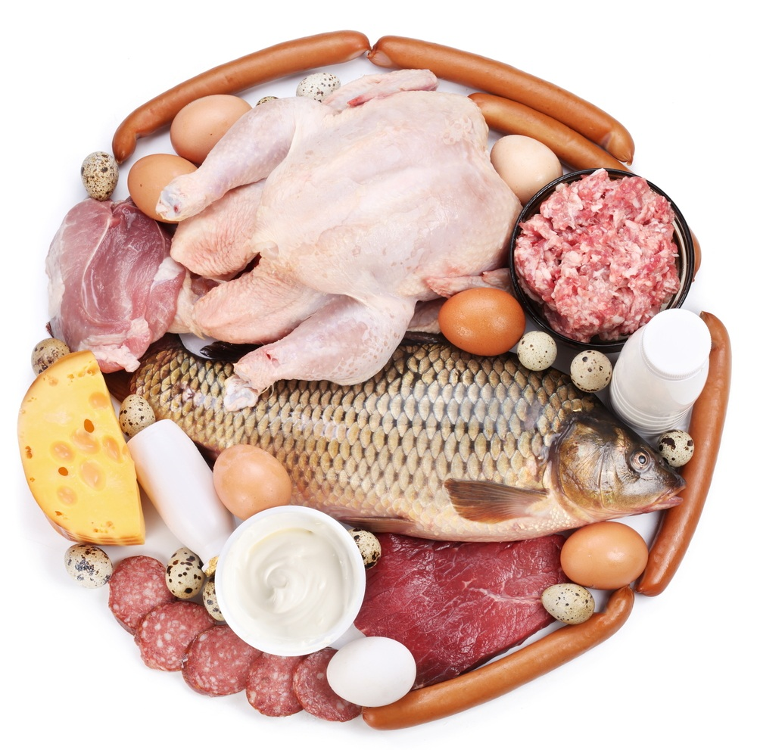
Sources of heme iron
Core Knowledge
Oysters, clams, mussels
Beef or chicken liver
Organ meats
Beef
Poultry
Canned light tuna

Slide 11
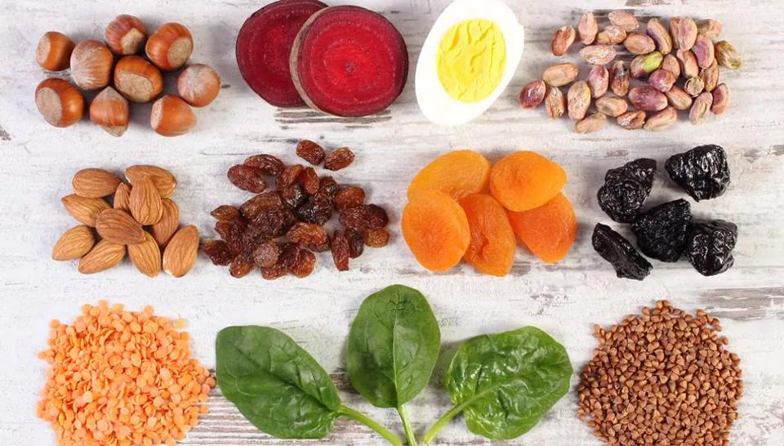
Sources of non-heme iron
Core Knowledge
Plant foods like
Whole grains
Nuts
Seeds
Legumes
Leafy greens

Slide 12
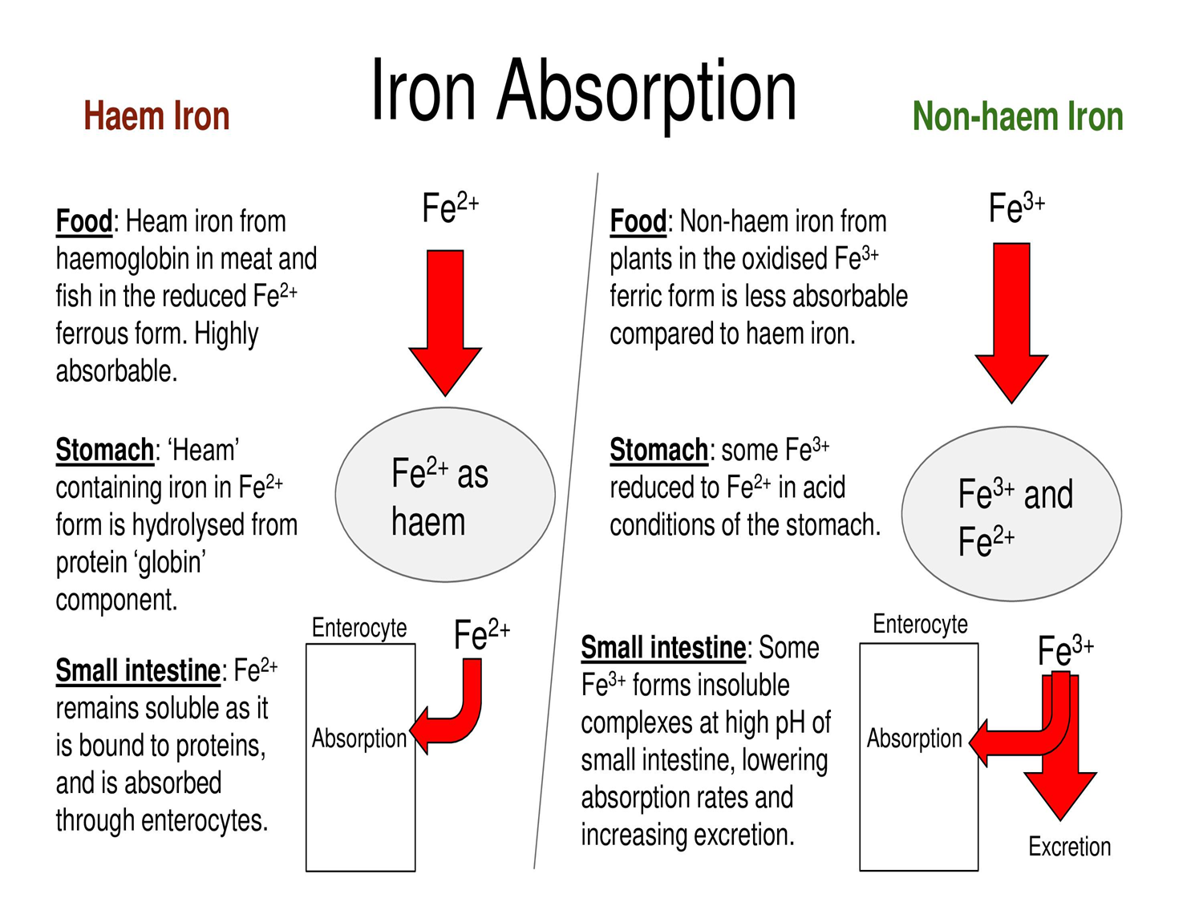
Absorption of Iron
Core Knowledge
Heme iron vs Non-heme iron

Slide 13
Absorption of Iron from gut
Core Knowledge
Iron in Fe3+ (ferric) form is first reduced to Fe2+ (ferrous) form by ferrireductase present on apical surface of enterocytes
Fe2+ is transported into the enterocyte by proton coupled divalent metal transporter (DMT1), it also transports other divalent ions, Cu++,Zn++, etc.
Either stored as Ferritin or transferred across basolateral membrane into plasma where it binds transferrin
Passage across basolateral membrane is carried out by iron regulatory protien-1 (Ferroportin-1)

Slide 14
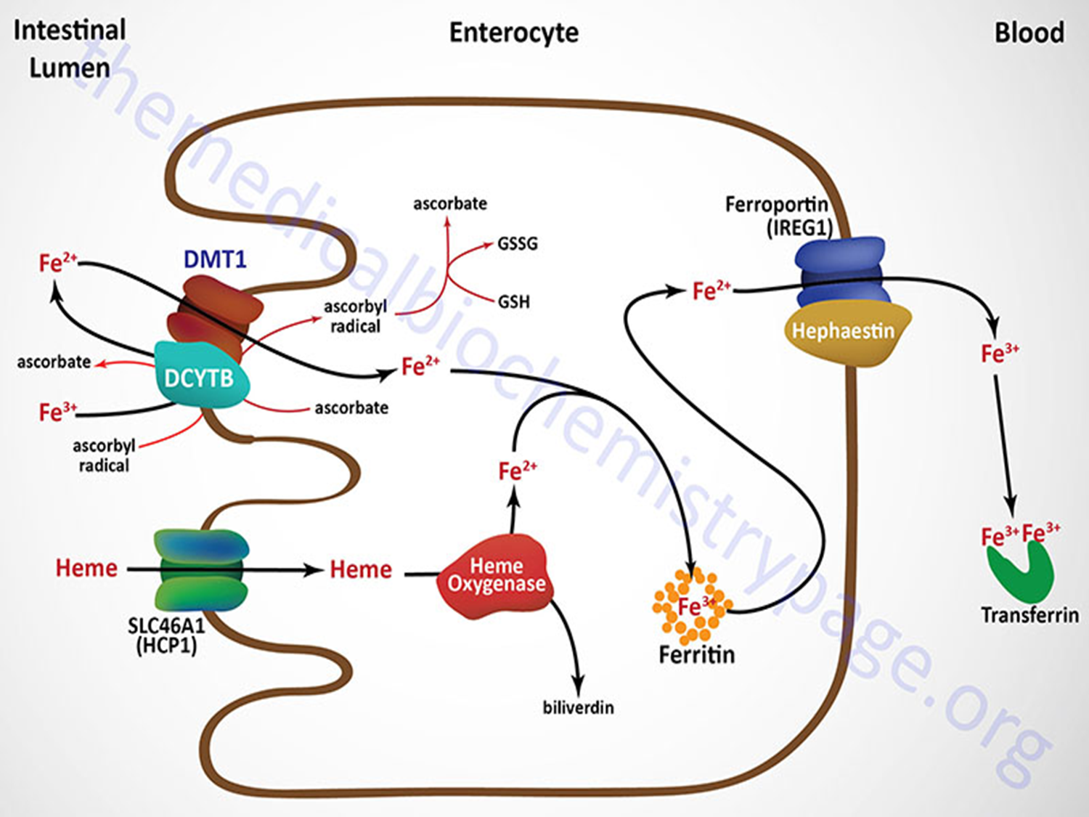
Absorption of Iron from gut
Core Knowledge

Slide 15
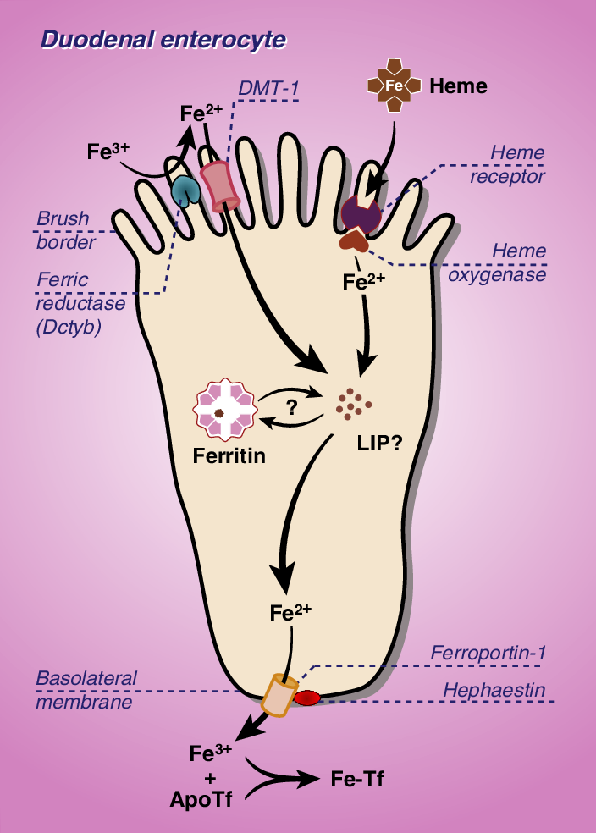
Core Knowledge
(IREG-1) ferroportin-1
the only know iron efflux transporter
Ferroportin-1 interact with
another protein Hephaestin
by oxidase activity to oxidize
fe2+ to Fe3+ which binds
with transferrin

Slide 16
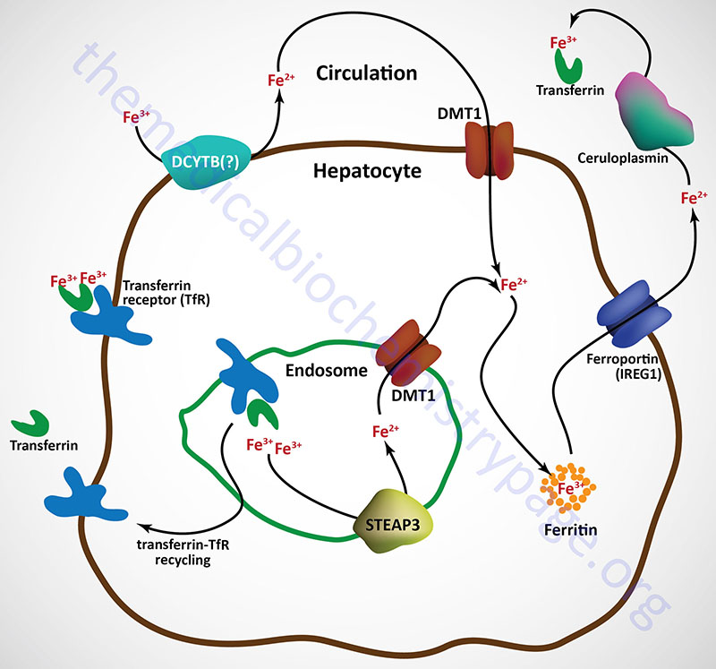
Core Knowledge
Ferroportin-1 interact with
another protein ceruloplasmin
in place of hepaestin in cells
other than enterocytes
by oxidase activity to oxidize
fe2+ to Fe3+ which binds
with transferrin

Slide 17
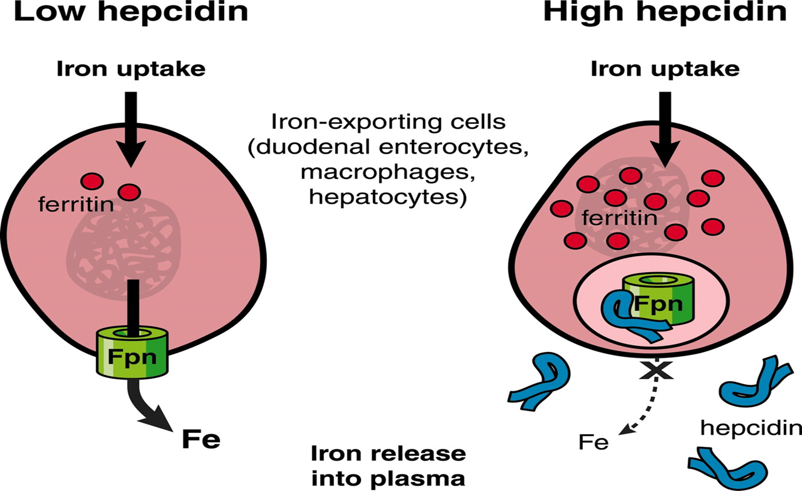
Hepcidin
Core Knowledge
Is a protein that is a key
regulator of the entry of
iron into the circulation
in mammals
Transcription of hepcidin
is suppressed when
iron is deficient

Slide 18
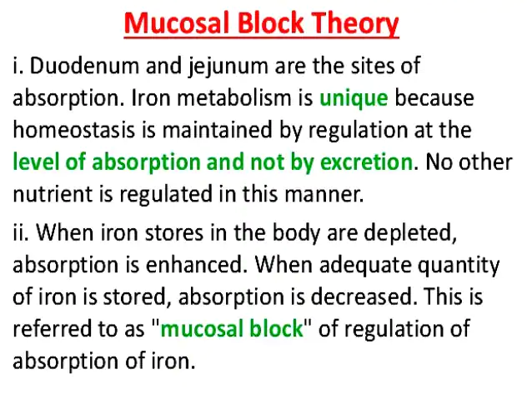
Absorption is tightly regulated at this stage
Core Knowledge
(mucosal block will
occur if iron is
enough in body)

Slide 19
Factors affecting iron absorption
Core Knowledge
Acidity, ascorbic acid and cysteine promote iron absorption
In iron deficiency anemia, Fe absorption is increased to 2-10 times that of normal
Small peptides and amino acids favor iron uptake
Phytate (found in cereals) and oxalate (found in leafy vegetables) interfere with iron absorption
A diet with high phosphate content decreases Fe absorption while low phosphate promotes
lmpaired absorption of iron is observed in malabsorption syndromes such as steatorrhea
In patients with partial or total surgical removal of stomach and/or intestine, iron absorption is severely impaired

Slide 20
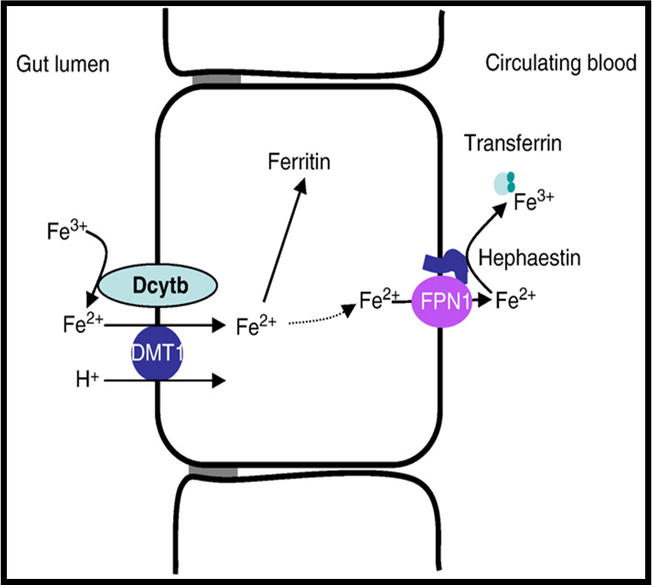
Transferrin
Core Knowledge
Transport of Iron
Transferrin β1- globulin, synthesized in liver mainly
Main protein responsible for iron transport
Transferrin is the main protein in the blood that binds to iron and transports it throughout the body
2 molecule of fe3+ are transported per molecule of transferrin

Slide 21
Core Knowledge
Concentration of transferrin in plasma is 300 mg/dl
It can bind 300 mg of iron /dl
This is total iron binding capacity (TIBC) of plasma
20 polymorphic types are present
Approximately 200 billion RBC (20ml of blood) are catabolized /day
25 mg of iron is released from these RBC
Human transferrin is encoded by the TF gene
The liver is the main site of transferrin synthesis, but other tissues and organs, including the brain, also produce transferrin

Slide 22
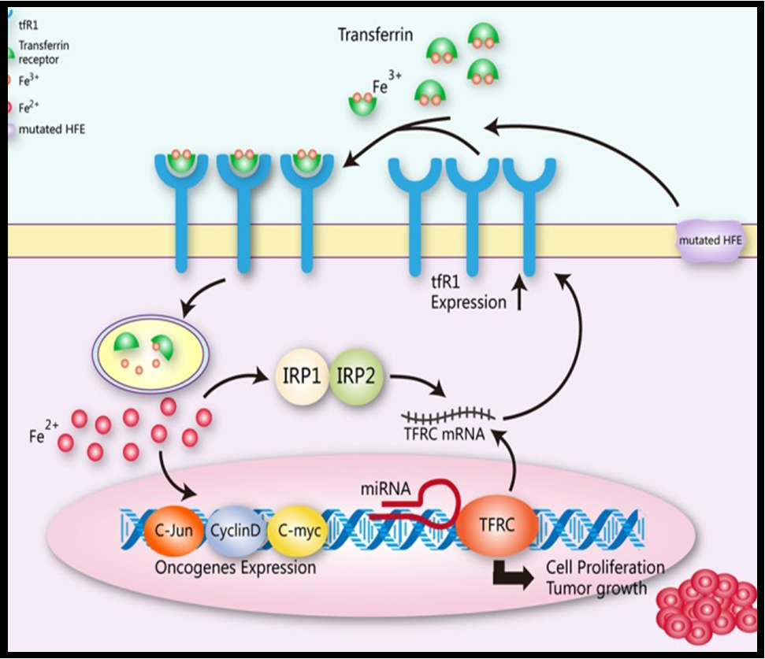
Core Knowledge
Transferrin receptors
are present on the cells,
transferrin binds with
the receptor and it is
internalized by receptor
mediated endocytosis
acidic pH inside the
lysosome dissociate
iron from protein

Slide 23
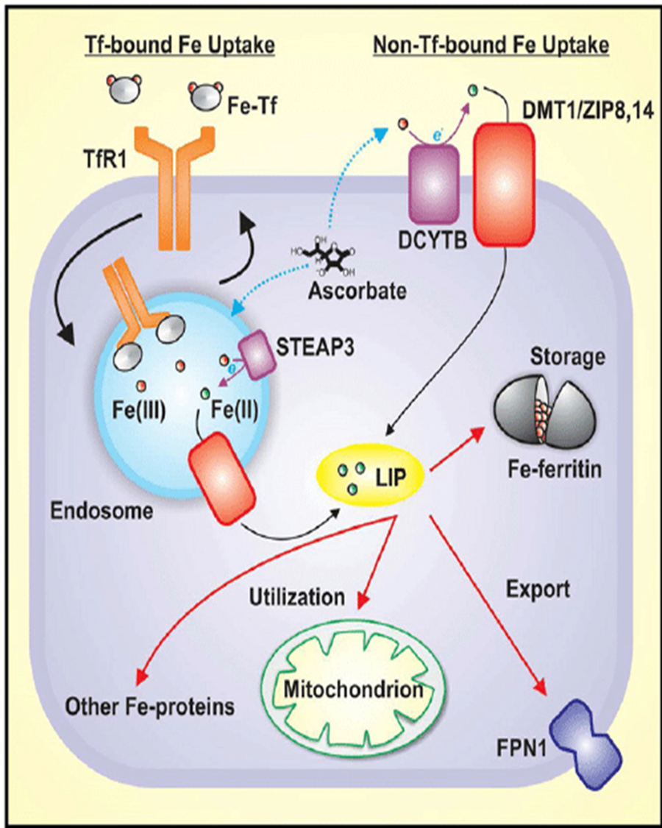
Under physiological conditions, most Fe is bound to Tf which binds to the transferrin receptor 1 (TfR1) on the cell surface that is then involved in receptor-mediated endocytosis with the Fe being released from Tf by a decrease in endosomal pH and reduction by an endosomal reductase [ e.g. , six transmembrane epithelial antigen of the prostate 3 (STEAP3)] or, potentially, by ascorbate. The Fe(II) is then transported across the endosomal membrane by divalent metal transporter 1 (DMT1) where it then becomes part of the poorly characterized labile iron pool (LIP) in the cytosol. Iron in the LIP acts as an intermediate and can be utilized for storage in the iron storage protein, ferritin, or used for synthesis of heme and iron-sulfur clusters in the mitochondrion or cytosol. Iron can also be exported from the cell by ferroportin 1 (FPN1). In conditions of iron overload, NTBI exists in the blood, and may be taken up by processes that include cell surface reduction by ferrireductases such as duodenal cytochrome b (DCYTB), or by ef fl uxed reductants, such as ascorbate. Intracellular ascorbate can also supply electrons for DCYTB-dependent ferrireduction. Such enzymes reduce ferric NTBI to its ferrous state, which can be imported from the plasma membrane by transporters such as DMT1

Slide 24
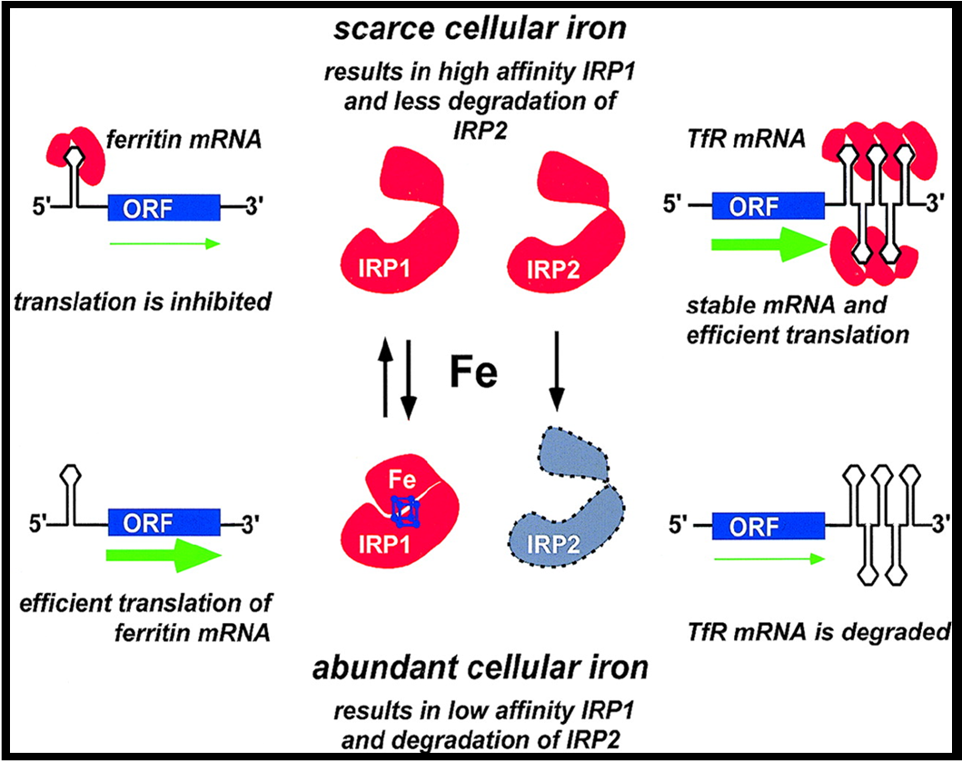
Regulation of transferrin receptor (TFR) synthesis
Core Knowledge

Slide 25
Core Knowledge
The IRE form hairpin loops on different parts of the two mRNAs
When iron levels are more in cell, then iron binds to the IRE-BP
Prevents its binding to IRE on the respective mRNAs
So the mRNA for ferritin is translated and mRNA for TFR is degraded
When iron levels are low
Iron is not bound significantly to the IRE-BP
Which can now bind to the IRE
So TfR is synthesized more and mRNA for ferritin is stored in inactive form

Slide 26
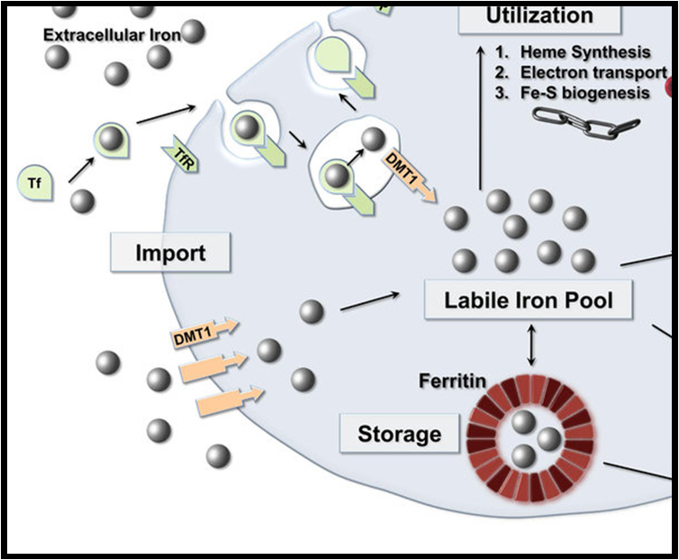
Ferritin
Core Knowledge
Ferritin is stored form of iron in liver, spleen and bone marrow
ln the mucosal cells, ferritin is the temporary storage form of iron

Slide 27
Core knowledge
A molecule of Apo ferritin can combine with 4,000 atoms of iron
The ferritin is produced by almost all living organisms including algae, bacteria, higher plants, and animals
In humans, it acts as a buffer against iron deficiency and iron overload
Plasma ferritin is also an indirect marker of the total amount of iron stored in the body
Hence serum ferritin is used as a diagnostic test for iron-deficiency anemia

Slide 28
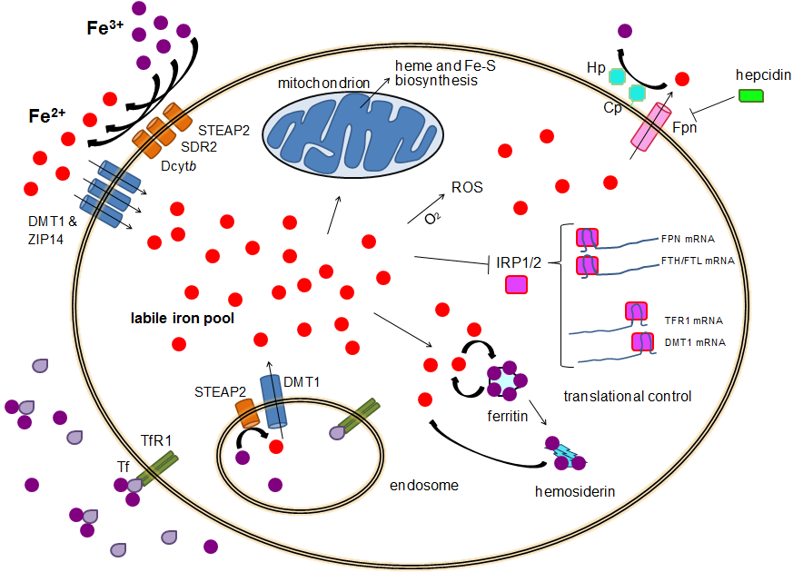
Hemosiderin
Core Knowledge
Is another iron storage protein
Hemosiderin accumulates in the body (spleen, liver) when the supply of iron is in excess of body demands

Slide 29
Core Knowledge
Hemosiderin is ill defined molecule
It is a degraded form of Ferritin
Ferritin and Hemosiderin store 1000 mg of iron
The iron within deposits of hemosiderin is very poorly available to supply iron when needed

Slide 30
Functions or iron in body
Horizontal Integration
lron mainly exerts its functions through the compounds in which it is present
Example
Haemoglobin and myoglobin are required for the transport of 02 and CO2
Cytochromes and certain non-heme proteins are necessary for electron transport chain and oxidative phosphorylation
Peroxidase, the lysosomal enzyme, is required for phagocytosis and killing of bacteria by neutrophils
lron boosts the immune system

Slide 31
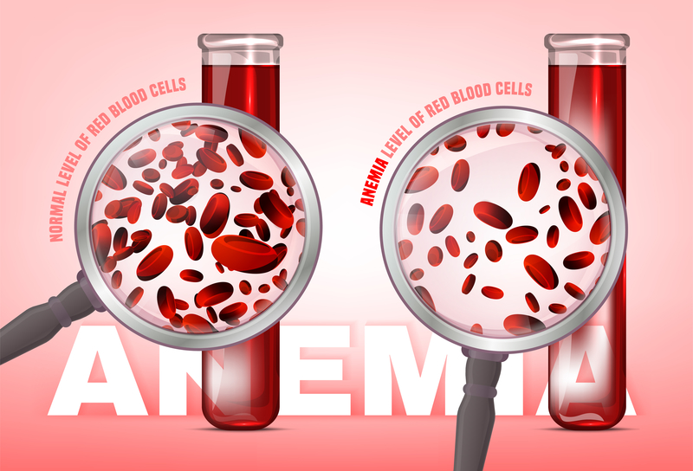
Clinical Integration
Iron deficiency anemia
Vertical Integration
This is the most prevalent nutritional disorder in world, including the well developed countries, causes could be
Inadequate intake of iron
Defective absorption of iron
Chronic blood loss
Repeated pregnancies
Hookworm infections

Slide 32
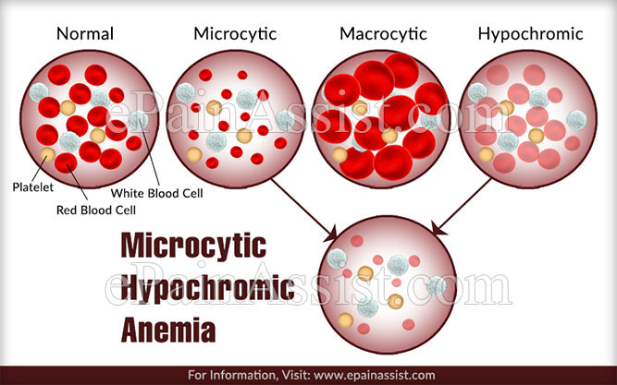
Clinical Integration
Histopathological Integration
Vertical Integration
lt is characterized by microcytic
hypochromic anemia with
reduced blood hemoglobin
levels (<12 g/dl)

Slide 33

Clinical Integration
Vertical Integration
Hemochromatosis
This is a rare disease in which iron is directly deposited in the tissues like liver, spleen, pancreas, skin

Slide 34
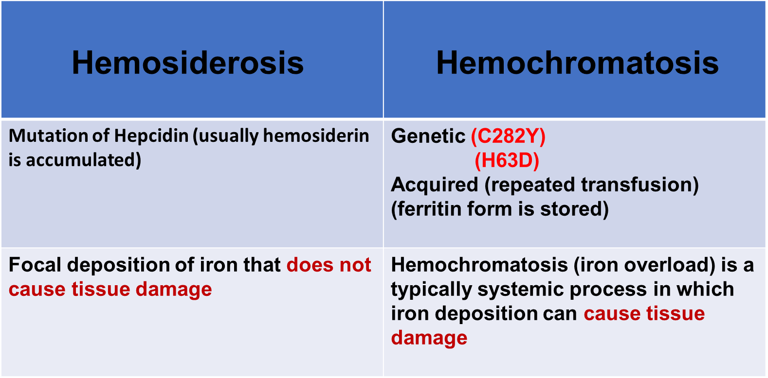
Hemosiderosis vs Hemochromatosis
Vertical Integration

Slide 35

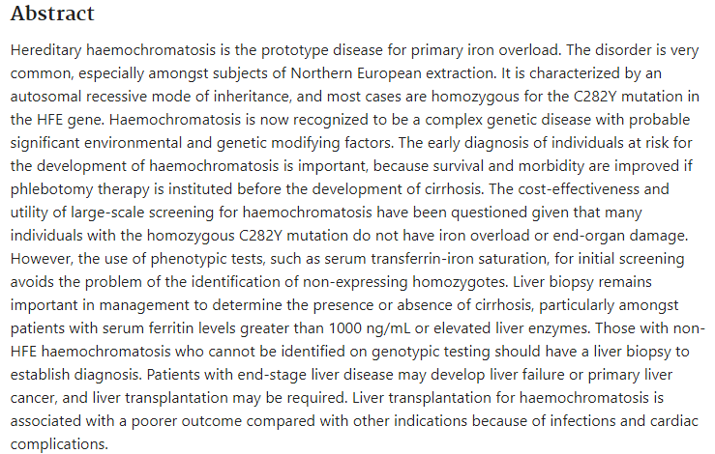
Suggested Research Article
https://doi.org/10.1046/j.1365-2036.2002.01371.x

Slide 36
Family Medicine
Spiral Integration
Family Medicine plays important role in following manner:
Diagnosis
Education
Dietary Guidance
Monitoring
Refer to Specialists

Slide 37
Artificial Intelligence
Spiral Integration
AI plays a significant role by enhancing various aspects of mineral analysis, diagnosis, and treatment monitoring.
Data Analysis
Diagnostic Support
Predictive Modeling
Drug Development
Personalized Medicine
Real-time Monitoring
Quality Control

Slide 38
Bioethics
Spiral Integration
Health Impacts
Environmental Impact
Labor Rights
Resource Distribution
Climate Change

Slide 39
References
Lippincott Illustrated Reviews: Biochemistry Chapter#29, page # 449.
Google Images.

Slide 40
How To Access Digital Library
Steps to Access HEC Digital Library
Go to the website of HEC National Digital Library.
On Home Page, click on the INSTITUTES.
A page will appear showing the universities from Public and Private Sector and other Institutes which have access to HEC National Digital Library HNDL.
Select your desired Institute.
A page will appear showing the resources of the institution
Journals and Researches will appear
You can find a Journal by clicking on JOURNALS AND DATABASE and enter a keyword to search for your desired journal.

Slide 41
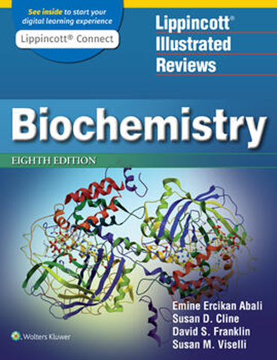
Learning resources
Lippincott Illustrated Review,
Biochemistry, (Eighth edition,
chapter 29, Pages 403-404)
Related articles
Google images

Slide 42


