Slide 1


Slide 2
Motto Vision; The Dream/Tomorrow
To impart evidence based research oriented medical education
To provide best possible patient care
To inculcate the values of mutual respect and ethical practice of medicine
Wisdom
Truth
Service

Slide 3


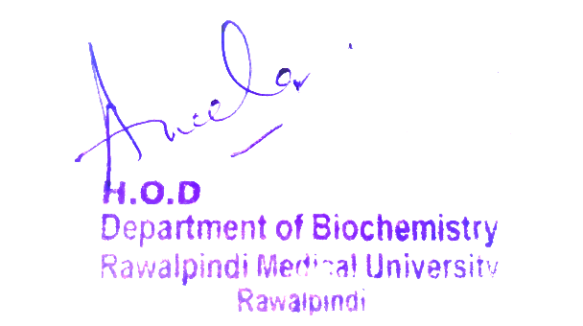
1st Year MBBS
MSK-1
Large Group Interactive Session (LGIS)
Classification of Minerlas
MSK-1 Module
1st Year MBBS(LGIS)
Classification Of Minerals
Presenter: Dr Uzma Zafar Date: 01-02-25
Deptt of Biochemistry
RMU

Slide 4
Sequence of LGIS
Learning Objectives
Horizontal Integration
Core Concept
Vertical Integration
Spiral Integration
Learning Resources

Slide 5
Learning Objectives
At the end of the lecture, students will be able to:
Classify the minerals into macro and micro minerals
Describe the sources and the process of absorption and excretion of the minerals i.e. Calcium and Phosphorus
Explain the factors affecting the regulation of Calcium and Phosphorus

Slide 6

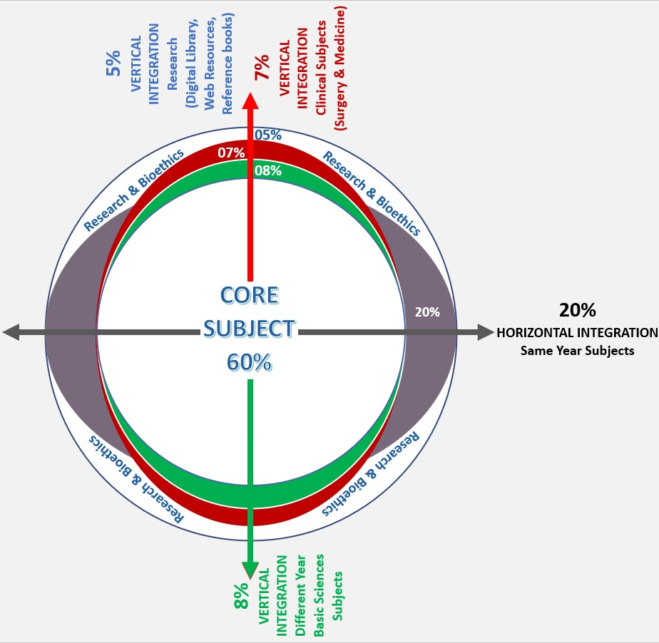
Professor Umar Model of Integrated Lecture
60%
Core Subject
20%
Horizontal
Integration
Physiology
Anatomy
8%
Vertical Integration
Pathology
Pharmacology
7%
Vertical Integration
Clinical Integration
5%
Vertical Integration
Research, Professionalism
Ethics
Digital library

Slide 7
Horizontal Integration

Slide 8
Functions of Calcium
Bone Health
Electrolyte Balance
Blood Health
Energy Production
Nerve Function
Enzyme Activation
Immune Function
Thyroid Function
Blood Pressure Regulation
Antioxidant Defense

Slide 9
Function of Phosphorus
Participate in the formation of bones and teeth.
Inorganic part of bones is 3Ca3 (PO4)2 Ca (OH)2
Carbonate is adsorbed on it
2. Important constituent of high energy compounds.
ATP, GTP, CTP, UTP, TTP , Creatine PO4
3. Important constituent of nucleic acids both DNA and RNA
4. Important constituent of phospholipids like lecithin, cephalin, plasmalogens
5. Important constituent of cell membrane
6. PO4 is most abundant anion present with in tissue cells

Slide 10
              Core Concept

Slide 11
Minerals
Minerals are inorganic in nature.
They are essential for vital processes.
These are about 29 in number.

Slide 12
Classification of Minerals
Minerals can be classified as
Macro minerals
Daily requirement > 100 mg
It forms 60-80 % of body’s inorganic material e.g. Calcium, Phosphorous, Magnesium, Sodium, Potassium, Chloride, Sulfur.
Micro minerals
Daily requirement < 100 mg, also known as Trace elements
Micro minerals are divided into
Essential trace elements
Additional trace elements
Toxic trace elements

Slide 13
Classification of Microminerals
Micro minerals are divided into:
Essential trace elements
Deficiency leads to serious disorders Cu, Mo, Mn , Zn, Co, Fl, Se, Fe, I, Cr
Additional trace elements
Exact role is not clear
No deficiency effects
Cd, Ni
Toxic trace elements
Produce bad effects
Enter the body through dirty air, water and food as, Pb, CN, Hg

Slide 14
Calcium
Introduction:
Calcium is a macro mineral.
Daily requirement > 100 mg/day
It is the most abundant mineral
It takes part in structural formation
Total body calcium:
1-1.4kg, 1-2% of body weight
(99% is present in bones and teeth)
(1% is present in remaining parts of the body)
Normal Plasma Calcium level: 9-11 mg/dl

Slide 15
Sources of Calcium
Milk and milk products are best sources (120 mg/dl of milk)
Egg yolk
Leafy vegetables
Hard drinking water
Some plants like spinach contain enough calcium but also contain oxalates and benzoates which make complexes with calcium and ↓ its absorption from intestine.
Calcium is also ingested as Ca(OH)2 on Betel leaves i.e. paans

Slide 16
Daily Requirement
In infants 360mg/day
In Growing children 800-1100mg/day
In Adults 800-1200mg/day
In Pregnancy and lactation extra 400mg/day

Slide 17
Absorption
Calcium is absorbed in inorganic form.
The absorption occurs mostly in proximal part of small intestine i.e. jejunum by Active transport.
Absorption occurs in two steps:
Uptake of Ca++ at the mucosal pole. It may involve Ca++ -Specific channels or a carrier
Efflux occur at serosal pole of the intestinal epithelium. It involves Ca++ Mg++ ATPase at serosal membrane

Slide 18
Factors affecting Absorption
1. Calcitriol (vitamin D3)
This hormone/vitamin is synthesized in body by sunlight from 7- dehydrocholesterol present in skin
It is required for the synthesis of specific transport protein responsible for active transport of Calcium in the proximal small intestine so it increases the absorption of Calcium.
2. Parathyroid hormone -PTH
It increases the absorption of calcium
It acts indirectly by increasing the activity of α-1 hydroxylase which is required for the activation of vitamin D3.

Slide 19
Factors affecting Absorption
3. Presence of anions
Oxalates, Carbonates, Sulfates , Phytates and Phosphates inhibit calcium absorption as they form insoluble Calcium salts
The Calcium soluble salts e.g. Calcium salts of Chloride, Gluconate and Lactate are absorbed to a greater extent
4. Proteins in diet
They facilitate Calcium absorption as Amino acid salts of Calcium are more soluble

Slide 20
Factors affecting Absorption
5. Intestinal pH
If pH is acidic it favors Calcium absorption as calcium salts are more soluble in acidic medium
Lactose in milk can form lactic acid and increases acidity of intestinal tract so facilitates Calcium absorption
6. Calcium deficiency
Calcium deficiency increases Calcium absorption

Slide 21
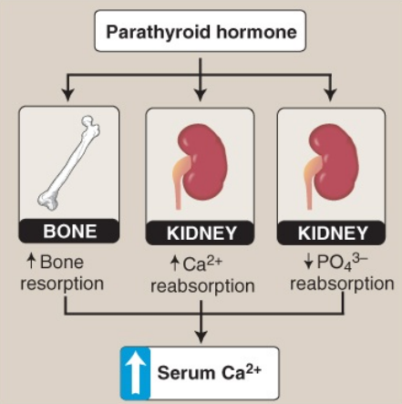
Effect of parathyroid hormone on serum calcium (Ca 2+ ). PO4 3– = phosphate

Slide 22
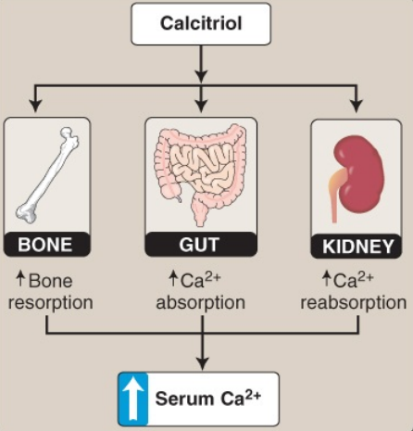
Effect of Calcitriol on Serum Calcium

Slide 23
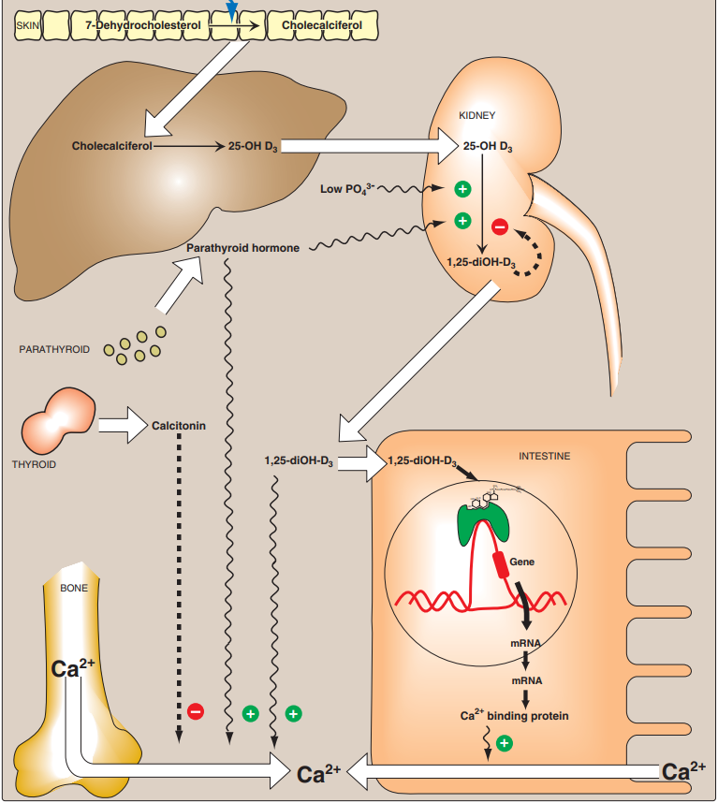
Cont….

Slide 24
Excretion
About 30% of calcium taken in diet is absorbed from intestine and 70% is excreted in faeces
Urinary daily excretion is 240 mg/day
A small amount is excreted in sweat

Slide 25
Phosphorus
It is a macro mineral
Total body phosphorous 700 grams
85% in skeleton
10% in muscles
05% in others
Normal levels
Whole blood level 48 mg /dl as
Inorganic phosphate esters
Lipid phosphorous

Slide 26
Phosphorus
RBC contain more phosphorous than plasma
RBC contain much more organic phosphate
Inorganic phosphorus is equally distributed in cells and plasma
Plasma inorganic phosphorous level
Adults 3- 4.5 mg/dl
Children 4-7 mg/dl

Slide 27
Phosphorus
Plasma inorganic phosphorous (Pi)
Occurs in 2 forms
H2PO4-1
HPO 4-2
Plasma Pi level is decreased in Rickets and hyperparathyroidism
Plasma Pi level is increased in Renal failure
Serum Pi determination should be done in fasting state

Slide 28
Sources
Present along with Ca++
Milk 93 mg %
Beans
Cereals
Egg yolk
Meat
Nuts

Slide 29
Absorption
Absorbed in inorganic form
Absorbed by an Active energy dependent process
About 2/3 of ingested Phosphorous is absorbed
An optimum Ca: P ratio is helpful in absorption
Excess of one decreases the absorption of both
- Excess of Aluminum and intake of unabsorbable antacids decreases its absorption
Excess of iron salts also interfere with its absorption due to formation of insoluble ferric phosphate
Vitamin D and lowered intestinal pH favors its absorption

Slide 30
Excretion
Mainly by kidney
Unabsorbed phosphorous is excreted in faeces

Slide 31
Daily Requirement
Age mg/day
0 -1year 300 – 500
1-10 800
11-24 1200
25-onwards 800
Pregnancy 1200
Lactation 1200

Slide 32
Sodium, chloride, and potassium
These macrominerals maintain water balance, osmotic equilibrium, acid–base balance (pH), and the electrical gradients across cell membranes that are essential for the functioning of neurons and myocytes.
Sodium and chloride: Na+ and Cl− are primarily extracellular electrolytes.
They are readily absorbed from foods containing salt (NaCl), much of which comes from processed foods.
(Note: Na+ is required for the intestinal absorption [and renal reabsorption] of glucose and galactos and free amino acids by Na+ -linked transporters. Cl− is used to form hydrochloric acid required for digestion

Slide 33
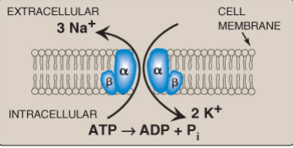
Sodium, chloride, and potassium
2. Potassium
In contrast to Na+ , K + is primarily an intracellular electrolyte.
The concentration differential of Na+ and K+ across the cell membrane is maintained by the Na+ /K+ ATPase
In contrast to Na+ and Cl− , K+ (like Mg2+) is underingested in Western diets because its primary sources, fruits and vegetables, are underingested.
Na+ /K+ ATPase. Na+ = sodium; K+ = potassium; ADP = adenosine diphosphate; Pi = phosphate.

Slide 34
Vertical Integration

Slide 35
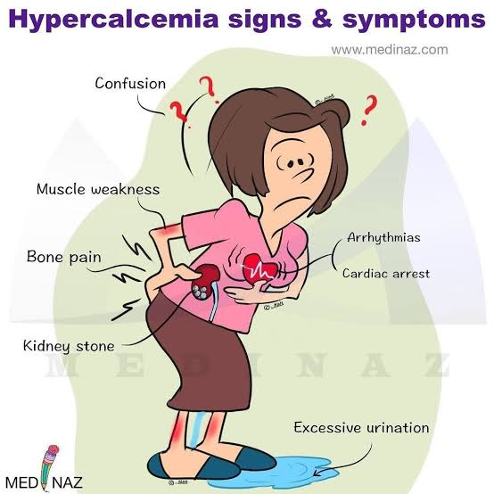
Hypercalcemia

Slide 36
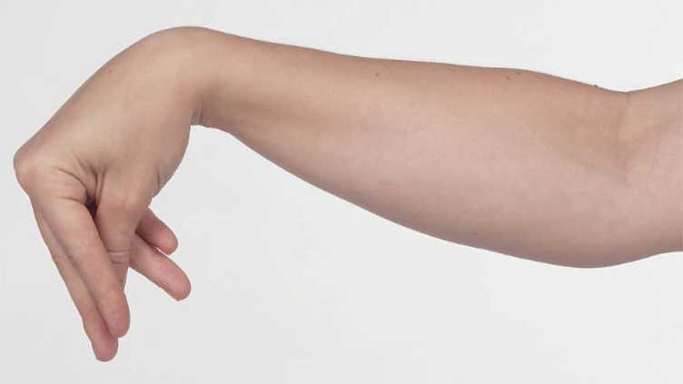
Tetany

Slide 37
Family Medicine
Family Medicine plays important role in following manner:
Diagnosis
Education
Dietary Guidance
Monitoring
Refer to Specialists

Slide 38
Artificial Intelligence
AI plays a significant role in te following aspects:
Exploration and Resource Assessment
Predictive Maintenance
Optimization of Mining Processes
Safety Monitoring
Environmental Monitoring and Compliance
Supply Chain Management
Automated Sorting and Processing

Slide 39
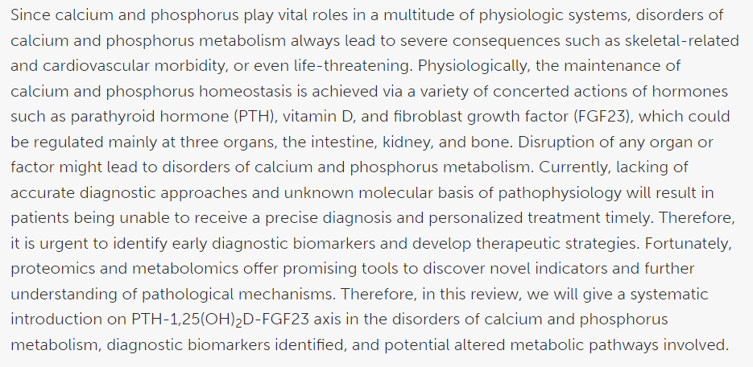
Suggested Research Article
Link:
https://www.frontiersin.org/articles/10.3389/fcell.2020.576110/full
Journal Name:
frontiers
Title:
Disorders of Calcium and Phosphorus Metabolism and the Proteomics/Metabolomics-Based Research
Author Name:
Meiheng Sun
Abstract:

Slide 40
How To Access Digital Library
Steps to Access HEC Digital Library
Go to the website of HEC National Digital Library.
On Home Page, click on the INSTITUTES.
A page will appear showing the universities from Public and Private Sector and other Institutes which have access to HEC National Digital Library HNDL.
Select your desired Institute.
A page will appear showing the resources of the institution
Journals and Researches will appear
You can find a Journal by clicking on JOURNALS AND DATABASE and enter a keyword to search for your desired journal.

Slide 41
Bioethics
Health Impacts
Environmental Impact
Labor Rights
Resource Distribution
Climate Change
Spiral Integration

Slide 42
Assessment
1. Oxide minerals are composed primarily of:
a. Oxygen and sulfur
b. Oxygen and carbon
c. Oxygen and silicon
d. Oxygen and metal ions
e. Oxygen and Nitrogen

Slide 43
Assessment
2.Blood Calcium
a)Consist entirely of diffusable calcium ions
b)Is involved in neuromuscular activity
c)Adult RDA of calcium 200mg/day
d)Concentration is controlled by hormonal action
e)Calcium doesn’t bind to calmodulin protein

Slide 44
Assessment
3. A deficiency of copper affects the formation of normal collagen by reducing the activity of which of the following enzyme?
a. Prolyl hydroxylase
b. Lysyl oxidase
c. Lysyl hydroxylase
d. Glucosyl transferase
e. Galactosyl transferase

Slide 45
Assessment
4. All the following statements regarding calcium are correct except:
a. It diffuses as a divalent cation
b. It freely diffuses across the endoplasmic reticulum of muscle cells
c. It can exist in the blood as ionic form and also protein bound
d. It is found in high concentration in bones
e. Required as a cofactor in some of reactions

Slide 46
Assessment
5. The normal route of calcium excretion is:
a. Kidney
b. Kidney and liver
c. Kidney and intestine
d. Kidney, intestine and pancreas
e. Pancreas, liver and kidney.

Slide 47
Key
D
D
B
B
C

Slide 48
Learning Resources
Textbook of Biochemistry, Lippincott 8th edition, chapter no.29 , page no.446
Google scholar
Google images

Slide 49


