Slide 1
METABOLIC RESPONSE OF TISSUE TO INJURY
Dr. Abdul Qadir
Assistant Professor of Surgery
Rawalpindi Medical University

Slide 2
Mission Statement of RMU
To impart evidence based research oriented medical education
To provide best possible patient care
To inculcate the values of mutual respect and ethical practice of medicine
Wisdom
Truth
Service

Slide 3
Learning Objectives
At the end of this session students will be able to:
Grasping the Concept and Types of Tracheo-Esophageal fistula
Recognizing the Risk Factors
Diagnosing TEF Effectively
Managing TEF Appropriately
Comprehending the Consequences of TEF
Understanding the Importance of Surgery

Slide 4
Professor Umar Model of Integrated Lecture
60%
CORE SUBJECT
20%
HORIZONTAL
INTEGRATION
Physiology
biochemistry
8%
VERTICAL INTEGRATION
Pathology
pharmacology
7%
VERTICAL INTEGRATION
Clinical integration
5%
VERTICAL INTEGRATION
Research, professionalism
Ethics
Digital library

Slide 5
HORIZONTAL INTEGRATION

Slide 6
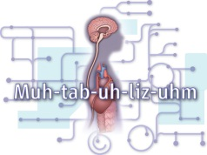
Why??
Restore tissue function
Eradicate invading Microorganisms.

Slide 7
Objectives
Homeostasis - Concept
Components of Responses
Mediators of Responses
Phases of Responses & Key elements
Factors – Exacerbate & Avoidable

Slide 8
Homeostasis
Maintenance of nearly constant conditions
in the internal environment.
Essentially all organs and tissues of the
body perform functions that help maintain
these constant conditions.

Slide 9
Core concept

Slide 10
Basic Concepts in Homeostasis
Homeostasis is the foundation of normal physiology.
Stress-free peri-operative care helps to restore
homeostasis following elective surgery.
Resuscitation, surgical intervention & critical care can return the severely injured patient to a situation in which homeostasis becomes possible once again.

Slide 11
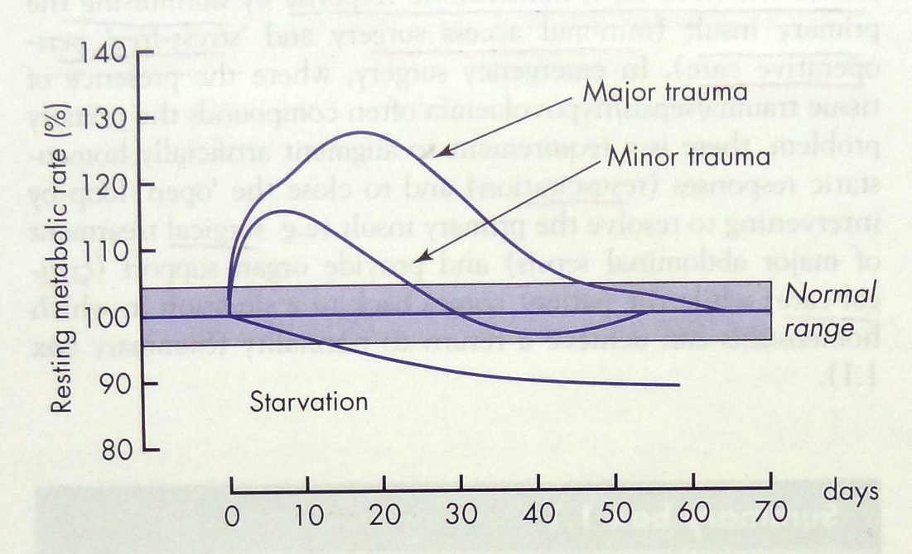
Nature of the injury response
Metabolic response to injury is Graded and evolves with time
Immunological
Hormonal
Cellular response

Slide 12
Response Components
Physiological Consequences
Metabolic Manifestations
Clinical Manifestations
Laboratory Changes

Slide 13
Response Components
PHYSIOLOGICAL
METABOLIC
↑ Cardiac Output
↑ Ventilation
↑ Membrane Transport
Weight loss
Wound Healing
Hypermetabolism
Acclerated Gluconeogenesis
Enhanced Protein breakdown
Increased Fat oxidation

Slide 14
Response Components
CLINICAL
LABORATORY
Fever
Tachycardia
Tachypnoea
Presence of wound or Inflammation
Anorexia
Leucocytosis/Leucopenia
Hyperglycemia
Elevated CRP/Altered acute phase reactants
Hepatic/Renal dysfunction

Slide 15
VERTICAL INTEGRATION

Slide 16
Mediators of Injury Response
Neuro – Endocrine [ Hormonal ]
Immune System [ Cytokines ]

Slide 17
Neuro-endocrine response to injury/critical illness
Biphasic :
Acute phase - An actively secreting pituitary & elevated counter regulatory hormones (cortisol, glucagon, adrenaline).Changes are thought to be beneficial for short-term survival.
Chronic phase - Hypothalamic suppression & low serum levels of the respective target organ hormones. Changes contribute chronic wasting.

Slide 18
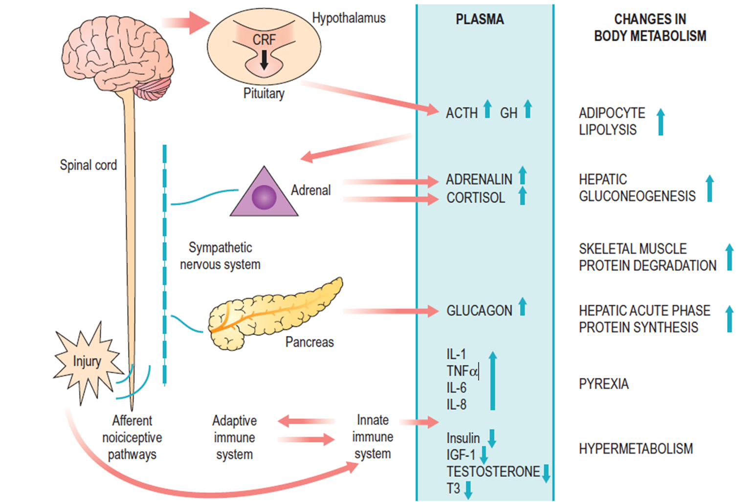

Slide 19
Corticotrophin-releasing factor (CRF) released from the hypothalamus increases adrenocorticotrophic hormone (ACTH) release from the anterior pituitary
ACTH then acts on the adrenal to increase the secretion of cortisol.
Hypothalamic activation of the sympathetic nervous system causes release of adrenalin and also stimulates release of glucagon.
Intravenous infusion of a cocktail of these ‘counter-regulatory’ hormones(glucagon, glucocorticoids and catecholamines) reproduces many aspects of the metabolic response to injury.
Innate immune system (principally macrophages) interacts in a complex manner with the adaptive immune system (T cells, B cells) in co-generating the metabolic response to injury.

Slide 20
Purpose - Neuro-endocrine response
Provide essential substrates for survival
Postpone anabolism
Optimise host defence

Slide 21
Immunological response
Counter regulatory phase
Proinflammatory phase
IL-1, IL-6, TNF-alpha
Hypothalamus → pyrexia
Hepatic acute phase protein
IL-1 receptor antagonist (IL-1Ra) and TNFsoluble receptors (TNF-sR-55 and 75)
Prevent excessive proinflammatory activities
Restore homeostasis
SIRS
COMP. ANTI-INFLAMMATORY RESPONSE SYNDROME
{ CARS }
MODS

Slide 23
Phases – Physiological response [ David Cuthbertson – 1930 ]
Injury
EBB
FLOW
RECOVERY
Hours
Days
Weeks
SHOCK
CATABOLISM
ANABO LISM
BREAKING DOWN ENERGY STORES
BUILDING UP USED ENERGY

Slide 24
Ebb and Flow Phases
Phase | Duration | Role | Physiological | Hormones
Ebb | 24 - 48 hrs | Conserve - blood volume & energy reserves - Repair | ↓ BMR, ↓ temp, ↓ CO, hypovolaemia, lactic acidosis | Catecholamines, Cortisol, aldosterone
Flow
Catabolic | 3 – 10 days | Mobilisation of energy stores – Recovery & Repair | ↑ BMR, ↑ Temp, ↑ O2 consump, ↑ CO | Cytokines + ↑ Insulin, Glucagon, Cortisol, Catechol but insulin resistance
Anabolic | 10 – 60 days | Replacement of lost tissue | +ve Nitrogen balance | Growth hormone, IGF

Slide 25
Key catabolic elements of flow phase
Hypermetabolism
Alterations in skeletal muscle
protein
Alterations in Liver protein
Insulin resistance

Slide 26
1. Hypermetabolism
Majority of trauma pts - energy expenditure appr.
15-25% > predicted healthy resting values.
Factors which increases this metabolism :
* Central thermodysregulation
* Increased sympathetic activity
* Increased protein turnover
* Wound circulation abnormalities

Slide 27
2.Skeletal muscle – Metabolism
1. Muscle wasting – result of ↑ muscle protein degradation + ↓ muscle protein synthesis. (RS & GIT). Cardiac muscle is spared.
2. Is mediated at a molecular level mainly by activation of the ubiquitin-protease pathway.
3. Lead - Increased fatigue, reduced functional ability, ↓QOL & ↑ risk of morbidity & mortality.

Slide 28
3.Hepatic acute phase response
Cytokines – IL- 6 ↑ Synthesis of Positive
acute phase proteins : Fibrinogen & CRP
Negative acute reactants : Albumin decreases
Not Compensated

Slide 29
4.Insulin resistance
Hyperglycaemia is seen – ↑ glucose production + ↓ glucose uptake – peripheral tissues. ( transient
induction of insulin resistance seen )
Due – Cytokines & decreased responsiveness of insulin- regulated glucose transporter proteins.
The degree of insulin resistance is ∞ to magnitude of the injurious process.

Slide 30
Changes in Body composition – following surgery / critical ill pts.
Catabolism – Decrease in Fat mass & Skeletal muscle mass.
Body weight – paradoxically Increase because of expansion of extracellular fluid space.

Slide 31
Factors - ↑ response to injury
Hypothermia
Pain
Starvation
Immobilisation
Sepsis
Hypotension

Slide 32
Avoidable factors that compound the response to injury
Continuing haemorrhage
Hypothermia
Tissue oedema
Tissue underperfusion
Starvation
Immobility

Slide 33
Avoidable Factors
Volume loss : Careful limitation of intra operative administration of colloids and crystalloids so that there is no net weight gain.
Hypothermia : RT – maintaining normothermia by an upper body forced air heating cover ↓ wound infection, cardiac complications and bleeding and transfusion requirements.

Slide 34
Avoidable Factors
Administration of activated protein C - to critically ill patients has been shown to ↓ organ failure and death. It is thought to act, in part, via preservation of the micro circulation in vital organs.
Maintaining the normoglycemia with insulin infusion during critical illness has been proposed to protect the endothelium and thereby contribute to the prevention of organ failure and death.

Slide 35
Avoidable Factors
Starvation : During starvation, the body is faced with an obligate need to generate glucose to sustain cerebral energy metabolism(100g of glucose per day).
Provision of at least 2L of IV 5% dextrose for fasting patients provides glucose as above.

Slide 36
Avoidable Factors
Tissue oedema : is mediated by the variety of mediators involved in the systemic inflammation. Careful administration of anti-mediators & reduce fluid overload during resuscitation reduces this condition.
Immobility : Has been recognized as a potent stimulus for inducing muscle wasting. Early mobilization is an essential measure to avoid muscle wasting.

Slide 37
App. to prevent unnecessary aspects of stress response
Minimal access techniques
Minimal periods of Starvation
Epidural analgesia
Early mobilisation

Slide 38
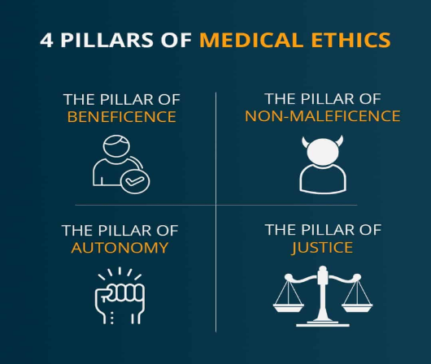
Promoting Biomedical Ethics Culture
Understanding Biomedical Ethics
The core pillars/principles of medical ethical include:

Slide 39
Beneficence
Understanding Biomedical Ethics
The principle of beneficence is the obligation of physician to act for the benefit of the patient and supports a number of moral rules to protect and defend the right of others, prevent harm, remove conditions that will cause harm, help persons with disabilities, and rescue persons in danger.

Slide 40
Suggested research article
Promoting IT & Research Culture
https://doi.org/10.3390/jcdd9110402

Slide 41
THANK YOU

