Slide 1
MANAGEMENT OF VENTRAL WALL HERNIAS
Professor Dr Muhammad Waqas Raza

Slide 2
Case Scenario
26 year old male presented with abdominal swelling/ lump for 10 years and pain abdomen for 4 months. The lump and pain becomes prominent on coughing or straining and reduces spontaneously on lying down. There is no history of chronic cough, constipation yellowish discoloration of skin or sclera or abdominal distension. There is no history of similar swelling in past or any history of previous abdominal surgery. On abdominal examination there is a paraumbilical swelling that is non tender, reducible and has a positive cough impulse.

Slide 3
Provisional Diagnosis
Paraumbilical Hernia

Slide 4
What are Ventral Wall Hernias?
Ventral hernias are defined as a defect of the fascia in the anterior abdominal wall with or without a bulge. Clinical presentation varies from small incidental defects to giant and complicated hernias with fistulas and viscera located outside the abdominal cavity covered only by peritoneum and skin.

Slide 5
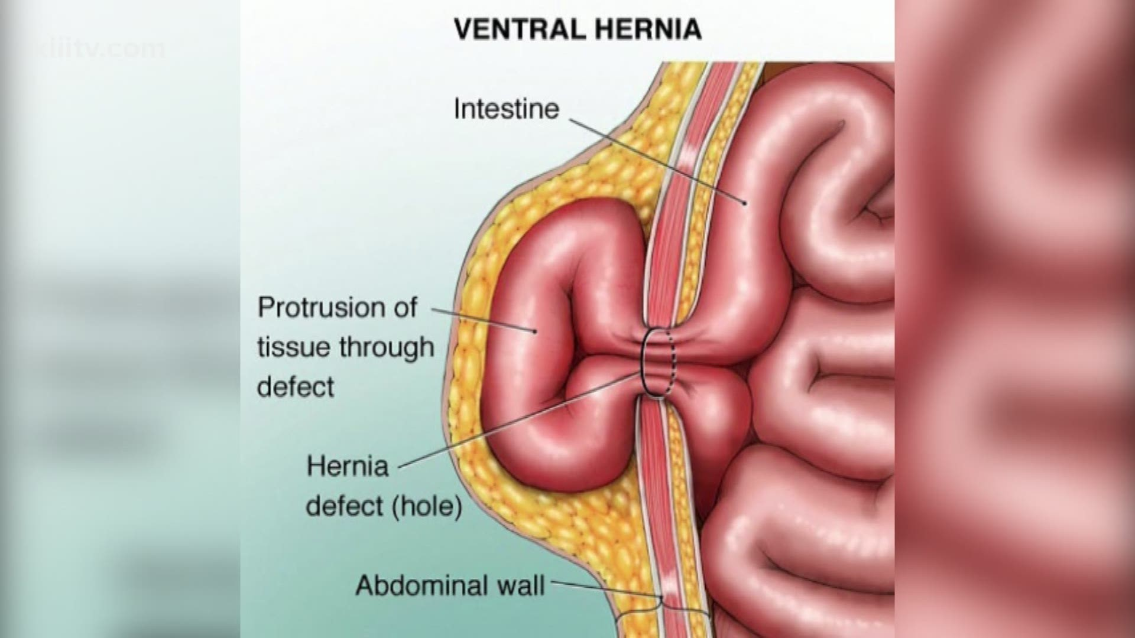

Slide 6
How do you classify Ventral Hernias
The European Hernia Society (EHS) classification divides hernias into
primary and
incisional (secondary)
then further subdivides them by
anatomical location and
size.
Incisional hernias are also categorised by recurrence in a binary fashion.

Slide 7
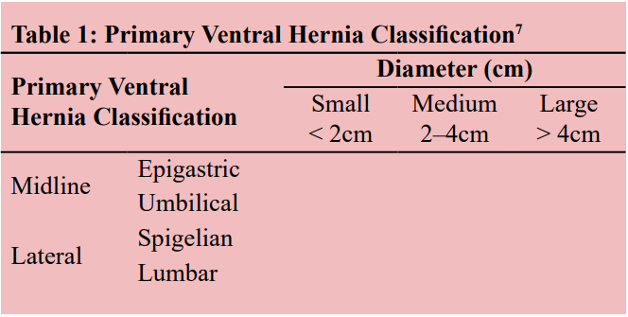

Slide 8
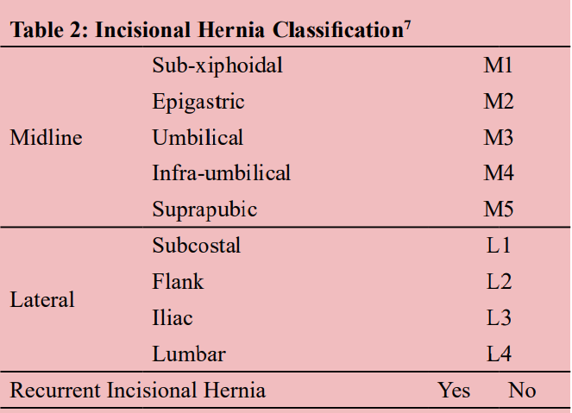

Slide 9
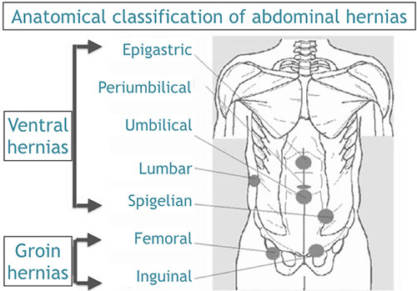

Slide 10
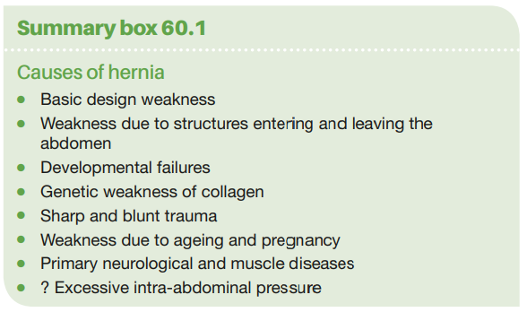

Slide 11
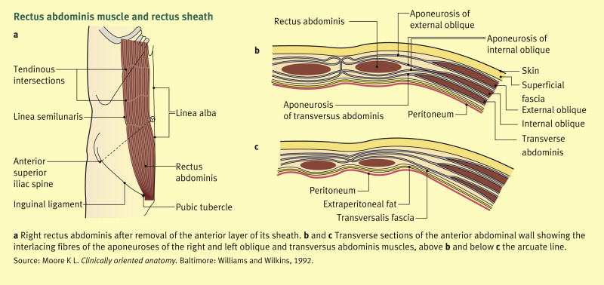
Relevant Anatomy

Slide 12
Abdominal structure is not homogenous.
WEAK POINTS:
Natural communications between abdominal cavity and other cavities
Passing of nerves or vessels towards superficial structures
Scars (posttraumatic, postoperative)
Intersection of facial structures

Slide 13
Weak Points (Examples)
Linea Alba
Umbilical Ring
Lumbar Triangle
Linea semilunaris
Femoral canal
Inguinal Canal

Slide 15
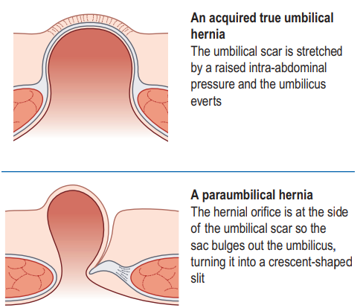
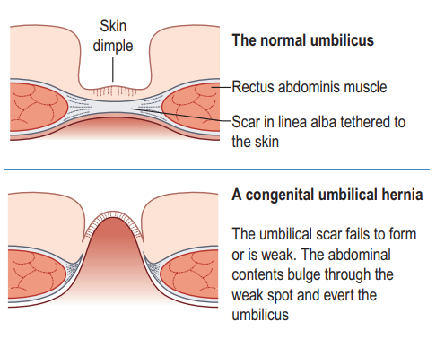
UMBILICAL HERNIAS

Slide 16
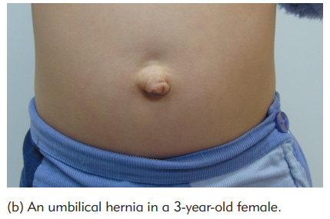
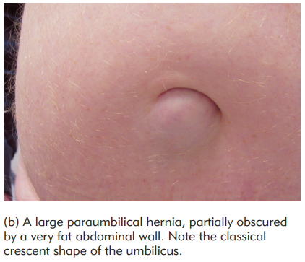

Slide 17
EPIGASTRIC HERNIAS
Protrusion of extraperitoneal fat, and sometimes a small peritoneal sac, through a defect in the linea alba somewhere between the xiphisternum and the umbilicus.

Slide 18
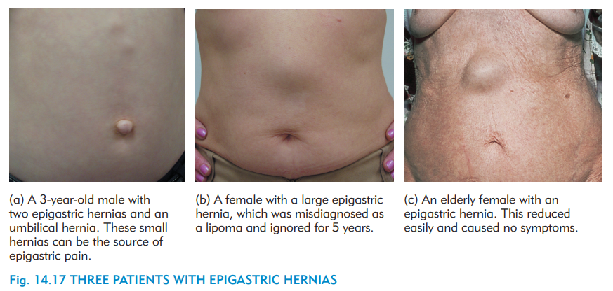

Slide 19
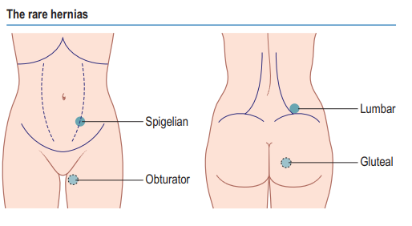
Rare Hernias

Slide 20
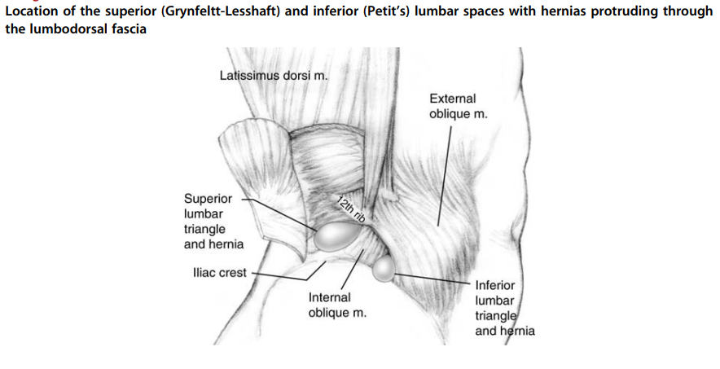
Location of the superior and inferior (Petit’s) lumbar spaces with hernias protruding through the lumbodorsal fascia

Slide 21
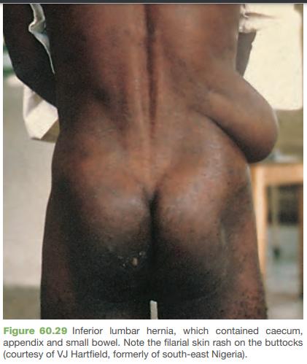

Slide 22
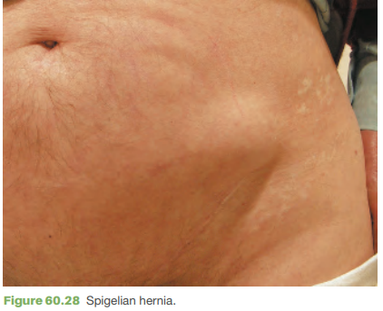

Slide 23
Risk Factors For Incisional Hernias

Slide 24
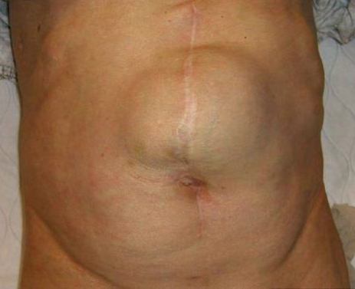
Incisional Hernias

Slide 25
Elective Presentation
A completely or partially reducible swelling occurring at a potential area of weakness in abdominal wall having an expansile cough impulse.

Slide 26
Emergency Presentation
Painful Tender Irreducible swelling with or without the cardinal symptoms of intestinal obstruction – colicky abdominal pain, vomiting, distension and absolute constipation.

Slide 27
IRREDUCIBLE
Contents of the hernia sac cannot be reduced into the abdomen
INCARCERATED
Contents are imprisoned in the sac(maybe due to adhesions) but are alive and functioning normally
OBSTRUCTED
A bowel of loop is trapped such that its lumen but not the blood supply is obstructed.
STRANGULATED
Compression or twisting has compromised the blood supply to the contents which are ischemic or infarcted

Slide 28
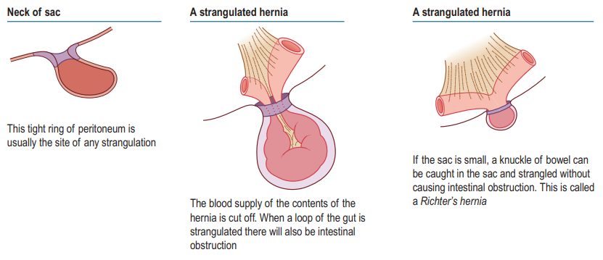

Slide 29
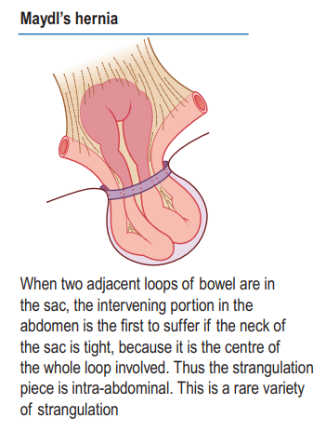
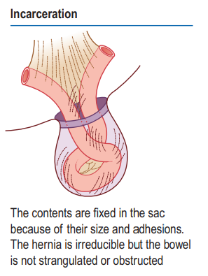

Slide 30
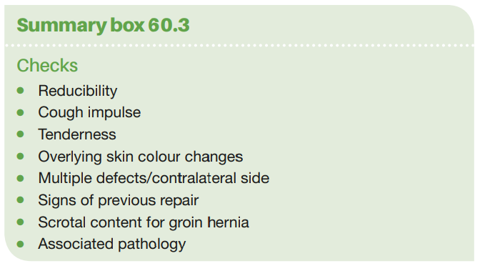

Slide 31
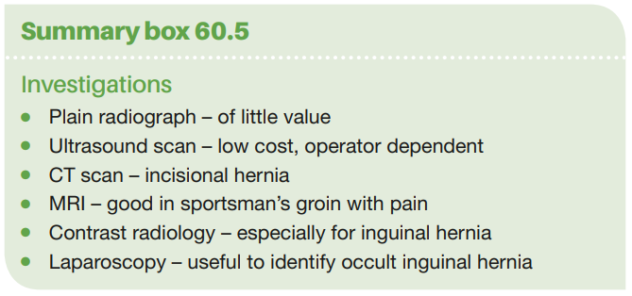

Slide 32
Management
● Not all hernias require surgical repair
● Small hernias can be more dangerous than large
● Pain, tenderness and skin colour changes imply high risk of strangulation

Slide 33
Surgical approaches to hernia
All surgical repairs follow the same basic principles:
1. reduction of the hernia content into the abdominal cavity with removal of any non-viable tissue and bowel repair if necessary;
2. excision and closure of a peritoneal sac if present or replacing it deep to the muscles;
3. reapproximation of the walls of the neck of the hernia if possible;
4. permanent reinforcement of the abdominal wall defect with sutures or mesh.

Slide 34
Techniques
Open (Primary or Mesh Repair?)
Laparoscopic (IPOM)

Slide 35
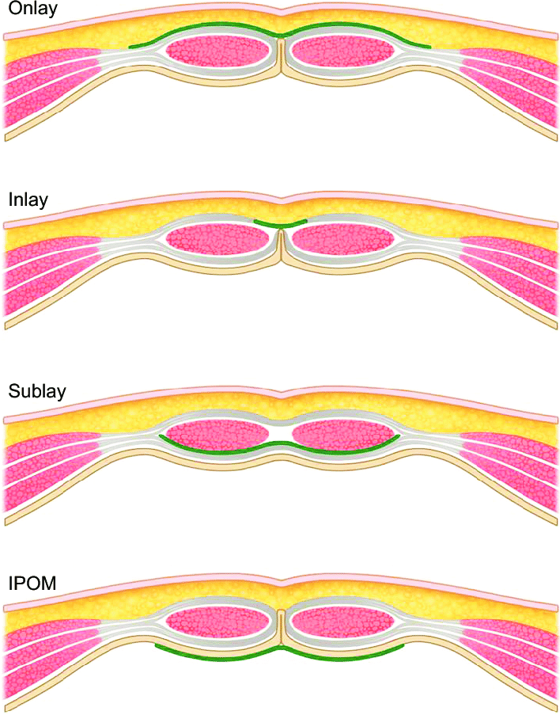
Nomenclature of Mesh Position

Slide 36
Management of Very Large Ventral Hernias
If the volume of the sac is more than 25% of the volume of the abdominal cavity (and this can be calculated from CT images), then there are likely to be issues of loss of abdominal domain when the hernia is repaired.

Slide 37
Abdominal Compartment Syndrome
High intra-abdominal pressure on attempting reduction and closure can lead to
visceral compression and
pulmonary complications due to impaired diaphragmatic movement.
A tight abdomen can lead to wound breakdown and failure of the repair.

Slide 38
Techniques to overcome the potential loss of abdominal domain
Preoperative abdominal expansion with progressive preoperative pneumoperitoneum over several weeks,
Resection of the omentum and/or colon at the time of repair,
Use of prosthetic mesh to span the uncloseable gap in the musculofascial layer, or
Ramirez’s component separation technique (Musculofascial advancement)

Slide 39
Complications
Intraoperative
Enterotomy
Postoperative
Mechanical Obstruction
Prolonged Ileus
Wound and Mesh Infections
Seroma & Hematoma

Slide 40
How will you manage this patient?
26 year old male presented with abdominal swelling/ lump for 10 years and pain abdomen for 4 months. The lump and pain becomes prominent on coughing or straining and reduces spontaneously on lying down. There is no history of chronic cough, constipation yellowish discoloration of skin or sclera or abdominal distension. There is no history of similar swelling in past or any history of previous abdominal surgery. On abdominal examination there is a paraumbilical swelling that is non tender, reducible and has a positive cough impulse.

Slide 41
ANY QUESTIONS?

Slide 42
THANKS

