Slide 1
MANAGEMENT OF RENAL CELL CARCINOMA
Dr. Zeeshan Qadeer Assistant Professor Urology Department
Rawalpindi Medical University

Slide 2
University Motto, Vision, Values & Goals
Mission Statement
To impart evidence-based research-oriented health professional education
Best possible patient care
Mutual respect, ethical practice of healthcare and social accountability.
Vision and Values
Highly recognized and accredited centre of excellence in
Medical Education, using evidence-based training techniques for development of highly competent health
professionals, who are lifelong experiential learner and are socially accountable.
Goals
The Undergraduate Integrated Learning Program is geared to provide you with quality medical education in an environment designed to:

Slide 3
SEQUENCE OF LGIS
Learning objectives
Core Subject (70%)
Vertical Integration (10%)
Horizontal Integration (15%)
Research (3%)
Biomedical Ethics (2%)

Slide 4
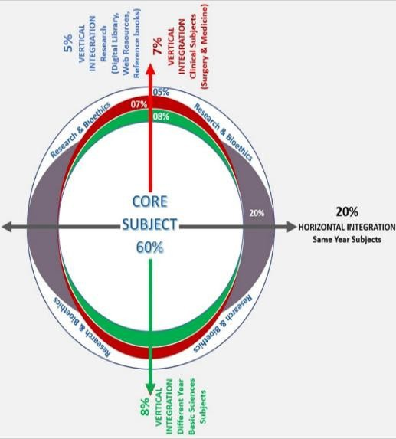
PROF UMER MODEL OF INTEGRATED LECTURE

Slide 5
LEARNING OBJECTIVES
Understand the management approach for localized and metastatic renal cell carcinoma (RCC), including surgical and non-surgical options.
Describe the indications and principles of radical nephrectomy and nephron-sparing surgery, including patient selection criteria.
Explain the role of palliative nephrectomy in metastatic RCC and its impact on symptom relief and survival.
Discuss the limited role of radiotherapy and chemotherapy in RCC, focusing on its radioresistance and chemoresistance mechanisms.
Explore targeted molecular therapies, including tyrosine kinase inhibitors (Sunitinib, Sorafenib) and their mechanism of action.
Understand the role of immunotherapy (Interferon, Interleukin-2) in RCC and its potential in improving patient outcomes.

Slide 6
CORE SUBJECT

Slide 7
INTRODUCTION
Management Overview
Localized disease management
Surgery
Radical Nephrectomy
Nephron Sparing Surgery
Metastatic Disease Management
Palliative Surgery
Radiotherapy
Chemotherapy
Targeted Molecular therapy
Immunotherapy

Slide 8
Management
Localized disease
Metastatic disease

Slide 9
Management of Localized disease
Localized disease
Surgery

Slide 10
Surgery- Radical nephrectomy
Gold standard treatment for localized RCC with contralateral normal kidney, adequate surgical margin.
Principles of Surgery- Early ligation of renal artery and vein , removal of kidney including Gerota’s fascia, removal of ipsilateral adrenal gland.

Slide 11
Nephron Sparing Surgery
Indications
Bilateral RCC
RCC in a solitary functioning kidney
Unilateral RCC with contralateral kidney under threat of its future function (Renal artery stenosis, Chronic pyelonephritis , Hydronephrosis, Ureteral reflux, Calculus disease, Systemic disease such as diabetes).
Tumor less than 4cms with normal opposite kidney.

Slide 12
Management of Metastatic Disease
Metastatic
Disease
Radio
Therapy
Chemo
Therapy
Targeted
Therapy
Immuno
Therapy
Surgery

Slide 13
VERTICAL INTEGRATION WITH SURGERY

Slide 14
Surgery
Palliative Nephrectomy – Indicated in patients with
Severe hemorrhage,
Severe pain,
Paraneoplastic syndrome
or compression of adjacent viscera
Solitary metastasis can be resected and may show some survival advantage

Slide 15
Surgery…
Resection of met’s
in pt. not relieved from palliative RT
In solitary mets.
Spontaneous regression of met’s
< 1 % of cases
only 4 (0.8%) of 474 patients in 9 series who underwent nephrectomy experienced regression of metastatic foci

Slide 16
Radio Therapy
Palliation
Used for local or symptomatic metastatic disease, such as painful osseous lesions or brain metastasis.
Higher doses (up to 35-40Gy) may be required to overcome radioresistance.
Symptomatic relief in 64-84% of patients

Slide 17
HORIZONTAL INTEGRATION WITH PHARMACOLOGY

Slide 18
Chemotherapy
RCC is a chemo resistant tumor. Phenomenon due to presence of multi drug resistant glycoprotein (MDR) in tumor cell - causes extrusion of the drug
Conventional therapy has little to offer.
5-FU alone has a response rate of 10%,
On-going clinical trials of combination chemotherapy including Gemcitabine and 5-FU.
Limited data reveals some response in non-clear cell RCC to Carboplatin, Cisplatin plus Gemcitabine.

Slide 19
Spiral Integration with Family Medicine
Risk factor modification (e.g., smoking cessation, hypertension control) in RCC prevention.
Early referral criteria for suspected renal tumors based on symptoms like hematuria and flank pain.

Slide 20
Biomedical Ethics
Ethical considerations in advanced RCC treatment, including patient autonomy and quality of life.
Informed consent for nephrectomy and targeted therapies, considering cost and side effects.

Slide 21
Research
Recent advancements in molecular-targeted therapy and their impact on RCC prognosis.
Ongoing clinical trials exploring novel immunotherapy combinations for metastatic RCC.

Slide 22
RECENT ADVANCES : Targeted Molecular Therapy
New treatment approach that targets only the cancer.
In renal cell carcinoma patients, this type of therapy uses drugs that stop the new blood vessels from growing, and targets certain factors that cause the cells to grow.
Tyrosine kinase (TK) inhibitors block the intracellular domain of the VGEF receptor
Sunitinib (Sutent)
Sorafenib (Nexavar)

Slide 23
Immunotherapy
Systemic type of treatment used to improve the body’s natural defenses.
Boosts the immune system and slows down the cancer growth
Interferon (IFN)
Interleukin (IL -2)

Slide 24
Summary
RCC has increasing incidence
Associated with tobacco and inherited disorders
Surgery is the only curative modality for Stage I, II, and III
RCC is radio resistant, RT’s role in paliation
Stage IV disease holds poor prognosis despite advancements in molecular understanding
IL-2, Sorafenib, Sunitinib, and Temsirolimus are FDA approved treatments for advanced RCC.

Slide 25
REFERENCES
Campbells urology 12th edition
Smith and Tanaghos urology 9th edition
EAU 2024 guidelines

