Slide 2
DR. TANVEER HUSSAIN
FCPS (Med), FRCP( Glasg)
FCPS (Gastro), CHPE
Associate Professor & HOD
Gastroenterology, RMU

Slide 3

University Motto, Vision, Values & Goals
University Motto, Vision, Values & Goals
Mission Statement To impart evidence-based research-oriented health professional education Best possible patient care Mutual respect, ethical practice of healthcare and social accountability. Vision and Values Highly recognized and accredited center of excellence in Medical Education, using evidence-based training techniques for development of highly competent health professionals, who are lifelong experiential learner and are socially accountable. Goals The Undergraduate Integrated Learning Program is geared to provide you with quality medical education in an environment designed to:

Slide 4
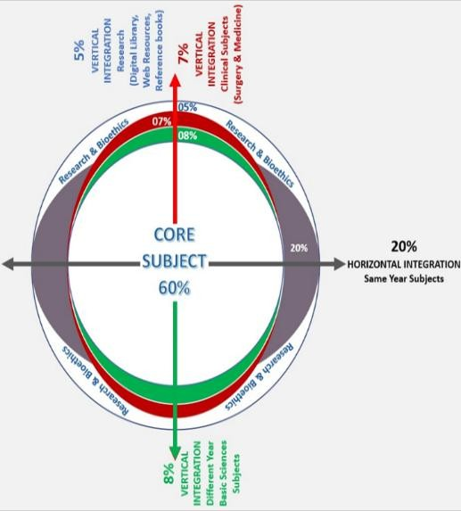
RMU Integrated Lecture Model

Slide 5
Liver diseases and Pregnancy

Slide 6
LOS
At the end of lecture, students will be able to understand
Etiopathogenesis & clinical features of the disease
Specific investigations of the disease
Treatment plan of the disease
Complication of the disease

Slide 7
Liver diseases and Pregnancy
Evaluation of Pregnant patient with abnormal Liver tests
Liver diseases unique to Pregnancy
Coincident Liver disease (HAV, HEV, HSV)
CLD, Cirrhosis and complication
Liver Masses in Pregnancy

Slide 8
Changes in different Tests during Pregnancy
Laboratory Test | Changes
White cell count | No change
Hemoglobin | Decreased
Platelets | No change
Aminotransferases | No change
Total bilirubin | No change
Alkaline phosphatase | Elevated
Gamma-glutamyl transferase | No change
Albumin | Decreased
International normalized ratio | No change
Alpha-fetoprotein | Elevated

Slide 9
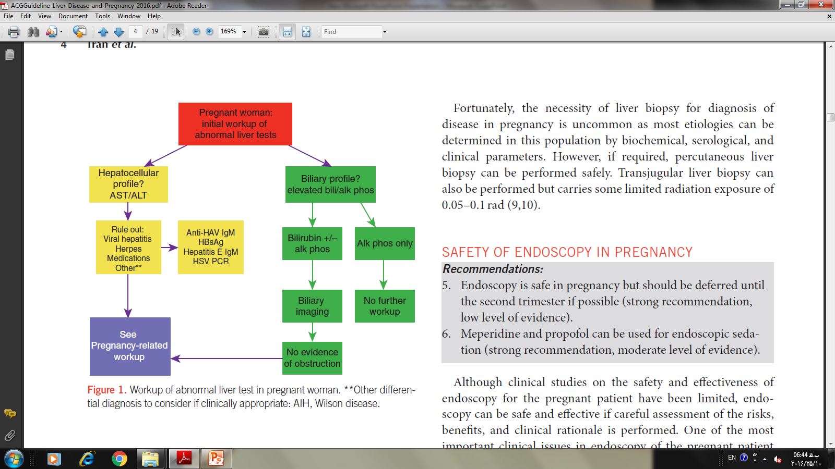
Evaluation of abnormal Liver test

Slide 10
Timeline of Liver diseases unique to Pregnancy
Trimester (Gestation)
First
0-12 weeks
Second
13-28 weeks
Third
29-40 weeks
Hyperemesis gravidarum
Intrahepatic cholestasis of pregnancy
Preeclampsia/eclampsia
HELLP syndrome
Acute fatty liver of pregnancy

Slide 11
Liver Test Abnormalities
Condition | Aminotransferase | Total Bilirubin
Hyperemesis gravidarum | 1-3× | <4 mg/dL
Intrahepatic cholestasis of pregnancy | 1-5× | <5 mg/dL
Preeclampsia/ Eclampsia | ≥2× | <5 mg/dL
HELLP syndrome | ≥2× | <5 mg/dL
Acute fatty liver of pregnancy | 5-10× | <10 mg/dL

Slide 12
Evaluation of hyperemesis gravidarum
Abnormal liver-associated tests in the first trimester
Biliary disease, viral causes, autoimmune causes, and medications excluded
Severe nausea/vomiting
No
Yes
Non liver-related causes of nausea/ vomiting such as UTI, pancreatitis, and GI infections excluded
Not hyperemesis gravidarum
Hyperemesis gravidarum

Slide 13
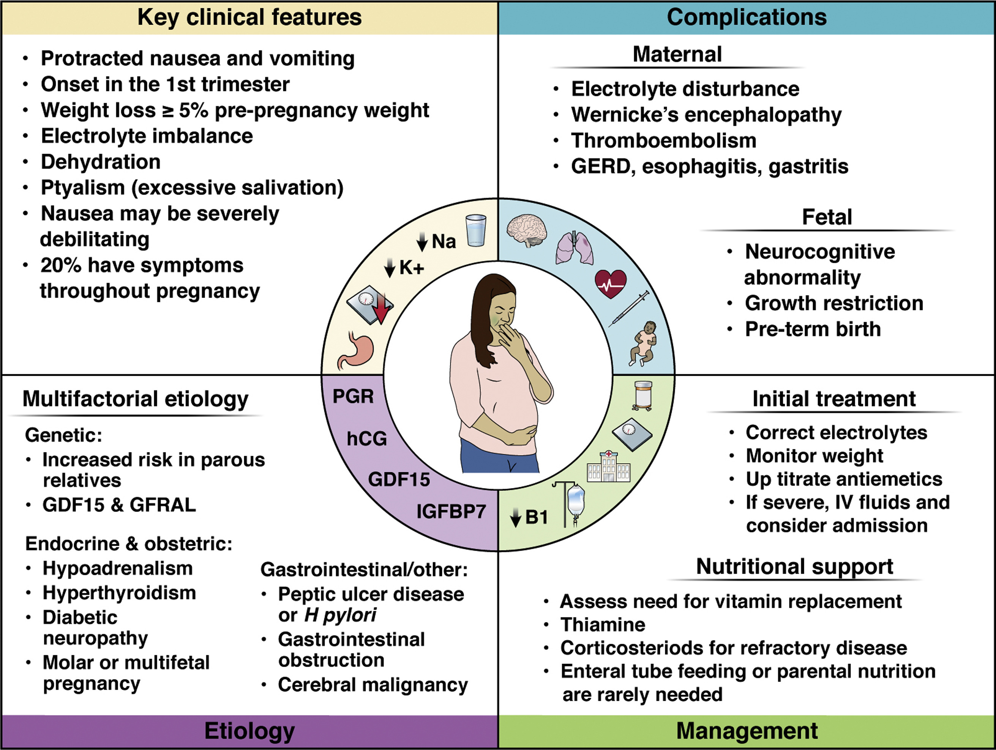
Gastroenterology 2022 16397-117.e1DOI: (10.1053/j.gastro.2022.01.060)
Copyright © 2022 AGA Institute Terms and Conditions
Notes:
Hyperemesis gravidarum. The etiology of HG is likely multifactorial and includes genetic, endocrine/obstetric, and gastrointestinal contributions. Symptoms range from mild to severe and warrant careful management to avoid complications. GDF15, growth differentiation factor 15; GERD, gastroesophageal reflux disease; GFRAL, receptor for GDF15; hCG, human chorionic gonadotropin; IV, intravenous; PGR, progesterone receptor.

Slide 14
Evaluation of patient with IHCP
Abnormal liver tests (cholestatic pattern) in 2nd or 3rd trimester
Biliary disease, viral causes, autoimmune causes, and medications excluded
Pruritus
No
Yes
Elevated bile acids
No
Yes
Not IHCP
IHCP

Slide 15
Evaluation of patient with preeclampsia
Abnormal liver tests in the second or third trimester (usually after 20 weeks of gestation)
Biliary disease, viral causes,
autoimmune causes, and medications excluded
Hypertension (≥140/90 mm Hg)
+ proteinuria (≥300 mg/24 hr)
No
Yes
Not PE/eclampsia
PE/eclampsia

Slide 16
Evaluation of a patient suspected of HELLP
Abnormal liver-associated tests in the second
or third trimester
Biliary disease,
viral causes,
autoimmune causes, and
medications excluded
Complete blood count
Hemolysis and thrombocytopenia
No
Yes
Not HELLP syndrome
HELLP syndrome

Slide 17
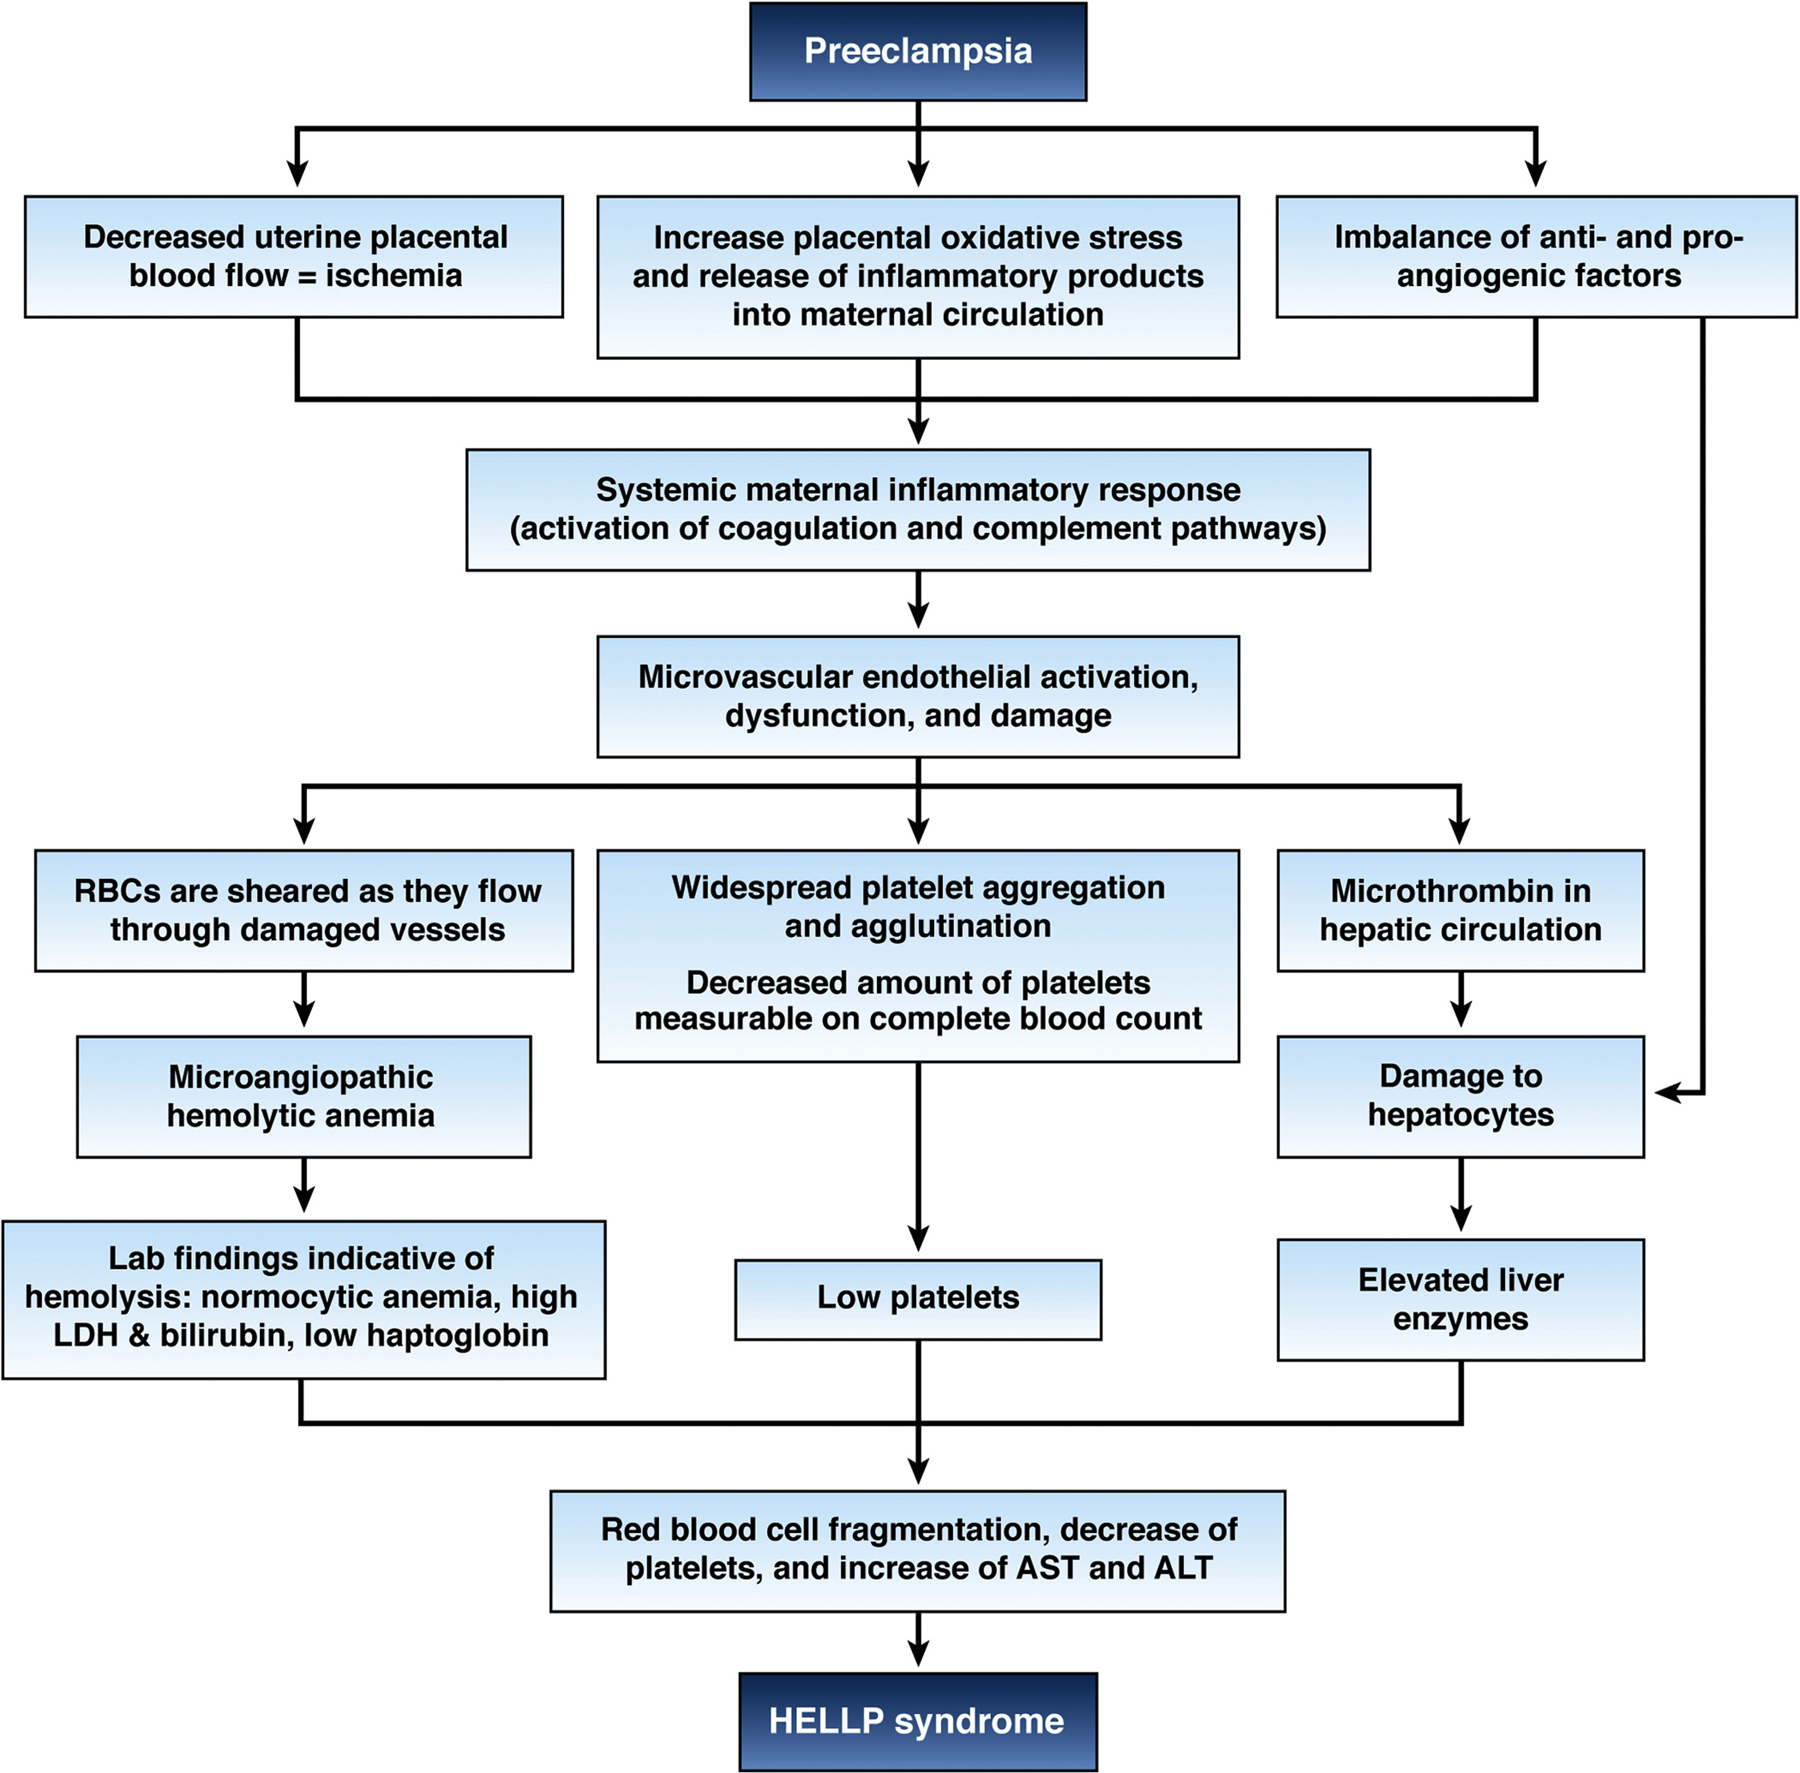
Gastroenterology 2022 16397-117.e1DOI: (10.1053/j.gastro.2022.01.060)
Copyright © 2022 AGA Institute Terms and Conditions
Notes:
Pathogenesis of HELLP. Preeclampsia-associated changes in the placenta set the stage for the development of HELLP. Ischemic injury with increased release of inflammatory mediators into the maternal circulation, and imbalance between pro- and antiangiogenic factors lead to activation of the coagulation and complement pathways. Abnormal oxidation of fatty acids by the fetus and release of metabolic intermediates into the mother's circulation cause liver and vascular dysfunction. The coagulation cascade is activated by adhesion of platelets on the activated and damaged endothelium. Platelets release thromboxane A and serotonin, causing vasospasm, platelet aggregation, and further endothelial damage. The red blood cells are sheared as they flow through damaged vessels, causing microangiopathic hemolytic anemia. Multiorgan microvascular injury and hepatic necrosis lead to the clinical manifestations of HELLP syndrome. LDH, lactate dehydrogenase; RBC, red blood cell.

Slide 18
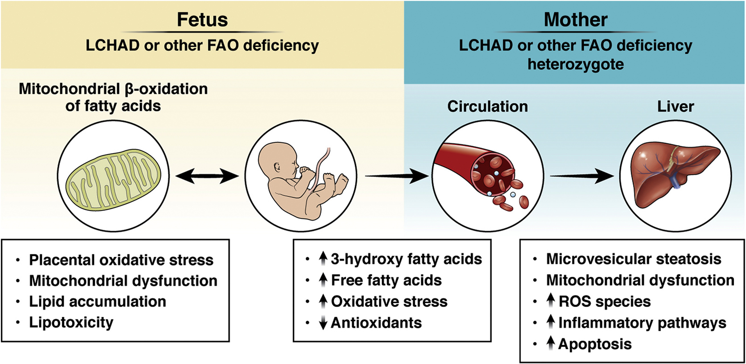
Gastroenterology 2022 16397-117.e1DOI: (10.1053/j.gastro.2022.01.060)
Copyright © 2022 AGA Institute Terms and Conditions
Notes:
Proposed pathogenesis of AFLP. Mitochondrial β-oxidation of fatty acids is a complex process that consists of multiple transport steps and sequential enzymatic reactions resulting in the removal of 2-carbon, acetyl-coenzyme A units. The 2 to 4 distinct enzymes, encoded by separate nuclear genes, exhibit different overlapping substrate specificities. If the fetus is homozygous for LCHAD and the mother is heterozygote, she has reduced capacity to oxidize long-chain fatty acids. The increased lipolysis, particularly in the third trimester, coupled with decreased β-oxidation, result in hepatotoxic long-chain 3-hydroxyacyl fatty acid metabolites, produced by the fetus or placenta, accumulating in the maternal circulation and liver. FAO, fatty acid oxidation; ROS, reactive oxygen species.

Slide 19
Swansea Criteria for AFLP
Symptoms
Vomiting
Abdominal pain
Polydipsia/polyuria
Encephalopathy
Laboratory Tests
Elevated bilirubin (>0.82 mg/dL)
Hypoglycemia (<72 mg/dL)
Elevated uric acid (>5.7 mg/dL)
Leukocytosis (>11 × 109/L)
High AST or ALT (>42 IU/L)
High ammonia (>66 mmol)
Renal impairment (Cr >1.7 mg/dL)
Coagulopathy (PT >14 s or APTT >34 s)
Imaging
Ascites or bright liver on ultrasound
Histology
Microvesicular steatosis on liver biopsy

Slide 20

The principles in Medical Ethics

Slide 21
The Principle of Confidentiality
Based on loyalty and trust
Maintain the confidentiality of all personal, medical and treatment informations
Information to be revealed with consent and for the benefit of the patient
Except when ethically and legally required
Disclosure should not be beyond what is required

Slide 22
Justice
Justice is a complex ethical principle, with meanings that range from the fair treatment of individuals to the equitable allocation of healthcare money and resources.
Justice is concerned with the equitable distribution of benefits and burdens to individuals in social institutions, and how the rights of various individuals are realized.
Allocating scarce medical resources.
Be able to justify your actions in every medical situation.

Slide 23
Ethical Issues in Modern Healthcare
Value conflicts arise where there appears to be no clear consensus as to the “Right thing to do.” These conflicts present problems requiring moral decisions, and necessitates a choice between two or more alternatives.
Examples:
Should a parent have a right to refuse immunizations for his or her child?
Does public safety supersede an individual’s right?

Slide 24
Research Driven Ethical Issues
Stem Cell Research
Research Cloning
Genome Project Results
Fertility Research

Slide 25
Research
Davidson's Principles and Practice of Medicine
24th Edition - March 1, 2022
Gastroenterology 2022 16397-117.e1DOI: (10.1053/j.gastro.2022.01.060

Slide 26
THANK YOU

