Slide 1



Slide 2



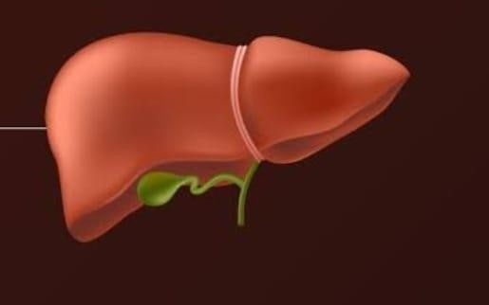




LIVER DISEASES IN PREGNANCY
DR. KHANSA IQBAL
ASSISTANT PROFESSOR
GU-II HFH
RWP

Slide 3


Prof. Umar’s Model of Teaching Strategy
Self Directed Learning Assessment Program
First Ten Minutes
Objectives :
To cultivate critical thinking, analytical reasoning, and problem-
solving competencies.
To instill a culture of self-directed learning, fostering lifelong
learning habits and autonomy.
How to Assess?
➢
Ten randomly selected students will be evaluated within the first 10 minutes of the lecture through 10 multiple-choice questions (MCQs) based on the PowerPoint presentation shared on Students Official WhatsApp group, one day before the teaching session.
➢
The number of MCQs from the components of the lecture will follow
the guidelines outlined in the Prof. Umar model of Integrated Lecture.
Component of LGIS
Core Know ledge
Horizontal Integration
Vertical Integration
Spiral Integration
No of MCQs
6-7
1-2
1
1

Slide 4
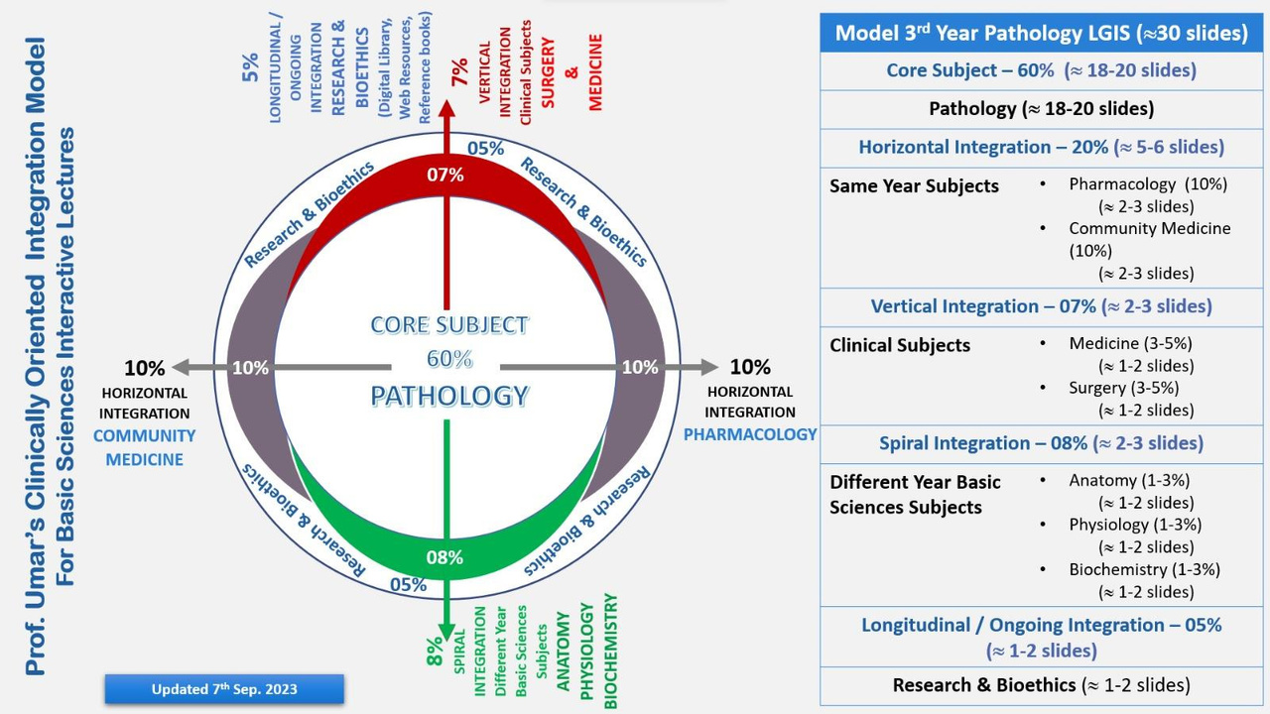
Professor Umar Model of Integrated Lecture
3

Slide 5
Mission Statement
University Motto, Vision, Values & Goals
▶ To impart evidence-based research-oriented health professional education
▶ Best possible patient care
▶ Mutual respect, ethical practice of healthcare and social accountability.
Vision and Values
▶ Highly recognized and accredited centre of excellence in Medical Education, using evidence-based training techniques for development of highly competent health professionals, who are lifelong experiential learner and are socially accountable.
Goals
▶ The Undergraduate Integrated Learning Program is geared to provide you with quality medical education in an environment designed to.

Slide 6
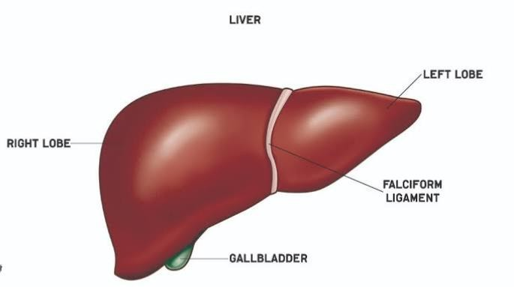
Anatomy of Liver
The liver is located in the upper right portion of the abdominal cavity, beneath the diaphragm. It is wedge shaped, bilobed structure contsist of 2 main lobes(right and left)

Slide 7

Physiology
Pregnancy directly affects the physiology of the liver
Hyper estrogenic condition (spider angioma and palmar erythema)
Gall bladder motility(decreased, increasing incidence of cholelithiasis)
Hemodilution leads to decreased albumin level
Increased Alkaline phosphatase(Placental origin)
Increased AFP(Fetal liver production)
Total Bilirubin, ALT, AST, GGT remain normal during pregnancy.

Slide 8
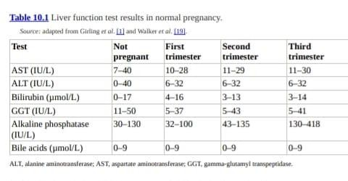
Liver Function Test in Pregnancy

Slide 9






Investigations of Liver Disease in Pregnancy
Baseline Investigations
Ultrasound abdomen
MRI without contrast if required
CT abdomen
ERCPs

Slide 10
Liver disease in pregnancy
Incidence is 3% of the pregnancies
Liver diseases are
Specific to pregnancy
co-incident with pregnancy
Pregnancy in preexisting liver disease

Slide 11
Conditions Specific to pregnancy
Hyperemesis gravidarum
Intrahepatic cholestasis of pregnancy Acute fatty liver of pregnancy
HELLP

Slide 12
Condition Coincident with pregnancy
Viral hepatitis.
Biliary disease (e.g cholelithiasis and primary
sclerosing cholangitis)
Vascular alterations (Budd–Chiari syndrome)
Drug-induced hepatotoxicity Liver transplantation

Slide 13
Pregnancy in preexisting chronic liver diseases
Cirrhosis and portal hypertension
Hepatitis B, C and E
Non-alcoholic fatty liver disease Wilson's disease
Autoimmune liver disease

Slide 14
Hyperemesis gravidarum
❑
❑
Nausea and vomiting are common in pregnancy.
Most frequently used definition is intractable vomiting resulting in ketosis, dehydration and weight loss of 5% or greater of body.
Abnormal gastric motility , hormonal factors and changes
in autonomic nervous system are thought to play a key role

Slide 15

Risk factors
Multiple gestations
Increase BMI Preexisting diabetes Psychiatric illness
Previous history of hyperemesis gravidarum

Slide 16
Management
Initial management is conservative
Intravenous hydration
Drug of choice is doxylamine( pyridoxine Vit B6)
Ginger may be used as non pharmacological option
In severe cases ondansterone is advised

Slide 17
Intrahepatic cholestasis of pregnancy
also known as obstetric cholestasis
Unexplained pruritis in pregnancy with abnormal liver
function test with raised bile acids resolving after delivery
Pruritis that involves palms and soles are particularly suggestive
Most common cause of jaundice in pregnancy in late 2nd
and 3rd trimester
Rapid postnatal resolution
It affects about 1.2%–1.5% of pregnancies

Slide 18
Adverse Effects of intrahepatic cholestasis
Premature labour
Fetal distress
Stillbirth

Slide 19
INVESTIGATIONS:
Elevated serum bile acids >10 μmol/L (most complications occur with levels >40 μmol/L)
Increased levels of transaminases and gamma-glutamyl transferase (GGT).
Additional tests can include a viral screen for hepatitis A, hepatitis B, hepatitis C, Epstein–Barr virus and cytomegalovirus
liver autoimmune screen (anti-smooth muscle and anti-
mitochondrial antibodies)
Abdominal ultrasound for liver status
Normal liver function does not exclude the diagnosis. LFTs should be repeated every 1–2weeks if pruritus is persistent.

Slide 20
Management
Ursodeoxycholic acid improves clinical symptoms and liver parameter.
600-2000mg or15mg/kg per day
Antihistamines
Dexamethasone
Vit k
Obstetric management may include early delivery(37 to 38 weeks of gestation) in severe cases to minimise the risk of late stillbirth

Slide 21

PREECLAMSIA
Blood pressure of 140/90 mmHg or more on two separate
occasion after the
previously normotensive
week of pregnancy in a
women with significant
₂₀th
proteinuria (300mg in 24 hours) and edema.

Slide 22
PREECLAMPSIA
❑
❑
❑
❑
❑
❑
B.P > 140/90 mmHg associated with proteinuria (24-h excretion
≥300 mg), diagnosed after 20 wk of uneventful gestation.
New-onset HTN with new onset of any of the following
serum creatinine >1.1 mg/dl or doubling of
concentration in absence of other renal disease
Platelet count <100,000/μl,
Pulmonary edema
• Cerebral/visual symptoms

Slide 23
Preeclampsia
Abnormal liver enzymes are present in up
to 30% of cases
It affects 5%–10% of pregnancies.
with aminotransferase activity as high as 10 times the upper limit of normal
Bilirubin concentrations are rarely
increased

Slide 24
Symptoms
Swelling of face or hands
Headache that will not go away
Seeing spots or changes in eyesight
Pain in the upper abdomen or shoulder
Nausea and vomiting (in the second half of pregnancy)
Sudden weight gain
Difficulty breathing

Slide 25
Management
❑
❑
❑
❑
Management of hypertension( labetalol, hydralazine and modified-
release nifedipine).
Intravenous magnesium sulphate (seizure prophylaxis and
treatment).
Obstetric management ( early delivery in severe cases due to
deterioration in maternal or fetal condition).
Liver dysfunction usually normalises within 2 weeks of delivery.
Measurement of platelet count, transaminases and serum creatinine

Slide 26
COMPLICATIONS
Ecclampsia
HELLP Syndrome
Oligohydroamnios
Placental Abruption

Slide 28
Haemolysis, elevated liver enzymes and low platelets syndrome(HELLP)
❑
❑
❑
❑
❑
❑
5 to 10% of women with pre-eclampsia develop HELLP
Second or third trimester but can also develop after
delivery (up to 30% of cases).
classified into mild, moderate or severe depending Alanine aminotransferase (ALT),
Lactate dehydrogenase (LDH) Platelet count.

Slide 29
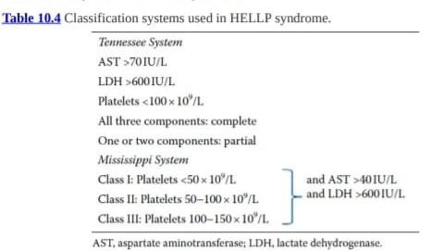

Slide 30
Investigations
Full blood count
LFTs
coagulation screen (including fibrinogen, prothrombin time and partial thromboplastin time)

Slide 31
Management
HELLP syndrome usually resolves after delivery.
Treatment for hypertension is the same as pre-eclampsia but prompt delivery is usually indicated.
However, if there is evidence of hepatic or renal failure, intensive care admission may be warranted.

Slide 32
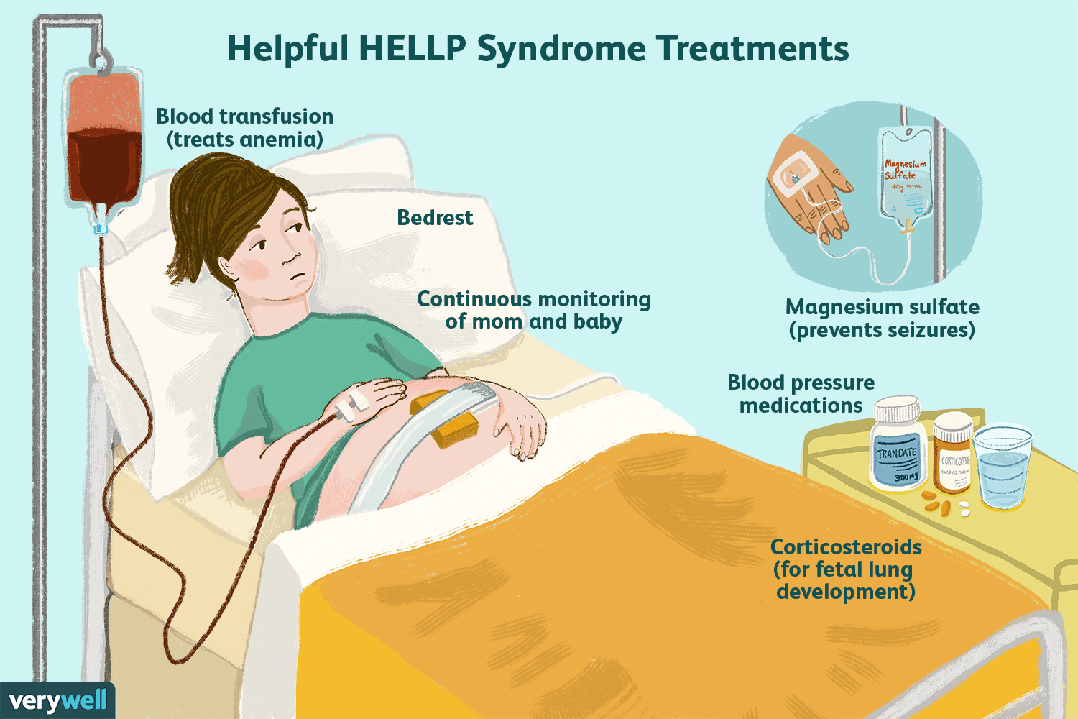

Slide 33
Acute fatty liver of pregnancy
Acute fatty liver of pregnancy (AFLP) is a rare disorder that is a medical and obstetric emergency.
The incidence is reported to be 1/7,000 to 1/16,000 pregnancies.
It usually occurs in the third trimester.
Increase in maternal and fetal mortality rates ranging from 1%–20%.
Risk factors include first pregnancy, multiple pregnancies and pregnancies carrying male fetus.

Slide 34
Swansea diagnostic criteria
Six or more of the following features in the absence of another explanation:
Vo. miting
Abdominal pain Polydipsia/polyuria Encephalopathy
High bilirubin (>14 μmol/L) Hypoglycaemia (<4 mmol/L) High uric acid (>340 μmol/L) Leucocytosis (>11 × 10⁶/L)
Ascites or bright liver on ultrasound
High AST/ALT (>42 IU/L)
High ammonia (>47 μmol/L)
Renal impairment (creatinine >150 μmol/L) Coagulopathy (PT >14 seconds or APTT >34 seconds) Microvesicular steatosis on liver biopsy

Slide 35
Management
supportive and expedited delivery, if diagnosed antenatally.
Multidisciplinary team involvement.
Critical biochemical and hematological monitoring
ICU care and if multisystem failure develops, mechanical ventilation may require.
dialysis and
Liver transplantation is warranted in cases of failure of recovery of liver function and severe hepatic encephalopathy.
After delivery, resolution may take up to 4 weeks.

Slide 36
Liver diseases concurrent with pregnancy
Drug-induced liver disease occurs in pregnancy in
about 3% of women (antibiotics and antihypertensive).
Drug-induced liver disease in pregnancy is
underreported.
The treatment is to stop the offending agent and monitor the synthetic function of the liver.

Slide 37
VIRAL HEPATITIS
Hepatitis B Acute Chronic
Hepatitis C Liver cirrhosis
Portal hypertension

Slide 38
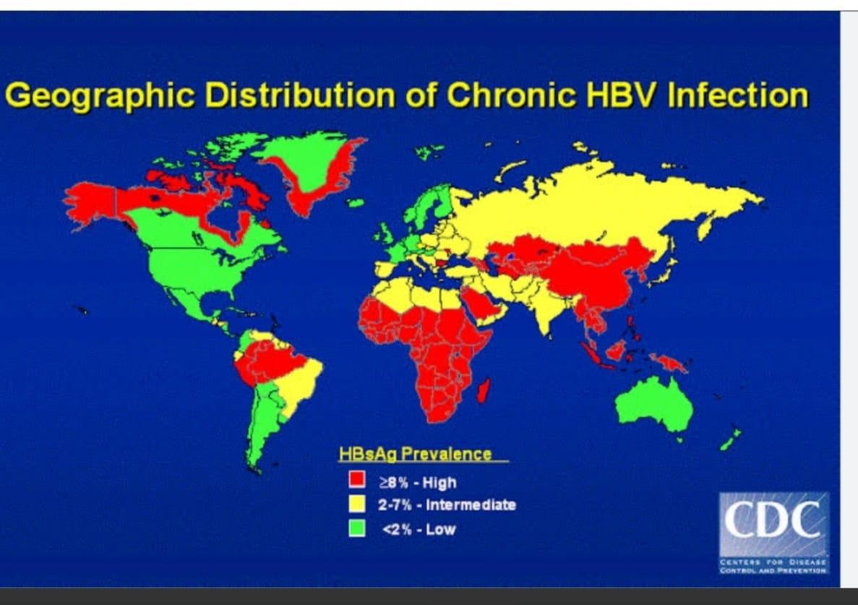

Slide 40
Hepatitis B virus
Acute or chronic form Transmission to child in 50%
Two strategies exist to reduce transmission rates Anti-viral therapy in 3rd trimester Hepatitis B immunoglobulin with Hep-B vaccination
Anti-viral therapy is recommended for viral levels >200,000 IU/mL.

Slide 41
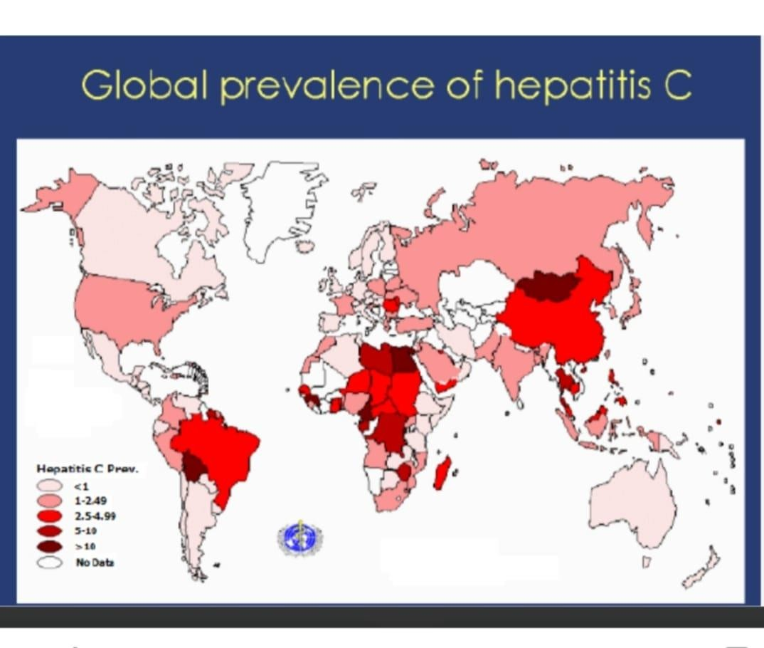

Slide 43
Hepatitis C virus
Chronic HCV infection in chronic carriers occurs in 8% of cases.
Mother to child transmission of HCV has become leading
cause of paediatric infection.
Mode of delivery and type of feeding do not represent
significant risk factor for mother to child transmission.
HCV RNA level in infants will allow early diagnosis
NO anti HCV treatment can currently be administered in pregnancy.

Slide 44
Hepatitis E Virus
Hepatitis E virus is problematic in pregnancy
typically occuring in epidemic form.
Development of Acute liver failure in 2nd and 3rd trimester can be associated with the mortality upto 20 %.

Slide 45
Liver cirrhosis and Portal Hypertension
Pregnant woman with liver cirrhosis and portal hypertension presents with worsening jaundice, progressive liver failure, ascites and hepatic encephalopathy.
The increase in total blood volume associated with pregnancy worsens pre-existing portal hypertension and variceal hemorrhage .

Slide 46
Cirrhosis and portal hypertension
Women with known cirrhosis who desire pregnancy should
be endoscoped to look for varices before pregnancy
If present, patient should be inform of the increased risk
with pregnancy
Patient at risk of variceal bleeding: primary prophylaxis with
non-selective beta blockers(propranolol or nadolol)
Newborns should be monitored during the first days of life(risk of hypoglycemia and bradycardia)

Slide 47
Non-alcoholic fatty liver disease
Non-alcoholic fatty liver disease (NAFLD) can be
considered a high-risk complication.
Associated with hypertensive disorders in pregnancy, gestational diabetes and postpartum haemorrhage and preterm birth.
Pre-pregnancy counselling and postpartum follow-up is advised, especially as it is a manifestation of metabolic syndrome.

Slide 48
Autoimmune liver disease
Autoimmune hepatitis can flare in pregnancy in 20% of
women.
Increase the risk of adverse fetal outcomes, such as
prematurity and preeclampsia.
The condition can be treated with corticosteroids and
azathioprine, which are both safe in pregnancy.
Disease activity should ideally be controlled prior to conception.

Slide 49
Wilson's disease
❑
❑
❑
❑
❑
Rare autosomal recessive condition (impairs copper metabolism in the liver)
Reflected by increased ceruloplasmin levels in both the brain and the liver.
Untreated, this condition can lead to spontaneous miscarriage.
if treated, successful pregnancies are possible.
Pre-pregnancy copper chelation and not withholding drug therapy in pregnancy are
thought to help improve pregnancy outcomes.

Slide 50
Pregnancy following Liver Transplantation
Successful pregnancy following liver transplantation has been widely reported
Fertility will return typically within six months of transplant
Tacrolimus , cyclosporin , Azathioprin and corticosteroid
therapy are widely and safely used in pregnancy

Slide 51
References
1.
Royal College of Obstetrics and Gynaecology . Obstetric cholestasis. RCOG, 2021.
National Institute for Health and Care Excellence . Hypertension in pregnancy: diagnosis and management: NICE guidelines [NG 133]. NICE, 2020.
Kaplan PB, Gücer F, Sayin NC, et al.. Maternal serum cytokine levels in women with hyperemesis gravidarum in the first trimester of pregnancy. Fertil Steril 2003;79:498–502
Ch'ng CL, Morgan M, Hainsworth I, Kingham JG. Prospective study of liver dysfunction in pregnancy in Southwest Wales. Gut 2002;51:876–80.
Bacq Y, Zarka O, Brechot J, et al.. Liver function tests in normal pregnancy: a prospective study of 103 pregnant women and 103 matched
controls. Hepatology 1996;23:1030–2.
Committee on Obstetric Practice. Committee opinion no. 723: Guidelines for
diagnostic imaging during pregnancy and lactation. Obstet
Gynecol 2017;130:e210–6.
García-Romero C, Guzman C, Cervantes A, Cerbón M. Liver disease in pregnancy: Medical aspects and their implications for mother and child. Ann Hepatol 2019;18:553–62.
2.
3.
4.
5.
6.
7.

Slide 52
Bioethics
The bioethics of liver disease in pregnancy are complex, primarily revolving around the need to balance the health of the mother with the well-being of the fetus, often requiring difficult decisions regarding treatment options, potential risks to the baby, and the need for informed consent, particularly when considering interventions that may impact the pregnancy outcome, including termination in severe cases.

Slide 53
Future Research
Rahim MN, Williamson C, Kametas NA, Heneghan MA. Pregnancy and the liver. The Lancet. 2025 Feb 8;405(10477):498-513.
White M, Han H, Khungar V. Acute fatty liver disease of pregnancy. Clinical Liver Disease. 2024 Jan 1;23(1):e0145.

Slide 54
Family Medicine
The primary concerns regarding liver disease in pregnancy are to differentiate between the pregnancy-specific physiological liver problems like hyperemesis gravidarum (severe morning sickness).
Differentiate between liver disorders of pregnancy like intrahepatic cholestasis of pregnancy (ICP), acute fatty liver of pregnancy (AFLP), and HELLP syndrome which can arise due to hormonal changes and physiological stress on the liver during pregnancy, potentially causing complications for both mother and fetus if not diagnosed and managed appropriately

Slide 55
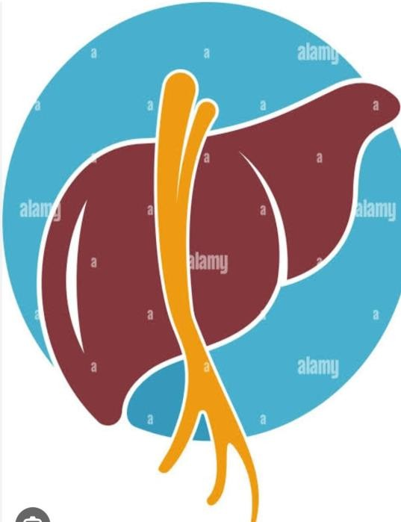
THANK YOU

