Slide 2
Leishmaniasis Disease
GASTROINTESTINAL HEPATOBILIARY & PARASITOLOGY II Module
3rd year MBBS
Dr. Kiran Fatima
Associate Professor
Department of Pathology
Rawalpindi Medical University

Slide 3
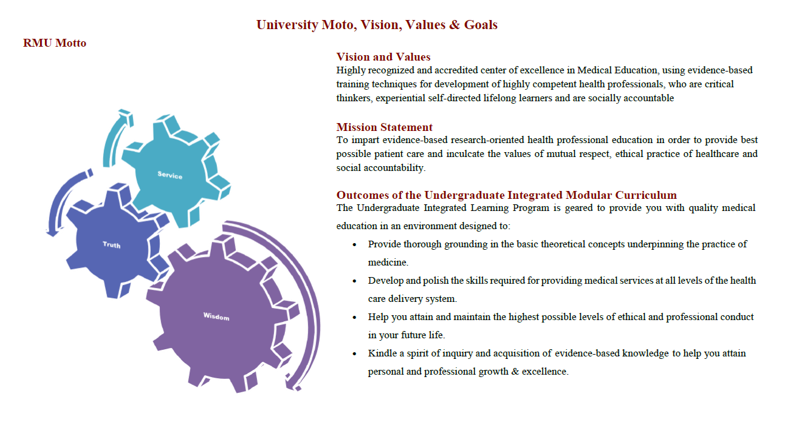

Slide 4
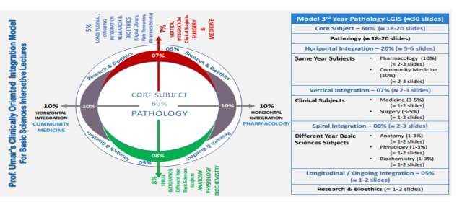

Slide 5
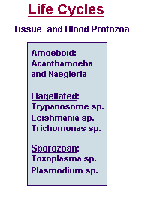
Life Cycles
CORE PATHOLOGY

Slide 6
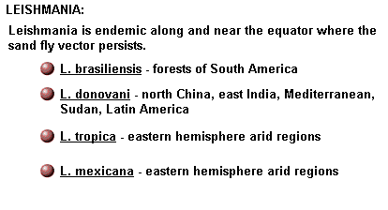
Leishmania
CORE PATHOLOGY

Slide 7
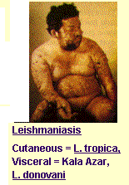
Leishmaniasis
CORE PATHOLOGY

Slide 8
Life Cycles
SPIRAL PATHOLOGY

Slide 9
Leishmania
CORE PATHOLOGY

Slide 10
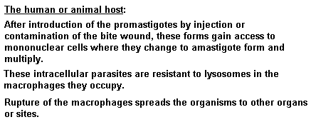
Leishmania
CORE PATHOLOGY

Slide 11
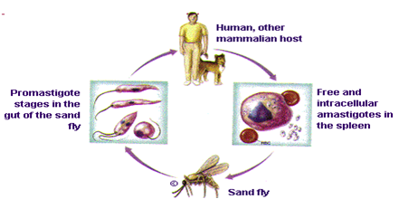
Leishmania
CORE PATHOLOGY

Slide 12
Leishmaniasis Disease
CORE PATHOLOGY
Leishmaniasis is transmitted by the bite of female phlebotomine sandflies.
The sandflies inject the infective stage, promastigotes, during blood meals.
Promastigotes that reach the puncture wound are phagocytized by macrophages and transform into amastigotes.
Amastigotes multiply in infected cells and affect different tissues, depending in part on the Leishmania species. This leads to the clinical manifestations of leishmaniasis.
Sandflies become infected during blood meals on an infected host when they ingest macrophages infected with amastigotes.

Slide 13
Leishmaniasis Disease
VERTICAL INTEGRATION
In the sandfly midgut, the parasites differentiate into promastigotes, which multiply and migrate to the proboscis.
Clinical Features:
Human leishmanial infections can result in two main forms of disease: Cutaneous leishmaniasis
Visceral leishmaniasis (also known as kala-azar).
The factors determining the form of the disease include:
Leishmanial species
Geographic location
Immune response of the host.
Cutaneous leishmaniasis is characterized by one or more cutaneous lesions on areas where sandflies have fed.
Persons with cutaneous leishmaniasis have one or more sores on their skin. The sores can change in size and appearance over time.

Slide 14
Leishmaniasis Disease
VERTICAL INTEGRATION
Cutaneous leishmaniasis sores often look somewhat like a volcano, with a raised edge and central crater.
A scab may cover some sores. The sores can be painless or painful.
Some people may have swollen glands near the sores (e.g., in the armpit if the sores are on the arm or hand).

Slide 15
Leishmaniasis Disease
VERTICAL INTEGRATION
Visceral leishmaniasis (kala-azar) typically presents with:
Fever
Weight loss
Enlarged spleen and liver (usually the spleen is bigger than the liver).
Some patients may have swollen glands.
Certain blood tests are abnormal, including:
Low blood counts (e.g., anemia, low white blood cell count, and low platelet count).
Some patients may develop post kala-azar dermal leishmaniasis.
Visceral leishmaniasis is becoming an important opportunistic infection in areas where it coexists with HIV.

Slide 16
Leishmaniasis Disease
VERTICAL INTEGRATION
Laboratory Diagnosis:
Examination of Giemsa-stained slides of the relevant tissue is still the technique most commonly used to detect the parasite.
Diagnostic Findings:
Microscopy
Isolation of the organism in culture (e.g., using the diphasic NNN medium) or in experimental animals (e.g., hamsters) constitutes another method of parasitological confirmation of the diagnosis. This method can also provide material for further investigations (e.g., isoenzyme analysis).
Antibody detection can be useful in visceral leishmaniasis, but is of limited value in cutaneous disease, where most patients do not develop a significant antibody response.

Slide 17
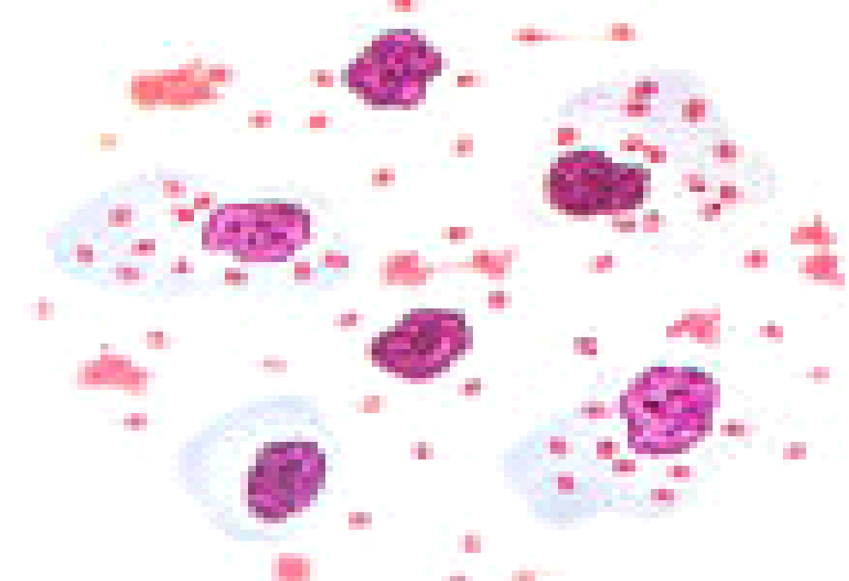
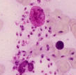
Leishmaniasis Disease
VERTICAL INTEGRATION
Other diagnostic techniques include:
Biochemical (e.g., isoenzymes)
Immunologic (e.g., immunoassays)
Molecular (e.g., PCR) approaches.
These techniques, however, are not readily available in general diagnostic laboratories.
SPIRAL INTEGRATION

Slide 18
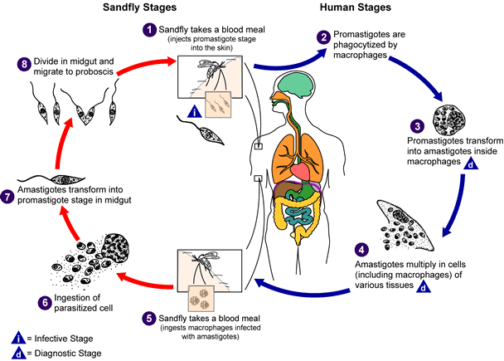
Leishmaniasis Disease
CORE PATHOLOGY

Slide 19
Clinical Classification-I
VERTICAL INTEGRATION
Visceral Leishmaniasis – Kala-azar
Leishmania donovani Complex
Mucocutaneous Leishmaniasis – Espundia
Leishmania braziliensis
Associated with forest workers

Slide 20
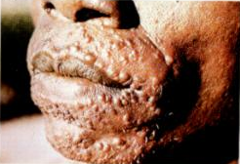
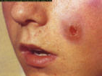
Clinical Classification-II
VERTICAL INTEGRATION
Primary Cutaneous Leishmaniasis Old World Disease:
L. tropica complex
L. major
L. tropica minor
New World Disease:
L. braziliensis complex
L. mexicana complex

Slide 21
Clinical Features - VL
VERTICAL INTEGRATION
Symptoms of Visceral Leishmaniasis (Kala-azar):
May be mild
Fever
Anorexia
Malaise
Vague abdominal pain
Splenomegaly
Hepatomegaly
Lymphadenopathy
Anaemia
Leukopenia

Slide 22
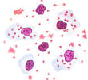
Laboratory Diagnosis VL
VERTICAL INTEGRATION
Diagnostic Methods for Leishmaniasis:
Biopsy
Aspirate
Culture
Animal Inoculation
PCR
Montenegro Skin Test
Antibodies
ELISA (Direct)
ELISA (Indirect)
Antigen Detection
ELISA
DNA Probes

Slide 23
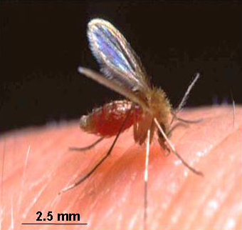
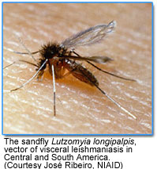
Laboratory Diagnosis VL
CORE PATHOLOGY
Cutaneous Leishmaniasis (CL):
Old World CL: Phlebotomus
Oriental Sore
Baghdad Boil
Delhi Boil
Found in Middle East, Africa, and India
New World CL:
Lutzomyia
Found in Latin America

Slide 24
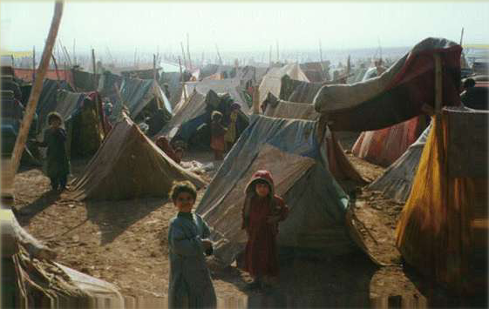
Epidemiology-CL
CORE PATHOLOGY
Factors Influencing Leishmaniasis Spread:
Sporadic Disease in Endemic Areas
Epidemic Outbreaks
Refugee Movements
Military Activities
Lutzomyia – Found in America
Phlebotomus – Found elsewhere

Slide 25
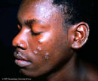
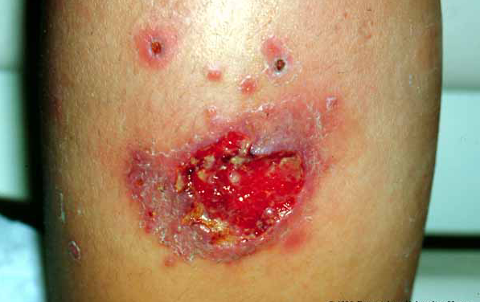
Pathogenesis-CL
CORE PATHOLOGY
Virulence Factors of Infecting Leishmania spp.:
Immune Response of Human Host:
Inoculated into the skin
Mixed acute and chronic inflammatory infiltrate
Areas of focal necrosis
Burn-like scar formation
Recovery associated with high level of resistance

Slide 26
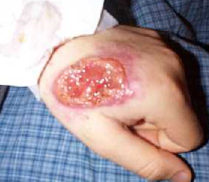
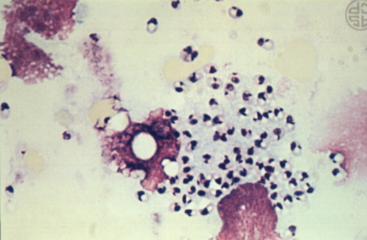
Diagnosis-CL
VERTICAL INTEGRATION
Endemic Area
Chronic Skin Lesion
Punch or Incisional Biopsy
Giemsa Staining
DNA Probes
Culture
ELISA
Leishmanin Skin Test

Slide 27
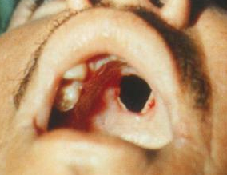
Mucocutaneous Leishmaniasis
CORE PATHOLOGY
Leishmania braziliensis (Mucocutaneous Leishmaniasis):
Affects: Nose, oral cavity, pharynx
Healed skin lesion
Clinical Features:
Chronic nasal symptoms
Discharge
Epistaxis (nosebleeds)
Tapered nose

Slide 28
Diagnosis MCL
VERTICAL INTEGRATION
Culture
Clinical Findings
Positive Leishmanin Skin Test
Antileishmanial Antibodies in Serum

Slide 29
1. Leishmanin
CORE PATHOLOGY
Reagent for Human Skin Testing
Leishmanin is a reagent recommended for skin testing in humans for epidemiological studies and as an aid in diagnosis. It has been approved by the World Health Organization (WHO) as a reference reagent.
Composition:
Promastigotes
Phosphate-buffered saline
Thiomersal
The strain is maintained in a virulent state through continuous passages in mice. Leishmanin is prepared by cultivating promastigotes in a monophasic medium and is supplied in a pyrogen-free, sterile form following Good Manufacturing Practice (GMP) guidelines.

Slide 30
Major Epidemics Of Leishmaniasis In Pakistan
SPIRAL INTEGRATION
Year | City | Province | No. of cases
1935 | Quetta | Balochistan | Un-known
1971-72 | Multan | Punjab | 2,500
1974 | Army Personnel (CL) | Balochistan | 892
1975 | Army Personnel (CL) | Balochistan | 502
1977-81 | Uthal (CL) | Balochistan | 700
2001 | Kurram Agency (CL) | NWFP (FATA) | 1200
2001 | Larkana, Dadu (CL) | Sindh | 11,700
2002 | Kurram Agency(CL) | NWFP (FATA) | 738

Slide 31
Prevention
HORIZONTAL INTEGRATION
Sand fly bites should be avoided.
Personal Protection:
Protective clothing
Insect repellents
Bed nets
Insecticide use in transmission settings
Other Control Measures:
Killing of stray dogs

Slide 32
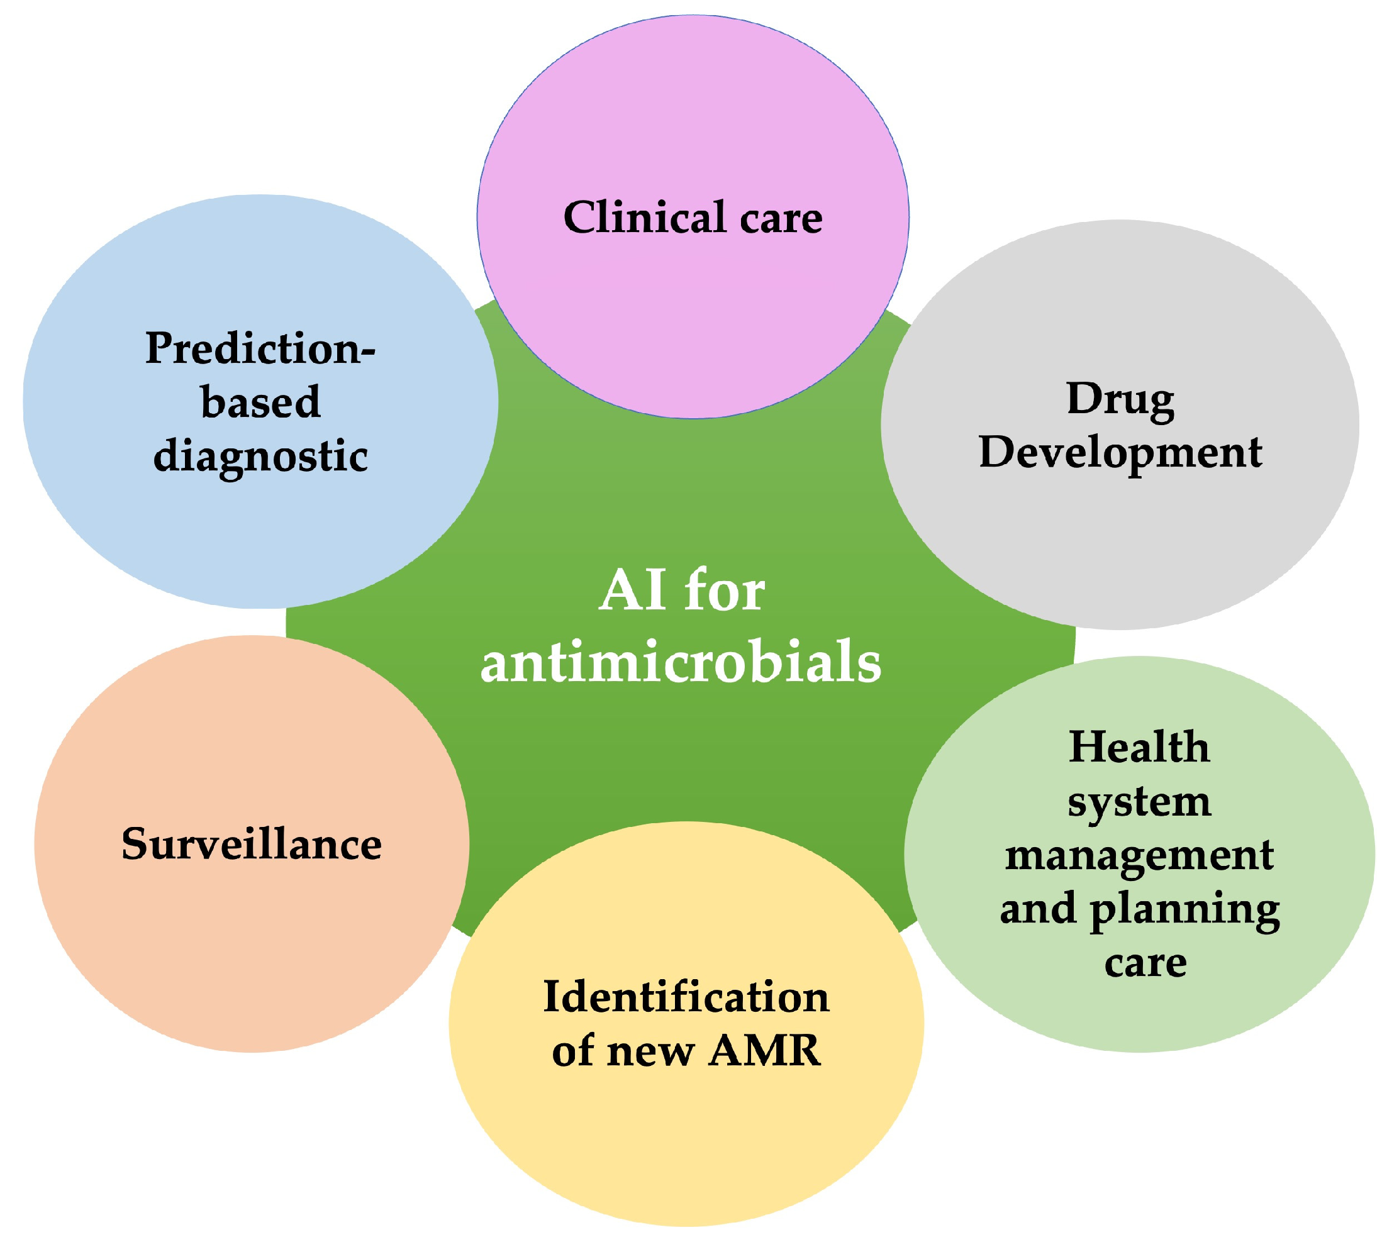
SPIRAL INTEGRATION

Slide 33
SPIRAL INTEGRATION

Slide 34
RESEARCH
https://bmcinfectdis.biomedcentral.com/articles/10.1186/s12879-021-06327-w
Research Abstract
Cutaneous Leishmaniasis (CL) is a neglected tropical disease that primarily affects poor communities. It is one of the major vector-borne diseases and is endemic in Pakistan.

