Slide 1
A middle aged woman with a hard lump right breast
Prof .Dr. M. Waqas Raza
FCPS FRCS MHPE
HOD surgucal unit 2 HFH Rawalpindi

Slide 2
Objectives
At the end of the session the students should be able to
Describe the surgical anatomy of breast
Able to take pertinent history
Enlist important steps in examination of patient
Chalk out a management plan of this patient

Slide 3
A 54 year old lady presented in OPD of DHQ hospital Rawalpindi with a 5 months H/O a firm to hard lump upper outer quadrant of left breast
How will you manage the patient ?

Slide 4
History /examination/Investigations/treatment

Slide 5
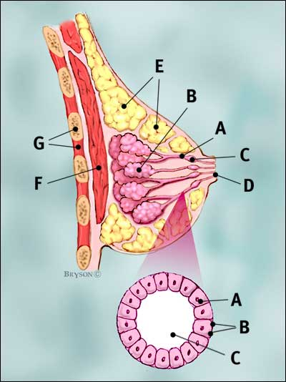
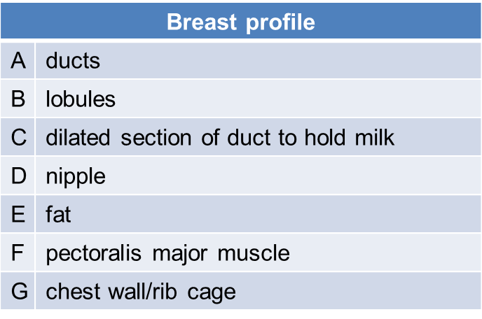
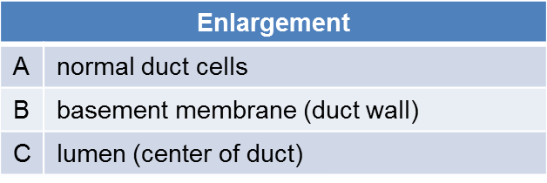
NORMAL BREAST TISSUE
Notes:
Breast ducts comprise only 10% of the breast mass
lobes
ducts
lymph nodes

Slide 6
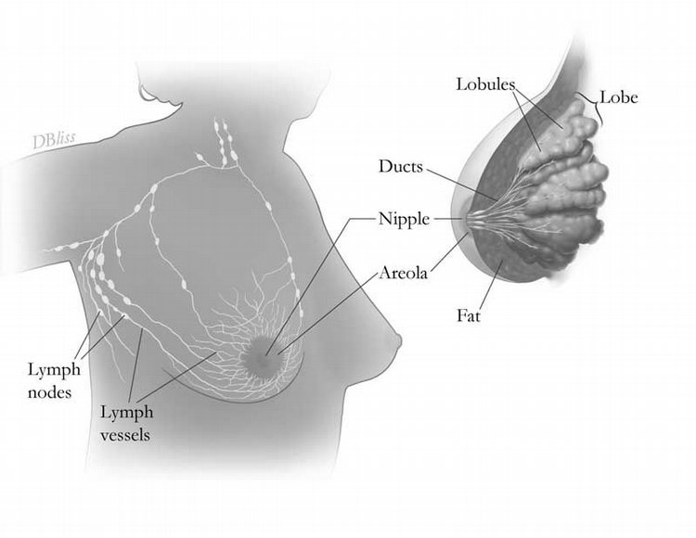
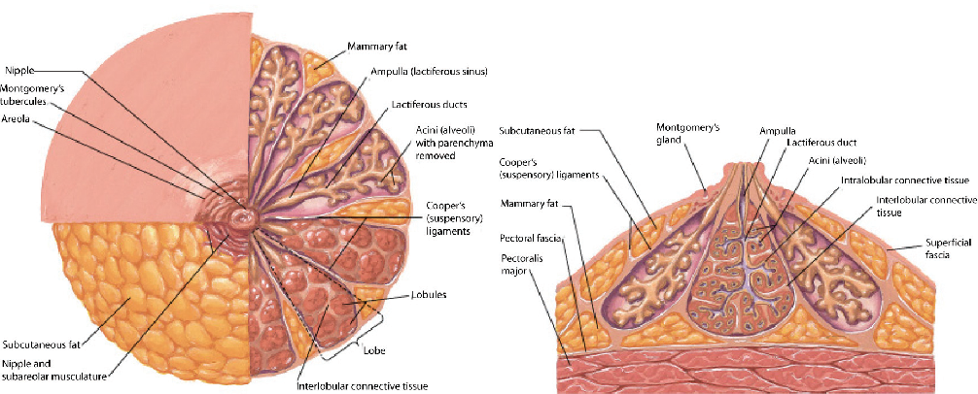
Breast Gland
Each breast has 15 to 20 sections (lobes)
Inside each lobe are many smaller structures called lobules
At the end of each lobule are tiny sacs (bulbs) that can produce milk
Coopers ligament
breast has no muscle tissue.

Slide 7
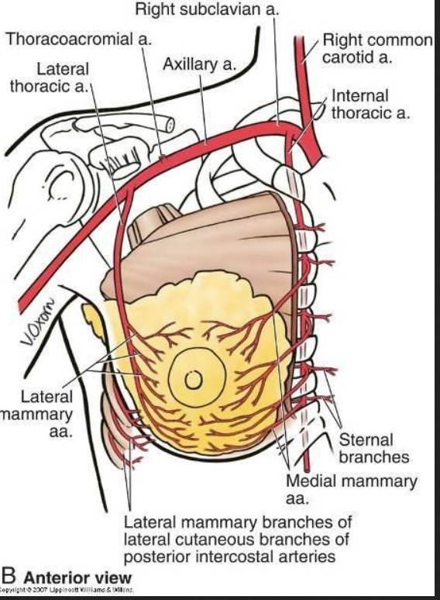
BLOOD SUPPLY

Slide 8
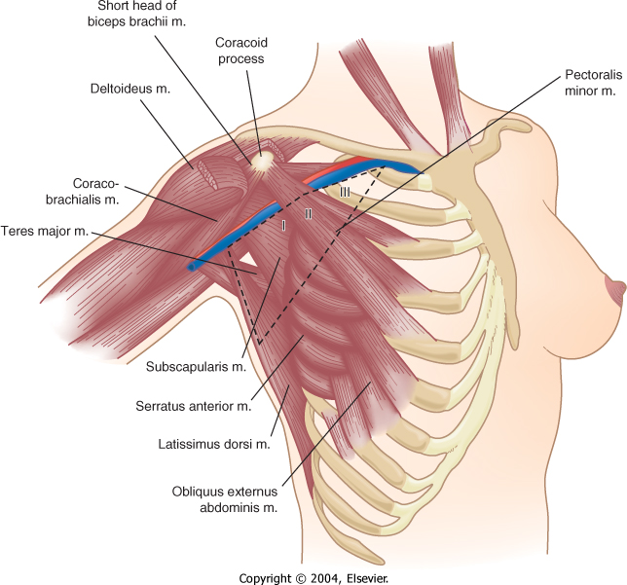
RELEVANT ANATOMY
Axillary lymph nodes defined by pectoralis minor muscle
  Level 1 – lateral
  Level 2 – posterior
  Level 3 – medial
Axillary nerves :
3 motor and sensory nerve
Long Thoracic Nerve
  Serratus anterior
  Thoracodorsal Nerve
  Latissimus Dorsi
Medial and lateral pectoral nerve
Intercostalbrachial Nerve
  Lateral cutaneous
  Sensory to medial arm & axilla

Slide 9
Axillary lymph nodes
I:
  Pectoral axillary lymph nodes (anterior),
  Subscapular axillary lymph nodes (posterior)
  Humeral axillary lymph nodes (lateral)
II:
  Central axillary lymph nodes
  Some apical axillary lymph nodes
  Interpectoral lymph nodes (Rotter’s) *
III:
  Apical axillary lymph nodes

Slide 10
Lymphatic plexus: (4 plexi)
Cutaneous plexus
Subcutaneous plexus (Subareolar part called Sappey’s plexus)
Fascial plexus : located in pectoralis major muscle fascia
Glandular plexus: in the mammary gland, including lobes and ducts
The glandular plexus is in communication with the sappey’s plexus
The fascial plexus communicates with the subcutaneous plexus through lymphatic vessels along the fibrous fasciculi of the stroma.

Slide 11
Routes: (3 routes)
All the lymphatics of the breast converge into the subareolar sappey plexus
  The lateral quadrants drain into the anterior axillary or pectoral group of lymph nodes(75%)
  The medial quadrants drain by internal thoracic group of nodes(20%)
  A few lymph vessels follow posterior intercostal arteries and drain into posterior intercostal nodes(5%)
Some vessels communicate
  with lymph vessels of opposite breast
  Cranialy with supraclavicular nodes and
  with lymph vessels of ant abdominal wall (subdiaphragmatic and subperitoneal lymph plexus)

Slide 12
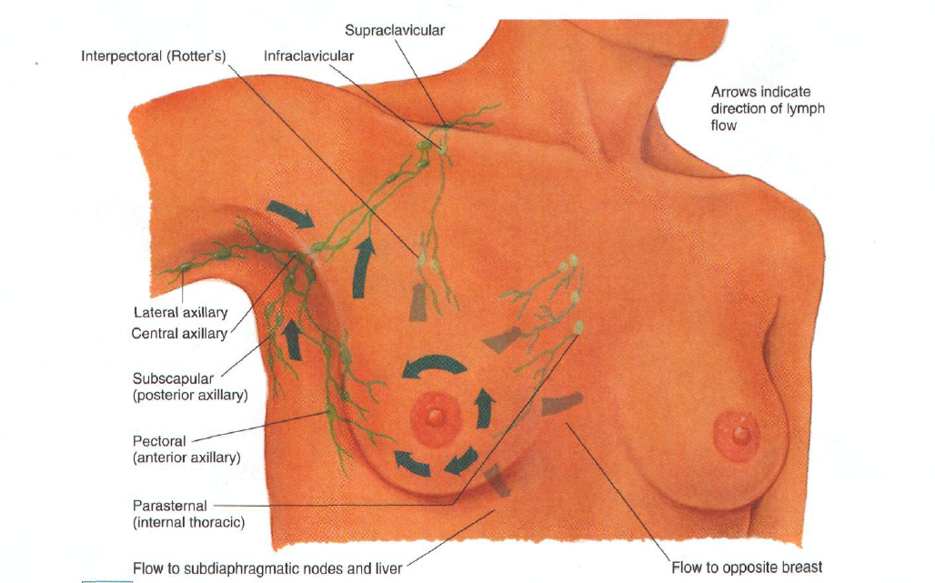

Slide 13
Importance of sappeys plexus
Sappey plexus assumes considerable importance in the identification of the sentinel lymph node, since the subareolar route is the most straightforward to infiltrate with an injected radiotracer/dye and the most suitable in special cases, such as non-palpable tumours, already excised tumours.

Slide 14
Breast Cancer
The most common form of cancer among women.
The second most common cause of cancer related mortality (second to lung cancer).
1 of 8 women (12.2%).
One third of women with breast cancer die from the disease.
Nearly 40,000 women die of breast ca every year
Incidence in PAK is 50/100,000.
Notes:
Breast cancer is the most common form of cancer in females
It is the second most common cause of cancer related mortality. It is second only to lung cancer.
The lifetime risk of breast cancer is 1 in 8 women or 12.2%
Of those diagnosed with the disease, one-third will die from the disease.

Slide 15
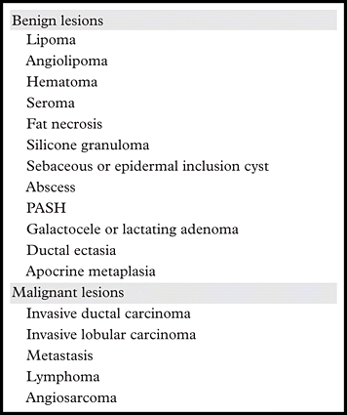

Slide 16
RISK FACTORS
Hormonal | Non-HORMONAL
Early menarche | Family history
Increased exposure to estrogen → OCPs and HRT. | Radiation exposure
late menopause, | Alcohol, smoking.
nulliparity, older age at first live birth | Somatic mutations ( BRCA 1/ 2, HER 2 Neu, EGFR, c- Myc, RAS)
Less breast feeding | High fat content
Low parity | Atypical hyperplasia
 | Carcinoma

Slide 17
PATHOGNESIS – GENETIC FACTORS
BRCA1
BRCA2
p53
CHEK2
Most common genes implicated in Breast carcinoma

Slide 18
Causes of Hereditary
Susceptibility to Breast Cancer
5 to 10% of breast cancers.
Contribution to Hereditary Breast Cancer
20%–40%
10%–30%
<1%
<1%
30%–70%
Gene
BRCA1
BRCA2
TP53
PTEN
Undiscovered genes

Slide 19
Features That Indicate Increased Likelihood of Having BRCA Mutations
Multiple cases of early onset breast cancer
Ovarian cancer (with family history of breast or ovarian cancer)
Breast and ovarian cancer in the same woman
Bilateral breast cancer
Ashkenazi Jewish heritage
Male breast cancer

Slide 20
Sporadic breast cancer
Over-exposure to estrogen
Because growth of breast tissue is highly sensitive to estrogens, the more a women is exposed to estrogen over her lifetime,the higher the risk for breast cancer.
Majority occur in post menopausal women and are ER positive.
Almost 75% of the tumors are estrogen dependent

Slide 21
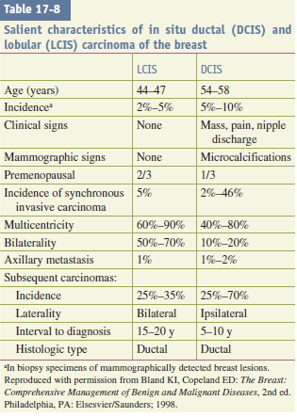
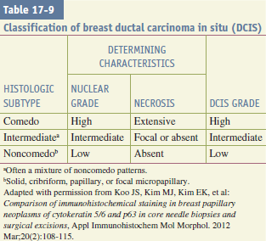

Slide 22
CLASSIFICATION
Invasiveness
  Invasive.
    Foote Stewart original classification
      Paget’s disease of the nipple
      Invasive ductal carcinoma—. Invasive type can be special type or no special type (NST) [not otherwise specified/NOS].
          Special type (ST) is 20% common; tubular, mucinous, cribriform, medullary, etc. and they carry good prognosis.
          No special type (NST) carry poor prognosis. Adenocarcinoma with no special type (80%) is more common.
      Invasive lobular carcinoma
      Rare cancers (adenoid cystic, squamous cell, apocrine)
    Inflammatory

Slide 23
PAGET’S DISEASE
Paget’s disease of the nipple was described in 1874.
It frequently presents as a chronic, eczematous eruption of the nipple, which may be subtle but may progress to an ulcerated, weeping lesion.
An underlying breast cancer (in situ or invasive) is present in 85 to 88 percent of cases, although often without an associated breast mass or mammographic abnormality
Surgical therapy for Paget’s disease may involve lumpectomy or mastectomy, depending on the extent of involvement of the nipple-areolar complex and the presence of DCIS or invasive cancer in the underlying breast parenchyma.
Notes:
Differentiation
from pagetoid intraepithelial melanoma is based on the
presence of S-100 antigen immunostaining in melanoma and
carcinoembryonic antigen immunostaining in Paget’s disease.

Slide 24
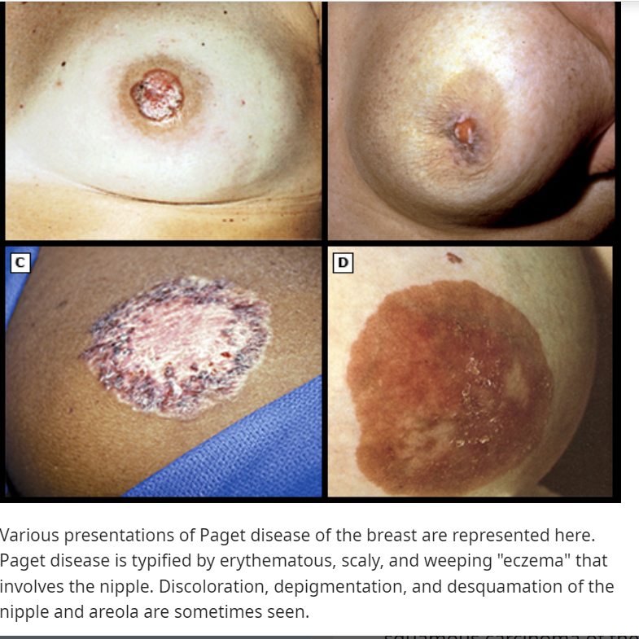
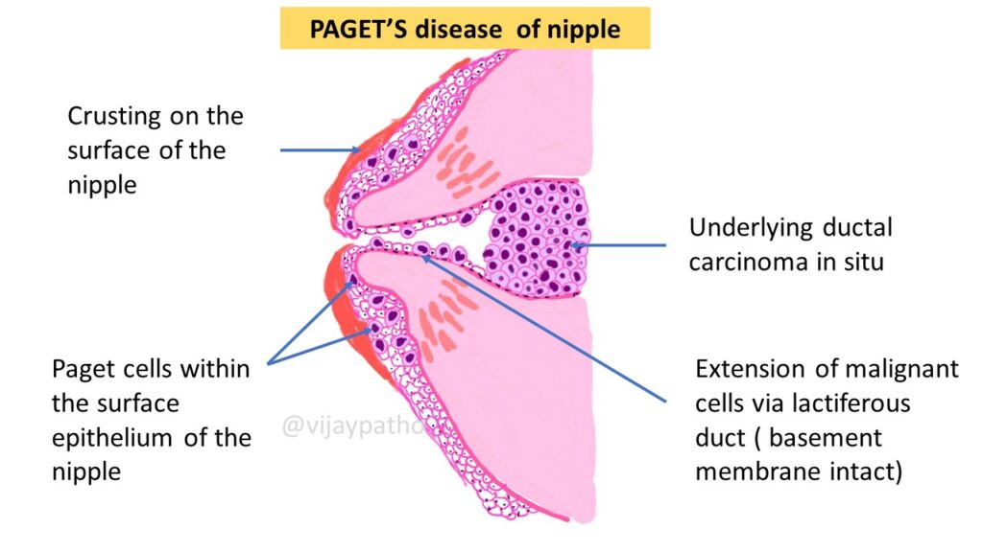

Slide 25
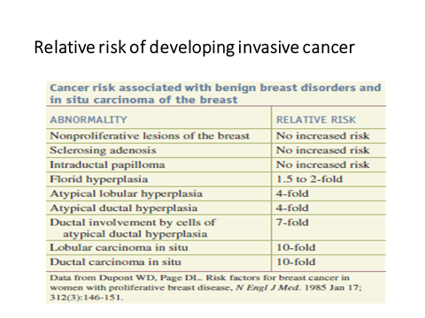

Slide 26
INVASIVE DUCTAL CARCINOMA
Invasive ductal carcinoma of the most common type of invasive breast cancer, accounting for 70 to 80 percent of invasive lesions.
In perimenopausal or postmenopausal women in the fifth to sixth decades of life.
The cancer cells often are arranged in small clusters, and there is a broad spectrum of histologic types with variable cellular and nuclear grades.

Slide 27
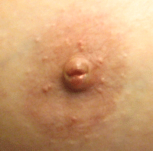
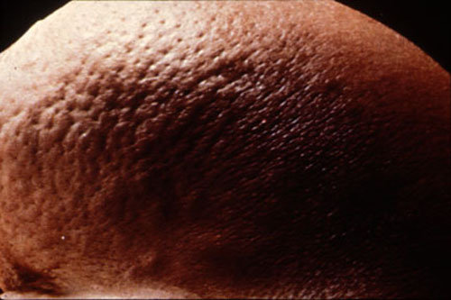
INVASIVE CARCINOMA – CLINICAL FEATURES
Hard fixed Palpable mass.
Axillary lymph node metastases
Fixity to the chest wall / skin dimpling.
Nipple retraction
Lymphatics - involved - block the local area of skin drainage → lymphedema, skin thickening.
Mammography → Radiodense mass
,microcalcification
Metastatic inv.

Slide 28
Invasive Carcinoma (NST) – histologic subtypes.
Divided into three grades based upon a combination of architectural and cytologic features, usually assessed utilizing a scoring system based on three parameters
Features | Well diff. Ca | Mod. diff.Ca | Poorly diff. Ca.
Tubule formation | Prominent | Less,solid clusters/single infiltrating cells | Ragged nests/solid sheets of cells
Nuclear pleomorphism | Small,round, monomorphic | Some nuclear pleomorphism | Nuclei – enlarged,irregular.
Mitotic figures | Rare | Present | Numerous
Proliferation rate | low | - | High
Tumour necrosis | - | - | Present

Slide 29
 | MUCINOUS | PAPILLARY | MEDULLARY | TUBULAR
AGE | Older women Median age 71 | 7th decade | In younger patients ,frequent brca 1 related BC. | Peri and early menopausal
INCIDENCE | 2% | 2% | 4% | 2%
MORPHOLOGY GROSS | Soft gelatinous appearance on gross examination, and they tend to be well circumscribed | Small and attain size of 3cm | Well circumscribed mass , tan-brown with areas of hemorrhage or necrosis. | Well-circumscribed mass
HISTOPATH | Nests of tumor cells dispersed in large pools of extracellular mucus; the cells tend to have uniform, low-grade nuclei | Papilla with fibrovascular stalk | Tumor cells are poorly differentiated (high-grade), grow in a syncytial pattern, and have an intense associated lymphoplasmacytic infiltrate | well-formed tubular or glandular structures infiltrating the stroma. Cuboidal to columnar cells and often have apical cytoplasmic protrusions or "snouts“ . Low grade
LYMPH NODE INVOLVEMENT | uncommon | Very common | Very common | Less common
RECEPTOR | Er +ve Her+ve | ER+ve | 10% show hormone receptors | ER+ve Her2-ve
PROGNOSIS | Favourable prognosis | Favourable prognosis | Better than NST | Favourable prognosis

Slide 30
Micropapillary carcinoma — Invasive micropapillary carcinoma is a particularly aggressive form of cancer that has a proclivity for lymph node metastasis even when small in size .
Metaplastic carcinoma — Metaplastic carcinoma is a well circumscribed tumor that consists of various combinations of poorly differentiated ductal adenocarcinoma, mesenchymal (sarcomatous), and other epithelial (eg, squamous cell) components.

Slide 31
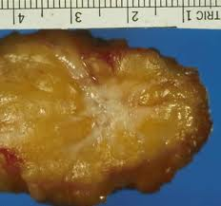
INVASIVE LOBULAR CARCINOMA
Invasive lobular carcinoma accounts for 10% of breast cancers.
At presentation, invasive lobular carcinoma varies from clinically inapparent carcinomas to those that replace the entire breast with a poorly defined mass.
It is frequently multifocal, multicentric, and bilateral. Biallelic loss of expression of (CDH1, →encodes E-cadherin) d/t mutations.
Because of its insidious growth pattern and subtle mammographic features ,Invasive lobular carcinoma may be difficult to detect.
Over 90% of lobular cancers express estrogen receptor.

Slide 32
How do we diagnose Carcinoma Breast
TRIPLE ASSESSMENT
Clinical | Imaging | Pathology
History | Mammography Ultrasound Ductography | FNAC Trucut biopsy, excisional biopsy Stereotactic core biopsy Vaccum assisted biopsy
examination | MRI of breast | Needle localized biopsy Seed localization biopsy

Slide 33
History
In ∼30% of cases, the woman discovers a lump in her breast.
Other less frequent presenting signs and symptoms of breast cancer include:
  breast enlargement or asymmetry;
  nipple changes, retraction, or discharge;
  ulceration or erythema of the skin of the breast; Peau d orange
  an axillary mass; and
  musculoskeletal discomfort.
  Chest pain and haemoptysis,Bone pain, tenderness, and pathological fracture ,Pleural effusion, ascites ,Liver secondaries, secondary ovarian tumour
However, up to 50% of women presenting with breast complaints have no physical signs of breast pathology.
Breast pain usually is associated with benign disease.

Slide 34
ANY SWELLING IN BREAST ABOVE AGE 30 IS CONSIDERED MALIGNANT UNTILL PROVEN OTHERWISE.
IN PT WITH AGE <30 BUT +IVE FAMILY HISTORY, CONSIDER MALIGNANT UNTILL PROVEN OTHERWISE.

Slide 35
DIAGNOSIS:
Breast Imaging
  ULTRASOUND
  MAMMOGRAPHY
  DUCTOGRAPHY
  MRI BREAST
Breast Biopsy

Slide 36
Breast Imaging

Slide 38
Ultrasound
Non invasive
Frequency 1-10 MHz
Cystic→ fluid filled lesions, no internal echoes.
Benign Solid lesions→ smooth and well defined borders.
Malignant lesions → irregular borders

Slide 39
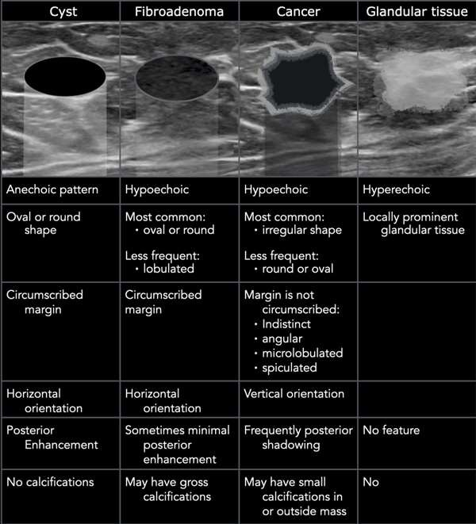

Slide 40
Mammography
Screening tool ,non invasive
  Age of 40
Mammography can show changes in the breast up to two years before a lump becomes palpable.
Two general categories of mammographic findings suggestive of a breast cancer: soft tissue mass or asymmetry and suspicious microcalcifications.
1. Soft tissue mass/asymmetry — The most specific mammographic feature of malignancy is a spiculated soft tissue mass nearly 90 percent of these lesions represent invasive cancer.
Approximately one-third of noncalcified cancers appear as spiculated masses
Notes:
Estimated reduction in mortality 15-25%
10% false positive rate
Despite the association of microcalcifications with DCIS, mammographic appearance alone cannot differentiate between purely intraductal and invasive ductal breast cancers

Slide 41
2. Microcalcifications — Microcalcifications are seen in approximately 60 percent of cancers detected mammographically.
malignant lesions →
Linear branching microcalcifications -camedo DCIS I
small, clustered type /grouped coarse heterogenous/Amorphous calcification – Invasive CA
benign lesions →well defined borders and peripheral calcifications

Slide 42
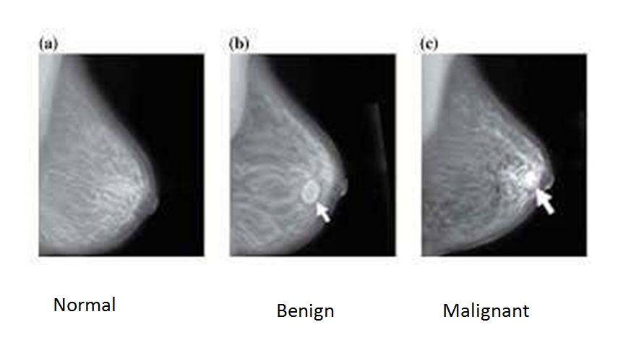

Slide 43
TYPES
Screen film Mammography
Digital Mammography (2D, 3D)
  digital and screen film mammography have similar accuracy;
  more accurate in women <50 years of age, women with mammographically dense breasts, and premenopausal or perimenopausal women.
  3D>2D
Contrast-enhanced digital mammography (CEDM):
  detects breast cancers at a rate similar to MRI
  The advantages of CEDM over MRI
    use of compression limits motion,
    there is decrease in cost,
    decrease in exam time,
    option for patients who are unable to tolerate or have MRI (such as the presence of a pacemaker or tissue expanders.)
Notes:
3D>2D as standard 2D mammography imaging is limited by superimposition of breast parenchyma and breast density.

Slide 44
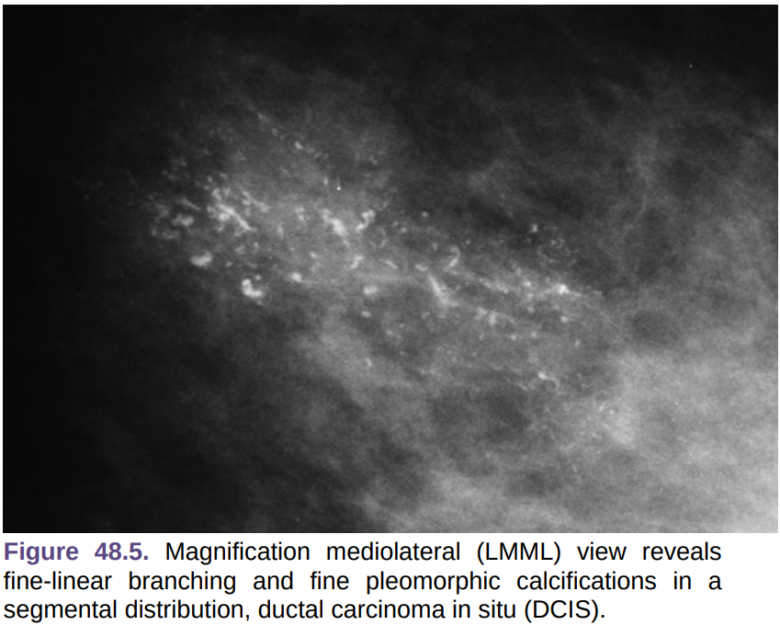
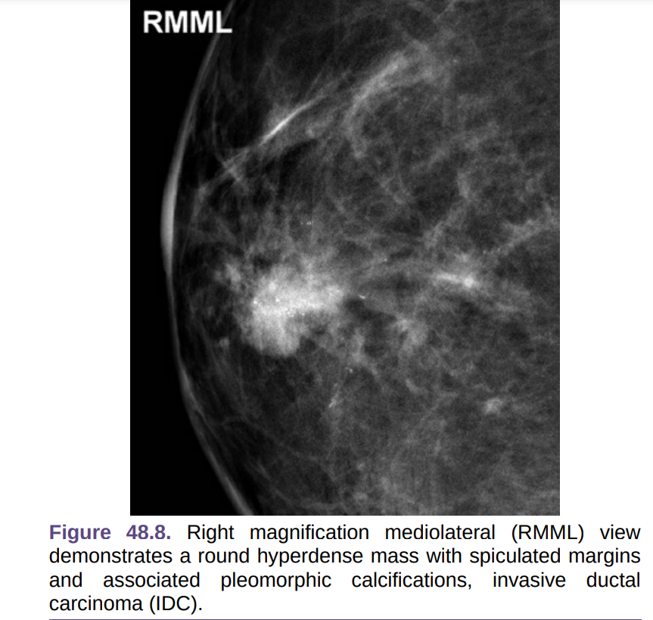

Slide 45
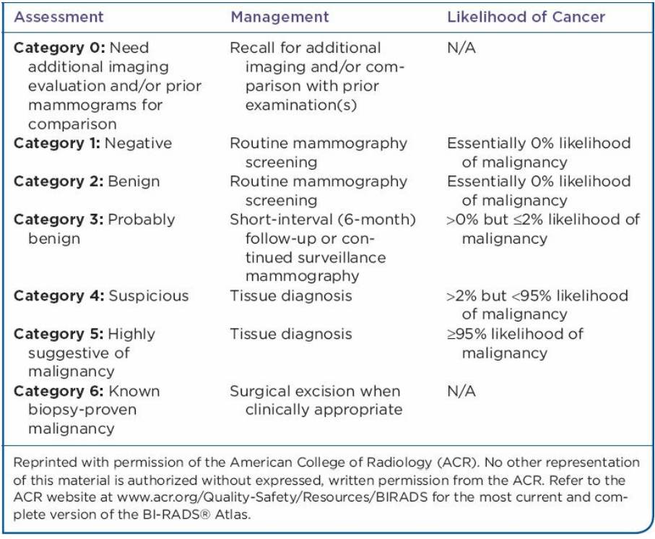
BI-RADS
BI-RADS Classification | Features
0 | Need additional imaging
1 | Negative – routine in 1 yr
2 | Benign finding – routine in 1 yr
3 | Probably benign, 6mo follow-up
4 | Suspicious abnormality, biopsy recommended
5 | Highly suggestive of malignancy; appropriate action should be taken

Slide 46
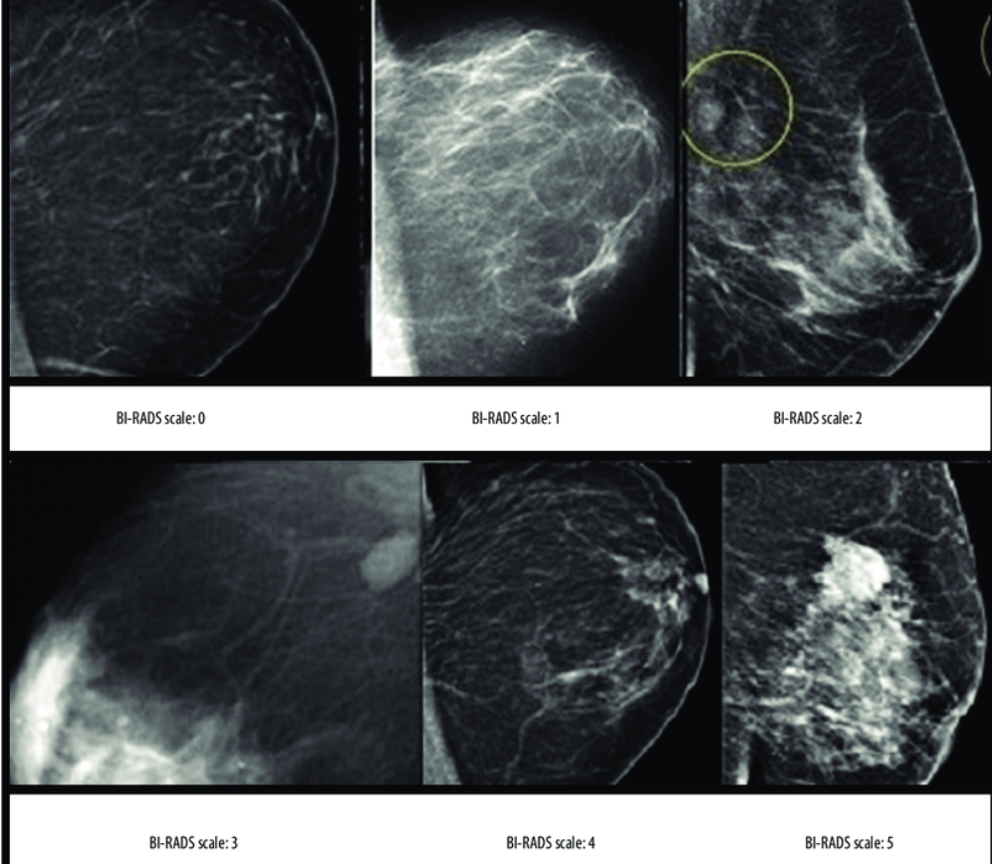
The Breast Imaging-Reporting and Data System (BI-RADS) scores according to the mammography.

Slide 47
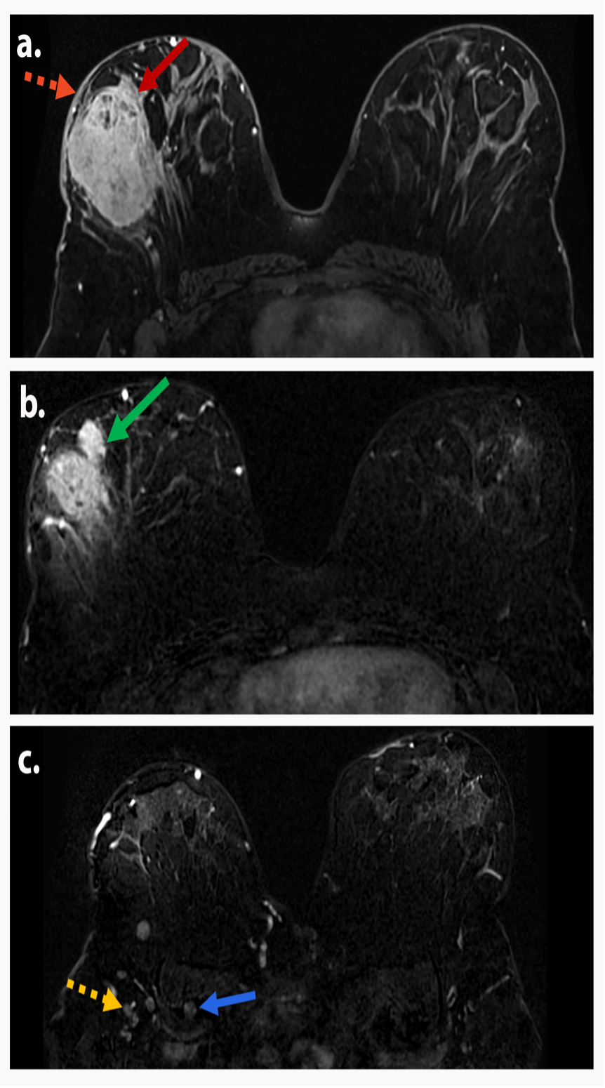
MRI BREAST
Used to screen
  the breasts of high-risk women who have a strong family history of breast cancer or who carry known genetic mutations require screening at an early age
  detect additional tumors in the index breast (multifocal or multicentric disease) that may be missed on routine breast imaging
  patient with nodal metastasis from breast cancer without an identifiable primary tumor.
  to assess response to therapy in the setting of neoadjuvant systemic treatment;
  to select patients for partial breast irradiation techniques; and
  evaluation of the treated breast for tumor recurrence
  Pregnant female

Slide 48
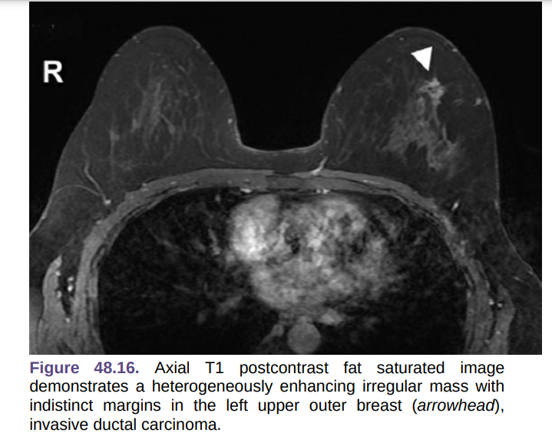

Slide 49
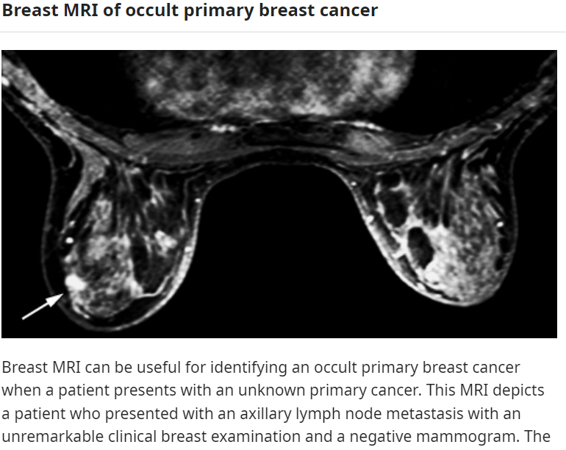

Slide 50
Breast Biopsy
A definitive diagnosis of breast cancer can be made only by a biopsy.
When a lump can be felt and is suspicious for cancer on mammography:
    FNAC
    Excisional biopsy
    İncisional biopsy
    Core biopsy
    Radioguided biopsy (for occult lumps)

Slide 51
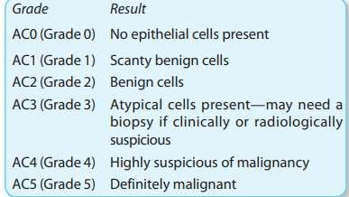
Palpable masses
  Fine-needle aspiration biopsy (FNAB)
    sensitivity greater than 80%.
    can determine the presence of malignant cells ONLY does not give information on tumor grade or the presence of invasion.
    Can determine ER-PR status

Slide 52
Core needle biopsy
  can distinguish between invasive and noninvasive cancer.
  provides information on tumor grade as well as receptor status.
Excisional biopsy
  used when a core biopsy cannot be done.
  infrequent diagnostic method.
  incisions are planned so that they can be incorporated into a future mastectomy incision if necessary.

Slide 53
Non Palpable Masses
It is done when lump is not clearly palpable.
  US guided core needle biopsy.
  Stereotactic mammographic core needle biopsy.
  MRI guided core needle biopsy.

Slide 54
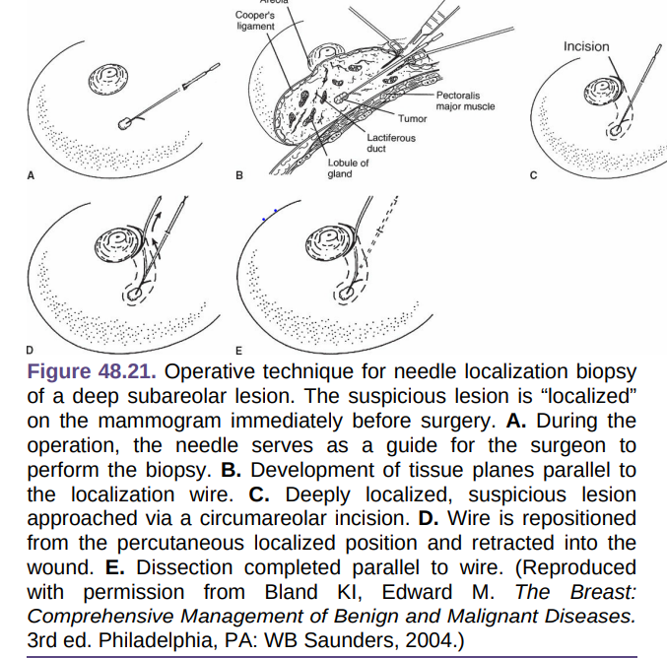

Slide 55
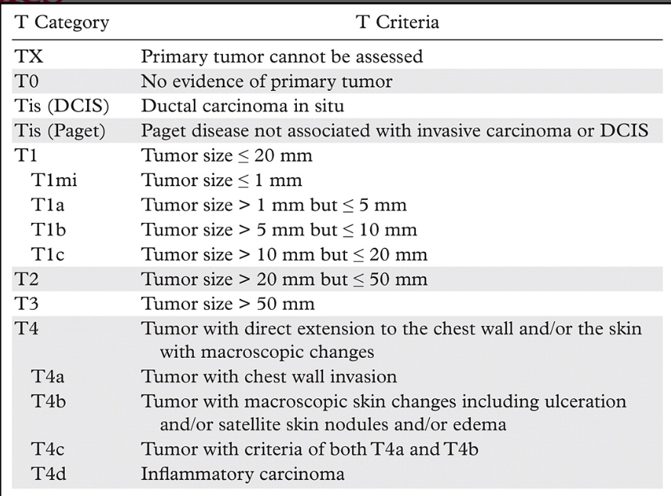

Slide 56
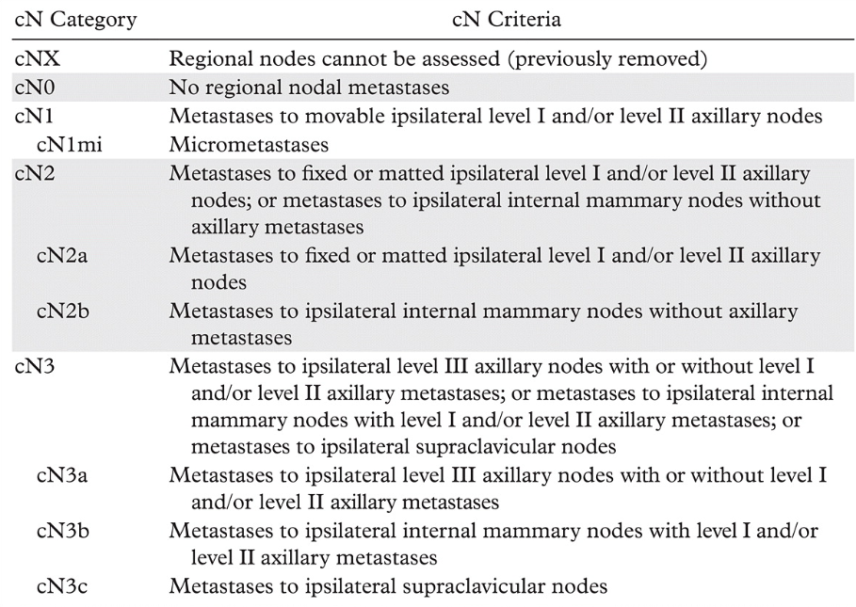

Slide 57
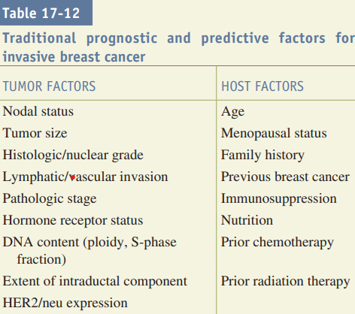

Slide 58
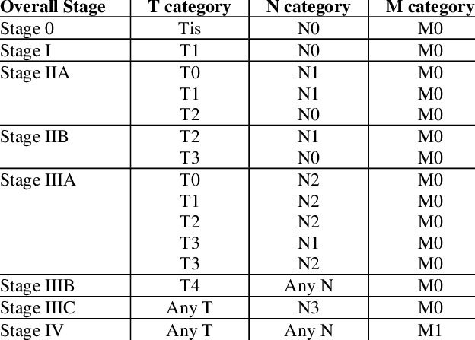

Slide 59
Early Invasive Breast CA | Stage 1, 2A & 2B
Advanced Locoregional Breast CA | Stage 3A & 3B
Distant mets | Stage 4

Slide 60
Workup in addition to breast-specific imaging
Complete blood cell count (CBC), complete metabolic panel including liver function tests (LFTs), and chest x-ray.
A bone scan, if the alkaline phosphatase or calcium level is elevated.
CT scan of the abdomen if LFTS are abnormal.
Patients with clinical stage III or IV disease should undergo bone scan and CT scan of the chest/abdomen/pelvis due to a high probability of distant metastases.

Slide 61
ER/PR Study
ER positivity is common in postmenopausal women (60%) compared to premenopausal women (30%).
In ER +ve status
  Prognosis is good.
  Hormone therapy including tamoxifen is more beneficial.
  Response to treatment is better.
In ER –ve status
  Prognosis is poor.
  Hormone therapy is not very beneficial (but used) as compared to ER +ve patients.
  Response to treatment is not good.

Slide 62
HER2/NEU (ERB2)
Her2/neu is a member of the epidermal growth factor receptor (EGFR) family and is involved in cell growth regulation.
Overexpression of Her2/neu is a poor prognostic factor, as it results in an increased rate of metastasis, decreased time to recurrence, and decreased overall survival.
Patients with Her2/neu amplified (HER2+) tumors are treated with targeted monoclonal antibody therapies, such as trastuzumab (Herceptin) or pertuzumab.

Slide 63
Other adverse tumor characteristics include
  not expressing any tumor biomarkers (triple negative),
  lymphovascular invasion, and
  other indicators of a high proliferative rate (>5% of cells in the S phase of mitosis or >20% Ki-67).

Slide 64

Management of Ca Breast
Options available;
Surgery
Radiotherapy
Hormone Therapy
Chemotherapy
Multi-pronged approach adopted
Single approach ineffectual

Slide 65
Treatment Strategy for Carcinoma Breast
Stage 0–DCIS | Less than 4 cm – wide local excision; RT to breast; hormone therapy More than 4 cm – total mastectomy with SLNB (if +ve axillary dissection); hormone therapy
Stage 0–LCIS | Screening mammogram yearly/ MRI breast/observation→annually Risk reduction with Tamoxifen or raloxifene (in premenopausal age)/bilateral mastectomy. LCIS is high-risk category to develop invasive carcinoma both invasive ductal or lobular.
Stage I and II (Early) | Breast conservative surgery (BCS) + RT + if SLNB +ve axillary dissection. If tumour > 1cm, +ve axillary nodes, high nuclear grade, vascular/lymphatic invasion, ER/Pr –ve with over expression HER2 Neu, then adjuvant chemotherapy.
Stage III | Neoadjuvant chemotherapy + MRM + RT + CT + Hormone therapy.
Stage IV | Hormone therapy (Trastuzumab/Lapatinib) with chemotherapy using taxanes or capacetabine + palliative mastectomy (toilet mastectomy if needed when fungation is present)

Slide 66
Sentinel lymph node biopsy
To assess the regional lymph nodes in women with early breast cancers who are clinically node-negative by physical examination and imaging studies.
staging of the axilla after chemotherapy →clinically node-negative disease at initial presentation.
safe in pregnancy when performed with radioisotope alone.

Slide 67
Sentinel lymph node biopsy →
SLNB is indicated for patients with Insitu, nonmetastatic, T1-T3 breast cancer and no palpable lymphadenopathy
Contraindications.
Inflammatory breast cancer or clinically palpable nodal disease regardless of response to neoadjuvant chemotherapy (NACT) tumor size 2.5 cm.

Slide 68
Procedure
It involves injection of blue dye (either Lymphazurin or methylene blue) in the operating room and/or technetium-labeled sulfur colloid. The goal is to identify the primary draining lymph node(s) in the axillary nodal basin.
A variety of injection techniques are used: Intraparenchymal versus intradermal ,peritumoral versus periareolar.
The SLN is identified by its blue color, by high activity detected by a handheld gamma probe, and/or by a blue lymphatic seen to enter a nonblue node. Palpable nodes are also sentinel nodes even if not blue or radioactive.
Twenty to 30% of the time more than one SLN is identified

Slide 69
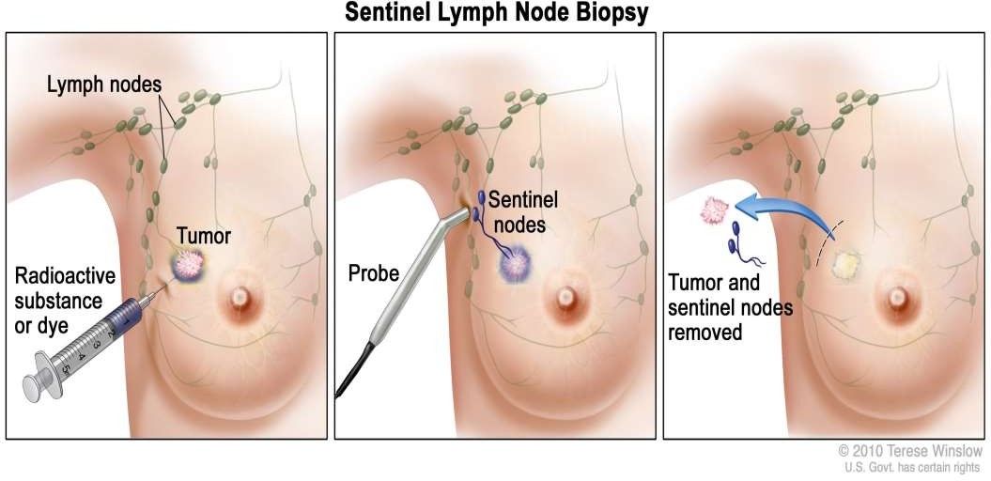

Slide 70
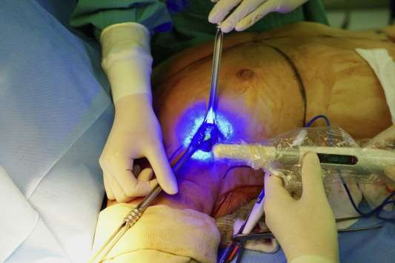
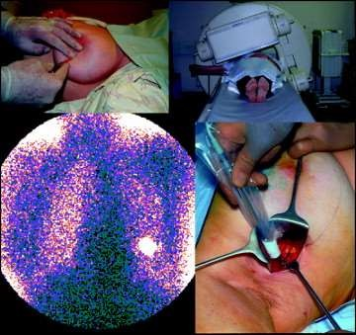

Slide 71
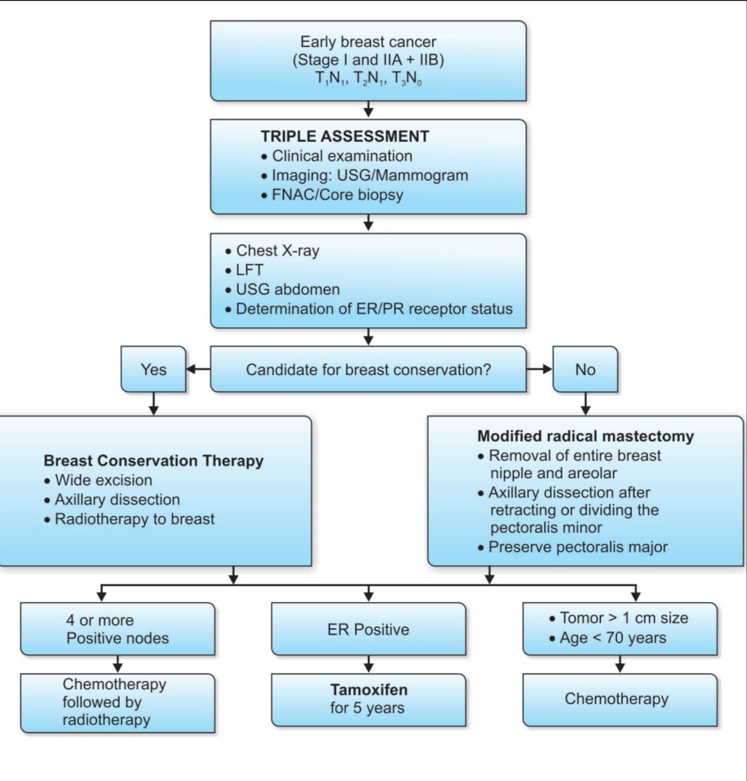

Slide 72
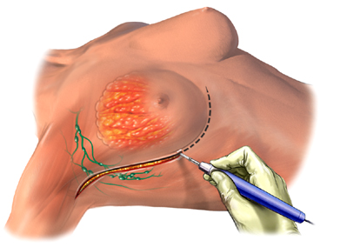
I. SURGICAL Approaches
Conservative Breast Surgeries
  Wide Local Excision [WLE]
  Lumpectomy
  Quadrantectomy
Simple Mastectomy
Total Mastectomy with Axillary Clearance
Skin-Sparing/Keyhole Mastectomy [SSM]
Modified Radical Mastectomy [MRM]
  Patey’s Operation
  Scanlon’s Operation
  Auchincloss’ MRM

Slide 73
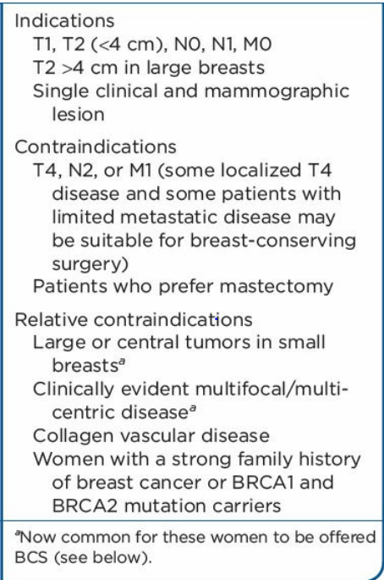

Breast conservation surgery
Indications:
There is no size limit for offering BCS other than the balance between the extent of disease and breast size

Slide 74
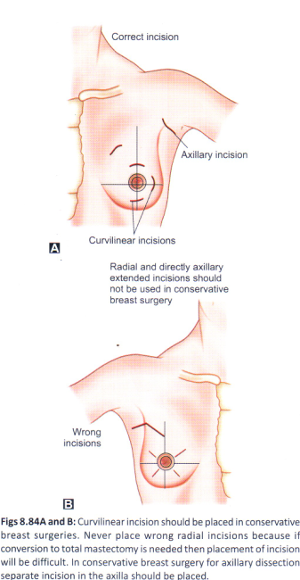
Breast conservation surgery
Wide Local Excision (WLE)/ Partial Mastectomy
Removal of unicentric tumour with 1cm clearance margin. Incision: Over tumour + Axillary Dissection + RT
Quadrantectomy:Removal of entire quadrant with ductal system with 2-3cm normal breast tissue clearance. Part of QUART Therapy (Quadrantectomy + Axillary dissection + RT. Not advocated now.)

Slide 75
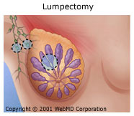
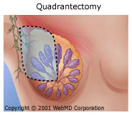

Slide 76
INDICATIONS FOR TOTAL MASTECTOMY/ MODIFIED RADICAL MASTECTOMY IN Early BREAST CANCER
Breast conservation contraindicated or unsuccessful
Patient preference
Breast cancer risk reduction

Slide 77
Mastectomy
Types of Mastectomy.
Simple mastectomy→removes all breast tissue, the nipple–areola complex, and necessary skin.
An extended simple mastectomy removes all breast tissue, the nipple–areola complex, necessary skin, and the level I axillary lymph nodes
Bilateral mastectomy.
Skin sparing mastectomy→ removes all breast tissue, the nipple– areola complex, and only 1 cm of skin around excised scars
Nipple-areolar sparing mastectomy.

Slide 78
Modified Radical mastectomy→ removes all breast tissue, the nipple–areola complex, necessary skin, and the level I and II axillary lymph nodes

Slide 79
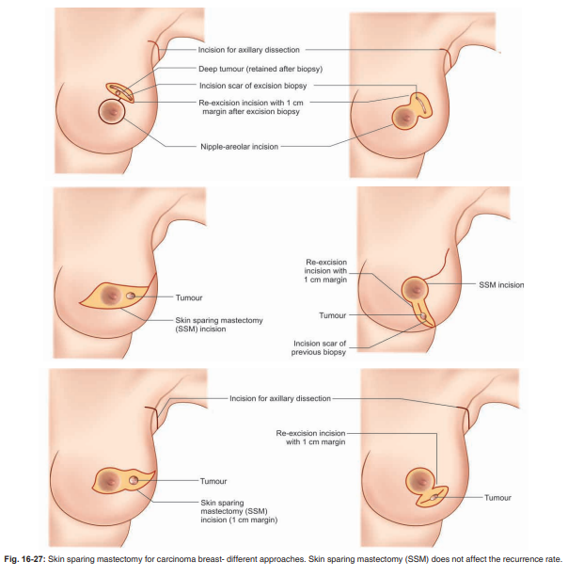

Slide 80
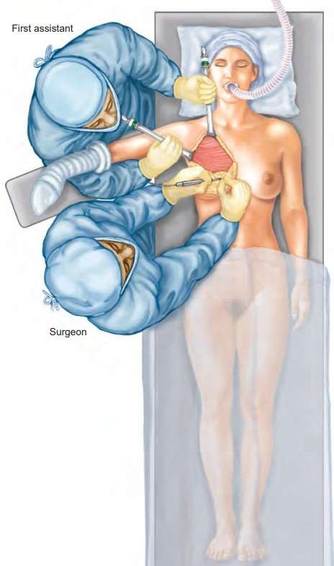
POSITION

Slide 81
INCISIONS

Slide 82
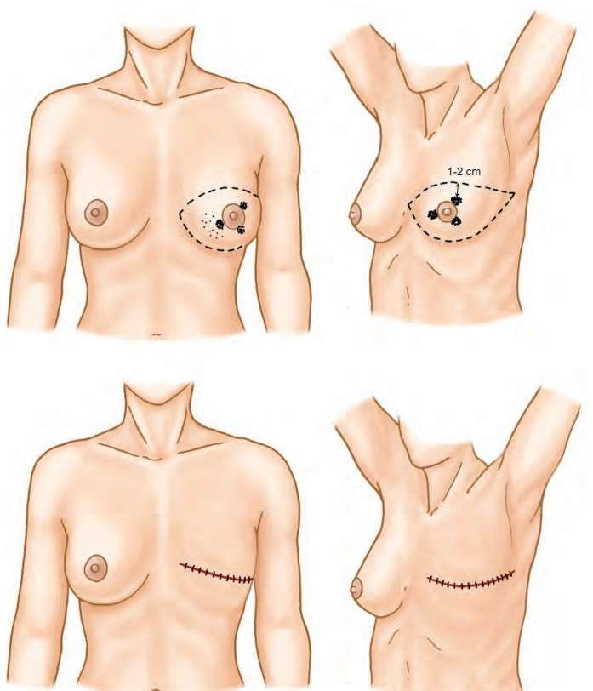
Classic Stewart elliptical incision→
central and subareolar primary lesions of the breast

Slide 83
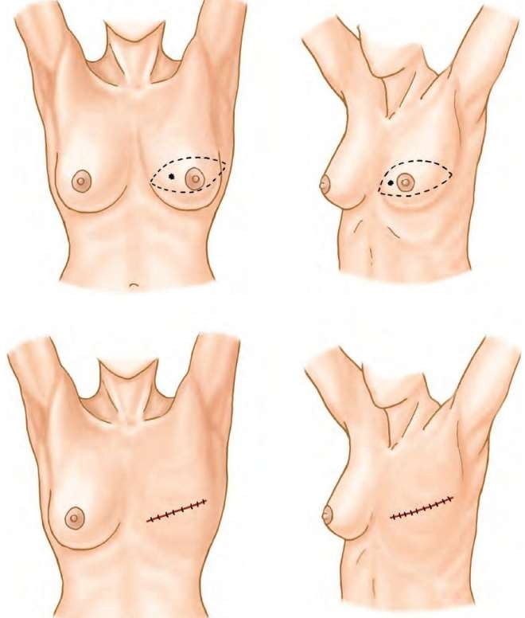
obliquely placed modified Stewart incision→
cancer of the inner quadrant of the breast

Slide 84
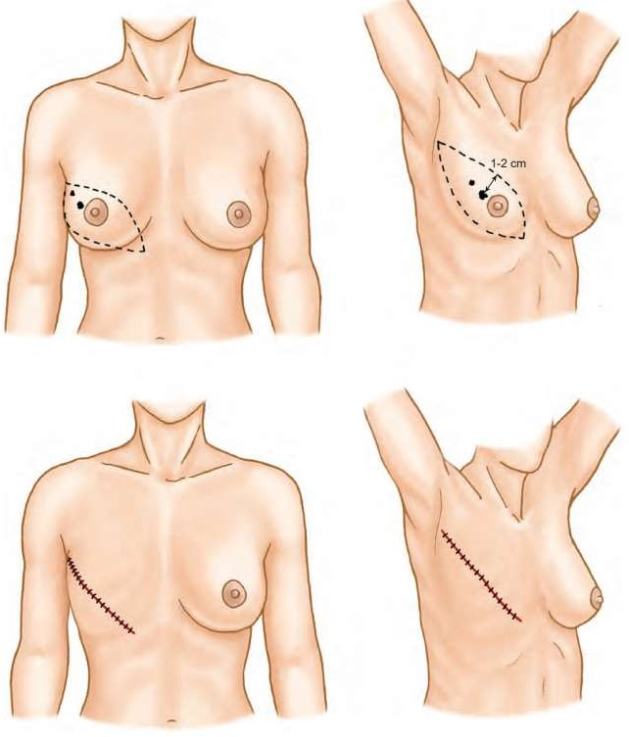
classic Orr oblique incision →
carcinoma of the upper outer quadrants of the breast

Slide 85
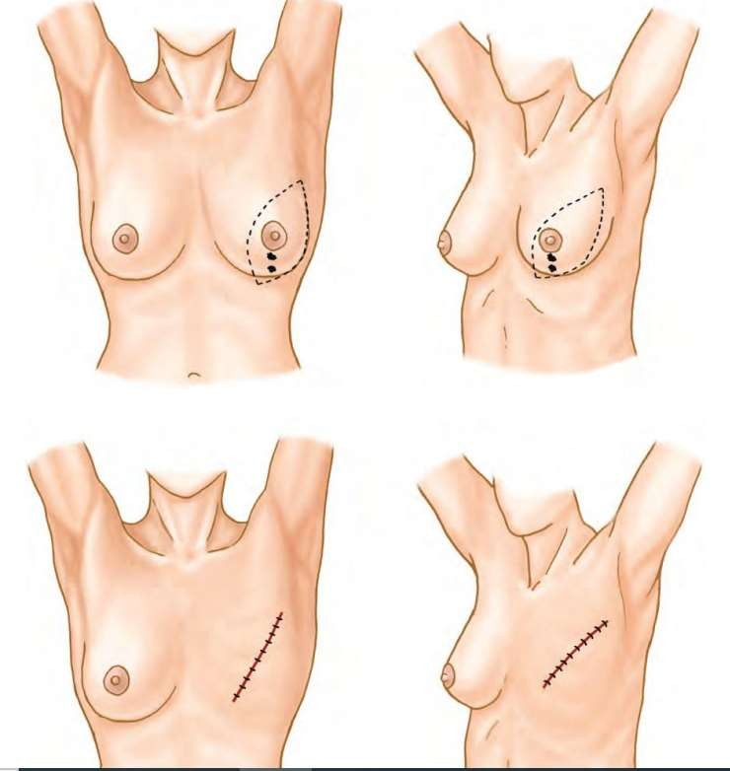
Variation of the Orr incision →
lower inner and vertically placed (6 o’clock) lesions of the breast

Slide 86
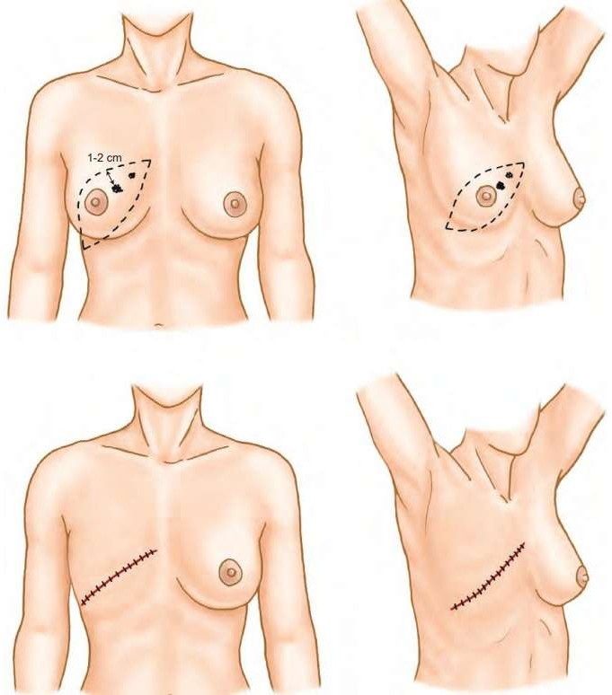
modified Stewart incision→
can incorporate the tumor en bloc, provided that the cancer is not too high on the breast and craniad from the nipple/areola complex

Slide 87
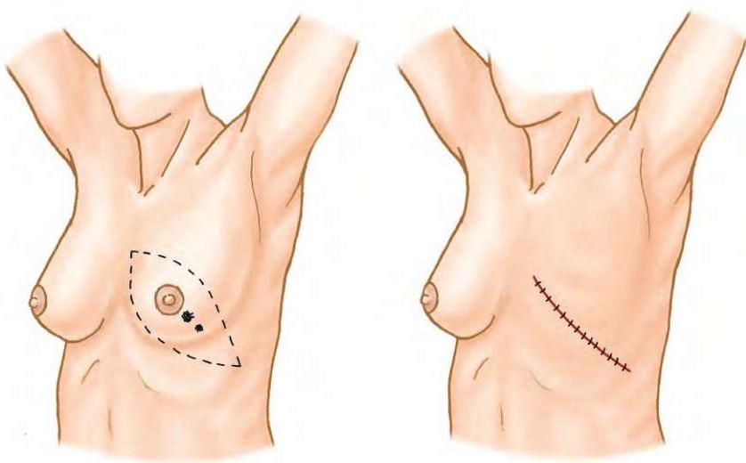
Incisions for cancer of the lower outer quadrants of the breast

Slide 88
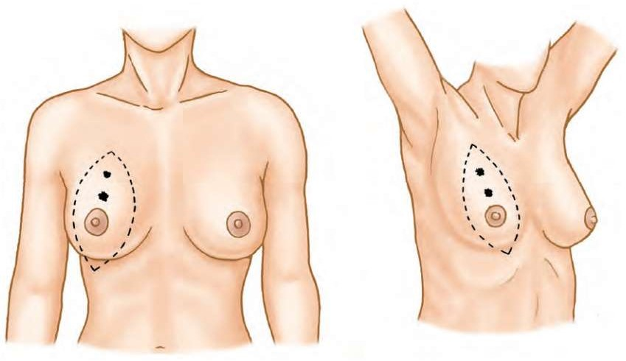
Depiction of skin flaps for lesions of the breast that are high lying, infraclavicular, or fixed to the pectoralis major muscle.

Slide 89

Limits of Modified radical mastectomy
laterally→ anterior margin of the latissimus
dorsi muscle
Medially→ sternal border
superiorly→subclavius muscle
inferiorly →caudal extension of the breast approximately 3 to 4 cm inferior to the inframammary fold.

Slide 90
:After incision of the investing fascia of the axillary space,the tendinous portion of the pectoralis minor muscle
underlying structures (axillary artery and vein, brachial plexus) are readily identified

Slide 91


Slide 92


Slide 93


Slide 94
RADIATION THERAPY
indications
Four or more positive axillary nodes
Lymphovascular invasion (1–3)—High grade tumors
Resection margin positive
Skin and chest wall involvement
Size more than 5 cm.

Slide 95

Types of radiotherapy to breast
Whole breast radiation therapy
Partial breast radiation therapy→ (APBI/IPBI)
Accelerated partial breast irradiation (APBI) is delivered after lumpectomy when the final pathology is known, typically using 5 to 10 fractions of 3.4 to 6 Gy given once or twice a day over 5 to 10 elapsed days
Notes:
single entry brachytherapy devices (SEBD)

Slide 96

Intraoperative partial breast irradiation (IPBI) delivers a single fraction of 18 to 21 Gy during surgery once the tumor has been removed and prior to surgical closure.

Slide 97
CHEMOPREVENTION
Hormone receptor-negative cancers that are >1 cm in size, adjuvant chemotherapy is appropriate.
INDICATIONS!
1. Node positive cases
2. HER2 positive cases
3. Triple negative
4. More than 0.5 cm size and less than 70 years of age.

Slide 98
Usually chemotherapy indicated within 6 weeks
6 Cycles of CMF (Cyclophosphamide, Methotrexate, 5 FU) or CAF (Adriamycin-based regimen)
4AC ( Adriamycine ,cyclophosphamide) → followed by 4AT (Adriamycin ,taxanes)

Slide 99

Regimens are guided by the tumor biomarkers. Typical regimens consist of four to eight cycles of a combination of cyclophosphamide and an anthracycline followed by a taxane administered every 2 to 3 weeks

Slide 100
HORMONAL therapy
Aromatase inhibitors
REVERSIBLE NON-STEROIDAL
Anastrazole and letrozole
IRREVERSIBLE STEROIDAL
exemestane

Slide 101
Newer aromatase inhibitors
Raloxifene 60 mg daily (newer molecule of Tamoxifen
LHRH agonists—Goserelin, Buserelin
Other LHRH agonists—Leuprolide
Antiestrogen—Fulvestrant
Progestational agents—Magestrol
Androgens—Fluoxymesterone.

Slide 102
ANTI ESTROGEN THERAPY
Tamoxifen (selective estrogen receptor modulator) in ER + tumors for 5 years → significant reduction in locoregional recurrence or distant metastasis.
DOSE 20mg daily for 10 years.
Preservation of bone density in postmenopausal women
Decrease in cholesterol
Reduction in cardiovascular morbidity (These are due to the estrogenic effects of Tamoxifen on extra mammary tissues).

Slide 103
Biological therapy
HER 2 + → Trastuzumab (herceptin) as infusion every 3 weeks for 1 year 0R every week for 9 weeks.
Pertuzumab.

Slide 104
New advances
FOR early detection!
One technology advance is 3-D mammography, also called breast tomosynthesis
HR-Positive Breast Cancer Treatment Advances
Abemaciclib (Verzenio), Ado-trastuzumab emtansine (Kadcyla)
Neratinib Maleate (Nerlynx) can be used in patients with early-stage HER2-positive

Slide 105
Triple-Negative Breast Cancer Treatment Advances
PARP inhibitors →
olaparib (Lynparza) and talazoparib (Talzenna), effectively
target TNBC caused by certain inherited BRCA gene mutations or other alterations that lead to defects in DNA damage repair.

Slide 106

Minimally invasive treatments
In the breast, ablative approaches have been studied to treat benign fibroadenoma and cancer, as well as to extend lumpectomy margins intraoperatively.
Thermal ablation of tumors is the in situ destruction of tumorous tissue by the local application of heat or cold
Heat-based modalities include radiofrequency ablation (RFA), interstitial laser therapy (ILT), microwave ablation (MWA), and high-intensity focused ultrasound (HIFU)
Cryotherapy uses low temperature to ablate tissue.
Notes:
Hyperthermia has been used to destroy tumor masses for over 4,000 years. Hippocrates describes that “if a tumor cannot be cut, it should be burned. If it cannot be burned, then it is incurable.” This concept is largely true today!

Slide 107


Slide 108
FOLLOW-UP
Frequency of follow-up
Every 3 months in the first year
Every 4 months in the second and third year
Every 6 months in the 4th and 5th years
Every year 5 years onwards.
At follow-up
For early cases • Assess morbidity of treatment • Assess performances status and measure weight
Look for recurrence or dissemination
Investigations • Chest X-ray: every year for 3 years • Ultrasound of liver: every year • Mammogram: every year • Other investigations, including bone scan or skeletal survey, according to symptoms and physical findings.
The frequency of investigations at follow-up should be modified according to the extent of the disease on presentation and risk factors.

Slide 109
THE END

