Slide 3
VISUAL PATHWAY & ITS LESIONS

Slide 4
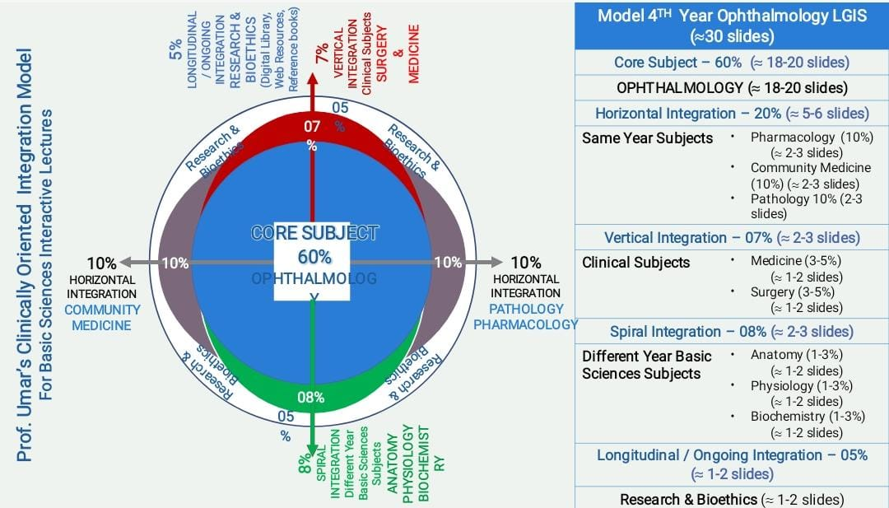
SEQUENCE OF LECTURE
VERTICAL INTEGRATION
HORIZONTAL INTEGRATION
CORE SUBJECT
EOLA (END OF LECTURE ASSESSMENT)
DIGITAL LIBRARY REFERENCES ( RESEARCH, BIOETHICS, ARTIFICIAL INTELLIGENCE.)

Slide 5
LEARNING OBJECTIVES
AT THE END OF THIS SESSION, STUDENTS SHOULD BE ABLE TO
DESCRIBE THE NEUROANATOMY OF VISUAL PATHWAYS
RECALL THE ANATOMY AND FUNCTIONS OF CRANIAL NERVES 2-7
ILLUSTRATE THE PUPPILARY LIGHT AND ACCOMODATION REFLEX PATHWAY
DESCRIBE THE OCULAR MOTILITY AND RELATED NEURONAL PATHWAYS
INTERPRET VISUAL FIELD DEFECTS AND LOCALIZE THE SITE OF LESION
DESCRIBE A SYSTEMIC-SIGN-AND-SYMPTOM ORIENTED NEURO-OPHTHALMIC PATIENT.

Slide 7
Visual pathway consists of
VERTICAL INTEGRATION
The optic nerves
The optic chiasma
The optic tracts
The lateral geniculate bodies
The optic radiations
The occipital cortex.

Slide 9
OPTIC NERVE
Core Subject
The fibers of the optic nerve originate in the retina.
The retina is divided into nasal and temporal halves at the level of the fovea centralis.
It joins optic chiasm at anterolateral angle.
It contains the afferent fibers of the pupillary light reflex.

Slide 10
Core Subject

Slide 11
THE OPTIC CHIASMA
Core Subject
Flat band like structure lying above the pituitary fossa.
There is semi decussation of the nerve fibers in optic chiasma.
The nerve fibers from nasal side of each retina cross over to the opposite side.
The nerve fibers from the temporal side do not cross but pass into optic tract of the same side.

Slide 12
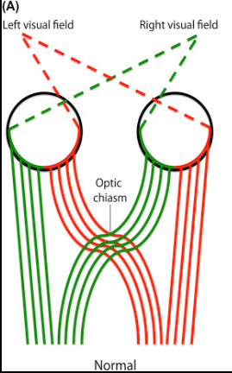
Core Subject
THE OPTIC CHIASMA

Slide 13
THE OPTIC TRACT
Core Subject
The optic tracts originate from the postero-lateral angle of the optic chiasm.
Cylindrical bands running outward and backwards.
They end in lateral geniculate bodies.
They have temporal fibers from same side and nasal fibers form opposite side.

Slide 14
Core Subject

Slide 15
THE LATERAL GENICULATE BODIES
Core Subject
These are oval structures situated at the posterior end of optic tracts.
The fibers of the optic tracts end in lateral geniculate bodies.
New fibers of optic radiation originate from them.

Slide 16
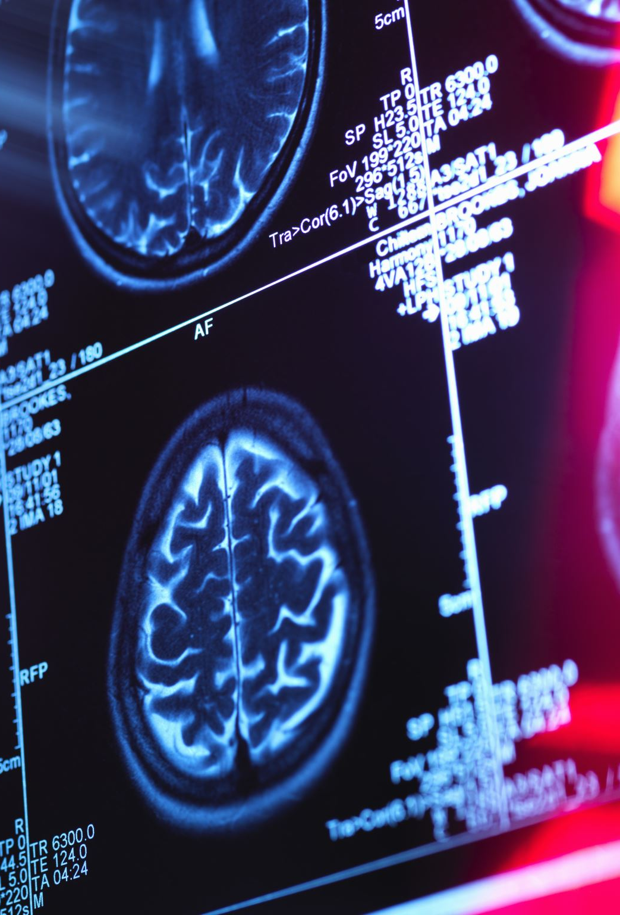
THE OPTIC RADIATIONS
Core Subject
The nerve fibers proceed backwards and medially as the optic radiations to terminate in the visual centers situated in the occipital lobes.

Slide 17
THE OCCIPITAL CORTEX
Core Subject
It is situated above and below the calcarine fissure in the occipital lobes extending up to the occipital pole.

Slide 18
Core Subject

Slide 19
THREE PARTS OF VISUAL NERVE PATHWAY
Core Subject
FIRST ORDER NEURON.
The neurons of the first order is the bipolar cell in retina
Rods and cones are sensory end organs.
SECOND ORDER NEURON.
These are ganglion cells in the retina.
Its processes pass along the optic nerve, optic chiasma, and optic tracts to the lateral geniculate bodies.
THIRD ORDER NEURONS.
These neurons takes up the impulses via the optic radiatios to the occipital lobe.

Slide 20
Core Subject

Slide 21
Some terminologies
HORIZONTAL INTEGRATION
Homonymous-having the same
Hemianopia-loss of vision in half the visual feild
Congruous-in harmony

Slide 22
LESIONS OF VISUAL PATHWAY
Horizontal Integration
Lesions of visual pathway usually cause defects in the visual fields and diminution of visual acuity depending on the site of lesion.
Hemianopia
Amblyopia
HEMIANOPIA It is a condition of loss of half the field of vision of both eyes
Amaurosis

Slide 23
OPTIC NERVE LESION
Core Subject
Marked loss of vision or complete blindness on the effected side.
Loss of direct light reflex of same side and loss of consensual on opposite side.
CAUSES
Acute optic neuritis
Optic neuropathy
Optic atrophy

Slide 24
Lesions at the proximal part of optic nerve
Core Subject
Ipsilateral blindness
Contralateral superior quadrantanopia (junction scotoma)
Loss of light reflex on effected side.
CAUSES
Tumor of pituitary gland
Meningioma

Slide 25
Lesion at the proximal part of right optic nerve
Core Subject

Slide 26
CHIASMAL LESION
Core Subject
Bitemporal haemianopia
Bitemporal haemianopic paralysis of pupillary reflexes.
CAUSES
Tumor of pituitary gland
Craniopharyngima
Suprasellar meningioma

Slide 27
Core Subject

Slide 28
OPTIC TRACT LESION
Core Subject
Homonymous haemianopia
Causes
Syphilitic meningitis
Tuberculous meningitis
Tumors Of hypothalamus

Slide 29
Left homonymous hemianopia caused by lesion of RIGHT optic tract
Core Subject

Slide 30
Right homonymous hemianopia caused by lesion of LEFT optic tract.
Core Subject

Slide 31
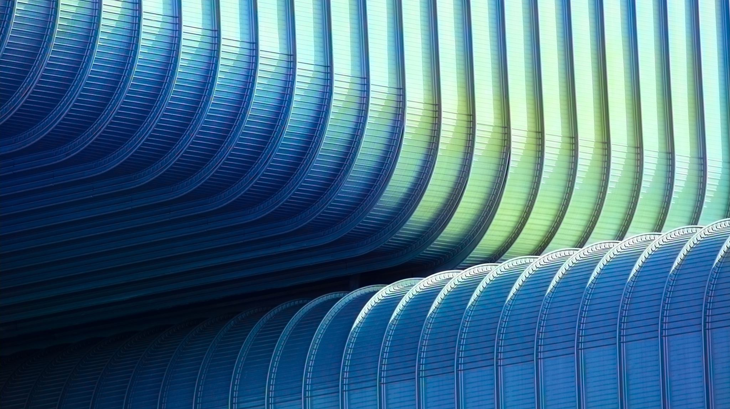
LATERAL GENICULATE BODY LESION
Core Subject
Homonymous haemianopia
Sparing of pupillary reflexes

Slide 32
OPTIC RADIATION LESION
Core Subject
Complete homonymous haenianopia in total optic radiation.
Inferior quadrantaric haemianopia (pie in the floor)
Parietal lobe radiations
Superior quadrantaric haemianopia (pie in the sky)
Temporal lobe radiations
Causes
Trauma
Primary and secondary tumors
Vascular occlusions

Slide 33
Inferior quadrantaric hemianopia PARIETAL LOBE lesion
Core Subject

Slide 34
Superior quadrantaric hemianopia TEMPORAL LOBE lesion
Core Subject

Slide 35
VISUAL CORTEX LESIONS
Core Subject
Congruous homonymous hemianopia usually sparing macula
Pupillary reflexes are normal
Causes
Occlusion of posterior cerebral artery supplying the anterior part of occipital cortex

Slide 36
Occipital lobe infarction. Visual field patterns show congruous right homonymous hemianopia respecting the vertical meridian and sparing fixation
Core Subject

Slide 37
END OF LECTURE ASSESSMENT

Slide 40
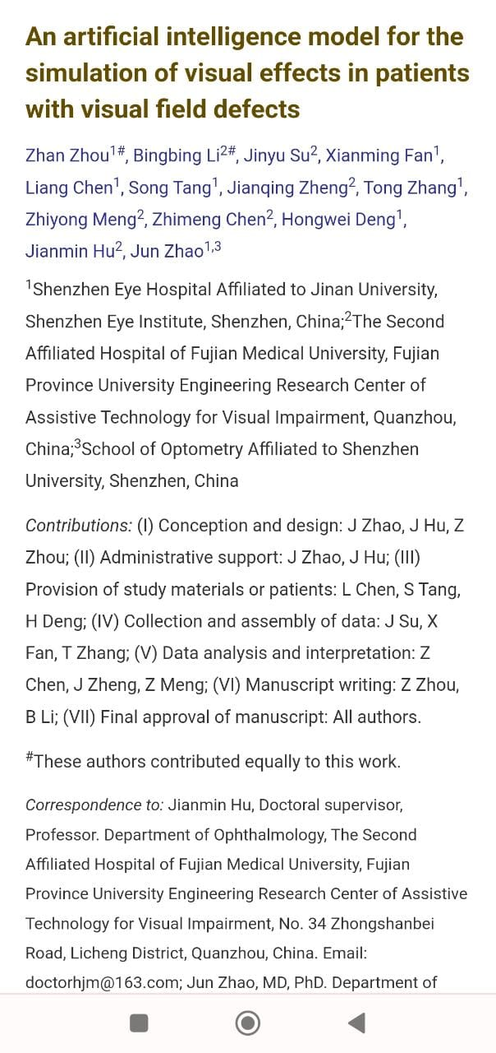
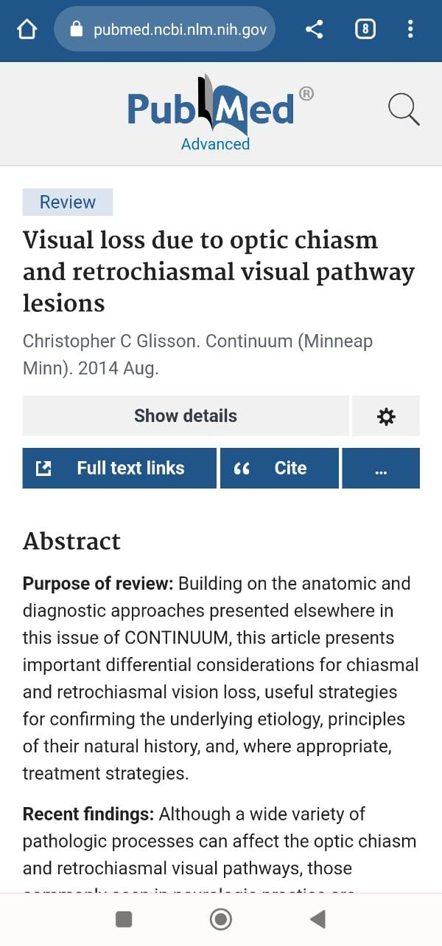
RESEARCH AND ETHICS
https://pubmed.ncbi.nlm.nih.gov/25099100/
ARTIFICIAL INTELLIGENCE
https://atm.amegroups.com/article/view/38003/html

Slide 41
REFERENCES
Kanski’s Clinical Ophthalmology 9th Edition
American Academy of Ophthalmology Basic Ophthalmology 10th Edition

