Slide 2
LIVER DISORDERS IN PREGNANCY
DR.MUHAMMAD ARIF
ASSOCIATE PROFESSOR
DEPARTMENT OF MEDICINE
HOLY FAMILY HOSPITAL
RAWALPINDI MEDICAL UNIVERSITY

Slide 3
University Motto, Vision, Values & Goals
Mission Statement
To impart evidence-based research-oriented health professional education Best possible patient care Mutual respect, ethical practice of healthcare and social accountability.
Vision and Values
Highly recognized and accredited centre of excellence in Medical Education, using evidence-based training techniques for development of highly competent health professionals, who are lifelong experiential learner and are socially accountable.
Goals
The Undergraduate Integrated Learning Program is geared to provide you with quality medical education in an environment designed to:

Slide 5
CORE CONCEPT
Liver disease during pregnancy can be categorized by the following characteristics:
Diseases that are unique to pregnancy
Some are primary liver diseases (eg, intrahepatic cholestasis of pregnancy, acute fatty liver of pregnancy), and others are systemic diseases with hepatic manifestations (eg, preeclampsia with severe features [including eclampsia; hemolysis, elevated liver enzymes, low platelets (HELLP) syndrome]; hyperemesis.

Slide 6
CORE CONCEPT
Diseases that are exacerbated by pregnancy
Pregnancy-related physiologic changes may increase the risk of liver-related diseases that may also occur in nonpregnant patients. Examples of such diseases include gallstones and vascular diseases (eg, Budd-Chiari syndrome).
Diseases that are not related but are coincidental to pregnancy (eg, acute viral hepatitis).

Slide 7
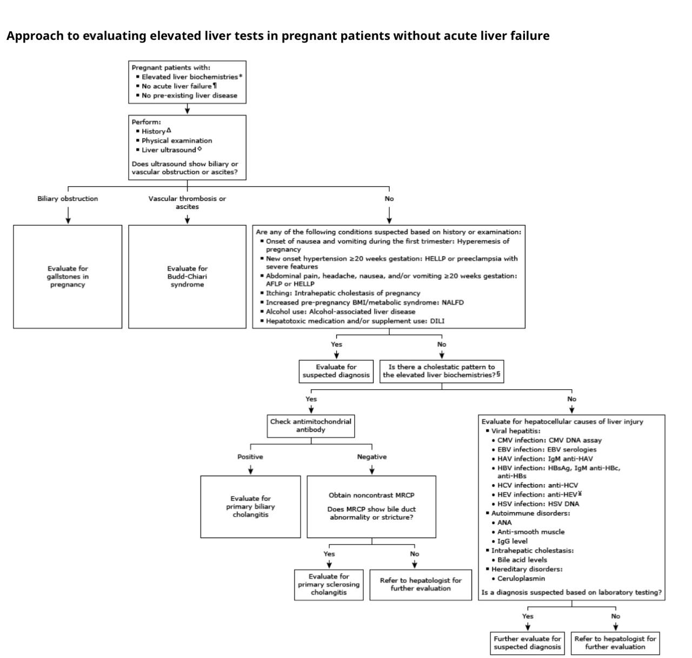
CORE CONCEPT

Slide 8
INDICATIONS OF BASELINE LIVER TESTS
CORE CONCEPT
We obtain baseline liver biochemical and function tests in pregnant patients with any of the following;
●History of pregnancy-related liver disease in prior pregnancy (eg, intrahepatic cholestasis of pregnancy, preeclampsia; hemolysis, elevated liver enzymes, low platelets (HELLP) syndrome; acute fatty liver)
●History of chronic hypertension or gestational hypertension
●Risk factors for liver disease (eg, metabolic syndrome, alcohol use disorder)
●Viral hepatitis identified on prenatal screening (eg, hepatitis B surface antigen-positive or anti-hepatitis C virus antibody positive)

Slide 9
CORE CONCEPT
Liver tests that are commonly measured include:
●Serum aminotransferases: ALT and AST
●Alkaline phosphatase
●Total bilirubin
●Prothrombin time/international normalized ratio
●Serum albumin

Slide 10
EVALUATION OF ACUTE LIVER FAILURE
CORE CONCEPT
Pregnant patients with acute severe liver injury (ie, serum aminotransferases typically more than 10 times the upper limit of normal, hepatic encephalopathy, and coagulopathy) have acute liver failure.
Such patients require urgent consultation with maternal-fetal medicine and hepatology specialists and referral to a liver transplantation center.

Slide 11
CORE CONCEPT
Causes of acute liver failure during pregnancy may be classified as:
●Pregnancy-related – Acute liver failure due to pregnancy-related causes generally occurs at ≥20 weeks of gestation. These obstetric emergencies include acute fatty liver of pregnancy or preeclampsia with severe features/eclampsia/hemolysis, elevated liver enzymes, low platelets (HELLP) syndrome.
●Nonpregnancy-related – Acute liver failure in pregnant patients may be due to nonpregnancy-related causes during any stage of pregnancy. Common causes of acute liver failure include acute viral hepatitis, drug-induced liver injury (eg, acetaminophen), and ischemic hepatitis.

Slide 12
PATIENTS WITHOUT ACUTE LIVER FAILURE
VERTICAL INTEGRATION
Initial evaluation
The initial evaluation for a pregnant patient with elevated liver biochemistries but without acute liver failure is similar to the evaluation of a nonpregnant patient and includes history, physical examination, laboratory studies, and a liver ultrasound.
For pregnant patients, assessing clinical features and interpreting the liver biochemistries must also take into account the timing of symptom onset and gestational age because these factors inform the differential diagnosis for diseases that are unique to pregnancy.

Slide 13
VERTICAL INTEGRATION
Patient history and presentation — The patient's clinical presentation and history may suggest a possible cause(s) for elevated liver biochemistries:
●Timing of symptom onset – The timing of symptom onset (gestational age) can help guide the evaluation :
•Gestational age <20 weeks – Severe nausea and emesis with onset in the first trimester suggests hyperemesis gravidarum.
•Gestational age ≥20 weeks – New onset hypertension at ≥20 weeks gestation is concerning for Hemolysis, elevated liver enzymes, low platelets (HELLP) syndrome or preeclampsia with severe features.
Symptoms of nausea, vomiting, headache, and abdominal pain in the third trimester are concerning for acute fatty liver of pregnancy.

Slide 14
VERTICAL INTEGRATION
●Risk factors for exposure to potential hepatotoxins (medications, dietary and herbal supplements, alcohol use, illicit substance use)
●Risk factors for nonalcohol-associated fatty liver disease (metabolic syndrome, dyslipidemia)
●Symptoms and signs of hepatobiliary disease (pruritus, jaundice).
●History of liver disease with prior pregnancy: Some pregnancy-related diseases (eg, intrahepatic cholestasis of pregnancy) commonly recur in subsequent pregnancies .

Slide 15
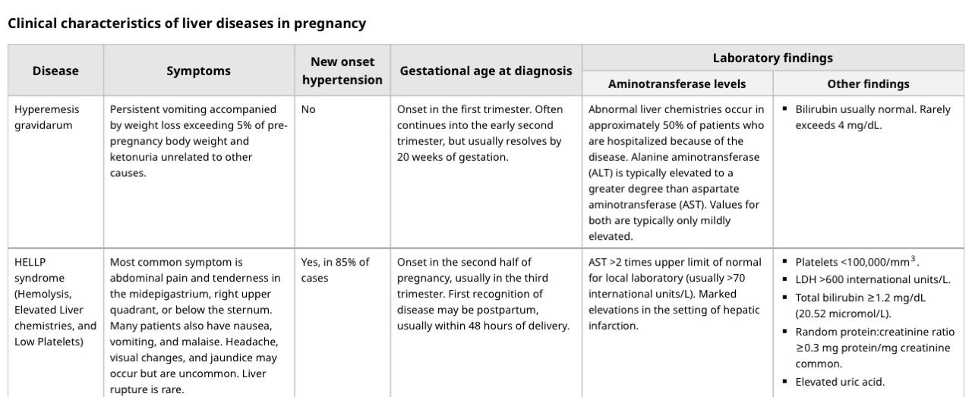
VERTICAL INTEGRATION

Slide 16
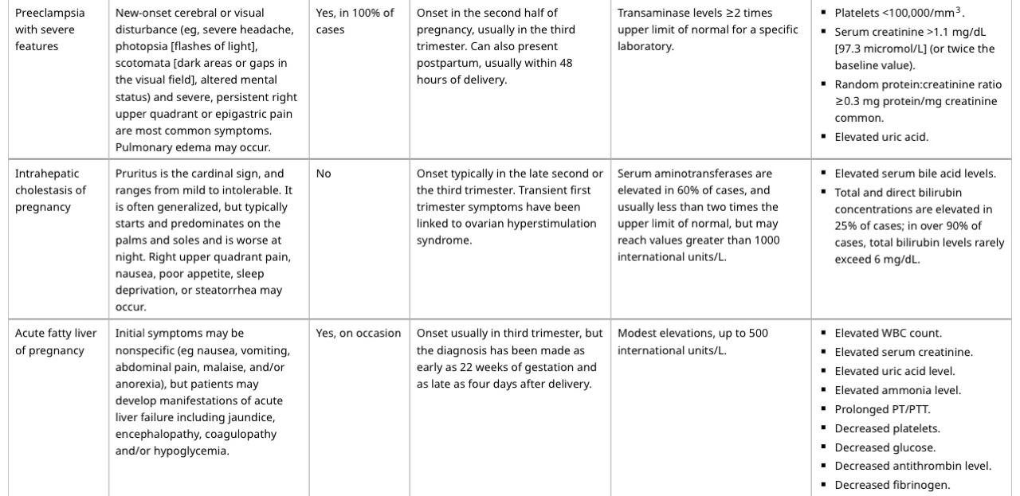

Slide 17
VERTICAL INTEGRATION
Physical examination — Findings on physical examination that suggest liver disease during pregnancy (but not necessarily acute liver failure) include ascites and jaundice. A palpable liver raises concern for hepatomegaly but may be difficult to detect when the uterus is enlarged near term.

Slide 18
VERTICAL INTEGRATION
Laboratory studies — For pregnant patients with elevated liver biochemistries, laboratory tests that are measured during the initial evaluation include :
●Complete blood count with platelets
●Serum creatinine, electrolytes, glucose
●Prothrombin time/international normalized ratio (INR)
Additional laboratory testing is determined based on symptoms and pattern of liver injury.

Slide 19
IMAGING
VERTICAL INTEGRATION
For pregnant patients with elevated liver biochemical and/or function tests, transabdominal ultrasound of the liver is performed initially because ultrasound is widely available and has not been associated with adverse fetal effects .
For patients with suspected vascular disorders (eg, right upper quadrant pain, ascites), we also obtain Doppler ultrasound study to exclude thrombosis of the hepatic or portal vein.

Slide 20
VERTICAL INTEGRATION
For patients in whom biliary obstruction or cholangiopathy is suspected but ultrasound is nondiagnostic, or for some patients with abnormal ultrasonography (eg, liver mass), additional imaging with noncontrast magnetic resonance imaging (eg, magnetic resonance cholangiopancreatography) is preferred rather than computed tomography (CT) to minimize radiation exposure to the fetus.
We do not use gadolinium-containing contrast agents because gadolinium crosses the placenta and may have harmful effects.
If CT is necessary, the cumulative ionizing radiation exposure should be minimized, preferably less than 0.05 Gy (50 mGy, 5 rads).

Slide 21
Differential diagnosis based on initial evaluation
VERTICAL INTEGRATION
For some pregnant patients, the cause for elevated liver biochemistries can be suspected based on patient history, gestational age, initial laboratory studies, and liver ultrasound (Algorithm 1 shared initially)
●Liver ultrasound with or without Doppler study: Liver ultrasound may show biliary obstruction or vascular thrombosis or ascites.

Slide 22
VERTICAL INTEGRATION
●Details of the patient's history (symptoms, medication use, comorbidities) may suggest a possible etiology:
•Severe nausea and vomiting during early pregnancy suggest hyperemesis.
•New onset hypertension and/or thrombocytopenia suggest preeclampsia with severe features or HELLP syndrome
Abdominal pain, headache, nausea, and vomiting in the third trimester is concerning for acute fatty liver of pregnancy or HELLP syndrome.

Slide 23
VERTICAL INTEGRATION

Slide 24
VERTICAL INTEGRATION
•Pruritus (with or without increased total bilirubin) suggests intrahepatic cholestasis of pregnancy.
•History of potentially hepatotoxic medication and/or supplement use suggests drug-induced liver injury.

Slide 25
VERTICAL INTEGRATION
•History of insulin resistance, polycystic ovarian syndrome, or dyslipidemia suggests increased risk for nonalcohol-associated fatty liver disease.
•History of recent alcohol use raises concern for alcohol-related liver disease.

Slide 26
Subsequent testing
VERTICAL INTEGRATION
Determining liver injury pattern —
For pregnant patients without a suspected etiology of abnormal liver biochemistries based on initial evaluation, subsequent testing is guided by the predominant pattern of liver injury :

Slide 27
CORE CONCEPT
Hepatocellular pattern –
Hepatocellular injury consists of a disproportionate elevation in serum aminotransferases compared with alkaline phosphatase. Other characteristics of liver enzymes (ie, magnitude of aminotransferase elevations) are interpreted similarly to patterns in nonpregnant patients.
Most liver disorders that are unique to pregnancy present with a hepatocellular pattern .

Slide 28
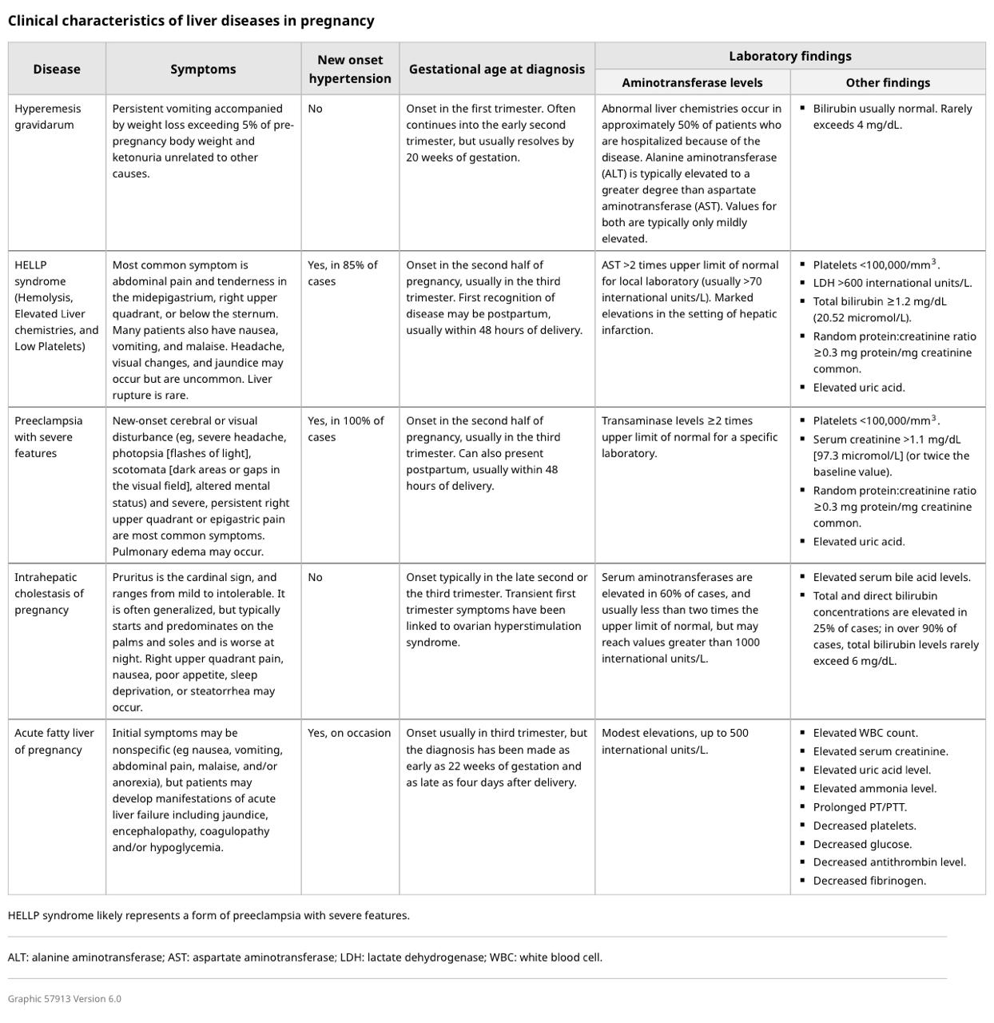
CORE CONCEPT

Slide 29
CORE CONCEPT
Common causes of non-pregnancy related hepatocellular injury include drug-induced liver injury, viral hepatitis, nonalcohol-associated fatty liver disease, alcohol-associated liver disease, and autoimmune hepatitis

Slide 30
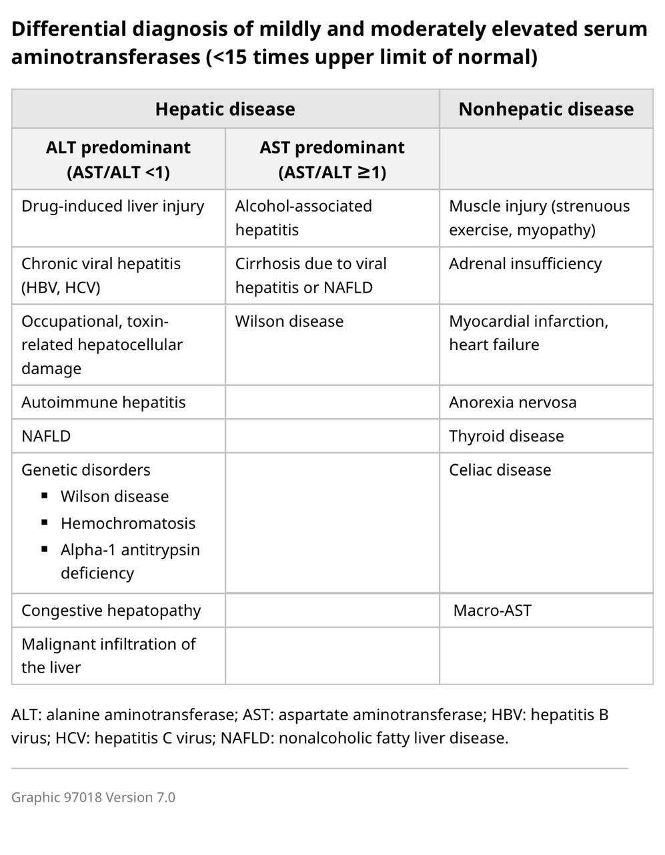
VERTICAL INTEGRATION

Slide 31
VERTICAL INTEGRATION
Patients with hepatocellular injury
Further testing for causes of hepatocellular injury includes (previous slide ):
●Acute viral hepatitis:
•Immunoglobulin M (IgM) anti-hepatitis A virus
•Hepatitis B surface antigen (HBsAg), IgM antibody to hepatitis B core antigen, antibody to HBsAg
•Anti-hepatitis C virus antibody with reflex to hepatitis C viral RNA

Slide 32
VERTICAL INTEGRATION
•IgM anti-hepatitis E virus (in regions where HEV infection is endemic)
•Herpes simplex virus DNA by polymerase chain reaction
•Cytomegalovirus DNA assay
•Epstein-Barr virus serologies

Slide 33
VERTICAL INTEGRATION
●Autoimmune hepatitis – Antinuclear antibodies, anti-smooth muscle antibodies, immunoglobulin G
●Intrahepatic cholestasis of pregnancy (ICP) – Total bile acid concentration. Patients with ICP typically present with itching during the late second or third trimester
●Wilson disease – Ceruloplasmin

Slide 34
VERTICAL INTEGRATION
Cholestatic pattern
A cholestatic pattern of injury consists of a disproportionate elevation in the alkaline phosphatase compared with the serum aminotransferases. However, alkaline phosphatase will be normally elevated during pregnancy due to placental production (ie, typically <2 times the upper limit of normal).
Nonpregnancy-related causes of cholestatic injury include choledocholithiasis, drug-induced liver injury, primary biliary cholangitis and primary sclerosing cholangitis .

Slide 35
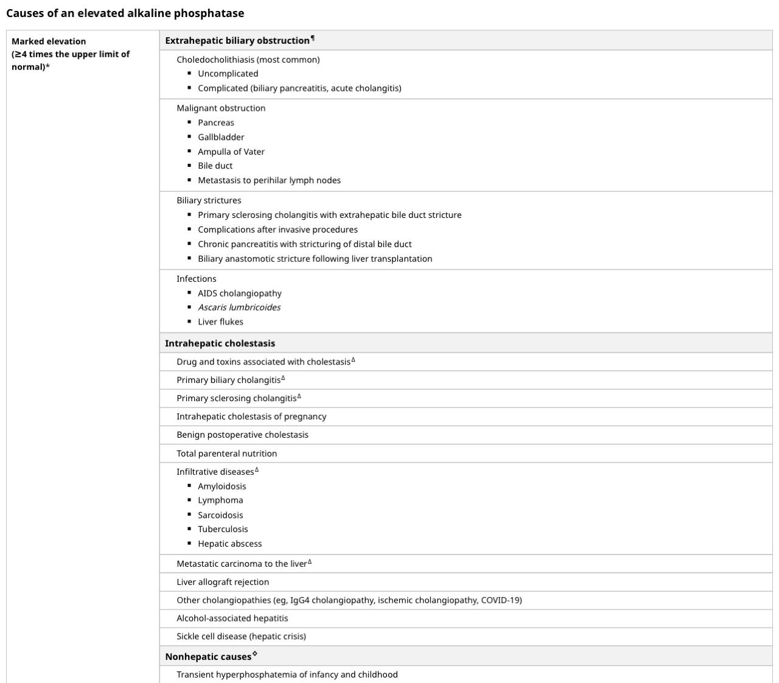
VERTICAL INTEGRATION

Slide 36
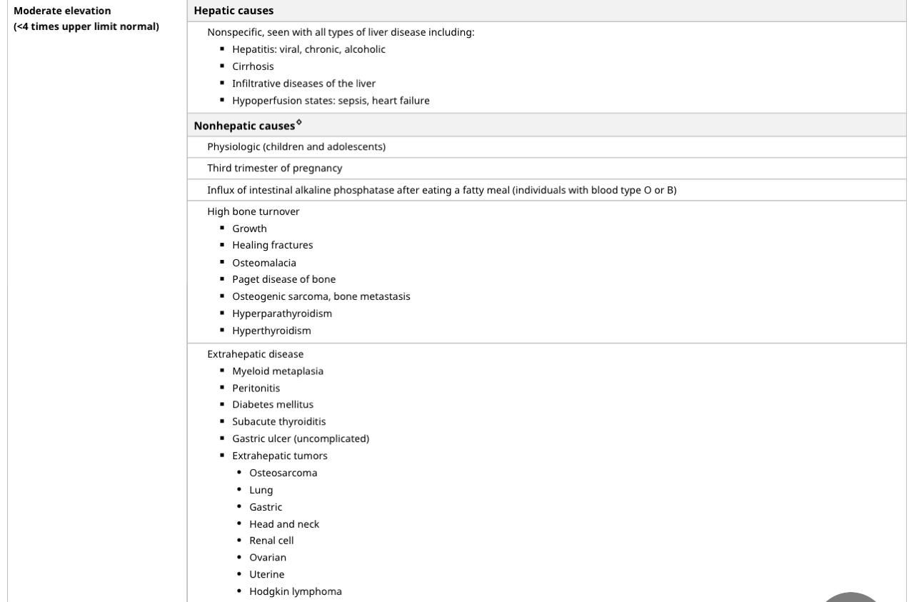
VERTICAL INTEGRATION

Slide 37
VERTICAL INTEGRATION
Of note, serum bilirubin can be elevated in both hepatocellular and cholestatic conditions. Thus, bilirubin is not usually helpful in differentiating between the two patterns. However, jaundice is uncommon in pregnancy-related liver diseases.

Slide 38
VERTICAL INTEGRATION
Patients with cholestasis
Further evaluation for causes of a cholestatic pattern of liver injury in a patient with normal liver ultrasound includes (previous slide table ):
●Primary biliary cholangitis – Antimitochondrial antibody
●Primary sclerosing cholangitis – Noncontrast magnetic resonance cholangiopancreatography
●Drug induced liver injury (DILI) with cholestatic features – DILI is suspected based on history of use of potentially hepatoxic drugs or supplements
During normal pregnancy, alkaline phosphatase is elevated from placental production (typically up to twice the nonpregnant level, but sometimes markedly higher ,thus, a mildly elevated alkaline phosphatase does not suggest cholestatic liver injury.

Slide 39
VERTICAL INTEGRATION
Other tests
A liver biopsy is rarely necessary for the diagnosis of liver diseases that are unique to pregnancy, such as hemolysis, elevated liver enzymes, low platelets (HELLP) syndrome, and acute fatty liver of pregnancy. Because it is invasive, a liver biopsy should be performed only when a diagnosis cannot be established based clinical presentation, laboratory studies, and imaging and when the results are needed to inform therapy or the timing of delivery.
For patients with coagulopathy, transjugular liver biopsy is an alternative approach.

Slide 40
LONGITUDINAL INTEGRATION

Slide 41
MCQs
Which of the following is the most common liver disorder unique to pregnancy?
A. Hepatitis B
B. Acute fatty liver of pregnancy (AFLP)
C. Intrahepatic cholestasis of pregnancy (ICP)
D. Cirrhosis

Slide 42
A pregnant woman presents with severe right upper quadrant pain, nausea, and vomiting. Her laboratory results show elevated liver enzymes and hemolysis. Which diagnosis is most likely?
A. Preeclampsia
B. Acute fatty liver of pregnancy (AFLP)
C. HELLP syndrome
D. Intrahepatic cholestasis of pregnancy (ICP)

Slide 43
A pregnant woman in her third trimester presents with intense pruritus and elevated bile acids. Which condition is most likely?
A. Preeclampsia
B. Intrahepatic cholestasis of pregnancy (ICP)
C. Acute fatty liver of pregnancy (AFLP)
D. Hyperemesis gravidarum

Slide 44
Which imaging modality is most useful for diagnosing hepatic complications in pregnancy?
A. X-ray
B. MRI without contrast
C. CT scan
D. Ultrasound

Slide 45
Which of the following is NOT a typical feature of HELLP syndrome?
A. Hemolysis
B. Elevated liver enzymes
C. Low platelet count
D. Hyperbilirubinemia

Slide 46
Acute fatty liver of pregnancy (AFLP) is most commonly diagnosed during which trimester?
A. First trimester
B. Second trimester
C. Third trimester
D. Postpartum period

Slide 47
What is the recommended management for a pregnant woman diagnosed with intrahepatic cholestasis of pregnancy (ICP)?
A. Immediate delivery
B. Ursodeoxycholic acid therapy
C. Antihistamines for pruritus
D. Liver transplant

Slide 48
Which enzyme is typically elevated in intrahepatic cholestasis of pregnancy (ICP)?
A. Alkaline phosphatase (ALP)
B. Aspartate aminotransferase (AST)
C. Alanine aminotransferase (ALT)
D. Gamma-glutamyl transferase (GGT)

Slide 49
KEY
C
C
3. B
4. D
5. D
6. C
7. B
8. A

Slide 50
THANK YOU

