Slide 2
Motto Vision; The Dream/Tomorrow
To impart evidence based research oriented medical education
To provide best possible patient care
To inculcate the values of mutual respect and ethical practice of medicine

Slide 3
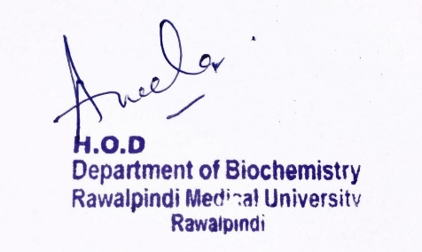
Respiratory Module 1st Year MBBS(LGIS)
RESPIRATORY MODULE P STRY pH Regulation & Buffers pH REGULTION, BUFFERS
Presenter: Dr Raja Khalid Yaqub Date: -0-25
Deptt of Biochemistry
RMU

Slide 4
Professor Umar Model of Integrated Lecture

Slide 5
Learning Objectives
At the end of this session student should be able to:
Discuss the pH
Importance of pH
Buffers and its Types
How buffers regulate the pH
Explain & correlate the clinical aspects of the core concept.
MCQ’s regarding pH
Appreciate term Beneficence (Bioethics)
Correlate and build core knowledge on the basis of latest research

Slide 6
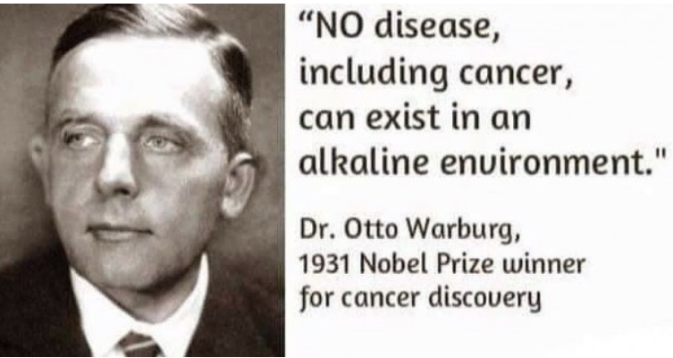
Core Knowledge

Slide 7
Core Knowledge

Slide 8
Core Knowledge

Slide 9
Core Knowledge

Slide 10
Core Knowledge

Slide 11
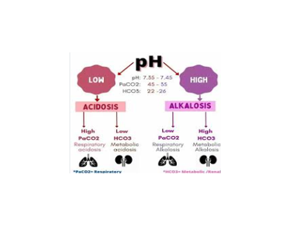
Core Knowledge

Slide 12
Core Knowledge

Slide 13
Core Knowledge

Slide 14
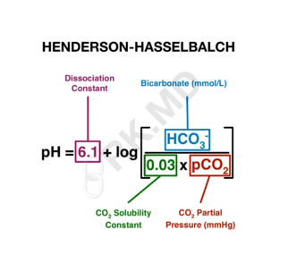
Core Knowledge

Slide 15
Core Knowledge

Slide 16
Core Knowledge

Slide 17
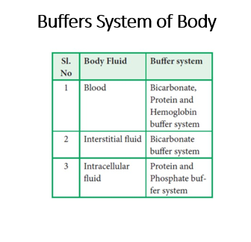
Core Knowledge

Slide 18
Core Knowledge

Slide 19
Core Knowledge

Slide 20
Role of Lungs & Kidneys
Horizontal Integration

Slide 21
Core knowledge

Slide 22
Core knowledge

Slide 23
Hb Buffer System
Core knowledge

Slide 24
Hemoglobin Buffer System
Core knowledge

Slide 26
Phosphate Buffer System

Slide 27
Respiratory Acid Base Control Mechanism
Core knowledge

Slide 28
Core knowledge

Slide 29
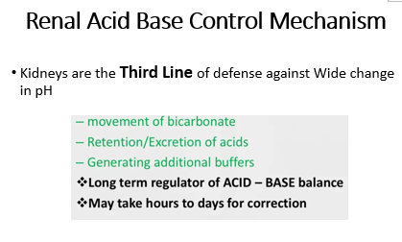
Core knowledge

Slide 31
How To Access Digital Library
Steps to Access HEC Digital Library
Go to the website of HEC National Digital Library.
On Home Page, click on the INSTITUTES.
A page will appear showing the universities from Public and Private Sector and other Institutes which have access to HEC National Digital Library HNDL.
Select your desired Institute.
A page will appear showing the resources of the institution
Journals and Researches will appear
You can find a Journal by clicking on JOURNALS AND DATABASE and enter a keyword to search for your desired journal.

Slide 32
Learning Resources
Lippincott Illustrated Reviews – Biochemistry – Eighth Edition, chap- 17, pages
Essentials of Medical Biochemistry by Mushtaq Ahmed. Ninth edition, Vol 1, chapter 2, pages 55-57.
Harper’s Illustrated Biochemistry 32nd Edition
Google Scholar
Google Images

