Slide 1
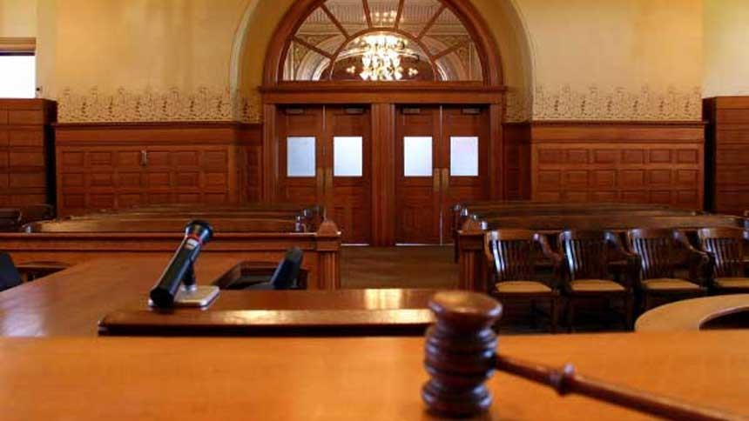
QISAS AND DIYAT ORDINANCE 1991
Dr Filza ali Dr Urooj

Slide 2
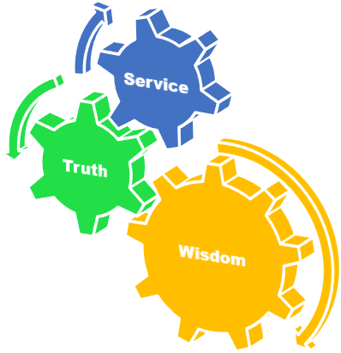
Motto of RMU

Slide 3
Vision of RMU
The Dream/ Tomorrow
To impart evidence based research oriented medical education
To provide best possible patient care
To inculcate the values of mutual respect and ethical practice of medicine

Slide 4
Prof Umar’s LGIS model

Slide 5
SEQUENCE OF LGIS
Learning Objectives
Core concept 70 %
Horizontal integration related to Pathology and Pharmacology 15 %(if applicable)
Relevant clinical concepts and medico legal application of core knowledge / Vertical integration 10%
Research article relevant to the topic 3%
Ethics and family medicine 2%

Slide 6
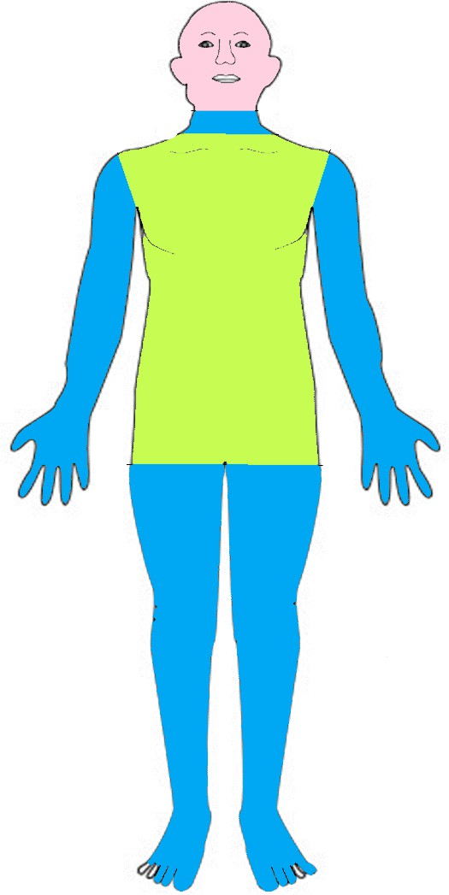
SHAJJAH
Core Concept
JURH JAIFAH
JURH GHAYR JAIFAH

Slide 7
JURH
Hurt on parts of the body other than head and face, which leaves a mark of the wound which may be permanent or temporary.
Core Concept
Jaifah: Wound extending to the body cavities of
the trunk.
Ghayr Jaifa: Jurh not amounting to Jaifa.
6

Slide 8
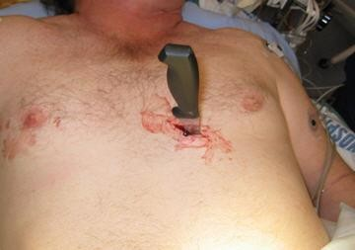
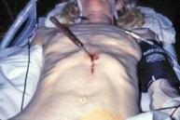
Jaifah: Wound extending to the body cavities of the trunk.
Core Concept

Slide 9
Ghayr Jaifah
Core Concept
Damiyah: Rupturing of skin with bleeding.
Badiaah: Cutting/incising of flesh without exposing bone.
Mutalahimah: Laceration of flesh.
Mudihah: Exposing of bone.
Hashimah: Fracturing of bone without dislocation.
Munaqqilah: Fracturing of bone with its dislocation.
8

Slide 10
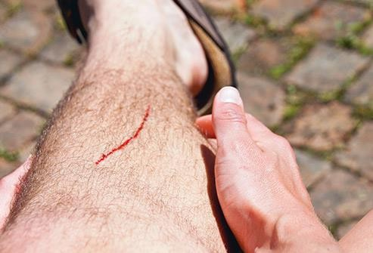
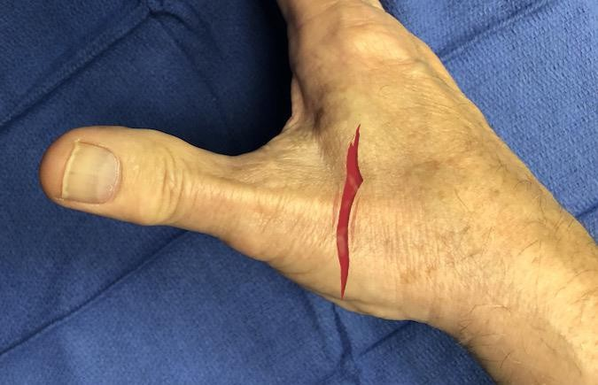
Damiyah: Rupturing of skin with bleeding.
Core Concept

Slide 11
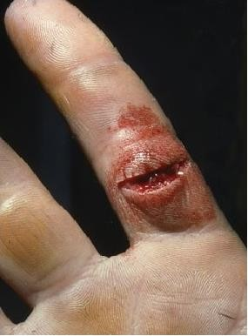
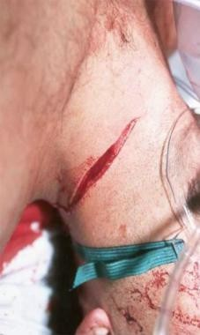
Badiaah: Cutting/incising of flesh without exposing bone.
Core Concept

Slide 12
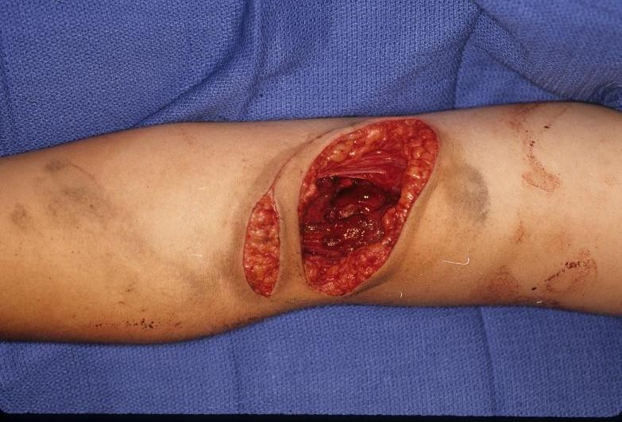
Mutalahimah: Laceration of flesh.
Core Concept

Slide 13
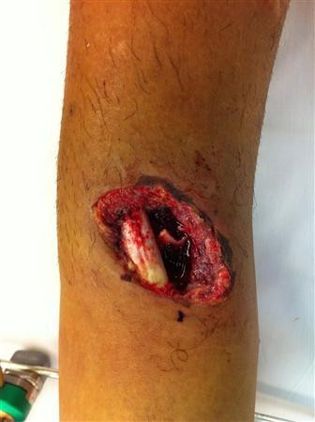
Core Concept
Mudihah: Exposing of bone.
Tibia

Slide 14
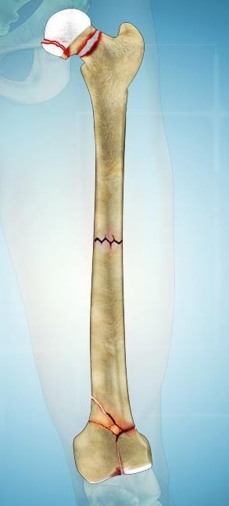
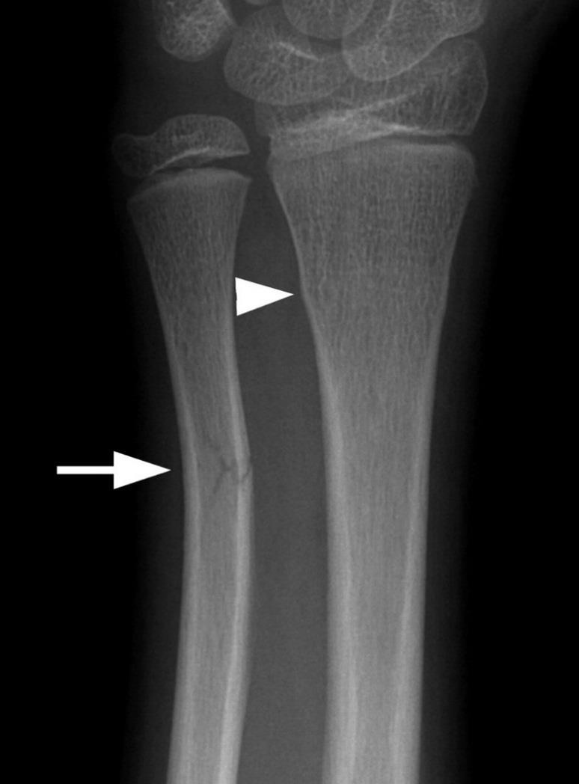
Hashimah: Fracturing of bone without dislocation.
Core Concept

Slide 15
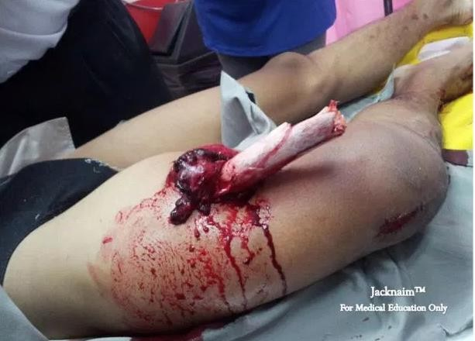
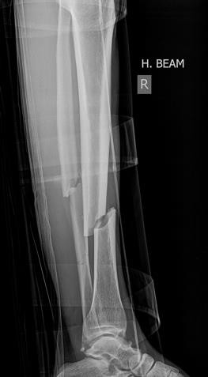
Munaqqilah: Fracturing of bone with its dislocation.
Core Concept

Slide 16
Core Concept
Damiyah
JAIFA
Badiaah
JURH
Mutalahimah
Mudihah
GHAIR JAIFA
Hashimah
Munaqqilah
15

Slide 17
e) OTHER KINDS OF HURT:
Core Concept
Hurt by Rash or Negligent Driving…….337 G
Hurt by Rash or Negligent act…….337 H
Hurt by Mistake (Khata)……..337 I
Hurt by means of Poison……..337 J
337 L 1 ….. Whoever causes hurt,in which the sufferer remains in severe bodily pain for twenty day or more or renders him unable to follow his ordinary pursuits for twenty days or more,
shall be liable to daman and also be punished with imprisonment of either description for a term which may extend to 7 years.
337 L 2 Whoever causes hurt not covered by sub-section shall be
punished with imprisonment of either description for a term
which may extend to 2 years or with daman or with both.

Slide 18
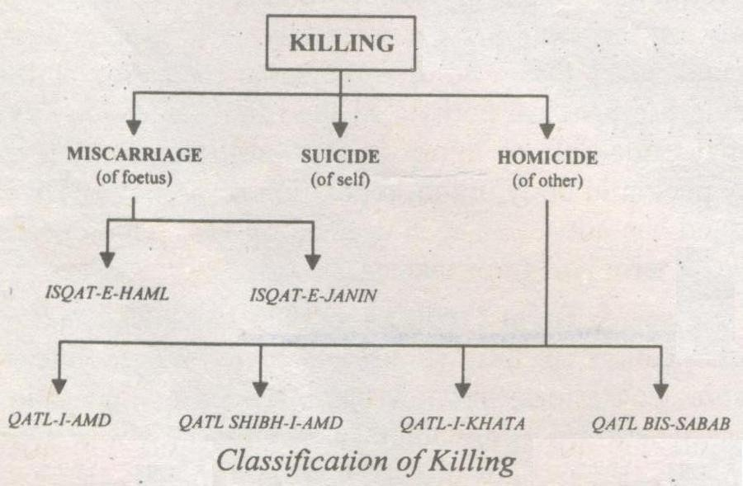
Core Concept
17

Slide 19
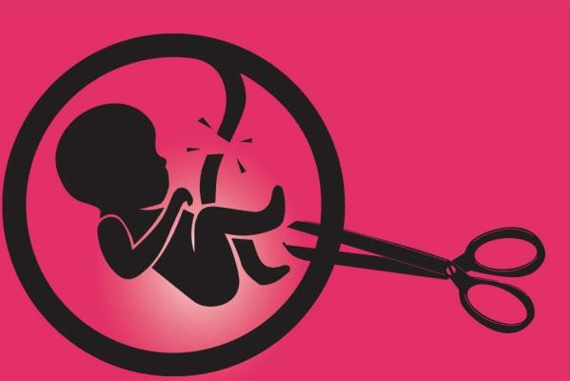
A: MISCARRIAGE: Killing of fetus
Core Concept
i. Isqat-I-Haml
Causing a woman with child whose organs have not been formed, to miscarry, without good faith for the purpose of saving life of the woman or providing necessary treatment.
*Isqat means Abortion
18

Slide 20
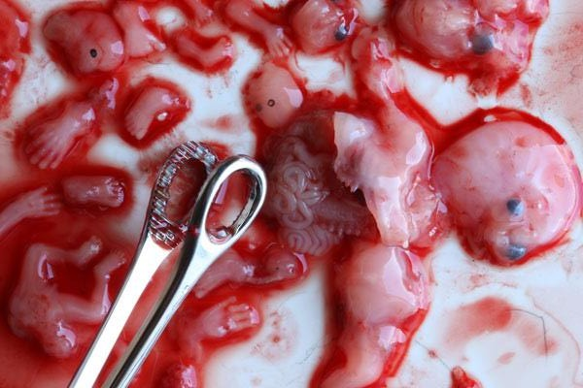
ii. Isqat-I-Janin
Core Concept
Causing a woman with child some of whose limbs or organs have been formed to miscarry, without good faith for the purpose of saving the life of the woman.
19

Slide 21
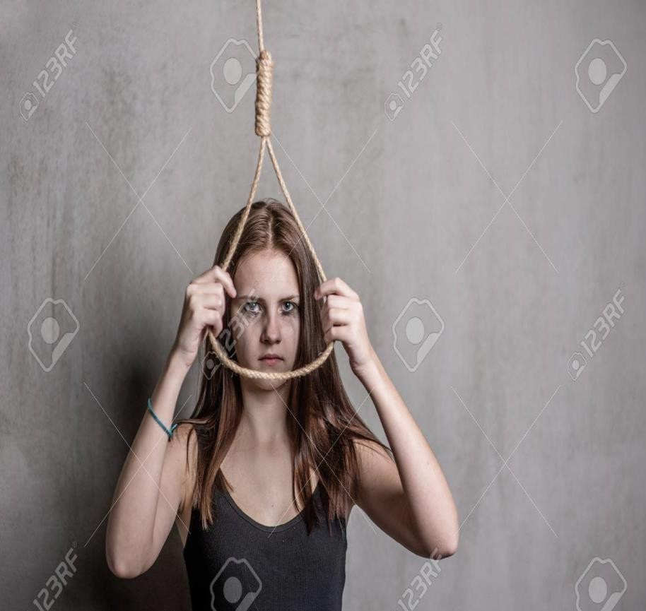
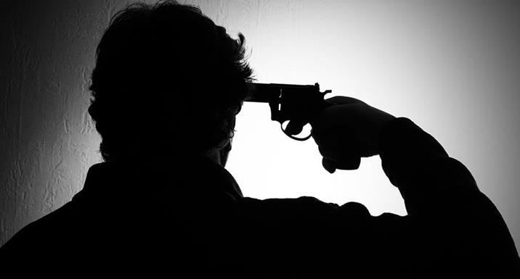
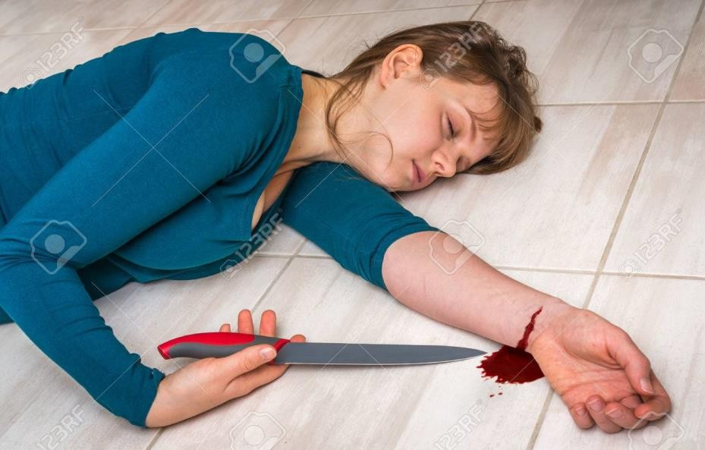
B: SUICIDE:
Core Concept
Killing of self

Slide 22
C: HOMICIDE: Killing of others
Core Concept
Qatl (homicide)
The killing of a human being by another human being.
Types:
Culpable
Non-Culpable
killing of a human being having a blame
Killing of human being without having a blame
justifiable e.g judicial hanging, Police killing
excusable
e.g Self defence
21

Slide 23
Kinds of Qatl: (culpable)
Core Concept
(I)
(II)
(III)
(IV)
Qatl-i-Amd (intention) Qatl Shibh-i-Amd (cause harm)
Qatl-i-Khata Qatl- Bis- Sabab
( Mistake of act or fact) (unlawful act)
22

Slide 24
Qatl-i-Amd:
Core Concept
Killing of human being with intention and knowledge of causing death.
Qatl Shibh-i-Amd:
Killing of human being with intention only to harm but death occurs which is unlikely.
23

Slide 25
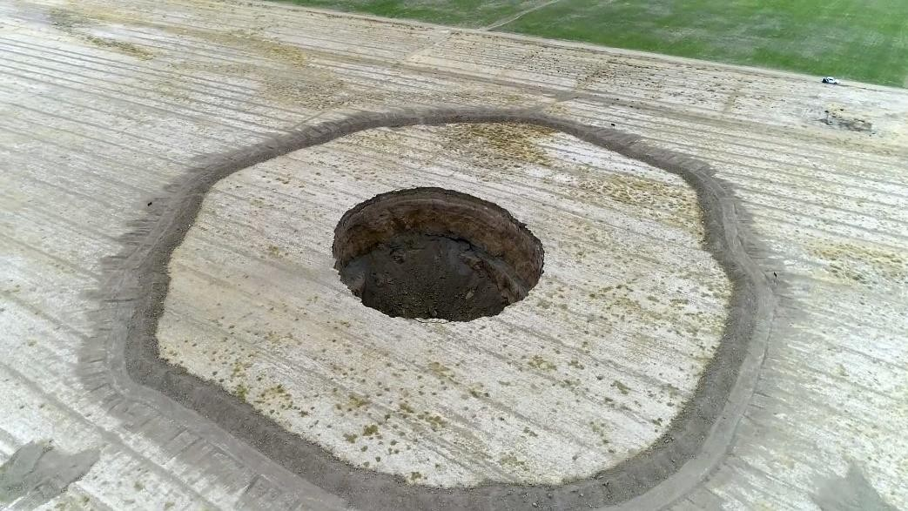
Qatl-i-Khata:
Killing of human being without any intention to kill or harm but death occurs by mistake of act or fact.
Core Concept
Qatl-Bis-Sabab:
Killing of human being without intention to cause harm
or death, but death occurs
during the course of an unlawful act.
24

Slide 26
RESEARCH
Research
https://www.amnesty.org/en/documents/asa33/004/19 91/en/
https://www.jstor.org/stable/26843905
https://www.ayubmed.edu.pk/JAMC/24-3/Iftikhar.pdf

Slide 27
The 4 basic ethical principles of
ETHICS
Beneficence
Non-Maleficence
Respect for autonomy
Justice
https://brill.com/previewpdf/book/978904742572 4/Bej.9789004172258.i-408_005.xml
BIOMEDICAL ETHICS

Slide 28
FAMILY MEDICINE
FAMILY MEDICINE
How to Approach a patient with Injuries ?
As a general physician it is obligatory to note down the details of each injury
The details and facts noted should be accurate
All injuries relevant to assault or of medico-legal significance should be notified to the
authorities & Police .
In the receiving hospital emergency room the priorities of emergency care, investigations and the indications for transfer of the patient to another facility plays important role.

Slide 29
How to use HEC Digital Library
Go to the website of HEC National Digital Library
http://www.digitallibrary.edu.pk
On Home Page, click on the INSTITUTES.
A page will appear showing the universities from Public and Private Sector and other Institutes which have access to HEC National Digital Library (HNDL).
Select your desired Institute.
A page will appear showing the resources of the institution
Journals and Researches will appear
You can find a Journal by clicking on JOURNALS AND DATABASE and enter a keyword to search for your desired journal

Slide 30
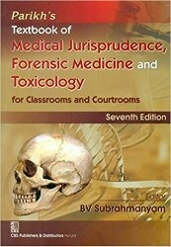
TEXT BOOKS & PRACTICAL NOTEBOOK:
Principles & Practice of Forensic Medicine.
by Nasib R. Awan
Parikh’s Textbook of Medical Jurisprudence,
Forensic Medicine & Toxicology.
Practical Manual Of Forensic Medicine
& Toxicology

