Slide 1
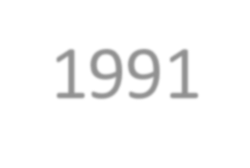
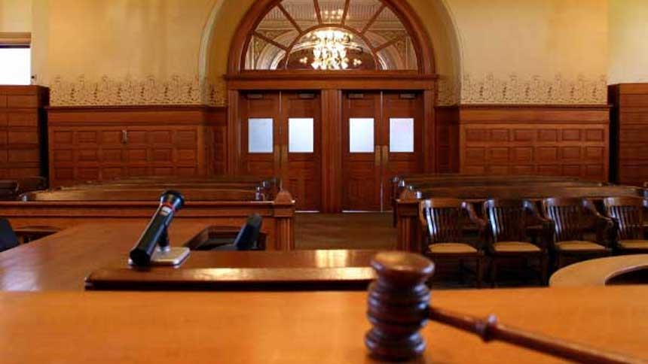
QISAS AND DIYAT ORDINANCE 1991
Dr Filza ali & Dr Naila

Slide 2
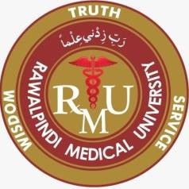
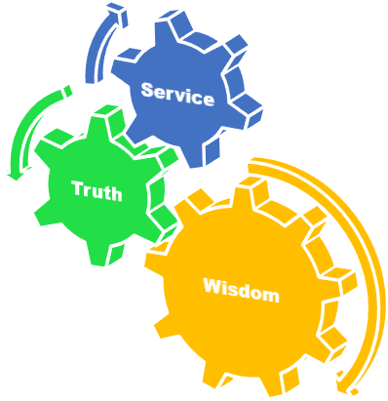
Motto of RMU

Slide 3
Vision of RMU
The Dream/ Tomorrow
To impart evidence based research oriented medical education
To provide best possible patient care
To inculcate the values of mutual respect and ethical practice of medicine

Slide 4
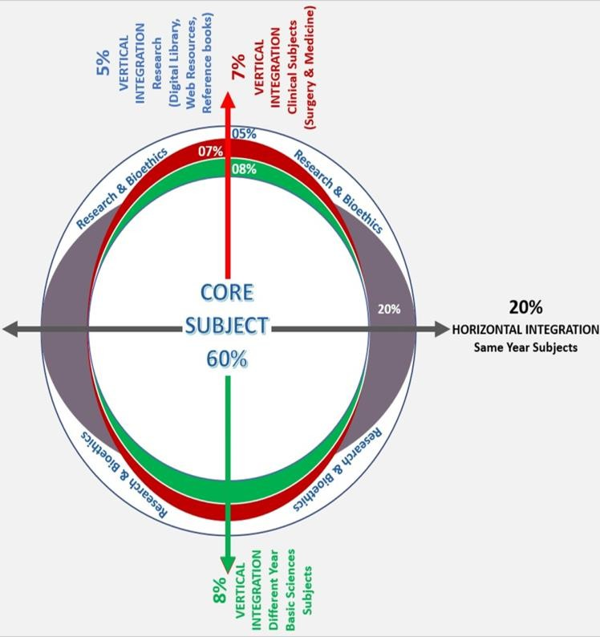
Prof Umar’s LGIS model

Slide 5
SEQUENCE OF LGIS
Learning Objectives
Core concept 70 %
Horizontal integration related to Pathology and Pharmacology 15 %(if applicable)
Relevant clinical concepts and medico legal application of core knowledge / Vertical integration 10%
Research article relevant to the topic 3%
Ethics and family medicine 2%

Slide 6
Core Concept
Qisas and Diyat Ordinance was made by the President of Pakistan in 1991, according to “Holy Quran and Sunnah”.
Now it has become a Law, as it is passed by the Parliament of Pakistan.

Slide 7
PUNISHMENTS
Core Concept
The punishments to which offenders are liable under the provisions of Pakistan Penal Code are:
Qisas
Diyat
Arsh
Daman
Tazir
Death
Imprisonment for life
Imprisonment which is of two description:
Rigorous i.e. with hard labor
Forfeiture of property
ii. Simple
10. Fine

Slide 8
Arsh: Compensation for causing hurt specified by law, to be paid by the offender to the victim or his heirs.
Core Concept
Daman: compensation for causing hurt not liable to Arsh, to be determined by the court and to be paid by the offender to the victim or his heirs.
7

Slide 9
Diyyat: Compensation for causing death which is specified in law payable to the heirs of the victim, by offender.
Core Concept
Value of Diyyat is determined according to the status and financial position of the convict, but it must not be less than 30,630 grams of silver. Price of 1gm of silver is fixed by State Bank Of Pakistan on 1st of July every year.
Qisas: Punishment by causing
Similar hurt at same part of body, of convict, as he has caused to victim.
Death if he has committed Qatl e Amd.
8

Slide 10
HURT ………………..Sec. 332
Core Concept
Whoever causes pain, harm, disease,
infirmity or injury to any person or
impairs, disables or dismembers any
organ of the body or part thereof of
any person without causing his death, is said to cause HURT.
Kinds of Hurt:
Itlaf-i-udw
Itlaf-i-salahiyyat-i-udw
Shajjah
Jurh
all kinds of other hurts
9

Slide 11
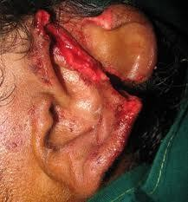
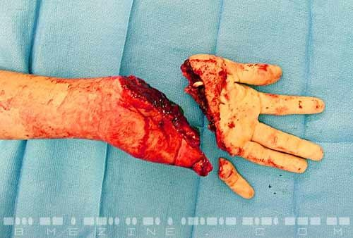
Itlaf-e-udw: Causing of dismemberment, amputation, severement of any limb or organ of the body of another person.
Core Concept
10

Slide 12
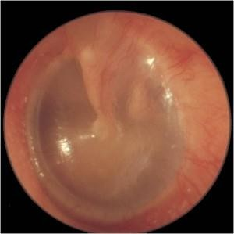
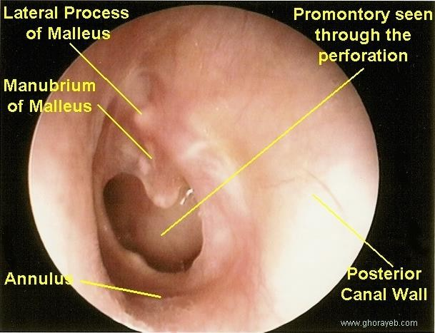
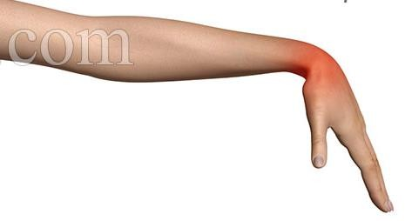
Itlaf-e-salahiyat e udw: Destroying or permanent impairing the function or capacity of an organ of the body or causing permanent disfigurement of another person.
Core Concept

Slide 13
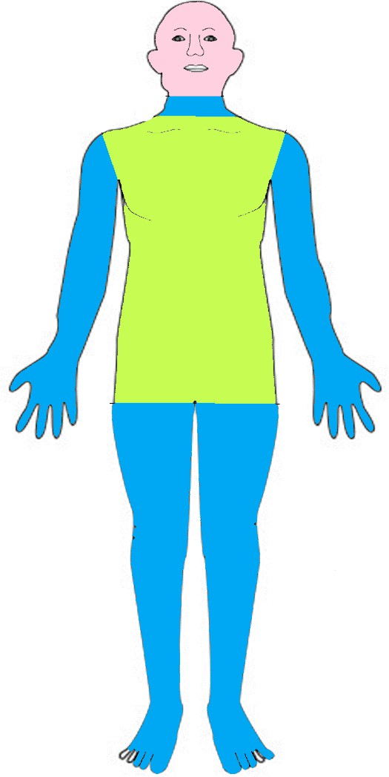
SHAJJAH
Core Concept
JURH JAIFAH
JURH GHAYR JAIFAH

Slide 14
SHAJJAH
Hurt on head or face which does not amount to Itlaf-e-Udw or Itlaf-e-Salahiyat-e-udw.
Core Concept
Shajjah-e- Khafifah: Hurt without exposing bone.
Shajjah-e- Mudihah: Exposing bone without its fracture.
Shajjah-e- Hashimah: Fracture of bone without dislocation.
Shajjah-e- Munnaqqilah: Fracture of bone with dislocation.
Shajjah-e- Ammah: Fracture of bone and the wound touching the membranes.
Shajjah-e- Damighah: Fracturing of bone with rupturing of the membranes ( exposing the brain)
13

Slide 15
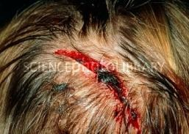
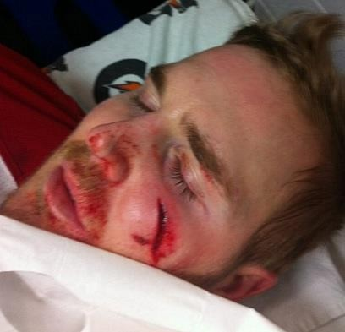
Shajjah-e- Khafifah: Hurt without exposing bone.
Core Concept

Slide 16
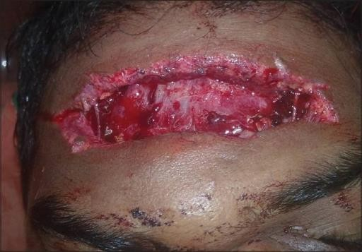
Shajjah-e- Mudihah: Exposing bone without its fracture.
Core Concept
Frontal bone

Slide 17
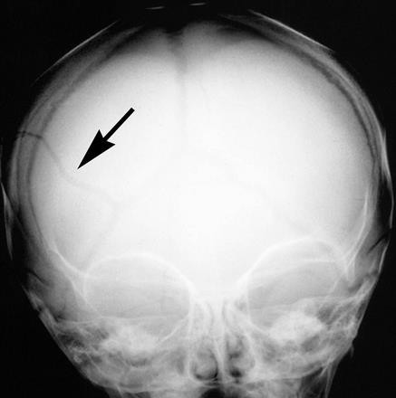
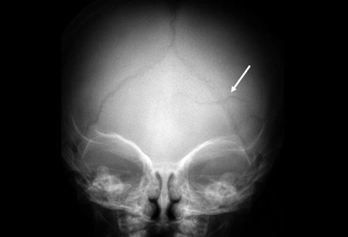
Shajjah-e- Hashimah: Fracture of bone without dislocation.
Core Concept

Slide 18
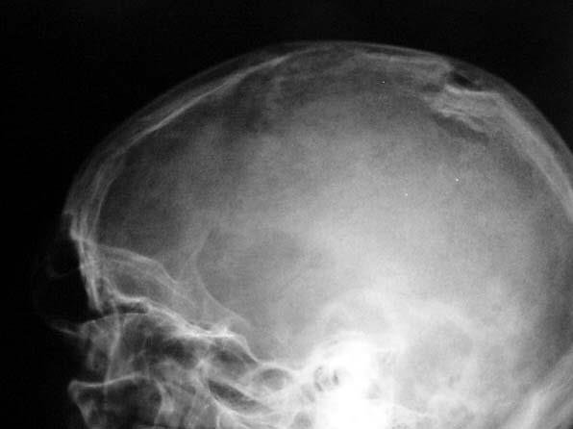
Shajjah-e- Munnaqqilah: Fracture of bone with dislocation.
Core Concept

Slide 19
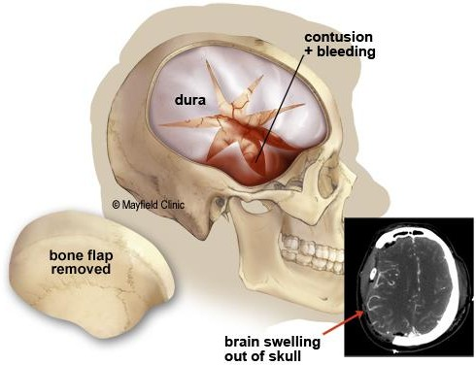
Shajjah-e- Ammah: Fracture of bone and the wound touching the membranes.
Core Concept

Slide 20
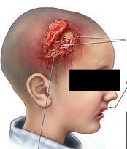
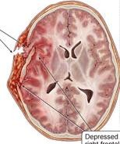
Shajjah-e- Damighah: Fracturing of bone with rupturing of the membranes ( exposing the brain)
Core Concept
Brain matter

Slide 21
SHAJJAH
Core Concept
Khafifah
Mudihah
Hashimah
Munaqqilah
Ammah
Damighah
20

Slide 22
RESEARCH
RESEARCH
https://www.amnesty.org/en/documents/asa33/004/19 91/en/
https://www.jstor.org/stable/26843905
https://www.ayubmed.edu.pk/JAMC/24-3/Iftikhar.pdf

Slide 23
The 4 basic ethical principles of
ETHICS
Beneficence
Non-Maleficence
Respect for autonomy
Justice
https://brill.com/previewpdf/book/978904742572 4/Bej.9789004172258.i-408_005.xml
BIOMEDICAL ETHICS

Slide 24
FAMILY MEDICINE
Family Medicnie
How to Approach a patient with Injuries ?
As a general physician it is obligatory to note down the details of each injury
The details and facts noted should be accurate
All injuries relevant to assault or of medico-legal significance should be notified to the
authorities & Police .
In the receiving hospital emergency room the priorities of emergency care, investigations and the indications for transfer of the patient to another facility plays important role.

Slide 25
How to use HEC Digital Library
Go to the website of HEC National Digital Library
http://www.digitallibrary.edu.pk
On Home Page, click on the INSTITUTES.
A page will appear showing the universities from Public and Private Sector and other Institutes which have access to HEC National Digital Library (HNDL).
Select your desired Institute.
A page will appear showing the resources of the institution
Journals and Researches will appear
You can find a Journal by clicking on JOURNALS AND DATABASE and enter a keyword to search for your desired journal

Slide 26
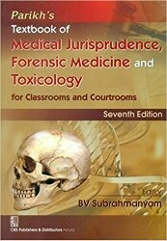
TEXT BOOKS & PRACTICAL NOTEBOOK:
Principles & Practice of Forensic Medicine.
by Nasib R. Awan
Parikh’s Textbook of Medical Jurisprudence,
Forensic Medicine & Toxicology.
Practical Manual Of Forensic Medicine
& Toxicology

