Slide 1
Biomedical Ethics
Dr.Sidra Hamid

Slide 2
Learning objectives
Islamic peculiarity of Biomedical ethics
Introduction of biomedical ethics

Slide 3
The Sayings of Holy Prphet (PBUH)
اِنَّمَا بُعِثْتُ لِأُتَمِّمَ مَکَارِمَ الْاَخْلَاقِ
میں مکارمِ اخلاق کی تکمیل کے لیے بھیجا گیا ہوں
۔(احمد)
مَنْ تَطَبَّبَ وَلَمْ یُعْلَمْ مِنْہٗ طِبٌّ فَھُوَ ضَامِنٌ (ابوداؤد)
جو آد می تجربے کے بغیر طبیب بن بیٹھا وہ (نقصان کی صورت میں) جواب دہ ہوگا۔
خیر الناس من ینفع الناس(کنز العمال: ج ۸ ص ۲۰۱، کتاب المواعظ والرقاق والخطب والحکم من قسم الافعال)

Slide 4
Biomedical ethics
Biomedical ethics are defined as:
  “The moral principles, which should guide the members of the medical profession in the course of their practice of medicine and in relationship with their patients and other members of the profession.”

Slide 5
Biomedical ethics
It is a code of conduct for the members of the medical profession in order to render the best possible services to humanity and maintain the honor and dignity of the profession.

Slide 6
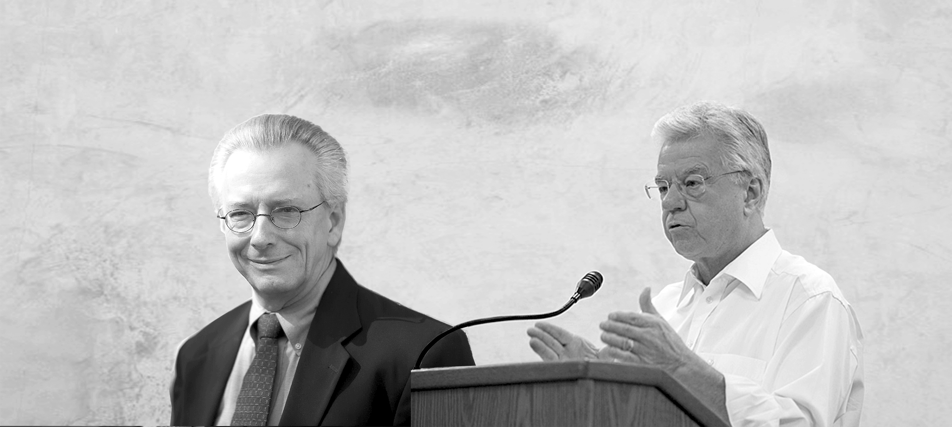
Thomas L Beauchamp (1939—present) and James F Childress (1940—present) are American philosophers, best known for their work in medical ethics.
Their book Principles of Biomedical Ethics was first published in 1985, where it quickly became a must read for medical students, researchers, and academics

Slide 7
The four principles of Beauchamp and Childress
The four principles of Beauchamp and Childress - autonomy, non-maleficence, beneficence and justice
have been extremely influential in the field of medical ethics, and are fundamental for understanding the current approach to ethical assessment in health care.

Slide 8
Non-maleficence
The principle of non-maleficence holds that there is an obligation not to inflict harm on others.

Slide 9
Example: stopping a medication known to be harmful or refusing to give a medication to a patient if it has not been proven to be effective.

Slide 10
Autonomy
Autonomy means that the patients are able to make independent decisions. This means that doctors & nurses should be sure patients have all of the needed information that is required to make a decision about their medical care and are educated. They do not influence the patient's choice.
The Right of Self-Determination or Autonomy would include the right to refuse treatment, the right to participate in research or refuse it. To exercise this right would require Informed Consent.

Slide 11
Beneficience
More commonly in medical ethics, beneficence is understood as a principle requiring that physicians provide, and to the best of their ability, positive benefits such as good health, prevent and remove harmful conditions from patients.

Slide 12
Justice
Justice in the context of medical ethics – is the principle that when weighing up if something is ethical or not, we have to think about whether it's compatible with the law, the patient's rights, and if it's fair and balanced.
Justice and fairness are used sometimes in place of each other.

Slide 13
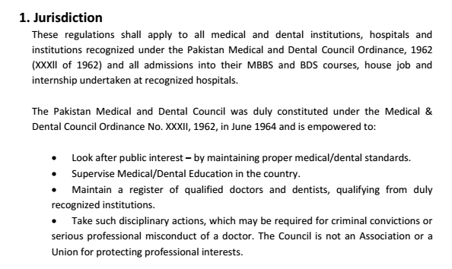
Notes:
the official power to make legal decisions and judgements.

Slide 14
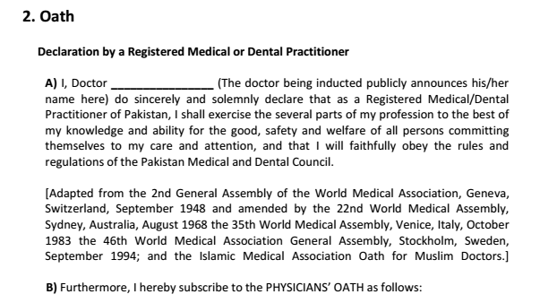

Slide 15
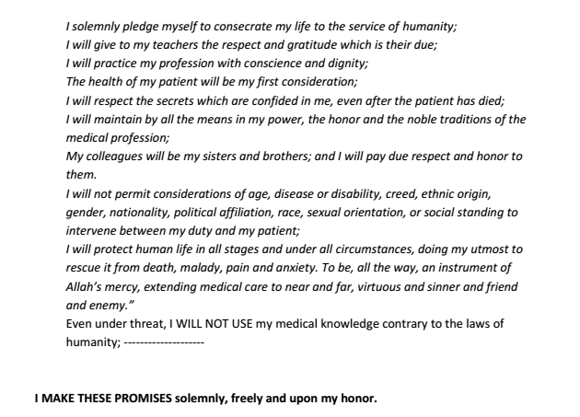

Slide 16
Major Biomedical Ethical issues
  (1) Patients’ Rights
  (2) Equity of resources
  (3) Confidentiality of the patients
  (4) Patient Safety
  (5) Conflict of Interests
  (6) Ethics of privatization
  (7) Informed Consent
  (8) Dealing with the opposite sex
  (9) Beginning and end of life
  (10) Healthcare team ethics

Slide 17


