Slide 2
Rawalpindi Medical University Main Campus

Slide 3
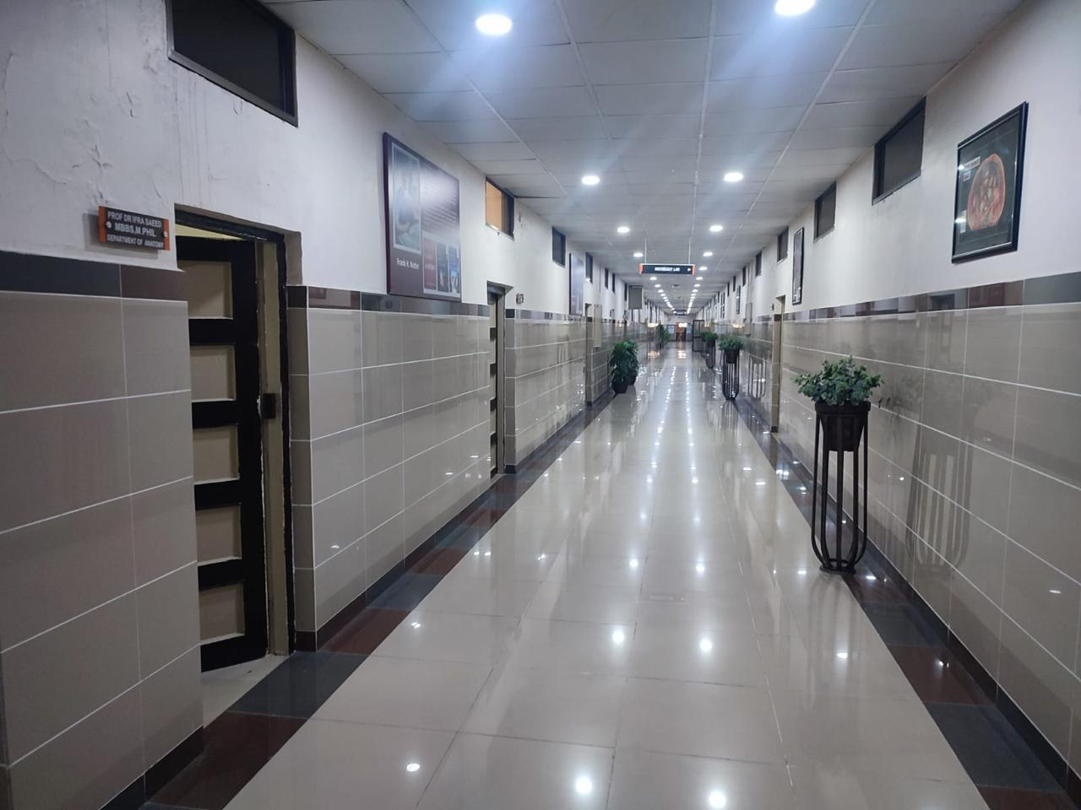
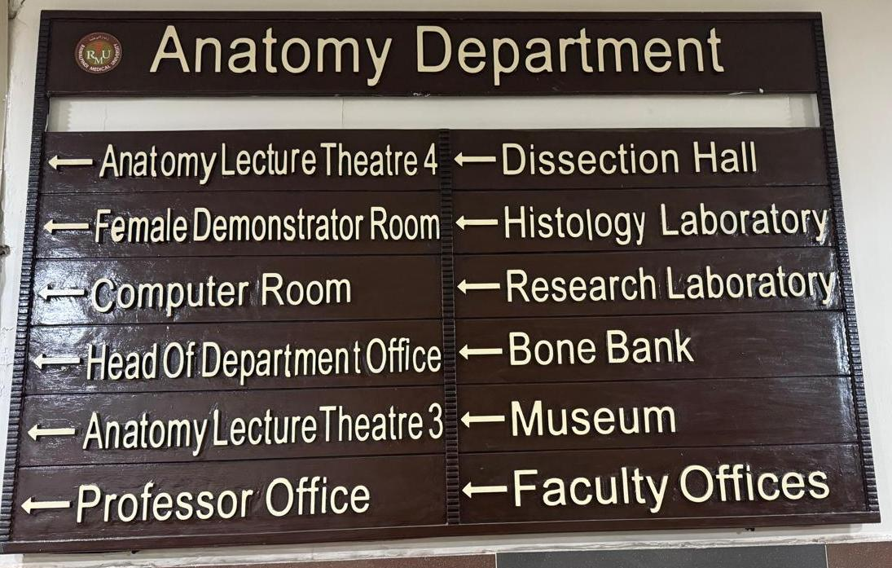
DEPARTMENT OF ANATOMY
RAWALPINDI MEDICAL UNIVERSITY
RAWALPINDI

Slide 4
Everyday I Look At Human Anatomy And Admire The Creation And Praise Oneness Of Creator

Slide 5
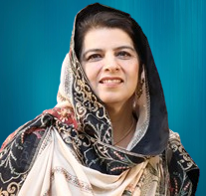
Department of Anatomy
The department caters to teaching and training of over 1200 undergraduate students in the following disciplines.
MBBS
1st Year & 2nd Year
PhD Anatomy
MPhil Anatomy
B.Sc and Allied Health Sciences
• Optometry
• Orthotics
• Doctor of physiotherapy
• Medical Imaging Technology(MIT)
• Medical Laboratory Technology(MLT)
Nursing
1st Year
Diploma in Medical Jurisprudence
(7 postgraduate students)
Prof Dr Ayesha Yousaf
MBBS, Mphil (Anatomy)
Head of Department
Dean Basic Health Sciences

Slide 6
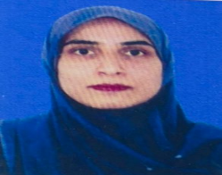
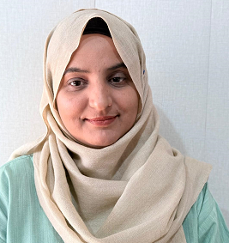
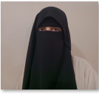
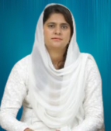
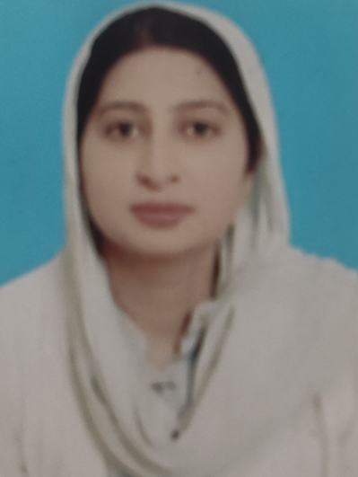
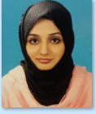
Professors
Prof Dr Ifra Saeed
MBBS, MPhil
Professor of Anatomy
Additional Director DME
Prof Dr Saima Naz
MBBS, PhD, CHPE
Professor of Anatomy
Prof Dr Ayesha Yousaf
MBBS, Mphil
Head of Anatomy Department
Dean Basic Health Sciences
Dr Arsalan Manzoor Mughal
MBBS, MPhil, MCPS-HPE, Cert Med Editing
Associate Professor of Anatomy
Co-Director MHPE, CHPE
Managing Editor JRMC
Dr Mohtashim Hina
MBBS, MPhil
Associate Professor of Anatomy
Incharge 1st Year MBBS
Dr Maria Tasleem
MBBS, MPhil
Assistant Professor of Anatomy
Incharge 2nd Year MBBS
Dr.Syeda Sara Bano
MBBS, MPhil,CHPE,ICMT, SEDA(UK), Certified Clinical Sonologist(RMU)
Assistant Professor of Anatomy
Dr.Sumyyia Bashir
MBBS, FCPS,CHPE
Assistant Professor of Anatomy
Dr.Sadia Aman
MBBS, MPhil,CHPE
Assistant Professor of Anatomy
Dr.Tayyaba Qureshi
MBBS, MPhil,CHPE
Assistant Professor of Anatomy

Slide 7
Senior Demonstrators
Dr Sajjad Hussain
MBBS
Senior Demonstrator
Dr Zeneara Saqib
MBBS
Senior Demonstrator
Dr Gaiti Ara Saeed
MBBS
Senior Demonstrator
Dr Tariq Furqan
MBBS
Senior Demonstrator
Dr Qurrat Ul Ain
MBBS
Senior Demonstrator
Dr Sadia Baqir
MBBS
APWMO
Dr Kashif Ashraf
MBBS
APMO

Slide 8
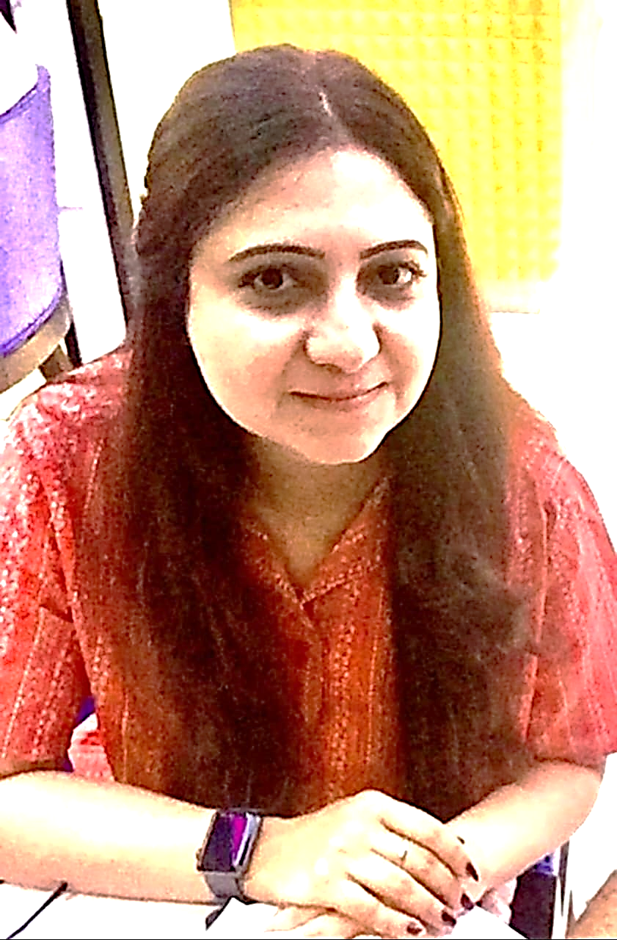
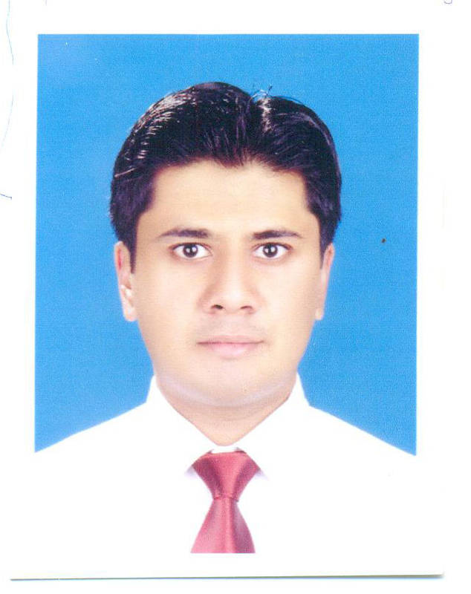
Demonstrators
Support Staff
S. No | Name | Designation
1. | Muhammad Kabir | Junior Technician
2. | Muhammad Hafeez | Lab. Attendant
3. | Muhammad Bilal | Computer operator
4. | Shahid Mehmood | Junior technician
5. | Waseem Akram | Lab. Attendant
6. | Abid Mehmood | Lab. Attendant
7. | Abdul Jabbar | Embalmer
8. | Umer Farooq | Chowkidar
9. | Shahzad Masih | Sweeper
Dr Minahil Haq
MBBS, MCPS (Radiology),
Mphil (Anatomy) , CHPE
Demonstrator
Dr Ali Raza
MBBS, MCPS (Family Medicine)
Demonstrator

Slide 9
Department of Anatomy
Vision
Center for clinically oriented human anatomy teaching, training and research for future health professionals
Mission
To train undergraduate medical and allied students at the university in clinically oriented applied anatomy.

Slide 10
Department of Anatomy
Objectives
Teach the knowledge, skill and attitudes of applied clinical anatomy to undergraduate medical students and allied health students
Develop research skills for gross anatomical, histological and embryological research.

Slide 11
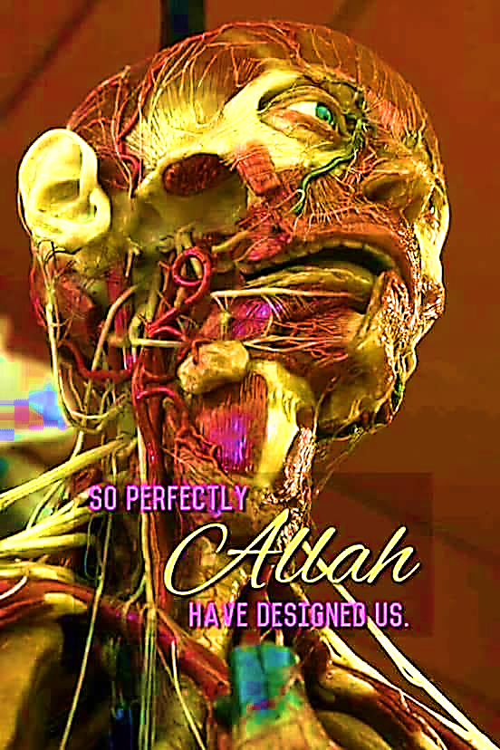
Gross
Anatomy

Slide 12
Histology

Slide 13
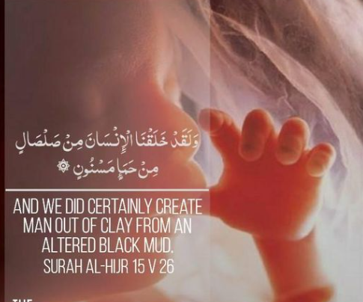
Embryology

Slide 14
Integrated Modular Curriculum
MBBS Program
1st Year MBBS
Block 1
Block 2
2nd Year MBBS
Block 1
Block 3
CVS
MSK II
Hematology & Immunity
Foundation
MSK-I
Respiration
GIT
Renal
Block 2
Reproduction
CNS
Block 3
Special Senses
Endocrinology
General Education Cluster

Slide 16
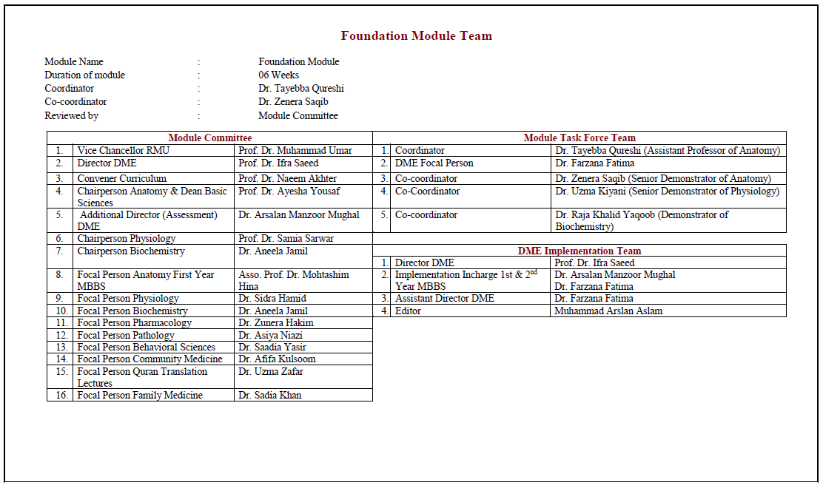

Slide 17
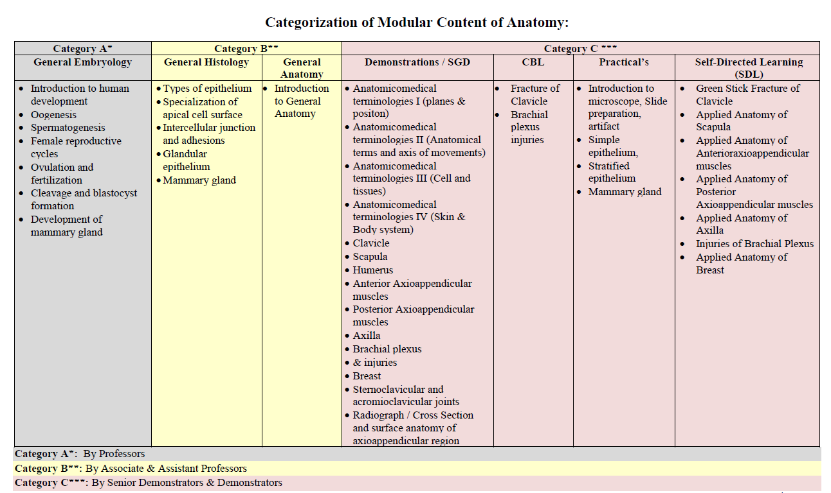

Slide 18
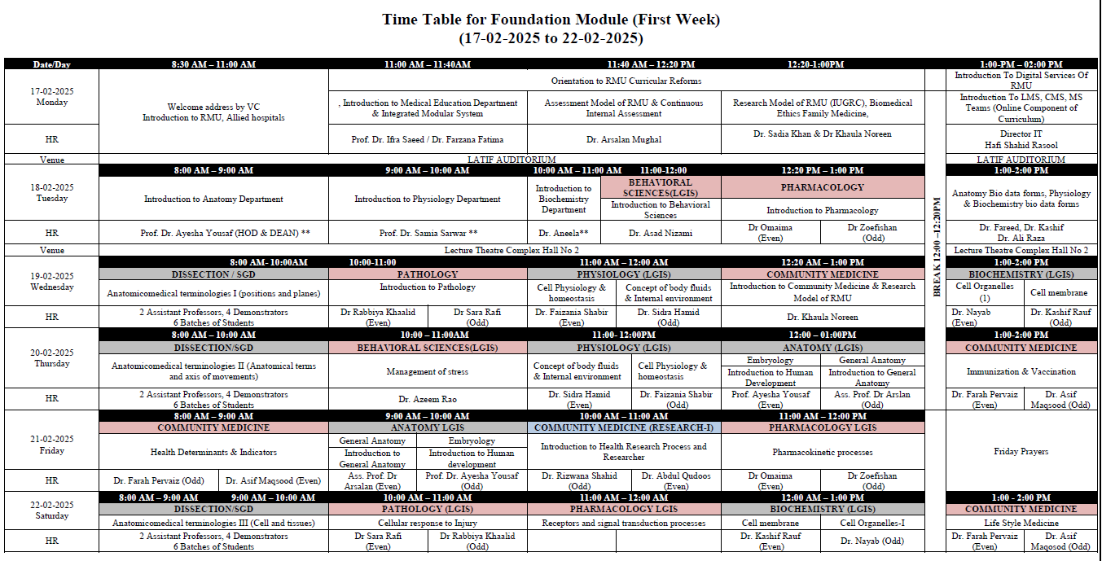

Slide 19
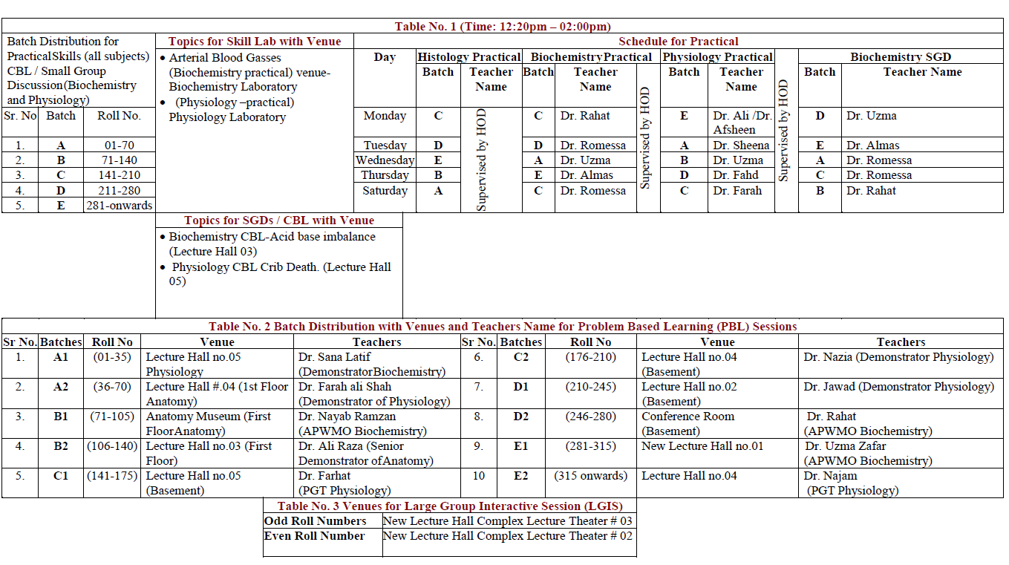

Slide 20
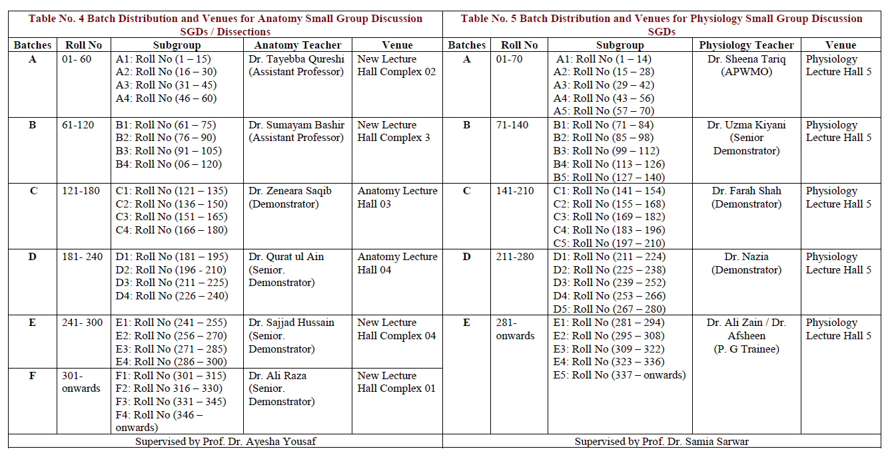

Slide 21
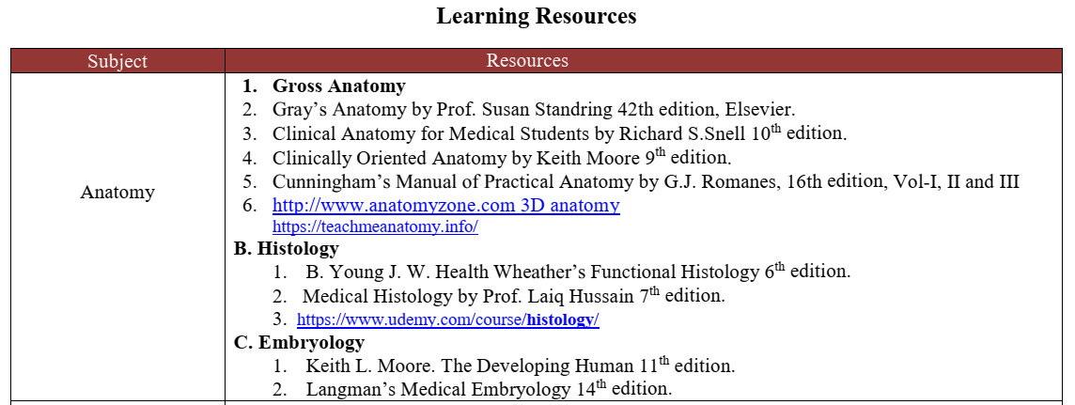

Slide 22
Anatomy Teaching Strategies
Large Group Interactive Session (LGIS)
Small Group Discussions (SGD/ Dissection)
Histology Practicals(SKILL LAB)
Case Based Learning (CBL)
Self Directed Learning (SDL)

Slide 23
Professor Umar Model of Integrated Lecture
60%
CORE SUBJECT
20%
HORIZONTAL
INTEGRATION
Physiology
biochemistry
8%
VERTICAL INTEGRATION
Pathology
pharmacology
7%
VERTICAL INTEGRATION
Clinical integration
5%
VERTICAL INTEGRATION
Research, professionalism
Ethics
Digital library

Slide 24
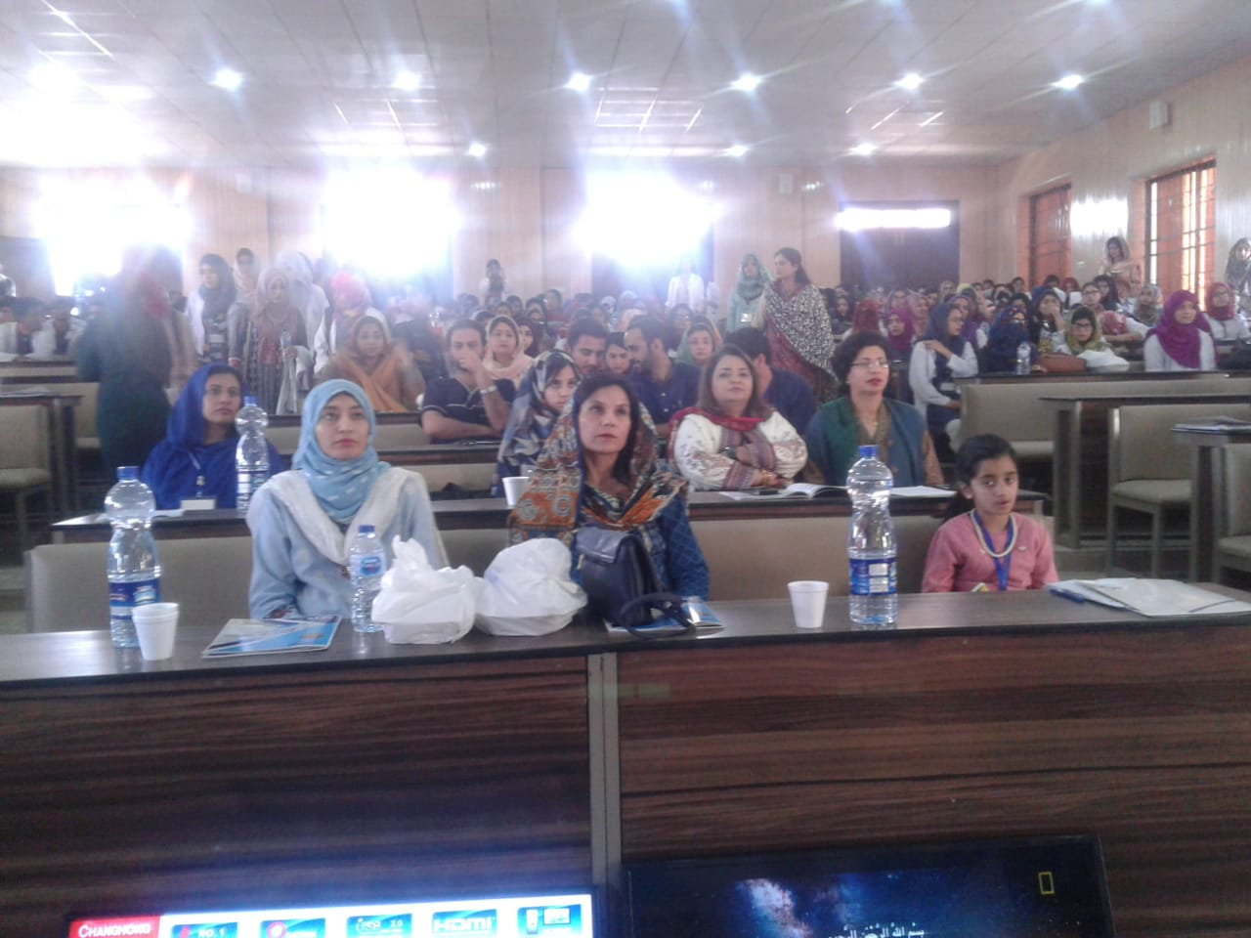
Large Group Interactive Session (LGIS)

Slide 25
LGIS Content Areas & Batches
General Embryology- Dr Ayesha Yousaf
General Histology- Dr Mohtasham Hina
General Anatomy- Dr Arsalan Manzoor Mughal
Venues for Large Group Interactive Session (LGIS) and SDL
Odd Roll Numbers | New Lecture Hall Complex Lecture Theater # 03
Even Roll Number | New Lecture Hall Complex Lecture Theater # 02

Slide 26
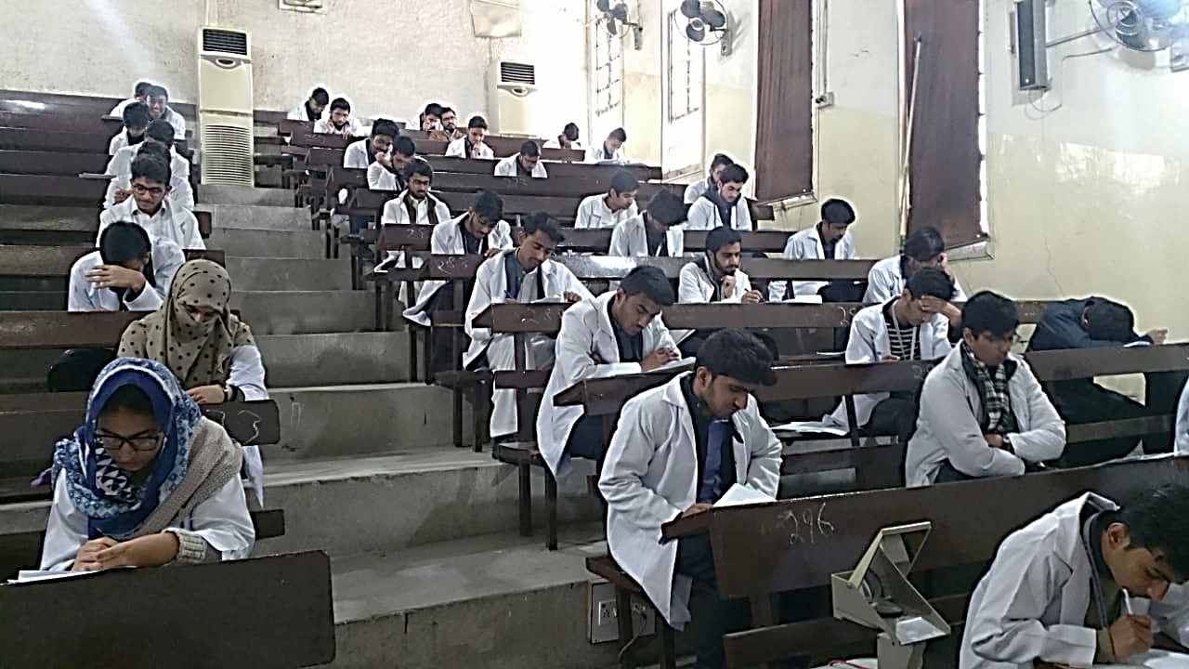
Small Group Discussions (SGD) (Dissection)

Slide 27
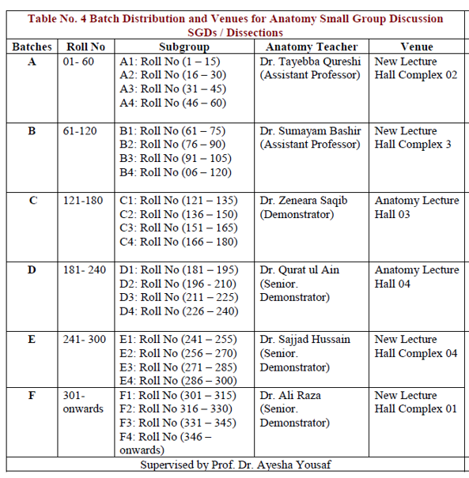
Small Group Discussion/ Dissection
Batch Distribution

Slide 28
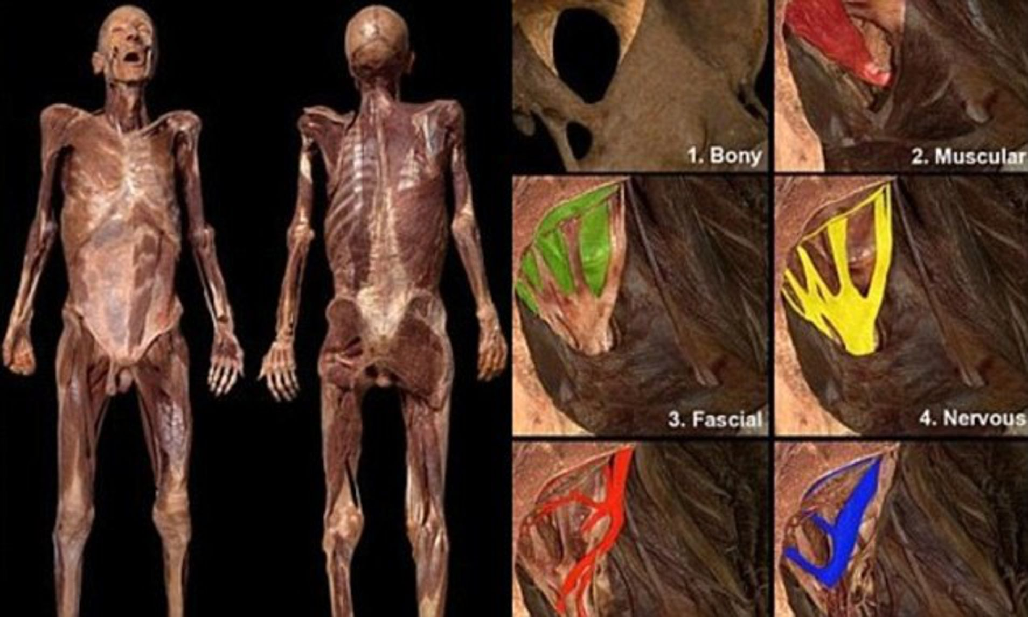
Standardization of SGD
70% Core Knowledge
10% Vertical & Spiral Integrations
20% Dissection on cadavers

Slide 29
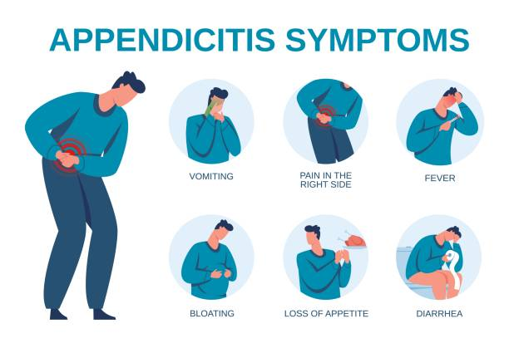
Standardization of CBL
Common clinical condition-based teaching

Slide 30
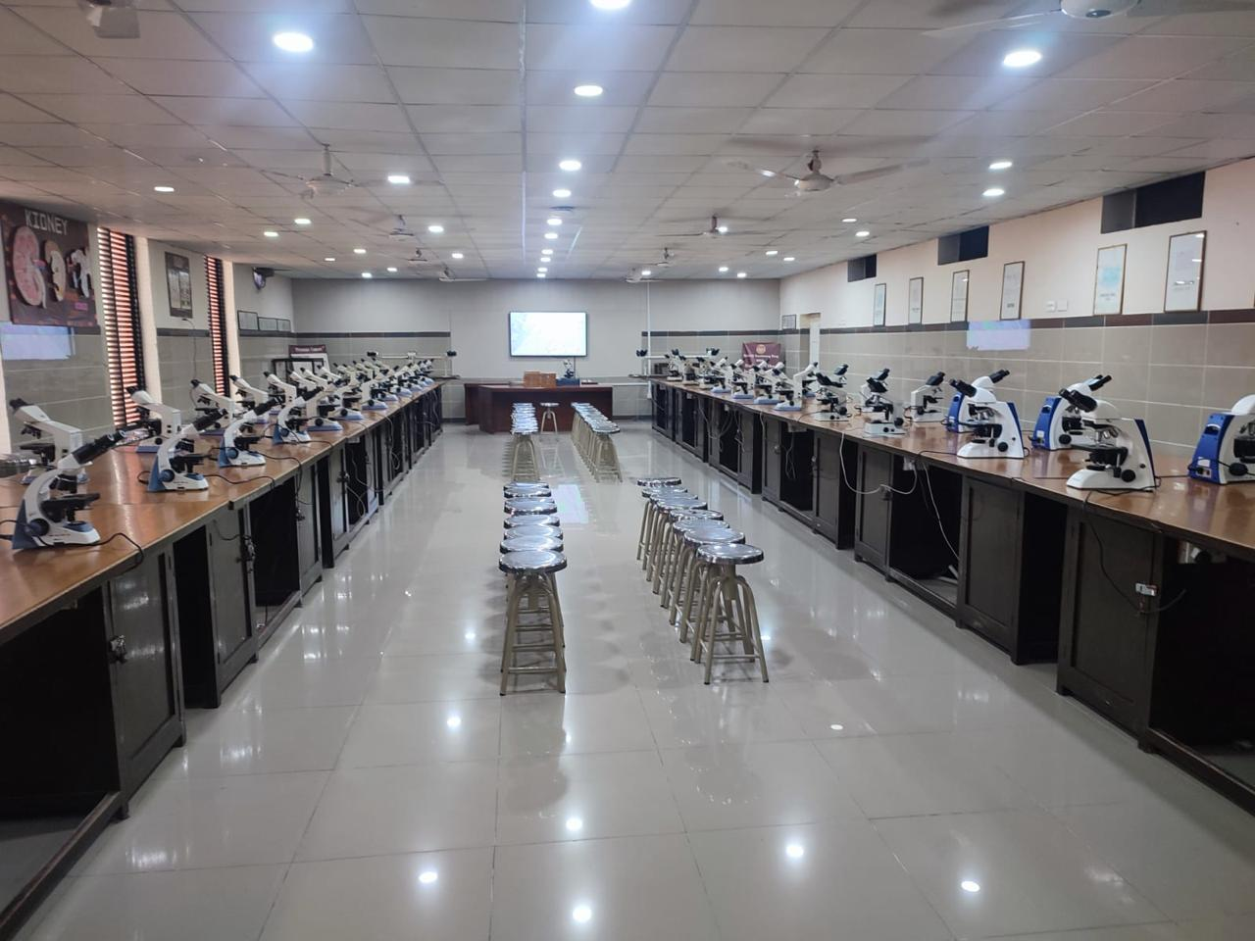
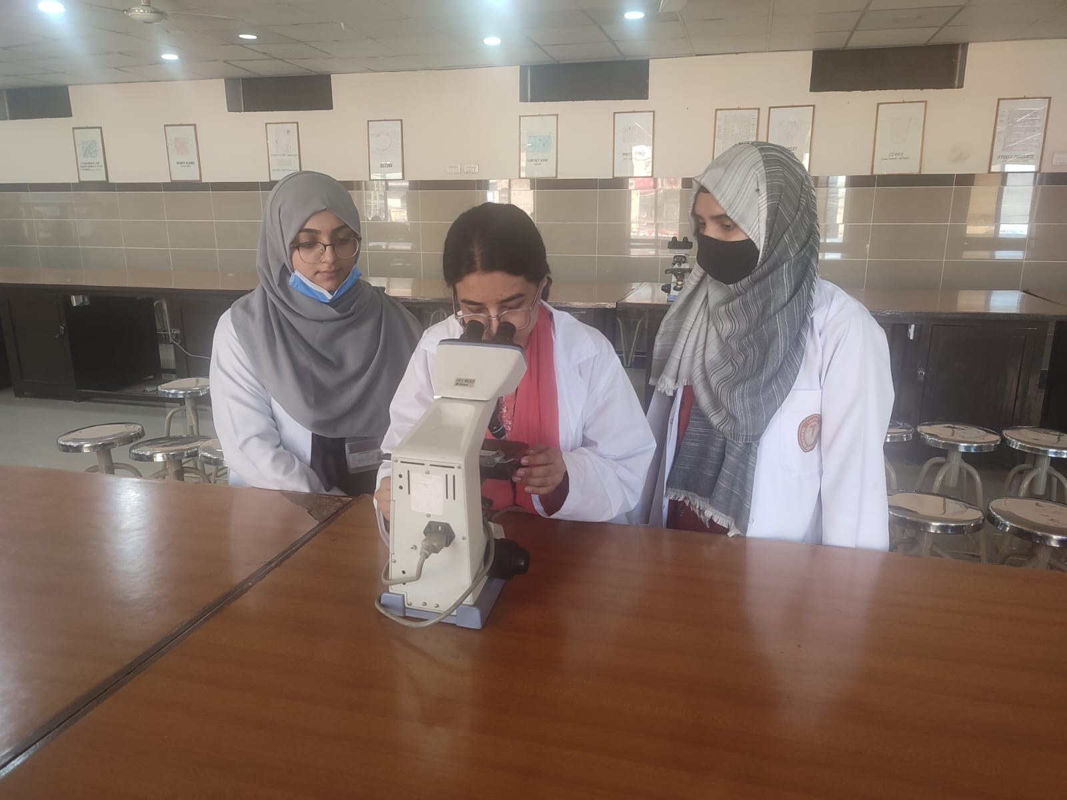
Histology Practical(Skill Lab)

Slide 31
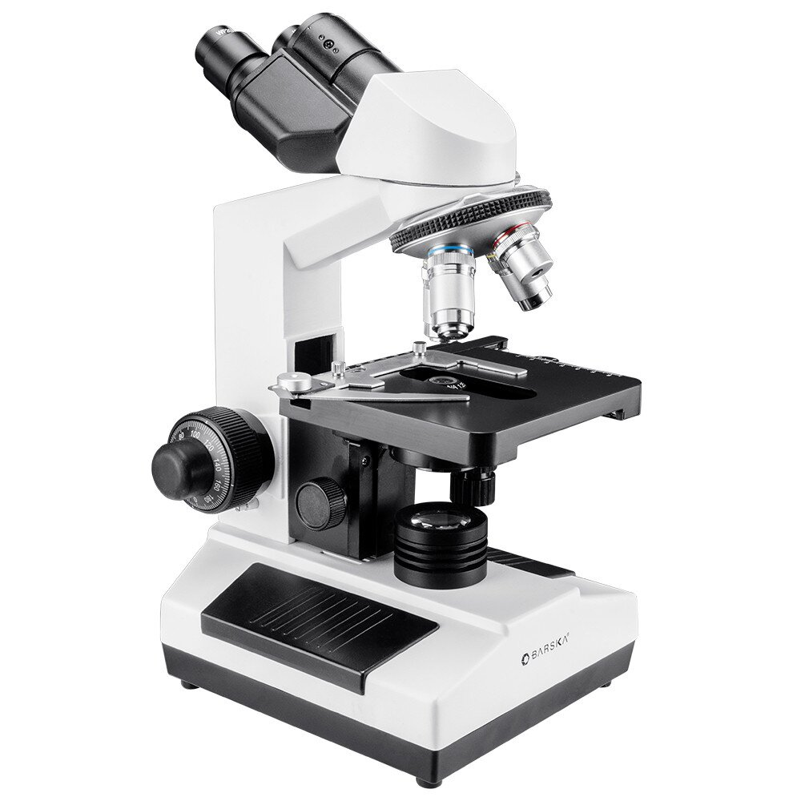
Standardization of Histology Practical
10% time for Demonstration
60% time for practical skills
20% time for drawing
10% time for checking

Slide 32
Histology Practical Batches
Schedule For Practical / Small Group Discussion
Day | Histology Practical | Biochemistry Practical | Physiology Practical | Physiology SGD | Biochemistry SGD
Monday | C (141-210) | B | E | A | D
Tuesday | D (211-280) | C | A | B | E
Wednesday | E (281onwards) | D | B | C | A
Thursday | B (71-140) | A | D | E | C
Saturday | A (1-70) | E | C | D | B

Slide 33
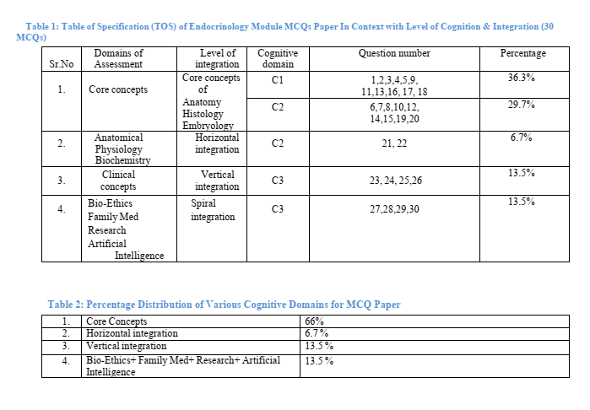
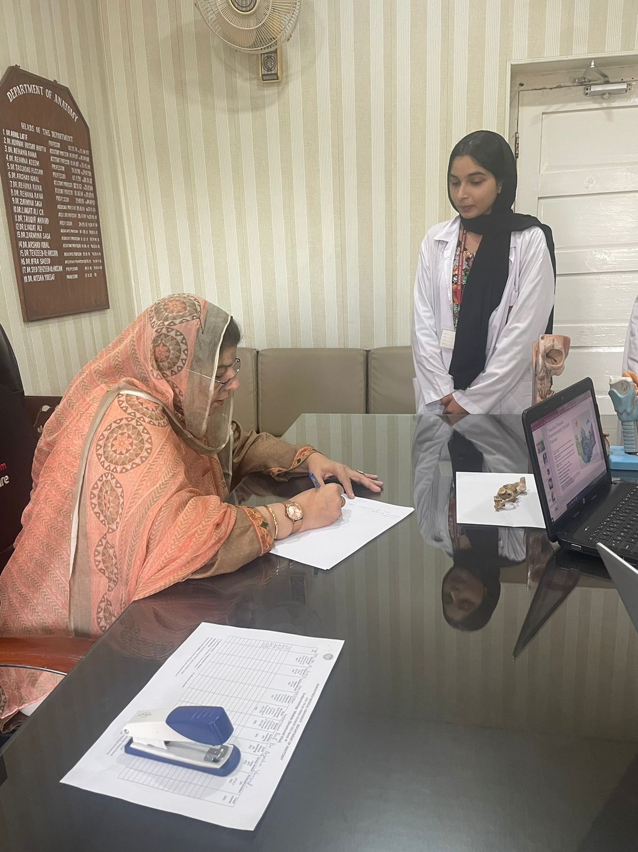
Assessment and Counseling

Slide 34
Spiral Integration
Research
Bioethics
Family Medicine
Artificial Intelligence

Slide 35
Self Directed Learning (SDL)
Topic related to SGD
Online Evaluation
30 MCQs Each on LMS(In Two Halves)

Slide 36
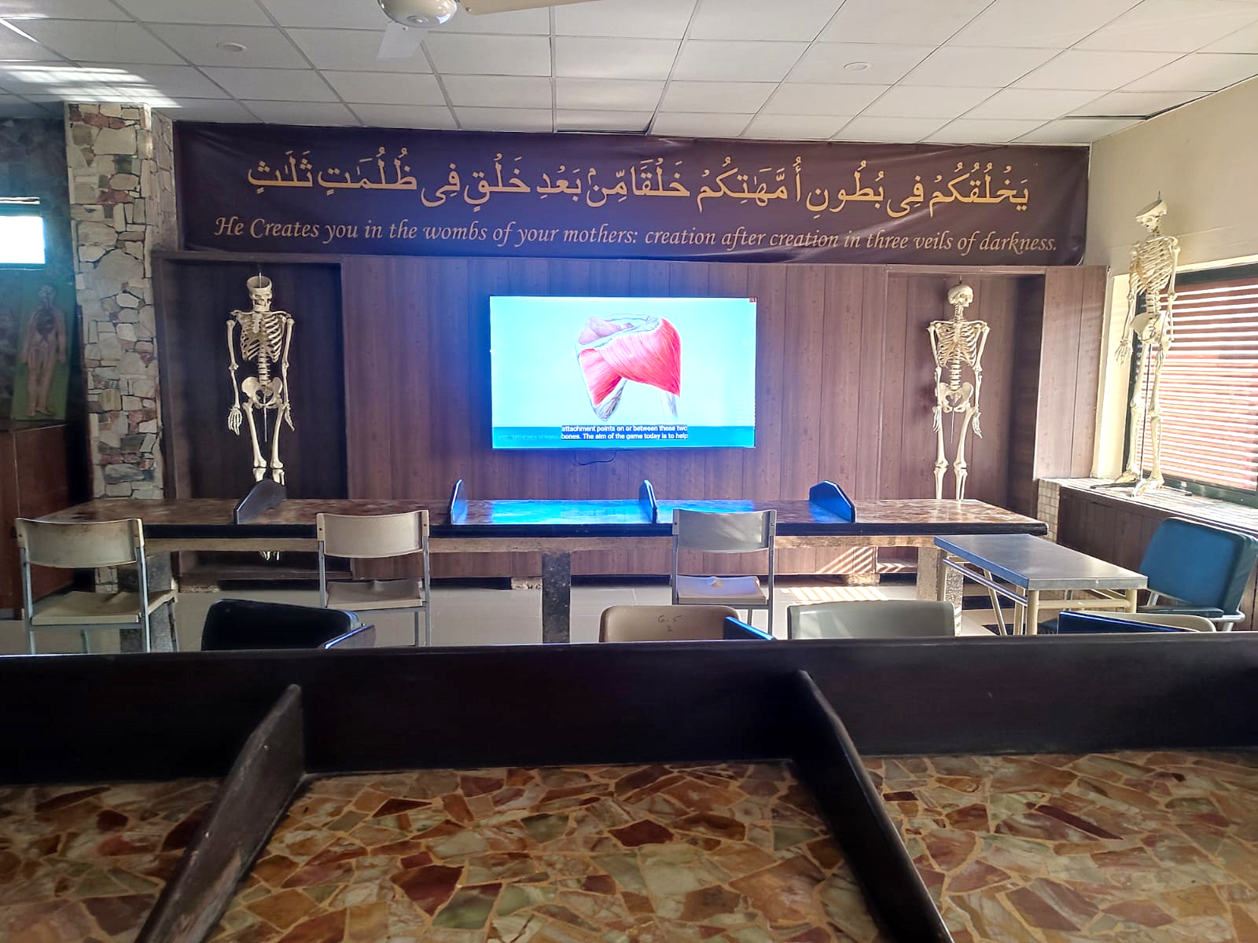
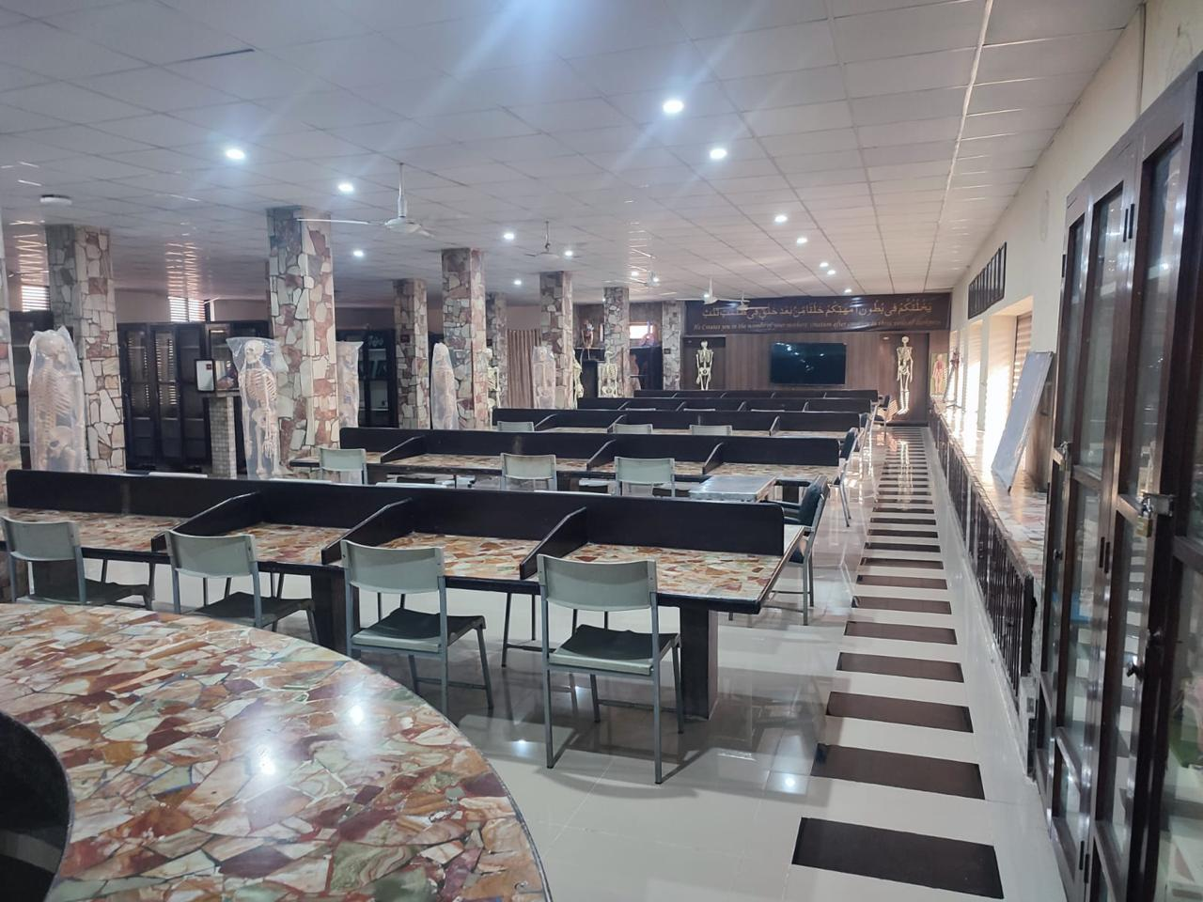
Bone Bank and Museum

Slide 37
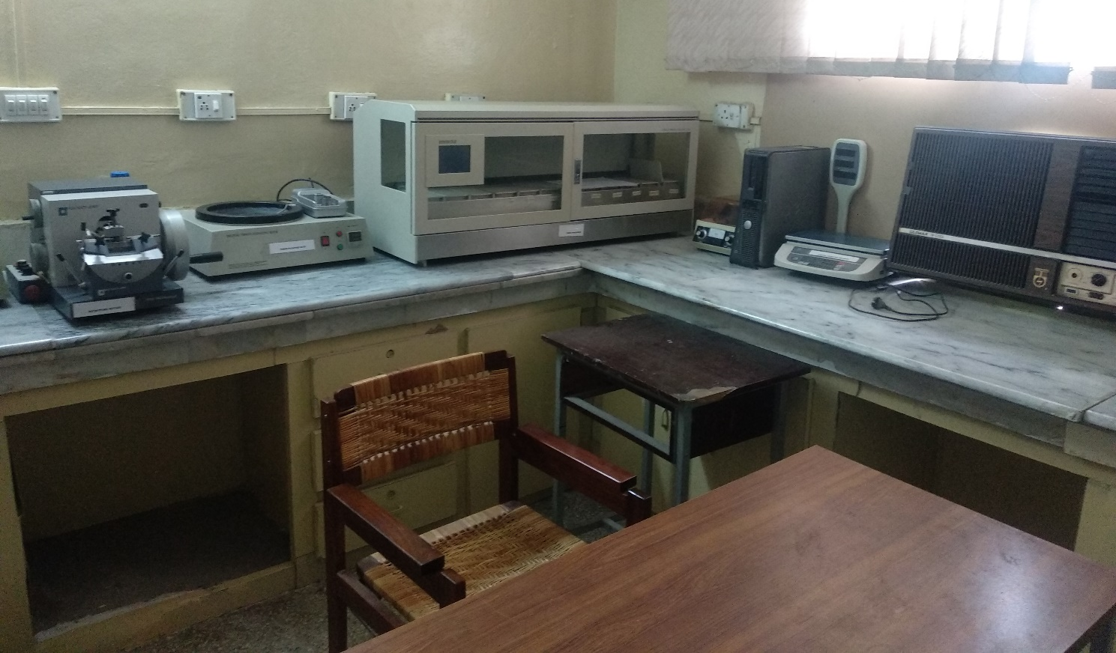
Anatomy Research Lab

Slide 38
Ongoing Research Projects
Comparison of severity of COVID-19 symptoms in vaccinated versus unvaccinated people; a retrospective cross-sectional study” by Prof Ayesha Yousaf
“Impact of Personality Traits on Educational Performance and Choice of Specialty in Undergraduate Medical Students” By Dr Arsalan Manzoor Mughal
“Are our medical educators stressed? A cross sectional study in a public sector Pakistani Medical University” by Dr Arsalan Manzoor Mughal
“Neurophobia among medical students of Rawalpindi Medical University” by Dr Arsalan Manzoor Mughal
“Undergraduate Readiness for Research at Rawalpindi Medical University in Pre-Clinical Years” by Dr Arsalan Manzoor Mughal
“Benzodiazepine Use and Misuse among Medical students in Punjab,Pakistan: Prevalence of and Motivation for Use” by Dr Maria Tasleem
“Relationship Between Attendance and Academic Performance Among Medical Students” by Dr Maria Tasleem
“Assessing Medical Students’ knowledge and perception about Health Research: Effectiveness of Research Curriculum in Rawalpindi Medical University” by Dr Gaiti Ara
“Risk factors associated with hepatocellular carcinoma in patients of RMU Allied Hospitals Oncology Department” by Dr Sadia Baqir
“Prevalence of primary Dysmenorrhea with its associated complaints and management strategies among students of RMU” by Dr Maryam Sohail
“Knowledge, Attitude and Practice based study of glycemic control and its related factors among Type II diabetes mellitus at public health care facilities Rawalpindi” by Dr Sajjad Hussain
“Exploring the relation between Selfesteem and GPA in medical undergraduate in Rawalpindi Medical University” by Dr Sajjad Hussain
“Assessment of attitude and vaccination status of pre-clinical students of Rawalpindi Medical University towards hepatitis B vaccination” by Dr Zaneera Saqib
“Awareness on menstrual hygiene among 1st and 2nd year RMU girls” by Dr Quarrat Ul Ain
“Knowledge regarding attitude and safe injection practices among medical students” by Dr Urooj Shah
“The power of physical activity in nurturing the Mental Health of Pakistani medical student- A narrative review” by Dr Ali Raza
“Comparison of Factors causing Emotional and Physical Distress among Hostelities and Day Scholars of Rawalpindi Medical University (RMU)” by Dr Ali Raza

Slide 39
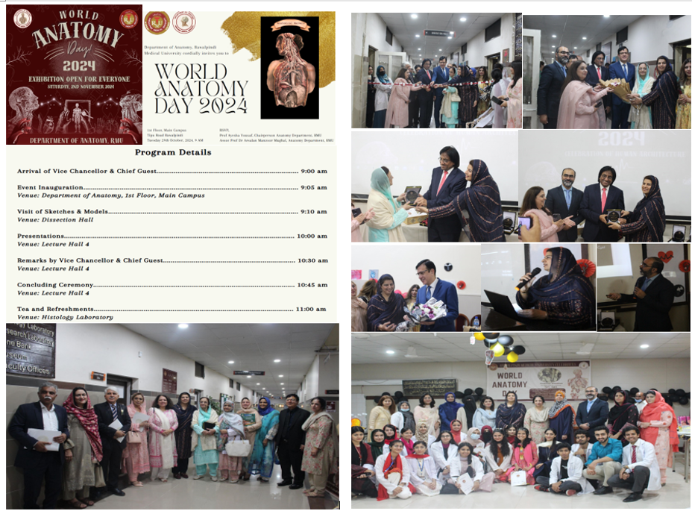
World Anatomy Day

Slide 40
