Slide 2
Infections of Skin
CNS & Psychiatry II 4th year MBBS
Dr. Mudassira Zahid
Department of Pathology
Rawalpindi Medical University

Slide 4
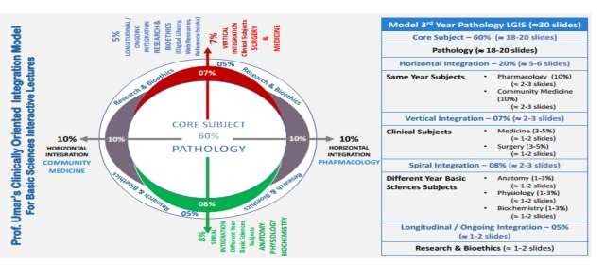

Slide 5
Learning Objectives
Describe Pathophysiology
Understand the underlying mechanisms of common skin diseases, such as eczema, psoriasis, acne, and skin cancers.
Recognize Clinical Features
Identify key clinical presentations and distinguishing features of common skin diseases.
Learning Resources: Robbins & Cotran Pathologic Basis Of Disease 10th Edition

Slide 6
Learning Objectives
Diagnostic Techniques
Explain the diagnostic tools and tests used to evaluate skin conditions, including biopsies, dermoscopy, and skin cultures.
Treatment Strategies
Describe treatment options for various skin diseases, including pharmacological therapies, lifestyle modifications, and procedural interventions.
Learning Resources: Robbins & Cotran Pathologic Basis Of Disease 10th Edition

Slide 7
Bacterial Skin Infections
SPIRAL INTEGRATION
PHYSIOLOGY
Impetigo
Folliculitis
Acne Vulgaris
Abscesses
Erysipelas
Cellulitis
Necrotizing Fasciitis
Anthrax
Leprosy
Spirochetal Infections
Syphilis

Slide 8
Viral Skin Infections
SPIRAL INTEGRATION
PHYSIOLOGY
Smallpox (Variola)
Chickenpox (Varicella)
Herpes Zoster (Shingles)
Herpes Simplex
Fungal Skin Infections
Tinea Versicolor
Deep Fungal Infections
Mycetoma

Slide 9
Impetigo
CORE PATHOLOGY
Cause: Superficial epidermal infection caused by Staphylococcus aureus or Streptococcus pyogenes
Most Commonly Affects: Children
Common Site: Face
Characteristics:
Highly contagious
Grossly begins as a blister filled with pus that ruptures, forming a thick yellow translucent crust
Microscopically, the blister is located in the superficial part of the epidermis
Treatment: Eradication of the infection with antibiotics leads to rapid healing without scarring

Slide 10
Folliculitis
CORE PATHOLOGY
Description: Hair follicle infection
Common Areas Affected: Can occur in any part of the body with hair, often on the face and upper trunk
Pathogen: Staphylococcus aureus (usual cause)
Clinical Features:
Acute inflammation with pain, swelling, and erythema
Suppuration can lead to an abscess or furuncle (common boil or pimple)

Slide 11
Acne Vulgaris
CORE PATHOLOGY
Not Primarily an Infection:
Lesions often become infected by superimposed bacterial infection.
Common Age Group:
Affects most adolescents around puberty.
Cause:
Uncertain, but elevated sex hormone levels at puberty may influence sebaceous secretion quality.
Certain foods may exacerbate the condition, suggesting an allergic phenomenon.
Poor hygiene plays an uncertain role.

Slide 12
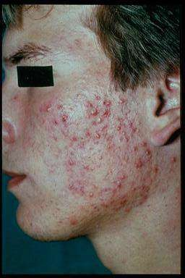
Acne Vulgaris - Pathogenesis
CORE PATHOLOGY
Consists of a pilosebaceous structure plugged with keratin and lipids.
Retained keratin and sebaceous secretions are degraded by anaerobic bacteria such as Propionibacterium acnes.
This leads to acute inflammation and
evolves into an abscess.

Slide 13
Leprosy (Hansen’s Disease)
CORE PATHOLOGY
Widespread in tropics and subtropics.
Caused by Mycobacterium leprae, a slender acid-fast bacillus; has not been cultured on artificial media.
A slowly progressive disease that causes serious damage to skin and peripheral nerves.
There is a spectrum of lesions in Leprosy:
Tuberculoid Leprosy
Lepromatous Leprosy
Borderline Leprosy

Slide 14
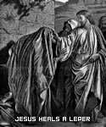
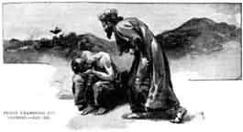
Leprosy: A Disease of Biblical Proportions
CORE PATHOLOGY

Slide 15
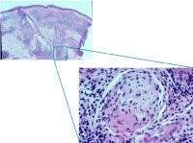
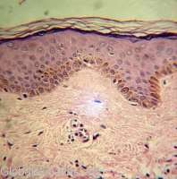
Mycobacterium Leprae
CORE PATHOLOGY
Gram Positive, Obligate, Intracellular, Acid-Fast Bacilli
Differs from all other mycobacteria in that it cannot be cultured in vitro.
Organism grows at 27-30 degrees C; thus it grows best in the cooler areas of the body: skin, peripheral nerves, anterior chamber of the eye, upper respiratory tract, and testes.
Has an affinity for macrophages and Schwann cells.
For Schwann cells in particular, the mycobacterium binds to the G domain of the alpha-chain of laminin 2 (found only in peripheral nerves) in the basal lamina.
Its slow replication within the Schwann cell will eventually stimulate a cell-mediated immune response, which creates a chronic inflammatory reaction.
As a result, swelling occurs in the perineurium, leading to ischemia, fibrosis, and axonal death.

Slide 16
A. Tuberculoid Leprosy
CORE PATHOLOGY
Occurs in patients who developed a good T cell response to the bacillus.
Organism is localized to the area of entry.
The number of lesions is small.
Bacteremic spread is rare.
Clinically, the skin lesion is a hypopigmented anaesthetic macule. (A macule is a flat, well-defined area of discoloration of the skin.)
Involvement of large peripheral nerves:
Ulnar
Common peroneal
Greater auricular

Slide 17
A. Tuberculoid Leprosy
CORE PATHOLOGY
Produces palpable thickening and nerve palsies:
Wrist drop
Foot drop
Tuberculoid Leprosy has a slowly progressive course without treatment.
It can be successfully treated.

Slide 18
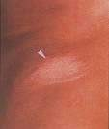
Tuberculoid Leprosy Characteristics
CORE PATHOLOGY
Occurs in individuals who have a vigorous cellular immune response to the organism.
Host cell-mediated immune responses are intact.
Disease usually involves the skin and peripheral nerve.
Skin often has one or a few well-demarcated, hypopigmented, or erythematous, hypoesthetic or anesthetic lesions, often with raised, active spreading edges and central clearing.
Characterized by the presence of non-necrotizing granulomas in the dermis and peripheral nerves with acid-fast bacilli absent or few in number.
Nerve involvement is usually asymmetric.
Low numbers of bacteria in skin lesions (<5 skin lesions, with absence of organisms on smear).

Slide 19
Histologically: Skin Lesion Characteristics
CORE PATHOLOGY
Epithelioid Cell Granulomas
Numerous Lymphocytes
Small number of Leprosy Bacilli

Slide 20
Histological Findings in Tuberculoid Leprosy (TT Form)
CORE PATHOLOGY
Well-developed epithelioid granulomas are observed in the papillary dermis, often around neurovascular structures.
The granulomas are surrounded by lymphocytes, which extend into the epidermis.
Langhans giant cells are common.
Dermal nerves are destroyed or swollen because of the granulomas.
Acid-fast bacilli are not observed.

Slide 21
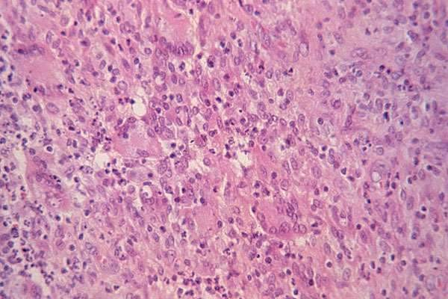
Tuberculoid Leprosy
CORE PATHOLOGY

Slide 22
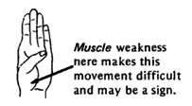
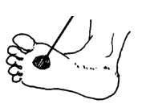
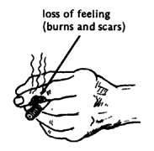
Signs of Tuberculoid Leprosy
CORE PATHOLOGY
Skin Lesions: Sharply demarcated, hypopigmented macules.
Enlarged peripheral nerves:
Ulnar nerve
Superficial Radial Cutane
Neuropathy
Hypoesthesia:
Temperature is the first sensation lost. Patients cannot sense extremes of hot or cold.
The next sensation lost is light touch, then pain, and finally deep pressure.
These sensory losses are especially apparent in the hands and feet. Therefore, the chief complaint may be a burn or ulcer in an anesthetic extremity.
Median nerve
Common Peroneal nerve
Greater Auricular

Slide 23
Lepromatous Leprosy
CORE PATHOLOGY
Lepromatous Leprosy occurs in patients who have a low level of cellular immunity.
In the absence of an effective T cell response, the bacillus multiplies unchecked in skin macrophages, forming large foamy Lepra Cells in which many acid-fast bacilli are found.
Histologically:
Skin macrophages forming large, foamy Lepra Cells containing many acid-fast bacilli.
Lymphocytes are present but not numerous.
Aggregation of macrophages causes thickening and nodularity of the skin.

Slide 24
Lepromatous Leprosy
CORE PATHOLOGY
The bacillus spreads via the bloodstream, causing widespread lesions in the skin, eye, upper respiratory tract, and testis.
Leprosy bacilli grow preferentially at temperatures less than 37°C, and internal viscera such as the spleen and liver, which are at core body temperature, are rarely affected.

Slide 25
Lepromatous Leprosy
CORE PATHOLOGY
Lepromatous leprosy is a serious disease that causes extensive destruction of tissue.
Involvement of the fingers, nose, and ears produces marked disfigurement.
Treatment is unsatisfactory.

Slide 26
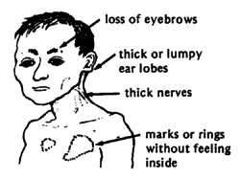
Lepromatous Leprosy
CORE PATHOLOGY
The loss of ability to kill bacteria appears to be specific for M. leprae.
Cell-mediated immunity is diminished.
Disease usually has extensive skin involvement.
Skin lesions are described as infiltrated nodules and plaques, occurring in cooler regions of the body, with sparing of axillas, groin, and scalp.
Nerve involvement is usually symmetric.
High numbers of bacteria in skin lesions (>6 skin lesions, with possible visualization of organisms on smear).
Results of skin tests with antigen from killed organisms (Lepromin) is nonreactive, and there is a predominance of suppressor CD8+ over CD4+ T lymphocytes.

Slide 27
Histological Findings in Lepromatous Leprosy (LL Form)
CORE PATHOLOGY
A diffuse infiltrate of foamy macrophages is present in the dermis below a subepidermal grenz zone.
An enormous number of acid-fast bacilli develop within the foamy macrophages, singly or in clumps called globi.
Lymphocytes are scant, and giant cells are typically absent.
Numerous bacilli invade the nerves, but these are fairly well preserved with little infiltrate.
Nodular, or dermatofibroma-like lesions in LL, referred to as histoid leprosy, result in a diffuse fascicular arrangement of spindled cells in the dermis admixed with foamy macrophages that contain numerous bacilli.

Slide 28
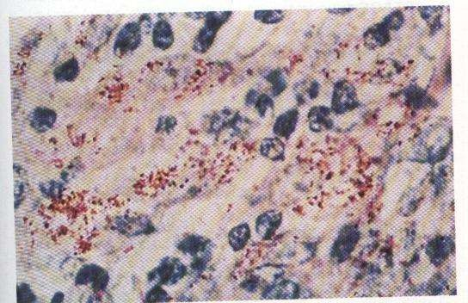
Lepromatous Leprosy
Acid-fast bacilli (red snappers) proliferate in the macrophages.
CORE PATHOLOGY

Slide 29
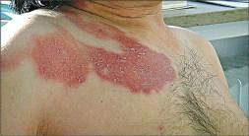
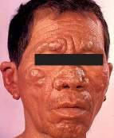
Physical Findings in Lepromatous Leprosy
VERTICAL INTEGRATION
CORE PATHOLOGY
Skin lesions:
Poorly defined borders
Raised, indurated lesions
Affects Face, Ears, Wrists, Elbows, Buttocks, and Knees
Hoarseness
Loss of eyebrows (madarosis)
Nasal collapse Lagophthalmos (inability to close the eye) — a late finding in LL, resulting from involvement of the zygomatic and temporal branches of the facial nerve (cranial nerve VII).

Slide 30
Physical Findings in Lepromatous Leprosy
VERTICAL INTEGRATION
CORE PATHOLOGY
Involvement of the ophthalmic branch of the trigeminal nerve (CN V2) can result in reduced corneal reflex, leaving dry eyes and reduced blinking.
Keratitis, Glaucoma, Iridocyclitis
Leonine facies – skin of the face becomes thickened and corrugated.
Axillary and inguinal lymphadenopathy

Slide 31
Comparison
CORE PATHOLOGY
 | Lepromatous | Border line | Tuberculoid
Cell- mediated immunity | Deficient | Intermediate | Present
Lepromin Test | Negative | Pos OR Neg | Positive
Number of lesions | Numerous | Many | Few
Visceral lesions | Common | Uncommon | Absent
Skin lesions appearance | Nodular | Variable | Macular
Hypoesthesia of lesions | Rare | Rare | Common

Slide 32
Comparison
CORE PATHOLOGY
 | Lepromatous | Border line | Tuberculoid
 | Few | Intermediate | Numerous
Number of Organisms | Numerous | Many | Few
Lepra Cells | Numerous | Present | Absent
Distribution of Macrophages | Diffuse | Aggregates | Granulomas
Erythema Nodosum Leprosum | Common | Common | Rare

Slide 33
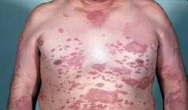
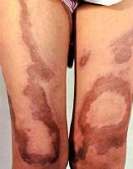
Borderline (Dimorphous)
CORE PATHOLOGY
Physical Findings in Borderline Leprosy
Single or multiple well-defined skin lesions similar to Tuberculoid lesions but with a raised center and delayed development of dysesthesia.
Often subdivided into borderline Lepromatous and borderline tuberculoid.

Slide 34
Diagnostic Criteria for Leprosy
VERTICAL INTEGRATION
CORE PATHOLOGY
The diagnosis of leprosy is primarily clinical.
The following criteria had a sensitivity of 97% with a positive predictive value of 98% in diagnosing leprosy. Diagnosis was based on 1 or more of the following signs:
Hypopigmented or reddish patches with definite loss of sensation.
Thickened peripheral nerves.
Acid-fast bacilli on skin smears or biopsy material.

Slide 35
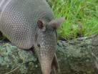
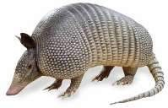
Reservoirs of M. Leprae
CORE PATHOLOGY
Humans are the primary reservoir of M. leprae.
There is an association between M. leprae and the nine-banded armadillo:
The armadillo migrated from Mexico to Texas more than 150 years ago.
Found in Texas and Louisiana.
Up to 19% of wild-caught armadillos in the southern & southeastern U.S. have naturally acquired leprosy.
The source of M. leprae in some leprosy-infected armadillos may be the soil.
Other animal reservoirs include chimpanzees and mangabey monkeys.

Slide 36
Syphilis
CORE PATHOLOGY
A common sexually transmitted disease.
Caused by a Spirochete: Treponema pallidum.
Causes skin lesions in both early and late stages.
Skin Lesions in Primary (Initial) Stage:
Primary Chancre on external genitalia, which exudes a serous fluid containing large numbers of treponemas.
Skin Lesions in Secondary Syphilis:
A large variety of skin rashes affect the entire body.
Condyloma Latum represents a specific lesion of secondary syphilis occurring in the anogenital region as a large, moist papule, the serous exudate of which contains large numbers of treponemas.

Slide 37
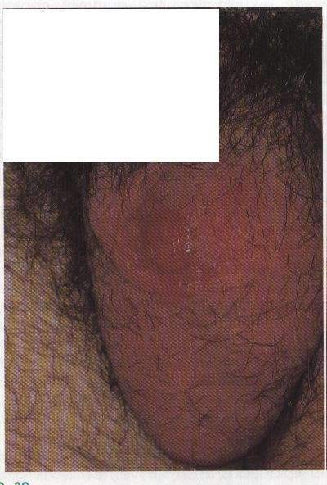
Skin Lesions in Late Syphilis
CORE PATHOLOGY
Gummas occur. These are nodular areas of granulomatous inflammation characterized by large central areas of gummatous necrosis.
Treponemas are not usually demonstrable in gummas.
Syphilis Chancre in the Scrotum

Slide 38
Incidence of Skin Lesions in Syphilis
CORE PATHOLOGY
Variable | Associations
Age | -Impetigo in children -Acne in adolescence -Pemphigus in old age
Sex | -Acne common in boys -Bullous Pemphigoid in pregnancy (‘herpes gestation’)
Anatomical site | -Psoriasis and dermatitis herpatiformis common on elbows & knees -Atopic Eczema antecubatal fossae - Scabies in finger webs

Slide 39
Incidence of Skin Lesions in Syphilis
CORE PATHOLOGY
Variable | Associations
Geography | -Psoriasis in developing world - Psoriasis in Faroe Islands (inbred community)
Exposure | -Basal cell carcinoma & Squamous cell carcinoma on sun- exposed sites -Basal cell carcinoma in arsenic exposure common on covered sites
Race | - Basal cell carcinoma and Squamous cell carcinoma and Melanoma rare in blacks ( protected by pigmentation)

Slide 40
Pathological Basis of Dermatological Signs and Symptoms
CORE PATHOLOGY
Clinical Sign | Pathological Basis
•Scaling | Hyperkeratosis Parakeratosis
•Erythema | Dilatation of blood vessels
•Blisters | Separation of layers of epidermis or epidermis from dermis
•Bruising | Leakage of blood into dermis
•Pigmentation | Increased activity or number of Melanocytes Endogenous or Exogenous pigments

Slide 41
Pathological Basis of Dermatological Signs and Symptoms
CORE PATHOLOGY
Clinical Sign | Pathological Basis
•Plaques | Increase in epidermal thickness
•Nodules | Epidermal Tumours Adenaxal tumours Dermal tumours
•Rashes restricted to exposed areas | Photosensitivity Contact Eczema
•Nail abnormalities Trauma to nail bed Psoriasis Systemic poisons

Slide 42
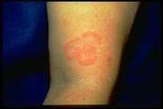
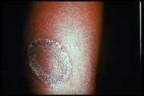
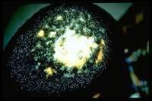
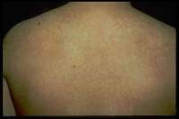
CORE PATHOLOGY
Centrifugal Rash (Fungal Infection)
Centrifugally spreading, reddish or pink plaques or patches with slightly raised advancing edges.
Annular appearance (ring-shaped).
Itchy rash caused by the fungus Trichophyton rubrum in most cases.
Tinea Corporis
Tinea Corporis
Tinea Capitis
Tinea Versicolor

Slide 43
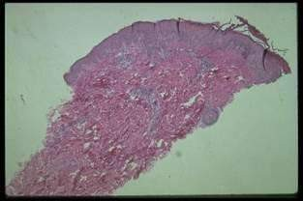
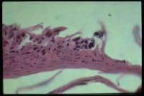
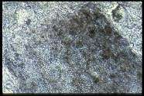
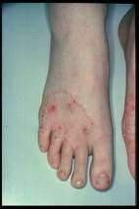
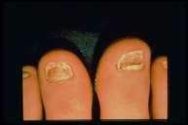
CORE PATHOLOGY
Centrifugal Rash (Fungal Infection)
Parakeratosis
Thick Stratum Corneum
Tinea Capitis KOH Prep (Hair) "Spaghetti and Meatballs" Appearance
Tinea pedis
Tinea Unguium

Slide 44
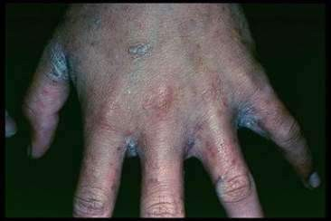
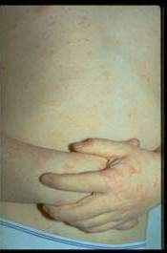
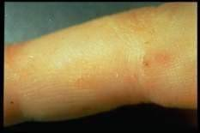
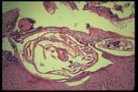
CORE PATHOLOGY
Scaly Red Rash Scabies
Scabies (or infestation with the Sarcoptes mite), especially when untreated, can lead to a widespread eczema rash with a few additional distinctive features such as heavy involvement in the groin or skin folds and, in particular, involvement of the interdigital web spaces with crusting.

Slide 45
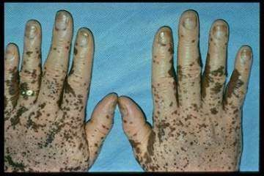
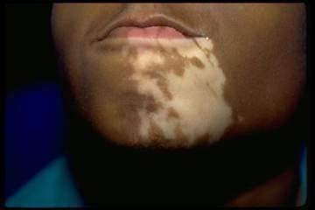
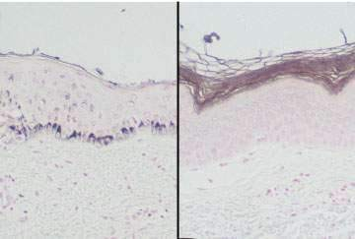
Pigment Changes: Vitiligo
CORE PATHOLOGY
With Fontana-Masson stain, lesions of long-standing vitiligo (right-hand panel) show no melanocytes. In normal skin (left panel), darkly stained melanocytes are visible along the dermoepidermal junction.

Slide 46
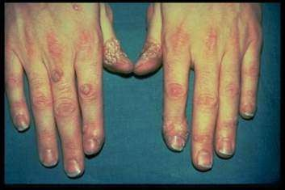
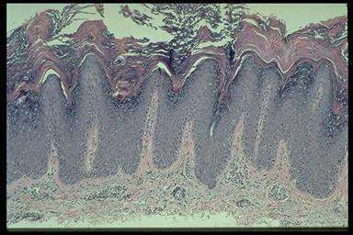
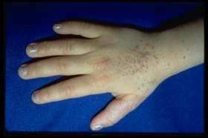
Papules/Plaques: Warts
CORE PATHOLOGY
The hallmarks of warts are hyperkeratosis, papillomatosis (outward expansion of the spinous layer), and acanthosis. The epidermis contains foci of vacuolated cells (koilocytes), clumped keratohyalin granules, and vertical tiers of parakeratotic cells (stratum corneum with retained nuclei).
HPV mediated.
Here shown is common wart
Flat wart

Slide 47
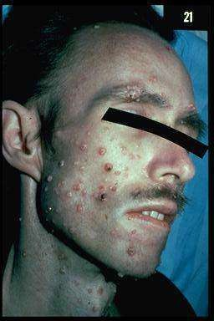
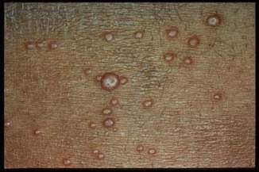
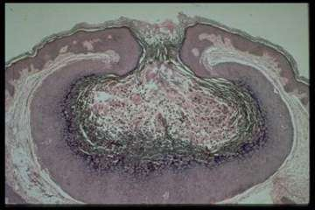
Papules/Plaques: Molluscum
CORE PATHOLOGY
Ballooning-like changes in the keratinocytes as they approach the granular layer. There are intracellular inclusion bodies known as molluscum bodies.
Dome-shaped pink-brown papules with secondary umbilication noted in many of the well-developed lesions.

Slide 48
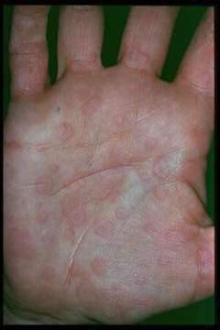
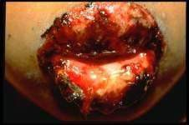
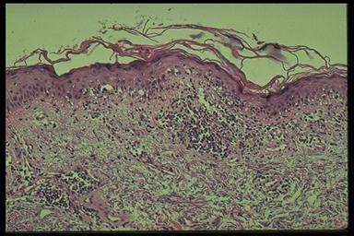
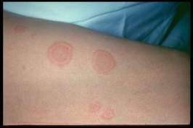
Papules/Plaques: Erythema Multiforme
CORE PATHOLOGY
The pathologic features of erythema multiforme include a perivascular, lymphocytic infiltrate of variable intensity, vacuolization of the dermal-epidermal junction, extravasation of red blood cells without vasculitis, papillary dermal edema, and variable eosinophilic necrosis of the epidermis.

Slide 49
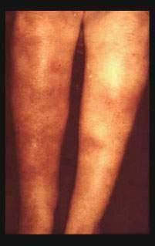
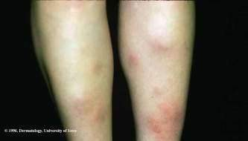
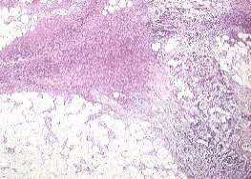
Nodules: Erythema Nodosum
CORE PATHOLOGY
Histologic findings associated with erythema nodosum are largely localized to the deep dermis and subcutaneous tissue. There is an accumulation of lymphocytes, neutrophils, histiocytes, and giant cells in the fibrous septae between fat lobules and perivascular infiltration of lymphocytes in the dermis.

Slide 50
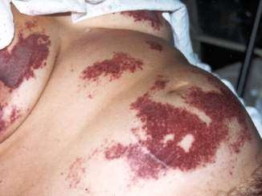
Purpura Vasculitis
CORE PATHOLOGY
Vasculitis of the superficial vascular plexus. One sees extravasation of red blood cells, indicating that the vessels must have been damaged. There is a lot of neutrophilic debris.
A larger vessel is involved in an inflammatory process.

Slide 51
Blisters Herpes
CORE PATHOLOGY
Note: These images are somewhat weak. Also, it's unclear whether they refer only to HSV-1 or both HSV-1 and HSV-2.
Cells in the epidermis are undergoing degenerative changes, with acantholysis (epidermal cells falling apart) and nuclear enlargement. In some specimens, one might be lucky enough to see the diagnostic multinucleated giant cells.

Slide 52
Systemic Lupus
CORE PATHOLOGY
Discoid Lupus: There is a perivascular and periappendiceal lymphocytic infiltrate that also tends to hug the dermo-epidermal junction, the latter type of infiltrate being referred to as "lichenoid."

Slide 53
Systemic Scleroderma
CORE PATHOLOGY
The collagen bundles are thickened and homogenized.

Slide 54
CORE PATHOLOGY

Slide 55
Research
https://www.medicalnewstoday.com/articles/316622#temporary-conditions

Slide 56
Take Home Message
Skin Diseases
Skin diseases encompass a wide range of conditions affecting the skin, such as infections, autoimmune disorders, and inflammatory responses.
Common conditions include:
Eczema
Psoriasis
Acne
Each condition has unique symptoms and treatments.
These diseases can significantly impact quality of life, often requiring tailored medical management and lifestyle adjustments.

Slide 57
Family Medicine
Case Presentation
Patient: A 35-year-old man presents with a red, inflamed rash and pustules on his nose, cheeks, and forehead, which worsen with hot drinks and sun exposure.
There is no itching, and the rash does not respond to moisturizers.
What is the most likely diagnosis?
A. Rosacea
Acne Vulgaris
Seborrheic Dermatitis
Eczema
Lupus Erythematosus
Answer: A. Rosacea

