Slide 1
Importance of Research & Development of New Therapies
بسم الله الرحمن الرحيم
Prof. Dr. Mohammad Akram Randhawa
MBBS (KE), MPhil (Pb), PhD (QU)
Fellowship Clinical Pharmacology (UK)
Department of Biomedical Ethics
Rawalpindi Medical University

Slide 2
Importance of Research & Development of New Therapies
Development of therapeutic agents for prevention and treatment of diseases has played a vital role in medicine for thousands of years.
Before 70-80 years diarrhea, tuberculosis, or pneumonia were common causes of death.
Thanks to discovery of new drugs, these diseases are now treatable.
Need for production of new drugs would continue for following reasons.
1. Previously Untreatable Conditions
With development of science it has become possible to understand pathogenesis of many known diseases at molecular and gene level.
We need to discover new drugs to precisely target and treat the cause.

Slide 3
Research & Development of New Therapies [ Cont.]
2. Overcome New Diseases
Because of Increased interaction with people [and animals], due to global migrations, a number of new diseases are being encountered.
For example, COVID-19 pandemic, we have learnt how easily new diseases can appear.
Many new diseases, like SARS-CoV-2, originate in animals.
Other examples of new diseases that have crossed from an animal host to humans, include HIV/AIDS, Ebola, flu, and even the common cold.
It is essential to produce new drugs to treat such diseases and prevent their spread.
3. Produce Low-Cost Drugs
Many drugs are too expensive and most people cannot afford, especially true in developing countries.
It is imperative that pharmaceutical companies develop more affordable drugs.

Slide 4
Research & Development of New Therapies [Cont.]
4. Differences in Body Metabolisms
Differences in body metabolism in various communities or individuals causes variations in drug response.
This means we need to produce new drugs that are suitable for a range of different people, or drugs that are suitable for a particular set of community.
5. Drug Resistance
Pathogenic microorganisms [fungi, bacteria and viruses] are becoming resistant to known drugs being used for their eradication.
Over 700,000 people each year around the world are killed because of these resistant microbes.
Therefore, we need to produce new medications to treat infections caused by resistant pathogen.
Antibiotics are also used in animal husbandry indiscriminately which leads to development of resistance.

Slide 5
Research & Development of New Therapies [Cont.]
An example of virus vaccination resistance is that of influenza vaccination. Vaccine must be modified to combat evolution of virus.
Similarly, malarial parasite is becoming resistant to conventional treatments.
Drugs often kill 99.9% of bacteria or fungus causing the infection.
It is possible that the 0.01% who survive are resistant to drug used
Now will multiply and become dominant form of that species and infect other people or original host.
Resistance and poor response to therapy is also observed in other drugs than antimicrobial drugs, e.g. Non-Steroidal Anti-inflammatory Drugs [NSAIDs] resistance in the treatment of dysmenorrhea.

Slide 6
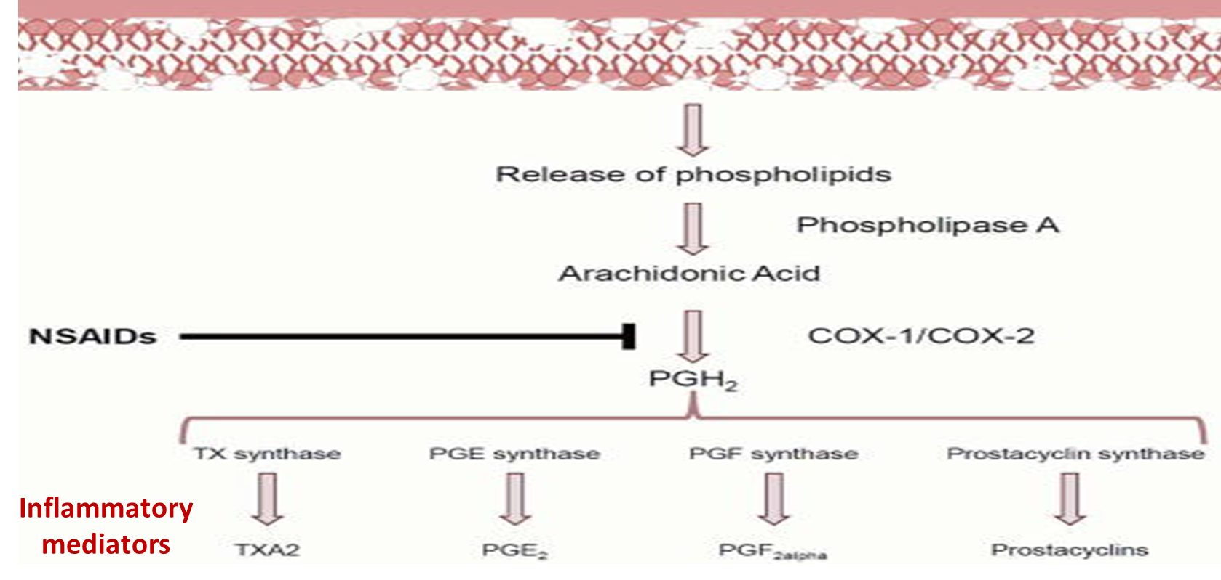
Figure 1. Pathophysiology of dysmenorrhea & role of NSAIDs
[NSAIDs] resistance in treatment of dysmenorrhea

Slide 7
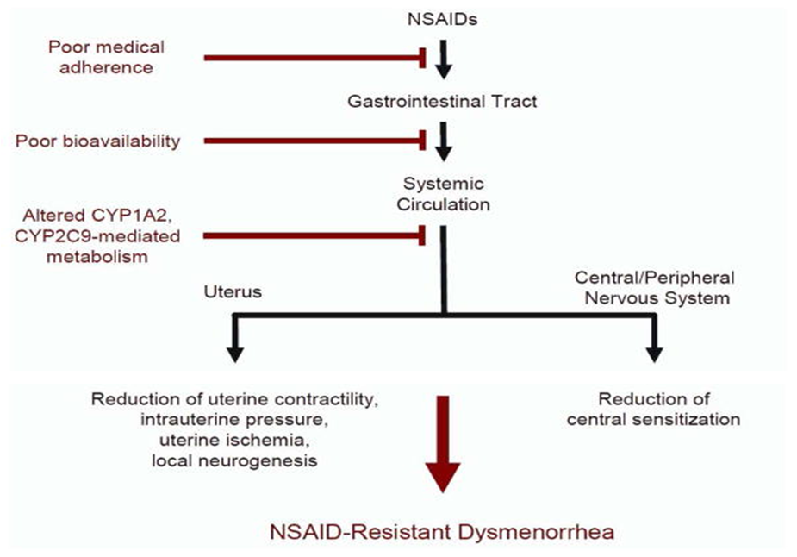
NSAIDs resistance in treatment of dysmenorrhea [Cont.]
Figure 2. Pharmacokinetic factors for NSAID resistance. NSAIDs reduce menstrual pain via suppression of peripheral [uterine] and systemic [CNS] PG effects (Black). Poor effect due to poor compliance and bioavailability and increased liver metabolism [Brown].

Slide 8
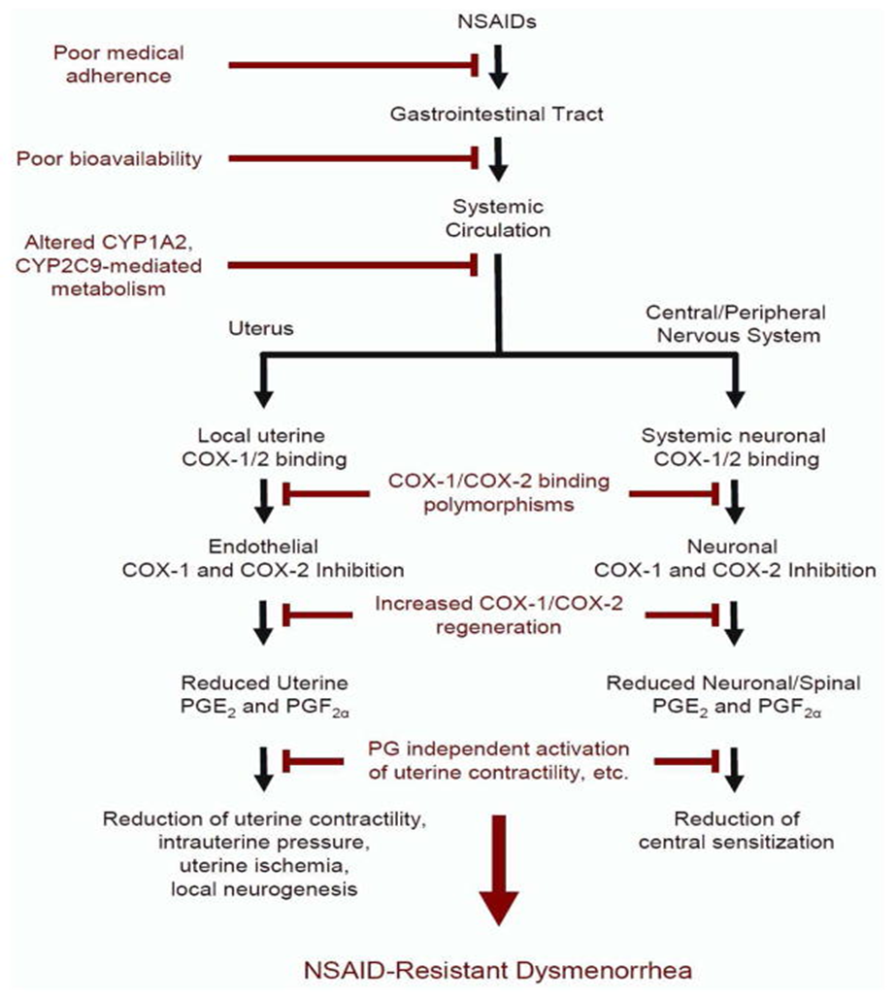
NSAIDs resistance in treatment of dysmenorrhea [Cont.]
Figure 3. Pharmacodynamic factors for NSAID resistance. Poor binding with COX enzyme, increased COX formation and uterine ccontraccction via effects other than PGs.

Slide 9
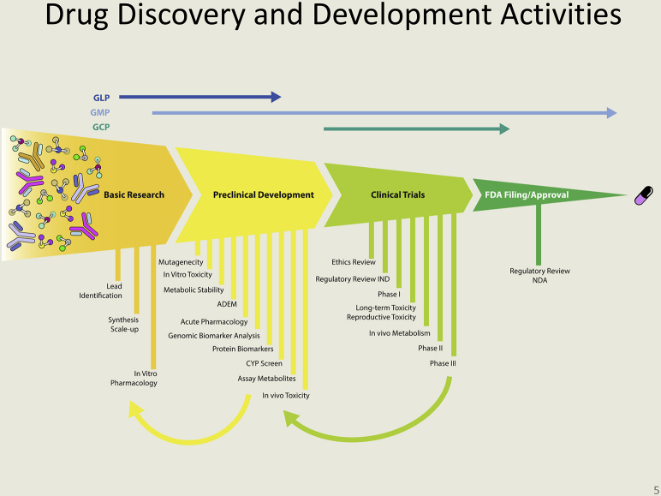
Discovery of new drugs [Overview]
Figure 4. Drug discovery road-map. Top; quality assurance; good laboratory practice (GLP), good manufacturing practice (GMP), good clinical practice (GCP).

Slide 10
Figure 5. Specific activities in Basic Research and Pre-clinical Development. Absorption, distribution, excretion, metabolism (ADEM), screening for activity at cytochrome P450 (CYP).

Slide 11
Figure 6. Specific activities in clinical trials. Federal Drug Administration [FDA]. Investigational New Drug (IND). New Drug Application (NDA).

Slide 12
Discovery of new drugs, Overview [Cont.]
Possibilities of discovery of new drug:
A. Compound centered approach: Classical approach
B. Target centered drug design: New approach
C. Chance discovery
Drug development & evaluation:
A. Pre-clinical studies: Potential drugs discovered by above mentioned approaches are studied at molecular level, on isolated tissues & whole animals, to find a more suitable compound, or ‘Lead Compound’.
Preclinical safety studies are done on ‘Lead Compound’.
B. Clinical studies: Once a drug is approved after pre-clinical studies its evaluation is done in human beings in 4 phases, Phase 1-4 studies.

Slide 13
Drug Discovery
A. Compound-centered approach

Slide 14
a. Isolation of active principles from natural sources
Plant origin:
Atropine, hyoscine, pilocarpine & physostigmine
Aspirin & colchicine
Digoxin & quinidine
Vinblastine, vincristine & paclitaxel
From microorganisms:
Streptokinase (bacteria)
Penicillins, cephallosporins & other antibiotics (fungi)

Slide 15
b. Synthesis of new drugs related to active principles
Homatropine from atropine (Semi-synthetic)
Synthetic atropine like drugs: e.g. tropicamide
Diacetylmorphine (heroin) from morphine (Semi-synthetic)
Synthetic opioids: e.g. meperidine & methadone
Neostigmine & pyridostigmine from physostigmine (Semisynthetic)

Slide 16
c. Synthesis of new compounds related to natural ligands
Natural neurotransmitters are:
Acetylcholine [Figure 7]
Noradrenaline, adrenaline & dopamine
Histamine & 5-HT (serotonin)
GABA, & glutamate

Slide 17
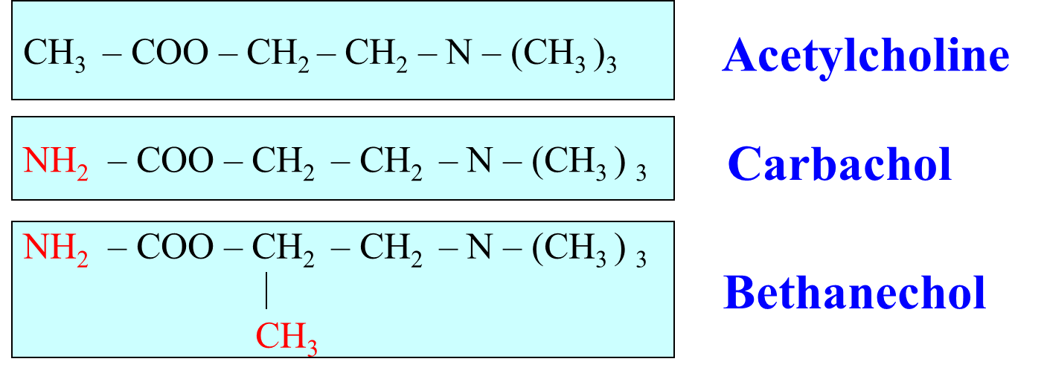
Figure 7. Minor changes in structure of natural neurotransmitter, Acetylcholine, i.e. change of a CH₃ by NH₂ in Carbachol and addition of another CH₃ in Carbachol to prepare Bethanechol have change their pharmacological properties [Table 1].
An example of analogues of natural acetylcholine

Slide 18
Table 1. Varied properties of Acetylcholine, Carbachol and Bethanechol due to minor differences in their chemical structures.

Slide 19
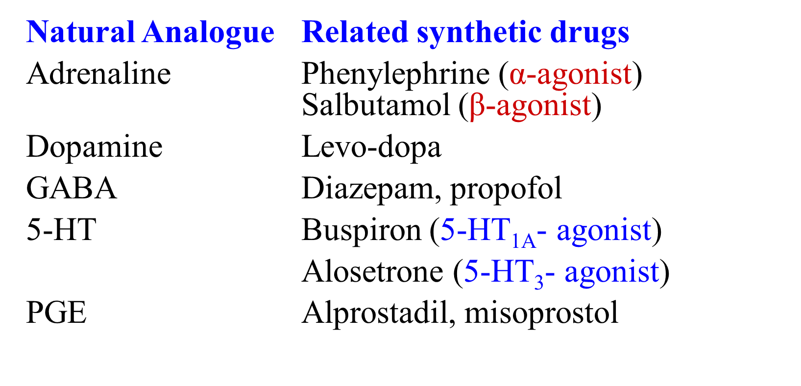
Some other examples of derivatives of natural analogs

Slide 20
Drug Discovery [Cont.]
B. Target-centered drug design

Slide 21
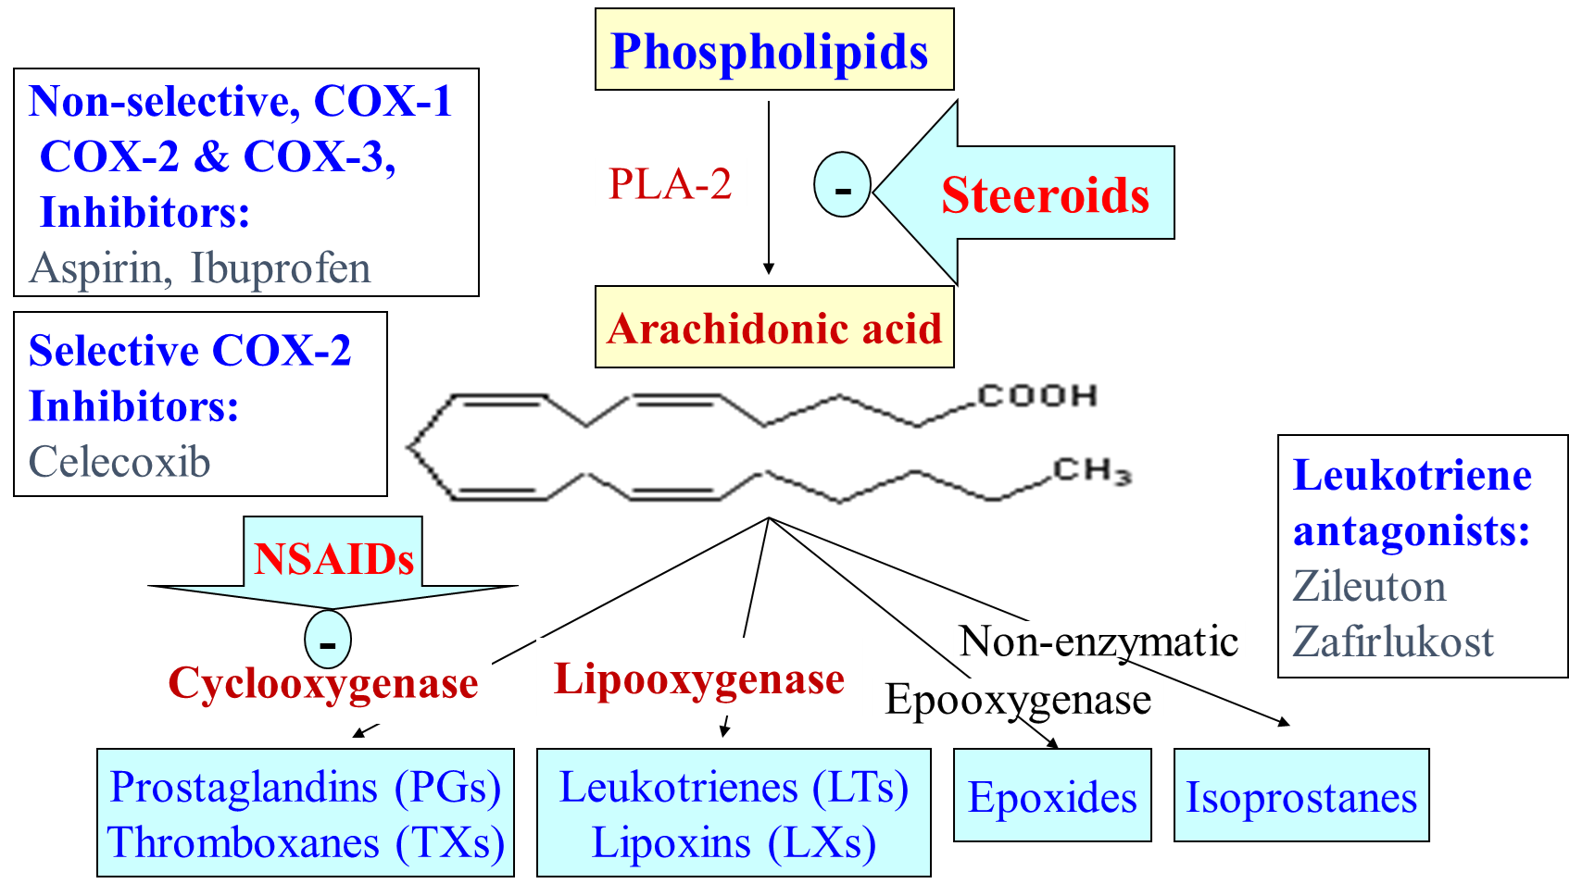
Figure 8. Steroids inhibits phospholipase-A, decreases synthesis of many inflammatory mediators. NSAIDS inhibit cyclooxygenase [COX] lower PGs and TXs synthesis. Lipooxygenase inhibitors reduce LTs and LXs.
Drugs targeting enzymes for synthesis of inflammatory mediators

Slide 22
Drug Discovery (Cont.)
C. Chance discoveries

Slide 23
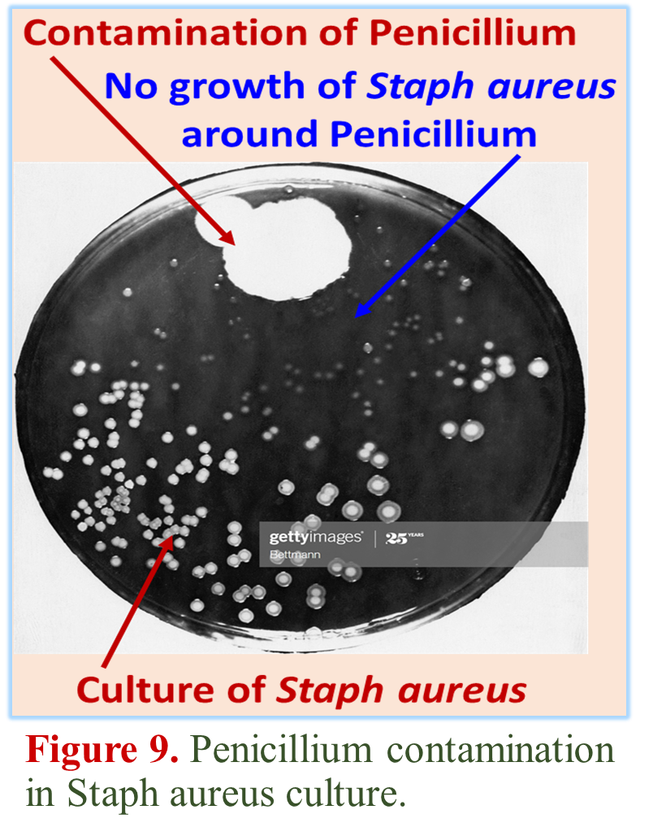
Discovery of Penicillin
Discovery of Penicillin by Alexander Fleming in 1928
Penicillium contamination in a petri-dish during culture of Staph. aureus
Lack of growth of Staph. aureus around Penicillium [Figure 9].
Later, active compound was found to be Benzyl Penicillin and its core structure Penicillinoic acid.
Now we have dozens of Penicillin derivatives, with much improved pharmacological activities.

Slide 24
A. Pre-clinical Studies
Once some compounds are prepared by drug centered or target centered approach, they are screened for their Pharmacological activities at:
Molecular, cellular, tissue, organ system, & whole animal levels
The type and number of initial screening tests depend on the pharmacologic and therapeutic goal.
For example:
Anti-infective drugs are tested against micro-organisms causing infection, some of which are resistant to standard drugs.
Hypoglycemic drugs, tested for their ability to lower blood sugar.
Antihypertensive drugs, tested to lower blood pressure, etc.

Slide 25
Studies at Molecular Level
Potential drug molecule is studied at molecular level (Receptors and molecular signaling pathways) to determine the mechanism of action and selectivity of drugs.
Receptor binding affinity is also determined.
Early studies are also done regarding drug metabolism & toxicity.
For example, studies on liver cytochrome P450 enzymes would be performed.
To know whether the drug is likely to induce or inhibit these enzymes & thus increase or decrease with the metabolism of other drugs.

Slide 26
Studies on Isolated Tissues
Effects on cell function determine whether the drug is an agonist, partial agonist, inverse agonist, or antagonist at relevant receptors.
Isolated tissues would be used to characterize the pharmacologic activity and selectivity of the new compound in comparison with reference compounds.
Comparison with other drugs would also be undertaken for its potency and efficacy, in a variety of in vitro & in vivo studies.
At each step in this process, the compound would have to meet specific performance and selectivity criteria to be carried further.

Slide 27
Studies on Whole Animal
Whole animal studies are necessary to determine the effects of drug on organ systems in normal animals and disease models.
For example, cardiovascular and renal function studies of new drugs are generally first performed in normal animals.
For an antihypertensive drug, animals with hypertension are treated to see whether blood pressure is lowered in a dose-related manner.
Evidence is collected for duration of action and efficacy via different routes of administration, e.g., oral and parenteral.
If the drug is found to be useful, it is further studied for possible adverse effects on major organs and systems, to include: respiratory, gastrointestinal, endocrine, and central nervous systems.

Slide 28
Lead Compound or Investigational New Drug
Initial studies on cells, isolated tissues & whole animals might suggest the need for further chemical modification to achieve more desirable pharmacokinetic or pharmacodynamic properties.
e.g., oral administration studies might show that drug is less absorbed or rapidly metabolized; & needs changes to improve bioavailability.
If drug was to be given long term, an assessment of tolerance, dependence and abuse potential would be necessary.
Possibility of drug interactions would also be examined.
When a drug achieves desirable results after these screening tests is considered as a lead compound, i.e., a leading candidate for an Investigational New Drug (IND).

Slide 29
Pre-clinical safety
Evaluation of safety of Lead Compound before clinical testing includes the following procedures:
a. Acute toxicity study:
A single dose is given to a small group of animals to see immediate toxic effect. Conducted on two species & two routes of administration, with objective to find:-
No-effect dose, maximum dose at which a specified toxic effect is not seen; Minimum lethal dose, smallest dose that is observed to kill any experimental animal; and median lethal dose (LD50), dose that kills approximately 50% of the animals.
These doses are used to caulate the initial dose to be tried in humans, usually taken as one hundredth to one tenth of no-effect dose.

Slide 30
Pre-clinical safety (Cont.)
b. Sub-acute or sub-chronic toxicity study: Three doses, two species, 2 weeks to 3 months use must show normal biochemical (Blood sugar, uric acid, etc.) & physiological (BP, ECG, etc.) tests.
c. Chronic toxicity study: Two species, one rodent & one non-rodent, 6 months use must show normal biochemical & physiological profiles.
d. Effect on Reproduction: Two species, a rodent & a non-rodent. Effect on animal mating, reproduction, birth defects are tested.
e. Carcinogenic potential: Drug is given for 2 years in 2 species, when drug is to be used for long time. Gross & microscopic changes for cancer are tested.
f. Mutagenicity potential: Effect on genetic stability and mutation are tested in bacteria (e.g. Ames test).

Slide 31
B. Clinical Studies, Evaluation in Humans
A very small fraction of lead compounds reach clinical trials and less than one third of drugs granted INDs pass clinical trials & reach market.
Design and execution of a good clinical trial requires a team of basic scientists, clinical pharmacologists, clinician specialists & statisticians, etc.
Designs of clinical trials:-
Crossover design, in which each subject receives either placebo (Control), standard treatment (Positive control) & test drug at alternating periods.
Single-blind design: Observer gives placebo, positive control, or test drug to subjects without their knowledge what they are receiving and measures the response This minimizes the subject bias.
Double-blind design: In this case a third party holds the code for each medication packet containing either placebo, positive control, or test drug and the code is opened at the completion of trial. This avoids subject and observer bias.

Slide 32
Evaluation in Humans (Cont.)
Non-blind or “open” study: In this case both the investigators and the subjects know what is being given.
Cohort studies: Utilize groups of patients that have (Exposed group) and have not (Control group) been exposed to test drug. Then results of each group are compared to see whether exposed group shows a higher or lower incidence of effect.
Randomized control trial (RCT): People participating in the trial are randomly allocated to group receiving test drug, standard treatment (Positive control),or placebo treatment (Placebo control).
In RCT each individual has equal chance to be in test or control group, thus minimizes selection bias.
RCT is often considered as the gold standard for clinical studies.

Slide 33
Evaluation in Humans (Cont.)
Evaluation of a new drug/treatment is done in 4 phases:
Phase-1: Conducted on a small group (20–100) of healthy volunteers. If drug is expected to be more toxic, e.g. anti-cancer drug, than done on volunteer patients. Usually open or single blind trials; done in Clinical Pharmacology Unit.
Objectives are to find a safe limit of dosage, suitable route of administration, predictable adverse effects, & pharmacokinetic measurements (Absorption, half-life & metabolism, etc.).
Phase-2: Drug is studied in a modest number of patients (100–200) with target disease to determine its efficacy, confirm dosage, and further explore its toxicity.
Usually single blind, cohort studies; conducted in teaching hospitals.

Slide 34
Evaluation in Humans (Cont.)
Phase-3: Drug is evaluated in larger numbers of patients (Thousands) with target disease, to further confirm safety and efficacy. Double-blind and crossover techniques are often used.
Performed in settings similar to those anticipated for ultimate use of drug; teaching and general hospitals. Usually children, elderly or pregnant patients are excluded.
Drug is formulated as intended for the market. Some new unexpected toxic effects may be noticed, like allergic reactions.
Phase-4 (Post-marketing surveillance): Done to monitor safety of new drug under actual conditions of use in large numbers of patients.
Is important to report any toxic effects noticed by the physician and detect rare adverse effects, e.g. 1 in 10,000., or drug interactions.

Slide 35
Orphan Drugs (or Drugs for Treatment of Rare Diseases)
Drugs for rare diseases can be difficult to research, develop, and market.
Because basic research in pathophysiology & mode of action of rare diseases receives little attention or funding in both academic and industrial settings.
Funding for development of drugs for rare diseases or ignored diseases that do not receive priority attention from traditional industry needs support from government or non-profit foundations.
Orphan Drug Amendment of 1983 provides incentives for the development of drugs for treatment of a rare disease, defined as “Any disease which affects less than 200,000 persons in the USA”.

Slide 36
Safeguards for Evaluation of Drugs in Humans
Institutional review boards (ethical committees), for approval of animal and human studies
Written informed consent of volunteer, after explaining nature of drug, study procedure, benefits & risks
Application for investigation on new drug (FDA in USA) in humans based on efficacy & safety in preclinical studies
Application for approval of new drug for marketing (FDA in USA), based on the data of preclinical & clinical studies
Post marketing surveillance (withdrawal of drug if any problem)
Note: FDA (Food and Drug Administration) USA is responsible for supervision and control of studies for the development and evaluation of drugs and nutritional substances.

Slide 37
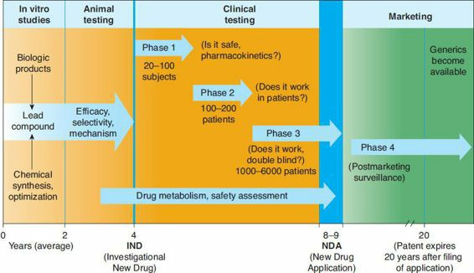
Figure 10. Summary of steps in development of new drug
FDA approval is required

Slide 38
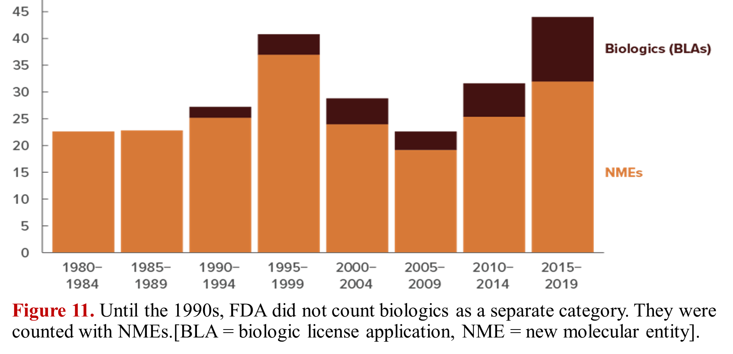
Average Annual Approvals of New Drugs by the FDA

