Slide 2
DEVELOPMENT OF NATIONAL HEALTH CARE QUALITY & PATIENT SAFETY POLICY
DR ASIF MAQSOOD BUTT
Public Health & Innovation

Slide 3
DR ASIF MAQSOOD BUTT
M.B.B.S, DIP Medicine (P.R.C), MPH (Pak), F.R.S.P.H(UK)
M.I.H.E.P (UK) M.R.S.T.M (UK) RCGP (International Affiliate) (UK)
__________________________________
Senior Demonstrator
Community Medicine Department
DEPUTY DIRECTOR (ADMIN) DEPARTMENT OFMEDICAL EDUCATION
PUBLIC HEALTH SPECIALIST & Gold Medal Innovation
Head of Public Health Chapter China Pakistan Medical Association
Founder Rawalian Community Awareness Program
Founder Markhor Fitness Club
Founder Journal of Health Education Promotion & Innovation
Rawalpindi Medical University, Rawalpindi
www.rmu-rcap.weebly.com____________________________
Guest speaker : Radio Pakistan , National channels
Article Writer : Pakistan Observer / Dr Asif Maqsood Butt
Motivational Speaker & Consultant Family Physician

Slide 4
CHIEF Medical Officer Central Jail Adyala Rawalpindi
Focal Person Covid 19 Control
Ex. DDHO Kotli Sattian , Rawalpindi
Ex. Admin & Incharge Student Affairs
Department of Medical Education
Rawalpindi Medical University
Rawalpindi
Member of Pakistan Academy Of Family Physicians (Pioneers)
Member of Organizing Committee Family Con '18 by PAFP (Pioneers)
Focal Person & Representative at Rawalpindi Medical University, Rawalpindi
Coordinator to HEC, ISB. Coordinator to ICRC Member of ORIC , RMU Ambassador : Rawalian Debating Order
Faculty Member of Rawalian Student Research Society
RMU CO-Ordinator For Social Integration Initiative
Founder Chairman XJMU PAKISTAN CHAPTER
Chief Operating Officer:
Pakistani Foreign Medical Students & Graduates
http://www.pfmsg.com/ https://www.facebook.com/pfmsg/

Slide 5
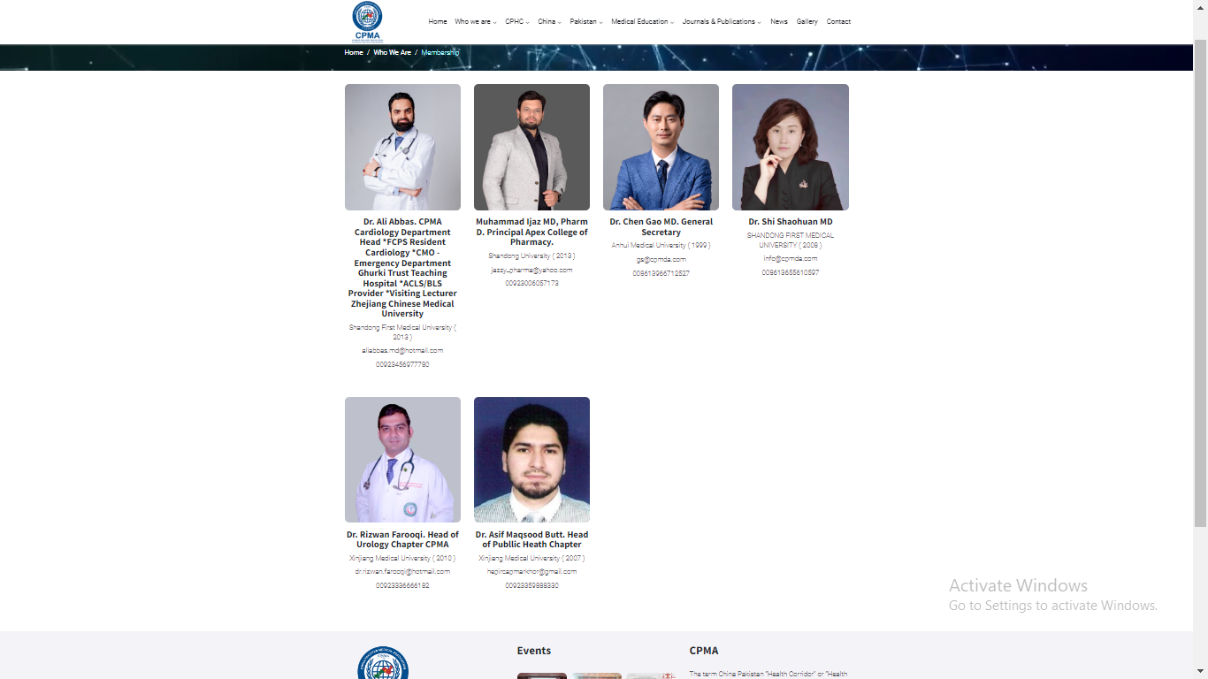

Slide 6
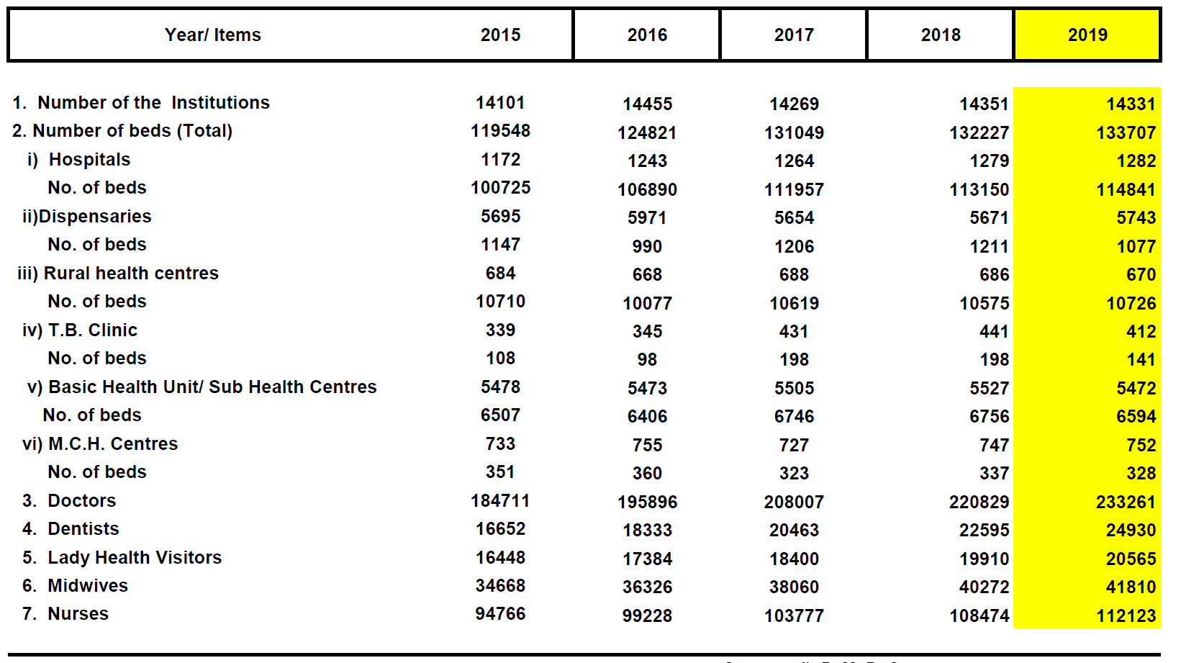
HEALTH STATUS ?
Notes:
The Health Corridor project is necessary project for Belt & Road Initiative inspired by President Xi Jinping BRI initiative. According to the data there are 280,000 doctors in Pakistan and there are 2000 Hospitals in Pakistan and there is need for development of infrastructure and doctors training which cannot be achieved by a single country alone. There is need for collaborative cooperation among Belt & Road countries for the development of healthcare facilities and doctors training.

Slide 7
HEALTH STATUS ?
In Pakistan, there are 281072 registered doctors (1 doctor for 782 people) among which 28736 BDS, 252336 MBBS doctors , 144441 male and 136631 female doctors registered with Pakistan Medical Commission.
There are 32030 specialist doctors(1 specialist doctor for every 6868 people) registered with CPSP among which 22607 are FCPS and 9433 MCPS and 298 accredited hospital by CPSP.
Notes:
In Pakistan, there are 281072 registered doctors (1 doctor for 782 people) registered with Pakistan Medical Commission.
There are 32030 specialist doctors(1 specialist doctor for every 6868 people) registered with CPSP.

Slide 8
A COMPARISON OF HEALTH INDICATORS

Slide 9
PATIENT DOCTOR INTERACTION
PATIENT DOCTOR RELATION
P& SHD , S & MED
PVT Hospitals
Laboratory
Blood Banks
PVT Clinics
PHAMACY
Allied Departments
HEALTH RISK BELIEVES
HEALTH SEEKING BEHAVIOUR
PREMODIAL, PREVENTIVE , PROMOTIVE
CURATIVE HEALTH SERVICES
REHABILITATION HEALTH SERVICES
QUALITY ADJUSTED LIFE YEARS
DISABILITY ADJUSTED LIFE YEARS

Slide 10
Doctors in Pakistan give less time to patients
Sweden 22 & half minutes
United States 20 minutes
British 10 minutes
India 2 minutes
Pakistan 1.79 minutes
Bangladesh 48 seconds
280 million records of patient visits to consultants as listed in 178 surveys conducted by 67 countries.
https://tribune.com.pk/story/1557407/1-doctors-pakistan-give-less-time-patients/
By Our Correspondent Published: November 14, 2017

Slide 11
THE PROBLEMS

Slide 12
Statistics from Pakistan
Eighth highest cause of mortality
Hepatitis C 7.1 million
Hepatitis B 5 million
150,000 new cases each year
According to WHO, 23,720 people died of hepatitis-related causes in Pakistan in 2016, which compares to a bus full of 64 people everyday.
Pakistan has the world’s second highest prevalence of hepatitis C,
Projected 20 million deaths between 2015-30.
Source: Ali, Syed Asad et al. “Hepatitis B and hepatitis C in Pakistan: prevalence and risk factors.” International journal of infectious diseases : IJID:official publication of the International Society for Infectious Diseases vol. 13,1 (2009): 9-19. doi:10.1016/j.ijid.2008.06.019
Source: https://www.who.int/health-topics/hepatitis#tab=tab_1

Slide 13
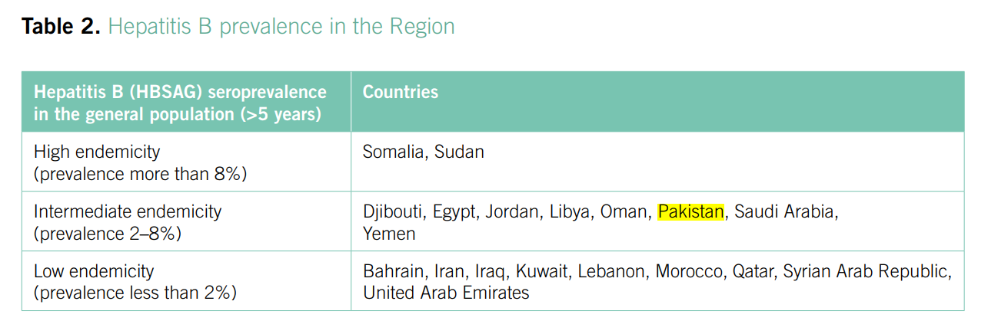
Source: Regional action plan for the implementation of the global health sector strategy on viral hepatitis 2017–2021

Slide 14
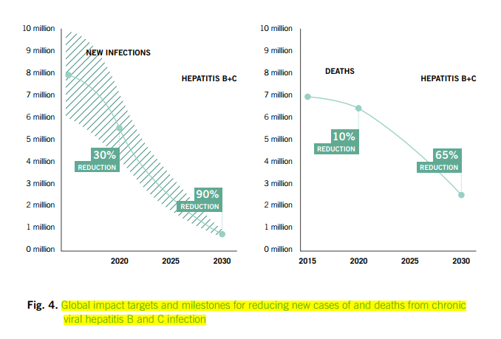
Source: Regional action plan for the implementation of the global health sector strategy on viral hepatitis 2017–2021

Slide 15
https://www.emro.who.int/pak/programmes/
https://www.emro.who.int/pak/programmes/prevention-a-control-of-hepatitis.html
2009 Pakistan
https://www.who.int/data/gho/data/themes/mortality-and-global-health-estimates/global-health-estimates-leading-causes-of-dalys
2019 Pakistan
https://www.who.int/data/gho/data/themes/mortality-and-global-health-estimates/global-health-estimates-leading-causes-of-dalys
United Kingdom
https://www.who.int/data/gho/data/themes/mortality-and-global-health-estimates/global-health-estimates-leading-causes-of-dalys
China
https://www.who.int/data/gho/data/themes/mortality-and-global-health-estimates/global-health-estimates-leading-causes-of-dalys
DOUBLE BURDEN OF DISEASES
COMMUNICABLE DISEASES
NON COMMUNICABLE DISEASES
NON COMMUNICABLE DISEASES

Slide 17
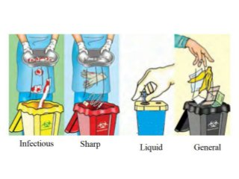
26 % : Training
74% : Never Attended
64% : Admin Responsibility

Slide 18
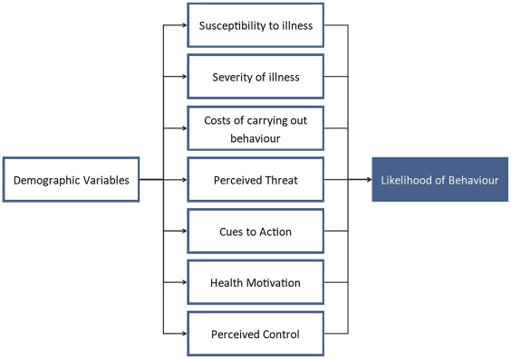
HEALTH SYSTEM ANXIETY
Quacks
Self Medication
Community perceptions / Believes
Community Engagement
COMMUNITY ???? ATTITUDE / ACTIONS

Slide 19
HEALTH SYTEM DEVELOPMENT PHASE
Observatory Phase
Learning Phase
Experimental Phase
Maturity Phase

Slide 20
PATIENT SUFFERINGS
Specialty Choices Among Future Doctors of Rawalpindi Medical College,
Rawalpindi in Perspective of Public Health
ADDITIONAL OBSERVATIONS
Public Health Facilities
Poor Referral system
Low Health Care Delivery Services At
Primary Health Care
______________________
More patients visit to
Private Hospitals and clinics
_____________________
Low compliance
3 to 4 consultations with different physicians
Low Follow-up
______________________
Resistance & Chronicity
of diseases & Illnesses
Low Primary ^ Secondary Health level
Low Regional Screening of diseases
Low Research at physicians level
Low Social Mobilization
Public Health : 02 %
Role of Family Physicians in Controlling Epidemic
Role in Disease Surveillance & Data Collection

Slide 21
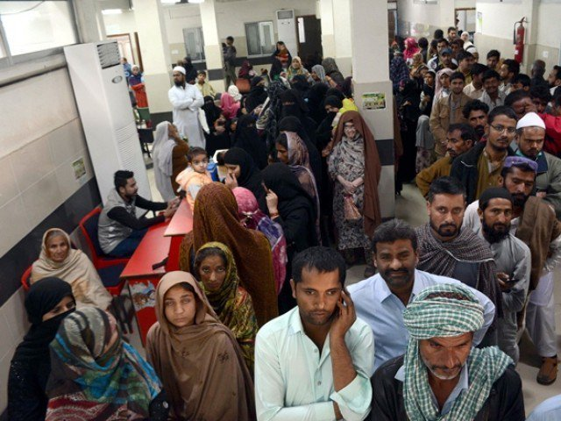
The mortality rate of children under the age of five in Pakistan remains high at 94 per 1,000 live births with diarrheal diseases, while infant mortality stands at 78 in 1,000 and maternal mortality ratio at an estimated 276 in 100,000. The report further revealed that Pakistan has a health service environment that was challenged by the impact of poverty, a changing burden of disease, communicable, non-communicable, the lack of access to quality health services for its rural population and lifestyles. The situation is further complicated by increasing numbers of both the aged population and young age groups.
A sorry state of affairs: ‘Condition of healthcare sector deteriorating fast’
https://tribune.com.pk/story/1680861/sorry-state-affairs-condition-healthcare-sector-deteriorating-fast

Slide 22
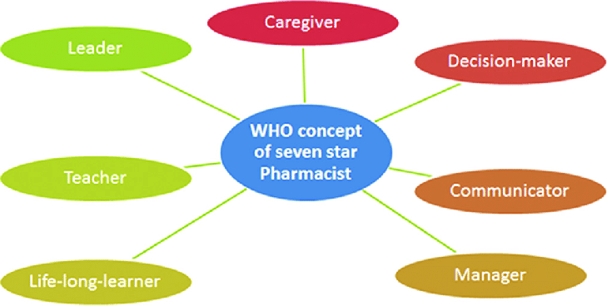
Seven star doctor

Slide 24
DEVELOPING WORLD
Communicable Diseases & Non Communicable Diseases are widespread and Pakistan is facing severe double burden of disease which in recent years has become a major international public health concern.
Communication, Collection of Data, Summarization, analysis and Instant Results are the major tasks.
Admin, Incharge and the Health / Administration authorities find it difficult to locate them as well as other issues which they are facing of such as Tracking System, Patient’s Health Care, Surveillance, Coordination, Team Facilitation, Feedback and Reporting System.

Slide 25
DEVELOPING WORLD
Problem / Issues Health Level Integration
Allied Departments Coordination
Epidemic time (Team daily attendance)
Micro plans (Indoor, Outdoor Teams, Sanitary Inspector
Public Health Worker, School Health , Nutrition Supervisor & Entomologist (in Dengue),
Surveillance of areas Sanitation Condition, Pictures of various potential breeding sites, Hot spots Registration their surveillance.
Locate the Patient Surveillance and screening of patient
Logistics The all Coordination & Integration with team for different logistics/ backup support in case of any unavoidable event Happens.
Data Gov’t Hospitals

Slide 26
DEVELOPING WORLD
Allied Departments Village, Union council, Tehsil and District level is mostly through telephonically and through WhatsApp groups; the same scenario repeat / experience by teams.
magnitude of the problem All use Google Map and picture captured by the team assessed by Incharges to analyze the and likewise the support needed.
Feedback and reporting is another important concern because of this team and supervisor has to suffer for loss of any report

Slide 27
ROLE OF DOCTOR ROLE OF PUBLIC HEALTH COMMUNITY ENGAGEMENT INDENTIFICATION OF PROBLEM & SOLUTION

Slide 28
GAPS

Slide 29
GAPS
To Improve Integration , Communication, Strategies
To Improve Tracking System, Patient’s Health Care, Surveillance, Coordination, Team Facilitation as well as strengthening the feedback and Reporting System In Pakistan.
Integration and synchronization of health levels

Slide 30
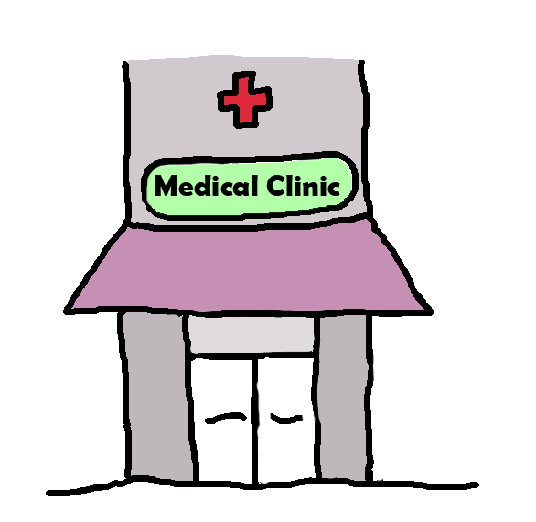
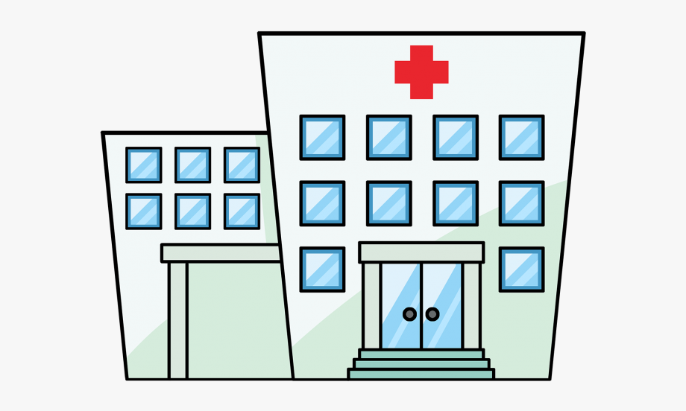
A Model; ROAD MAP TO ACHIEVE SUSTAINABLE DEVELOPMENT GOALS 2030 National Health Policy for Integrated Health Care Delivery System Integrated Management System, Family Physicians & Public Health Information System
QUALIFICATION | FPRS | PUBLIC SECTOR
MBBS | PRIMARY HEALTH CARE PROVIDER | BASIC HEALTH UNIT
MBBS + CERTIFICATE / DIPOLMA PIBLIC HEALTH OR MCPS FAMILY MEDICINE | SECONDARY HEALTH CARE PROVIDER | RHC , THQ , DHQH
MBBS FCPS / MCPS / FRCS / FRCP MPH | TERTIARY HEALTH CARE PROVIDER | TEACHING HOSPITALS
UNIVERSAL REGISTRATION SYSTEM
(Private – Private & Private with Public Health Care Centers.
Encouraging Research , General Survey And Epidemic Survey.

Slide 32
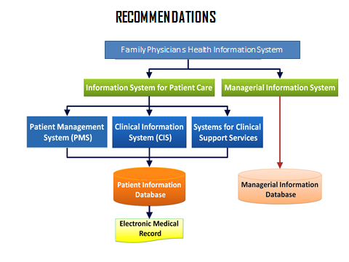
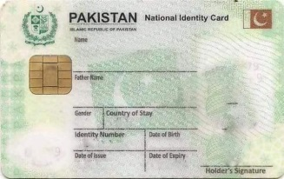
Registration
Doctors UC wise
UC wise Healthy & Diseased
Pt. Care & Health Data
Rx & Follow Up
Compliance to Rx
Emergency crises
Physician Shift within UC
Patient Referral
Paper free health care settings and for healthy outcomes and improvement of health care delivery system.

Slide 33
Primary & Secondary Health Care MO
UC MO / UC GP / UC Physician
Community Screening
Disease Surveillance
Social Mobilization
Research at Physicians level report to consultants & Tertiary Care Administration
Integration, Coordination and Synchronization
Reduce Resistance & chronicity of Diseases
Re’Con at P&SHC
Evidence Based Practice

Slide 34
INNOVATIVE IDEA / SOLUTION
Appropriate & remedial Measures
Self-paced Auto- Integrated System
The Regional Screening of diseases at Physicians level & Primary and secondary Health Department.
It will also maintain all the employees’ record, their deployment, their schedules, previous Data, location tracking, online Training as well as co-ordination with all Allied departments.
Integration, Coordination, Synchronization of health care delivery services

Slide 35
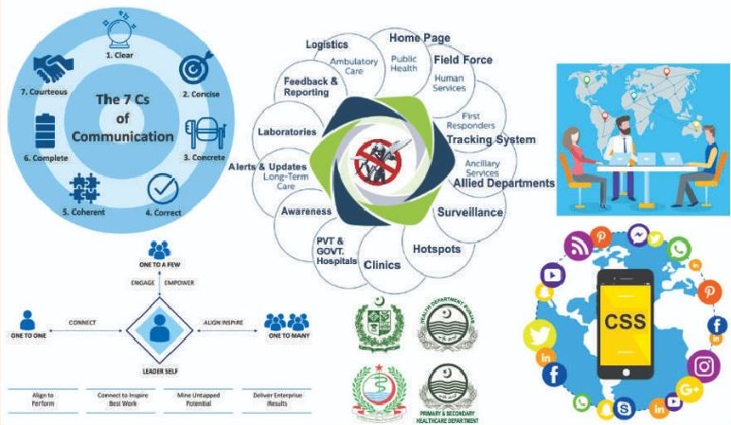
CSS

Slide 36
Home page
Field Force
Allied Departments
Surveillance & Screening
Alerts & Updates
Tracking System
Hot Spot
Clinics
Hospitals
Public
Laboratory Dx
Feedback & Reporting
Logistics
Rx & Pharmacy
Hospitals
PVT

Slide 38
