Slide 2
Infective Endocarditis
Dr. Abrar Akbar
Associate Professor , MICU , Holy Family Hospital

Slide 3
UNIVERSITY MOTTO, VISION, VALUES & GOALS
MISSION STATEMENT
To impart evidence-based research-oriented health professional education
Best possible patient care
Mutual respect, ethical practice of healthcare and social accountability.
VISION AND VALUES
Highly recognized and accredited centre of excellence in Medical Education,
Using evidence-based training techniques for development of highly
Competent health professionals, who are lifelong experiential learner and are
Socially accountable.

Slide 4
GOALS
The Undergraduate Integrated Learning Program is geared to
provide you with quality medical education.
Provide thorough grounding in the basic theoretical concepts underpinning the practice of medicine.
• Develop and polish the skills required for providing medical services at all levels of the Health care delivery system.
• Help you attain and maintain the highest possible levels of ethical and professional conduct in your future life.
• Kindle a spirit of inquiry and acquisition of knowledge to help you attain personal and professional growth & excellence.

Slide 5
SEQUENCE OF LGIS
Learning objectives
Definition
Integration with pathophysiology
Types and risk factors of Infective Endocarditis
Related Clinical Features
Complications
Investigations
Management
Research articles related to topic
Ethics

Slide 6
LEARNING OBJECTIVES
AT THE END OF THIS LECTURE STUDENTS SHALL BE ABLE TO LEARN:
Definition and causes of Infective Endocarditis
Classification of Infective Endocarditis
Pathophysiology of Infective Endocarditis
Signs and symptoms of Infective Endocarditis
Investigations
Medical management
Recent advances
Ethics

Slide 8
Introduction:
Microbial infection of the Endocardium
A vegetation characteristically found on the valvular leaflets

Slide 9
Classification:
ACUTE VS. SUBACUTE
CAUSATIVE AGENT
NATIVE VALVE VS. PROSTHETIC VALVE
RIGHT-SIDED VS. LEFT-SIDED
CULTURE-POSITIVE VS. CULTURE-NEGATIVE

Slide 10
Classification:
Acute
Affects normal heart valves
Rapidly destructive
Metastatic foci
Commonly Staph.
If not treated, usually fatal within 6 weeks
Sub acute
Often affects damaged heart valves
Indolent nature
If not treated fatal by one year

Slide 11
Pathophysiology:
Turbulent blood flow
Disrupts the endocardium making it “sticky”
Bacteremia
Delivers the organisms to the endocardial surface
Adherence
Of the organisms to the endocardial surface
Eventual invasion
Of the valvular leaflets

Slide 12
Risk Factors:
Intravenous drug abuse
Artificial heart valves and pacemakers
Acquired heart defects
Calcific aortic stenosis
Mitral valve prolapse with regurgitation
Congenital heart defects
Intravascular catheters

Slide 13
Causative Organisms:
Common bacteria
S. aureus
Streptococci
Enterococci
Not so common bacteria
Fungi
Pseudomonas
HACEK

Slide 14
Symptoms:
Acute High grade fever and chills SOB Arthralgias/ myalgias Abdominal pain Pleuritic chest pain Back pain | Subacute Low grade fever Anorexia Weight loss Fatigue Arthralgias/ myalgias Abdominal pain N/V
The onset of symptoms is usually ~2 weeks or less
from the initiating bacteremia

Slide 15
Signs:
Fever
Heart murmur
petechiae
subungal or “splinter” hemorrhages
Clubbing
Splenomegaly
neurologic changes
Osler’s Nodes
Janeway lesions
Roth Spots

Slide 16
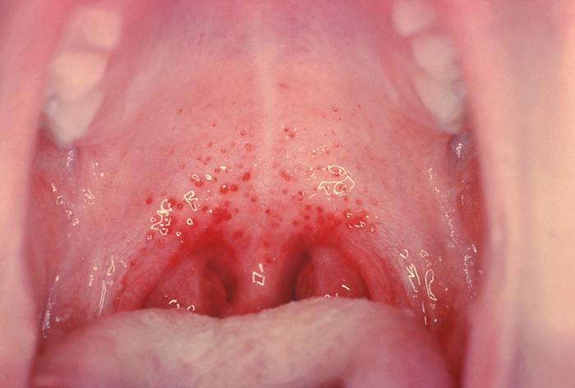
Petechiae: Non specific, located on extremities and mucous membranes.

Slide 17
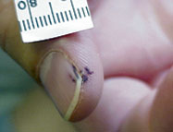
SPLINTER HEMORRHAGES
Nonspecific
Nonblanching
Linear reddish-brown lesions found under the nail bed
Usually do NOT extend the entire length of the nail

Slide 18
Osler’s node: More specific Painful, erythematous Located on pulp of fingers and toes.

Slide 19
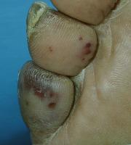
Janeway lesions:More specific , erythematous, blanching, non painful, located on palms and soles.

Slide 21
COMPLICATIONS
Congestive heart failure
When the vegetations grow as the infection proceeds, small pieces may break off, travel through the blood, and become lodged in other locations throughout the body. These locations include:
The intestines
The lungs
The kidneys
The liver
The brain
Systemic embolization
Four etiologies
Embolic
Local spread of infection
Metastatic spread of infection
Formation of immune complexes – glomerulonephritis and arthritis

Slide 22
EMBOLIC COMPLICATIONS
Occur in up to 40% of patients with IE
Predictors of embolization
Size of vegetation
Left-sided vegetations
Fungal pathogens, S. aureus, and Strep. Bovis
Incidence decreases significantly after initiation of effective antibiotics

Slide 23
Stroke
Myocardial Infarction
Fragments of valvular vegetation or vegetation-induced stenosis of coronary ostia
Ischemic limbs
Hypoxia from pulmonary emboli
Abdominal pain (splenic or renal infarction)

Slide 24
LOCAL SPREAD OF INFECTION
Heart failure
Extensive valvular damage
Paravalvular abscess (30-40%)
Most common in aortic valve, IVDA, and S. aureus
May extend into adjacent conduction tissue causing arrythmias
Higher rates of embolization and mortality
Pericarditis
Fistulous intracardiac connections

Slide 25
METASTATIC SPREAD OF INFECTION
Metastatic abscess
Kidneys, spleen, brain, soft tissues
Meningitis and/or encephalitis
Vertebral osteomyelitis
Septic arthritis

Slide 26
Diagnosis:
Blood Cultures
Minimum of three blood cultures
Positive Result
Typical organisms present in at least 2 separate samples

Slide 27
Additional tests:
CBC
ESR and CRP
Complement levels (C3, C4)
RF
Urinalysis
Baseline chemistries and coags

Slide 28
Imaging:
Chest x-ray
Look for multiple focal infiltrates and calcification of heart valves
ECG
Rarely diagnostic
Look for evidence of ischemia, conduction delay, and arrhythmias
Echocardiography

Slide 29
Modified Duke’s Criterion:

Slide 30
Treatment:
Parenteral antibiotics
High serum concentrations to penetrate vegetations
Prolonged treatment to kill dormant bacteria clustered in vegetations
Surgery
Intracardiac complications
Surveillance blood cultures

Slide 31
TREATMENT INFECTIVE ENDOCARDITIS

Slide 32
RESEARCH
Hubers SA, DeSimone DC, Gersh BJ, Anavekar NS. Infective endocarditis: a contemporary review. InMayo Clinic Proceedings 2020 May 1 (Vol. 95, No. 5, pp. 982-997). Elsevier.

Slide 33
ETHICS
Before doing any medical treatment, informed consent must be taken
Prognosis should be explained to patients and attendants

Slide 34
THANK YOU FOR ACTIVE LISTENING !

