Slide 2
INFECTIONS IN PREGNANCY; Respiratory and Gastrointestinal Infections
DR.MUHAMMAD ARIF
ASSOCIATE PROFESSOR
DEPARTMENT OF MEDICINE
HOLY FAMILY HOSPITAL
RAWALPINDI MEDICAL UNIVERSITY

Slide 3
University Motto, Vision, Values & Goals
Mission Statement
To impart evidence-based research-oriented health professional education Best possible patient care Mutual respect, ethical practice of healthcare and social accountability.
Vision and Values
Highly recognized and accredited centre of excellence in Medical Education, using evidence-based training techniques for development of highly competent health professionals, who are lifelong experiential learner and are socially accountable.
Goals
The Undergraduate Integrated Learning Program is geared to provide you with quality medical education in an environment designed to:

Slide 5
CORE CONCEPT
Overview:
Infections during pregnancy can lead to significant maternal and fetal complications.
Understanding RTIs and GIs is crucial for improving outcomes.

Slide 6
CORE CONCEPT
Objective:
Discuss common infections
Risk factors
Diagnosis
Management
Prevention strategies.

Slide 7
VERTICAL INTEGRATION
Respiratory Tract Infections (RTIs)
Common cold
Nasal congestion is the most common symptom and other common symptoms include sore throat, cough, and malaise.
Acute bronchitis:
Suspected in patients with acute onset of a persistent cough (often lasting one to three weeks) and who do not have clinical findings suggestive of pneumonia (eg, fever, tachypnea, rales, signs of parenchymal consolidation).

Slide 8
VERTICAL INTEGRATION
Acute sinusitis: includes nasal congestion, purulent nasal discharge, maxillary tooth discomfort, hyposmia, and facial pain or pressure.
The choice of antibiotic is generally the same as in nonpregnant females (eg, either amoxicillin 500 mg orally three times daily or 875 mg orally twice daily
or amoxicillin-clavulanate 500 mg/125 mg orally three times daily or 875 mg/125 mg orally twice daily or
an oral third-generation cephalosporin with or without clindamycin for penicillin-allergic patients who can tolerate cephalosporins).
Fluoroquinolones and doxycycline are typically avoided.

Slide 9
VERTICAL INTEGRATION
Influenza:
Highly contagious viral infection; can cause severe respiratory illness.
Influenza should be suspected in patients with abrupt onset of fever, cough, and myalgia when influenza virus activity is present in the community.
Other symptoms, such as malaise, sore throat, nausea, nasal congestion, and headache, are common as well.
Antiviral therapy
For pregnant patients and those up to two weeks postpartum with suspected acute influenza, prompt empiric treatment with appropriate influenza antiviral medications (eg, oseltamivir 75 mg orally twice daily for five days) is recommended regardless of vaccination status

Slide 10
VERTICAL INTEGRATION
Community Acquired Pneumonia:
Can be caused by bacteria, viruses, or fungi; higher risk during pregnancy.
The classic symptoms of community-acquired pneumonia (CAP) are sudden onset of rigors followed by fever, pleuritic chest pain, shortness of breath, and cough productive of purulent sputum; however, most patients do not present with classic symptoms.

Slide 11
VERTICAL INTEGRATION
​​ Chest radiograph is required to diagnose CAP and indications for obtaining a chest radiograph (posteroanterior and lateral views) in pregnancy are the same as in nonpregnant patients and include
Shortness of breath and/or cough in association with
Fever,
Tachycardia
Tachypnea
Decreased oxygen saturation,
or rales, or signs of consolidation on lung examination.

Slide 12
Indications of hospitalization
VERTICAL INTEGRATION
Pregnant patients with CAP who have very mild disease (eg, stable normal heart and respiratory rates, oxygen saturation (SaO2) ≥95 percent during ambulation, absence of serious comorbidities) and who can maintain oral intake and adhere to medical therapy can be treated as outpatients
Most hospitalized patients can be managed initially on either a general medical ward or labor and delivery unit; ICU admission is needed for those requiring mechanical ventilation or with severe sepsis/septic shock.

Slide 13
VERTICAL INTEGRATION
The severe spectrum of illness is suggested by
Respiratory rate >30 breaths/minute,
Partial pressure of oxygen (PaO2)/fraction of inspired oxygen (FiO2) ratio <250,
Multilobar infiltrates,
Confusion/disorientation,
Uremia (blood urea nitrogen level >20 mg/dL),
Leukopenia (white blood cell count <4000 cells/mm3),

Slide 14
VERTICAL INTEGRATION
Thrombocytopenia (platelet count <100,000 cells/mm3),
Hypothermia (core temperature <36°C),
Hypotension requiring aggressive fluid resuscitation,
Hypoglycemia (in nondiabetic patients),
Hyponatremia,
or Unexplained metabolic acidosis or Elevated lactate level.

Slide 15
Choice for outpatient antibiotic treatment
VERTICAL INTEGRATION
Following algorithm is followed for outpatient treatment of CAP

Slide 16
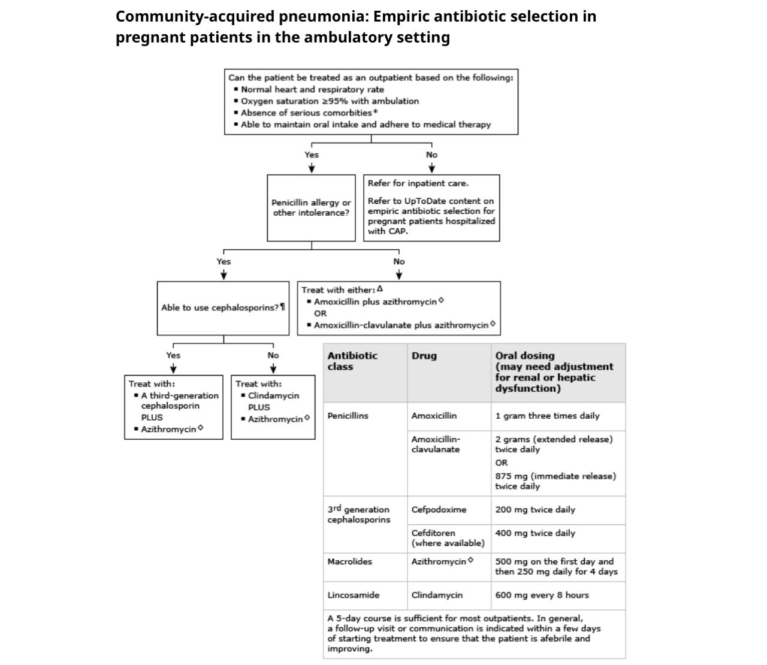
VERTICAL INTEGRATION

Slide 17
LONGITUDINALINTEGRATION

Slide 18
Choice of inpatient antibiotic therapy
VERTICAL INTEGRATION
Most patients – For pregnant patients hospitalized for CAP who do not have severe disease or risk factors for drug-resistant pathogens , we suggest combination therapy with:
•An antipneumococcal beta-lactam (ceftriaxone [(1 to 2 g IV daily], cefotaxime [1 to 2 g IV every eight hours], ampicillin-sulbactam [3 g IV every six hours]) plus
•Azithromycin (500 mg IV or orally daily)

Slide 19
VERTICAL INTEGRATION
Maternal and Fetal Risks of RTIs
Maternal Risks:
Severe respiratory distress leading to hospitalization.
Increased risk of secondary bacterial infections.
Fetal Risks:
Preterm labor and delivery.
Potential for intrauterine growth restriction (IUGR) and low birth weight.

Slide 20
VERTICAL INTEGRATION
Diagnosis of RTIs
Clinical Assessment:
History of exposure
Symptoms
Physical examination.

Slide 21
VERTICAL INTEGRATION
Diagnostic Tests:
PCR and Rapid Antigen Tests: For influenza and COVID-19.
Chest X-ray: If pneumonia is suspected; consider safety and indications.

Slide 22
VERTICAL INTEGRATION
Management of RTIs
Antiviral Medications:
Oseltamivir: For influenza; safe during pregnancy.
Monoclonal antibodies: For COVID-19 (based on current guidelines).
Supportive Care:
Hydration, rest, and symptomatic relief (e.g., acetaminophen for fever).
Vaccination Recommendations:
Influenza and COVID-19 vaccines are safe and recommended for pregnant individuals.

Slide 23
CORE CONCEPT
Gastrointestinal Infections (GIs)
Common Pathogens:
Norovirus: Highly contagious; often associated with outbreaks.
Salmonella: Typically from contaminated food; can cause severe diarrhea.
Listeria monocytogenes: Associated with ready-to-eat foods; serious risk for pregnant women.
Symptoms: Nausea, vomiting, diarrhea, abdominal cramping.

Slide 24
CORE CONCEPT
Maternal and Fetal Risks of GIs
Maternal Complications:
Dehydration leading to electrolyte imbalance; potential hospitalization.
Fetal Risks:
Listeriosis can lead to miscarriage, stillbirth, or neonatal sepsis.
Risk of preterm labor with severe GI symptoms.

Slide 25
VERTICAL INTEGRATION
Diagnosis of GIs
Clinical History:
Recent travel, dietary habits, exposure to outbreaks.
Diagnostic Tests:
Stool cultures to identify pathogens.
PCR for specific viral infections (e.g., norovirus).

Slide 26
VERTICAL INTEGRATION
Management of GIs
Rehydration:
Oral rehydration solutions; IV fluids for severe cases.
Nutritional Support:
Gradual reintroduction of bland foods as tolerated.
Antibiotics:
Reserved for severe bacterial infections or high-risk cases (e.g., Listeria).

Slide 27
HORIZONTAL INTEGRATION
Prevention Strategies
Hygiene Practices:
Handwashing, food safety (e.g., proper cooking temperatures).
Vaccination:
Influenza and COVID-19 vaccinations.
Education:
Importance of recognizing symptoms early and seeking care.

Slide 28
EYE INFECTIONS IN PREGNANCY
CORE CONCEPT
Common infections include conjunctivitis , keratitis and uveitis.
Symptoms include redness, swelling, discharge, pain or visual blurring.
Common pathogens include bacteria and viruses.
Common antibiotic drops safe in pregnancy and lactation include erythromycin and polymyxin B.
Quinolones and aminoglycosides should not be due to potential side effects.
Corticosteroids eye drops are safe to use during pregnancy.

Slide 29
ENT INFECTIONS IN PREGNANCY
CORE CONCEPT
Approximately 30% of pregnant women experience nasal disorders, such as rhinitis (inflammation of the nasal lining) and sinus congestion.
These changes may lead to a higher rate of sinus infections and an increased incidence of nosebleeds (epistaxis).
Other ENT problems during pregnancy are generally similar to non-pregnancy rates.
Symptoms include burning, sharp, or dull pain, swelling, redness, or inflammation of the ear canal, itching in and around the ear, hearing loss, tinnitus, or ringing in the ear, headache, yellow or green drainage from the ear.

Slide 30
CORE CONCEPT
The following drugs are considered relatively safe:
beta-lactam antibiotics, macrolides and acyclovir.
Non-selective NSAIDs (until the 32nd week), nasal decongestants (with caution and up to 7 days), intranasal corticosteroids, with budesonide as the treatment of choice.
first generation antihistamines, or cetirizine (third trimester) and loratadine (second and third trimester) from the second generation, H2 receptor antagonists (except nizatidine) and proton pump inhibitors (except omeprazole), can be used to relieve patients from the related symptoms. Meclizine and dimenhydrinate, as antiemetics in vertigo attacks.
Systemic administration of prednisone and prednisolone can be considered in selected cases.

Slide 31
CORE CONCEPT
Conclusion
Key Takeaways:
Early recognition and management are essential.
Preventive measures can significantly reduce risks.
Importance of a multidisciplinary approach in managing infections during pregnancy.

Slide 32
MCQs
1.Which of the following is the most common respiratory tract infection during pregnancy?
A) Tuberculosis
B) Influenza
C) Pneumonia
D) Bronchitis

Slide 33
2.Which of the following is a safe antiviral medication for treating influenza in pregnant women?
A) Acyclovir
B) Oseltamivir
C) Ribavirin
D) Zanamivir

Slide 34
3.Which of the following is a potential complication of respiratory infections during pregnancy?
A) Gestational hypertension
B) Fetal growth restriction
C) Hyperemesis gravidarum
D) Polyhydramnios

Slide 35
4.Which antibiotic is considered safe for treating bacterial pneumonia in pregnant women?
A) Doxycycline
B) Azithromycin
C) Ciprofloxacin
D) Tetracycline

Slide 36
5.What is the preferred imaging modality for diagnosing pneumonia in pregnant women?
A) CT scan
B) MRI
C) Chest X-ray with abdominal shielding
D) Ultrasound

Slide 37
6.Which vaccine is recommended for pregnant women to prevent respiratory tract infections?
A) MMR vaccine
B) Varicella vaccine
C) Influenza vaccine
D) HPV vaccine

Slide 38
7.Which of the following is a potential complication of untreated severe gastroenteritis in pregnancy?
A) Gestational diabetes
B) Fetal growth restriction
C) Polyhydramnios
D) Pre-eclampsia

Slide 39
8.Which vaccination is recommended during pregnancy to prevent certain types of gastroenteritis?
A) Rotavirus vaccine
B) Hepatitis A vaccine
C) Hepatitis B vaccine
D) Cholera vaccine

Slide 40
9.A pregnant woman presents with fever, abdominal pain, and diarrhea. Which of the following pathogens should be suspected if she reports recent consumption of undercooked poultry?
A) Shigella
B) Listeria monocytogenes
C) Salmonella
D) Norovirus

Slide 41
MCQs Ans
1.B
2.B
3.B
4.B
5.C
6.C
7.B
8.B
9.C

Slide 42
THANKYOU

