Slide 1
IMAGING AND STAGING OF RENAL CELL CARCINOMA
Dr. Zeeshan Qadeer Assistant Professor Urology Department
Rawalpindi Medical University

Slide 2
University Motto, Vision, Values & Goals
Mission Statement
To impart evidence-based research-oriented health professional education
Best possible patient care
Mutual respect, ethical practice of healthcare and social accountability.
Vision and Values
Highly recognized and accredited centre of excellence in
Medical Education, using evidence-based training techniques for development of highly competent health
professionals, who are lifelong experiential learner and are socially accountable.
Goals
The Undergraduate Integrated Learning Program is geared to provide you with quality medical education in an environment designed to:

Slide 3
SEQUENCE OF LGIS
Learning objectives
Core Subject (70%)
Vertical Integration (10%)
Horizontal Integration (15%)
Research (3%)
Biomedical Ethics (2%)

Slide 4
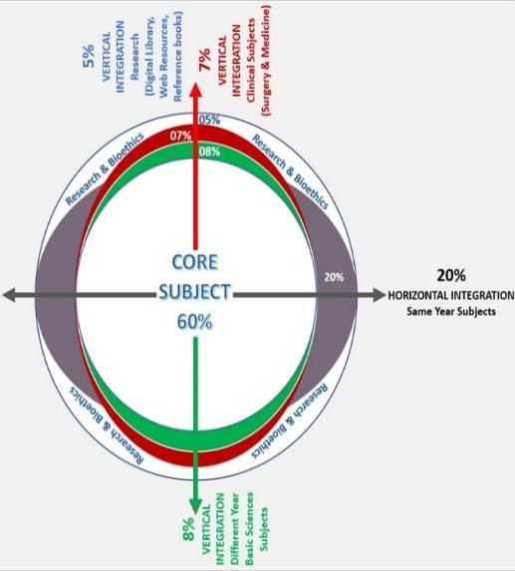
PROF UMER MODEL OF INTEGRATED LECTURE

Slide 5
LEARNING OBJECTIVES
Understand the role of different imaging modalities (Ultrasound, IVU, CT, MRI) in the detection and evaluation of renal cell carcinoma (RCC).
Describe the characteristic imaging features of RCC and differentiate between benign and malignant renal lesions.
Explain the TNM staging system for RCC, including tumor size, lymph node involvement, and distant metastasis.
Interpret clinical staging investigations, including chest X-ray, bone scan, and laboratory tests for RCC.
Discuss the importance of imaging in treatment planning, such as assessing vascular invasion and metastatic spread.
Recognize the advancements in imaging techniques, including 3D CT reconstruction and MRI for vena caval involvement.

Slide 6
CORE SUBJECT

Slide 7
INTRODUCTION
Imaging Modalities :
Ultasound
CT Scan
MRI
IVU
Staging

Slide 8
CLINICAL STAGING
Chest X-ray or Chest CT
CT/MRI scan of abdomen or pelvis
Bone scan with plan films (for elevated alkaline phosphatase or bone pain).
Laboratory: CBC, LFT's, alkaline phosphotase, BUN, creatinine.

Slide 9
VERTICAL INTEGRATION WITH RADIOLOGY

Slide 10
Imaging
Increased use of imaging has increased the detection of renal lesions most of which are simple cysts. Also a greater percentage of small renal lesions have been noted which has changed the therapeutic strategy towards renal lesions.
CT and MRI findings are fairly classical for renal tumors. Initial diagnosis with IV urography or ultrasound may require further confirmatory testing.

Slide 11
Imaging
Ultrasonagraphy
Excellent in distinguishing cystic from solid masses.
30-50% of patients >50 years will have renal cysts

Slide 12
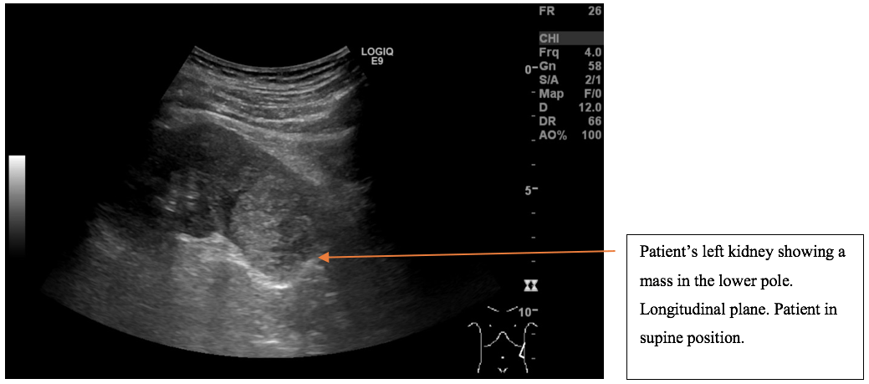

Slide 13
Imaging
Intravenous Urography
Starting point for hematuria evaluations
Abnormal findings require other imaging for conformation
Calcification pattern suggestive
Speckled or mottled, 90% cancer
Rim calcification 10-20% cancer

Slide 14
Imaging
Computed tomography
Provides an excellent assessment of the parenchyma and nodal status. Thin slice images provide superior definition of smaller lesions. Good assessment of nodal status is provided. Tissue signature of fat allows diagnosis of AML. 3-D reconstruction now available

Slide 15
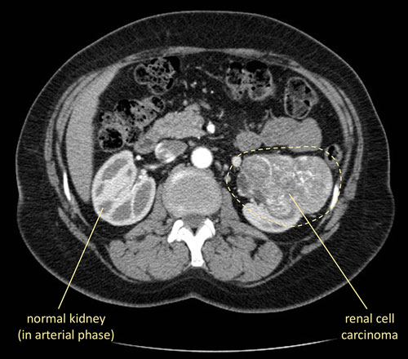
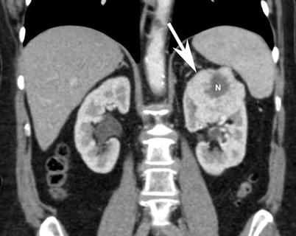

Slide 16
Imaging
Magnetic Resonance Imaging
Non ionizing radiation modality provides excellent demonstration of solid renal masses and is image test of choice to demonstrate extent of vena caval involvement with tumor. Useful in patients with renal insufficiency

Slide 17
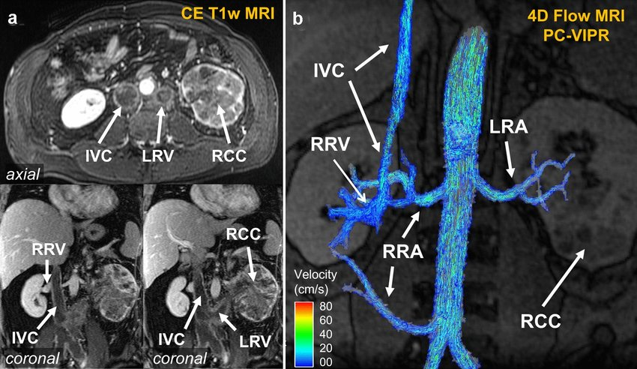

Slide 18
HORIZONTAL INTEGRATION WITH PATHOLOGY

Slide 19
American Join Committee on Cancer (AJCC) TNM Staging System.
Primary tumor (T)
TX: Primary tumor cannot be assessed (information not available).
T0: No evidence of a primary tumor.
T1a: Tumor is 4 cm in diameter or smaller and is limited to the kidney.
T1b: Tumor is larger than 4 cm but smaller than 7 cm and is limited to the kidney.

Slide 20
T2: Tumor is larger than 7 cm but is still limited to the kidney.
T2a : Tumour size between 7cm to 10cm
T2b : Tumour size greater than 10cm but limited to kidney.
T3a: Tumour extends into renal vein ot tumouor invades the peri-renal / renal sinus fit but not beyond Gerota’s fascia.
T3b: Tumour involving vena cava below the diaphragm.
T3c: Tumour involving vena cava above the diaphragm.

Slide 21
T4: Tumor has spread beyond Gerota’s fascia or ipsilateral adrenal gland.
Regional lymph nodes (N)
NX: Regional lymph nodes cannot be assessed (information not available).
N0: No regional lymph node metastasis.
N1: Metastasis to regional (nearby) lymph node.

Slide 22
Extent of Metastasis (M)
MX: Presence of distant metastasis cannot be assessed (information not available).
M0: No distant metastasis.
M1: Distant metastasis present; includes metastasis to non-regional (not near the kidney) lymph nodes and/or to other organs (such as the lungs, bones, or brain).

Slide 23
Renal Cell Cancer Stage Grouping
Stage I: T1a-T1b, N0, M0. The tumor is 7 cm or smaller and limited to the kidney. There is no spread to lymph nodes or distant organs.
Stage II: T2, N0, M0. The tumor is larger than 7 cm but is still limited to the kidney. There is no spread to lymph nodes or distant organs.
Stage III: T1a-T3b, N1, M0 or T3a-T3c, N0, M0. Several combinations of T and N categories are included in this stage. These include any tumor that has spread to only one nearby lymph node but not to other organs.

Slide 24
Stage IV: T4, N0-N1, M0 or Any T, N2, M0 or Any T, Any N, M1. Several combinations of T, N, and M categories are included in this stage, which includes any cancers that have spread directly through the fatty tissue and beyond Gerota’s fasia.

Slide 25
Spiral Integration with Family Medicine
Early detection and risk assessment of RCC in primary care settings.
Screening in high-risk populations, such as smokers and hypertensive patients.

Slide 26
Biomedical Ethics
Ethical considerations in incidental findings of renal masses and patient counseling.
Patient autonomy and shared decision-making in RCC treatment options.

Slide 27
Research
Emerging imaging techniques, such as PET scans and artificial intelligence in RCC diagnosis.
Recent advancements in molecular imaging and targeted radiotracers for metastatic RCC.
https://pmc.ncbi.nlm.nih.gov/articles/PMC9856305/

Slide 28
REFERENCES
Campbells urology 12th edition
Smith and Tanaghos urology 9th edition
EAU 2024 guidelines

