Slide 2
Ischemic Heart Disease
Dr. Abrar Akbar
Associate Professor

Slide 3
UNIVERSITY MOTTO, VISION, VALUES & GOALS
MISSION STATEMENT
To impart evidence-based research-oriented health professional education
Best possible patient care
Mutual respect, ethical practice of healthcare and social accountability.
VISION AND VALUES
Highly recognized and accredited centre of excellence in Medical Education,
Using evidence-based training techniques for development of highly
Competent health professionals, who are lifelong experiential learner and are
Socially accountable.

Slide 4
GOALS
The Undergraduate Integrated Learning Program is geared
to Provide you with quality medical education.
Provide thorough grounding in the basic theoretical
concepts underpinning the practice of medicine.
• Develop and polish the skills required for providing medical
services at all levels of the Health care delivery system.
• Help you attain and maintain the highest possible levels of
ethical and professional conduct in your future life.
• Kindle a spirit of inquiry and acquisition of knowledge to help
you attain personal and professional growth & excellence.

Slide 5
SEQUENCE OF LGIS
Learning objectives
Definition
Integration with pathophysiology
Types and risk factors of Ischemic heart disease
Related Clinical Features
Complications
Investigations
Management
Research articles related to topic
Ethics

Slide 6
LEARNING OBJECTIVES
AT THE END OF THIS LECTURE STUDENTS SHALL BE ABLE TO LEARN:
Definition and causes of Ischemic heart disease
Classification of Ischemic heart disease
Pathophysiology of Ischemic heart disease
Signs and symptoms of Ischemic heart disease
Investigations
Medical and Surgical management
Recent advances
Ethics

Slide 7
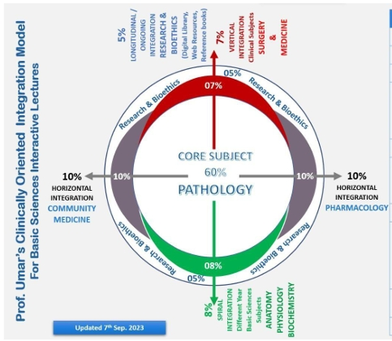

Slide 8
Definition:

Slide 9
Risk factors:

Slide 10
Classification:

Slide 11
Continued:

Slide 12
Signs:

Slide 15
Symptoms:

Slide 17
Investigation And Diagnosis:

Slide 21
Tests:

Slide 23
Treatment:

Slide 29
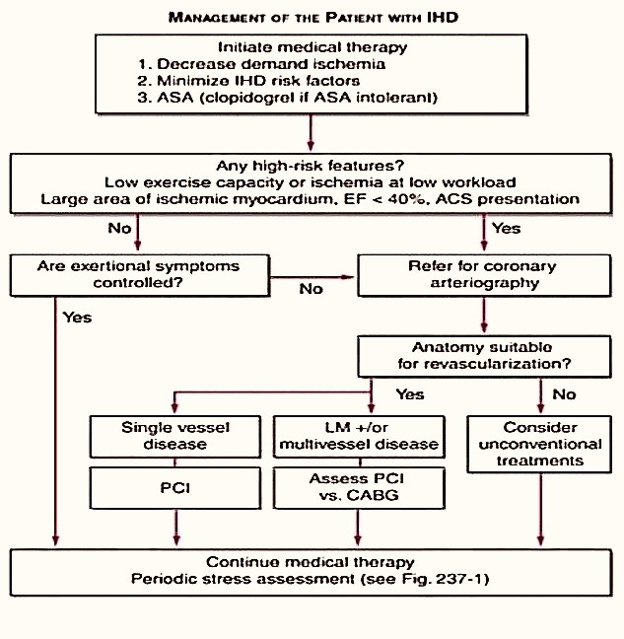

Slide 31
RESEARCH
https://www.sciencedirect.com/science/article/pii/S0001299820300088

Slide 32
ETHICS
Before doing any medical or surgical treatment, informed consent must be taken
Prognosis should be explained to patients
and attendants

