Slide 2
Inflammatory Bowel Disease (IBD)
GASTROINTESTINAL HEPATOBILIARY & PARASITOLOGY II Module
3rd year MBBS
Dr. Mudassira Zahid
Associate Professor
Department of Pathology
Rawalpindi Medical University

Slide 3
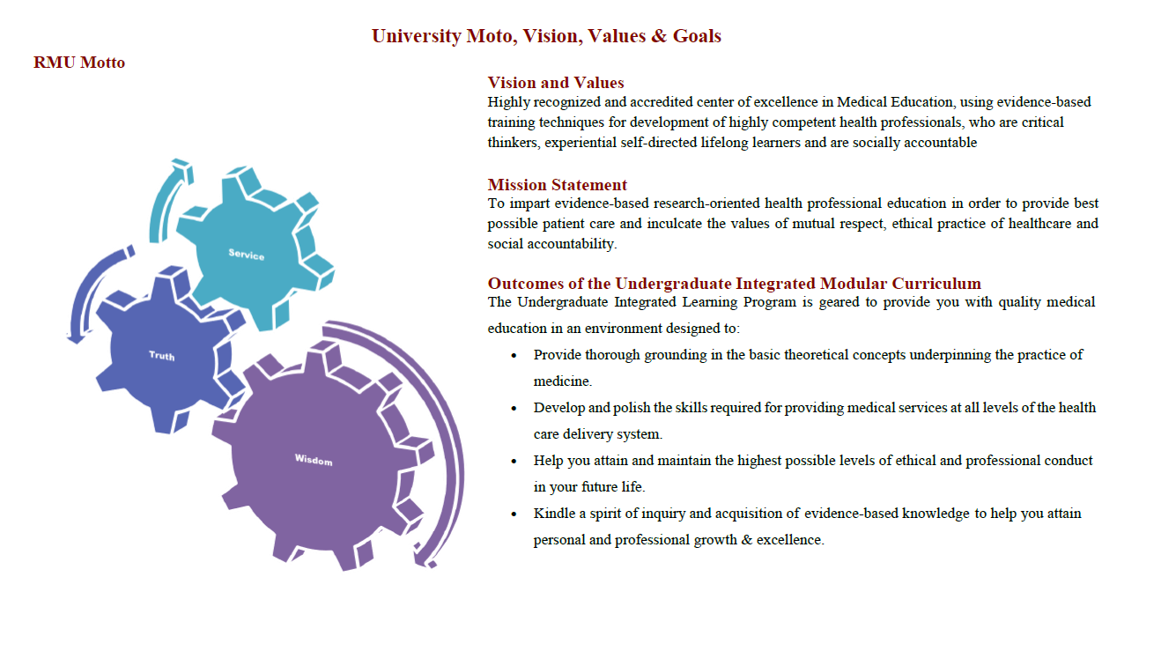

Slide 4
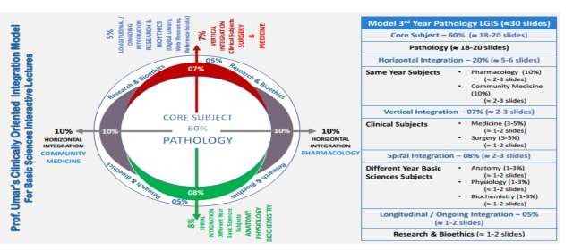

Slide 5
Learning Objectives
Describe the pathogenesis of IBD.
Differentiate between the morphological features of Crohn's disease and ulcerative colitis.
Describe the clinical features of Crohn's disease and ulcerative colitis.
Learning Resources: Robbins & Cotran Pathologic Basis Of Disease 10th Edition

Slide 6
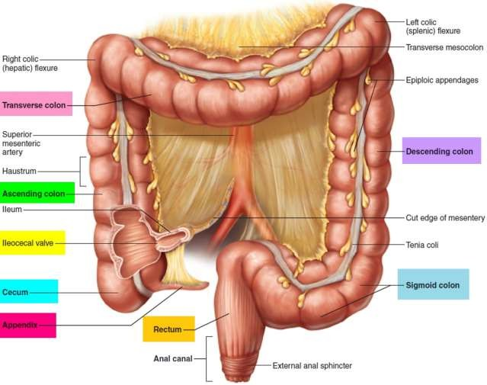
Anatomy
VERTICAL INTEGRATION

Slide 7
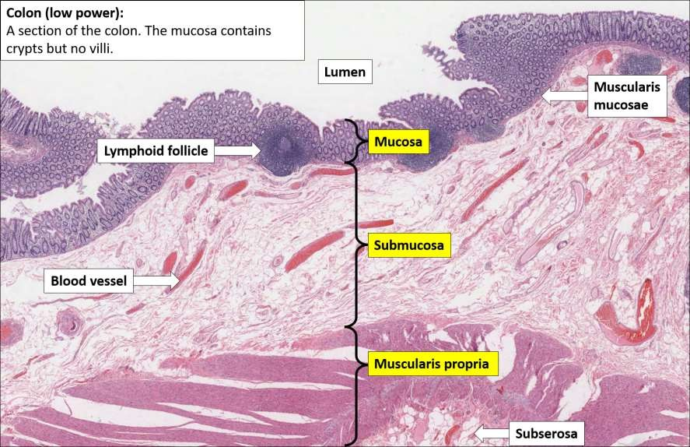
Anatomy
VERTICAL INTEGRATION

Slide 8
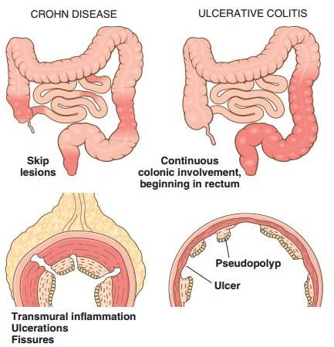
Inflammatory bowel disease (IBD)
CORE PATHOLOGY
Inflammatory bowel disease (IBD) is a chronic condition resulting from inappropriate mucosal immune activation. Two major forms:
Ulcerative colitis is limited to the colon and rectum and extends only into the mucosa and submucosa.
Crohn's disease may involve any area of the GIT and frequently is transmural (regional enteritis).

Slide 9
Irritable Bowel Syndrome (IBS)
CORE PATHOLOGY
IBS is common in females, typically affecting adolescents or young adults.
IBS results from a combination of:
Abnormal host interactions with intestinal microflora
Intestinal epithelial dysfunction
Aberrant mucosal immune responses

Slide 10
Pathogenesis
CORE PATHOLOGY
Genetics:
The risk of disease is increased when there is an affected family member.
Genetic risk is higher in Crohn's disease.
Risk is associated with NOD2 (nucleotide oligomerization binding domain 2).
The NOD2 gene codes for proteins involved in autophagy and clearance of intracellular bacteria.

Slide 11
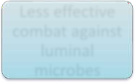
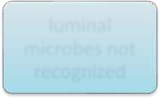
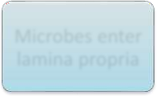
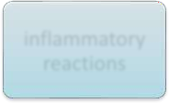
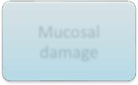
Pathogenesis
CORE PATHOLOGY
Binds to intracellular bacterial peptidoglycans
Encodes a protein
NOD2 gene
Less effective combat against luminal microbes
luminal microbes not recognized
Activates
NF-κB
Microbes enter lamina propria
Inflammatory reactions
Mucosal damage

Slide 12
Pathogenesis
CORE PATHOLOGY
Mucosal immune responses:
Immune response is important in ulcerative colitis.
Activation of TH17 and TH1 cells and production of IL-23.
Derangements in mucosal immunity and immunoregulation contribute to the development of both ulcerative colitis and Crohn's disease.

Slide 13
Mucosal immune responses:
CORE PATHOLOGY
Bacterial products are processed by dendritic cells
Dendritic cells stimulate T cells and secrete IL - 23
Bacteria enter
the mucosa
Macrophages and neutrophils cause inflammation and damage the mucosa
Activated T cells stimulate macrophages and neutrophils
Ulcerative colitis
or crohn disease

Slide 14
Pathogenesis
CORE PATHOLOGY
Epithelial defects:
Defects in intestinal epithelial tight junction barrier function.
Activate innate and adaptive mucosal immunity.
Sensitize subjects to disease.
Microbiota:
The quantity of microbial organisms in the gastrointestinal lumen is enormous, amounting to 50% of fecal mass.
The composition of this microbial population is modified by diet and disease.

Slide 15
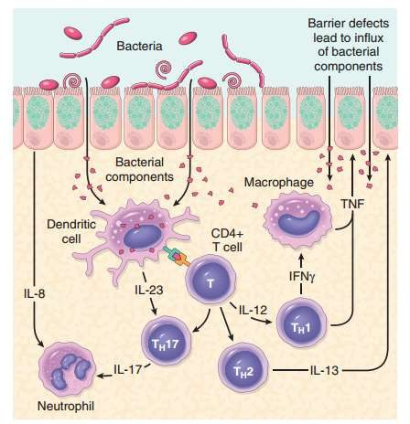
CORE PATHOLOGY

Slide 16
Release of TNF and other immune-mediated signals.
CORE PATHOLOGY
Increase tight junction permeability
Inflammation
in excess
Activates innate and adaptive immune responses
Increases the flux of luminal material

Slide 17
Crohn Disease
CORE PATHOLOGY
The most common sites:
Terminal ileum
Ileocecal valve
Cecum

Slide 18
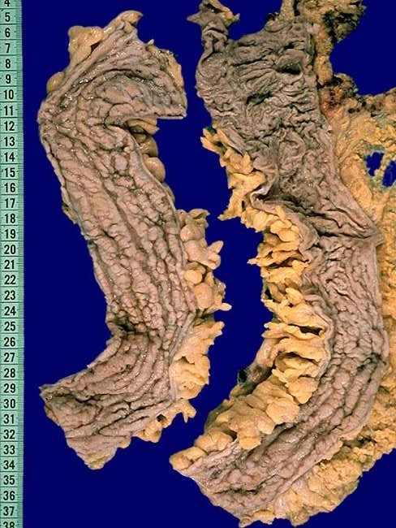
Crohn Disease
CORE PATHOLOGY
Gross:
Skip lesions: Multiple, separate, sharply delineated areas of disease.
Serpentine ulcers: Aphthous ulcers that coalesce to form elongated, serpentine ulcers oriented along the axis of the bowel.
Loss of mucosal folds: Due to edema.
Cobblestone appearance of mucosa: Diseased tissue with ulceration is depressed, and normal mucosa appears raised.

Slide 19
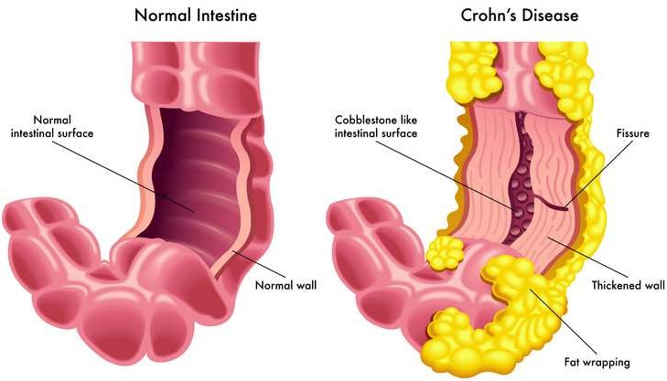
Crohn Disease
CORE PATHOLOGY
Gross:
Fissures: Extension of ulcers deep down produces fissures. These can perforate and form fistulas in the wall.
Creeping fat: Mesenteric fat frequently extends around the serosal surface.

Slide 20
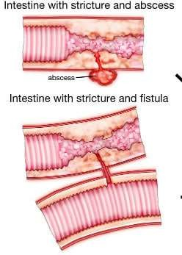
Crohn Disease
CORE PATHOLOGY
Gross:
Strictures: The intestinal wall is thickened due to transmural edema, inflammation, submucosal fibrosis, and hypertrophy of the muscularis propria, all of which contribute to stricture formation.

Slide 21
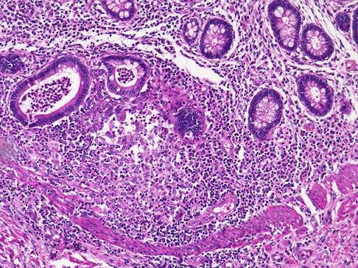
Crohn Disease
CORE PATHOLOGY
Microscopy:
Chronic inflammation, which is transmural.
Mucosal ulceration with an abrupt transition between ulcerated and normal mucosa.
Cryptitis: Neutrophils infiltrate and damage crypt epithelium.
Crypt abscess: Clusters of neutrophils within a crypt lumen.
Granulomas may also be found outside of the intestine, e.g., in mesenteric lymph nodes, skin, or lungs.
Cutaneous granulomas form nodules that are referred to (misleadingly) as metastatic Crohn's disease.

Slide 22
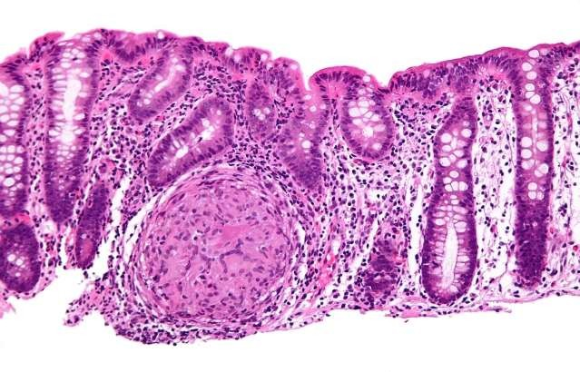
Crohn Disease
CORE PATHOLOGY
Microscopy:
Distortion of mucosal architecture: Glandular branching and irregular shape and orientation of glands. Repeated cycles of crypt destruction and regeneration.
Noncaseating granulomas: A hallmark of Crohn's disease, found in any layer of the intestinal wall.

Slide 23
Crohn Disease
CORE PATHOLOGY
Microscopy:
Epithelial metaplasia: Chronic relapsing injury results in metaplasia in the epithelial lining.
Colonic epithelium changes into gastric antral appearing glands (pseudopyloric metaplasia).
Paneth cell metaplasia.
Mucosal atrophy: Loss of crypts after years of disease.

Slide 24
Crohn Disease
VERTICAL INTEGRATION
Clinical Features:
Disease begins with intermittent attacks of relatively mild diarrhea, fever, and abdominal pain.
Periods of active disease are typically interrupted by asymptomatic intervals.
Iron deficiency anemia may develop in persons with colonic disease.
Malabsorption occurs in extensive small bowel disease.
Serum protein loss and hypoalbuminemia, generalized nutrient malabsorption, or malabsorption of vitamin B12 and bile salts.

Slide 25
Crohn Disease
VERTICAL INTEGRATION
Clinical Features:
Fistulas develop between loops of bowel and may also involve the urinary bladder, vagina, and abdominal or perianal skin.
Perforations and peritoneal abscesses are common.
Extraintestinal manifestations of Crohn's disease include uveitis, migratory polyarthritis, sacroiliitis, ankylosing spondylitis, erythema nodosum, and clubbing of the fingertips, any of which may develop before intestinal disease is recognized.
Risk of colonic adenocarcinoma is increased in patients with long-standing colonic Crohn's disease.

Slide 26
Ulcerative Colitis
CORE PATHOLOGY
Gross:
Location: Limited to the colon and rectum.
Always involves the rectum: Ulcerative proctitis.
Extends proximally in a continuous fashion:
Involves part of the colon (ulcerative proctosigmoiditis) or
Involves all of the colon (pancolitis).
The small intestine: Normal.

Slide 27
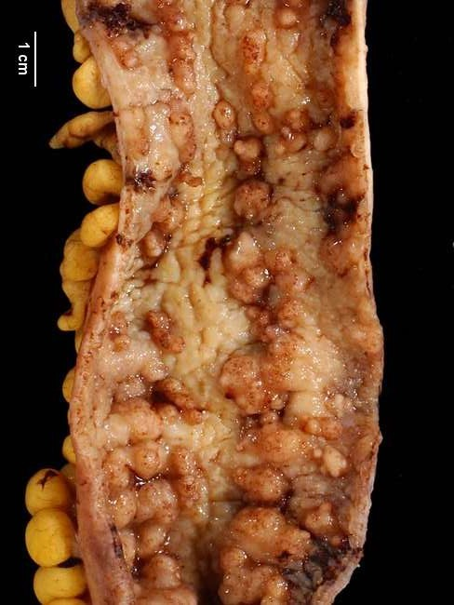
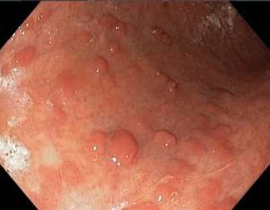
Ulcerative Colitis
CORE PATHOLOGY
Gross:
Backwash ileitis: UC does not directly involve the small intestine. However, mild mucosal inflammation of the distal ileum can be present in severe cases of pancolitis.
Colonic mucosa: Slightly red and granular-appearing.
Broad-based ulcers: Ulcers aligned along the long axis of the colon, but typically do not replicate the serpentine ulcers seen in Crohn disease.
Pseudopolyps: Isolated islands of regenerating mucosa bulge into the lumen, creating small elevations.

Slide 28
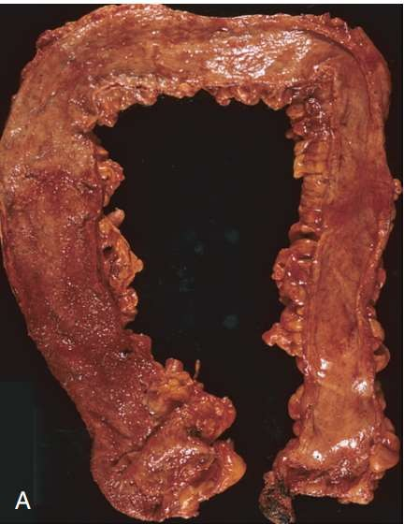
Ulcerative Colitis
CORE PATHOLOGY
Gross:
Mucosal atrophy: Chronic disease may lead to a flat, smooth mucosal surface, lacking normal folds.
Serosal surface: Normal.
Toxic megacolon: Inflammation and inflammatory mediators damage the muscularis propria, disturbing neuromuscular function and leading to colonic dilation.

Slide 29
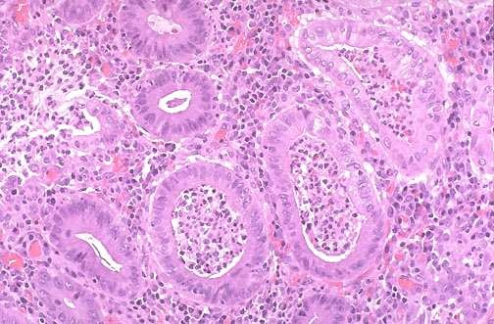
Ulcerative Colitis
CORE PATHOLOGY
Microscopy:
Inflammatory infiltrates, limited to the mucosa and superficial submucosa.
Cryptitis.
Crypt abscesses.
Crypt distortion.

Slide 30
Ulcerative Colitis
CORE PATHOLOGY
Microscopy:
Epithelial metaplasia.
No skip lesions.
Granulomas are not present.
Healed lesions: Submucosal fibrosis, mucosal atrophy, and distorted mucosal architecture remain as residua.

Slide 31
Ulcerative Colitis
VERTICAL INTEGRATION
Clinical features:
Relapsing disorder.
Bloody diarrhea with expulsion of stringy, mucoid material.
Lower abdominal pain and cramps, temporarily relieved by defecation.
Extraintestinal manifestations: Migratory polyarthritis, sacroiliitis, ankylosing spondylitis, uveitis, skin lesions, pericholangitis, and primary sclerosing cholangitis.

Slide 32
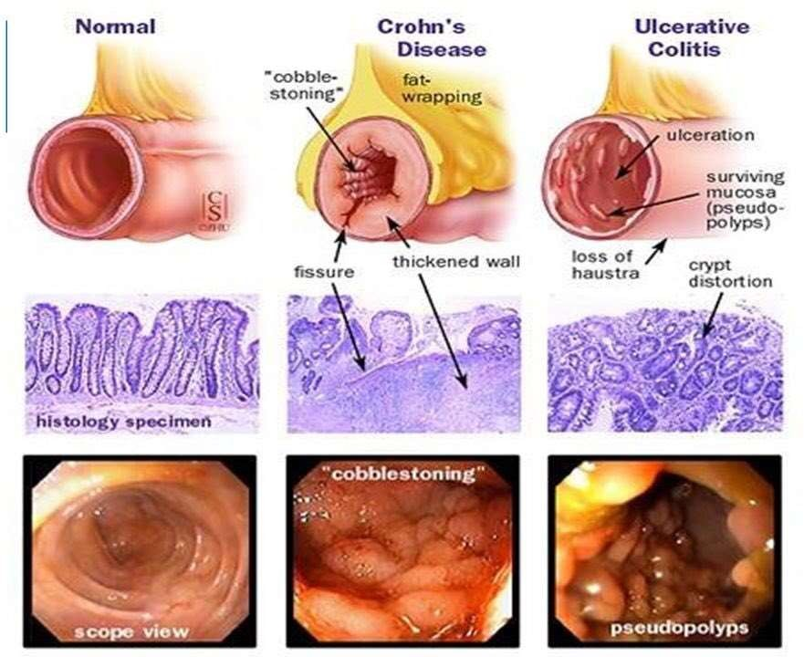
Ulcerative Colitis
CORE PATHOLOGY

Slide 33
Colitis-Associated Neoplasia
VERTICAL INTEGRATION
One of the most feared long-term complications is the development of neoplasia.
This process begins as dysplasia and progresses slowly towards full-blown carcinoma.
The risk of dysplasia is related to several factors:
Risk increases sharply 8 to 10 years after disease initiation.
Patients with pancolitis are at greater risk than those with only left-sided disease.
Greater frequency and severity of active inflammation (characterized by the presence of neutrophils) increases risk.
Dysplasia is classified histologically as low-grade or high-grade.

Slide 34
Therapy
HORIZONTAL INTEGRATION
Aminosalicylates
Corticosteroids
Immune-modifying agents
Anti-TNF monoclonal antibody therapies

Slide 35
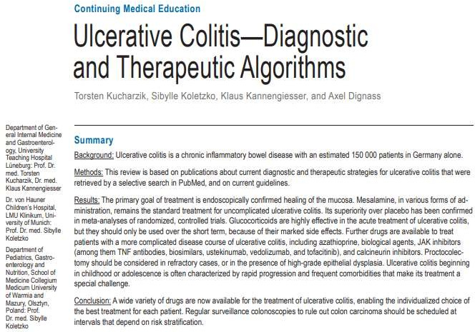
Research
Dtsch Arztebl Int. 2020 Aug; 117(33-34): 564–574.
Published online 2020 Aug
doi:10.3238/arztebl.2020.0564

Slide 36
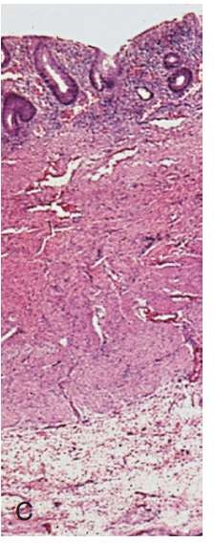
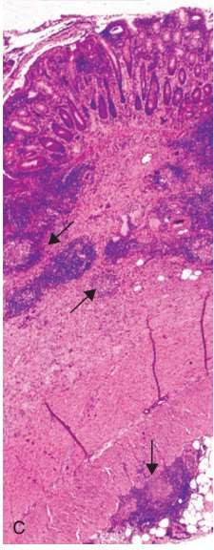
Assessment
Mucosal and superficial submucosal inflammation
Granulomas
(arrows)
Transmural inflammation
ULCERATIVE COLITIS
CROHNS DISEASES

Slide 37
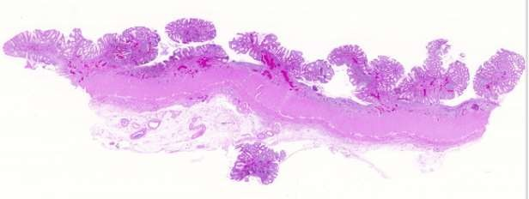
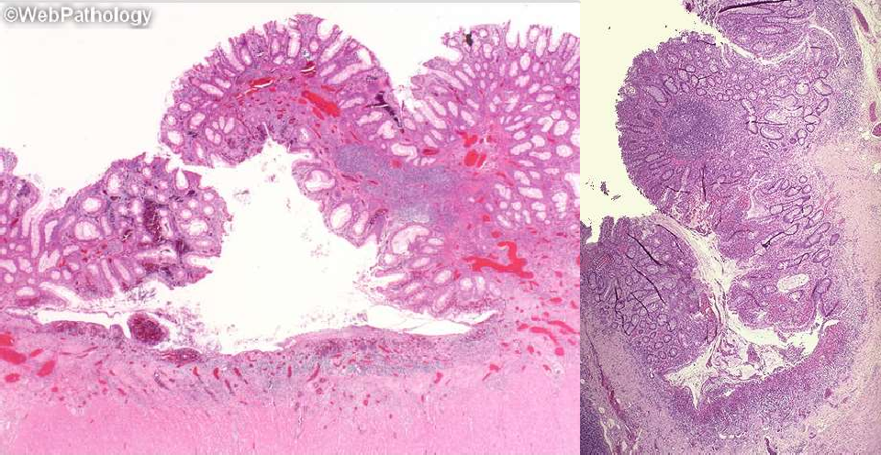
Assessment

Slide 38
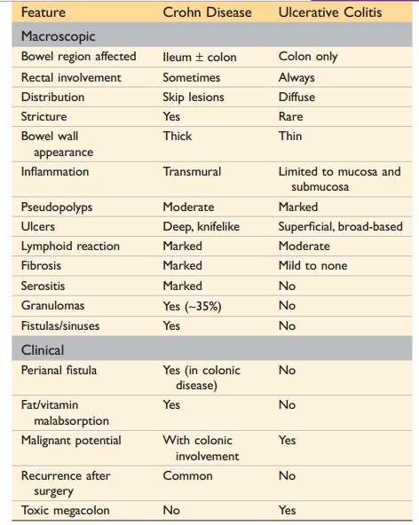
Assessment

