Slide 1
HYPERTENSIVE DISORDERS OF PREGNANCY AND FETAL GROWTH RESTRICTION
DR MALIHA SADAF
ASSISTANT PROFESSOR
GYNAE UNIT-2
HOLY FAMILY HOSPITAL

Slide 2
University Motto, Vision, Values & Goals
Mission Statement
To impart evidence-based research-oriented health professional education
Best possible patient care
Mutual respect, ethical practice of healthcare and social accountability.
Vision and Values
Highly recognized and accredited center of excellence in Medical Education, using evidence-based training techniques for development of highly competent health professionals, who are lifelong experiential learner and are socially accountable.
Goals
The Undergraduate Integrated Learning Program is geared to provide you with quality medical education in an environment designed to.

Slide 3
SEQUENCE OF LGIS
Learning objectives
Hypertensive disorder’s of pregnancy and IUGR (core concept = 70%)
Related anatomy (horizontal integration 15%)
Related clinical findings (vertical integration – 10%)
Research article related to topic (3%)
Ethics (2%)

Slide 4
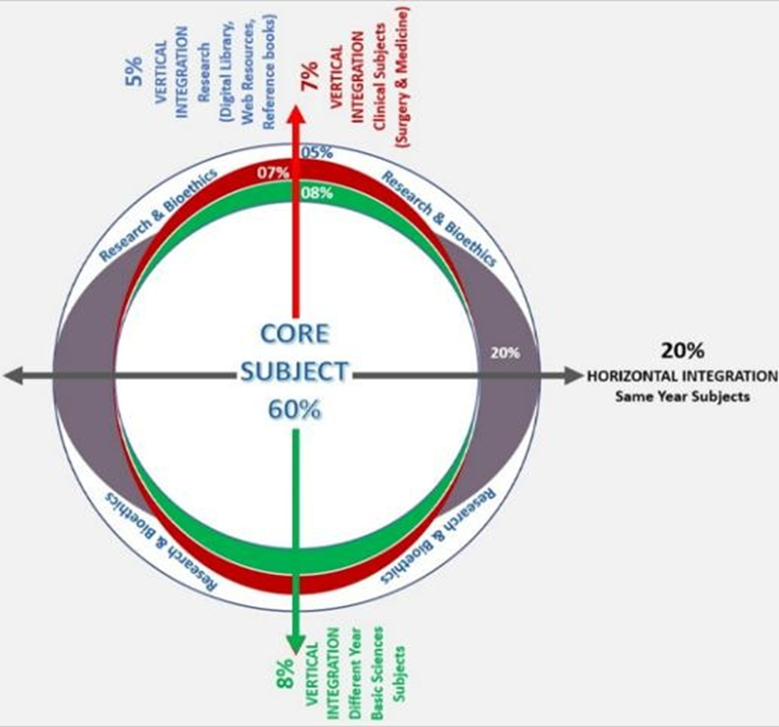
PROF UMER MODEL OF INTEGRATED LECTURE

Slide 5
DEGREES OF HYPERTENSION
Mild : Systolic blood pressure 140-149 mmHg
and diastolic Blood pressure 90-99 mm Hg.
Moderate : Systolic blood pressure 150-159 mmHg and diastolic blood pressure 100-109 mmHg.
Severe : Systolic blood pressure >160mmHg
and diastolic blood pressure >110 mmHg.

Slide 6
HYPERTENSIVE DISORDERS
Chronic Hypertension
Gestational Hypertension
Preeclampsia
Eclampsia

Slide 7

CHRONIC HYPERTENSION
Blood pressure exceeding 140/90 mmHg before pregnancy or before 20 weeks' gestation.
When hypertension is first identified during a woman's pregnancy and she is at less than 20 weeks' gestation.

Slide 8
CAUSES
Essential (90%)
Secondary
♦Renal Disease (PCKD , GN)
♦ Renal vascular Disease ( renal artery stenosis)
♦ Endocrine Disorder (mineralocorticoid excess, pheochromocytoma , hyperthyroidism or hypothyroidism , inc. growth hormone hyperparathyroidism)
♦ Coarctation of Aorta
♦ Oral Contraceptive pills

Slide 9
MANAGEMENT
Pre-pregnancy advice:
Angiotension receptor blockers, Angiotension converting enzyme inhibitors and thiazide diuretics can cause Oligohydramnios, fetal and neonatal renal failure, bony malformations, limb contractures, pulmonary hypoplasia, prolonged hypotension and neonatal death.
Stop ARBs/ACE inhibitors if became pregnant.

Slide 10
MANAGEMENT
Pregnant Female:
Weight Management
Exercise
Healthy eating
Salt restriction
Target Blood pressure 135/85 mmHg with antihypertensive

Slide 11
MANAGEMENT
Labetalol
Nefidipine
Methyldopa
Aspirin 75-150mg once daily. from 12 week

Slide 12
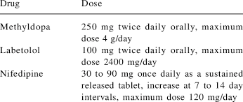

Slide 13
MANAGEMENT
Postnatal:
B.P monitoring twice daily for 2 days
B.P monitor at least once b/w day 3 to 5
Target B.P less than 140/90 mmHg
Review antihypertensive after 2 weeks
Stop methyldopa with in 2 days
Medical review after 6-8 weeks

Slide 14
GESTATIONAL HYPERTENSION
Systolic blood pressure of 140 mm Hg or higher and/or a diastolic blood pressure of 90 mm Hg or higher.
The high blood pressure first happens after 20 weeks of pregnancy.
Absence of Proteinuria

Slide 15
PATHOPHYSIOLOGY
Placental insufficiency :-
* Diffuse placental thrombosis
* Inflammatory placental decidual vasculopaty
* Abnormal trophoblastic invasion of the
endometrium .
Altered maternal immune response to fetal/placental tissue may contribute.

Slide 16
PATHOPHYSIOLOGY
Endothelial damage
Pathologic capillary leak
Rapid weight gain
Nondependent edema (face or hands)
Pulmonary edema
Hemoconcentration
Decreased uteroplacental blood flow.

Slide 17
PATHOPHYSIOLOGY
Vasospasm with arterial constriction
contribute to hypertension in preeclampsia and relatively reduced intravascular volume compared with that of a normal pregnancy.
Increased arterial stiffness

Slide 18
RISK FACTORS
Nulliparity.
Age 40 years or older.
Pregnancy interval of more than 10 years.
Family history of pre-eclampsia.
Multi-fetal pregnancy.
BMI of 35 kg/m2 or more.
Gestational age at presentation.
Previous history of pre-eclampsia or gestational hypertension.
Pre-existing vascular disease.
Pre-existing kidney disease.

Slide 19
MANAGEMENT
Degree of Hypertension
 | Mild to Moderate Hypertension B.P 140/90 to 150/109 | Severe Hypertension B.P 160/110 or more
Admission in Hospital | NOT | Admit
Pharmacological Treatment | offer | offer
Target Blood Pressure | ≤135/85 mmHg | ≤135/85 mmHg
B.P measurement | once or twice a week | Every 15- 30 mints untill B.P < 160/110
Dipstick proteinuria | Once or twice a week | Daily
BLIs (Uric acid) | At presentation than weekly | At presentation than weekly
Fetal Assessment | Scan at presentation than fortnightly | Scan at presentation than fortnightly

Slide 20
TIMING OF BIRTH
Do not offer planned early birth before 37 weeks to women with gestational hypertension whose blood pressure is lower than 160/ 110 mmHg, unless there are other medical indications.
For women with gestational hypertension whose blood pressure is lower than 160/110 mmHg after 37 weeks, timing of birth, and maternal and fetal indications for birth should be agreed between the woman and the senior obstetrician.
If planned early birth is necessary, offer a course of antenatal corticosteroids and magnesium sulfate if indicated, in line with the NICE guideline on preterm labour and birth.

Slide 21
POSTNATAL MANAGEMENT
Measure blood pressure:
daily for the first 2 days after birth.
at least once between day 3 and day 5 after birth.
For women with gestational hypertension who did not take antihypertensive treatment and have given birth, start antihypertensive treatment if their blood pressure is 150/100 mmHg or higher.
Offer women who have had gestational hypertension and who remain on antihypertensive treatment, a medical review with their GP or specialist 2 weeks after transfer to community care.
Offer all women who have had gestational hypertension a medical review with their GP or specialist 6–8 weeks after the birth.

Slide 22
FETAL GROWTH RESTRICTION

Slide 23
DEFINATION
Fetal growth restriction (FGR) is broadly defined as an estimated fetal weight (EFW) 0r abdominal circumference (AC) <10th percentile for gestational age.
Severe FGR is generally defined as an EFW or AC <3rd percentile for gestational age.

Slide 24
CLASSIFICATION
Early FGR refers to diagnosis before 32 weeks gestation in the absence of congenital anomalies.
Late FGR refers to diagnosis after 32 weeks gestation in the absence of congenital anomalies.

Slide 25
CLASSIFICATION
Symmetrical FGR
Asymmetrical FGR
Comprises of 20-30% of FGR.
Refers to growth patterns in which all fetal organs are decrease proportionally due to global impairment of cellular hyperplasia early in gestation.
Pathological process in early gestation
Comprises of remaining 70-80%.
Refers to relatively greater decrease in abdominal size than in head circumference.
Capacity of fetus to adopt pathological environment in late gestation.

Slide 26
What is the optimum method of screening for the SGA fetus/neonate and care of “at risk” pregnancies?
All women should be assessed at booking for risk factors for SGA fetus/neonate to identify those who require increased surveillance.

Slide 27
History And Physical Examination
Serial measurement of symphysis fundal height (SFH) is recommended at each antenatal appointment from 24 weeks of pregnancy as this improves prediction of SGA neonate.
SFH plotted on a customized chart rather than a population–based chart as this may improve prediction of SGA neonate.
Women in whom measurement of SFH is inaccurate (for example: BMI > 35, large fibroids, hydramnios) referred for serial assessment of fetal size using ultrasound.

Slide 28
Optimum method of diagnosing SGA fetus and FGR
Fetal abdominal circumference (AC) or estimated fetal weight (EFW) < 10th centile can be used to diagnose SGA fetus.
Use of a customized fetal weight reference may improve prediction of SGA neonate and adverse perinatal outcome.
When using two measurements of AC or EFW to estimate growth velocity, they should be at least 3 weeks apart to minimize false–positive rates for diagnosing FGR.

Slide 29
Investigations indicated in SGA fetuses
Detailed fetal anatomical survey and uterine artery Doppler by a fetal medicine specialist if severe SGA is identified at the 18–20 week scan.
Karyotyping in severely SGA fetuses with structural anomalies and in those detected before 23 weeks of gestation, especially if uterine artery Doppler is normal.
Serological screening for congenital cytomegalovirus (CMV) and toxoplasmosis infection, syphilis and malaria should be considered in high-risk populations

Slide 30
Interventions in The Prevention of SGA Fetuses
Antiplatelet agents commenced at, or before, 16weeks of pregnancy.
Promote smoking cessation
Single course of antenatal corticosteroids.

Slide 31
Optimal Method and Frequency of Fetal Surveillance in SGA

Slide 32
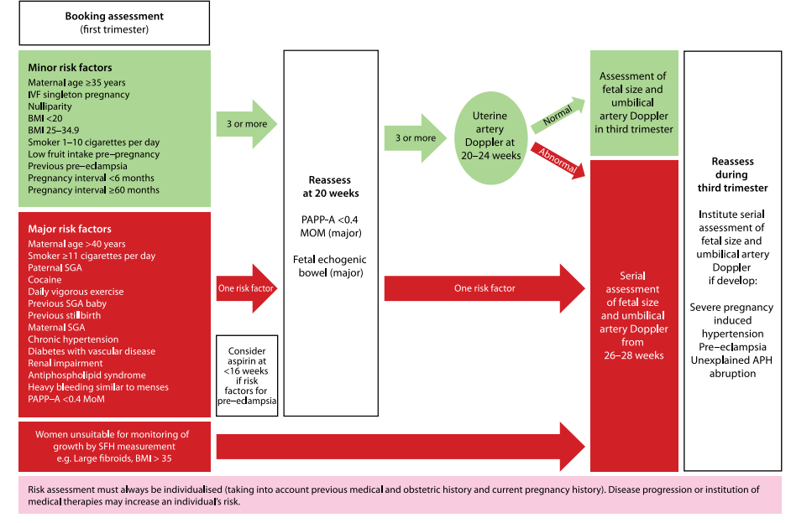

Slide 33
Umbilical artery Doppler should be the primary surveillance tool in the SGA fetus.
CTG, Biophysical profile, Ultrasound assessment of amniotic fluid volume should not be used as the only form of surveillance in SGA fetuses.
Ductus venosus Doppler should be used for surveillance in the preterm <32 weeks SGA fetus with abnormal umbilical artery Doppler and used to time delivery.

Slide 34
Optimal Gestation To Deliver The SGA Fetus

Slide 35
In the preterm SGA fetus with umbilical artery AREDV detected prior to 32 weeks of gestation, delivery is recommended when DV Doppler becomes abnormal.
Even when venous Doppler is normal, delivery is recommended by 32 weeks of gestation and should be considered between 30–32 weeks of gestation.
If MCA Doppler is abnormal, delivery should be recommended no later than 37 weeks of gestation.

Slide 36
SGA fetus detected after 32 weeks of gestation with an abnormal umbilical artery Doppler, delivery no later than 37 weeks of gestation is recommended.
In the SGA fetus detected after 32 weeks of gestation with normal umbilical artery Doppler, a senior obstetrician should be involved in determining the timing and mode of birth of these pregnancies. Delivery should be offered at 37 weeks of gestation.

Slide 37
How the SGA fetus should be delivered?

Slide 38
In the SGA fetus with umbilical artery AREDV delivery by caesarean section is recommended.
In the SGA fetus with normal umbilical artery Doppler or with abnormal umbilical artery PI but end–diastolic velocities present, induction of labour can be offered.

Slide 39
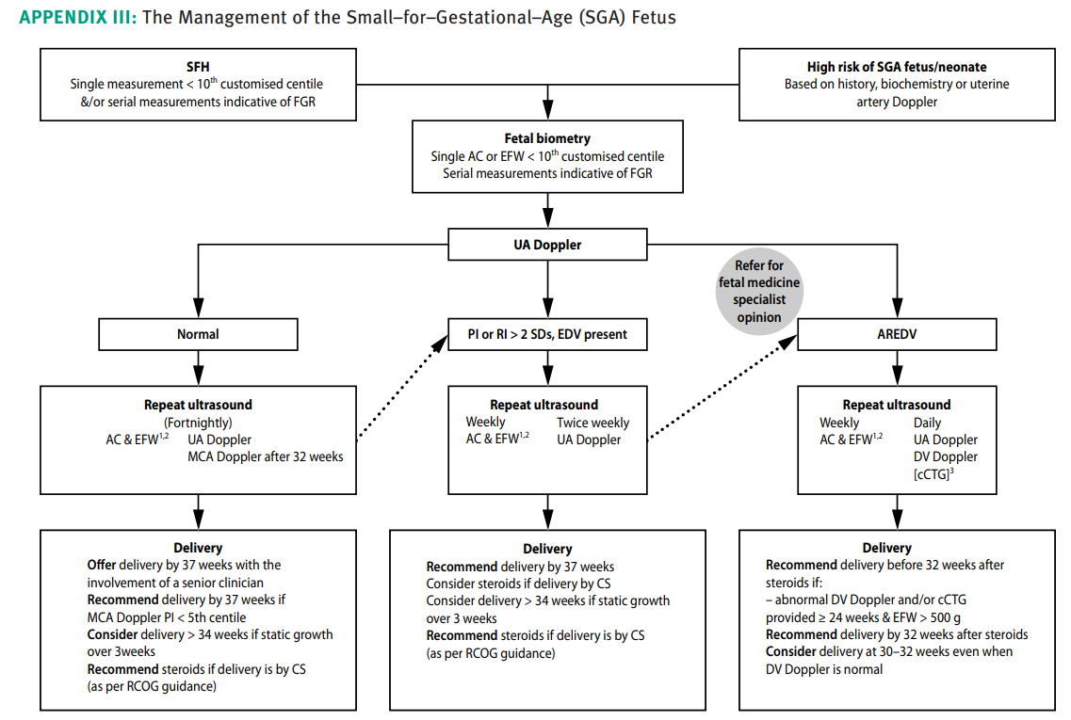

Slide 40
Bioethics
Early detection, treatment, and prevention
Ambulatory blood pressure monitoring can help diagnose HDP.
Early prediction models can help identify women at risk for preeclampsia.

Slide 41
Future Research
Alemayehu A, Demissie A, Ibrahim I, Geremew A, Mohammed F, Gudeta M, Oljira L, Dessie Y, Assefa N. Burden, risk factors, and maternal postpartum and birth outcomes of hypertensive disorder of pregnancy in Ethiopia, 2024: A systematic review and meta-analysis. SAGE Open Medicine. 2024 Oct;12:20503121241274741.
Radparvar AA, Vani K, Fiori K, Gupta S, Chavez P, Fisher M, Sharma G, Wolfe D, Bortnick AE. Hypertensive Disorders of Pregnancy: Innovative Management Strategies. JACC: Advances. 2024 Mar 1;3(3):100864.

Slide 42
Family Medicine
Close monitoring and prompt management of high blood pressure throughout pregnancy particularly in high risk patients.
Accurate diagnosis of different types of hypertensive disorders appropriate blood pressure monitoring, timely initiation of medication and close fetal surveillance to identify potential hazards with high blood pressure.

Slide 43
THANKYOU

