Slide 2
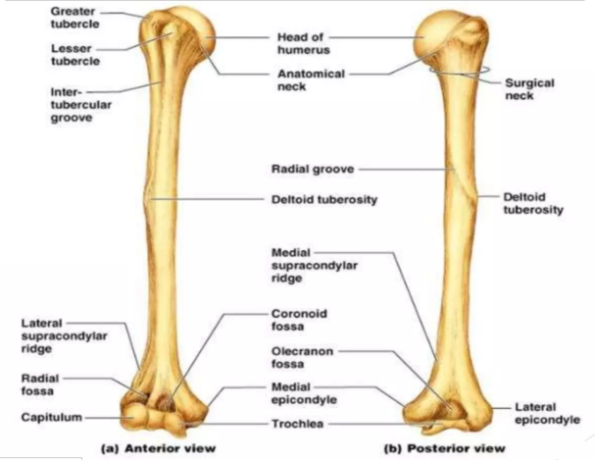
Humerus Bone
Foundation Module
1st Year MBBS SGD
1/3/2025
Dr Ali Raza

Slide 3
Vision; The Dream/Tomorrow
Motto
To impart evidence based research oriented medical education
To provide best possible patient care
To inculcate the values of mutual respect and ethical practice of medicine
Wisdom
Truth
Service

Slide 4
Professor Umar Model of Integrated Lecture

Slide 5
Assessment
Q: The bicipital groove is
Horizontal groove between lesser and greater tubercles.
Contains ascending branch of the anterior circumflex humeral artery.
Is located in scapula
Gives insertion to sartorius
Latissimus dorsi in the roof of the groove.
Q: About the middle of the humerus
Is crossed by the radial groove
Is crossed by the ulnar groove
Has insertion of the subscapularis
Has brachial artery crossing from backwards
Is the commonest site of fracture
Q: The upper end of the humerus presents the following features except
Head.
Neck.
Greater tubercle.
Lesser tubercle.
Capitulum
Q: The lower end of the humerus presents the features except:
Capitulum, a lateral rounded convex projection.
Trochlea, a medial pulley-shaped structure.
Radial fossa, a small fossa above the capitulum.
Coronoid fossa, a small fossa above the trochlea.
Greater tubercle

Slide 6
Learning Objectives
Determine the side
Demonstrate anatomical position, general features, attachments, and articulation (shoulder and elbow).
Describe the importance of anatomical and surgical neck of the humerus.
Correlate axillary, radial, median, and ulnar nerve damage with respect to various fractures of the humerus.
Describe the significance of the bicipital groove, angle of humeral torsion, and carrying angle.
Discuss ossification and fractures.
Understand the curative and preventive healthcare measures.
Apply the strategic use of artificial intelligence in healthcare.
Practice principles of bioethics.
Use the HEC digital library.
Read a relevant research article.

Slide 7
Core Concept
No of Slides - 15

Slide 8
Anatomical Position And Side Determination
The rounded head at the upper end faces medially, backward, and upwards.
The lesser tubercle, greater tubercle, and vertical groove at the upper-end face anteriorly.
The olecranon fossa on the lower flattened end faces posteriorly.

Slide 10
Features
Upper end:
Head
Anatomical neck
Lesser tubercle
Greater tubercle
Intertubercular sulcus or bicipital groove
Surgical neck
Morphological neck

Slide 14
Cont.
Shaft:
Borders
Anterior
Lateral
Medial
Surfaces
Antero medial
Antero lateral
Posterior surface

Slide 17
Cont.
Lower end:
Articular part
Capitulum
Trochlea
Non-articular part
Medial epicondyle
Lateral epicondyle
Medial supracondylar ridge
Lateral supracondylar ridge
Coronoid fossa
Radial fossa
Olecranon fossa

Slide 20
Muscle Attachment

Slide 23
Vertical Integration
No of Slides - 6

Slide 24
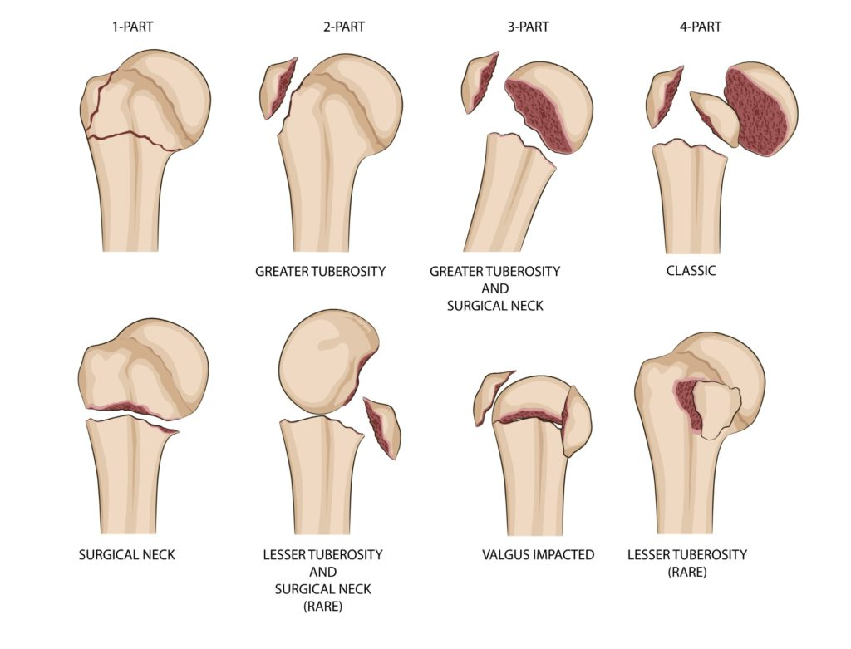
Fractures of Humerus
Fracture Head of Humerus
Associated with anterior and posterior dislocation of shoulder joint.

Slide 25
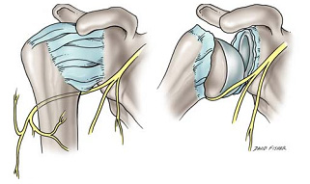
Cont.
Fracture of Anatomical Neck of Humerus
Mostly associated with posterior dislocation of the shoulder joint.
Fracture of Greater Tubercle
Associated with direct trauma or violent avulsion of supraspinatus muscle.
The fractures of the upper end of the humerus are related to axillary nerve damage.

Slide 26
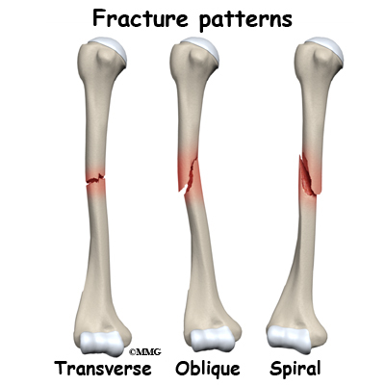
Cont.
Fracture of Shaft of Humerus
Results from direct trauma or fall on the outstretched hand.
Fractures are associated with radial nerve damage.

Slide 27
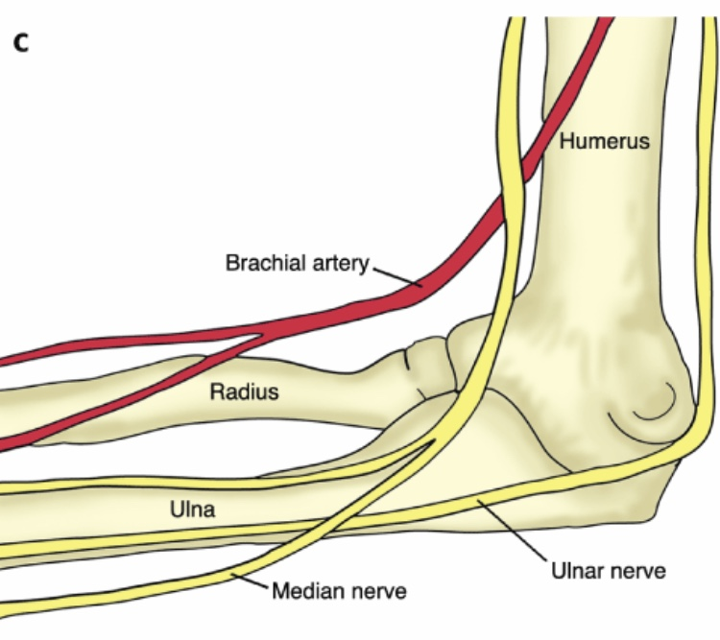
Cont.
Supracondylar Fractures of Humerus
Common in children by falling on the outstretched hand.
Median nerves and brachial artery may be damaged.

Slide 28
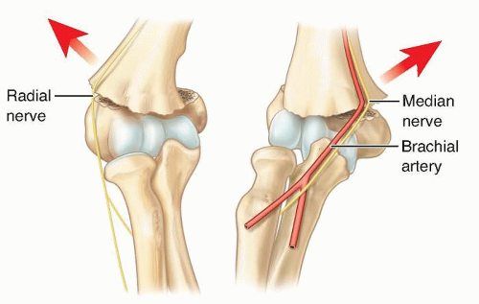
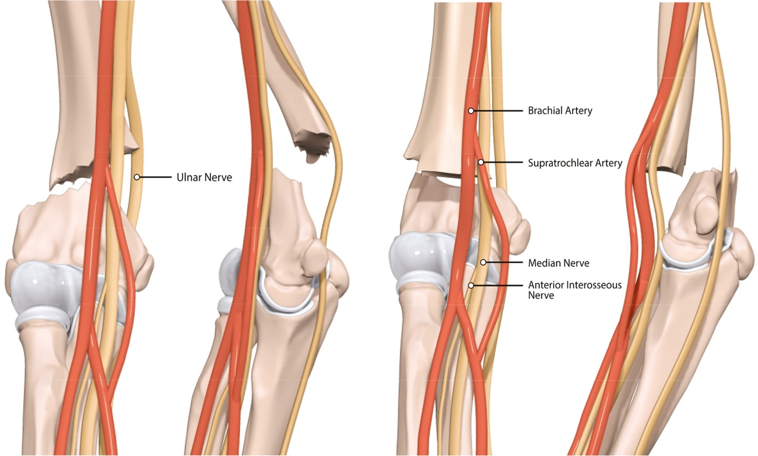

Slide 29
Avulsive Fracture Of Medial Epicondyle

Slide 30
Spiral Integration
No of Slides - 9

Slide 31
Biomedical Ethics

Slide 32
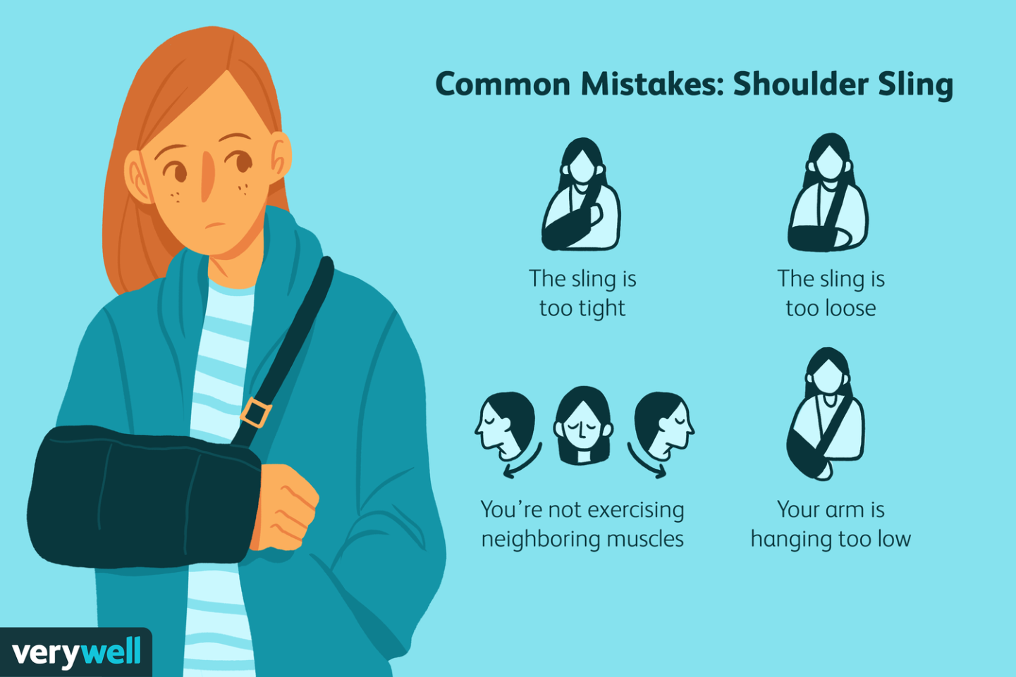
Family Medicine
Diagnosis and Initial Management: Family physicians diagnose and stabilize humerus fractures, prescribing pain relief and referring to specialists if needed.
Monitoring and Follow-up: They oversee healing progress, address complications, and provide ongoing support during recovery.
Rehabilitation and Referral: Family physicians coordinate rehabilitation efforts, including physical therapy, and refer to specialists for advanced interventions when necessary.

Slide 33
Artificial Intelligence
1. Diagnosis Assistance: AI algorithms can analyze medical imaging scans to aid in the accurate and efficient detection of humerus fractures, assisting radiologists and clinicians in interpretation.
2. Treatment Planning: AI can help clinicians determine the optimal treatment approach for humerus fractures by analyzing patient data, such as fracture characteristics, medical history, and outcomes from similar cases.
3. Outcome Prediction: AI models can predict patient outcomes following humerus fracture treatment, providing valuable insights for clinicians in patient management and decision-making.

Slide 34
Research Article
Topic: A study on segments of the humerus and its clinical importance
Authors: Prasad NC, Shivashankarappa A, Pavan P Havaldar, Shruthi BN, and Shaik Hussain Saheb.
Date: 2017
https://www.researchgate.net/publication/322279908_A_study_on_segments_of_humerus_and_its_clinical_importance

Slide 36
Assessment
Q: The bicipital groove is
Horizontal groove between lesser and greater tubercles.
Contains ascending branch of the anterior circumflex humeral artery.
Is located in scapula
Gives insertion to sartorius
Latissimus dorsi in the roof of the groove.
Q: About the middle of the humerus
Is crossed by the radial groove
Is crossed by the ulnar groove
Has insertion of the subscapularis
Has brachial artery crossing from backwards
Is the commonest site of fracture
Q: The upper end of the humerus presents the following features except
Head.
Neck.
Greater tubercle.
Lesser tubercle.
Capitulum
Q: The lower end of the humerus presents the features except:
Capitulum, a lateral rounded convex projection.
Trochlea, a medial pulley-shaped structure.
Radial fossa, a small fossa above the capitulum.
Coronoid fossa, a small fossa above the trochlea.
Greater tubercle

Slide 37
Key
Q: The bicipital groove is
Horizontal groove between lesser and greater tubercles.
Contains ascending branch of the anterior circumflex humeral artery.
Is located in scapula
Gives insertion to sartorius
Latissimus dorsi in the roof of the groove.
Q: About the middle of the humerus
Is crossed by the radial groove
Is crossed by the ulnar groove
Has insertion of the subscapularis
Has brachial artery crossing from backwards
Is the commonest site of fracture
Q: The upper end of the humerus presents the following features except
Head.
Neck.
Greater tubercle.
Lesser tubercle.
Capitulum
Q: The lower end of the humerus presents the features except:
Capitulum, a lateral rounded convex projection.
Trochlea, a medial pulley-shaped structure.
Radial fossa, a small fossa above the capitulum.
Coronoid fossa, a small fossa above the trochlea.
Greater tubercle

Slide 38
Learning Resources
1.Clinically Oriented Anatomy by Keith Moore 9th edition.
2.Cunningham’s Manual of Practical Anatomy by G.J. Romanes, 16th edition, Vol-I, II and III
3. http://www.anatomyzone.com 3D anatomy
https://teachmeanatomy.info

Slide 39
Use of Digital Library
1. Go to the website of HEC National Digital Library.
2. On the Home Page, click on the INSTITUTES.
3. A page will appear showing the universities from the Public and Private Sector and other Institutes that have access to HEC National Digital Library HNDL.
4. Select your desired Institute.
5. A page will appear showing the resources of the institution
6. Journals and Research will appear
7. You can find a Journal by clicking on JOURNALS AND DATABASE and entering a keyword to search for your desired journal.

Slide 40
Thank You!

