Slide 1
HOW TO APROACH A PATIENT WITH Stroke

Slide 2

Vision & Mission of RMU
Wisdom
Truth
Service
To impart evidence based research oriented medical education
To provide best possible patient care
To inculcate the values of mutual respect and ethical practice of medicine

Slide 3

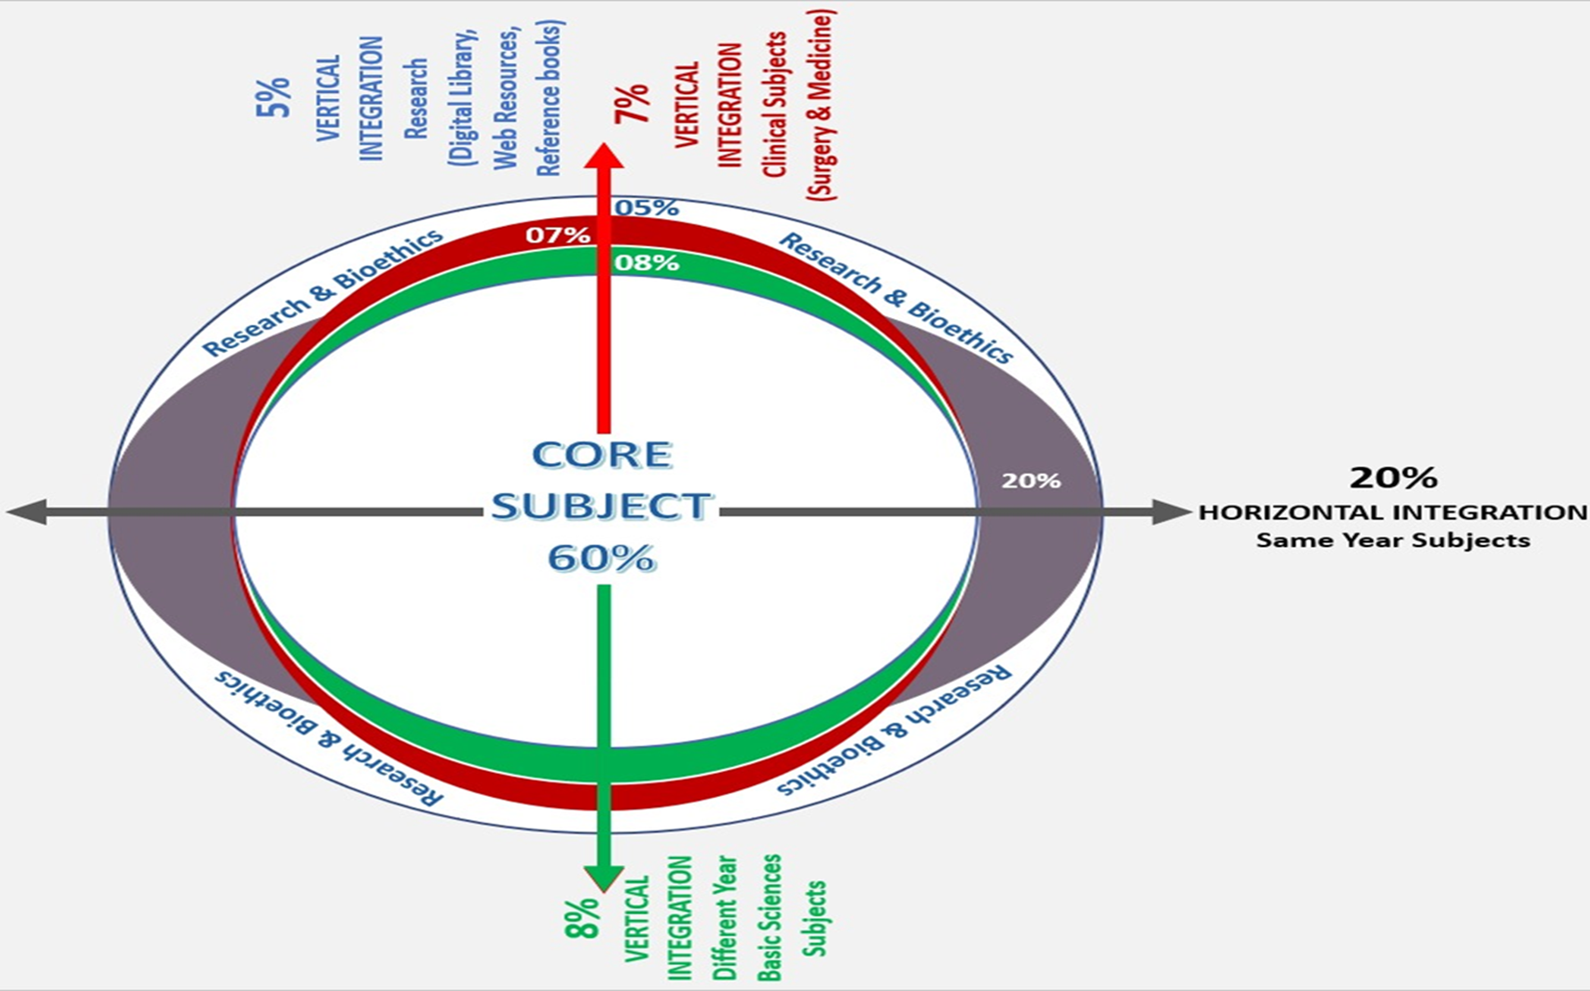
Sequence Of Lecture
Learning outcomes (1 slide)
Core Subject (24 slides)
EOLA(End of lecture assessment) (1 slide)
Further reading/Digital Library References (I slide)
( Research, Bioethics, Artificial Intelligence)

Slide 4
Stroke
Stroke is Acute brain injury caused by:
Ischemic stroke: Reduced blood supply to a region of the brain resulting in brain ischemic and neuronal death (87%)
Hemorrhagic stroke: Primary brain hemorrhage resulting in compression of normal brain tissue (13%)

Slide 5
CLASSIFICATION OF STROKE
>The AHA/ASA classification broadly characterizes stroke into following four broad subtypes.
1.Central nervous system infarction.
2.Intracerebral hemorrhage. (ICH)
3.Subarachnoid hemorrhage. (SAH)
4.Stroke caused by cerebral venous thrombosis.

Slide 6
Anterior and Posterior Cerebral Arterial Circulation
Internal carotid arteries and their branches: supply the anterior circulation
Vertebral arteries and the basilar artery (and their branches): supply the posterior cerebral circulation

Slide 7
Mechanism of Ischemic Stroke and Transient Ischemic Attacks
Atherosclerotic cerebrovascular disease (20%):
    Extracranial carotid or vertebral artery disease
    Intracranial cerbrovascular disease
Penetrating small arterial disease (25%)
Cardiogenic source (33%):
    Atrial fibrillation & other arrythmias
    Myocardial infarction
    Valvular disease
    Ventricular thrombi
    Aortic plaque
Unusual causes (<5%): dissection, migraine, illicit drugs, vasculitis, venous strokes, hypercoagulability,…
Cryptogenic source (no mechanism identified)

Slide 8
Transient Ischemic attack (TIA)
Definition: duration of transient neurologic symptoms lasting less than 1 hour
Transient reduction of blood flow to a region in brain in the absence of evidence of infarction on brain imaging
Mechanisms for TIA similar as for ischemic stroke
Reconstitution of flow to the hypoperfused region hence the resolution of symptoms
Significance of TIAs is increased risk of stroke after a TIA specifically early on after a TIA
Prompt evaluation of mechanism and appropriate treatment

Slide 9
Transient Ischemic Stroke
ABCD2 score
  Age ≥ 60 years: score 1
  HTN (≥140/90): score 1
  Diabetes mellitus: score 1
  TIA duration: 10-59 min (score 1); ≥60min (score2)
  Clinical: Hemiparesis with or without speech deficit (score 2); speech impairment without hemiparesis (score 1)
Higher ABCD2 scores are associated with greater risk of stroke during the 2, 7, 30, and 90 days
Definite admission for ABCD2 score of ≥4
Caution to work the TIA patients urgently to address underlying source and treat appropriately
Notes:
ABCD2
Score
2-day
Stroke
Risk
Comment
0-3 1.0%
Hospital observation may be
unnecessary without another
indication (e.g., new atrial fibrillation)
4-5 4.1% Hospital observation justified in most
situations
6-7 8.1% Hospital observation worthwhile

Slide 10
Ischemic Stroke

Slide 11
Signs and Symptoms of Stroke
Acute Onset of Neurologic Symptoms and Signs of Central Nervous System Nature

Slide 12
Acute Onset of Any of the Below Symptoms
Hemiparesis or quadriparesis ( latter in basilar occlusion)
Facial weakness
Aphasia
Dysarthria
Limb/truncal/gait ataxia +/- nausea & vomiting
Vertigo, tinnitus, hearing deficit (posterior circ.)
Impairment of vision in homonymous visual field defect
Monocular impairment of vision (amaurosis fugax)
Diplopia
Impairment or loss of consciousness or confusion
Hemineglect (visual or sensory)
Headache (non-specific symptom)
New onset seizure (3-4%) or acute new movement abnormality
Adopted from AHA

Slide 13
Differential Diagnosis
Space occupying lesion (tumor, infection/ abscess, Epidural, Subdural Hematomas)
Subarachnoid hemorrhage
Seizures
Hypoglycemia
Migraine
Syncope
Labyrinthine disorders

Slide 14
NIH Stroke Scale
Provides a structured, quantifiable neurologic examination
NIHSS has 11 parts similar to our neurologic exam
Score between 0 and 42
NIHSS scores ≥20 indicate a severe stroke
NIHSS score on admission has been correlated to stroke outcome
Requires speech/language cards & safety pin.
Quantifies clinical stroke deficit:
    < 4 = mild stroke
    > 15 = poor prognosis if no treatment
    > 22 = ↑ risk for ICH

Slide 15
NIH Stroke Scale
“Traditional” order of items”
1a. LOC
1b. LOC questions
1c. LOC commands
2. Best gaze
3. Visual fields
4. Facial palsy
5a. Right arm motor
5b. Left arm motor
6a. Right leg motor
6b. Left leg motor
7. Limb ataxia
8. Sensory
9. Best language
10. Dysarthria
11. Extinction/
inattention

Slide 16
Evaluation &Treatment

Slide 17
Initial Treatment
Table 1. NINDS* and ACLS** Recommended Stroke Evaluation Time Benchmarks for Potential Thrombolysis Candidate
TIME INTERVAL | TIME TARGET
Door to doctor | 10 min
Acess to neurological expertise | 15 min
Door to CT scan completion | 25 min
Door to CT scan interpretation | 45 mins
Door to treatment | 60 mins
Admission to stroke unit or ICU | 3 hour

Slide 18
Blood Glucose Blood Pressure | Treat Hypoglycemia with D50. Treat Hyperglycemia with Insulin If serum glucose >200mg/dl. Treat it with Labetalol or Nicardipine or Sodium Nitropruside.

Slide 19
Code Stroke
Code Stroke system, alerts all the team members including CT, X-ray, EKG, lab, pharmacy and the staff.

Slide 20
Initial Evaluation
Cardiac monitoring, pulse-ox, ECG
Stat CT brain
c-xray
CBC, Platelet, PT, APTT
Accucheck & blood glucose, serum electrolytes
Cardiac markers, ABG’s
Blood alcohol level, Toxicology screen, Pregnancy test

Slide 21
DIAGNOSIS:
Demographic data
Cranial assessment
Vital signs
History taking
Sensory assessment
Motor assessment

Slide 22
CT Brain

Slide 23
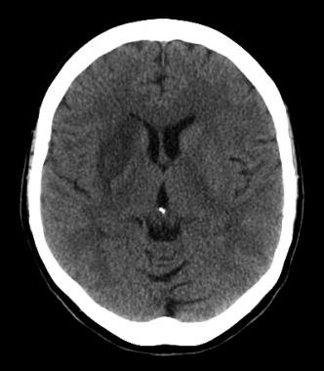
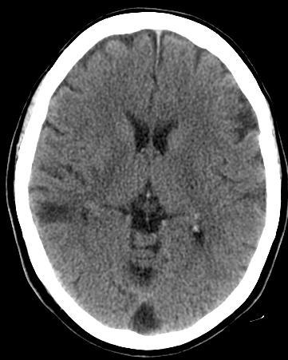
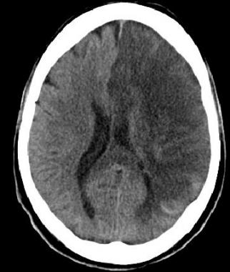
Axial noncontrast computed tomography (NCCT) demonstrates diffuse hypodensity in the right lentiform nucleus, with mass effect upon the frontal horn of the right lateral ventricle. The patient is a 70-year-old female with history of left-sided weakness for several hours duration
This 60-year-old female underwent NCCT after an episode of left upper extremity weakness. NCCT demonstrates cortical and subcortical hypodensity involving the right mid to anterior temporal lobe.
Noncontrast CT in this 52-year-old male with history of worsening right-sided weakness and apahasia demonstrates diffuse hypodensity and sulcal effacement.

Slide 24
MRI Brain

Slide 25
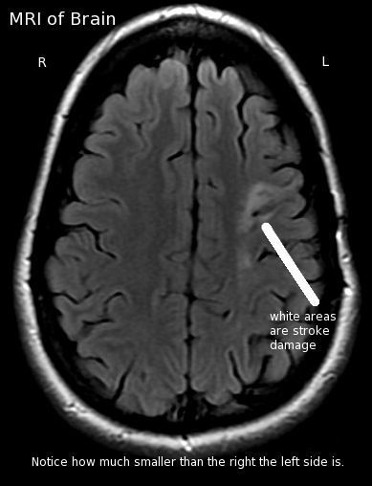

Slide 26
Acute Therapy
Intravenous recombinant tissue Plasminogen Activator (IV t-PA) given within 3 hour of symptoms onset in acute ischemic strokes

Slide 27
IV t-PA treatment
IV t-PA was FDA approved for acute ischemic stroke Rx based on the NINDS study group
Inclusion and Exclusion criteria

Slide 28
Intravenous t-PA
Standard FDA approved therapy for acute stroke Rx
Window of treatment has been prolonged after ECASSIII to 4.5 hours
Not all patients are eligible for the 3 to 4.5 hour window

Slide 29
Inclusion Criteria for IV t-PA
Ischemic Stroke clinically
Persistent neurologic deficit beyond an isolated sensory deficit / ataxia
CT brain: No Blood
Initiation of Rx within 3 hours

Slide 30
Exclusion Criteria
Onset to treatment >3 hr (NINDS)
Rapid improvement
Blood on CT
Oral anticoagulant & PT>15 sec, INR>1.7
Heparin (last 48 hr) & increased PTT
Platelet<100,000
SBP>185 or DBP>110
Aggressive treatment of b.p.
Stroke or head trauma (3 months)
Major surgery (2 wks)

Slide 31
Cont’d Exclusion Criteria
Prior ICH
GI tract/ Urinary bleed
Seizure at onset
Signs & Sx’s of SAH
Non-compressible site of arterial puncture

Slide 32
Additional Exclusions for the 3 to 4.5 Hour
Age≥80 years
Any use of anticoagulant regardless of the PT/APTT
NIHSS≥25
Coexistent history of stroke and diabetes mellitus.

Slide 33
Management Post Thrombolysis
Admit to ICU
BP monitoring
Treat SBP≥185 and DBP≥110
No anticoagulants, no anti-platelet for 1st 24 hr post t-PA

Slide 34
Cont’d Management of Patients Post-thrombolysis
Worsening of neurologic state---CT brain
ICH---Neurosurgery consult
Possible surgical intervention
Preferably: no foley or NG for 2 hr > t-PA

Slide 35
Acute Interventional Treatment
Intraarterial thrombolysis or mechanical thrombectomy
Successful recanalization has been shown
PROACT II: intra-arterial pro-Urokinase was positive
3 interventional studies published in 2013 were negative for benefit from endovascular Rx
Implementation of stent retrieval devices (superior in recanalization)
MR CLEAN (Multicenter Randomized Clinical trial of Endovascular treatment for Acute ischemic stroke in the Netherlands) : positive trial.
Notes:
SYNTHESIS Expansion trial, IMS-III, MR RESCUE negative trials
Solitaire™ FR With the Intention For Thrombectomy as Primary Endovascular Treatment for Acute Ischemic Stroke (SWIFT PRIME) Clinical Trial

Slide 36
Endovascular Rx
At the time being and in the United States the only FDA approved acute treatment for stroke is IV t-PA
Mechanical thrombectomy: (currently)
  Add on-Rx to the standard FDA approved stroke Rx IV t-PA in cerebral infarction with proximal large arterial occlusion within 8 hours from onset
  Or as alternative Rx in patients who do not qualify for IV t-PA
For basilar artery occlusion the window is prolonged to up to 24 hours for concern of locked in syndrome

Slide 37
Poor Outcome Predictors in Ischemic Stroke
Age
Elevated blood sugar
Initial NIHSS score which is a measure of the patient’s initial deficit
Cerebral infarction changes on CT brain

Slide 38
Is Stroke Preventable??

Slide 39
Prevention
Primary prevention
Secondary prevention

Slide 40
Primary Prevention
Primary prevention starts at the level of the physician playing the role of the primary care and occasionally at the level of the cardiologist and the stroke neurologist
Key is identification of underlying risk factors and modification and treatment of modifiable risk factors

Slide 41
Primary Prevention Elements
Establishing good medical history and family history
Identifying the patient’s vascular risks including medical illnesses, habits such as smoking and substance use and genetic predisposition through review of significant family history for cardiovascular risk factors and stroke
Exam elements which are key: pulse (rate and establishing how regular), blood pressure, carotid auscultation (bruits), cardiac auscultation (murmurs and abnormal rhythm), symmetry and detection of pulses, diabetic peripheral changes

Slide 42
Identification of Risk Factors for Stroke
Non-modifiable risk factors
Modifiable risk factors

Slide 43
Modifiable Risk Factors
Risk factors that can be controlled by life style changes or by medications or surgery

Slide 44
Non-modifiable Risk Factors
Age: the risk of stroke doubles with every decade after the age of 55 years
Sex: lifetime risk in Male>Female but risk in F>M after age of 80 years
Race and ethnicity:
  Stroke incidence and subtypes: higher in African Americans and Hispanics >Caucasians
  Stroke related mortality is higher in African American population
  Asian population has an increased risk of hemorrhagic stroke subtype compared to Caucasians

Slide 45
Non-modifiable Risk Factors
Genetic Factors
Family history: inherited susceptibility, inherited predisposition to risk factors, similar culture and lifestyle
Hyperhomocysteinemia: C677T allele (one or more) of the methylenetetrahydrofolate reductase gene (MTHF)
Inherited coagulopathies
Notes:
Large vessel stroke: genes association w 9p21, 6p 21.1, 7q21

Slide 46
Well Documented Modifiable Risk Factors
Hypertension
Smoking
Diabetes Mellitus
Carotid disease
Cardiac disease: Atrial Fibrillation, Myocardial infarction secondary to coronary artery disease
Dyslipidemia or hyperlipidemia (high cholesterol, high LDL, low HDL)
Migraine with aura in women
Obstructive sleep apnea

Slide 47
Less-Documented Potentially Modifiable Risk Factors
Illicit drug abuse
Hypercoagul-opathy
Sickle cell disease
Estrogen/HR hormonal therapy
Inflammation
Infection
Obesity
Lack of exercise
Poor diet
Alcohol abuse
Hyperhomocystei-nemia

Slide 48
Summary
Family history: identify people who have higher risk and counseling those patients
Genetic counseling for rare genetic disorders
Non-invasive imaging/ screening for patients with specific disorders: screen for cerebral artery aneurysms in patients with ≥ 2 first degree members with SAH/cerebral aneurysms, polycystic kidney disease

Slide 49
Summary:
Physical activity is recommended:
  Moderate to vigorous intensity aerobic
  Suggested ≥ 40 min/ time, 3-4 days /wk 2013 AHA/ACC guidelines
Weight reduction for BMI≥ 25
Dietary restriction of salt and increased potassium in diet (HTN conrtol)
DASH, AHA, Mediterranean diets

Slide 50
Summary: Primary Prevention
Cessation of smoking esp. in women who have migraines with aura and who are on OCPs
Cessation of illicit drugs
Cessation of alcohol or limitation to ≤1 drink/day for women and ≤2 drinks/day for men

Slide 51
Summary: Primary Prevention
Control of BP<140/90 mm Hg
Control of blood sugar but avoid intensive glycemic control
Use of statins in diabetic patients maybe protective and particularly if high risk factors
Maximize medical management with statins and antiplatelets in carotid artery disease
Anticoagulation is reserved for atrial fibrillation and cardiac thrombi or potent hypercoagulable states (latter in secondary prevention)

Slide 52
Summary: Primary Prevention
Use of ACE Inhibitors and or an angiotensin II receptor blocker (ARB) in diabetes mellitus
No documented benefit for aspirin in primary prevention of stroke (may consider patients with high risk factors) with the exception of some possible benefit for women>65 years old

Slide 53

Thank You!

