Slide 2
Professor Umar’s Model of Integrated Lecture

Slide 3
Clinical Case
A 50-yr-old housewife presents with the complaints of progressive weight gain of 15kg in 6 months, postural dizziness, memory loss, slow speech, deepening of her voice, dry skin, constipation and cold intolerance.
On examination, she has a temperature of 96.8 F, pulse 58/min and regular, BP 110/60. She is moderately obese, speaks slowly and has a puffy face, with pale, thick and dry skin. The thyroid gland is not palpable. The deep tendon reflex time is delayed.
What is the likely diagnosis?

Slide 4
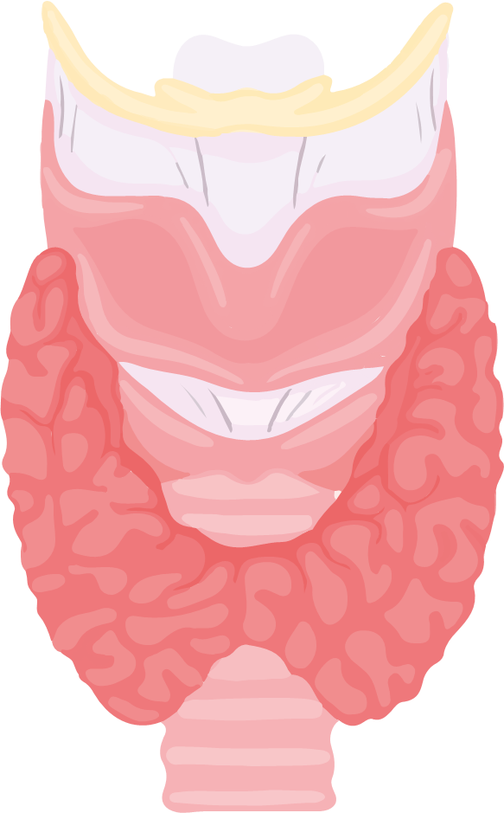
HYPOTHYROIDISM
Dr Sana Ahmed
SR Medicine Unit 1, BBH
MBBS, FCPS Medicine, MRCP (UK), CHPE

Slide 5
LEARNING OBJECTIVES:
At the end of this session students should be able to:
Clinically correlate the pathophysiology
of thyroid-hormone axis with common causes of hypothyroidism
Enlist the common causes of hypothyroidism.
Understand the clinical features of a patient with hypothyroidism.
Formulate an investigation and treatment plan for a patient with hypothyroidism.
Understand the salient features of hypothyroidism in pregnancy and elderly patients.

Slide 6
Hypothalamic-pituitary-thyroid axis:

Slide 7
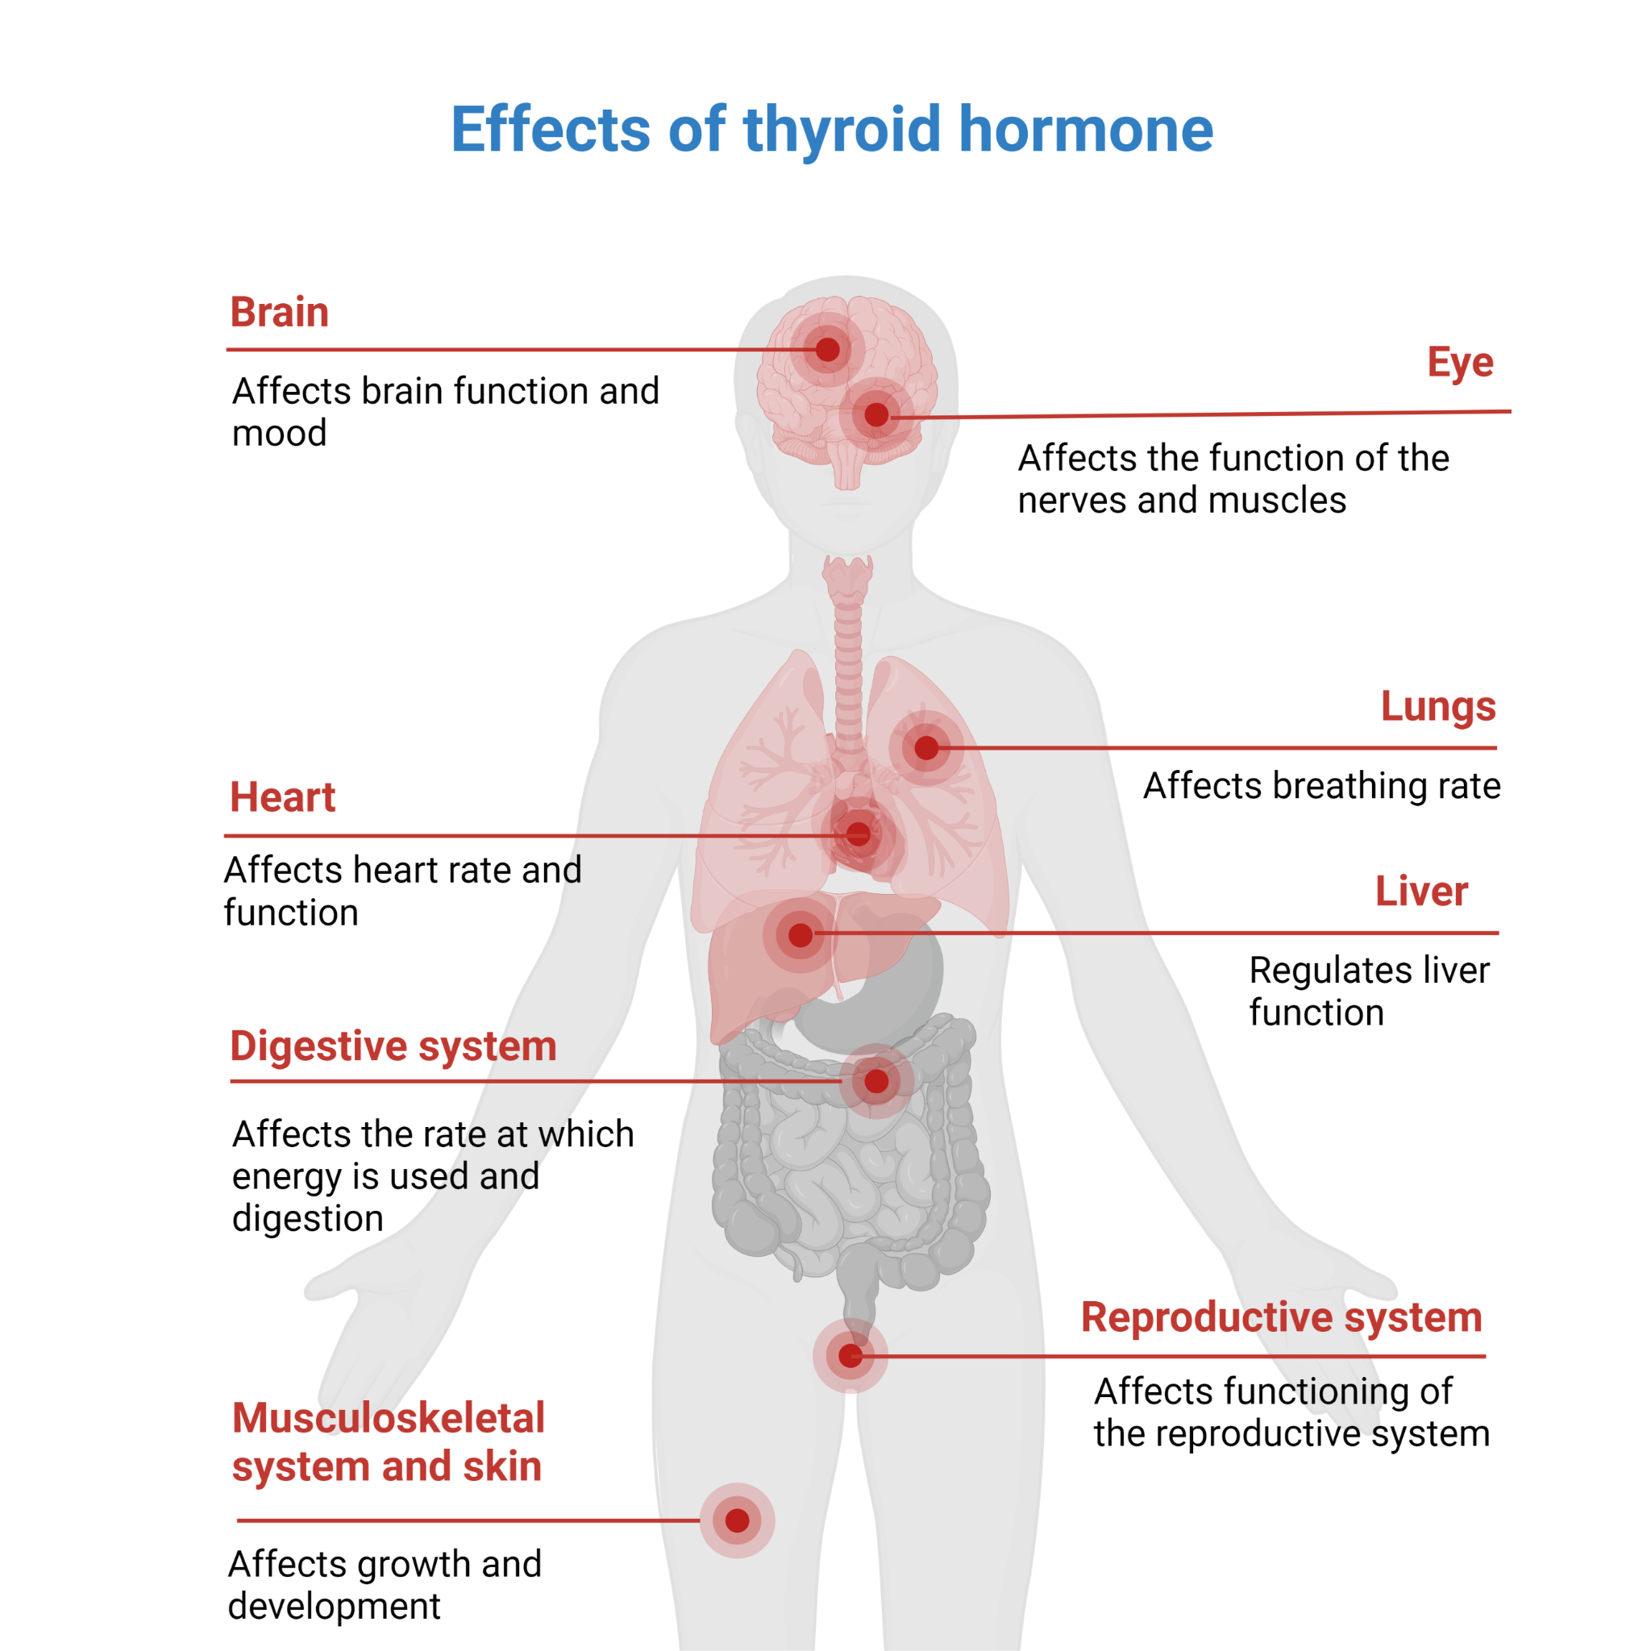

Slide 8
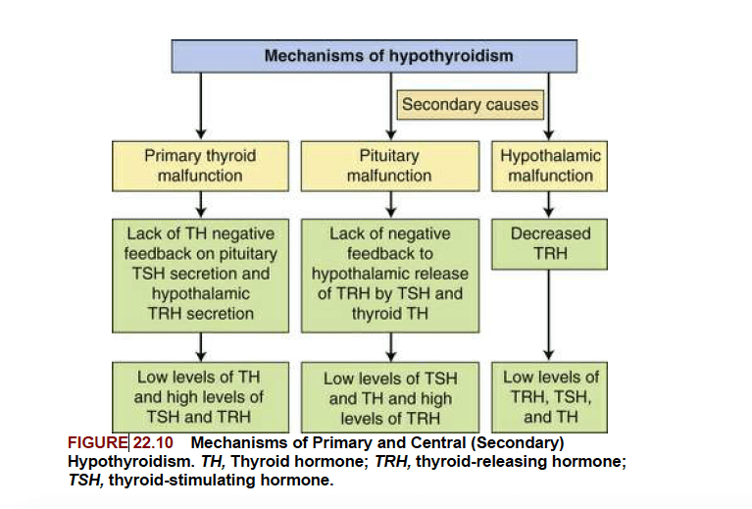
Pathophysiology of Hypothyroidism:

Slide 9
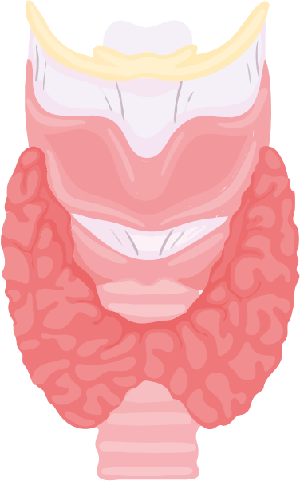
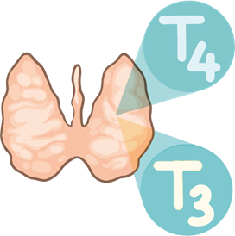
Core Concept

Slide 10
What is hypothyroidism?
A clinical condition that results from inadequate production or action of thyroid hormone.
It can be
Overt: (dec. in serum thyroxine levels)
Subclinical: (TSH is mildly elevated but T4 levels are normal.)

Slide 11
CLASSIFICATION OF HYPOTHYROIDISM
Types:-
Primary hypothyroidism---cause within thyroid.
Secondary hypothyroidism---cause within pituitary/ hypothalamus.

Slide 12
Etiology of Hypothyroidism:

Slide 13
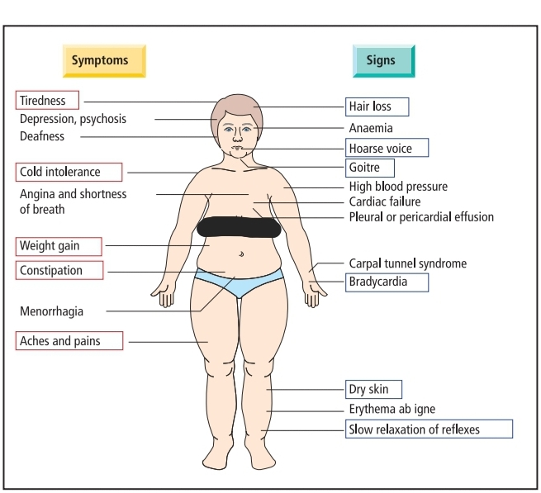
Approach to a patient with hypothyroidism:
History Examination

Slide 14
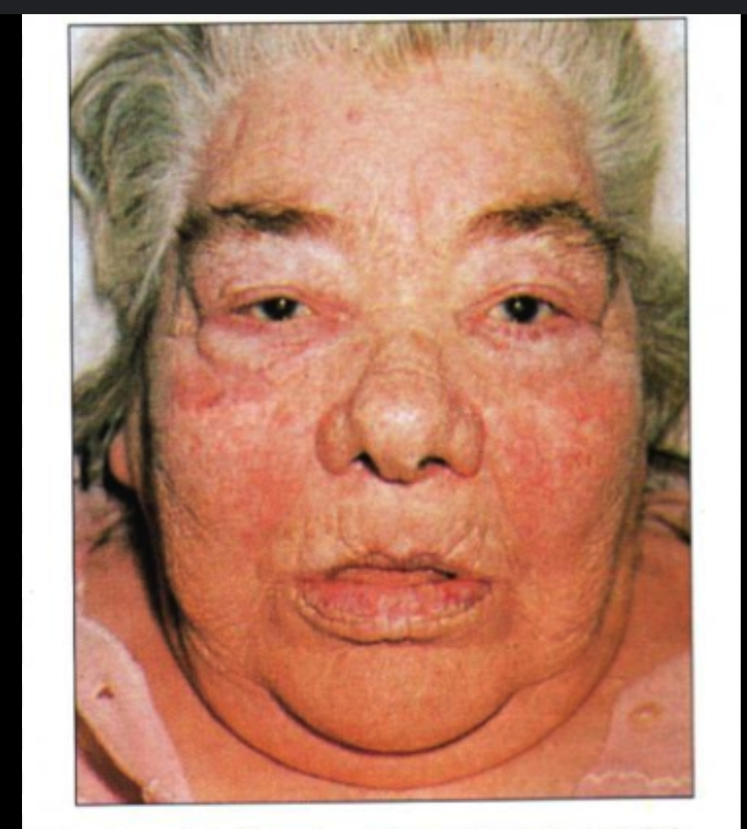
Facial appearance:
Dry , coarse sparse hair
Thinning of lateral eyebrows
Periorbital puffiness
Puffy, dull face with dry skin
Coarse facial features.

Slide 15
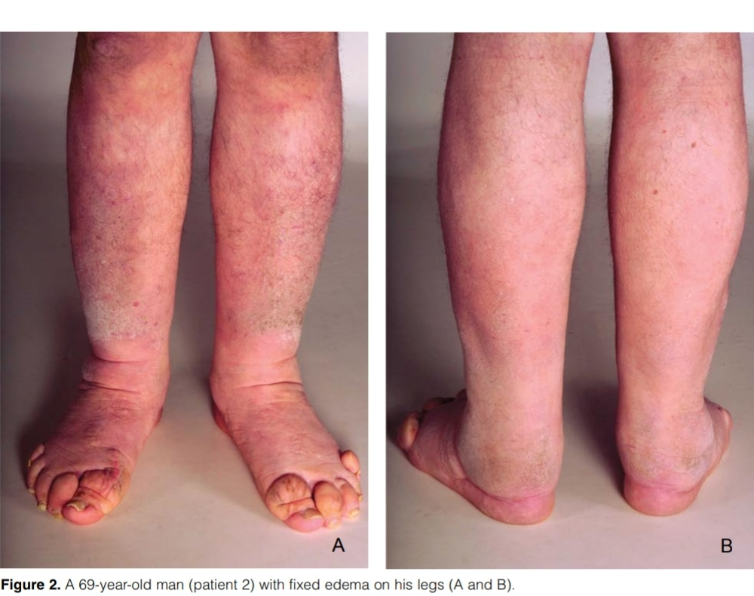
Thyroid dermopathy:
PRETIBIAL MYXEDEMA:
Localized,
Nonpitting edema
Commonly of lower extremities
Hyperpigmented,
thickened,
plaque-like skin

Slide 16
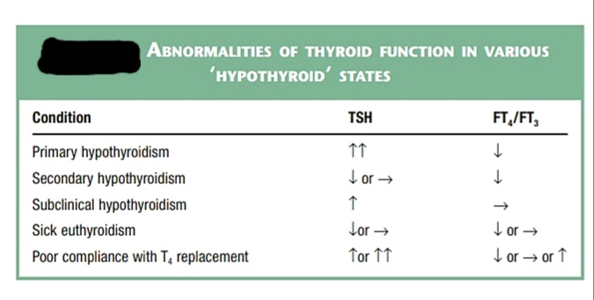
DIAGNOSIS:
LAB INVESTIGATIONS:
THYROID FUNCTION TESTS:
TSH is the most sensitive screening tool (0.40-4.2mIU/L)

Slide 17
DIAGNOSIS:
OTHER LAB INVESTIGATIONS:
CBC WITH PERIPHERAL FILM: Normo.;chromic Macrocytic anemia.
SERUM ELECTROLYTES: hyponatremia
BLOOD GLUCOSE: may be normal/low
LIPID PROFILE: hypercholestrolemia, hypertriglyceridemia
MUSCLE ENZYMES: CPK, AST, LDH may be raised
AUTOIMMUNE SCREENING: Serum anti-TPO Antibodies, Serum anti-Tg (thyroglobulin) Ab,
Notes:
Blood glucose: (dec. gluconeogenesis, dec. insulin clearance) (AUTOIMMUNE SCREENING: to determine etiology or to predict future hypothyroidism)
MUSCLE ENZYMES: (increased muscle membranes permeability)

Slide 18
DIAGNOSIS:
ECG: bradycardia, low voltae, proloned PR interval, T wave abnormalities
IMAGING STUDIES:
ULTRASOUND NECK AND THYROID: thyroid nodules, infiltrations.
CHEST XRAY: for pericardial effusion/ superadded pulmonary infections.
ECHOCARDIOGRAPHY: when pericardial effusion is suspected.

Slide 19
Pericardial effusion in a patient with hypothyroidism

Slide 20
TREATMENT

Slide 21
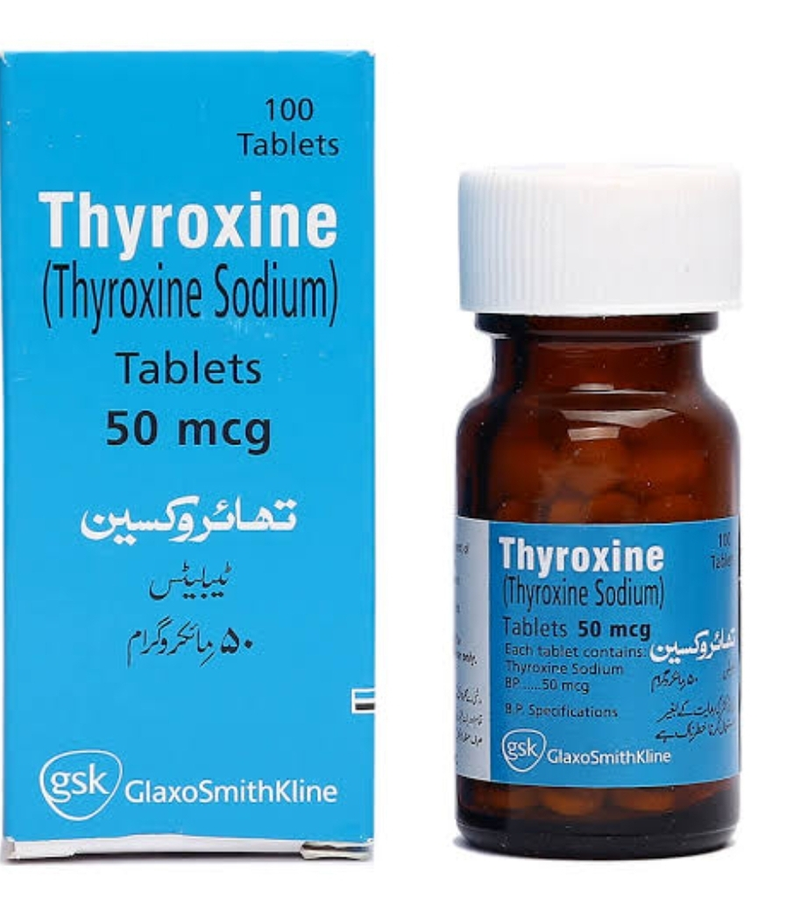
TREATMENT:
THYROID HORMONE REPLACEMENT:
Levothyroxine(LT4) 1.6ug/kg/day
Usual starting dose in 50-75ug/day.
Elderly/ patients with IHD: starting dose is ¼ to ½ of expected dosage (25-50ug/day), should be adjusted in small increments every 4-6 weeks

Slide 22
TREATMENT:
Thyroxine has half life of seven days
Clinical benefit begins in 3-5 days.
Reduction in wt. and periorbital puffiness occurs quickly.
Skin and Hair changes need 3 to 6 months.

Slide 23
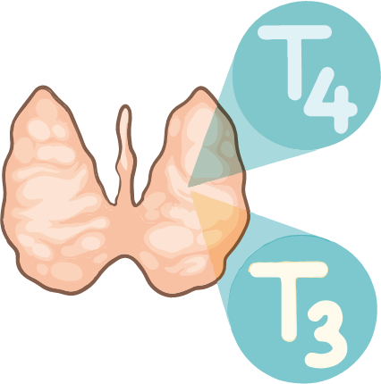
MONITORING AND FOLLOW UP:
Dosing changes should be made every 4-6 weeks until TSH is in target range.
Target serum TSH is to the lower part of reference range (0.5- 2 mU/L) and serum T4 normal or even slightly raised
After dose is stabilized: follow-up every 6months to 1 year with clinical evaluations and TSH monitoring.

Slide 24
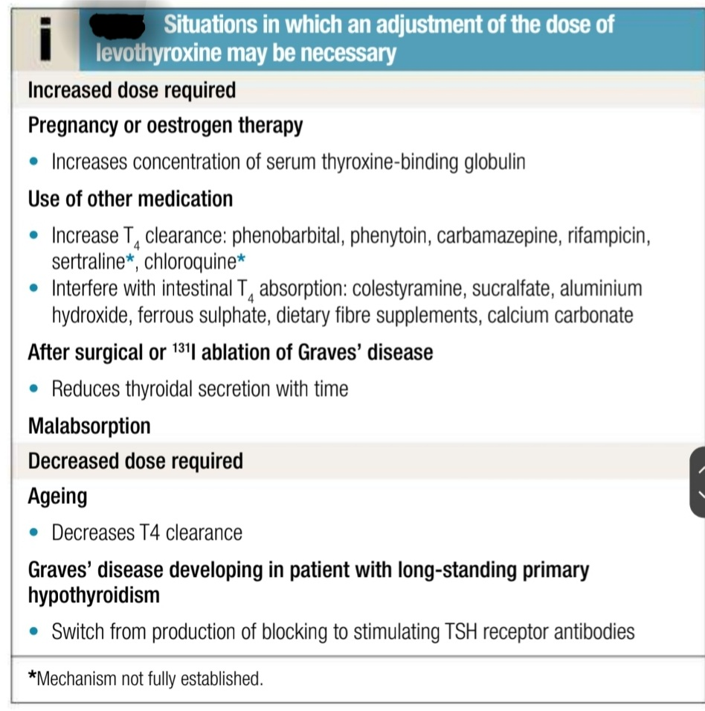

Slide 25
Clinical Case
A 50-yr-old housewife presents with the complaints of progressive weight gain of 15kg in 6 months, postural dizziness, memory loss, slow speech, deepening of her voice, dry skin, constipation and cold intolerance.
On examination, she has a temperature of 96.8 F, pulse 58/min and regular, BP 110/60. She is moderately obese, speaks slowly and has a puffy face, with pale, thick and dry skin. The thyroid gland is not palpable. The deep tendon reflex time is delayed.
What is the likely diagnosis?

Slide 26
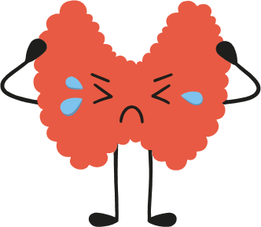
MYXEDEMA COMA
A rare life threatening presentation of prolonged hypothyroidism
Precipitants :Intercurrent systemic illness, myocardial infarction, stroke and trauma/surgery, narcotic/hypnotic drugs.
Clinical Presentation:
Looks Hypothyroid, age more than 65 yrs, altered sensorium
Hypothermia, Hyporeflexia, Hypoglycemia, Bradycardia,
Complications:
Heart failure , fluid electrolyte abnormalities, coma , seizures,

Slide 27
MYXEDEMA COMA:
Treatment :
Preferably in intensive care
Send blood for T3, T4, TSH, CBC, U&E, Cultures, Cortisol, ABGs
Give high flow oxygen if cyanosed.
Correct any hypoglycemia and hypothermia.
Give T3 5-20µg I.V. slowly
Give Hydrocortisone 100mg per 8 hours I.V. if pituitary hypothyroidism is suspected
I.V. 0.9% saline, (avoid precipitating LVF)
If infection suspected give broad spectrum antibiotics

Slide 28
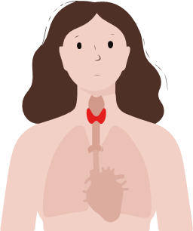
HYPOTHYROIDISM IN PREGNANCY:
higher incidence of stillbirths, miscarriages and congenital abnormalities with untreated hypothyroidism.
Pregnant women: About 25% higher doses.

Slide 29
Research and Bioethics

Slide 30
COMMUNICATION SKILLS:
Patient Counselling:
Thyroxine should be taken as a single dose , early morning, 30 min before eating.
Brand consistency is recommended.
Fibre and bran products may impair absorption, as also medicines like cholestyramine, colestipol, sucralfate, aluminum hydroxide.
Do not modify dose or stop treatment without consultation.
Overtreatment may lad to decrease bone mineral density and cardiac problems.
Increase dietary iodine intake. Increase iron rich foods, fruits and green leafy vegetables.

Slide 31
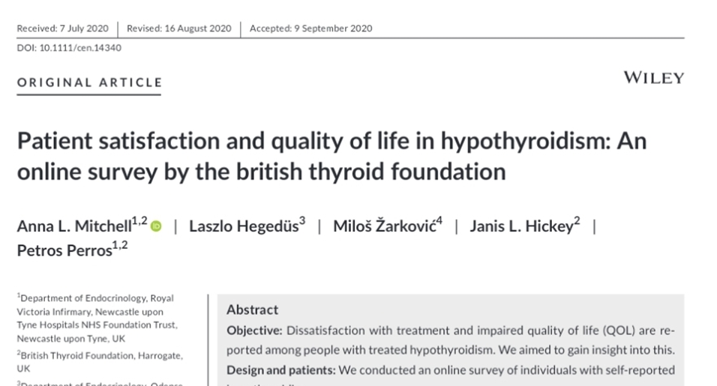
RESEARCH:

Slide 32
References:
Davidson, S. et al. (2023) ‘Endocrinology’, in Davidson’s principles and practice of medicine. London ; New York ; Oxford ; Philadelphia ; St. Louis ; Sydney: Elsevier, pp. 655–699.
McPhee, S.J., Rabow, M.W. and McQuaid, K.R. (2023) ‘Endocrine disorders’, in Current Medical Diagnosis Treatment 2023. New York: McGraw-Hill, p. 1099.
Zammitt, N. and Sandilands, E.A. (2022) in Essentials of Kumar and Clark’s Clinical Medicine. Edinburgh: Elsevier.

