Slide 2
HYPERTENSION
Dr Abrar Akbar
Associate Professor
Medical ICU, HFH

Slide 3
UNIVERSITY MOTTO, VISION, VALUES & GOALS
MISSION STATEMENT
To impart evidence-based research-oriented health professional
education
Best possible patient care
Mutual respect, ethical practice of healthcare and social
accountability.
VISION AND VALUES
Highly recognized and accredited centre of excellence in
Medical Education,Using evidence-based training techniques
for development of highly Competent health professionals,
who are lifelong experiential learner and are Socially accountable.

Slide 4
GOALS
The Undergraduate Integrated Learning Program is geared
to Provide you with quality medical education.
Provide thorough grounding in the basic theoretical
concepts underpinning the practice of medicine.
• Develop and polish the skills required for providing medical
services at all levels of the Health care delivery system.
• Help you attain and maintain the highest possible levels of
ethical and professional conduct in your future life.
• Kindle a spirit of inquiry and acquisition of knowledge to help
you attain personal and professional growth & excellence.

Slide 5
SEQUENCE OF LGIS
Learning objectives
Definition
Integration with pathophysiology
Types and risk factors of Hypertension
Related Clinical Features
Complications
Investigations
Management
Research articles related to topic
Ethics

Slide 6
LEARNING OBJECTIVES
AT THE END OF THIS LECTURE STUDENTS SHALL BE ABLE TO LEARN:
Definition and causes of Hypertension
Classification of Hypertension
Pathophysiology of Hypertension
Signs and symptoms of Hypertension
Investigations
Medical management
Recent advances
Ethics

Slide 7
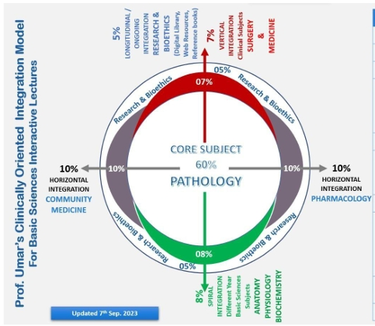
PROF UMER MODEL OF INTEGRTED LECTURE

Slide 8
Definition
Hypertension is a long term medical condition in which blood pressure in the arteries is persistently elevated.
Persistent systolic BP more than or equal to 140 mmHg and/or diastolic BP more than or equal to 90 mmHg.

Slide 9
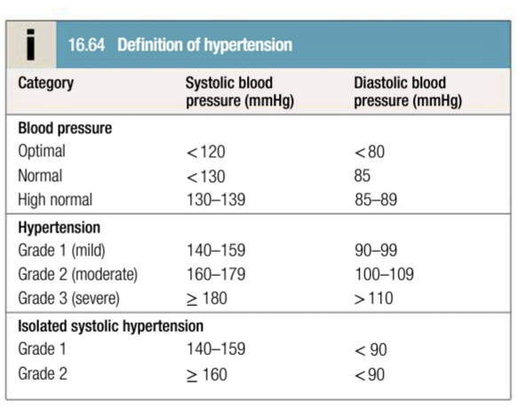

Slide 10
Pathophysiology
Normal Blood pressure is maintained by four mechanisms:
Sympathetic Nervous System Activities
Activities of Vascular Endothelium
Activities of Renal System
Activities of Endocrine System

Slide 11
Sympathetic nervous system involvement
Falling BP activates sympathetic nervous system. It increases heart rate and cardiac contraction.
Increased heart rate and cardiac contraction cause peripheral arteriolar vasoconstriction and promote release of renin from kidney.
So ultimately blood pressure is increased by increased systemic vascular resistance and increased cardiac output.

Slide 12
Activities of vascular endothelium
Vascular endothelium produces vasoactive substances and growth factors e.g nitric acid, endothelin etc.
These substances are potent vasoconstrictors and increase the blood pressure by increasing peripheral vascular resistance.

Slide 13
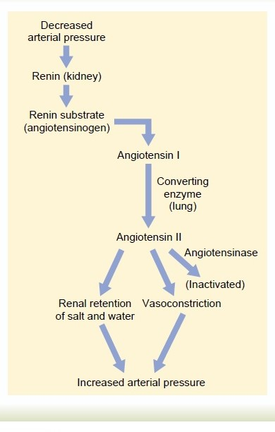
Renal System Involvement

Slide 14
Endocrine System
When angiotensin-II is stimulated in adrenal cortex, it results in aldosterone secretion.
Aldosterone stimulates kidneys to retain sodium and water. Thus the BP and cardiac output will get increased.

Slide 15
Etiology
Primary Hypertension: elevation in BP without any identified cause. 90-95%.
Secondary hypertension: elevation in BP due to an exact cause. 5-10 %.

Slide 16
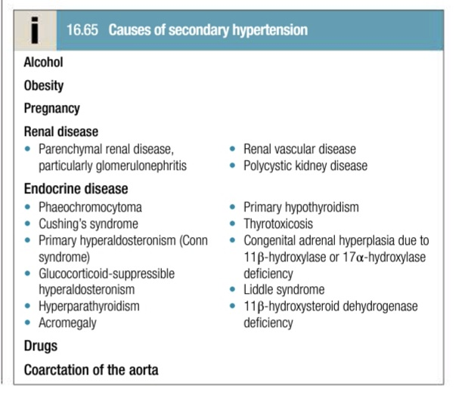

Slide 17
Risk Factors
Modifiable | Non-Modifiable
Weight | Family history
Stress | Age
Unhealthy diet | Gender
Addictions | Race and ethnicity
Sedentary lifestyle | Diabetes mellitus
 | Other chronic diseases

Slide 18
Clinical Features
Sometimes hypertension does not cause any symptoms; hence known as silent killer disease.
In some patients symptoms develop:
severe headache
blurred vision
dizziness
nausea
vomiting
epistaxis
SOB
irregular heartbeat
papilledema
facial flushing

Slide 19
Complications
Cardiovascular system:
Ventricular Hypertrophy
Ischemic Heart disease
Heart Failure
Aneurysm
Kidneys:
Nephropathy
Proteinuria
Renal failure
Central nervous system:
Stroke
Hypertensive Encephalopathy
Subarachanoid Hemorrhage
Multi infarct Dementia
Eyes :
Hypertensive Retinopathy
Blindness

Slide 20
Investigations
History and physical examination
urinalysis- for blood, protein, glucose
CBC, RFTs and serum electrolytes
BSR
Serum total and hdl cholesterol
TFTs
ECG

Slide 21
Specialized Investigations
CXR: to detect cardiomegaly, coarctation of aorta, heart failure
Ambulatory BP recording: to assess borderline or ‘white-coat’ hypertension
Echocardiogram: to detect or quantify left ventricular hypertrophy
Renal Ultrasound: to detect possible renal disease
Urinary catecholamines: to detect possible pheochromocytoma
Urinary cortisol and dexamethasone suppression test: to detect possible cushing's syndrome
Plasma renin activity and aldosterone: to detect possible primary aldosteronism

Slide 22
Management
Management of hypertension is two pronged
Lifestyle modification
Pharmacological therapy

Slide 23
Lifestyle modification
Weight reduction
DASH diet (dietary approaches to stop hypertension)
Dietary sodium reduction
Exercise
Stress management
Reduced alcohol intake

Slide 24
Intervention Thresholds
Clinic BP <140/90: offer to check BP at least every 5 years
Clinic BP ≥140/90: offer ABPM
ABPM ≥135/85 ABPM ≥150/95
Lifestyle intervention antihypertensive drugs
Patient education
Annual review
Clinic BP ≥180/100: antihypertensive drugs

Slide 25
Pharmacological Therapy
Diuretics: thiazides or loop diuretics are used. They inhibit sodium reabsorption. E.g chlorothiazide, furosemide.
ACE Inhibitors: reduce conversion of angiotensin-I to angiotensin-II and prevent vasoconstriction. Should be used with care in patients with impaired renal functions. E.g captopril, enalapril.

Slide 26
Angiotensin receptor Blockers: have similar efficacy to ACE inhibitors but do not cause cough. E.g valsartan
Calcium Channel Blockers: block movement of extracellular calcium into cell thus causing vasodilation. E.g amlodipine.
Beta- blockers: reduce workload of heart and blood vessels, no longer used as first line antihypertensive. Not used in patients with heart failure. E.g metoprolol, bisoprolol.

Slide 27
Combined alpha and beta blockers: sometimes more effective than beta blockers alone. E.g labetalol.
Vasodilators: act directly on the muscles in the walls of arteries. E.g hydralazine.
Aspirin and Statins reduce the cardiovascular risk associated with hypertension.

Slide 28
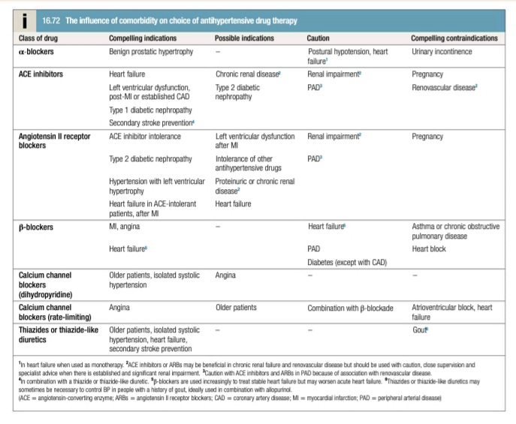

Slide 29
Drug combinations
Age <55 yrs
Age > 55 years
Ace Inhibitors or ARBs
Calcium channel blocker
ACE inhibitor/ARB + calcium channel blocker
ACE inhibitor/ARB + calcium channel blocker+ thiazide diuretic
ACE inhibitor/ARB + calcium channel blocker + thiazide diuretuic + further diuretic or alpha or beta blockers

Slide 30
RESEARCH
Oparil S, Acelajado MC, Bakris GL, Berlowitz DR,
Cífková R, Dominiczak AF, Grassi G, Jordan J
, Poulter NR, Rodgers A, Whelton PK.
Hypertension. Nature reviews. Disease primers.
2018 Mar 22;4:18014.

Slide 31
ETHICS
Before doing any medical treatment, informed
consent must be taken
Prognosis should be explained to patients
and attendants

Slide 32
Thank You

