Slide 1
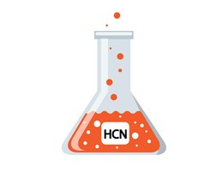
HYDROCYANIC ACID
Dr. Filza Ali & Dr Naila
Forensic Medicine & Toxicology

Slide 2
Motto of RMU

Slide 3
Visin sion of Rawalpindi Medical University The Dream/ Tomorrow
Rawalpindi Medical University The Dream/ Tomorrow
🞄 To impart evidence based research oriented
medical education
🞄 To provide best possible patient care
🞄 To inculcate the values of mutual respect and ethical practice of medicine

Slide 4
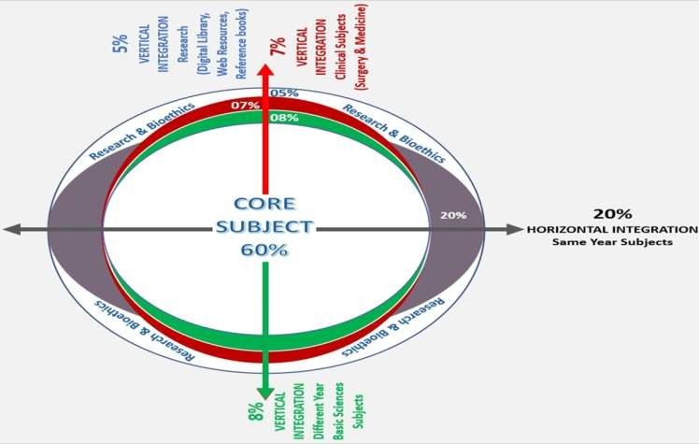
Prof Umar’s LGIS Model

Slide 5
SEQUENCE OF LGIS
Learning Objectives
Core concept 70 %
Horizontal integration related to Pathology and Pharmacology 15 %
Relevant clinical concepts and medico legal application of core knowledge / Vertical integration 10%
Research article relevant to the topic 3%
Ethics and family medicine 2%

Slide 6
Learning outcomes
Students will be able to:
Briefly explain the properties and uses of Hydrocyanic acid/ cyanide.
Describe the Mode of action and Clinical findings of acute and chronic cyanide poisoning.
State the Autopsy findings & Treatment of Hydrocyanic acid/ cyanide.
Describe its Medico legal aspects.

Slide 7
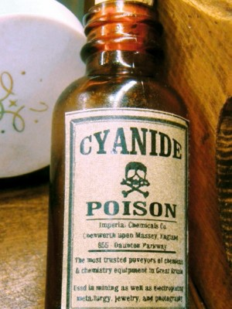
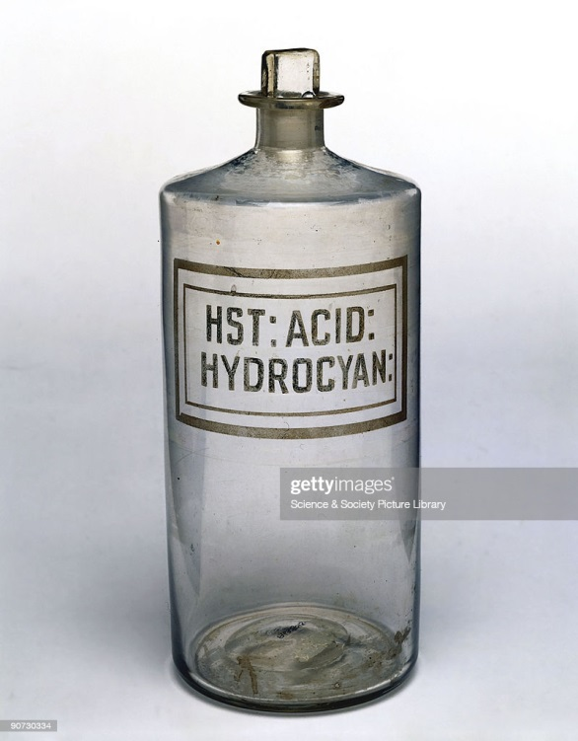
Core Concept

Slide 8
HYDROCYANIC ACID (VEGETABLE ACID POISON)
Core Concept
Hydrocyanic acid is a general protoplasmic poison. It inhibits the cytochrome oxidase system for oxygen utilization in cells. Death is due to cytotoxic or histotoxic anoxia, although the blood may contain a normal oxygen content. Other enzyme systems are also inhibited but to lesser degree. Cyanides show, in addition, a corrosive effect on the mucous membrane.

Slide 9
HYDROCYANIC ACID AND CYANIDES
Core Concept
Hydrocyanic acid, also known as cyanogen or
prussic acid, is a colorless gas with a penetrating odour resembling that of bitter almonds. Liquid hydrocyanic acid is a highly volatile colorless fluid. Hydrocyanic acid combines with bases of several metals and strong alkalis to form cyanides(salts).

Slide 10
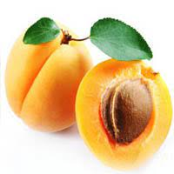
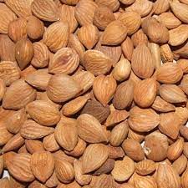
Bitter Almonds
Apricot

Slide 11
Core Concept
The cyanides are white powders and are used in photography, electroplating, metallurgy, tanning, fumigation of ships and in agriculture to prevent plant decay.
Calico Printing

Slide 12
HYDROCYANIC ACID:-
Core Concept
IMPORTANT Derivatives:-
Hydrogen cyanide.
Acrylonitrite.
Cyanogen chloride.
Cyanaides.
Nitroprussides.
Cyanogenetic glycosides.

Slide 13
USES:-
Core Concept
Fumigant.
Chemical synthesis.
Production of synthetic rubber.
Metal cleaning.
Hardening.
Refining and in the recovery of gold from ores.
Photography.

Slide 14
SOURCES:-
Core Concept
(i) Seeds of apple, cherry, peach, apricot, plum, jet
berry bush and Toyon.
Fatal dose of these seeds varies from 5-25 seeds for a small child. They are only dangerous if the seed capsule is broken.

Slide 15
MODE OF ACTION:-
Core Concept
Cyanide poisons by inhibiting the cytochrome
Oxidase system for oxygen utilization in the cells. Cyanide first causes a marked increase in respiration by affecting chemoreceptor's in the carotid body and respiratory centre and then paralyze all cells.

Slide 16
CLINICAL FINDINGS:-
Core Concept
The principal manifestations of poisoning with
these compounds are rapid respiration, blood pressure fall, convulsions and coma.

Slide 17
(A) ACUTE POISONING:-
Core Concept
If the dose is large, then there is :
Immediate unconsciousness.
Convulsions.
death within 1-15 minutes.

Slide 18
Core Concept
INGESTION, INHALATION OR ABSORPTION THROUGH THE SKIN CAUSES FOLLOWING
SYMPTOMS:-
Dizziness.
Increased respiration.
Vomiting.
Flushing of face.
headache.
drowsiness.
drop in blood pressure
rapid pulse.
unconsciousness.
convulsions.

Slide 19
FATAL DOSE:-
Core Concept
50-60 mg of pure acid, 30 drops of pharmacopoeial preparation, 60 drops of crude oil of bitter almonds, and 200 mg of potassium cyanide.
FATAL PERIOD:-
In some cases death is immediate but the average period may be taken as about 2-10 minutes for hydrocyanic acid and 30 minutes for sodium or potassium cyanide.

Slide 20
CHRONIC POISONING:-
Core Concept
Repeated inhalation of small amount causes:-
Dizziness.
Weakness.
Congestion of Lungs.
Hoarseness.
Conjunctivitis.

Slide 21
Core Concept
Loss of appetite.
Weight loss.
Mental deterioration.
Tropical ataxic neuropathy.
Thyroid * insufficiency occurs as a result of conversion of cyanide to thiocyanate.

Slide 22
TREATMENT:-
Core Concept
(A) INHALED CYANIDE.
(i) Emergency measures.
Remove to uncontaminated atmosphere.
Give amyl nitrite inhalation, 1 ampoule (0.2 ml), every 5 minutes. Stop administration if the systolic blood pressure goes below 80 mm Hg.
Give artificial respiration with 100% oxygen in order to maintain high blood oxygen tension.

Slide 23
histotoxic anoxia.
Vertical Integration
Core Concept
MODE OF DEATH:
AUTOPSY FINDINGS:
On opening the skull, there is odor of bitter almonds. There is congestion and corrosion of the gastric mucosa.
Non-specific findings of Asphyxia like congestion, fluidity of the blood, pulmonary edema and petechial hemorrhage is present.
PM lividity is PINK in color.

Slide 24
(ii)Antidote.
Core Concept
(a) Sodium nitrite:
Give 3% sodium nitrite solution I/V at rate of 2.5- 5 ml/minute. Stop administration if the systolic blood pressure goes below 80 mm. Hg. Administration of nitrite forms methemoglobin which combines with cyanide to form, cyanmethemoglobin which is non toxic.

Slide 25
Core Concept
Sodium Thiosulfate: Follow sodium nitrite with 25% 5ml./minute Thiosulphate which convert cyanide to thiocyanate.
Hydroxycobalamin has also been suggested as an antidote.
Antidote for sodium nitrite/Amylnitrite is Methylene Blue.

Slide 26
Core Concept
(B) INGESTED CYANIDE:
(i) Emergency measures
Amylnitrite inhalation, 1 ampoule (0.2 ml) every 5 minutes.
Gastric lavage should be delayed until nitrite and thiosulfate antidotes have been given.
Give artificial respiration with 100% oxygen in order to maintain high blood oxygen tension. Prognosis in acute cyanide poisoning, survival for 4 hours is usually followed by recovery.

Slide 27
MEDICO-LEGAL IMPORTANCE
Vertical Integration
Suicidal, homicidal and accidental cases are common but
principally used as suicidal agent as its common usage in the gardens and in photography,also used as cattle poison.
Rasputin was given Potassium cyanide, he survived because he was suffering from severe gastritis and achlorhydria because he used to drink alcohol. Another reason is that the KCN given to him was quite old and not effective '

Slide 28
Core Concept
POISONED BY POTASSIUM CYANIDE - CORROSION OF THE GASTRIC MUCOSA
Death occurred a few minutes after ingestion. The effect of sodium cyanide is similar.

Slide 29
Research
Research
https://pubchem.ncbi.nlm.nih.gov/compound/Hydrogen-Cyanide
https://en.wikipedia.org/wiki/Hydrogen_cyanide
https://www.sciencedirect.com/topics/pharmacology-toxicology-and-pharmaceutical-science/hydrogen-cyanide

Slide 30
Biomedical Ethics
Ethics
The determination of a patient's death is of considerable medical and ethical significance.
Death is a biological concept with social implications.
Acting with honesty, transparency, respect, and integrity is critical to trust in the patient-physician relationship, and the profession, in life and in death.

Slide 31
Family Medicine
Family Medicine
Initial management should be focused on acute stabilization and supportive care till the correct substance is identified
🞂​Plan of management is to provide supportive care, prevention of poison absorption, use of antidote wherever is indicated, and enhancement of elimination techniques.
🞂​The most commonly used include activated charcoal, acetylcysteine, naloxone, sodium bicarbonate, atropine, flumazenil, therapeutic antibodies and various vitamins.

Slide 32
How To Access Digital Library
Steps to Access HEC Digital Library
Go to the website of HEC National Digital Library.
On Home Page, click on the INSTITUTES.
A page will appear showing the universities from Public and Private Sector and other Institutes which have access to HEC National Digital Library HNDL.
Select your desired Institute.
5.A page will appear showing the resources of the institution
6. Journals and Researches will appear
7. You can find a Journal by clicking on JOURNALS AND DATABASE and enter a keyword to search for your desired journal.

Slide 33
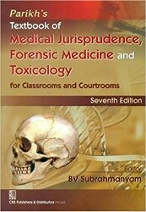
TEXT BOOKS & PRACTICAL NOTEBOOK:
Principles & Practice of Forensic Medicine.
by Nasib R. Awan
Parikh’s Textbook of Medical Jurisprudence,
Forensic Medicine & Toxicology.
Practical Manual Of Forensic Medicine
& Toxicology

