Slide 1
Human Immunodeficiency Virus/AIDS
Dr. Muhammad Mujeeb Khan
FCPS (Medicine)
Dip. DM (UK), Dip. Nutrition (Pak),
MSc. Infectious Diseases (UK)
Associate Professor
Rawalpindi Medical University, Rawalpindi

Slide 2
University Motto, Vision, Values & Goals
Mission Statement
To impart evidence-based research-oriented health professional education
Best possible patient care
Mutual respect, ethical practice of healthcare and social accountability.
Vision and Values
Highly recognized and accredited centre of excellence in medical education, using evidence-based training techniques for development of highly competent health professionals, who are lifelong experiential learner and are socially accountable.
Goals
The Undergraduate Integrated Learning Program is geared to provide you with quality medical education in an environment designed.

Slide 3
PROF UMER MODEL OF INTEGRATED LECTURE

Slide 4
SEQUENCE OF LGIS
Learning objectives
What is HIV/AIDS and how to diagnose it?(core concept = 70%)
Related pathology and pharmacology (horizontal integration 15%)
Recent advances and developments. (vertical integration – 10%)
Research article related to topic (3%) Ethics (2%)

Slide 5
LEARNING OBJECTIVES
At the end of the lecture students will have learnt about
Define HIV and AIDS and recognize their global and regional impact.
Explain the structure of HIV and detail each step of its life cycle (entry, reverse transcription, integration, replication, assembly, budding).
Explain Pathogenesis and Immune Response.
Identify Clinical Phases and Presentations.
Discuss Diagnostic Strategies.
Summarize ART drug classes, regimen choices, and monitoring strategies.
Recognize Complications and Their Management.

Slide 6
Introduction
Definition:
HIV:
Human Immunodeficiency Virus, a retrovirus that attacks the immune system.
AIDS:
Acquired Immunodeficiency Syndrome, the advanced stage of HIV infection.
Historical Context:
First identified in the early 1980s.
Global Relevance:
Major public health challenge worldwide.

Slide 7
Epidemiology
Global Statistics:
In 2023, around 630,000 people died from HIV related causes, while about 1.3 million people acquired HIV, bringing the total number of people in the world with HIV to a total of 39.9 million.
Regional Focus:
About 210,000 total HIV positive patients have been identified in Pakistan till date, and the infection rates are going up with recent outbreaks.
High-Risk Populations:
Sexual risk groups, injection drug users, and vertical transmission in neonates.

Slide 8
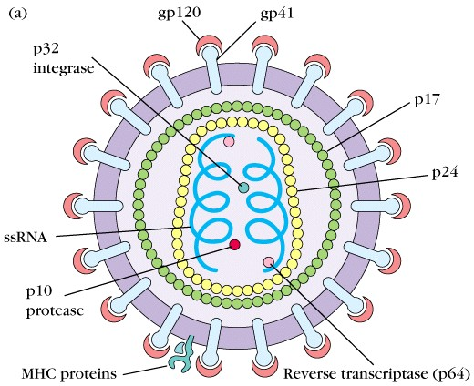
HIV Virology
Virus Classification:
Retrovirus with a single-stranded RNA genome.
Key Structural Components:
Envelope:
Contains glycoproteins (gp120 and gp41).
Capsid:
Encases two copies of RNA and essential enzymes.
Enzymatic Machinery:
Reverse transcriptase, integrase, and protease.

Slide 9
Modes of Transmission
Primary Routes:
Sexual Contact:
Heterosexual and homosexual exposures.
Parenteral:
Contaminated needles, blood transfusions.
Vertical Transmission:
From mother to child during pregnancy, birth, or breastfeeding.
Less Common Routes:
Occupational exposure (e.g., needle sticks).

Slide 11
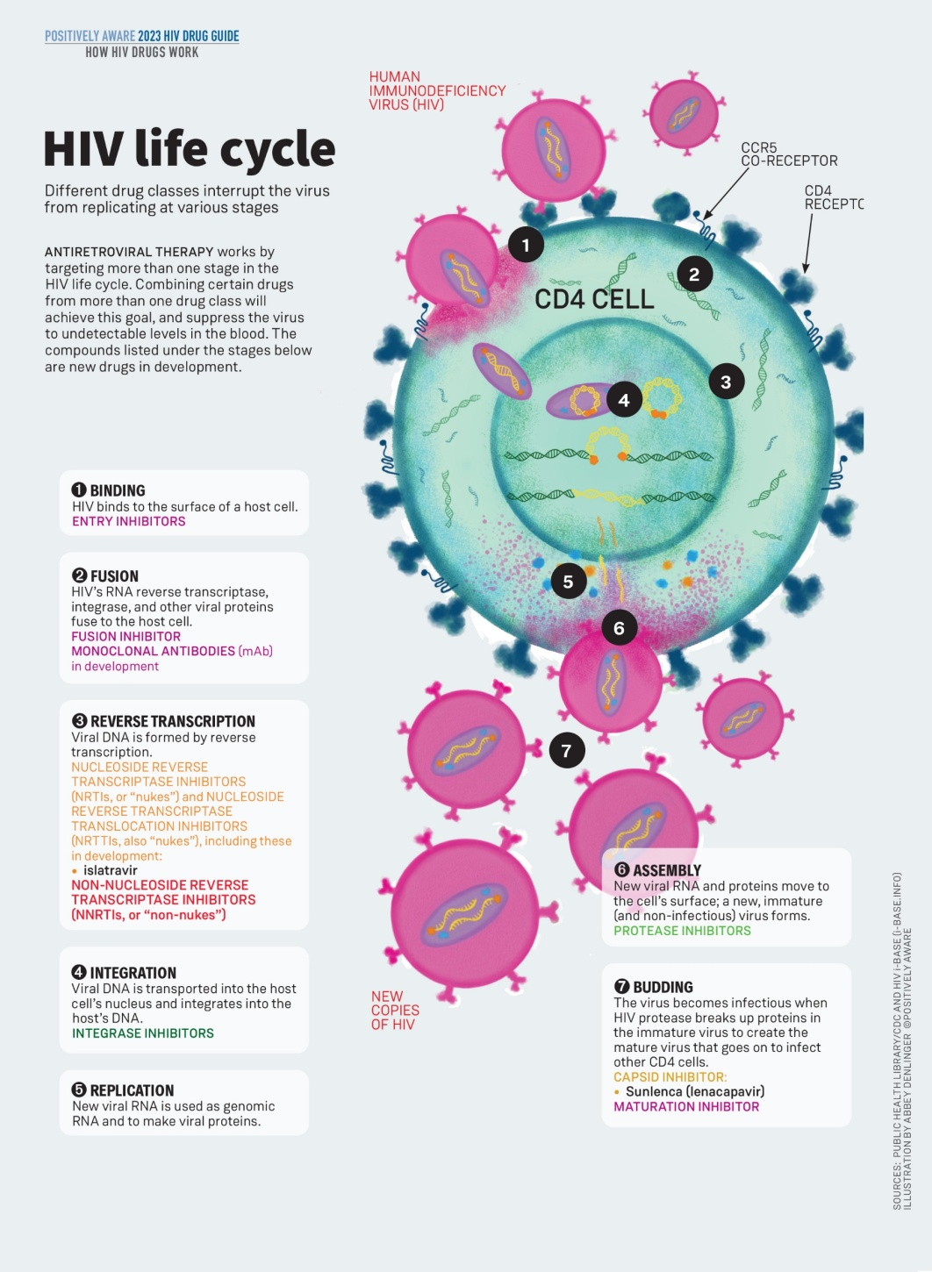
HIV LIFE CYCLE
Key Stages:
Attachment & Entry
Reverse Transcription
Integration
Replication & Assembly
Budding & Maturation
Significance:
Each step represents a potential target for therapeutic intervention.

Slide 12
Detailed HIV Life Cycle
Attachment & Entry:
gp120 binds to the CD4 receptor and co-receptors (CCR5 or CXCR4).
Fusion:
Viral envelope fuses with the host cell membrane.
Reverse Transcription:
Viral RNA is converted into DNA by reverse transcriptase.
Integration:
Viral DNA is integrated into the host genome by integrase.
Replication & Assembly:
Host machinery produces viral RNA and proteins; new virions are assembled.
Budding & Maturation:
Virions bud off from the host cell and mature through protease-mediated cleavage.

Slide 13
Pathogenesis of HIV Infection
CD4+ T-cell Depletion:
Direct viral killing and apoptosis.
Immune System Dysregulation:
Impaired cell-mediated immunity leading to vulnerability to opportunistic infections.
Progressive Immunodeficiency:
Transition from asymptomatic to symptomatic stages over time.

Slide 14
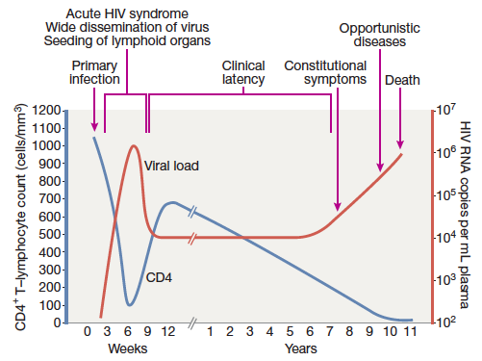
VIROLOGICAL AND IMMUNOLOGICAL PROGRESION OF UNTREATED HIV INFECTION

Slide 15
SCREENING RECOMMENDATIONS
One time screening in all adult patients at their First health encounter
Pregnant women: HIV testing at each pregnancy
High risk group: Annual screening
Homosexual men and transgender women
Persons who inject drugs
Person who exchange sex for money or drugsPersons from regions with generalized HIV epidemics
Persons who have sex partners with unctrolled HIV

Slide 16
DIAGNOSIS OF HIV
Early HIV infection: When antibodies are not formed yet
p24 Antigen Assay
PCR (HIV RNA Detection)
HIV is diagnosed by host antibodies and HIV is confirmed with 2 positive tests

Slide 17
4th-Generation HIV Antigen/Antibody Test
Detects HIV antibodies & p24 antigen
If negative. HIV less likely
If Positive then
HIV-1/2 Differentiation Assay
Confirms if infection is HIV-1 or HIV-2
If indeterminate results then PCR

Slide 18
PATHOLOGICAL INVESTIGATIONS
CD 4 count
Viral load
Hepatitis B surface antigen
Hepatitis C antibody
Liver function tests
Full blood count
Urinalysis, serum creatinine
Syphilis serology
Cervical smear in women
Serum cryptococcal antigen (if CD4 < 100)
Tuberculin skin test
Sexually transmitted infection screen

Slide 19
Clinical Phases of HIV Infection
Stage 1: Acute HIV infection
Flue like illness
Very contagious at this stage
Duration of symptoms usually upto 2 weeks
Stage 2: Clinical latency
Virus reproduces at low level
Duration varies from person to person
Minimal or no symptoms
Stage 3 AIDS
Development of specific opprotunistic
infections, cancers and sever
manifestation of HIV itself

Slide 20
CLINICAL FEATURES OF PRIMARY INFECTION
Fever
Maculopapular Rash
Pharyngitis
Lymphadenopathy
Myalgia/Arthralgia
Diarrhea
Headache
Oral and Genital Ulceration
Meningo encephalitis

Slide 21
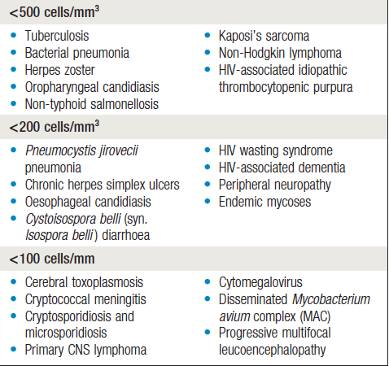
HIV ASSOCIATED DISEASES & CD4 COUNT

Slide 22
Clinical Presentation
Patient Profile:
32-year-old male with a history of high-risk sexual behavior.
Presentation:
Persistent fever, significant weight loss, generalized lymphadenopathy, and oral candidiasis.
Clinical Course:
Initially experienced an acute retroviral syndrome followed by a prolonged latency phase.
Now presents with opportunistic infections indicative of progression to AIDS.

Slide 23
IMMUNE RECONSTITUTION INFLAMMATORY SYNDROME (IRIS)
Paradoxical worsening of an existing opportunistic infection or unmasking of a latent infection
This is due to exagerrated immune response with pronounced inflammatory features
For example:
Patient with CMV retinitis develop uveitis (After initiation of ART)
Patient with Cough & hemoptysis developed pleural effusion, lymphadenopathy, worsening of cough after initiation of anti retroviral therapy
How to avoid IRIS: Start ART after the 8 weeks of antitubercular therapy (In case of pulmonary tuberculosis)

Slide 24
CRITERIA FOR STARTING ANTIRETROVIRAL THERAPY (ART)
All HIV positive patients, irrespective of CD4 count or clinical status
Patients with opportubistic infections:
Tuberculosis + HIV: ART should be deffered until 8 weeks
Cryptococcal meningitis + HIV: ART should be deffered for 5 weeks
Other major opportunistic infections + HIV : ART should be with in 2 weeks
Early initiation of ART increases the risk of immune reconstitution inflammatory syndrome (IRIS)

Slide 25
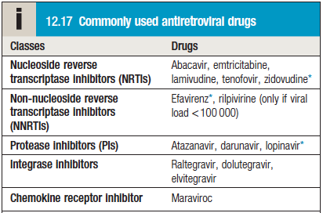
SELECTING THE ANTIRETROVIRAL REGIMEN
There are 5 classes of antiretroviral drugs
Combination of Two NRTI’s + one NNRTI or Protease inhibitor or Integrase inhibitor

Slide 26
TREATMENT OF COMMON OPPORTUNISTIC INFECTIONS
Opportunistic infections | Treatment
Pneumocystis jirovecii pneumonia | Co-trimoxazole, prednisone (if hypoxic)
Cerebral toxoplasmosis | Sulfadiazine plus pyrimethamine
Cryptococcosis | Liposomal amphotericin B Plus plus flucytosine
Esophageal candidiasis | Fluconzole
Disseminated mycobacterium avium complex | Clarithromycin + ethambutol
Cystoiospora belli diarrhea | Co-trimoxazole

Slide 27
Recent Advances in HIV Research
Long-Acting Anti Retroviral Therapy:
Developments in injectable formulations for better adherence.
Vaccine Research:
New approaches and promising candidates under trial.
Gene Editing and Cure Strategies:
Exploratory studies using CRISPR and other novel technologies.
Pre- and Post-Exposure Prophylaxis:
Advances in PrEP and PEP strategies to prevent HIV transmission.

Slide 28
Emerging Therapies and Future Directions
Novel Drug Targets:
Research on new molecules and targets beyond current ART.
HIV Reservoirs:
Strategies to identify and eliminate latent viral reservoirs.
Precision Medicine:
Tailoring treatment based on individual genetic and viral factors.
Hope for a Cure:
“Shock and kill” and “block and lock” strategies under investigation.

Slide 29
Thank You

