Slide 2
DR. TANVEER HUSSAIN
MBBS,FCPS (Med), FRCP (Glasg)
FCPS (Gastro), CHPE
Associate Professor & HOD
Gastroenterology, RMU

Slide 3

University Motto, Vision, Values & Goals
Mission Statement To impart evidence-based research-oriented health professional education Best possible patient care Mutual respect, ethical practice of healthcare and social accountability. Vision and Values Highly recognized and accredited center of excellence in Medical Education, using evidence-based training techniques for development of highly competent health professionals, who are lifelong experiential learner and are socially accountable. Goals The Undergraduate Integrated Learning Program is geared to provide you with quality medical education in an environment designed to:

Slide 4
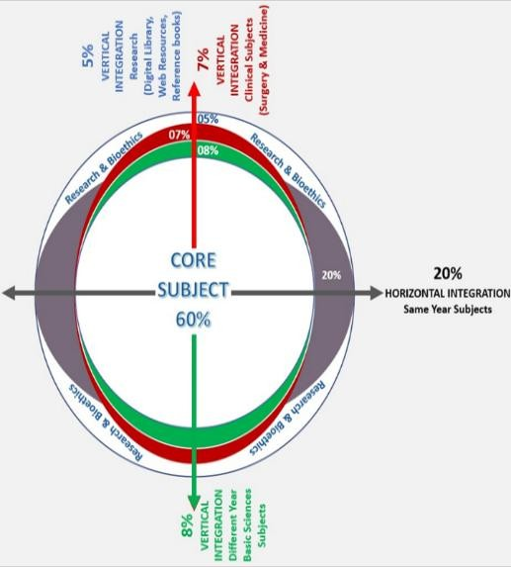
RMU Integrated Lecture Model

Slide 5
LOs
At the end of lecture, students will be able to understand
Etiopathogenesis & clinical features of the disease
Specific investigations of the disease
Treatment plan of the disease
Complication of the disease

Slide 6
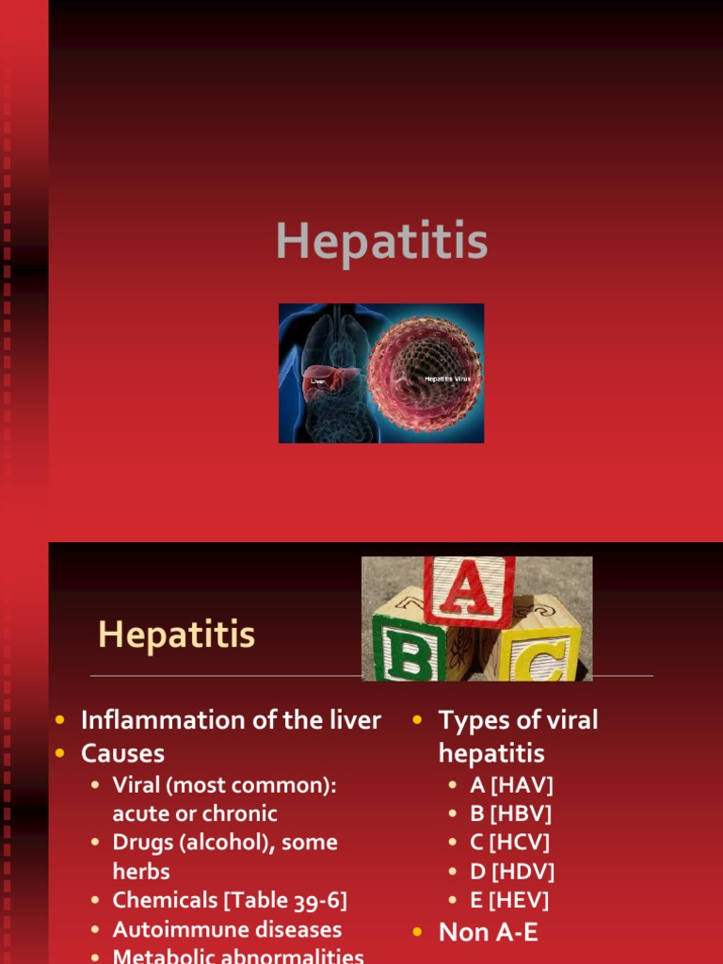

Slide 7
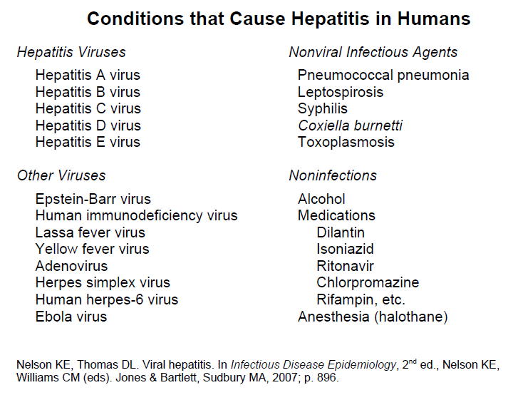

Slide 8
Viral Hepatitis:
Symptoms & Sign of viral hepatitis can include:
  Fever
  Fatigue
  Loss of appetite
  Nausea
  Vomiting
  Abdominal pain
  Jaundice
  Dark urine
  Clay-colored stool
  Joint pain

Slide 9
Viral Hepatitis

Slide 10
Hepatitis A Diagnosis

Slide 11
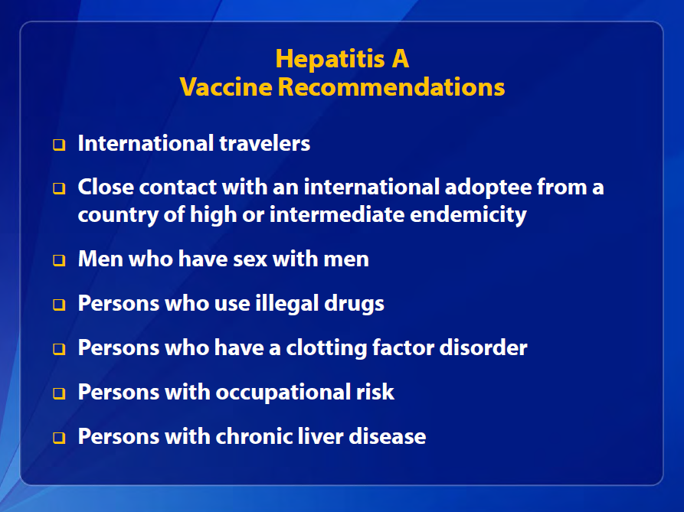

Slide 12
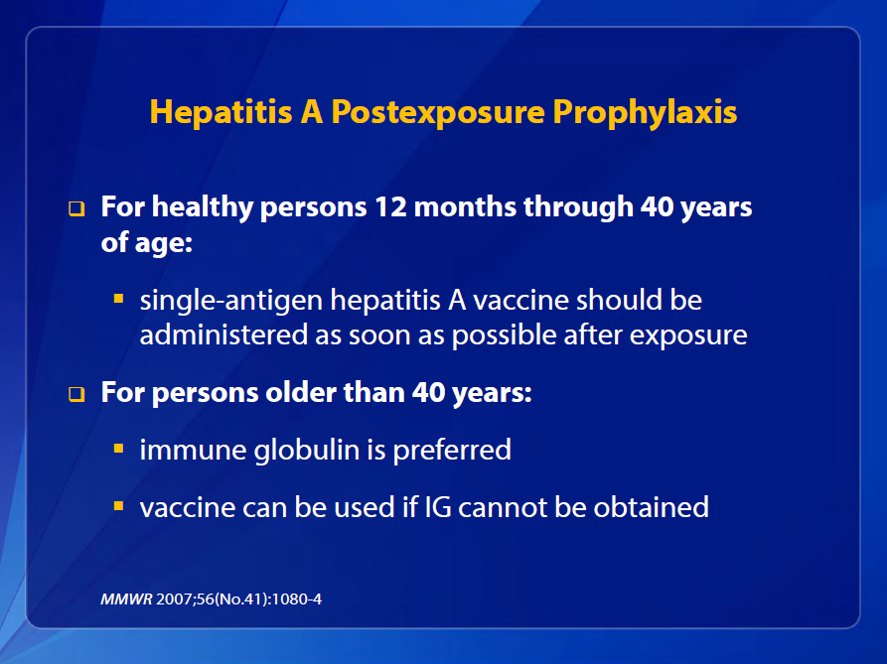

Slide 13
Hepatitis A Prevention
Vaccine is the best protection.
Good sanitation measures are essential for preventing environmental contamination.
Good personal hygiene is also essential for prevention and control including:
  Hand washing with soap:
    After using the bathroom
    After changing a diaper
    Before preparing and eating food

Slide 14
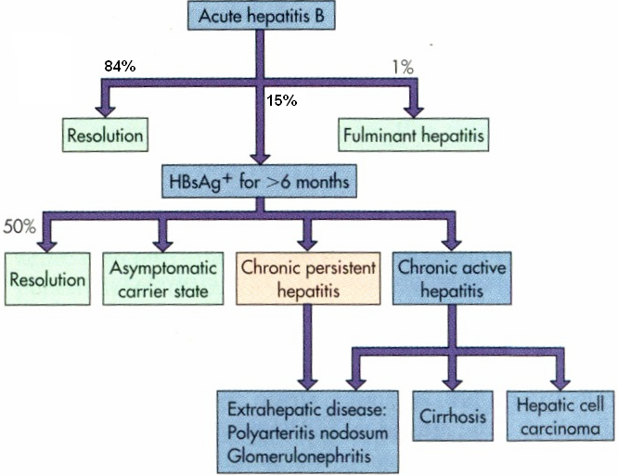
Clinical outcomes of acute hepatitis B infection

Slide 16
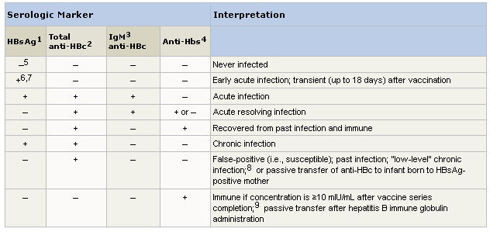
HBV Markers
Interpretation of serologic test results for HBV infection

Slide 17
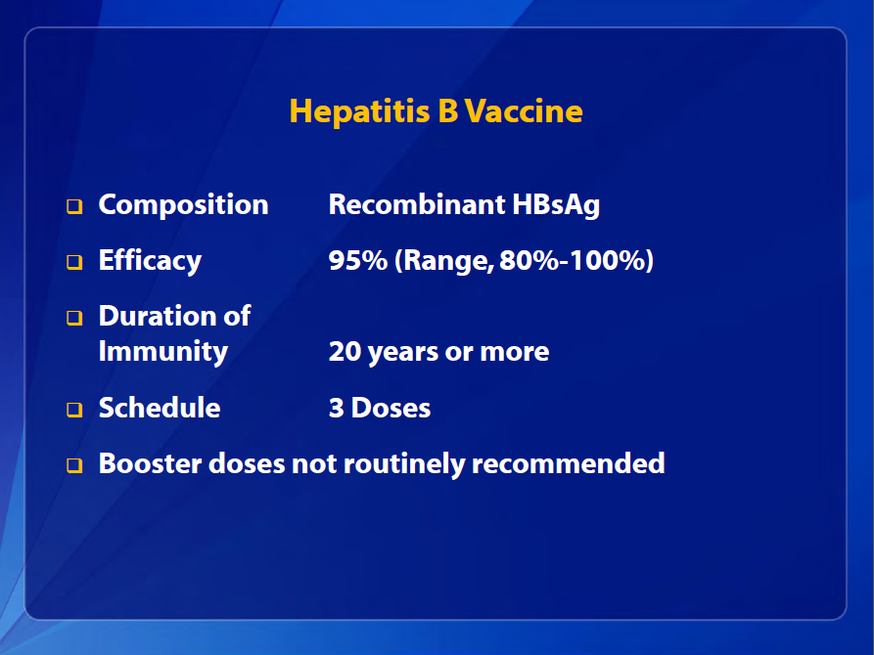

Slide 18
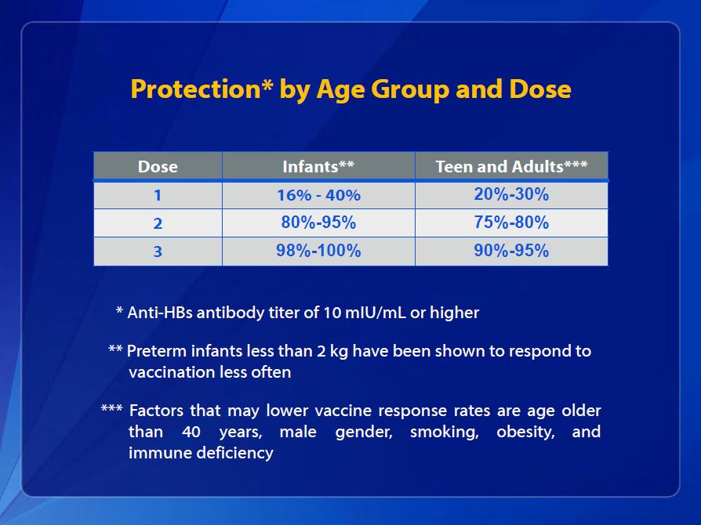

Slide 19
Hepatitis E
The highest attack rate is seen among persons aged 15-40 years.
  Most hepatitis E outbreaks, highest rates of clinically disease have been in young to middle-age adults.
  lower disease rates in younger age groups may be the result of an icteric and/or subclinical HEV infection.
Fatality rate overall is 1%-3%.
  In pregnant women, fatality rate can be as high as 15%-25%.

Slide 20
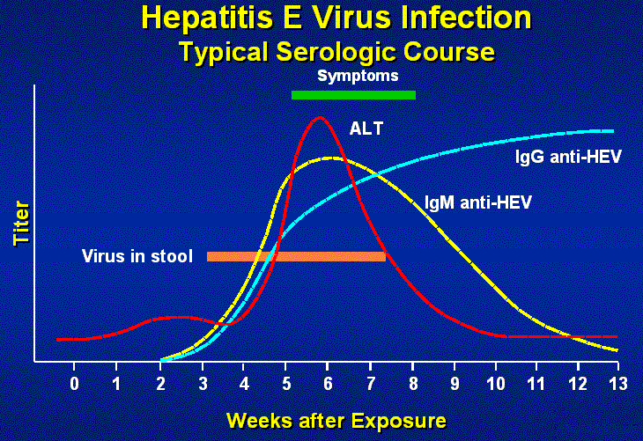

Slide 21
Hepatitis E Prevention
Hepatitis E vaccine was just approved for use
Good sanitation measures are essential for preventing environmental contamination.
Good personal hygiene is also essential for prevention and control
  Hand washing with soap:
    After using the bathroom
    After changing a diaper
    Before preparing and eating food

Slide 22
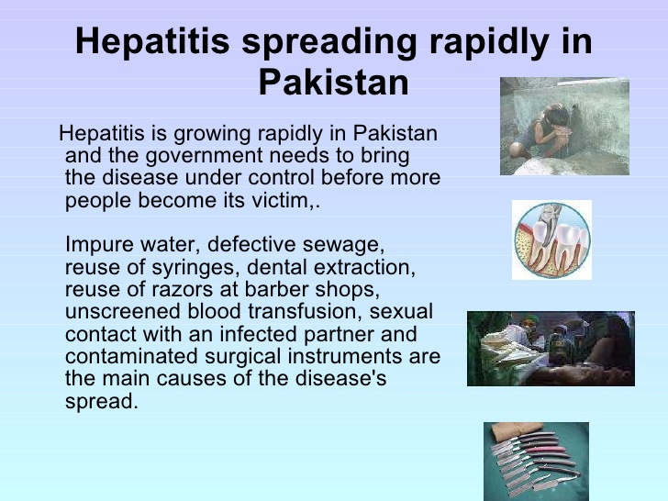

Slide 23


Slide 24
Chronic Hepatitis

Slide 25
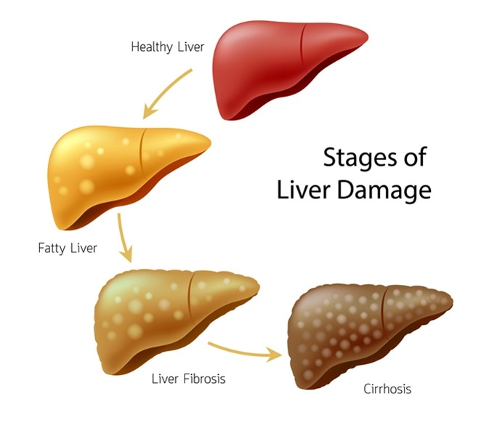

Slide 26
HBV INFECTION

Slide 27
CASE SCENARIO
25 years old shopkeeper visited GI clinic with following investigations
HBsAg +
ALT 20IU/
USG(Ab) normal
Q 1. What further investigations you will need for diagnosis?

Slide 28
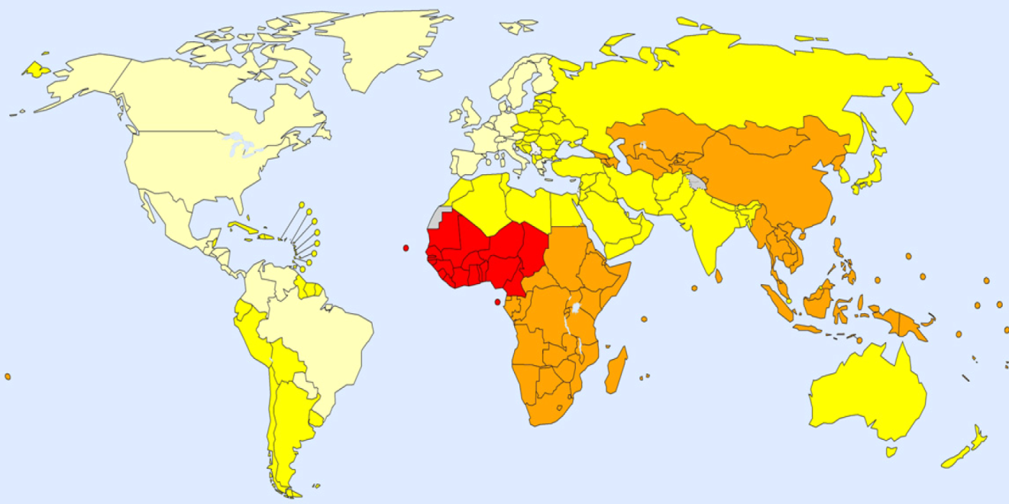
Epidemiology and public health burden
Worldwide ≈250 million chronic HBsAg carriers.
686,000 deaths from HBV-related liver disease and HCC in 2013.
HBsAg prevalence, adults (19−49 years), 2005
Decreasing prevalence in some endemic countries, e.g. Taiwan
Possible reasons:
Improved socioeconomic status
Vaccination
Effective treatments
<2%
2−4%
5−7%
≥8%
Not applicable
Increasing prevalence in some European countries:^{5,}
Migration from high endemic countries
1. EASL CPG HBV. J Hepatol 2017;67:370–98;

Slide 29
New nomenclature for chronic phases
The natural history of chronic HBV infection has been schematically divided into ﬁve phases
 | HBeAg positive |  | HBeAg negative
 | Phase 1 | Phase 2 | Phase 3 | Phase 4 | Phase 5
 | Chronic HBV infection | Chronic hepatitis B | Chronic HBV infection | Chronic hepatitis B | Resolved HBV infection
HBsAg | High | High/ intermediate | Low | Intermediate | Negative
HBeAg | Positive | Positive | Negative | Negative | Negative
HBV DNA | >10⁷ IU/mL | 10⁴–10⁷ IU/mL | <2,000 IU/mL* | >2,000 IU/mL | <10 IU/mL‡
ALT | Normal | Elevated | Normal | Elevated† | Normal
Liver disease | None/minimal | Moderate/ severe | None | Moderate/ severe | None§
Old terminology | Immune tolerant | Immune reactive HBeAg positive | In active carrier | HBeAg negative chronic hepatitis | HBsAg negative /anti-HBc positive
Chronic hepatitis B
Chronic HBV
infection
EASL CPG HBV. J Hepatol 2017;67:370–98

Slide 30
Goals and endpoints of therapy
Goals
Improve survival and quality of life by preventing disease progression and HCC.
Prevent mother-to-child transmission, hepatitis B reactivation , prevent and treat HBV-associated extrahepatic manifestations
Recommendations
Main endpoint Induction of long-term suppression of HBV DNA | I | 1
Valuable endpoint Induction of HBeAg loss (± anti-HBe seroconversion) in HBeAg-positive patients with chronic hepatitis B* | II-1 | 1
Additional endpoint ALT normalization (biochemical response)† | II-1 | 1
Optimal endpoint HBsAg loss (± anti-HBs seroconversion)‡ | II-1 | 1
EASL CPG HBV. J Hepatol 2017;67:370–98

Slide 31
Indications for treatment
Primarily based on the combination of 3 criteria
  HBV DNA, serum ALT and severity of liver disease
Recommendations
Should be treated
Patients with HBeAg-positive or -negative chronic hepatitis B* | I | 1
Patients with cirrhosis, any detectable HBV DNA, regardless of ALT level | I | 1
Patients with HBV DNA >20,000 IU/mL and ALT >2x ULN, regardless of severity of histological lesions | II-2 | 1
May be treated Patients with HBeAg-positive chronic HBV infection† >30 years old, regardless of severity of liver histological lesions | III | 2
Can be treated Patients with HBeAg-positive or -negative chronic HBV infection and family history of HCC or cirrhosis and extrahepatic manifestations‡ | III | 2
Grade of evidence
Grade of recommendation
EASL CPG HBV. J Hepatol 2017;67:370–98
Notes:
ALT, alanine aminotransferase; HBeAg, hepatitis B ‘e’ antigen; HCC, hepatocellular carcinoma; ULN, upper limit of normal

Slide 32
Monitoring of patients currently not treated
Patients with no current indication of antiviral therapy should
be monitored
  Periodical assessments of serum ALT, HBV DNA and non-invasive
  markers for liver fibrosis
Recommendations
Follow-up at least every 3–6 months HBeAg-positive chronic HBV infection, <30 years old | II-2 | 1
Follow-up at least every 6–12 months HBeAg-negative chronic HBV infection and serum HBV DNA <2,000 IU/ml | II-2 | 1
Follow-up every 3 months for the first year and every 6 months thereafter HBeAg-negative chronic HBV infection, serum HBV DNA ≥2,000 IU/ml | III | 1
Grade of evidence
Grade of recommendation
EASL CPG HBV. J Hepatol 2017;67:370–98

Slide 33
Current treatment strategies for Chronic HBV
Features | PegIFNα | ETV, TDF, TAF
Route of administration | Subcutaneous injections | Oral
Treatment duration | 48 weeks | Long-term until HBsAg loss*
Tolerability | Low | High
Long-term safety concerns | Very rarely persistence of on-treatment AEs† | Probably not‡
Contraindications | Many§ | None‖
Strategy | Induction of a long-term immune control | Inhibition of viral replication
Level of viral suppression | Moderate | Universally high
Effect on HBeAg loss | Moderate¶ | Low in first year, moderate over long term
Effect on HBsAg levels | Variable¶ | Low**
Risk of relapse after treatment cessation | Low for those with sustained response 6–12 months after therapy | Moderate if consolidation treatment provided after HBeAg seroconversion. High for HBeAg-negative disease
Early stopping rules | Yes | No
Risk of viral resistance | No | Minimal to none††
EASL CPG HBV. J Hepatol 2017;67:370–98

Slide 34
Definitions of response to treatment
Responses | NA therapy | PegIFNα therapy
Virological (on-treatment) | Response: HBV DNA <10 IU/ml Primary non-response: <1 log₁₀ decrease in HBV DNA after 3 months of therapy Partial response: HBV DNA decreased by >1 log₁₀ but still detectable after ≥12 months of therapy in compliant patients Breakthrough: confirmed HBV DNA increase of >1 log₁₀ above on-therapy nadir | Response: HBV DNA <2,000 IU/ml
Virological (off-treatment) | Sustained response: HBV DNA <2,000 IU/ml for ≥12 months after end of therapy
Serological | HBeAg loss and development of anti-HBe* HBsAg loss and development of anti-HBs
Biochemical | ALT normalization† (confirmed by ALT determination at least every 3 months for at least 1 year post-treatment)
Histological | Decrease in necroinﬂammatory activity† without worsening in ﬁbrosis compared with pre-treatment histological ﬁndings
EASL CPG HBV. J Hepatol 2017;67:370–98

Slide 35
Discontinuation of NA treatment
Long-term therapy with NAs is usually required
  HBV eradication is not usually achieved
Recommendations
NAs should be discontinued After confirmed HBsAg loss (± anti-HBs seroconversion) | II-2 | 1
NAs can be discontinued In HBeAg-positive patients, without cirrhosis, who achieve stable HBeAg seroconversion and undetectable HBV DNA and complete ≥12 months of consolidation therapy Close post-NA monitoring is warranted | II-2 | 2
NAs may be discontinued In selected HBeAg-negative patients, without cirrhosis, who achieve long-term (≥3 years) virological suppression, if close post-NA monitoring can be guaranteed | II-2 | 2
EASL CPG HBV. J Hepatol 2017;67:370–98

Slide 36
HCV co-infection
HCV co-infection accelerates liver disease progression and increases the risk of HCC in patients with chronic HBV infection.
  All patients with chronic HBV infection should be screened for HCV.
Grade of evidence
Grade of recommendation
Recommendations
Treatment of HCV with DAAs may cause reactivation of HBV. Patients fulfilling the standard criteria for HBV treatment should receive NA treatment | II | 1
HBsAg-positive patients undergoing DAA therapy should be considered for concomitant NA prophylaxis until 12 weeks after completion of DAA treatment, and monitored closely | II-2 | 2
HBsAg-negative, anti-HBc-positive patients undergoing DAA therapy should be monitored and tested for HBV reactivation in case of ALT elevation | II | 1
EASL CPG HBV. J Hepatol 2017;67:370–98

Slide 37
Pregnant women
Management may depend on severity of liver disease and timing of a future pregnancy.
Recommendations
Screening for HBsAg in the first trimester is strongly recommended | I | 1
In women of childbearing age without advanced fibrosis planning a pregnancy in the near future, it may be prudent to delay therapy until the child is born | II-2 | 2
In pregnant women with chronic hepatitis B and advanced fibrosis or cirrhosis, therapy with TDF is recommended | II-2 | 1
In pregnant women already on NA therapy, TDF should be continued while ETV or other NA should be switched to TDF | II-2 | 1
In all pregnant women with HBV DNA >200,000 IU/ml or HBsAg >4 log₁₀ IU/ml, antiviral prophylaxis with TDF should start at Week 24–28 of gestation and continue for up to 12 weeks after delivery | I | 1
Breast feeding is not contraindicated in HBsAg-positive untreated women or those on TDF-based treatment or prophylaxis | III | 2
EASL CPG HBV. J Hepatol 2017;67:370–98

Slide 38
Patients with extrahepatic manifestations
Extrahepatic manifestations can be associated with HBV infection
  Vasculitis, skin manifestations (purpura), polyarteritis nodosa,
  arthralgias, peripheral neuropathy and glomerulonephritis.
HBsAg-positive patients with extrahepatic manifestations
and active HBV replication may respond to antiviral therapy
  PegIFNα can worsen some immune-mediated extrahepatic manifestations
Recommendations
Patients with replicative HBV infection and extrahepatic manifestations should receive antiviral treatment with NAs | II-2 | 1
PegIFNα should not be administered in patients with immune-related extrahepatic manifestations | III | 1
EASL CPG HBV. J Hepatol 2017;67:370–98

Slide 39
What further investigations you will need for diagnosis?
HBeAg
Anti HBe
HBV DNA(Qt)
Fibroscan/ biopsy

Slide 40
HCV Infection

Slide 41
CASE SCENARIO
40 years old shopkeeper, visited GI OPD clinic with following investigations. He informed that he took Peg-IFN for HCV in 2010.
Hb 13.4 g/dl TLC 5.3 Platelets 113 x 10
PCR HCV RNA + USG(Ab) Fatty liver with coarse
GT 3 echotexture
BMI 28 kg/m2 TSH N
Q.1 What is diagnosis?
Q.2 Other investigations?
Q.3 What is the treatment

Slide 42
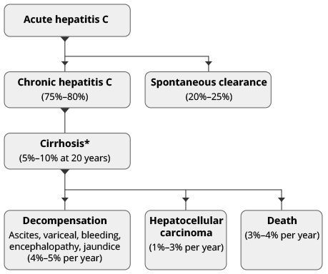
Natural history of HCV

Slide 43

HCV Screening is the First Step
Cure
Assessment
Testing
Treatment
Counseling
Screening

Slide 44
How to evaluate the HCV positive patient
History
Other risk factors for advanced fibrosis
Physical examination
Investigations

Slide 45
Fibrosis Assessment
Does this patient have cirrhosis ?
Risks factors
  Long duration of infection
  Alcohol , NAFLD, cofactors
  Signs of chronic liver disease
  Lab findings-Platelet count, AST/ALT ratio, synthetic (INR, albumin) or excretory (bilirubin) dysfunction
APRI score
http://www.hepatitisc.uw.edu/page/clinical-calculators/apri
AST and platelet count
> 1.0 ? Cirrhosis, < 0.5 cirrhosis unlikely
Transient Elastography (Fibroscan)
  > 12.5 consider cirrhosis
  FIB-4

Slide 46

Treatment recommendations for TN or TE patients with CHC without cirrhosis
GT |  | SOF/VEL | GLE/PIB | SOF/VEL/VOX | SOF/LDV | GZR/EBR | OBV/PTV/r + DSV
1a | TN | 12 weeks | 8 weeks | No | 8–12 weeks | 12 weeks (HCV RNA ≤800,00 IU/mL) | No
 | TE | 12 weeks | 8 weeks | No | No | 12 weeks (HCV RNA ≤800,00 IU/mL) | No
1b | TN | 12 weeks | 8 weeks | No | 8–12 weeks | 8 weeks (F0–F2) 12 weeks (F3) | 8 weeks (F0–F2) 12 weeks (F3)
 | TE | 12 weeks | 8 weeks | No | 12 weeks | 12 weeks | 12 weeks
2 | TN | 12 weeks | 8 weeks | No | No | No | No
 | TE | 12 weeks | 8 weeks | No | No | No | No
3 | TN | 12 weeks | 8 weeks | No | No | No | No
 | TE | 12 weeks | 12 weeks | No | No | No | No
4 | TN | 12 weeks | 8 weeks | No | 12 weeks | 12 weeks (HCV RNA ≤800,00 IU/mL) | No
 | TE | 12 weeks | 8 weeks | No | No | No | No
5 | TN | 12 weeks | 8 weeks | No | 12 weeks | No | No
 | TE | 12 weeks | 8 weeks | No | No | No | No
6 | TN | 12 weeks | 8 weeks | No | 12 weeks | No | No
 | TE | 12 weeks | 8 weeks | No | No | No | No
EASL CPG HCV. J Hepatol 2018;69:461–511.
Notes:
Abbreviations: CHC, chronic hepatitis C infection; DSV, dasabuvir; EBR, elbasvir; GLE, glecaprevir; GT, genotype; GZR, grazoprevir; HCV, hepatitis C virus; LDV, ledipasvir; OBV, ombitasvir; PIB, pibrentasvir; PTV/r, paritaprevir/ritonavir; SOF, sofosbuvir; TE, treatment-experienced; TN, treatment-naïve; VEL, velpatasvir; VOX, voxilaprevir

Slide 47
Treatment monitoring
Week 0
  CBP, ELU, LFTs, INR, HCV RNA level (quantitative)
Week 4
  CBP, LFTs
End of Treatment
  CBP, LFTs, HCV PCR (qualitative)
12 weeks post EOT
  CBP, LFTs, HCV PCR (qualitative)
At each visit assess for
  Medication adherence
  treatment side effects
  Drug-drug interactions

Slide 48
Monitoring after successful HCV treatment
SVR, no cirrhosis, and normal LFT results
if cured do not require clinical follow-up for hepatitis C
SVR and abnormal LFT results
persistently abnormal LFT results require evaluation for other liver disease:
  fasting glucose, insulin lipid levels,
  ANA, ASMA, anti-LKM antibodies, total IgG AMA
  caeruloplasmin, α-1-antitrypsin, iron studies
SVR, cirrhosis:
require long-term monitoring and should be enrolled in screening programs
  hepatocellular carcinoma
  oesophageal varices
  Osteoporosis
  Vaccination (hepatitis A and B)
No SVR
Require specialist follow up

Slide 49
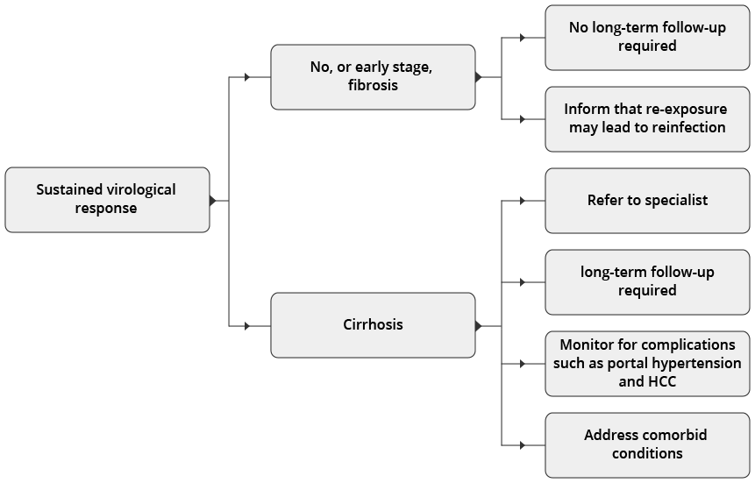
Long-term follow up

Slide 50
Autoimmune Hepatitis

Slide 51
Epidemiology: prevalence
AIH is an non-resolving chronic liver disease that occurs in both sexes but affects mainly women
The incidence of AIH is increasing ,AIH occurs in all ethnic groups and in all age groups
Bimodal distribution usually with peaks around puberty and between 4th and 6th decade
A significant proportion of patients are above 65 years of age
1. Grønbæk L, et al. J Hepatol 2014;60:612–7;
EASL CPG AIH. J Hepatol 2015;63:971–1004
Notes:
AIH, autoimmune hepatitis; SIR, standardized incidence rate
Grønbæk L, Vilstrup H, Jepsen P. Autoimmune hepatitis in Denmark: incidence, prevalence, prognosis, and causes of death. A nationwide registry-based cohort study. J Hepatol. 2014 Mar;60(3):612-7. doi: 10.1016/j.jhep.2013.10.020. Epub 2013 Oct 26.

Slide 52
Presentation of AIH
Asymptomatic to acute/severe or even fulminant
Insidious onset (most common clinical phenotype)
  Either without apparent symptoms or with one or more of the following non-specific symptoms:
    Fatigue, general ill health, right upper quadrant pain, lethargy, malaise, anorexia, weight loss, nausea, pruritus, fluctuating jaundice and polyarthralgia involving the small joints without arthritis (sometimes dating back years)
EASL CPG AIH. J Hepatol 2015;63:971–1004
Notes:
AIH, autoimmune hepatitis

Slide 53
Acute onset (about 25% of patients)
  Acute exacerbation of chronic AIH, or
  True acute AIH without histological findings of chronic liver disease
  Centrilobular zone 3 necrosis (central perivenulitis) usually predominant
  Autoantibodies or other classical features can be absent
Cirrhosis already present in ~1/3 of patients at diagnosis
  Irrespective of the presence of symptoms
  Due to delay in diagnosis (often long asymptomatic course)

Slide 54
Sub classification of AIH
sub-classiﬁcation of AIH based on autoantibody pattern
  Validity and clinical implications of this sub-classification are uncertain
Sub-type | Features
AIH-1 | Almost 90% of AIH cases Detection of ANAs, SMAs or anti-SLA/LP Association with HLA DR3, DR4 and DR13 Any age at onset Variable clinical and histopathological severity | excellent treatment response, but variable relapse rates after drug withdrawal and need for long-term maintenance therapy
AIH-2 | Up to 10% of AIH cases Anti-LKM1, anti-LC1 and rarely anti-LKM3 Association with HLA DR3 and DR7 Onset usually in childhood/young adulthood Clinical and histopathological severity commonly acute and advanced | Sometimes failure of treatment and frequent relapse rates after drug withdrawal; need for long-term maintenance therapy very common
AIH-3 | Up to 10% of cases Only SLA/LP positive similar to AIH-1 Ro52-antibody positive | Lifelong immuno-suppression in most cases
Notes:
AIH, autoimmune hepatitis; ANA, antinuclear antibody; HLA, human leucocyte antigen; LC, liver cytosol; LKM, liver-kidney microsomal; LP, liver-pancreas; SLA, soluble liver antigen; SMA, smooth muscle antibody

Slide 55
Diagnostic algorithm for AIH
Liver disease of unknown origin
IFL autoantibody test on rodent tissue sections
+ SLA/LP (ELISA or blot)
ANA+
SMA+
LKM1/LC1+
SLA/
LP+
Test Negative
Clinical suspicion*
remains
Consider AIH*
Repeat testing in
specialty lab
(including pANCAs and specific immunoassays for LKM1, LKM3, LC1, SLA/LP, F-actin, Ro52,
gp210†, sp100†)
Negative
Consider alternate diagnoses or
Autoantibody-negative AIH
Liver biopsy
Positive
Consider AIH
*Test also for elevated IgG levels; †These antibodies are highly specific for PBC diagnosis
EASL CPG AIH. J Hepatol 2015;63:971–1004
Notes:
AIH, autoimmune hepatitis; ANA, antinuclear antibody; ELISA, enzyme-linked immunosorbent assay; IFL, immunofluorescence; Ig, immunoglobulin; LC, liver cytosol; LKM, liver-kidney microsomal; LP, liver-pancreas; pANCA, perinuclear antineutrophil cytoplasmic antibody; PBC, primary biliary cirrhosis; SLA, soluble liver antigen; SMA, smooth muscle antibody
Suggested diagnostic algorithm for autoimmune hepatitis using routine autoantibody testing by indirect immunofluorescence (IFL) and enzyme linked immunosorbent assay (ELISA) testing with a set of four autoantibodies. A liver biopsy is always required for the demonstration of inflammatory hepatitis, as well as for staging and grading of the liver disease.

Slide 56
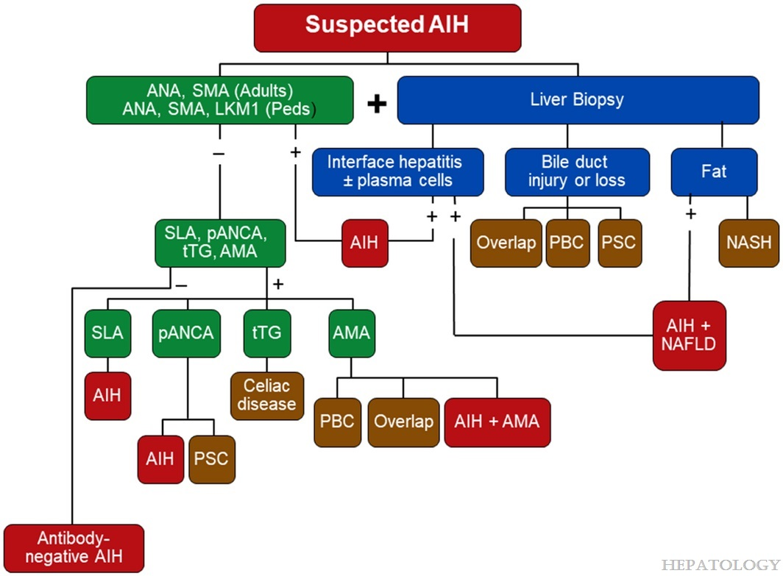

Slide 57
Role of Liver Biopsy
No combination of markers are diagnostic for AIH,
biopsy is necessary to:
  Confirm diagnosis since long-term treatment with drugs with lots of side effects will be needed
  To determine level of liver fibrosis
    If advanced fibrosis or cirrhosis is present, hepatocellular carcinoma surveillance (HCC) is needed
  To determine if liver steatosis is present which could result in progression of fibrosis

Slide 58
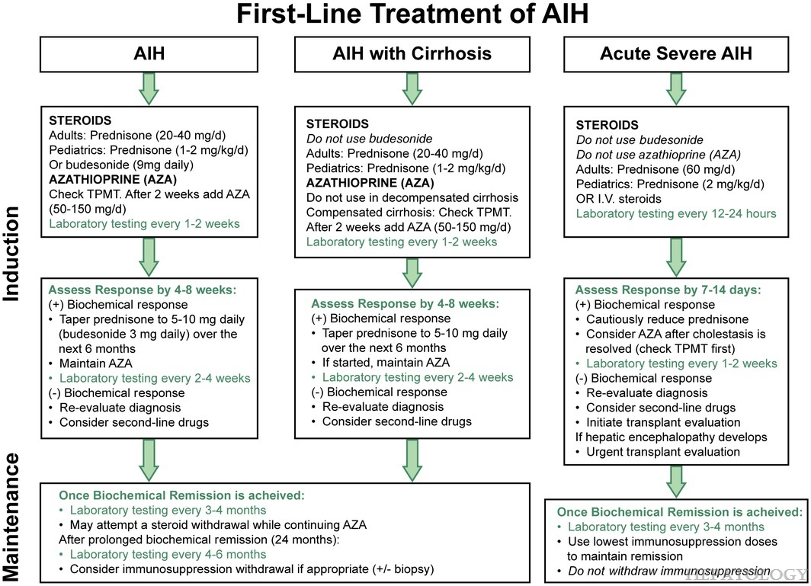

Slide 59

The principles in Medical Ethics

Slide 60
What are Ethical Principles

Slide 61
The Principles in Medical Ethics:
The Principle of Non-Maleficence
The Principle of Beneficence
The Principle of Autonomy
The Principle of Veracity
The Principle of Confidentiality(or Fidelity)
The Principle of Social Responsibility and Justice

Slide 62
The Principle of Non Maleficence:
A procedure does not harm the patient involved or others in society.
Concern about:
First do no harm
Sanctity of life
Be aware double effect doctrine, where a treatment intended for good unintentionally causes harm.

Slide 63
Family Medicine:
Vaccination against HBV infection is the only way to eradicate this infection.
All patients with HCV infection should offer treatment.
Persistent abnormal liver function tests need evaluation for underlying cause.

Slide 64
Research:
Davidson's Principles and Practice of Medicine
24th Edition - March 1, 2022
Journal of Hepatology 2020 vol. 73 j 1170–1218
EASL recommendations on treatment of hepatitis C:
https://www.aasld.org/practice-guidelines/chronic-hepatitis-b

Slide 65
THANK YOU

