Slide 2
H.Pylori And Campylobacter
Microbes And Antimicrobials Module
3rd year MBBS
Dr. Mudassira Zahid
Associate Professor
Department of Pathology
Rawalpindi Medical University

Slide 4
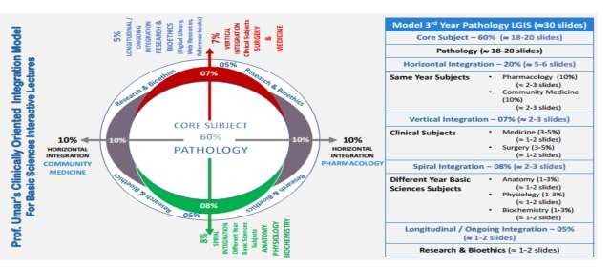

Slide 5
Learning Outcomes
Describe the characteristics and pathogenicity of H. pylori and Campylobacter in relation to the diseases caused by them.
Learning Resources: Robbins & Cotran Pathologic Basis Of Disease 10th Edition

Slide 6
Learning Objectives
Discuss related diseases of Helicobacter and Campylobacter (C2).
Discuss the pathogenesis and laboratory diagnosis of Campylobacter and Helicobacter (C2).
Learning Resources: Robbins & Cotran Pathologic Basis Of Disease 10th Edition

Slide 7
Questions
Classify the Campylobacteraceae family – Core
Describe the structural morphology of H. pylori and Campylobacter – Core
What are the risk factors for acquiring H. pylori and Campylobacter infection? – Horizontal
Describe the virulence factors of H. pylori – Core
Describe the virulence factors of Campylobacter – Core
What are the diagnostic tests for H. pylori infection? – Core / Research
What are the diagnostic tests for Campylobacter infection? – Core
What is the treatment for H. pylori infection? – Vertical
What is the treatment for Campylobacter infection? – Vertical
Demonstrate the 6 steps of hand hygiene – Ethics

Slide 8
Campylobacteraceae Family
A. Helicobacter Pylori
B. Campylobacter Species
1. Campylobacter jejuni
2. Campylobacter illeii
3. Campylobacter coli

Slide 9
A. Helicobacter Pylori
Morphology: Gram-negative, corkscrew or spiral shape.
Flagellated bacteria (lophotrichous flagella – bunches of flagella on one side).
Characteristics:
Motile.
Requires a microaerophilic environment for growth.
Reservoirs:
Humans, cats, and dogs.
Transmission:
Fecal-oral route.
Diseases:
Gastritis.
Peptic ulcers.
Gastric cancer.

Slide 10
Risk Factor:
Poor hygienic practices

Slide 11
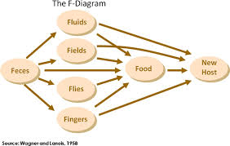
Fecal Oral Transmission

Slide 12
Virulent Factors
Flagella:
Provides motility and helps with penetration into the gastric mucous layer.
Enzymes:
Urease: Neutralizes gastric acid, stimulates chemotaxis, and helps in the production of inflammatory cytokines.
Adhesins: Mediates binding to host cells.
Phospholipase & Mucinase: Disrupts gastric mucous.
Catalase: Prevents phagocytic killing by neutralizing peroxides.
Superoxide dismutase: Prevents phagocytic killing by host cells.
Toxins:
Cytotoxins: Induces vacuolation in epithelial cells.

Slide 13
Pathogenesis
Invades the gastric epithelium by creating an alkaline environment.

Slide 14
Diagnosis & Treatment Of H. Pylori
H. pylori Stool Antigen:
Positive up to 5 to 7 days of infection.
H. pylori Serum Antibodies:
Detectable after 7+ days of infection.
Urea Breath Test:
Diagnostic test for H. pylori infection.
Gastric Biopsy:
Can be used to diagnose H. pylori infection.
Culture & Sensitivity of Gastric Biopsy:
Use Columbia agar and incubate for 5-7 days in a microaerophilic environment (5% oxygen, 10% CO2, 85% nitrogen).
Tests: Urease, Oxidase, and Catalase positive.

Slide 15
Diagnosis & Treatment Of H. Pylori
TREATMENT: 14 to 21 days
Ampicillin + Metronidazole + Clarithromycin + Omeprazole

Slide 16
B. Campylobacter Species
Morphology:
Gram-negative, curved, spiral, and ‘S’ shaped.
Non-spore forming.
Characteristics:
Bipolar flagella present.
Requires a microaerophilic environment for growth.
Reservoirs:
Cows, hens, birds, etc.
Routes of Infection:
Fecal-oral (contaminated water, dairy products, and improperly cooked poultry).
Diseases:
Gastroenteritis.
Common Species:
Campylobacter jejuni
C. lari
C. coli

Slide 17
Virulent Factors & Pathogenesis
Flagella:
Provides motility.
Adhesin Proteins: Help in mucosal attachment.
Invasin Proteins:
Enable invasion into the intestinal walls.
Cytopathic Toxins:
Initiate inflammation.
Enterotoxins:
Initiate inflammation, leading to infection of the intestines.
Endotoxin:
Responsible for systemic infection.

Slide 18
Virulent Factors & Pathogenesis
Pathogenesis:
Invasion of the small intestine → Cytopathic effect on enterocytes → Disruption of fluid absorption → Diarrhea.

Slide 19
Diagnosis
Cultured in microaerophilic environment: 0.5% oxygen, 10% CO2, and 85% nitrogen
Darting motility in wet mount
Media used: Blood agar & Charcoal-based selective media
Incubation: 3 days at 42°C
Oxidase & catalase: Positive
Antibody detection: Against somatic ‘O’ and flagellar ‘H’ antigens

Slide 20
Treatment & Complications
TREATMENT:
Fluoroquinolones
3rd generation cephalosporins
COMPLICATIONS:
Reactive arthritis
Septic abortion
Guillain-Barré Syndrome:
Damage to the peripheral nervous system
Ascending muscle paralysis 🡪 can cause respiratory arrest
Treatment: Plasma exchange (Plasmapheresis)

Slide 21
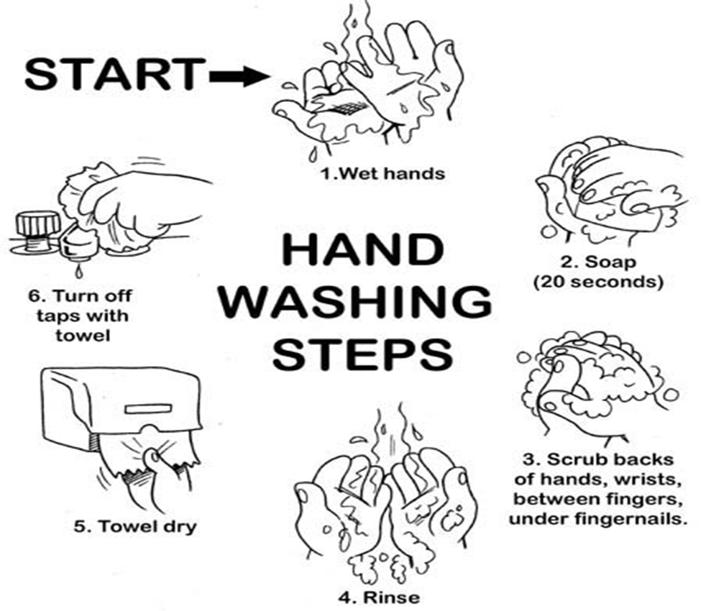
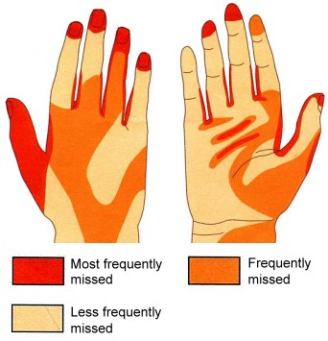
Six Steps For Proper Hand Washing
Proper hand washing can prevent many infections

Slide 22
Research
DOI: 10.1136/gutjnl-2015-309252

Slide 23
Summary
H. pylori is the most common cause of acid peptic disease.
The production of urease enzyme by H. pylori neutralizes gastric pH and facilitates pathogenesis.
Use of alkaline foods like milk, yogurt, etc., promotes the growth of H. pylori.
H. pylori stool antigen is the confirmatory test.
C. jejuni infects the jejunum and is responsible for causing gastroenteritis.
Microaerophilic environment required: 0.5% oxygen, 10% CO2, & 85% nitrogen.

