Slide 2
GLAUCOMA
Dr AMBREEN GUL
Assistant Professor
Ophthalmology Department, BBH, RMU
Sources:
Kanskis-Clinical-Ophthalmology-Systematic-Approach
Oxford Handbook of Ophthalmology Book by Philip I. Murray
The Wills Eye Manual: Office and Emergency Room Diagnosis and Treatment of Eye Disease

Slide 3
Sequence of lecture:
Core Subject
Spiral Integration
Horizontal Integration
Vertical integration
EOLA(End of lecture assessment)
Digital Library References
( Research, Bioethics, Artificial Intelligence)

Slide 4
Learning objectives
At the end of one hour large group interactive session (LGIS) using the PowerPoint , fourth year medical student should be able to
Define secondary glaucoma?
Enumerate different types of secondary glaucoma?
Describe clinical features and treatment options of different types of secondary glaucoma?

Slide 5
Horizontal integration

Slide 6
Secondary glaucoma
Core subject

Slide 7
Introduction
Any form of glaucoma in which there is identifiable cause of increased intraocular pressure pressure resulting in optic nerve damage and vision loss
Can be open-angle or angle-closure type
Can be unilateral or bilateral

Slide 8
Classification Of Secondary Glaucoma
Open Angle
Pseudo exfoliation glaucoma
Pigmentary glaucoma
Neovascular glaucoma
Phacolytic glaucoma
Angle-recession glaucoma
Glaucoma in acute anterior uveitis
Steroid induced glaucoma
Angle-closure
Phacomorphic glaucoma
Advanced neovascular glaucoma
Malignant glaucoma
Inflammatory glaucoma
Glaucoma associated with tumors

Slide 9
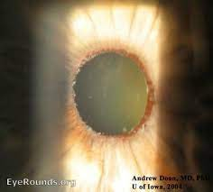
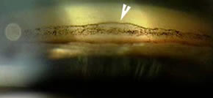
Pseudo-exfoliation Glaucoma
White fibrillary amyloid like material deposited on iris, anterior lens capsule and trabecular meshwork
Dandruff like pseudo exfoliation deposits in angle on gonioscopy

Slide 10
Treatment
Medical treatment but failure is common
Laser trabeculoplasty
Filtration surgery
Trabecular aspiration

Slide 11
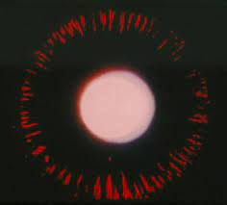
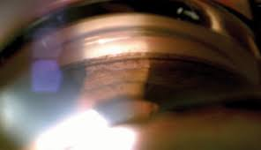
Pigmentary Glaucoma
Pigment granules from iris pigment epithelium and their deposition on cornea and lens
Iris transillumination defects
Gonioscopy shows pigment anterior to Schwalbe line forming Sampaolesi line

Slide 12
Treatment
Medical antiglaucoma
Trabeculectomy
Laser trabeculoplasty

Slide 13
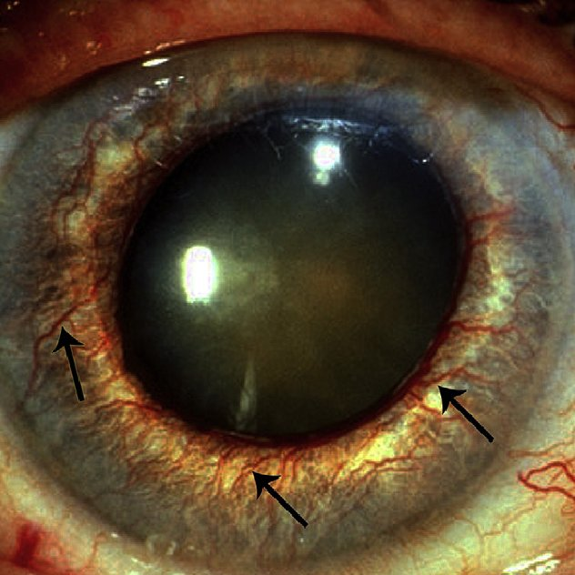
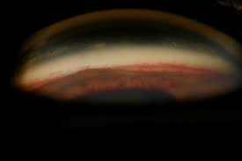
Neovascular Glaucoma
Aggressive iris neovascularization (rubeosis iridis) due to severe chronic retinal ischemia
Gonioscopy shows angle neovascularization
Etiology
Ischemic CRVO
Proliferative diabetic retinopathy
CRAO
Long standing retinal detachment
Chronic inflammation

Slide 14
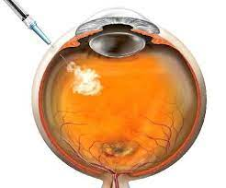
Treatment
Medical treatment of antiglaucoma
Topical atropine 1% to prevent synechiae formation
Intraocular anti VEGF
Pan retinal photocoagulation
Filtration surgery
Ciliary body ablation (cyclocryotherapy or cyclodiode)

Slide 15
Phacolytic Glaucoma
Lens proteins leak through intact lens capsule into aqueous humor leading to trabecular obstruction
Floating white particles into anterior chamber

Slide 16
Treatment
Medical control of raised IOP
Anterior chamber wash
Cataract removal

Slide 17
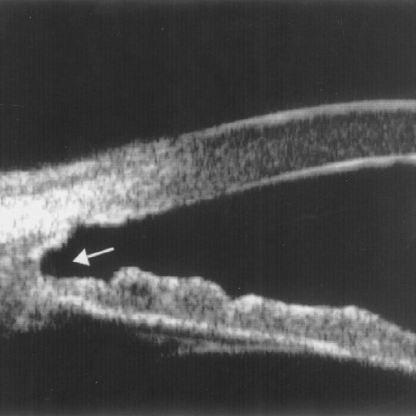
Angle Recession Glaucoma
Blunt trauma leading to rupture of face of the ciliary body, portion between iris root and scleral spur
Gonioscopy shows widening of the ciliary body face

Slide 18
Treatment
Medical treatment but is unsatisfactory
Laser trabeculoplasty
Trabeculectomy with antimetabolites

Slide 19
Steroid induced glaucoma
Caused by increased resistance to the outflow of aqueous at the level of the trabecular meshwork
Occurs after administration of topical steroids (6 weeks course)
<5mmHg in 2/3rd (non responders)
5-15mmHg in 1/3rd (moderate responders)
>15mmHg in 4-6% (high responders)

Slide 20
Treatment
Medical treatment
Laser trabeculoplasty
Filtration surgery

Slide 21
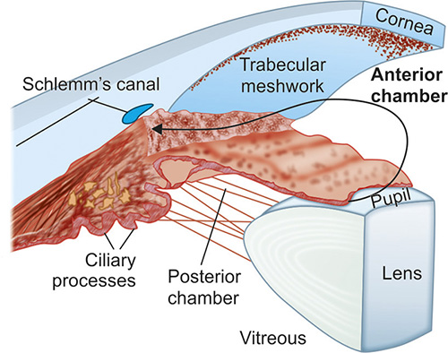
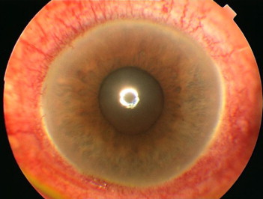
Inflammatory Glaucoma (Open Angle)
Acute anterior uveitis
Acute trabeculitis
Trabecular obstruction by inflammatory cells and debris
Chronic anterior uveitis
Chronic trabeculitis leading to trabecular scarring and sclerosis

Slide 22
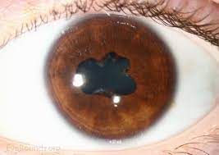
Inflammatory Glaucoma (Angle Closure)
Pupillary block
Posterior synechiae 360 degree
Seclusio pupillae
Non-pupillary block
Deposition of inflammatory cells and debris in the angle
Gradual synechial angle closure

Slide 23
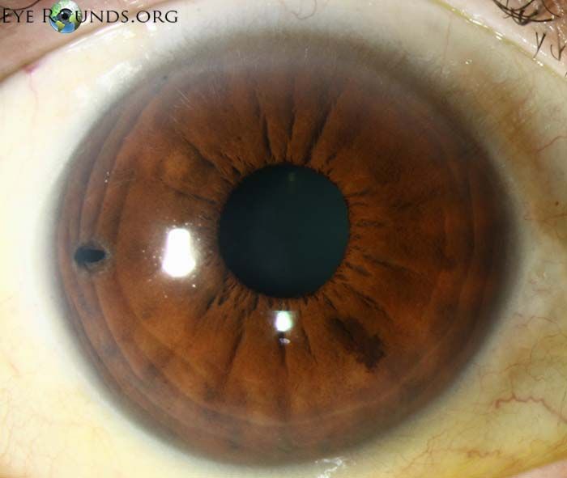
Treatment
Medical treatment
Laser iridotomy for pupil block angle closure cases
Trabeculectomy with MMC
Glaucoma drainage devices
Cyclodestructive procedures

Slide 24
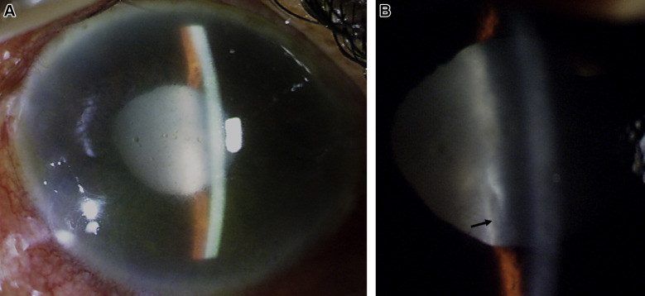
Phacomorphic Glaucoma
Intumescent cataractous lens
Anteroposterior growth leads to iridolenticular contact and pupillary block with iris bombe
More likely in eyes with shorter axial length and shallower AC

Slide 25
Treatment
Medical treatment
Systemic hyperosmotic agents
Laser iridotomy
Do not give miotics
Cataract extraction is definitive treatment

Slide 26
Malignant Glaucoma
Posterior misdirection of aqueous humor into the vitreous cavity
Continuous expansion of the vitreous cavity and increased posterior segment pressure
Patients who underwent filtration surgery

Slide 27
Treatment
Cycloplegic agents
Antiglaucoma drugs
Peripheral iridectomy
YAG laser hyaloidotomy
Pars-plana vitrectomy

Slide 28
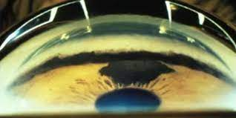
Glaucoma Associated With Tumors
5% of eyes with intraocular tumors develop secondary elevation of IOP
Iris melanoma, ciliary body melanoma, choroidal melanoma, retinoblastoma
Angle invasion
Trabecular infiltration
Secondary angle closure

Slide 29
EOLA( End Of Lecture Assessment)
A 62-year-old female was referred with a 2-year history of anterior uveitis of unknown etiology. Past medical history and general physical examination were unremarkable. Upon ocular examination, her best-corrected visual acuity (BCVA) was 20/25 in the OD and 20/60 in the OS. Tonometry showed intraocular pressures (IOP) of 29 mmHg and 22 mmHg in her right and left eyes, respectively. The slit-lamp examination showed clinical signs of bilateral granulomatous anterior uveitis and cataracts; gonioscopy revealed open angles with some peripheral anterior synechiae for both eyes. What is the most likely diagnosis?

Slide 30
Research and recent advances

Slide 31
BIOETHICS
Let's look at a situation, where a 55-year-old patient is diagnosed with advanced glaucoma in both the eyes and ophthalmologists advise him against driving, but the patient refuses the suggestion. In view of public welfare, shall the ophthalmologist ensure that his vehicle driving license is revoked? There are ethical issues of protecting the patient's confidentiality, protecting society, and protecting the patient from the potential harm if the patient continues to drive.
One has to balance the patient's autonomy and beneficence in making the correct decision.

Slide 32
Role of Artificial intelligence
Intraocular pressure:
Sensimed triggerfish (sensimed AG, lausanne, switzerland), which is a contact lens based continuous IOP monitoring device which actually measures only the corneal strain changes due to IOP fluctuations.
Optic disc photography:
Indian startup kalpah innovations(vishakapatnam, india) released retinal image analysis – glaucoma(ria-g) cloud based software in 2016 to analyse fundus images to look for the likelihood of glaucoma. It uses advanced image processing algorithms to measure disc size, cup size, CD ratio, neuroretinal rim thickness, disc damage likelihood score(ddls) and to look for violation of ISNT rule.

