Slide 1
GESTATIONAL TROPHOBLASTIC DISEASE
Dr. Maliha Sadaf
Gynae unit II
Holy Family Hospital

Slide 2
University Motto, Vision, Values & Goals
Mission Statement
To impart evidence-based research-oriented health professional education
Best possible patient care
Mutual respect, ethical practice of healthcare and social accountability.
Vision and Values
Highly recognized and accredited centre of excellence in Medical Education, using evidence-based training techniques for development of highly competent health professionals, who are lifelong experiential learner and are socially accountable.
Goals
The Undergraduate Integrated Learning Program is geared to provide you with quality medical education in an environment designed to.

Slide 3
SEQUENCE OF LGIS
Learning objectives
Gestational Trophoblastic Disease (core concept = 70%)
Related anatomy (horizontal integration 15%)
Related clinical findings (vertical integration – 10%)
Research article related to topic (3%)
Ethics (2%)

Slide 4
PROF UMER MODEL OF INTEGRATED LECTURE

Slide 5
LEARNING OUTCOME
Classify gestational trophoblastic disease
Identify clinical features of gestational trophoblastic disease
Enlist investigations required to diagnose GTD
Formulate a management plan including treatment for GTD and follow up plan after treatment.
Identify features of gestational trophoblastic neoplasia during follow up after treatment for premalignant GTD
Categorise patients requiring chemotherapy into low risk and high risk group
Devise a follow up plan after chemotherapy

Slide 6
Gestational trophoblastic disease
Gestational trophoblastic disease (GTD) consists of a range of pregnancy-related disorders derived from disordered proliferation of the placental trophoblast.
GTD has distinctive morphological, histopathological and genetic characteristics that enable subdivision into benign and malignant GTD.

Slide 7
How do you classify gestational trophoblastic disease

Slide 8
Gestational trophoblastic disease
1.Premalignant disorders
Complete hydatidiform mole.
Partial hydatidiform mole.
2. Gestational trophoblastic neoplasia (GTN)
Invasive mole
Choriocarcinoma
Placental-site trophoblastic tumour.
GTN can progress, invade, metastasize, and lead to death if left untreated.

Slide 9
Gestational trophoblastic disease Origin and genetics
An abnormal pregnancy characterised by varying degrees of trophoblastic proliferation (both cytotrophoblast and syncytiotrophoblast) and vesicular swelling of placental villi (villous hydrops) associated with an absent or an abnormal fetus/embryo.
Pathophysiology

Slide 10
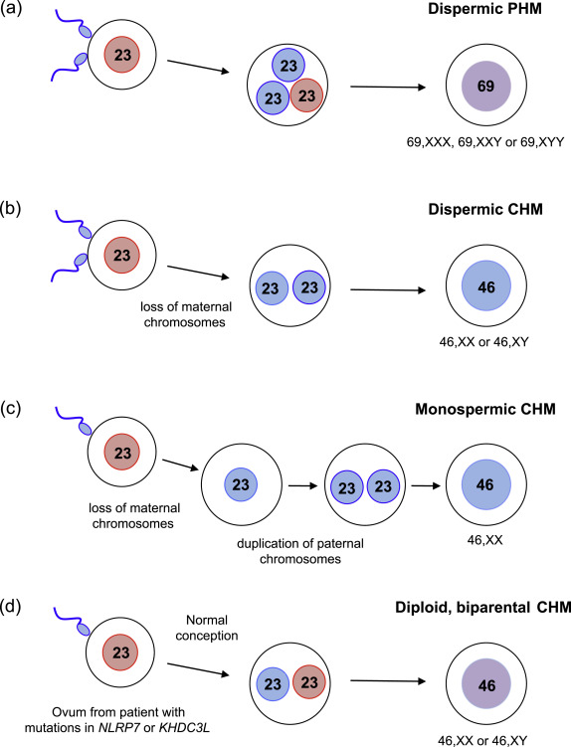

Slide 11
Gestational trophoblastic disease Risk factors
More common in women of Asian than non-Asian ethnicity
Advanced or very young maternal age
Previous molar pregnancy (risk of recurrence after one or two moles is 2% and 20% respectively; recurrence risk is not altered if there is a change in male partner)
Potential but low Increased risk of malignant transformation of CHM/PHM if using combined oral contraceptive pill while hCG levels remain elevated
Familial/sporadic clusters of biparental complete hydatidiform mole (autosomal recessive)

Slide 12
 | Complete (CHM)+ | Partial (PHM)
Origin | Monospermic or dispermic fertilisation of ‘empty’ ovum | Dispermic fertilisation of ovum
Karyotype | All diploid and of paternal origin | Paternal and maternal origin
Prevalence | 1 per 1000 pregnancies | 3 per 1000 pregnancies
Fetal tissue and fetal red blood cells | Absent | Present, fetus is abnormal
Histopathology | Diffuse villous hydrops Diffuse trophoblast hyperplasia Macroscopically, the cystic villi have the appearance of ‘clusters of grapes’ | Focal villous hydrops with scattered abnormally sized/scalloped villi Focal trophoblast hyperplasia Trophoblastic pseudoinclusions Identifiable fetal tissues
Risk of requiring chemotherapy for persisting GTD/GTN | 15% | 0.5%

Slide 13
Macroscopic histopathology Complete mole

Slide 14
CASE SCENARIO
Mrs XY reported with irregular vaginal spotting at 10 weeks gestation, on evaluation you are suspecting molar pregnancy
Enlist the clinical features that will help in diagnosis of GTD?
Enlist the investigations you will advise her

Slide 15
Clinical presentation and assessment
Clinical features
Common presentation is vaginal bleeding in early pregnancy.
Uterus may be larger than dates
Hyperemesis gravidarum

Slide 16
INVESTIGATIONS
Full blood count, blood group and rhesus antibody serology
Serum human chorionic gonadotrophin (hCG) [hCG levels are often > 100 000 iu/l with complete hydatidiform mole (CHM) but not partial hydatidiform mole (PHM)]
Pelvic ultrasound e.g snow storm appearance and bilateral theca luteal cyst in CHM , focal cystic spaces within the placenta,
Histopathological analysis of products of conception (POC)

Slide 17
Pelvic ultrasound of CHM

Slide 18
What is the treatment option for this patient ?

Slide 19
Gestational trophoblastic disease Treatment
Surgical evacuation
The preferred treatment for women with suspected molar pregnancy is surgical evacuation of the uterus using suction currettage.
Medical termination
Where possible, medical termination of molar pregnancies, including prostaglandin cervical preparations, should be avoided. This is due to the mainly theoretical risk of increasing trophoblastic embolisation by inducing uterine contractions.
Oxytocic agents, if required, should ideally only be commenced after completing uterine evacuation.

Slide 20
CASE SCENARIO
Mrs XY is diagnosed to have molar pregnancy , for which suction evacuation was done
Devise a follow up plan for her

Slide 21
Follow up
Follow up to detect persistent gestational trophoblastic disease (GTD) or GTN (invasive mole, choriocarcinoma, placental site trophoblastic tumour
Avoid pregnancy during follow up period
Reliable contraception( avoid intrauterine device)
Two-weekly serum and urine samples until hCG concentrations are normal (non-elevated) range
Once HCG is normalised:
If this occurred ≤56 days after evacuation, measure urine concentrations monthly for 6 months from the date of evacuation
If this occurred >56 days after evacuation, measure urine concentrations monthly for 6 months from the date hCG became normalized.

Slide 22
Persistent GTD/ GTN
SYMPTOMS
Irregular bleeding following evacuation of a hydatidiform mole.
Acute respiratory, abdominal or neurological symptoms after any pregnancy. For example:
Pulmonary metastases: dyspnea, cough and chest pain
Gastrointestinal tract metastases: abdominal pain, hemoptysis, malena
Brain metastases: evidence of increased intracranial pressure, intracerebral hemorrhage, headaches, seizures.
Signs suggestive of post-molar GTN include:
An enlarged, irregular uterus
Persistent, bilateral ovarian enlargement
Elevated hCG.
Systemic involvement

Slide 23
Enlist indications of chemotherapy for persistent gestational trophoblastic disease/ gestational trophoblastic neoplasia

Slide 24
Indications for chemotherapy for GTD
Rising hCG concentration after evacuation
Histological diagnosis of choriocarcinoma
Evidence of metastases in the brain, liver, gastrointestinal tract or lung (radiological opacities >2 cm on chest radiograph)

Slide 25
FIGO scoring system for GTN
Parameter | FIGO prognostic score
 | 0 | 1 | 2 | 4
Age (years) | <40 | ≥40 | – | –
Antecedent pregnancy | Mole | Abortion | Term pregnancy | –
Interval (months) from index pregnancy to chemotherapy | <4 | 4–<﻿7 | 7–<﻿13 | >13
Pretreatment hCG (IU/l) | <10³ | 10³–<﻿10⁴ | 10⁴–<﻿10⁵ | >10⁵
Largest tumour size | <﻿ | 3–<﻿5 cm | ≥﻿5 cm | –
Site of metastases | Lung | Spleen, kidney | Gastrointestinal tract | Brain, liver
Number of metastases | 0 | 1–4 | 5–8 | >8
Previous chemotherapy | – | – | Single drug | Two or more drugs

Slide 26
CHEMOTHERAPY
Low-risk (prognostic score ≤6)
monotherapy e.g Methotrexate with folinic acid rescue
survival rate 100 %
High-risk high risk (prognostic score more than 7)
The etoposide, methotrexate, and dactinomycin (EMA)-cyclophosphamide and vincristine (CO) regimen is recommended
5 year survival is 75 to 90 %
The treatment causes reversible alopecia and is myelosuppressive.

Slide 27
Follow up after chemotherapy
Beta hCG follow up for 5 years
Patients are advised not to become pregnant until 12 months after completion of chemotherapy
Neither low- or high-risk treatment affects fertility or congenital abnormality rates in subsequent pregnancies.

Slide 28
Case Scenario
A 40 years old P1 has reported to OPD at 14 weeks of pregnancy with complaints of irregular vaginal bleeding and excessive vomiting. On examination uterus id 18 week size.
How will you investigate her?
What are the treatment options if she is diagnosed as GTD?

Slide 29
RESEARCH
Gestational Trophoblastic Disease at Sultan Qaboos University Hospital: Prevalence, Risk Factors, Histological Features, Sonographic Findings and Outcomes. Oman Med J. 2019 May; 34(3): 202-204
Imaging in Gestational Trophoblastic Disease. 2019 Aug; 40(4): 332-349(PubMed)

Slide 30
BIOMEDICAL ETHICS
Gestational Trophoblastic Disease is curable
Follow up and early referral to oncology department is mandatory for good prognosis

Slide 31
FAMILY MEDICINE
Family Physicians should be educated about proper follow-up and referral of these cases.

