Slide 2
Genus Trypanosoma
GASTROINTESTINAL HEPATOBILIARY & PARASITOLOGY II Module
3rd year MBBS
Dr. Mudassira Zahid
Associate Professor
Department of Pathology
Rawalpindi Medical University

Slide 3
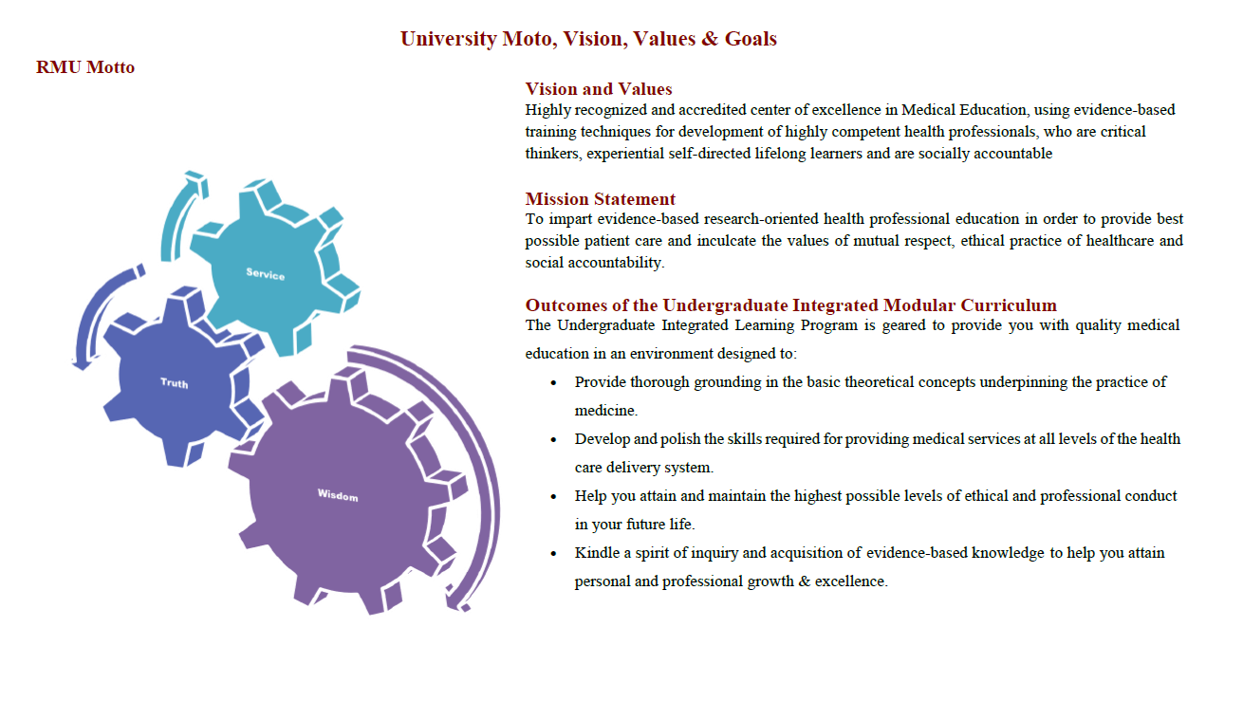

Slide 4
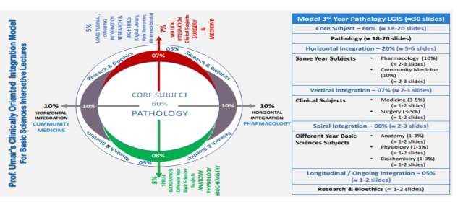

Slide 5
Learning Objectives
Students will learn about the genus Trypanosoma.
African Trypanosomiasis (Sleeping Sickness)
Trypanosoma brucei
Trypanosoma brucei gambiense
Trypanosoma brucei rhodesiense
American Trypanosomiasis (Chagas Disease)
Trypanosoma cruzi
Learning Resources: Robbins & Cotran Pathologic Basis Of Disease 10th Edition

Slide 6
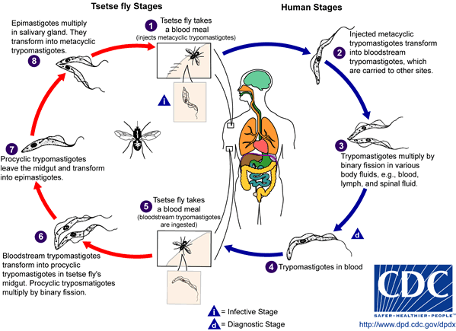

Slide 7
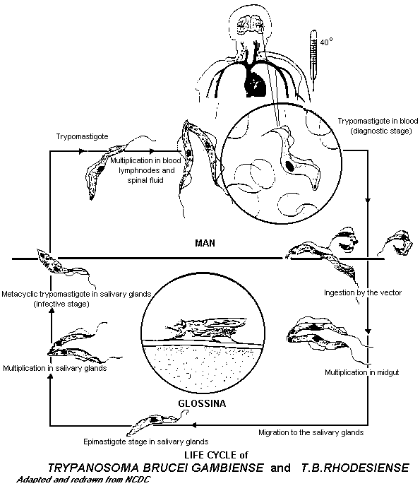
CORE PATHOLOGY

Slide 8
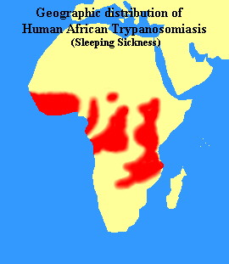
CORE PATHOLOGY
Sleeping sickness occurs in Africa.
Trypanosoma brucei rhodesiense (T. b. rhodesiense) is found in East and Central-East Africa.
Trypanosoma brucei gambiense (T. b. gambiense) is found in Central and West Africa.

Slide 9
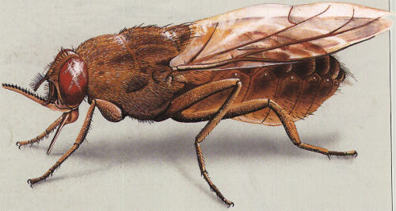
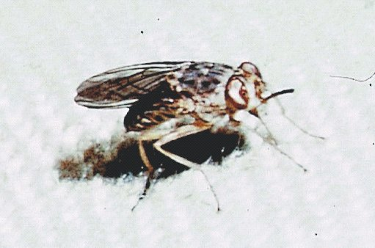
CORE PATHOLOGY
Trypanosoma brucei gambiense (T. b. gambiense) and Trypanosoma brucei rhodesiense (T. b. rhodesiense) cause approximately 20,000 cases annually in endemic areas.
African trypanosomiasis is transmitted by several species of tsetse flies (Glossina spp.).
Adult Glossina tachinoides is found in West Africa.

Slide 10
West African (Gambian) Sleeping Sickness
CORE PATHOLOGY
Caused by: Trypanosoma brucei gambiense
Reservoir: Humans
Vector: Tsetse flies (Glossina spp.)
Incubation Period (IP): 1–2 weeks
Disease Progression:
Fly bite → Parasitemia → Localization in lymph nodes
Early Symptoms:
Fever, chills, headache
Hepatosplenomegaly
Posterior cervical lymphadenopathy ("Winterbottom's sign")

Slide 11
West African (Gambian) Sleeping Sickness
CORE PATHOLOGY
CNS Involvement (after several months):
Headache, mental dullness
Sleep disturbances (excessive sleepiness)
Coma and death due to chronic meningoencephalitis

Slide 12
Diagnosis of African Trypanosomiasis
CORE PATHOLOGY
Demonstration of Trypomastigotes in:
Peripheral blood
Bone marrow
Lymph nodes
Cerebrospinal fluid (CSF)
Laboratory Methods:
Direct Microscopy (stained & unstained samples)
Serological Tests:
Direct agglutination
ELISA (Enzyme-Linked Immunosorbent Assay)
Cultivation in Weinman’s or Tobie’s medium
Inoculation in rats for parasite detection

Slide 13
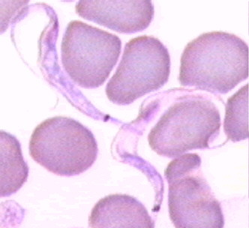
Trypanosomiasis – Trypomastigote Forms
SPIRAL INTEGRATION
Both Trypanosoma brucei gambiense and Trypanosoma brucei rhodesiense exist in two forms in peripheral blood:
Long, slender form:
Size: ~30 µm in length
Function: Capable of multiplying in the host
Stumpy form: Size: ~18 µm in length
Function: Non-dividing stage

Slide 14
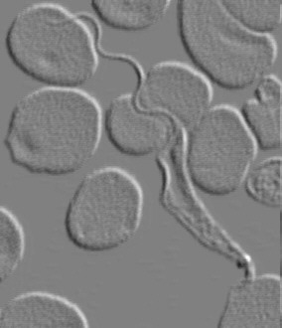
Trypanosomiasis
SPIRAL INTEGRATION
Trypanosoma brucei gambiense and Trypanosoma brucei rhodesiense: Trypanosomes appear in the peripheral blood 5 to 21 days after the infecting bite.

Slide 15
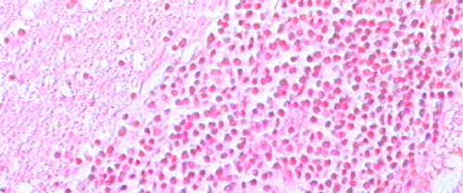
African Trypanosomiasis
SPIRAL INTEGRATION
Trypanosoma brucei gambiense and Trypanosoma brucei rhodesiense:
The typical pathological lesion of trypanosomiasis is perivascular round-cell infiltration (perivascular cuffing).
This occurs due to the presence of glial cells, lymphocytes, and plasmocytes (Mott cells).
Staining method: Hematoxylin and Eosin (H&E stain).

Slide 16
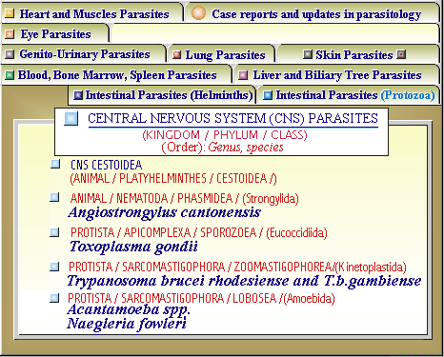
SPIRAL INTEGRATION

Slide 17
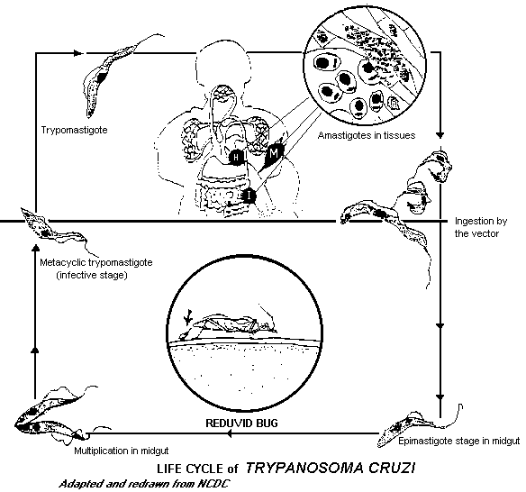
Life Cycle of Trypanosoma cruzi
CORE PATHOLOGY

Slide 18
American Trypanosomiasis
CORE PATHOLOGY
Trypanosoma cruzi (T. cruzi): Infective metacyclic trypomastigotes are shed in the feces of the triatomine (kissing bug).
Mode of Entry into Host:
Through skin lesions
Via mucosal surfaces, including the mouth
In humans, entry can also occur through the conjunctiva of the eyes
Incubation Period (IP): 1–2 weeks

Slide 19
American Trypanosomiasis
CORE PATHOLOGY
Manifestations of Trypanosoma cruzi Infection
Acute Form (Common in Children)
Symptoms:
Fever
Generalized non-pitting edema
Duration: Lasts 3–4 weeks
Complications:
May progress to myocarditis or meningoencephalitis
Chronic Form (Common in Adults)
Can present in different forms:
Neurotropic (affecting the nervous system)
Cardiotropic (affecting the heart)
Viscerotropic (affecting internal organs)

Slide 20
Pathogenesis of American Trypanosomiasis (Chagas Disease)
CORE PATHOLOGY
Intracellular multiplication of amastigotes occurs in various tissues, including:
Myocardium
Skeletal muscles
Neuroglial cells
Reticuloendothelial system cells
Leads to cell and tissue damage
Damage to autonomic nerves results in megadisease, including:
Megaesophagus
Megacolon
Megaureter

Slide 21
Pathogenesis of American Trypanosomiasis (Chagas Disease)
CORE PATHOLOGY
Diagnosis of Trypanosoma cruzi
Demonstration of T. cruzi in:
Blood
Tissues
Serology (antibody detection)
Culture in NNN (Novy-MacNeal-Nicolle) medium
Animal inoculation (e.g., guinea pig)
Prophylaxis
Control of triatomine bugs to prevent transmission

Slide 22
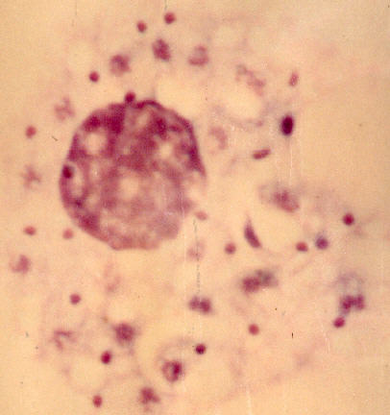
American Trypanosomiasis
SPIRAL INTEGRATION
Trypanosoma cruzi (T. cruzi) trypomastigotes can infect most cell types.
Polymorphonuclear leukocytes (PMNs) and macrophages are among the first cells to interact with T. cruzi in vivo.
In Vitro Observation:
T. cruzi infection of macrophages shows the presence of amastigotes.
Wright-Giemsa stain reveals replicating amastigotes within the host cell.

Slide 23
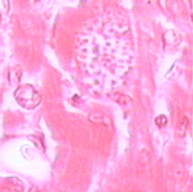
American Trypanosomiasis
CORE INTEGRATION
Trypanosoma cruzi (T. cruzi) Life Cycle in the Host:
Trypomastigotes enter host cells and transform into amastigotes.
Amastigotes multiply intracellularly via binary division, triggering inflammatory and immune responses in vivo.
In vitro, they destroy host cells.

Slide 24
American Trypanosomiasis
CORE INTEGRATION
Parasite Release and Spread:
Amastigotes are released into the bloodstream as trypomastigotes.
Trypomastigotes are non-dividing forms but can:
Infect a wide range of host cells, with muscle and glial cells being the most commonly parasitized.
Be ingested by another reduviid bug (kissing bug) to continue the parasite life cycle in the vector.

Slide 25
American Trypanosomiasis
CORE INTEGRATION
Trypomastigotes reach myocardial cells and penetrate them.
Inside the cells, they transform into amastigotes and multiply.
This leads to the formation of a pseudocyst within the myocardial tissue.

Slide 26
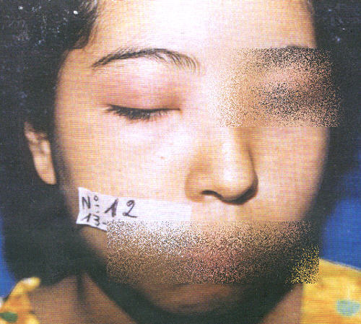
American Trypanosomiasis Clinical Features
VERTICAL INTEGRATION
Phases of Trypanosoma cruzi Infection
Acute Phase:
Often asymptomatic or unnoticed.
May present with an inflamed swelling (chagoma) at the site of parasite entry.
Romana’s sign: Swelling involving the eyelids, but occurs in only 1–2% of cases.
Mortality: Less than 5%.
Fatal cases (mostly in children <2 years old) result from:
Acute heart failure
Meningoencephalitis

Slide 27
American Trypanosomiasis Clinical Features
VERTICAL INTEGRATION
Romana’s sign is a clinical manifestation typically observed in the acute phase of Chagas' disease (Trypanosoma cruzi infection).
It presents as unilateral painless swelling of the eyelids, resulting from the parasite entering through the conjunctiva.
This occurs in only 1–2% of cases.

Slide 28
American Trypanosomiasis
CORE PATHOLOGY
Chronic Phase of Trypanosoma cruzi Infection (Chagas’ Disease)
Develops 10–20 years after the initial infection.
Affects internal organs, including:
Heart (leading to cardiomyopathy and heart failure)
Esophagus (causing megaesophagus)
Colon (leading to megacolon)
Peripheral nervous system
Lesions of Chagas’ disease are incurable.
In severe cases, death may result from heart failure.

Slide 29
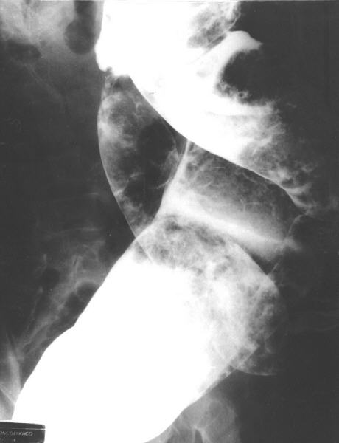
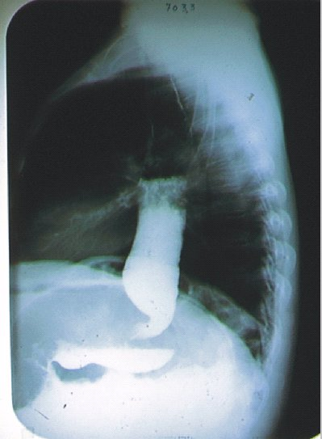
VERTICAL PATHOLOGY
TC14a: X-ray showing megaesophagus in Chagas' disease.
TC14: Chagasic megacolon with enlargement of the sigmoid colon.

Slide 30
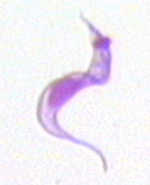
American Trypanosomiasis
CORE PATHOLOGY
Trypanosoma cruzi (T. cruzi) Trypomastigotes: Possess a prominent subterminal kinetoplast, which may distort the cell membrane.
Have an elongated nucleus.
Feature an undulating membrane.
TC16: T. cruzi trypomastigote
Bloodstream trypomastigotes measure 15–20 µm in length.
Typically appear in a C or S-shaped form.

Slide 31
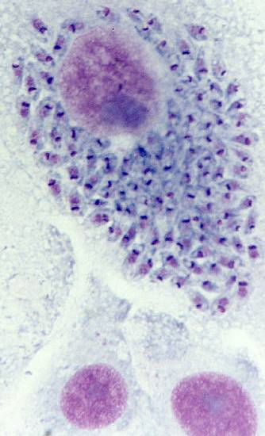
American Trypanosomiasis
CORE PATHOLOGY
Trypanosoma cruzi (T. cruzi) Multiplication:
Occurs only in the amastigote phase.
Amastigotes grow and multiply intracellularly.
Preferentially infect muscle cells and other tissue cells.

Slide 32
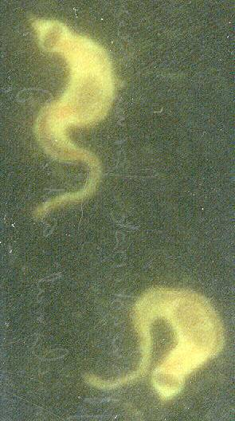
American Trypanosomiasis
CORE PATHOLOGY
Laboratory Diagnosis of Trypanosoma cruzi:
Serological tests:
Indirect Fluorescent Antibody (IFA) test
Enzyme-Linked Immunosorbent Assay (ELISA)
Molecular tests:
Polymerase Chain Reaction (PCR) specific for T. cruzi

Slide 33
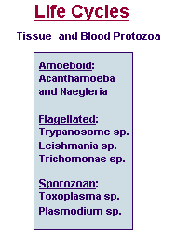
Life Cycles
CORE PATHOLOGY

Slide 34
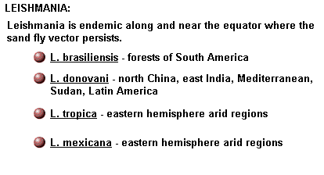
Leishmania
CORE PATHOLOGY

Slide 35
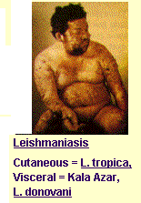
Leishmaniasis
CORE PATHOLOGY

Slide 36
Life Cycles
SPIRAL PATHOLOGY

Slide 37
Leishmania
CORE PATHOLOGY

Slide 38
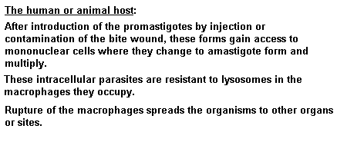
Leishmania
CORE PATHOLOGY

Slide 39
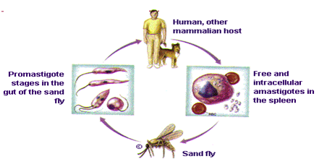
Leishmania
CORE PATHOLOGY

Slide 40
Leishmaniasis Disease
CORE PATHOLOGY
Leishmaniasis is transmitted by the bite of female phlebotomine sandflies.
The sandflies inject the infective stage, promastigotes, during blood meals.
Promastigotes that reach the puncture wound are phagocytized by macrophages and transform into amastigotes.
Amastigotes multiply in infected cells and affect different tissues, depending in part on the Leishmania species. This leads to the clinical manifestations of leishmaniasis.
Sandflies become infected during blood meals on an infected host when they ingest macrophages infected with amastigotes.

Slide 41
Leishmaniasis Disease
VERTICAL INTEGRATION
In the sandfly midgut, the parasites differentiate into promastigotes, which multiply and migrate to the proboscis.
Clinical Features:
Human leishmanial infections can result in two main forms of disease: Cutaneous leishmaniasis
Visceral leishmaniasis (also known as kala-azar).
The factors determining the form of the disease include:
Leishmanial species
Geographic location
Immune response of the host.
Cutaneous leishmaniasis is characterized by one or more cutaneous lesions on areas where sandflies have fed.
Persons with cutaneous leishmaniasis have one or more sores on their skin. The sores can change in size and appearance over time.

Slide 42
Leishmaniasis Disease
VERTICAL INTEGRATION
Cutaneous leishmaniasis sores often look somewhat like a volcano, with a raised edge and central crater.
A scab may cover some sores. The sores can be painless or painful.
Some people may have swollen glands near the sores (e.g., in the armpit if the sores are on the arm or hand).

Slide 43
Leishmaniasis Disease
VERTICAL INTEGRATION
Visceral leishmaniasis (kala-azar) typically presents with:
Fever
Weight loss
Enlarged spleen and liver (usually the spleen is bigger than the liver).
Some patients may have swollen glands.
Certain blood tests are abnormal, including:
Low blood counts (e.g., anemia, low white blood cell count, and low platelet count).
Some patients may develop post kala-azar dermal leishmaniasis.
Visceral leishmaniasis is becoming an important opportunistic infection in areas where it coexists with HIV.

Slide 44
Leishmaniasis Disease
VERTICAL INTEGRATION
Laboratory Diagnosis:
Examination of Giemsa-stained slides of the relevant tissue is still the technique most commonly used to detect the parasite.
Diagnostic Findings:
Microscopy
Isolation of the organism in culture (e.g., using the diphasic NNN medium) or in experimental animals (e.g., hamsters) constitutes another method of parasitological confirmation of the diagnosis. This method can also provide material for further investigations (e.g., isoenzyme analysis).
Antibody detection can be useful in visceral leishmaniasis, but is of limited value in cutaneous disease, where most patients do not develop a significant antibody response.

Slide 45
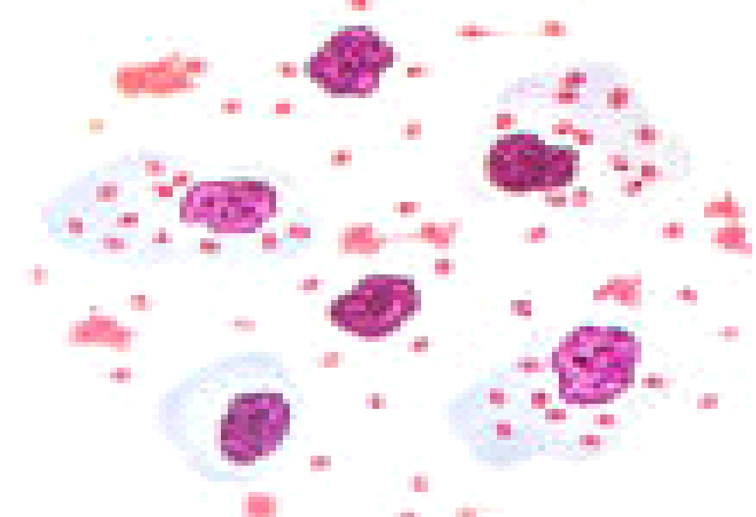
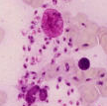
Leishmaniasis Disease
VERTICAL INTEGRATION
Other diagnostic techniques include:
Biochemical (e.g., isoenzymes)
Immunologic (e.g., immunoassays)
Molecular (e.g., PCR) approaches.
These techniques, however, are not readily available in general diagnostic laboratories.
SPIRAL INTEGRATION

Slide 46
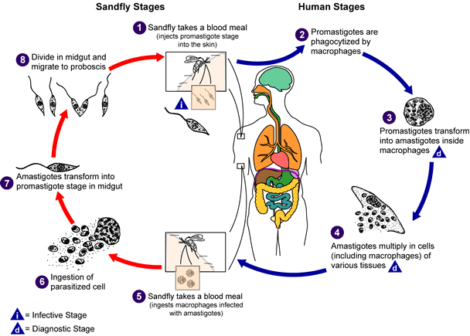
Leishmaniasis Disease
CORE PATHOLOGY

Slide 47
Clinical Classification-I
VERTICAL INTEGRATION
Visceral Leishmaniasis – Kala-azar
Leishmania donovani Complex
Mucocutaneous Leishmaniasis – Espundia
Leishmania braziliensis
Associated with forest workers

Slide 48
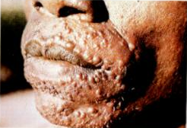
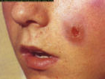
Clinical Classification-II
VERTICAL INTEGRATION
Primary Cutaneous Leishmaniasis Old World Disease:
L. tropica complex
L. major
L. tropica minor
New World Disease:
L. braziliensis complex
L. mexicana complex

Slide 49
Clinical Features - VL
VERTICAL INTEGRATION
Symptoms of Visceral Leishmaniasis (Kala-azar):
May be mild
Fever
Anorexia
Malaise
Vague abdominal pain
Splenomegaly
Hepatomegaly
Lymphadenopathy
Anaemia
Leukopenia

Slide 50
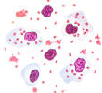
Laboratory Diagnosis VL
VERTICAL INTEGRATION
Diagnostic Methods for Leishmaniasis:
Biopsy
Aspirate
Culture
Animal Inoculation
PCR
Montenegro Skin Test
Antibodies
ELISA (Direct)
ELISA (Indirect)
Antigen Detection
ELISA
DNA Probes

Slide 51
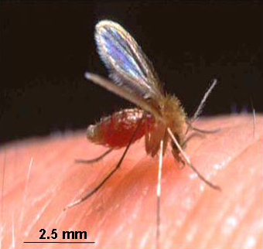
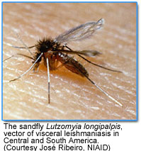
Laboratory Diagnosis VL
CORE PATHOLOGY
Cutaneous Leishmaniasis (CL):
Old World CL: Phlebotomus
Oriental Sore
Baghdad Boil
Delhi Boil
Found in Middle East, Africa, and India
New World CL:
Lutzomyia
Found in Latin America

Slide 52
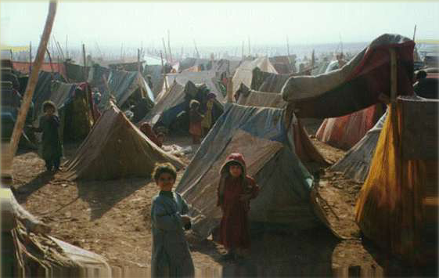
Epidemiology-CL
CORE PATHOLOGY
Factors Influencing Leishmaniasis Spread:
Sporadic Disease in Endemic Areas
Epidemic Outbreaks
Refugee Movements
Military Activities
Lutzomyia – Found in America
Phlebotomus – Found elsewhere

Slide 53
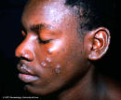
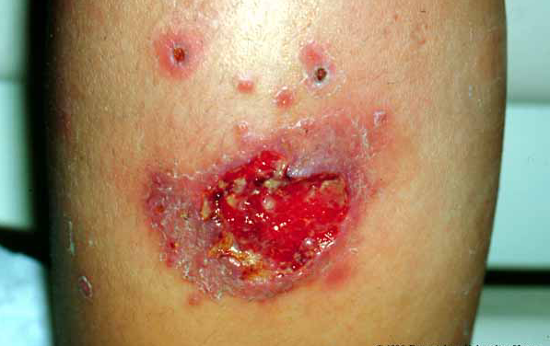
Pathogenesis-CL
CORE PATHOLOGY
Virulence Factors of Infecting Leishmania spp.:
Immune Response of Human Host:
Inoculated into the skin
Mixed acute and chronic inflammatory infiltrate
Areas of focal necrosis
Burn-like scar formation
Recovery associated with high level of resistance

Slide 54
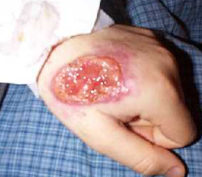
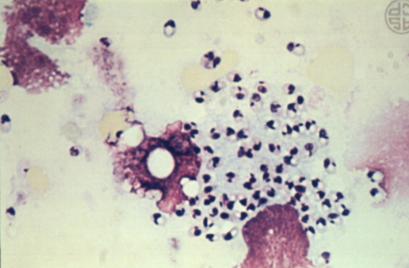
Diagnosis-CL
VERTICAL INTEGRATION
Endemic Area
Chronic Skin Lesion
Punch or Incisional Biopsy
Giemsa Staining
DNA Probes
Culture
ELISA
Leishmanin Skin Test

Slide 55
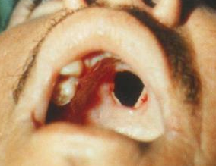
Mucocutaneous Leishmaniasis
CORE PATHOLOGY
Leishmania braziliensis (Mucocutaneous Leishmaniasis):
Affects: Nose, oral cavity, pharynx
Healed skin lesion
Clinical Features:
Chronic nasal symptoms
Discharge
Epistaxis (nosebleeds)
Tapered nose

Slide 56
Diagnosis MCL
VERTICAL INTEGRATION
Culture
Clinical Findings
Positive Leishmanin Skin Test
Antileishmanial Antibodies in Serum

Slide 57
1. Leishmanin
CORE PATHOLOGY
Reagent for Human Skin Testing
Leishmanin is a reagent recommended for skin testing in humans for epidemiological studies and as an aid in diagnosis. It has been approved by the World Health Organization (WHO) as a reference reagent.
Composition:
Promastigotes
Phosphate-buffered saline
Thiomersal
The strain is maintained in a virulent state through continuous passages in mice. Leishmanin is prepared by cultivating promastigotes in a monophasic medium and is supplied in a pyrogen-free, sterile form following Good Manufacturing Practice (GMP) guidelines.

Slide 58
Major Epidemics Of Leishmaniasis In Pakistan
LONGITUDINAL INTEGRATION
Year | City | Province | No. of cases
1935 | Quetta | Balochistan | Un-known
1971-72 | Multan | Punjab | 2,500
1974 | Army Personnel (CL) | Balochistan | 892
1975 | Army Personnel (CL) | Balochistan | 502
1977-81 | Uthal (CL) | Balochistan | 700
2001 | Kurram Agency (CL) | NWFP (FATA) | 1200
2001 | Larkana, Dadu (CL) | Sindh | 11,700
2002 | Kurram Agency(CL) | NWFP (FATA) | 738

Slide 59
Prevention
VERTICAL INTEGRATION
Sand fly bites should be avoided.
Personal Protection:
Protective clothing
Insect repellents
Bed nets
Insecticide use in transmission settings
Other Control Measures:
Killing of stray dogs

Slide 60
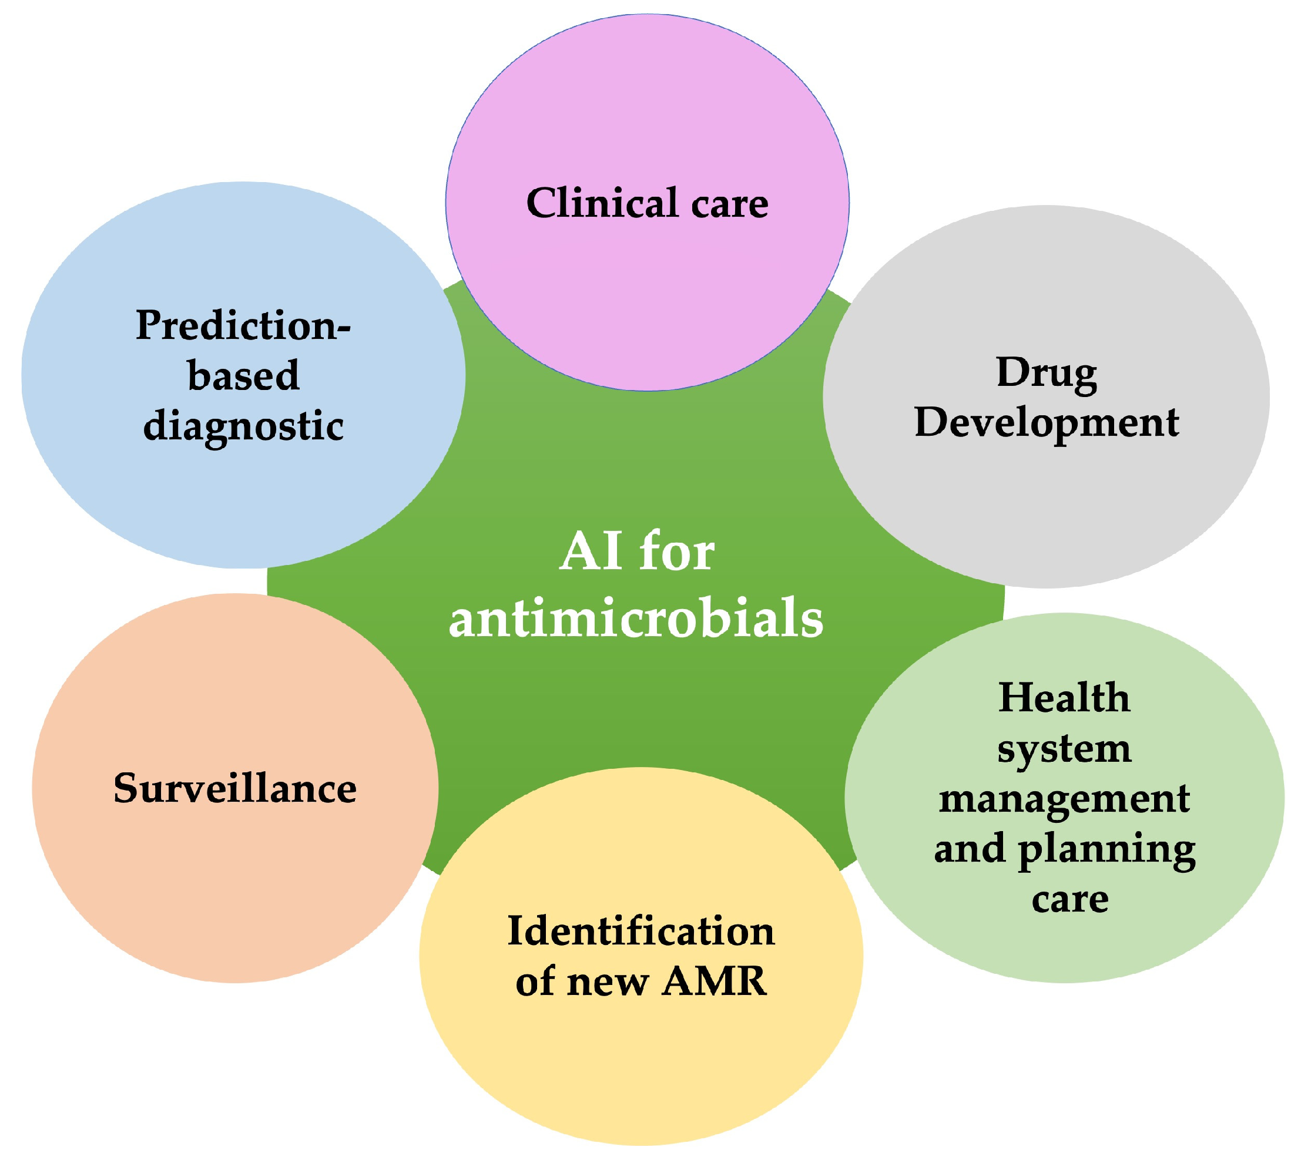
LONGITUDINAL INTEGRATION

Slide 61
LONGITUDINAL INTEGRATION

Slide 62
LONGITUDINAL INTEGRATION
https://bmcinfectdis.biomedcentral.com/articles/10.1186/s12879-021-06327-w
Research Abstract
Cutaneous Leishmaniasis (CL) is a neglected tropical disease that primarily affects poor communities. It is one of the major vector-borne diseases and is endemic in Pakistan.

