Slide 1
GENERAL TOXICOLOGY-II
Dr Filza Ali
Dr Urooj shah
Forensic Medicine & Toxicology

Slide 3
To impart evidence based research oriented medical education
To provide best possible patient care
To inculcate the values of mutual respect and ethical practice
of medicine
Vision of Rawalpindi Medical University The Dream/ Tomorrow

Slide 4
Prof Umar’s LGIS Model

Slide 5
SEQUENCE OF LGIS
Learning Objectives
Core concept 70 %
Horizontal integration related to Pathology and Pharmacology 15 %
Relevant clinical concepts and medico legal application of core knowledge / Vertical integration 10%
Research article relevant to the topic 3%
Ethics and family medicine 2%

Slide 6
Enlist different sign and symptoms of poisoning
Briefly describe the diagnostic criteria of poisoning both in living and dead.
State the reasons of failure to detect poison
Briefly explain the procedure of collection and preservation of viscera in suspicion of poisoning
Define an antidote and Classify antidotes
Learning Objectives:

Slide 7
There is no single symptom and no definite group of symptoms which are absolutely characteristic of poisoning. Following points should arouse suspicion of poisoning:
Core Concept
Symptoms appear immediately or within a short period after
food or drink.
Symptoms are uniform in character and increase rapidly in
severity.
When several persons eat or drink from the same source of food or drink at the same time, all suffer from similar symptoms at or about the same time.
Discovery of poison in food taken, in the vomitus or in the
excreta is strong proof of poisoning.
Diagnosis of Poisoning in Living

Slide 8
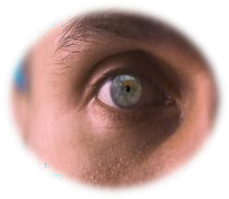
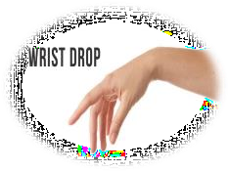
Core Concept
Sudden onset of abdominal pain, nausea, vomiting, diarrhea and collapse.
Sudden onset of coma with constriction of pupils.
Unexplained coma, especially in children.
Coma in an adult, known to have a depressive illness.
Rapid onset of a peripheral neuropathy, such as wrist-drop.
Symptoms Suggestive of Poisoning

Slide 9
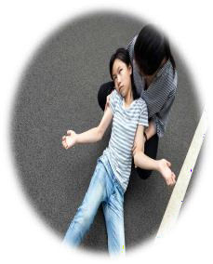
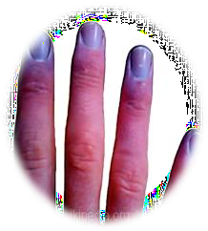
Core Concept
Rapid onset of a neurological or GIT illness in persons known to be occupationally exposed to chemicals.
Sudden onset of convulsions.
Delirium with dilated pupils.
Paralysis, especially of lower motor neuron type.
Jaundice and hepato-cellular failure.
Oliguria with proteinuria and hematuria.
Persistent cyanosis
Symptoms Suggestive of Poisoning

Slide 10
Core Concept
Symptoms are exaggerated after the administration of suspected food, fluid or medicine.
Malaise, cachexia, depression and gradual deterioration of general condition of the patient.
Repeated attacks of diarrhea and vomiting.
Removal of patient from his usual surroundings causes the symptoms to disappear.
Traces of poison found in the urine, blood, stool or vomit.
Features Indicative of Chronic Poisoning

Slide 11
Core Concept
Post-mortem Examination/ Autopsy findings:
External Findings
Colour changes in the corroded skin and mucous membrane.
Post-mortem staining Colour of staining in poisoning.
Smell present about the mouth and nose.
Natural orifices, e.g. mouth, nostrils, rectum and vagina may show presence of poisonous material.
Injection marks should be looked for with care.
Skin should be examined for lesions, like hyperkeratosis and
pigmentation, seen in chronic arsenic poisoning.
Jaundice may occur in poisoning with phosphorus and potassium chlorate.
Diagnosis of Poisoning in Dead

Slide 12
Core Concept
Internal Findings
Smell: The skull should be opened first to detect unusual odors in the brain because the opening of the body masks such odors.
Mouth and throat: Examine for any evidence of inflammation, erosion or staining. Areas of necrosis of the pharynx may be seen in death associated with agranulocytosis caused by amidopyrine, thiouracil, dinitrophenol, sulphonamide and barbiturates.
Respiratory system: Corrosives may cause edema of glottis and congestion and desquamation of mucous membrane of trachea and bronchi due to trickling of acid or alkali into the respiratory tract.
Diagnosis of Poisoning in Dead

Slide 13
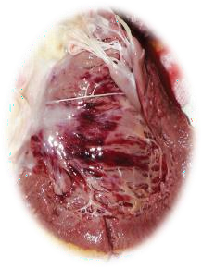
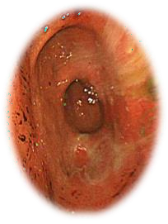
Core Concept
Esophagus:Corrosive alkalis produce marked softening and desquamation of the mucous membrane.
Heart: Subendocardial hemorrhage in left ventricle is seen in poisoning with arsenic, antimony, barium, mercury, phosphorus, and viper bite and in certain conditions, like
heat stroke, acute infectious disease, e.g.
influenza, and traumatic asphyxia.
Stomach: Hyperemia of mucous
membrane (ridges are more involved) is caused
by irritant poison, usually at the cardiac end
and greater curvature of stomach.
Diagnosis of Poisoning in Dead

Slide 14
Core Concept
Duodenum and intestines: Normal GIT rules out poisoning by corrosives (acids, alkalis and phenol), mercury and arsenic.
Liver: (hepatotoxic poisons): Arsenic, phosphorus, CCl4 , alcohol, chlorpromazine, chloroform, paracetamol, thallium, Alphos and zinc phosphide. Liver necrosis is caused by phosphorus and chloroform . Fatty liver is caused by arsenic, and FeSO4 .
Kidneys: (nephrotoxic poisons): Arsenic, mercury, oxalic acid, carbolic acid, CCl4 , cantharides, turpentine, thallium, Alphos and zinc phosphide. • Parenchymatous degenerative changes are seen in metal and cantharidin poisoning.
Diagnosis of Poisoning in Dead

Slide 15
Core Concept
Eliminated by vomiting and diarrhea, e.g. irritant poison.
Disappeared from the lungs by evaporation or oxidation.
After absorption may be detoxified, conjugated and eliminated from
the system.
Rapidly metabolized, making extraction difficult.
Biological toxins and venoms which may be protein in nature, cannot be separated from body tissues.
Organic poisons, like alkaloids and glucosides may detoxify by oxidation during life
Due to faulty preservation or from decomposition of the body.
In a slow acting poison, death may be delayed and by then the poison may have been completely excreted.
Wrong or insufficient material may have been sent for analysis.
Failure to Detect Poison

Slide 16
name, address, hospital number and the date of collection.
Core Concept
The samples must be meticulously labelled with the patient's
The doctor's signature should also be placed on the label.
The sample should be handed to a specific person, often a police officer, whose name is noted, and who will take the sample to the laboratory—maintaining the chain of evidence
Samples Preserved for Toxicological Analysis

Slide 17
Core Concept
Blood: Before autopsy, 10-20 ml of blood can be drawn from the femoral (best sample), jugular or subclavian vein by a syringe. Blood should never be collected from the pleural or the abdominal cavities, as it can be contaminated with gastric or intestinal contents, lymph, mucus, urine, pus or serous fluid.
Urine: . Before dissection, urine can be collected via catheter or
abdominal wall puncture.
Feaces: In suspected heavy metal poisoning, such as arsenic, mercury or lead. A sample of 20-30 g should be taken in a plain screw-topped jar or in a plastic container with a snap-on lid
Vomit and stomach contents: Vomit is placed either in a clean
glass jar or a plastic tub with a tight-fitting lid.
Collection of Specimens

Slide 18
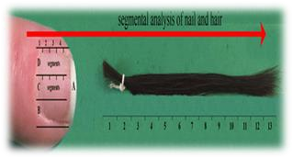
Core Concept
Liver and other organs: Liver concentrates many drugs, making them identifiable when the blood and urine concentrations may have declined to very low levels. After cutting the organ to examine it, the entire or half of the liver along with the
Gallbladder should be placed in a clean container. Sometimes, bile may be required for analysis, it is particularly useful for seeking presence of chlorpromazine and morphine.
Hair and nail clippings: If a heavy metal poison is suspected
e.g. Arsenic or Thallium, some hair, cut or pulled at the roots, together with all nail clippings, should be removed in their entirety and collected in separate envelopes. Their detection may be possible by neutron-activation analysis
C ollection of Specimens

Slide 19
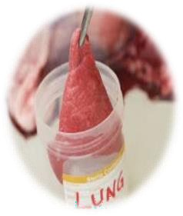
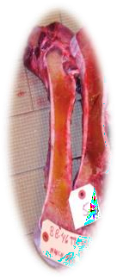
Core Concept
Lungs: In solvent abuse (‘glue sniffing’) and death from gaseous or volatile substances, the lung is mobilized and the main bronchus tied off tightly with a ligature. The hilum is then divided and the lung is put into a nylon bag immediately and the bag is then sealed. Plastic (polythene) bags are not suitable, as they are permeable to volatile substances.
Bone: About 200 g is collected. It is convenient to remove about 10-15 cm of the shaft of the femur.
C ollection of Specimens

Slide 20
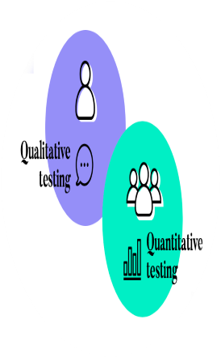
Core Concept
‘Screening tests’ are said to be ‘qualitative,’ where a test is either positive (indicating that the drug/toxin is present) or negative (indicating that the drug/toxin is not present).
When specific levels of drugs or toxins are determined, the tests are said to be ‘quantitative.’
C ollection of Specimens

Slide 21
Viscera should be preserved in cases of:
Core Concept
Suspected death due to poisoning
Deceased was intoxicated or used to drugs
Cause of death could not be found after autopsy
Accidental death involving driver of a vehicle or machine operator
Death due to burns (if needed)
Advanced decomposition
Any case, if requested by the Magistrate
Preservation of Viscera

Slide 22
Core Concept
Material | Quantity
Vomit | 300 ml (whole, if quantity is less)
Stomach washout | 500 ml
Blood | 10 ml
Urine | 100 ml
Preservation Of Viscera In Living

Slide 23
Core Concept
Material | Quantity
Stomach and its contents | 300 ml (whole, if quantity is less)
Upper part of small intestine and its contents | About 15-30 cm length
Liver (along with gallbladder) | 300-500 g
Kidney | Longitudinal half of each kidney
Spleen | Whole
Blood | 10 ml
Urine | 100 ml
Preservation of Viscera In Dead (Routine)

Slide 24
Core Concept
Material | Suspected Poisoning
Heart | Cardiac poisons(Digitalis & Aconite)
Brain | Organophosphorus, opium, carbon monoxide, cyanide, barbiturates
Spinal cord | Strychnine
CSF &Vitreous humor | Alcohol, chloroform
Lung | Gaseous poisons,
Skin | Injected poisons
Bone, hair and nails | Heavy metals
Preservation of Viscera in Poisoning

Slide 25
Core Concept
The specimen is preserved at 4°C until they are analyzed.
For long-term storage, it has to be kept in freezer (-10°C).
In order that putrefaction may not set in and render chemical
analysis difficult, certain preservatives are used.
Viscera:
The most commonly used preservative for viscera is saturated solution of common salt. 15 It is easily available, cheap and effective preservative.
In cases of suspected alkali or acid poisoning (except carbolic
acid), rectified spirit is used.
It is not used in cases of suspected poisoning with
Alcohol, Kerosene, Phosphorus and Formic acid
Preservation of Samples

Slide 26
Core Concept
Blood
for toxicological analysis [for alcohol, cocaine, cyanide and carbon monoxide (CO)] is preserved in sodium or potassium fluoride at the concentration of 10 mg/ml of blood and anticoagulant potassium oxalate, 30 mg/10 ml of blood.
In case of suspected CO poisoning, a layer of 1- 2 cm of liquid paraffin is added immediately over the blood sample to avoid exposure to atmospheric oxygen.
If solvent abuse and anesthetic death is suspected, the glass container should have a foil-lined lid to prevent gas from escaping.
Preservation of Samples

Slide 27
Core Concept
Urine: Persevered by adding small amount of thymol. Fluoride should be added to urine if alcohol, cyanide or cocaine is suspected in the sample.
Vitreous humor is preserved using sodium fluoride (10
mg/ml.
Bones, hair and nails: No preservative is required. It has to be dried in normal temperature and sealed in plastic bag.
Bone marrow is preserved in a test tube containing 4-5 ml of 5% albumin-normal saline solution and stored at 4°C.
Preservation of Samples

Slide 28
Core Concept
The use of disposable, hard plastic or glass containers are recommended for preservation.
All samples should be properly sealed and labeled with the patient's name, hospital number, nature of sample, collection site, preservative used and date and time of collection.
It should be handed over to the Investigating Officer after obtaining proper receipt.
Along with the viscera box, the following documents are also sent:
Copy of the inquest papers, brief facts of the case and the case sheet.
Copy of autopsy report.
Letter requesting the chemical examiner to examine the viscera and inform the medical officer of its findings.
Preservation of Samples

Slide 29
Core Concept
Definition: Antidotes are substances that act specifically to prevent, inhibit, inactivate, counteract, reverse or relieve the action or poisonous effects of a toxic agent, i.e. they are remedies used to counteract the action of poisons.
Mechanical/Physical Antidotes It neutralize poisons by
mechanical action or prevent their absorption.
Activated charcoal: Fine, black, odorless powder produced by destructive distillation of various organic materials, usually wood pulp and then treating at high temperature with a variety of activating agents, such as steam or CO2, to increase its adsorptive capacity.
Antidotes & Its Types

Slide 30
Core Concept
Demulcents are substances which form protective coating on the gastric mucous membrane, e.g. milk, starch, egg-white, mineral oil, aluminum hydroxide and milk of magnesia. Contraindications: Fats and oils should not be used for oil-soluble poisons, such as kerosene, phosphorus, OPC, DDT, phenol, turpentine, aniline and CCl4.
Bulky foods acts as mechanical antidote to glass
powder by imprisoning its particles within its meshes.
Antidotes & Its Types

Slide 31
Core Concept
Chemical Antidotes They counteract the action of poison by forming harmless or insoluble compounds, or by oxidizing poison when brought into contact with them.
Potassium permanganate has oxidizing properties, 1:5000 solution is used. The wash must be continued till the solution coming out of stomach is pink in color. It is effective against most of the alkaloids (opium, strychnine or atropine), barbiturates, phosphorus and cyanide.
Tannic acid (4%) in the form of strong tea precipitates alkaloids, lead, silver, aluminum, cobalt and copper.
Antidotes & Its Types

Slide 32
Core Concept
Dilute alkalis e.g. milk of magnesia, alkaline hydroxide or ammonia will neutralize acid; bicarbonates should not be given because of risk of rupture of stomach due to liberated CO2.
Tincture iodine or Lugol’s iodine precipitates alkaloids, lead, mercury, silver and quinine.
Common salt reacts with AgNO3 by direct chemical
action forming insoluble AgCl.
Albumin precipitates HgCl2 and CuSO4 precipitates phosphorus.
Chemical action Canned fruit juice and lemon juice are other alternatives
Antidotes & Its Types

Slide 33
Core Concept
Universal Antidote: It is a combination of physical and chemical antidotes; used in those cases where the nature of ingested poisons is unknown or when it is suspected that two or more poisons were taken.
Physiological/Pharmacological Antidotes: These agents produce effects which are opposite to that of poison. They are used after some of the poison is absorbed into the circulation. The antagonism is usually not complete and it may itself produce undesirable side effects. For example, atropine for pilocarpine, diazepam for strychnine, naloxone for morphine, amyl nitrite for cyanide, N-acetyl cysteine for acetaminophen, atropine and oximes for OPC, and anti-snake venom for snake bite poisoning.
Antidotes & Its Types

Slide 34
Research
https://daily.jstor.org/bioethics-key-concepts- research/
http://jszmc.com/wp-content/uploads/2019/05/40-2018.pdf
https://pjmhsonline.com/index.php/pjmhs/article/view/602
https://www.ncbi.nlm.nih.gov/pmc/articles/PMC6197137/
Research

Slide 35
Ethics
A medical officer is required to report to police all the cases of suspected poisoning.
Use of Poison information services may also be made. If there is any indication of danger to the general public, for example, food poisoning from a hotel
https://www.ncbi.nlm.nih.gov/pmc/articles/PMC5570727/
https://esctj.journals.ekb.eg/article_328291_2449bd316c9 86d0a241926b585f8f00f.pdf
Biomedical Ethics

Slide 36
Family Medicine
https://journals.indexcopernicus.com/api/file/viewByFileI
d/499549.pdf
https://familydoctor.org/condition/poisoning/
https://cdn.mdedge.com/files/s3fs-public/jfp-archived- issues/1981-volume_12-13/JFP_1981- 09_v13_i3_recurrent-childhood-poisoning-as-a-famil.pdf
https://www.aafp.org/pubs/afp/issues/2010/0201/p316.ht
ml
Family Medicine

Slide 37
How To Access Digital Library
1. Go to the website of HEC National Digital Library.
2. On Home Page, click on the INSTITUTES.
3. A page will appear showing the universities from Public and Private Sector and other Institutes which have access to HEC National Digital Library HNDL.
4. Select your desired Institute.
5. A page will appear showing the resources of the institution
6. Journals and Researches will appear
7. You can find a Journal by clicking on JOURNALS AND DATABASE and enter a keyword to search for your desired journal.

Slide 38
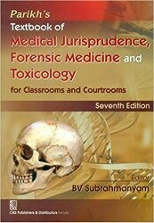
Learning Resources
Principles & Practice of Forensic Medicine.
by Nasib R. Awan
Parikh’s Textbook of Medical Jurisprudence,
Forensic Medicine & Toxicology.

Slide 39
THANK YOU

