Slide 2
DR. TANVEER HUSSAIN
FCPS (Medicine), FRCP (Glasg)
FCPS (Gastroenterology), CHPE
Associate Professor & HOD
Gastroenterology, RMU

Slide 3

University Motto, Vision, Values & Goals
Mission Statement To impart evidence-based research-oriented health professional education Best possible patient care Mutual respect, ethical practice of healthcare and social accountability. Vision and Values Highly recognized and accredited center of excellence in Medical Education, using evidence-based training techniques for development of highly competent health professionals, who are lifelong experiential learner and are socially accountable. Goals The Undergraduate Integrated Learning Program is geared to provide you with quality medical education in an environment designed to:

Slide 4
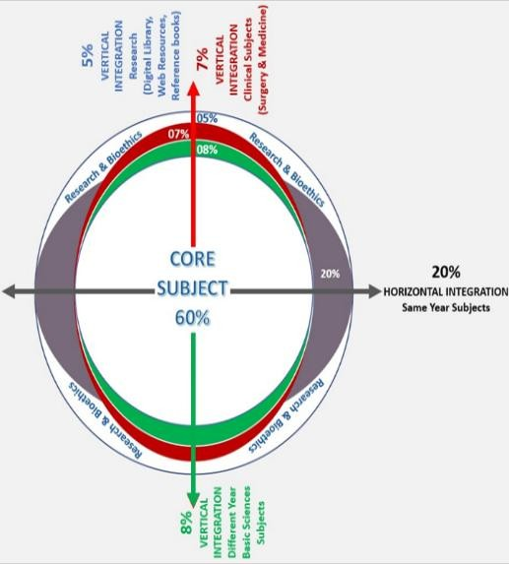
RMU Integrated Lecture Model

Slide 5
LOs
At the end of lecture, students will be able to understand
Etiopathogenesis & clinical features of the disease
Specific investigations of the disease
Treatment plan of the disease
Complication of the disease

Slide 6
CASE SCENARIO
A 33 yrs old male presented with three-month history of episodic epigastric pain, “burning” sensation in his chest, associated dry cough, and occasional regurgitation. The pain worsens after eating and when he was lying flat. The patient has increasing postprandial fullness and early satiety. He also stated waking up from pain and burning, with a sore throat and hoarse voice. The symptoms were partially relieved by adjusting from a lying to a sitting position and with the use of OTC medications, Mylanta and Famotidine
His examination revealed
Pulse :78/min BP: 140/85 mmHg BMI: 31Kg/m²
What is the likely diagnosis.
What investigations required for diagnosis.
What is the treatment

Slide 7

Gastroesophageal Reflux Disease

Slide 8
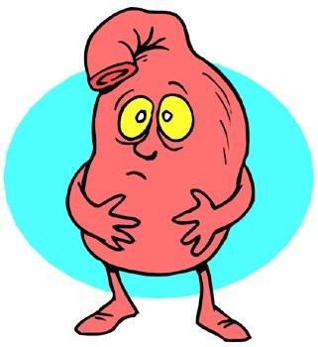

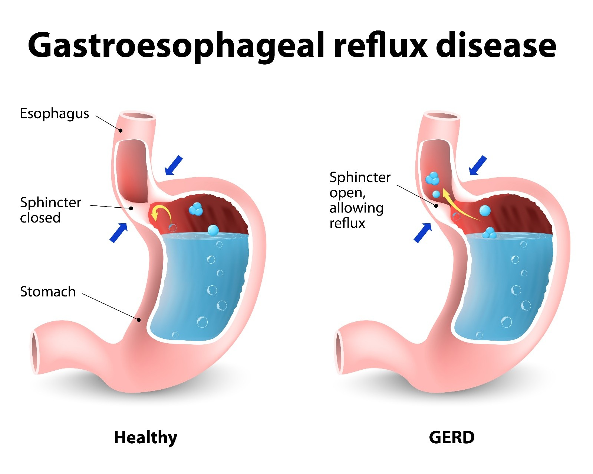
Definition
GERD is the condition in which the reflux of gastric contents into the esophagus results in symptoms and/or complications.
GERD is objectively defined by the presence of characteristic mucosal injury seen at endoscopy and/or abnormal esophageal acid exposure demonstrated on a reflux monitoring study.
^{ACG} Clinical Guideline for the Diagnosis and Management of Gastroesophageal Reflux Disease, Am J Gastroenterol 2022;117:27–56. https://doi.org/10.14309/ajg.0000000000001538; published online November 22, 2021

Slide 9
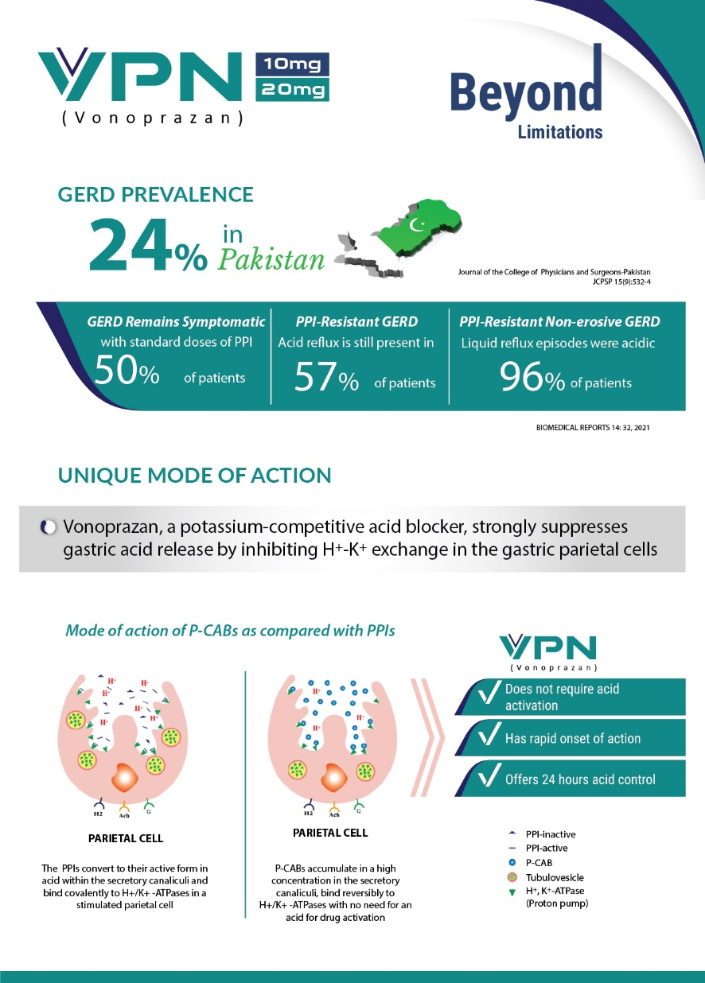
GERD

Slide 10
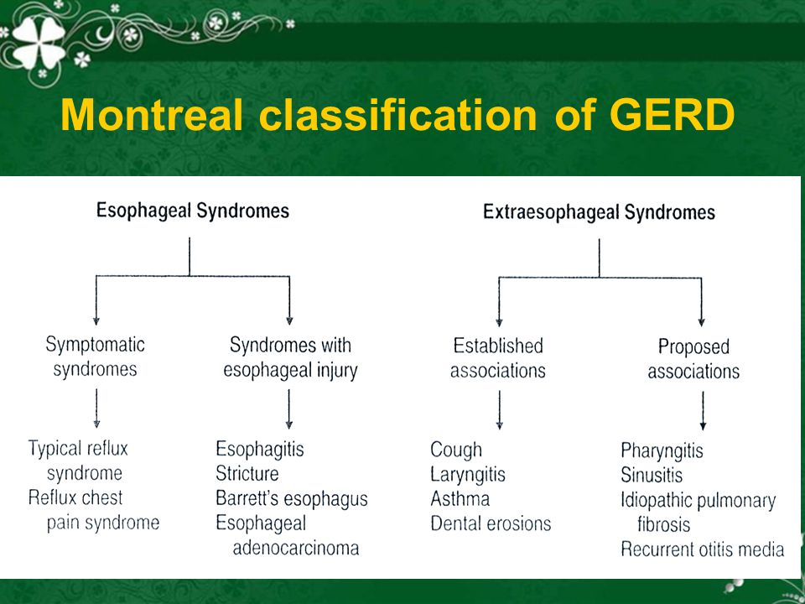

Slide 11
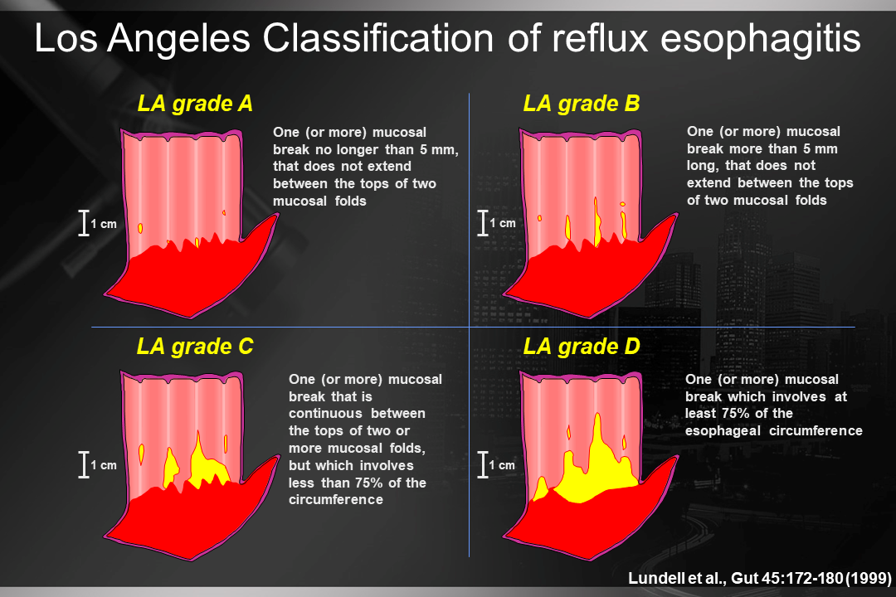

Slide 12
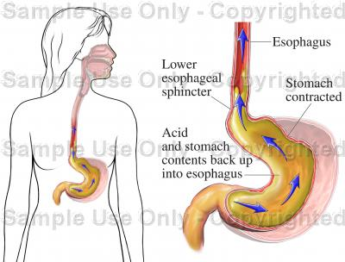
symptoms of GERD
Persistent heartburn and acid regurgitation.
Belching
Waterbrash (sudden excess of saliva)
Sour taste in the mouth
Food stuck in throat
Difficulty or pain when swallowing
Chest pain
Hoarseness
Choking or throat tightness.
Chronic sore throat
Dry cough
Bad breath
Inflammation of the gums
Erosion of tooth enamel (the surface of the teeth)

Slide 13
Diagnosis of GERD
Patients with classic GERD symptoms of heartburn and regurgitation without
alarm symptoms, an 8-wk trial of empiric PPIs once daily before a meal.
Patients with chest pain who have had adequate evaluation to exclude
heart disease, testing for GERD (endoscopy and/or reflux monitoring) is recommended.

Slide 14
Diagnosis of GERD
Endoscopy as the first test for patients with dysphagia or other alarm
symptoms and for patients with multiple risk factors for Barrett’s esophagus.
Patients for whom the GERD is suspected but not clear, and endoscopy
shows no evidence of GERD, reflux monitoring be performed off therapy to establish the diagnosis.
No reflux monitoring off therapy as a diagnostic test for GERD in patients with endoscopic evidence of LA grade C or D reflux esophagitis or in patients with long- segment Barrett’s esophagus.

Slide 15
Extra esophageal GERD
Patients who have extra esophageal manifestations of GERD without typical GERD symptoms should undergo reflux testing for evaluation before PPI therapy.
For patients with both extra esophageal and typical GERD symptoms, considering a trial of twice-daily PPI therapy for 8–12 wks before additional testing.
Upper GI endoscopy should not be used to establish a diagnosis of GERD-related asthma, chronic cough, or LPR.

Slide 16
Long-term complications of GERD
Inflammation of the esophagus
Bleeding or ulcers
strictures
Barrett's esophagus and adenocarcinoma
Supraesphageal manifestations
  Asthma
  chronic cough
  pulmonary fibrosis
  ENT manifestations

Slide 17
GERD Management
Weight loss in overweight and obese patients.
Avoiding meals within 2–3 hrs of bed time.
Avoidance of tobacco products/smoking.
Avoidance of “trigger foods” .
Elevate head of bed for night time GERD symptoms.

Slide 18
Management
PPI administration 30–60 min before meal rather than at bed time.
Patients with GERD who do not have EE or Barrett’s esophagus, and
whose symptoms have resolved with PPI therapy, an attempt should be
made to discontinue PPIs
Patients with GERD who require maintenance therapy with PPIs, the PPIs
should be administered in the lowest dose that effectively controls GERD
symptoms and maintains healing of reflux esophagitis.
Maintenance PPI therapy indefinitely or anti reflux surgery for patients with LA
grade C or D esophagitis.

Slide 19
Management
No treatment with Pro kinetic for GERD unless there is objective evidence of gastroparesis.
No sucralfate for GERD except during pregnancy.
On-demand/or intermittent PPI therapy for heartburn symptom control in patients with NERD.
Evaluation for non-GERD causes in patients with possible extra esophageal manifestations.

Slide 20
Foods and Medications that can effect GERD Symptoms
Foods/Beverages |  | Medications
Decreased LES Pressure
Fatty meal |  | Anticholinergics
Carminatives (peppermint, spearmint) |  | Barbiturates
Chocolate |  | Caffeine
Coffee, cola, tea |  | Dihydropyridine calcium channel blockers
Garlic |  | Dopamine
Onions |  | Estrogen
Chili peppers |  | Nicotine
Alcohol (wine) |  | Nitrates
 |  | Progesterone
 |  | Tetracycline
 |  | Theophylline
Direct Irritants to Esophageal Mucosa
Spicy foods | Aspirin
Orange juice | Bisphosphonates
Tomato juice | NSAIDs
Coffee | Iron
Tobacco | Quinidine
 | Potassium chloride

Slide 21
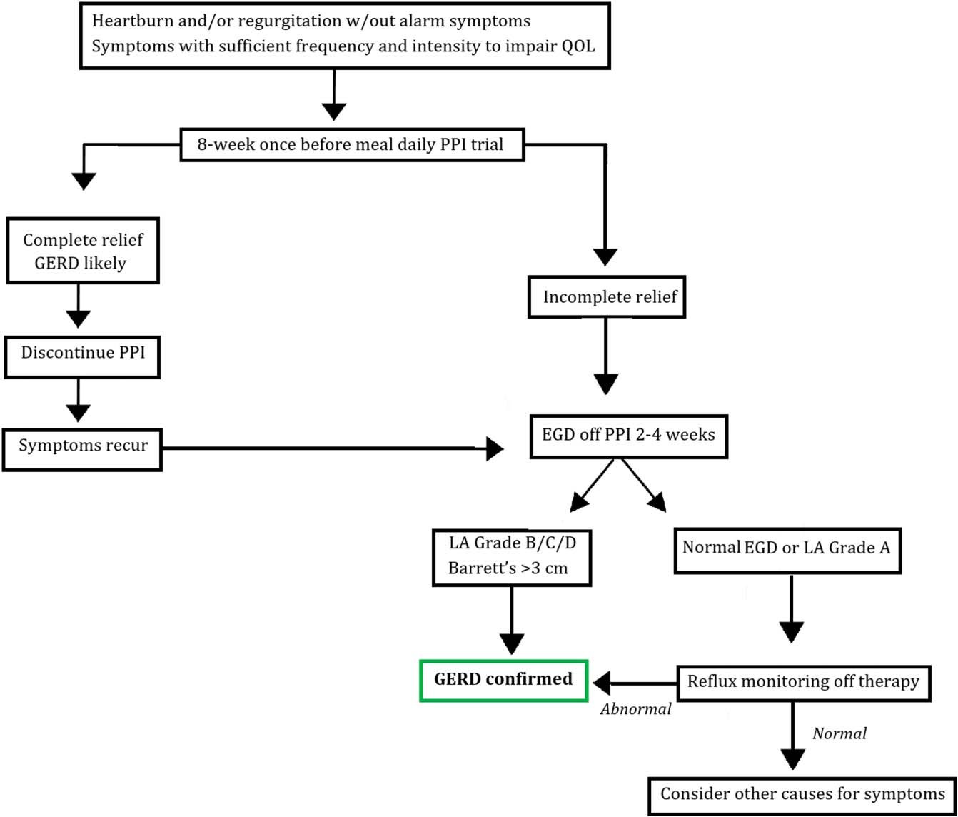
Diagnosis and Management of GERD

Slide 22
GERD Curable ?

Slide 23
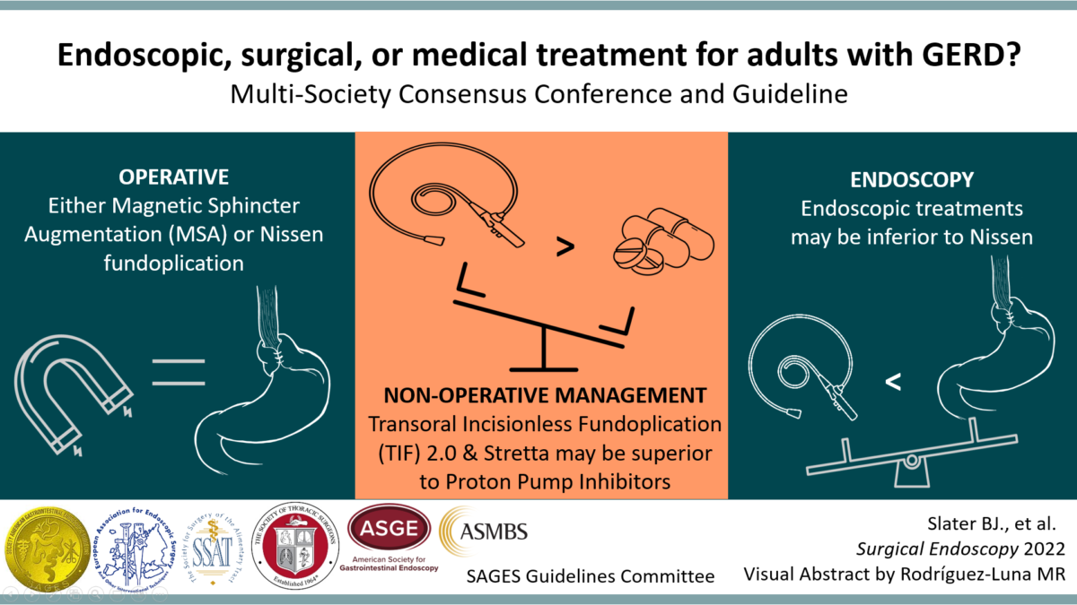

Slide 24
Peptic Ulcer Disease

Slide 25
PUD
PUD , ulceration anywhere in the GI tract mucosa exposed to acid and pepsin
They can range in size from a few millimeters to a few centimeters
The 2 most common forms/locations of PUD are
  Duodenal ulcer
  Gastric ulcer

Slide 26
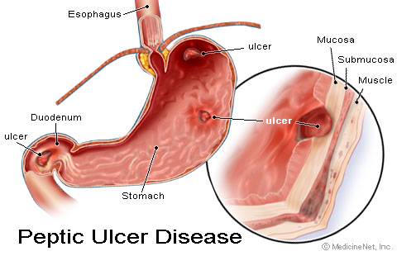

Slide 27
Etiology and Pathophysiology
An imbalance between aggressive factors and mechanisms that maintain
mucosal integrity
There is an increase in mucosal injury and a decrease in mucosal defense
  Aggressive factors (H. pylori, NSAIDs) cause mucosal injury and a decrease in mucosal defenses and healing (decreased mucous, decreased bicarbonate, decreased mucosal blood flow)

Slide 28
Causes
Common
  Helicobacter pylori (H.pylori) infection
  Nonsteroidal Anti-inflammatory Drugs (NSAIDs)
  Critical illness (stress-related mucosal damage)
Uncommon
  Idiopathic (non-H.pylori, non- NSAID)
  Hypersecretion of gastric acid (e.g. Zollinger Ellison syndrome)
  Viral infections
  Radiation therapy
  Chemotherapy

Slide 29
Signs and Symptoms
Symptoms depend on ulcer location, ulcer etiology, and patient age
NSAID-induced ulcers are often silent
  Complications such as bleeding and perforation are often the initial presentation
Pain localized to the epigastrium is the most common symptom
The pain is described as burning, gnawing, cramping, or hunger
A typical nocturnal pain that wakes the patient from sleep (especially between 12 and 3am)

Slide 30
Gastric and Duodenal Ulcer
Pain often does not follow a consistent pattern; not predictable
Food will sometimes cause or accentuate pain
Nausea, vomiting, anorexia, and weight loss are more common with gastric ulcer than duodenal ulcer
Pain more likely follows a consistent pattern (compared to gastric ulcer)
  Epigastric pain occurs in 60% - 90% of patients with duodenal ulcers
Food often relieves pain but the pain usually returns 1 to 3 hours after eating
Nocturnal epigastric pain often occurs
40% - 70% have additional non-specific dyspeptic complaints (belching, bloating, abdominal distension, food intolerance)

Slide 31
Complications
Major complications
  Bleeding
    Occurs in about 15% of patients with active PUD
  Perforation
    Occurs in about 7% of patients with active PUD
  Mortality
    Mortality from acute bleeding is about 6% - 10%

Slide 32
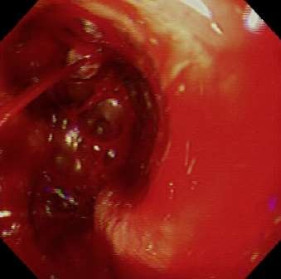
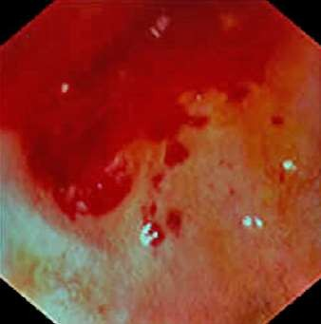
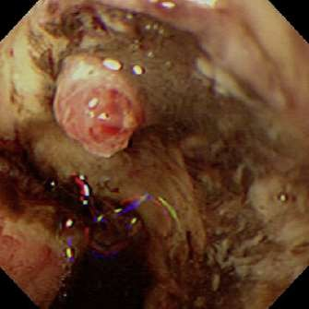
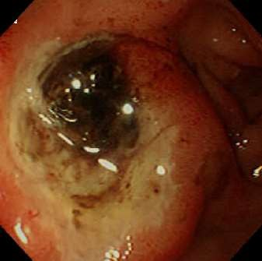
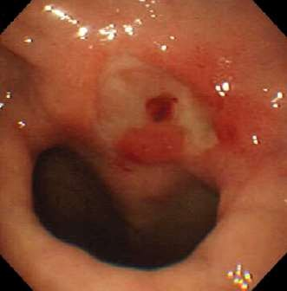
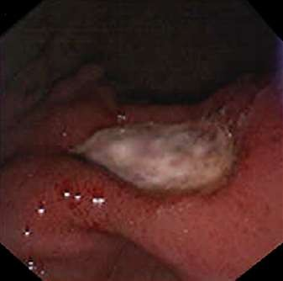
Forrest Classification
I-a (arterial jet ) I-b (oozing) II-a (visible vessel)
II-b (adherent clot)
II-c (flat pigmentation)
III (clean base)

Slide 33
Tests for H. pylori
Invasive tests (Requires endoscopy with biopsy)
  Histology
  Culture
  Rapid urease testing
Noninvasive
  Serological test
  Urea breath test
  Fecal antigen test

Slide 34
Indications for confirming eradication include:
  Continued dyspeptic symptoms
  H. pylori-associated MALT (mucosal associated lymphoid tissue) lymphoma
  Resection for gastric cancer

Slide 35
Treatment
Choice of treatment depends on etiology ( HP or NSAIDs) and whether treatment is for initial management or prevention of recurrence
Overall goals
  Relief of pain
  Healing of ulcer
  Prevention of recurrence
  Prevent or reduce complications

Slide 36
Treatment
Eliminate or reduce psychological stress
Smoking cessation
Eliminate or reduce NSAID use
Avoid foods that cause dyspepsia
Active HP positive ulcer.
eradicate HP, heal the ulcer, and ultimately cure the disease
NSAID-induced peptic ulcer
heal the ulcer as quickly as possible

Slide 37
Treatment
H. pylori eradication regimens
  Triple Therapy
  Bismuth-based Quadruple Therapy
  Sequential Therapy
  Salvage Therapy

Slide 38
Surgical procedures
  Gastroduodenostomy
  Gastrojejunostomy
  Vagotomy
  Pyloroplasty

Slide 39
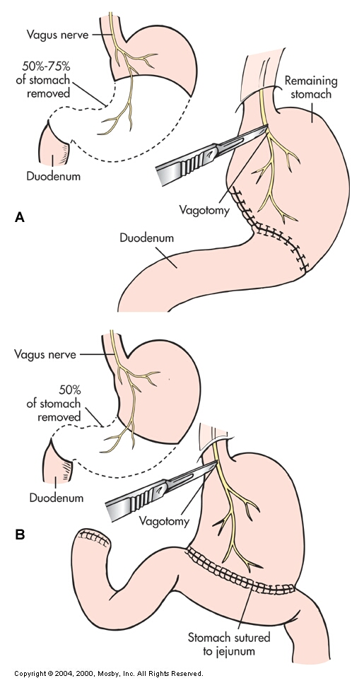
A. Billroth I Procedure
B. Billroth II Procedure

Slide 40
Algorithm for the treatment of peptic ulcer disease

Slide 41
Algorithm for the treatment of peptic ulcer disease

Slide 42
ACHALASIA

Slide 43
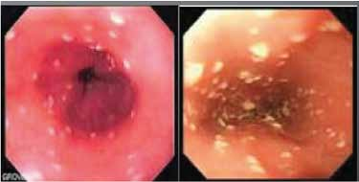
CASE SCENARIO
55 yrs old housewife, presented with progressive dysphagia for 6 months, she complained of diﬃculty in swallowing food since 6 months ago, started with solid food. she had loss of appetite and loss of weight (10 kg over the last 2 months).There was no signiﬁcant past surgical history. Clinically she was pale & dehydrated, heart rate 80/min (regular) and blood pressure 120/80mmHg. Abdominal examination was unremarkable except for mild tenderness over epigastric region. Lungs were clear with no crepitation bilaterally. Other systemic examinations were unremarkable.
Her HB was 12.9 g/dl; WBC 7,700/dl and Serum Na & K was 138 & 3.5mmol/L respectively. Her OGD revealed residual food particles accumulated at the lower esophagus, with dilated lower esophagus and generalized whitish lesions.
What is the most likely diagnosis.
What other investigations needed for diagnosis.
Name different treatment modalities

Slide 44
Definition
Achalasia is a primary esophageal motor disorder of unknown etiology characterized by
degeneration of the myenteric plexus, which results in impaired relaxation of the esophagogastric junction (EGJ), along with the loss of organized peristalsis in the esophageal body.

Slide 45
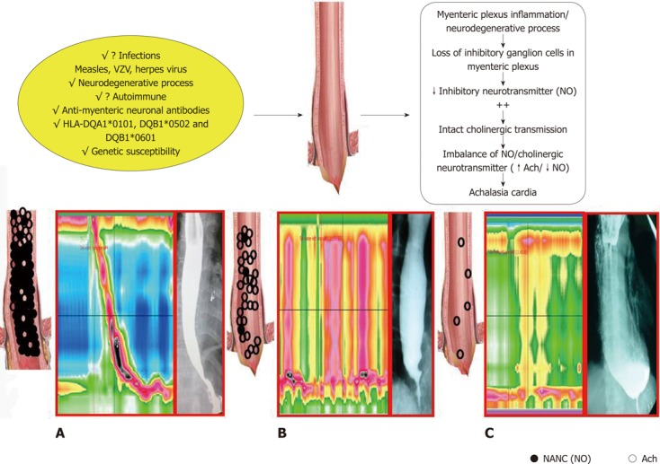

Slide 46
Clinical Presentation
Dysphagia for solids and liquids without oropharyngeal transfer difﬁculties in roughly 90% of patients
Regurgitation in 75%
Weight loss in 60%
Chest pain in 50%
Heartburn in 40%

Slide 47
Diagnosis
Endoscopy: exclude pseudo achalasia or other forms of mechanical obstruction at the EGJ., esophageal dilation, retention of food and secretions, and “puckered” EGJ
Barium swallow/ timed Esophagram “bird beak”
HRM incomplete relaxation of the EGJ coupled with the absence of organized peristalsis.

Slide 48
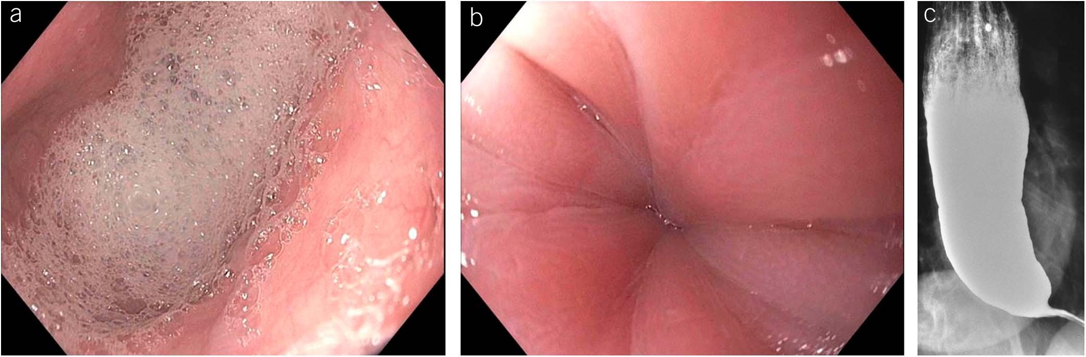
Diagnosis

Slide 49
Types
Type I or classic achalasia with low intra esophageal pressure,
Type II with pan-esophageal pressurization.
Type III with high-amplitude spastic contractions

Slide 50
Medical Treatment
Oral pharmacologic therapy
Calcium channel blockers
Nitrates
Anticholinergics , (beta)-adrenergic agonists and theophylline
Endoscopic pharmacologic therapy
Botulinum toxin

Slide 51
Treatment
Pneumatic dilation (PD)
Laparoscopic Heller myotomy
POEM
EndoFLIP

Slide 52
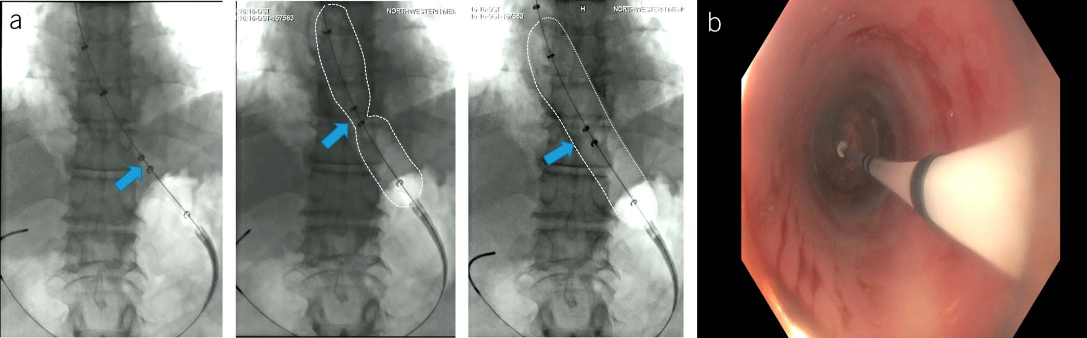
Pneumatic dilation

Slide 53
Treatment Response
Eckardt score
Dysphagia
Regurgitation
Chest pain
Weight loss
Timed barium esophagram (TBE)

Slide 54
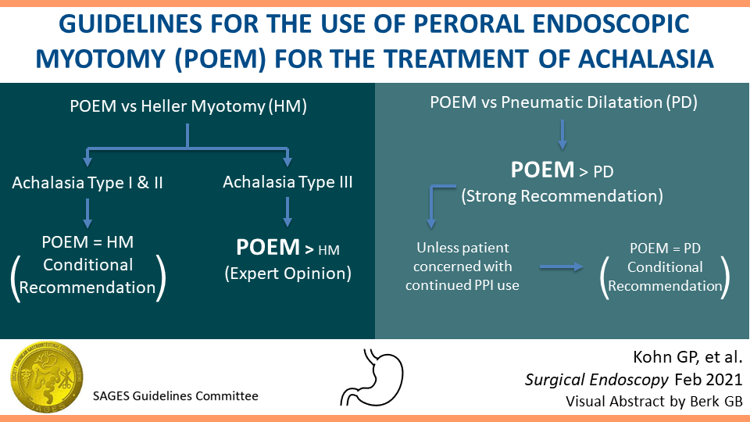

Slide 55




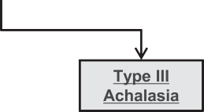
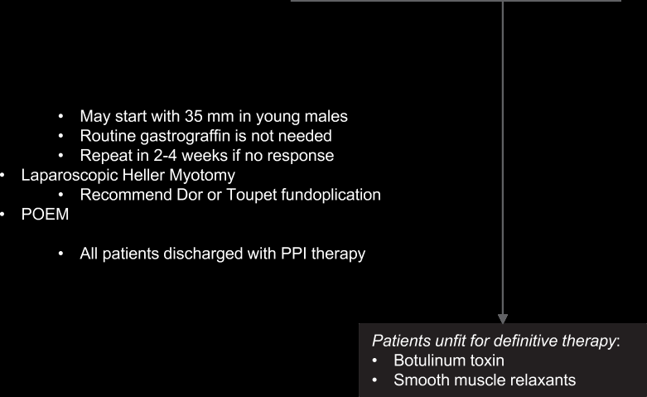


Algorithm

Slide 56

The principles in Medical Ethics

Slide 57
Components of Medical Ethics
The Physician -- Patient Relationship
The Physician -- Physician Relationship
The relationship of the Physician to Healthcare System
The Relationship of the Physician to Society

Slide 58
The content of clinical ethics:
Specific issues:
Truth-telling, informed consent, end of life care,
palliative care, allocation of clinical resources and
ethics of medical research.
Doctor-patient relationship:
Honesty, competence, integrity, and respect for
persons.

Slide 59
Family Medicine:
Endoscopy is the first test for patients with dysphagia or other alarm symptoms and for patients with multiple risk factors for Barrett’s esophagus
NSAID-induced ulcers are often silent
  Complications such as bleeding and perforation are often the initial presentation
Every patient with dysphagia should have investigation

Slide 60
Research:
Davidson's Principles and Practice of Medicine
24th Edition - March 1, 2022
The American Journal of Gastroenterology 117(1):p 27-56, January 2022. | DOI: 10.14309/ajg.0000000000001538
J Gastroenterol (2021) 56:303–322
https://doi.org/10.1007/s00535-021-01769-0
Am J Gastroenterol 2020;115:1393–1411. https://doi.org/10.14309/ajg.0000000000000731; published online August 10, 2020

Slide 61


Slide 62


