Slide 2
Gastric Neoplasms
GASTROINTESTINAL HEPATOBILIARY & PARASITOLOGY II Module
3rd year MBBS
dr
Department of Pathology
Rawalpindi Medical University

Slide 4
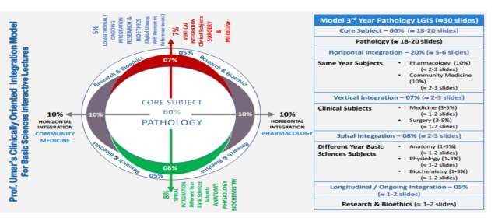

Slide 5
Learning Objectives
At the end of the practical, students must be able to:
Classify gastric neoplasms.
Correlate the morphological features of different gastric polyps with their malignant potential.
Describe the etiological factors for gastric carcinomas.
Differentiate between features of an inflammatory gastric ulcer and a neoplastic gastric ulcer.
Correlate the pathogenesis of gastric carcinoma with its morphological features.
Grade and stage a gastric adenocarcinoma.
Learning Resources: Robbins & Cotran Pathologic Basis Of Disease 10th Edition

Slide 6
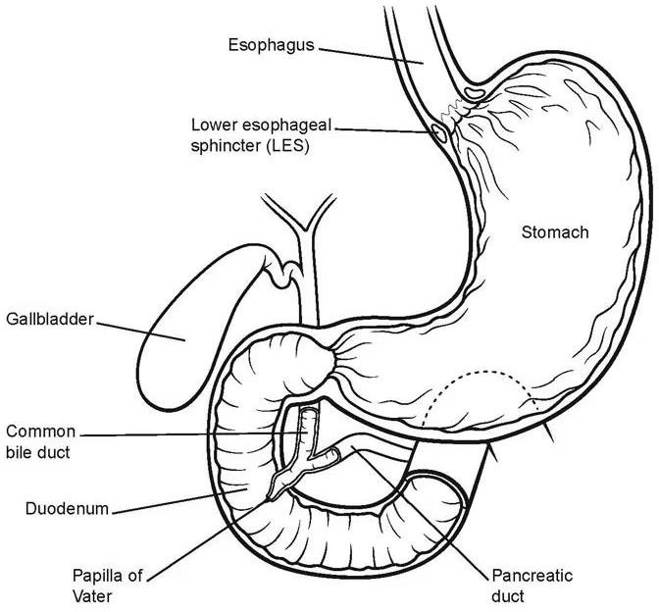
Anatomy
VERTICAL INTEGRATION ANATOMY

Slide 7
Epidemiology
HORIZONTAL INTEGRATION
COMMUNITY MEDICINE
Gastric malignancies account for the second most common cause of cancer death worldwide.
Adenocarcinoma is the most common gastric malignancy, comprising more than 90% of all gastric cancers.
Its incidence is high in Chile, Japan, Iceland, and Finland.
It commonly presents in the 5th and 6th decades.
It affects males twice as often as females.

Slide 8
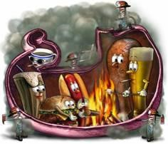
Etiology
HORIZONTAL INTEGRATION
COMMUNITY MEDICINE
Predisposing conditions :
Pernicious anemia & atrophic gastritis (achlorhydria)
Previous partial gastric resection
Smoking
Alcohol consumption
Gastroesophageal reflux disease (GERD)
Environmental:
H. pylori seropositive patients have 6-9 fold increased risk
Low socioeconomic status
Diet (prevention)
Genetic:
Blood group A
HNPCC: Hereditary non-polyposis colon cancer

Slide 9
Pathogenesis
CORE SUBJECT PATHOLOGY
Mutations: Several mutations are seen in patients with gastric carcinoma:
CDH1: Encodes E-cadherin, a protein that contributes to epithelial intercellular adhesion. The loss of E-cadherin function due to mutation in the CDH1 gene is a key step in the development of diffuse gastric cancer.
APC gene mutation: Found in patients with Familial Adenomatous Polyposis (FAP) and contributes to the development of intestinal-type gastric cancer.

Slide 10
Pathogenesis
CORE SUBJECT PATHOLOGY
Mutations: Several mutations are seen in patients with gastric carcinoma:
β-catenin gene: Encodes for β-catenin, a protein that binds to both E-cadherin and APC protein. Mutations in this gene play a role in gastric carcinogenesis.
Microsatellite instability: Associated with hypermethylation of genes, including TGFβRII, BAX, IGFRII, and p16/INK4a, which contribute to the development of gastric cancer.
TP53 mutations: Present in the majority of sporadic gastric cancers of both histologic types.

Slide 11
Pathogenesis
CORE SUBJECT PATHOLOGY
H. pylori:
Chronic gastritis promotes the development and progression of:
Chronic inflammation – Increased production of interleukin-1β (IL-1β) and tumor necrosis factor (TNF).
Cell damage and atrophy of mucosa.
Intestinal metaplasia.
Increased risk of intestinal-type gastric carcinoma.

Slide 12
CORE SUBJECT PATHOLOGY
H. pylori infection
Progression of gastritis to carcinoma
Superficial gastritis
Atrophic gastritis
Intestinal metaplasia
Dysplasia
Cancer

Slide 13
Pathogenesis
CORE SUBJECT PATHOLOGY
EBV:
About 10% of gastric adenocarcinomas are associated with Epstein-Barr virus (EBV) infection.
EBV-positive tumors tend to occur in the proximal stomach.
Most commonly, these tumors have a diffuse morphology with a marked lymphocytic infiltrate.

Slide 14
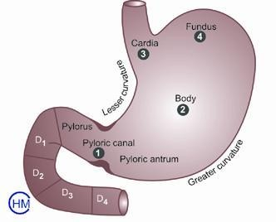
Classification on basis of location
SPIRAL INTEGRATION
Gastric adenocarcinomas are classified according to
Location in the Stomach
Gross Morphology
Histologic Morphology
The gastric cancer may arise in the:
Antrum (50%)
Gastric body (30%)
Fundus or cardia (20%)

Slide 15
Classification
CORE SUBJECT PATHOLOGY
The gross macroscopic types of gastric cancers are:
Polypoid or proliferative
Ulcerating
Ulcerating/infiltrating
Diffuse infiltrating (linitis plastica)

Slide 16
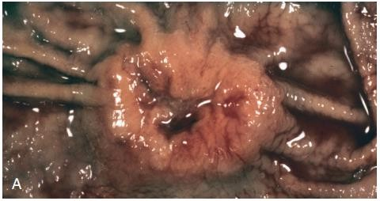
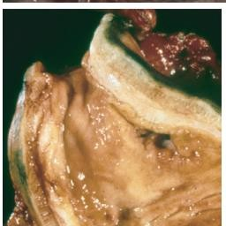
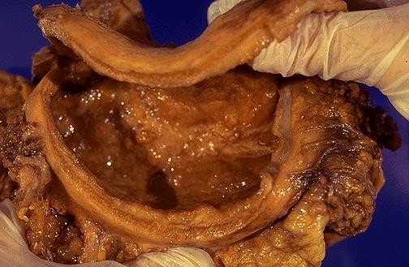
Morphology
CORE SUBJECT PATHOLOGY
The Lauren classification based upon morphology
Intestinal & Diffuse
Intestinal: Bulky tumors, grow in the form of an exophytic mass or an ulcerated tumor.
Diffuse: Infiltrative growth pattern. Rugal flattening and a rigid, thickened wall that imparts a "leather bottle" appearance, termed linitis plastica.

Slide 17
Morphology
CORE SUBJECT PATHOLOGY
Intestinal:
Composed of glandular structures.
The cells contain mucin vacuoles.
Abundant mucin may be present in gland lumina.
3 degrees of differentiation: well, moderately, and poorly differentiated.

Slide 18
Morphology
CORE SUBJECT PATHOLOGY
Diffuse:
Composed of dis-cohesive cells with large mucin vacuoles that expand the cytoplasm and push the nucleus to the periphery, creating a signet-ring cell morphology.
These cells permeate the mucosa and stomach wall individually or in small clusters

Slide 19
Other Types Of Gastric Neoplasms
CORE SUBJECT PATHOLOGY
Adenocarcinoma
Lymphoma
Stromal( GIST)
Carcinoid
Metastasis
90%
5%
2%
<1%
<1%
Adenosquamous/squamous <1%
Miscellaneous <1%

Slide 20
Progression Of Cancer
VERTICAL INTEGRATION
Early Gastric Cancer:
which is confined to the submucosa regard- status.
Defined as cancer
Mucosa and less of lymph nodes
Advanced Gastric Cancer:
Tumor that has involved the propria of the stomach wall.

Slide 21
Progression Of Cancer
VERTICAL INTEGRATION
Whatever the histologic variant, carcinomas eventually penetrate the wall, involve the serosa, spread to regional and more distant lymph nodes, and metastasize widely.
The earliest lymph node metastasis may sometimes involve a supraclavicular lymph node (Virchow's node).
Intraperitoneal spread in females to both ovaries gives rise to the so-called Krukenberg tumors.

Slide 22
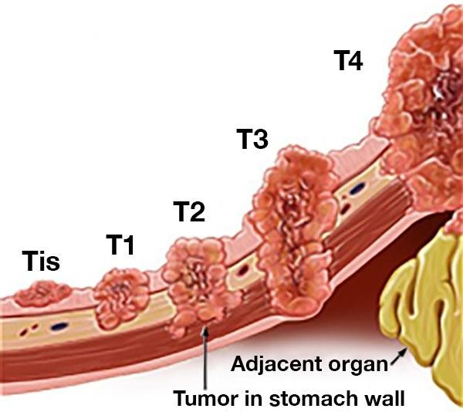
Staging Of Gastric Cancer
VERTICAL INTEGRATION
PRIMARY TUMOR (T)
Tis | Intraepithelial tumour
T1 | Tumour invades LP or submucosa
T2 | Tumour invades muscularis propria or subserosa
T3 | Tumour penetrates serosa without invasion of adjacent structures
T4 | Tumour invades adjacent structures

Slide 23
Staging Of Gastric Cancer
TNM System
VERTICAL INTEGRATION
 | Regional Lymph Nodes (N)
N0 | No regional lymph node metastases
N1 | Metastasis in 1 to 6 regional lymph nodes
N2 | Metastasis in 7 to 15 regional lymph nodes
N3 | Metastasis in more than 15 regional lymph nodes

Slide 24
Staging Of Gastric Cancer
TNM System
VERTICAL INTEGRATION
 | Distant Metastasis (M)
M0 | No distant metastasis
M1 | Distant metastasis

Slide 25
Evaluation Of Gastric Cancer
VERTICAL INTEGRATION
History
Clinical Examination
Investigations
The clinical features of gastric cancer may arise from:
Local disease
Its complications
Its metastases

Slide 26
Clinical Features
VERTICAL INTEGRATION
Often asymptomatic until late stage
Marked weight loss
Anorexia
Feeling of abdominal fullness or discomfort
Epigastric mass
Iron deficiency anemia
Left supraclavicular mass (Troisier’s Sign)
Obstructive jaundice (secondary in porta hepatitis)
Pelvic mass (Krukenberg)

Slide 27
Investigations
VERTICAL INTEGRATION
Upper Gastrointestinal Endoscopy with multiple biopsies and brush cytology
Radiology:
CT Scan of the chest and abdomen
Ultrasound (US) of the upper abdomen
Barium Meal
Diagnostic Laparoscopy

Slide 28
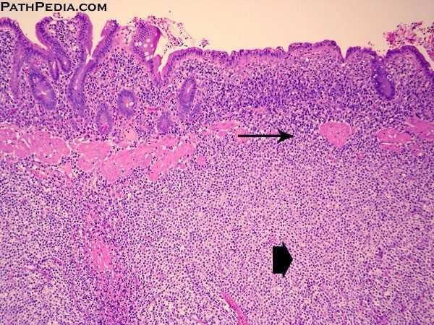
Gastric Lymphoma
CORE SUBJECT PATHOLOGY
Primary lymphomas of the stomach are called Mucosa-Associated Lymphoid Tissue (MALT) Lymphomas
(Usually) Low-grade B-cell lymphoma
Related to H. pylori-induced chronic gastritis

Slide 29
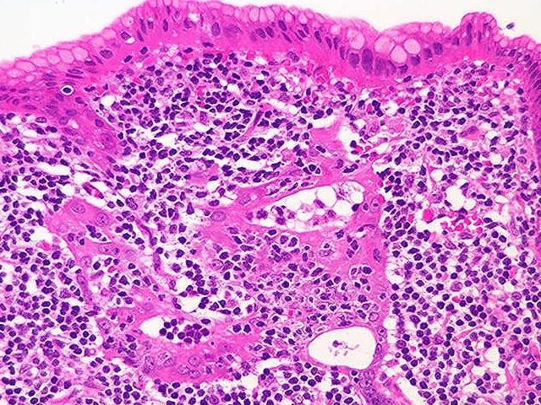
Gastric Lymphoma (MALToma)
CORE SUBJECT PATHOLOGY
Neoplastic cells infiltrate the epithelium, resulting in lymphoepithelial lesions.
Strongly associated with H. pylori infection and can often be cured by eliminating the infection.

Slide 30
GIST (Gastrointestinal Stromal Tumors)
CORE SUBJECT PATHOLOGY
GISTs are the most common mesenchymal tumor of the abdomen.
More than half of these tumors occur in the stomach.

Slide 31
Pathogenesis of GIST (Gastrointestinal Stromal Tumors)
SPIRAL INTEGRATION
CORE SUBJECT PATHOLOGY
GISTs arise from the interstitial cells of Cajal.
Activating mutations in genes encoding for tyrosine kinases are found in all GISTs.
Approximately 75% to 80% of all GISTs have a tyrosine kinase c-KIT mutation.
Another 8% of GISTs have mutations leading to overexpression of a tyrosine kinase, platelet-derived growth factor receptor A (PDGFRA).
Imatinib is used as a tyrosine kinase inhibitor and is a target for therapy in the treatment of GISTs.

Slide 32
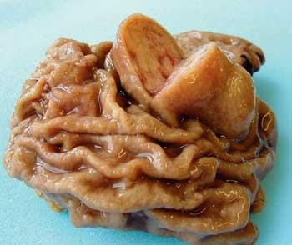
Gastrointestinal Stromal Tumors (GIST)
CORE SUBJECT PATHOLOGY
Gross:
Primary gastric GISTs usually form a solitary, well-circumscribed, fleshy, submucosal mass.
Metastases may form multiple small serosal nodules or fewer large nodules in the liver.
Spread outside of the abdomen is uncommon.
Microscopy:
GISTs can be composed of thin, elongated spindle cells or plumper epithelioid cells.

Slide 33
Carcinoid Tumors
CORE SUBJECT PATHOLOGY
Arise from neuroendocrine organs (e.g., the endocrine pancreas) and neuroendocrine-differentiated gastrointestinal epithelia (e.g., G-cells).
A majority are found in the GIT, commonly in the small intestine.
The tracheobronchial tree and lungs are the next most commonly involved sites.
Gastric carcinoids may be associated with:
Endocrine cell hyperplasia
Chronic atrophic gastritis
Zollinger-Ellison syndrome

Slide 34
Carcinoid Tumors
CORE SUBJECT PATHOLOGY
The WHO classification describes these as low- or intermediate-grade neuroendocrine tumors.
The grade is based on:
Mitotic activity
The fraction of cells immunohistochemically positive for Ki67, a mitotic marker.
High-grade neuroendocrine tumors, termed neuroendocrine carcinoma, frequently display necrosis.
In the GI tract, neuroendocrine carcinoma is most common in the jejunum.

Slide 35
Gastric Carcinoid Tumor
CORE SUBJECT PATHOLOGY
Gross:
Intramural or submucosal masses.
Create small polypoid lesions.
The tumor's appearance is desmoplastic.
It is yellow or tan in color.
It elicits an intense desmoplastic reaction.
This reaction may cause kinking of the bowel and obstruction.

Slide 36
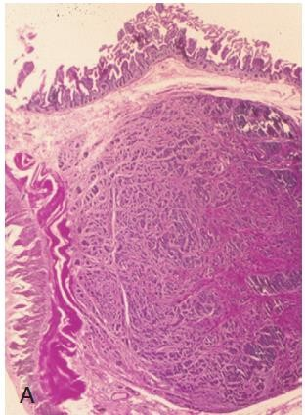
Gastric Carcinoid Tumor
CORE SUBJECT PATHOLOGY
Microscopy:
Composed of islands, trabeculae, strands, glands, or sheets of uniform cells.
Cells have scant, pink granular cytoplasm.
The nucleus is round to oval with a stippled appearance.

Slide 37
Antineoplastic Agents
HORIZONTAL INTEGRATION
Platinum-based combination chemotherapy:
First-line regimens include:
Epirubicin/cisplatin/5-FU or docetaxel/cisplatin/5-FU.
Other combinations include oxaliplatin and irinotecan.
Trastuzumab: For patients who have not received previous treatment for metastatic disease.
Ramucirumab: For the treatment of advanced stomach cancer or gastroesophageal (GE) junction adenocarcinoma.
Nivolumab: In combination with fluoropyrimidine- and platinum-containing chemotherapy for first-line therapy of advanced or metastatic gastric or GE junction cancer.

Slide 38
Neoadjuvant, Adjuvant, and Palliative Therapies
HORIZONTAL INTEGRATION
Potentially useful therapies in gastric cancer include the following:
Neoadjuvant Chemotherapy
Intraoperative Radiotherapy (IORT)
Adjuvant Chemotherapy (e.g., 5-FU)
Adjuvant Radiotherapy
Adjuvant Chemoradiotherapy
Palliative Radiotherapy
Palliative-Intent Procedures (e.g., wide local excision, partial gastrectomy, total gastrectomy, simple laparotomy, gastrointestinal anastomosis, bypass)

Slide 39
AI In Diagnosis Of Early Gastric Cancer
Early gastric cancer diagnosed by serum m RNA in serum
Endoscopic biopsy can be analyzed by AI algorithms for correlation of clinical and epidemiological genetic factors to provide risk and personalized treatment
AI is used in research to analyze gene mutations and insight into genetic etiology

Slide 40
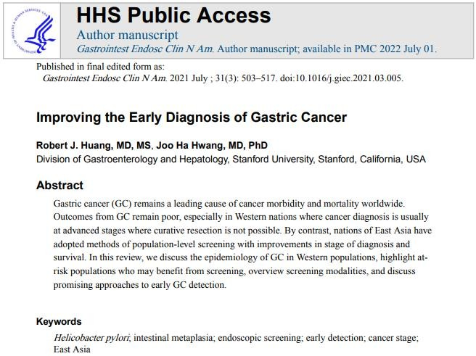
Gastrointestinal Endoscopy Clinics of North America. 2021 Jul;31(3):503-517. doi: 10.1016/j.giec.2021.03.005.

