Slide 2
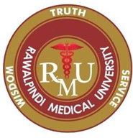
Gallbladder Diseases
GASTROINTESTINAL HEPATOBILIARY & PARASITOLOGY II Module
3rd year MBBS
Dr. Mudassira Zahid
Associate Professor
Department of Pathology
Rawalpindi Medical University

Slide 3
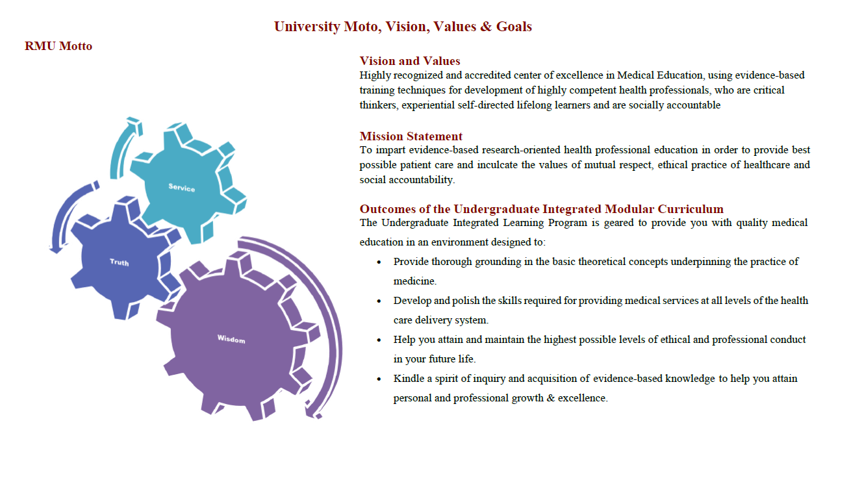

Slide 4
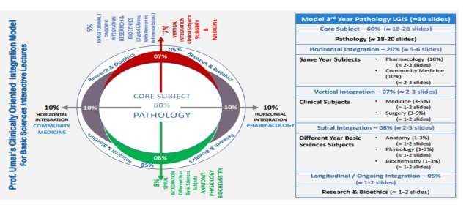

Slide 5
Learning Objectives
Describe the Gallbladder Diseases with Their Pathogenesis and Morphological Features
Learning Resource:
Robbins & Cotran Pathologic Basis of Diseases, 10th Edition, Pages 872-876
Serum lipid levels are risk factors of gallstones https://lipidworld.biomedcentral.com/articles/10.1186/s12944-019-1184-3

Slide 6
Study Questions
Gallbladder Study Outline
Vertical Anatomy
What is the normal gross and histological structure of the gallbladder?
Vertical Physiology
What is the function of the gallbladder?
Core Topics
What are the congenital anomalies associated with the gallbladder?
Describe the pathogenesis and risk factors for cholesterol gallstones.
Describe the pathogenesis and risk factors for pigment gallstones.
How do you classify gallbladder tumors?

Slide 7
Study Questions
Gallbladder Study Outline
Vertical Surgery
What are the complications of gallstones?
Vertical & Pathology
Correlate the clinical and morphological features of acute and chronic cholecystitis.
Horizontal Pharmacology
What are the pharmacological options for the symptomatic treatment of gallbladder stones?
Spiral Family Medicine
What should be the role of a doctor in promoting lifestyle modifications for the prevention of gallbladder stones?

Slide 8
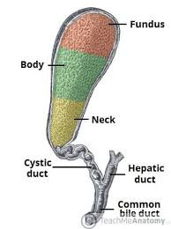
Gross Anatomy of the Gallbladder

Slide 9
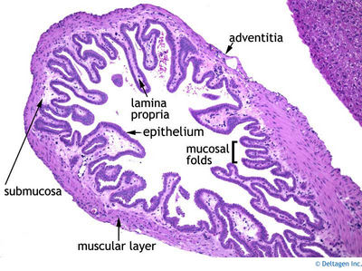
Gall Bladder Histology

Slide 10
Functions of the Gallbladder
Bile Storage:
The gallbladder stores bile produced by the liver until it is needed for digestion.
Bile plays a crucial role in breaking down fats in the small intestine.
Concentration of Bile: The gallbladder removes water and electrolytes from bile, making it more concentrated and potent.
This ensures bile is more effective for digestion.
Release of Bile:
When food, especially fatty foods, enters the small intestine, the gallbladder contracts.
It releases bile into the intestine via the common bile duct, aiding in fat digestion and emulsification.

Slide 11
Functions of the Gallbladder
Facilitation of Digestion:
Bile contains bile salts, which emulsify fats, breaking them into smaller particles.
This process makes fats easier for digestive enzymes to act upon.
It also enhances the absorption of fat-soluble vitamins (A, D, E, and K) and fatty acids.
Regulation of Cholesterol Levels:
The gallbladder helps regulate cholesterol levels by excreting excess cholesterol through bile.
This process prevents cholesterol accumulation and aids in maintaining lipid balance.

Slide 12
Non-Neoplastic Disorders of the Gallbladder
Classification:
Cholelithiasis (Gallstones)
Cholesterolosis (Strawberry Gallbladder)
Cholecystitis
Acute Cholecystitis
Chronic Cholecystitis
Congenital Abnormalities

Slide 13
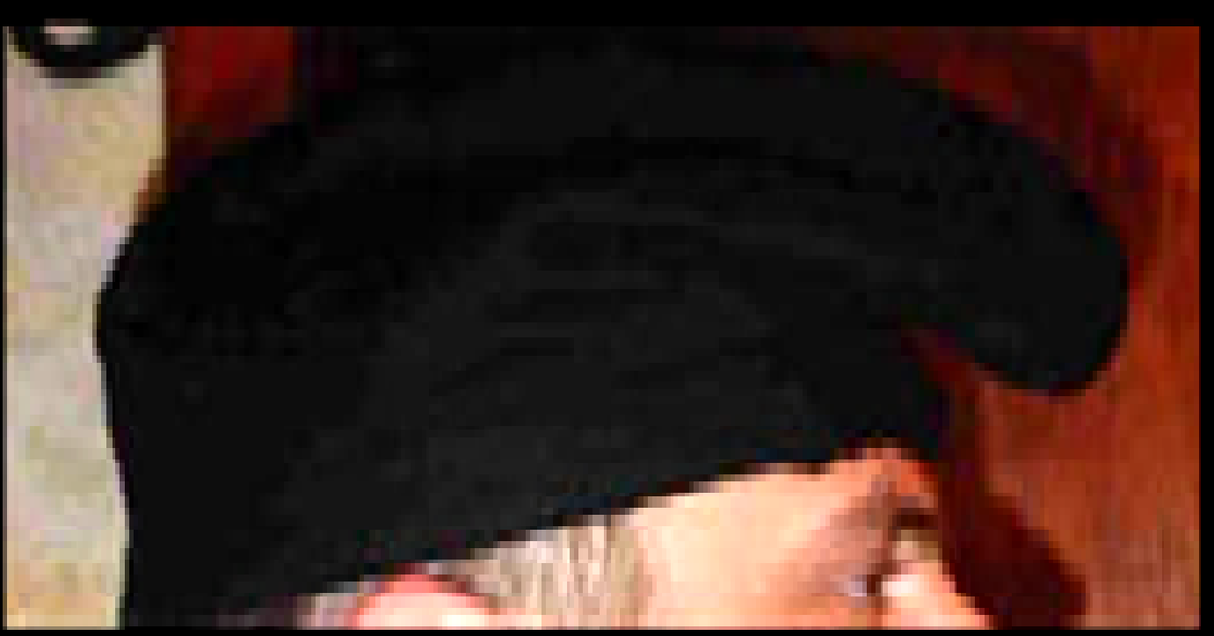
Congenital Anomalies of the Gallbladder
Congenitally Absent Gallbladder
Gallbladder Duplication
Conjoined or independent cystic ducts
Septated Gallbladder
Longitudinal or transverse septum creating a bilobed gallbladder
Aberrant Locations (5-10% of the population)
Partial or complete embedding in liver tissue
Folded Fundus (Phrygian Cap)
Most common anomaly
Agenesis of Hepatic or Common Bile Ducts
Absence of all or part of the bile ducts
Biliary Atresia
Narrowing or absence of biliary channels

Slide 14
Cholelithiasis (Gallstones)
Prevalence:
Affects 10–20% of the adult population in developing countries
Over 80% of cases are silent
Patients remain asymptomatic for decades, without biliary pain or complications
Types of Gallstones:
Cholesterol Stones (90%)
Contain >50% crystalline cholesterol monohydrate
Pigment Stones
Composed predominantly of bilirubin calcium salts

Slide 15
Major Risk Factors for Gallstones
Cholesterol Stones
Demography: More common in Northern Europe, North & South America
Advancing Age
Female Sex Hormones:
Female Gender
Oral Contraceptives
Pregnancy
Obesity & Metabolic Syndrome
Rapid Weight Reduction
Gallbladder Stasis
Inborn Disorders of Bile Acid Metabolism
Hyperlipidemia Syndrome

Slide 16
Major Risk Factors for Gallstones
Pigment Stones
Demography: More common in Asia > Western countries & rural > urban areas
Chronic Hemolytic Syndrome
Biliary Infection
Gastrointestinal Disorders:
Ileal Disease (e.g., Crohn’s disease)
Ileal Resection or Bypass
Cystic Fibrosis with Pancreatic Insufficiency

Slide 17
Pathogenesis of Cholesterol Stones
Cholesterol Solubility in Bile:
Cholesterol is made soluble by aggregation with water-soluble bile salts and water-insoluble lecithins (both act as detergents).
Supersaturation:
When cholesterol concentration exceeds the solubilizing capacity of bile (supersaturation), it can no longer stay dispersed.
Nucleation & Crystal Formation:
Excess cholesterol nucleates into solid cholesterol monohydrate crystals, which eventually grow into gallstones.

Slide 18
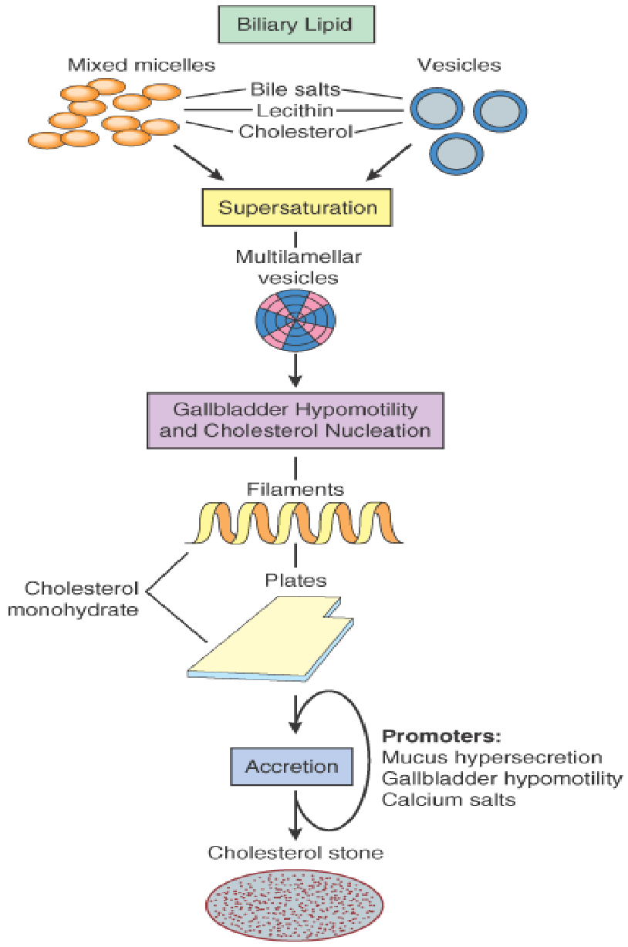
Cholesterol Gallstone Formation: Four Key Conditions
Supersaturation of Bile with Cholesterol
Bile must contain cholesterol in excess of its solubilizing capacity.
Gallbladder Hypomotility
Reduced motility promotes stasis, allowing cholesterol crystals to nucleate.
Accelerated Cholesterol Nucleation
Factors in bile enhance the rapid formation of cholesterol crystals.
Mucus Hypersecretion & Crystal Aggregation Excess mucus traps nucleated crystals, facilitating their aggregation into stones.

Slide 19
Pathogenesis of Pigment Stones
Pigment gallstones are mixtures of:
Abnormal insoluble calcium salts of unconjugated bilirubin
Inorganic calcium salts
Elevated levels of unconjugated bilirubin in bile increase the risk of developing pigment stones in: Hemolytic syndrome
Infection of the biliary tract with:
Escherichia coli
Ascaris lumbricoides
Liver fluke → increases pigment stone formation.

Slide 20
Morphology of Cholesterol Stones
Composition:
Contain 50% - 100% cholesterol (pure cholesterol stones are rare).
Number:
Can be multiple or single.
Size:
Up to several cm in diameter.
Radiographic Properties: Radiolucent if cholesterol content is high.
Radiopaque if mixed with calcium carbonate.

Slide 21
Cholesterol Gallstones
Pure Cholesterol Stones:
Color: Pale yellow
Shape: Round to oval
Texture: Finely granular, hard external surface
Cross-Section:
Appearance: Glistening, radiating crystalline palisade
With Increasing Calcium Carbonate, Phosphates & Bilirubin: Changes from grey-white to black
Surface Characteristics:
Rounded or faceted due to tight opposition of stones

Slide 22
Morphology
Pigment Gallstones
Classified into Black and Brown Stones
Black Pigment Stones
Location: Found in sterile gallbladder bile
Composition:
Oxidized polymers of calcium salts of unconjugated bilirubin
Calcium carbonate
Calcium phosphate
Glycoprotein
Cholesterol monohydrate crystals
Brown Stones
Location: Found in infected intrahepatic or extrahepatic ducts
Composition:
Pure calcium salts of unconjugated bilirubin
Mucin glycoprotein
Cholesterol
Calcium salts of palmitate and stearate

Slide 23
Black Pigment Stones
Size: Rarely exceed 1.5 cm in diameter
Number: Usually multiple
Shape & Texture:
Contours are typically spiculated and molded
May be laminated and soft with a soap-like/greasy consistency
Radiographic Properties:
50–75% are radiopaque due to the presence of calcium carbonate and phosphates
Stones containing calcium soaps are radiolucent

Slide 24
Complications of Gallstones
Infections & Inflammation:
Empyema
Perforation
Fistulas
Inflammation of the biliary tree (cholangitis)
Obstructive Conditions: Obstructive cholestasis
Pancreatitis
Stone Size & Risk:
Larger calculi → Less likely to enter cystic/common ducts and cause obstruction
Very small stones or gravel → More dangerous, higher risk of blockage
Severe Complications:
Gallstone Ileus: Large stone erodes into an adjacent bowel loop, causing intestinal obstruction
Increased risk of gallbladder carcinoma

Slide 25
Cholecystitis – Inflammation of the Gallbladder
Almost always associated with gallstones
Can present in different forms:
Acute Cholecystitis
Chronic Cholecystitis
Acute cholecystitis superimposed on chronic cholecystitis

Slide 26
Acute Cholecystitis – Morphology & Features
Severe Acute Cholecystitis:
Extensive ulceration of mucosa
Hemorrhage
Edema
Dense transmural infiltrate of neutrophils and mononuclear inflammatory cells

Slide 27
Acute Cholecystitis

Slide 28
Clinical Features of Acute Cholecystitis
Pain: Right upper quadrant (RUQ) or epigastric pain
Systemic Symptoms: Fever, anorexia, tachycardia, sweating, nausea, and vomiting
Laboratory Findings:
Hyperbilirubinemia → suggests obstruction of the common bile duct
Leukocytosis
Elevated serum alkaline phosphatase
History: Previous episodes of pain

Slide 29
Chronic Cholecystitis
Cause: Result of repeated bouts of mild to severe acute cholecystitis
Association: 90% associated with cholelithiasis
Age & Gender: Peaks in 40s and 50s, more common in females
Symptoms:
Recurrent right upper quadrant (RUQ) pain or GI upset
Nausea, vomiting, intolerance for fatty foods
Symptoms similar to acute cholecystitis
Microbiology: E. coli & Enterococci cultured from bile in 1/3rd of cases

Slide 30
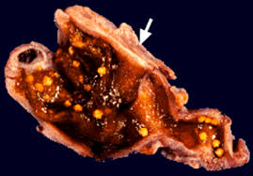
Morphology
Changes: Minimal to variable
Serosa:
Smooth, glistening / dull due to subserosal fibrosis
Dense fibrous adhesions from acute inflammation
On Sectioning:
Wall: Variably thickened, grey-white
Lumen: Contains clear green-yellow mucoid bile and/or stones
Mucosa: Generally preserved

Slide 31
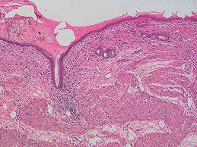
Morphology
Microscopy of Chronic Cholecystitis
Mild Cases:
Scattered lymphocytes, plasma cells, and macrophages in mucosa and subserosal fibrous tissue
More Advanced Cases:
Subepithelial and subserosal fibrosis with mononuclear cell infiltration
Thickened wall with Rokitansky-Aschoff sinuses
Atrophic mucosa and fibrotic lamina propria

Slide 32
Morphology
Microscopy
Reactive mucosal proliferation with fusion of mucosal folds → formation of buried crypts of epithelium within the gallbladder wall
Outpouching of mucosal epithelium through the wall → formation of Rokitansky-Aschoff sinuses

Slide 33
Complications
Bacterial superinfection → leads to cholangitis or sepsis
Perforation → results in local abscess formation
Rupture → causes diffuse peritonitis
Biliary-enteric fistula → leads to bile drainage into adjacent organs

Slide 34
Neoplastic Disorders of the Gallbladder
Benign Tumors
Fibromas
Myomas
Hemangiomas
Adenomyomatosis
Adenoma with Dysplasia
Malignant Tumors
Carcinoma of the Gallbladder
Lymphomas
Carcinoids

Slide 35
Treatment of Gallbladder Disorders
Oral Bile Acid Therapy – Ursodeoxycholic Acid
Contact Dissolution Therapy – e.g., MTBE
Pain Management Medications – NSAIDs
Cholesterol-lowering Medications – Statins
Gallbladder Emptying Agents – e.g., Ursodiol, Cholecystokinin Analogs
Antibiotics
Cholecystectomy

Slide 36
Biomedical Ethics
Confidentiality – Doctors must respect patient confidentiality.
Empathy & Counseling – Patients should be shown empathy and counseled appropriately.

