Slide 2
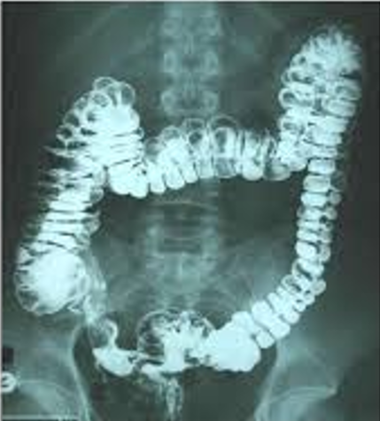
Gastrointestinal Tract (GIT) Module 2nd Year MBBS(SGD) Radiological Anatomy of GIT
Presenter: Dr. Minahil Haq Date: 24-03-25

Slide 3
Prof. Umar’s Model of Teaching Strategy Self Directed Learning Assessment Program
Objectives :To cultivate critical thinking, analytical reasoning, and problem-solving competencies.
To instill a culture of self-directed learning, fostering lifelong learning habits and autonomy.
How to Assess?
➢Ten randomly selected students will be evaluated within the first 10
minutes of the lecture through 10 multiple-choice questions (MCQs)
based on the PowerPoint presentation shared on Students Official
WhatsApp group, one day before the teaching session.
➢The number of MCQs from the components of the lecture will follow
the guidelines outlined in the Prof. Umar model of Integrated Lecture.
Component of LGIS | Core Knowledge | Horizontal Integration | Vertical Integration | Spiral Integration
No. of MCQs | 6-7 | 1-2 | 1 | 1

Slide 4
Professor Umar Model of Integrated Lecture

Slide 5
LEARNING OBJECTIVES
Identify structures on a normal X-ray abdomen
• Appreciate Air fluid shadows.
• Mark anatomical landmarks.
• Correlate the clinical conditions
• Understand preventive& curative health care measures
• Practice the principles of Bioethics
• Apply Strategic use of AI in health care
• Read relevant research articles

Slide 7
PLAIN X-RAY ABDOMEN
A plain radiograph of the abdomen is extremely valuable in
Excluding biliary and renal calculi ii. In urgent surgery for diagnosing: • acute intestinal obstruction • paralytic ileus • rupture of a hollow viscus

Slide 9
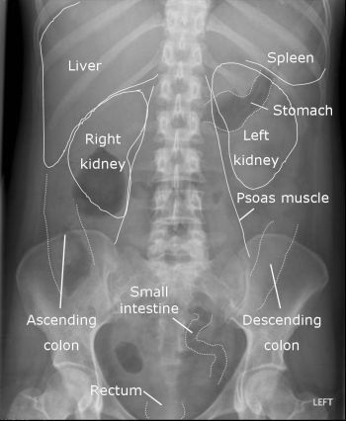

Slide 10
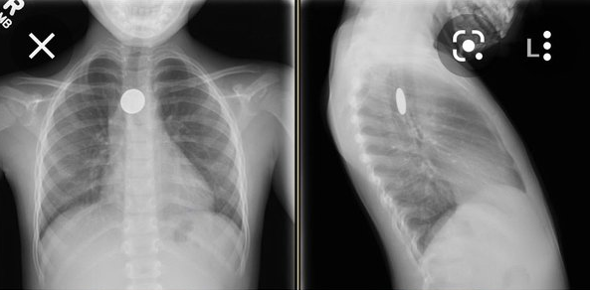
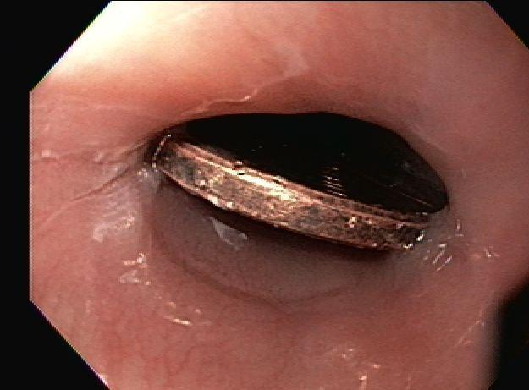
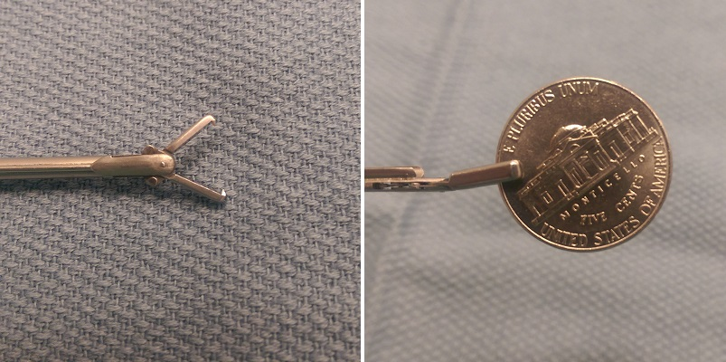

Slide 11
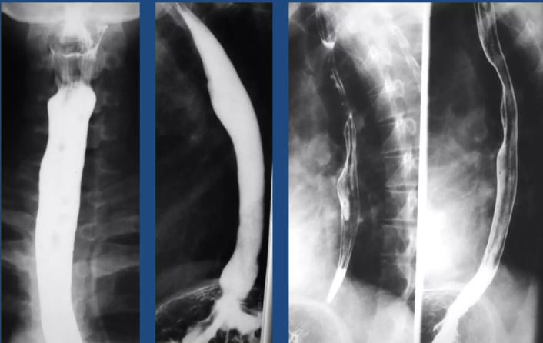
Normal Esophagus With Barium Meal

Slide 12
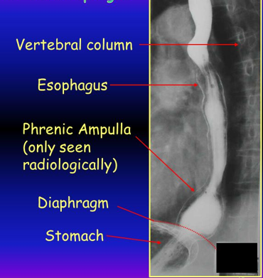

Slide 13
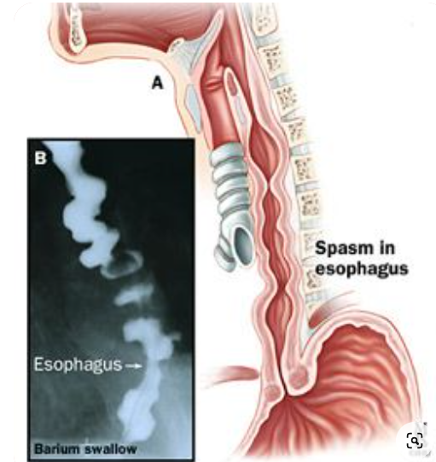
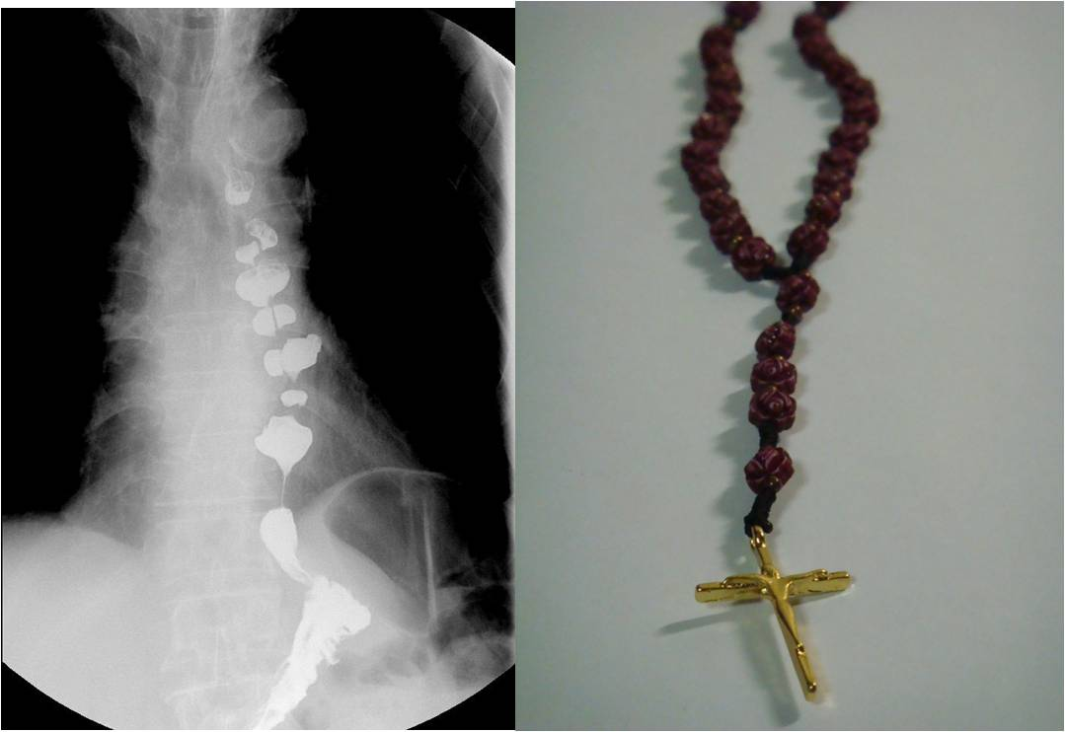
Nut–cracker esophagus/Rosary bead esophagus (Diffuse Esophageal spasm)
Notes:
Strong coordinated contractions

Slide 14
DES (Diffuse Esophageal Spasm)
Notes:
Weak uncoordinated contractions

Slide 15
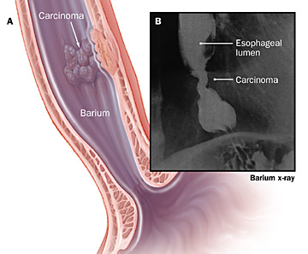

Slide 16
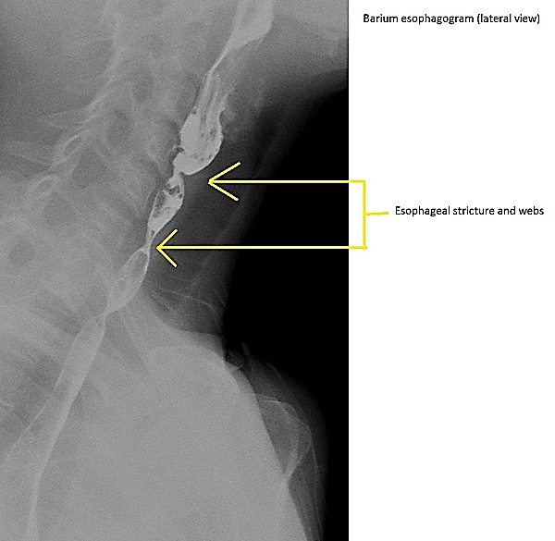

Slide 17
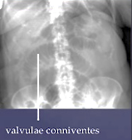
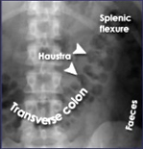
Notes:
Kerckrings folds

Slide 23
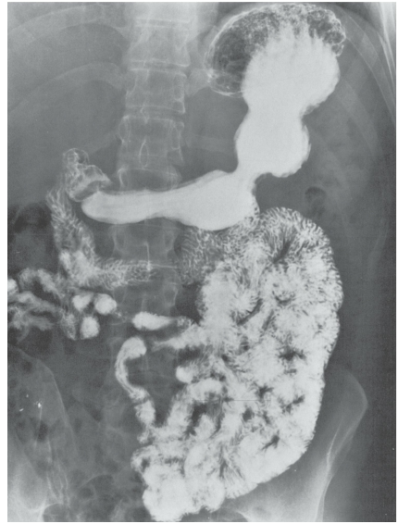
Anteroposterior radiograph of the stomach and the small intestine after ingestion of barium meal.

Slide 24
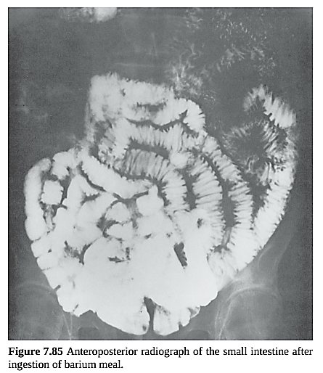

Slide 25
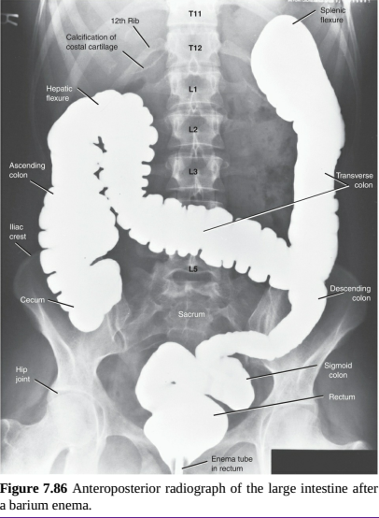

Slide 26
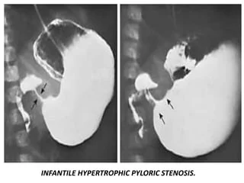
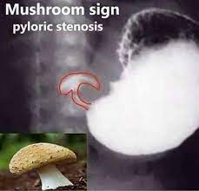

Slide 27
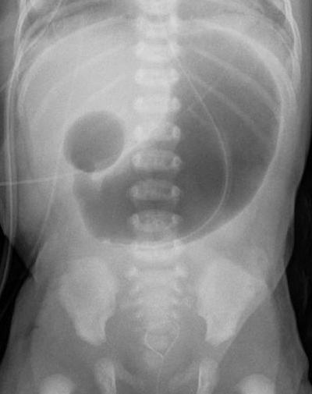
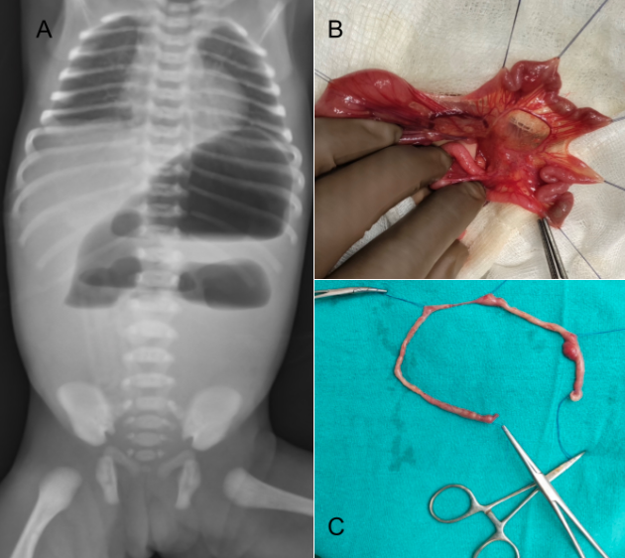
Duodenal/Jejunal Atresia (Double Bubble Sign)on X-ray

Slide 28
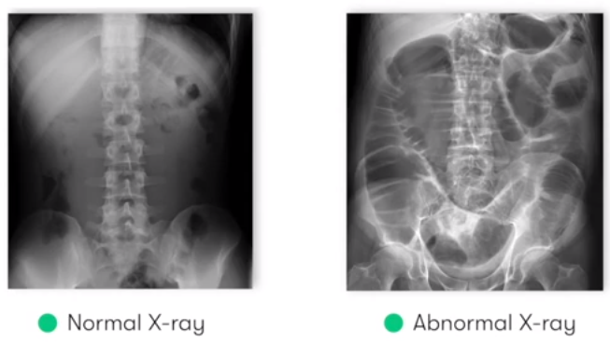
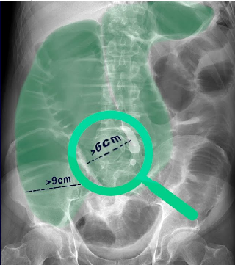
Large Bowel Obstruction(LBO)

Slide 29
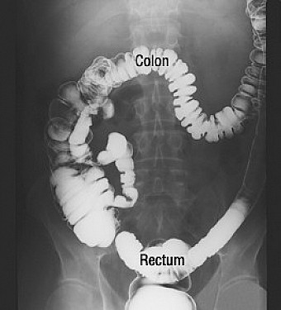
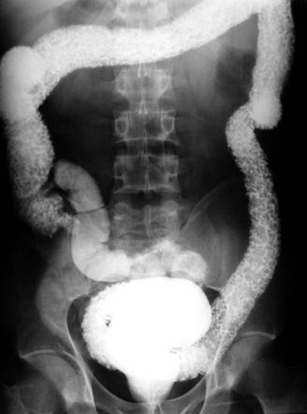
Barium Enema (Normal/Ulcerative Collitis)

Slide 30
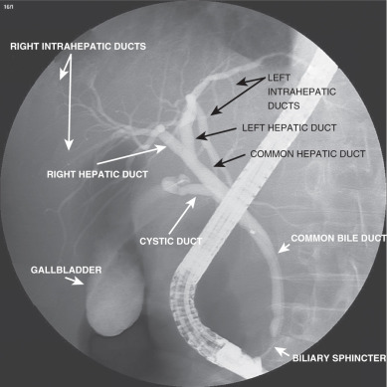
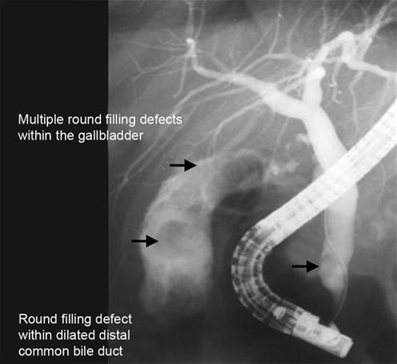
ERCP(Endoscopic Retrograde Cholangio Pancreatography)

Slide 31
Ultrasound bdomen

Slide 32
Gall Bladder

Slide 33
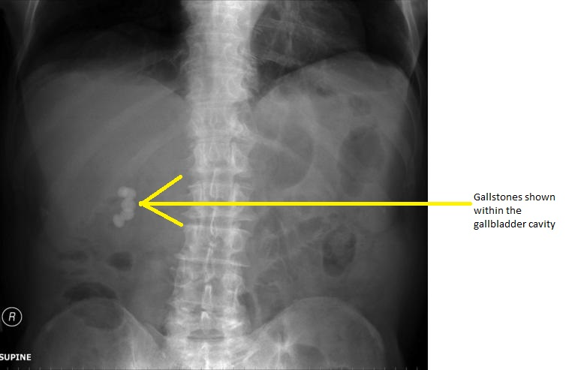
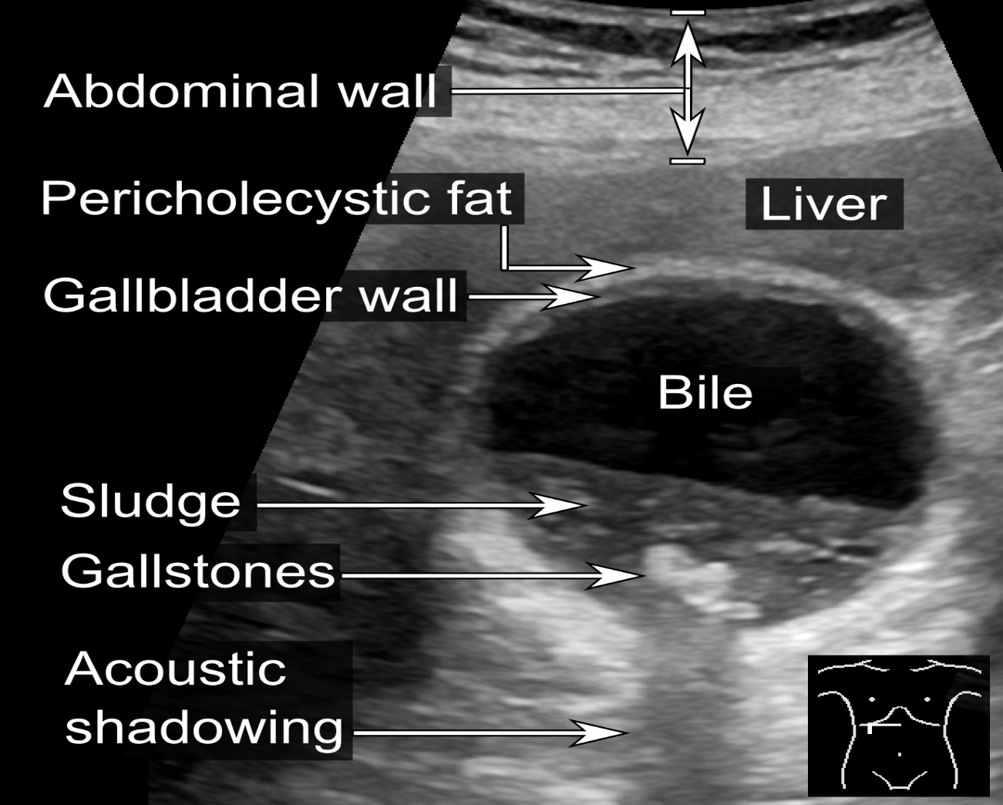
Gall bladder(X-ray/USG)

Slide 34
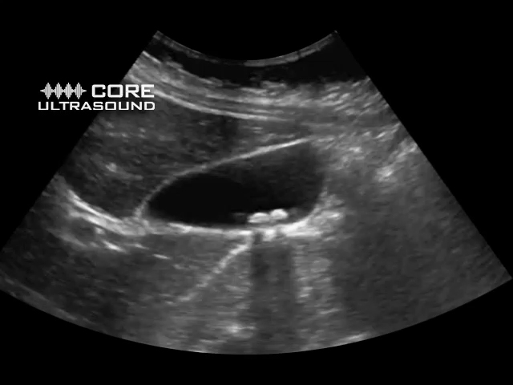

Slide 35
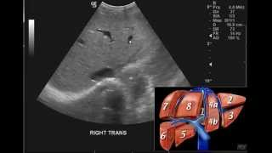
Liver

Slide 36
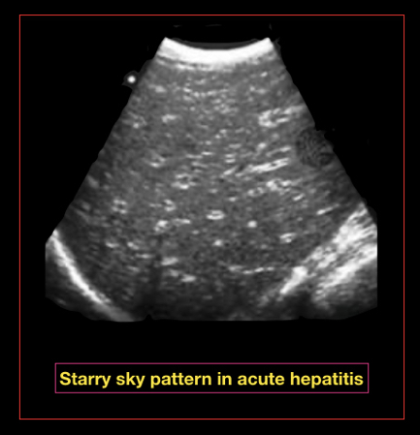
Utrasonography Of Liver

Slide 37
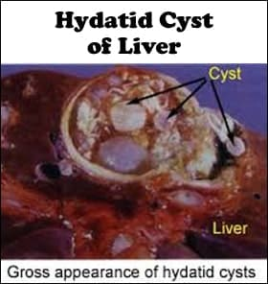
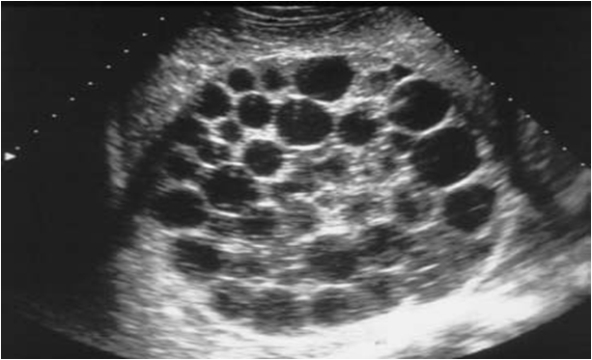

Slide 38
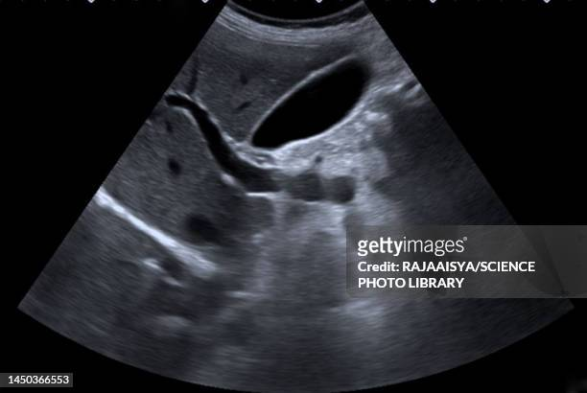
P.V

Slide 39
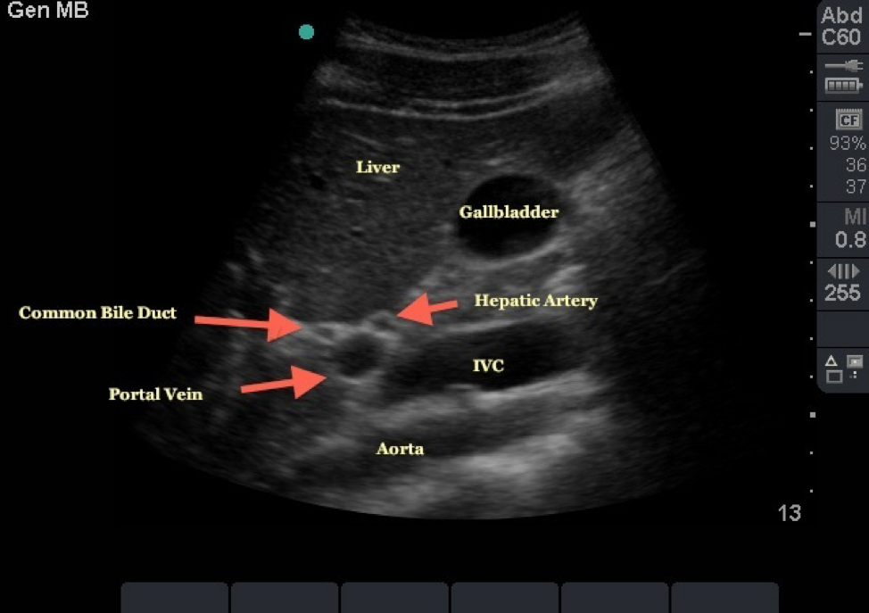

Slide 40
Layers of GIT

Slide 41
Small gut

Slide 42
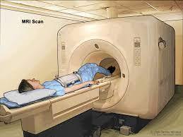
CT scan & MRI

Slide 43
CT scan abdomen

Slide 44
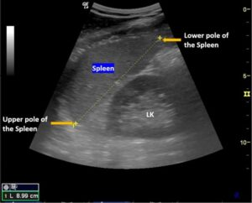
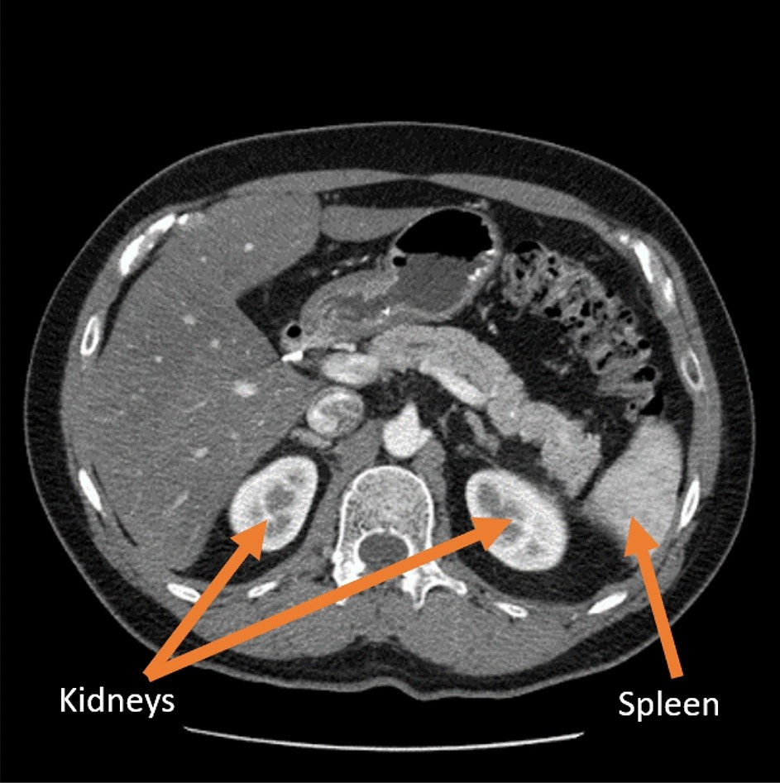
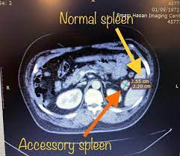
USG/CT ScanOf Spleen

Slide 45
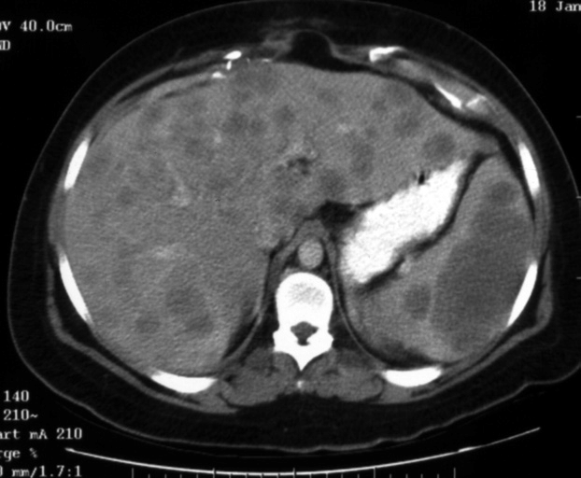
CT Scan of Hepatosplenomegaly

Slide 46
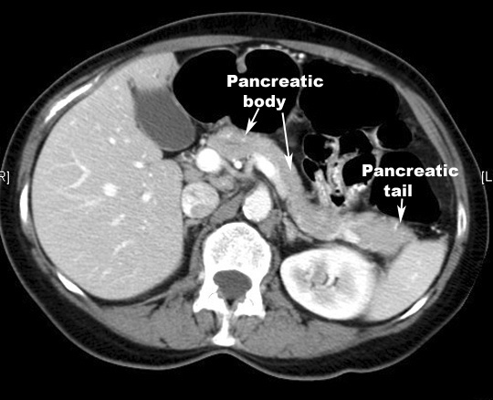
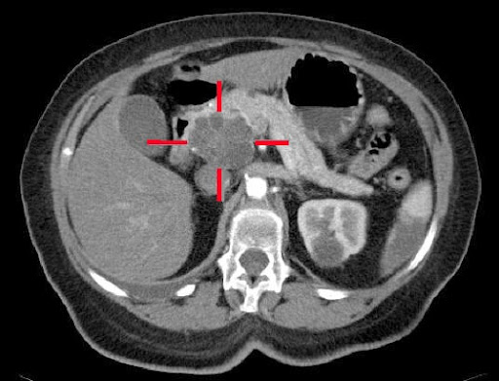
CT Scan of Normal/Abnormal Pancreas

Slide 47
MRI abdomen

Slide 48
Family Medicine & Professionalism
A team of doctors and other professionals will discuss your treatment, its benefits and the possible side effects with you. They are called a multidisciplinary team.
The treatment you have depends on:
1. Where the gastrinoma is and its size
2. Whether you have 1 or more tumors
3. Whether the gastrinoma has spread to other parts of the body
4. And your general health

Slide 49
RESEARCH ARTICLE
In bone and soft tissue sarcomas (STS), surgery was to the only local curative treatment, but recently, radiation therapy and interventional radiology has evolved to potentially curative treatment, namely in small size tumours. Indication for local treatment in STS needs validation in multidisciplinary team. Most will agree on local treatment for single metastatic location in a well-controlled disease and for no local treatment in a rapidly evolving multi-metastatic disease. The challenge is in patients who are in between, for whom benefit of disease control on overall survival should be evaluated. Local treatment has been reported beneficial in some large retrospective series, regardless of the association with chemotherapy in selected patients with oligometastatic disease.

Slide 50
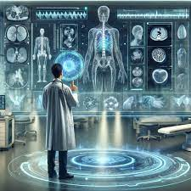
AI-can potentially aid in enhancing diagnostic accuracy & efficiency

Slide 52
Learning Resources
Films & Scans of cases presented at BBh & Holy Family Hospitals
Few case studies from PubMed & Google Scholar
Human Cross sectional anatomy (Atlas of body sections, CT and MRI images) 4th Edition

Slide 53
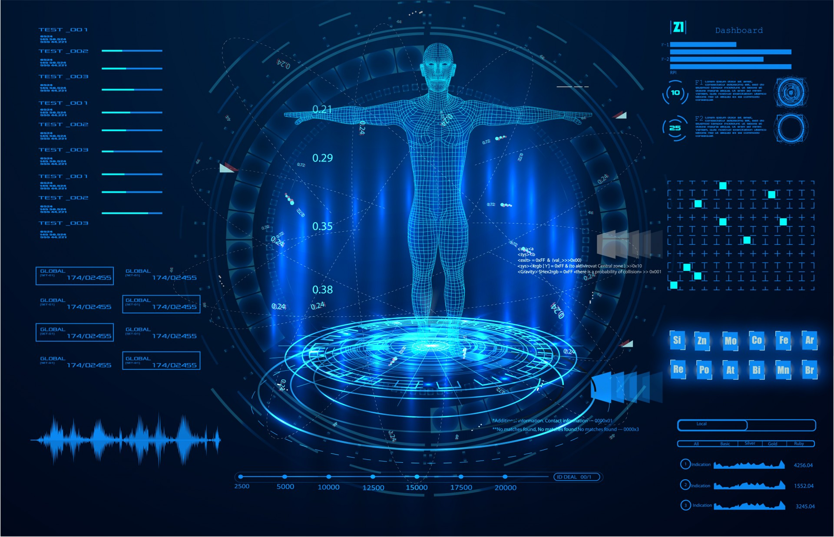
TKANKU

