Slide 1


Slide 2


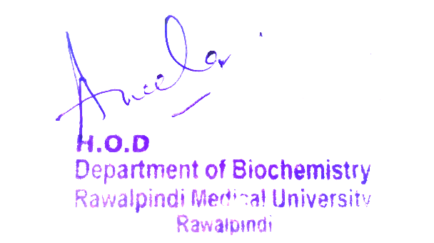
2nd Year MBBS
Introduction to Carbohydrate Metabolism and Glycolysis
Large Group Interactive Session
Presenter: Dr Uzma Zafar Date: 01-02-25
Deptt of Biochemistry
RMU

Slide 3
Motto, Vision, Dream
To impart evidence based research oriented medical education
To provide best possible patient care
To inculcate the values of mutual respect and ethical practice of medicine
Wisdom
Truth
Service

Slide 4
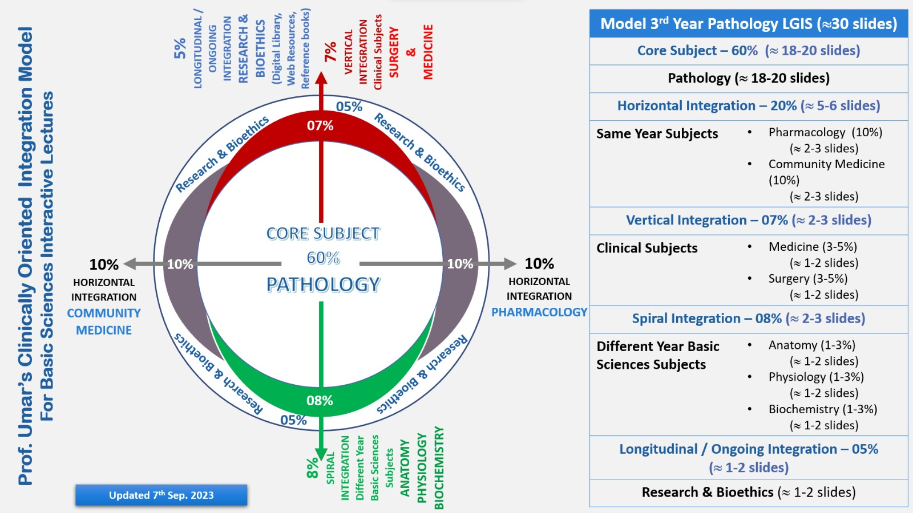
Professor Umar Model of Integrated Lecture

Slide 5
Learning Objectives
At the end of this session students should be able to
Understand metabolic pathways.
Discuss Glucose entry into the cells.
Explain types, reactions and regulation of Glycolysis.

Slide 6
Metabolism
Core Knowledge
Metabolism is the sum of all the chemical changes occurring in a cell, a tissue, or the body.
Metabolites are intermediate products of metabolism
In a pathway, the product of one reaction serves as the substrate of the subsequent reaction.
Most pathways can be classified as either catabolic (degradative) or anabolic (synthetic).

Slide 7
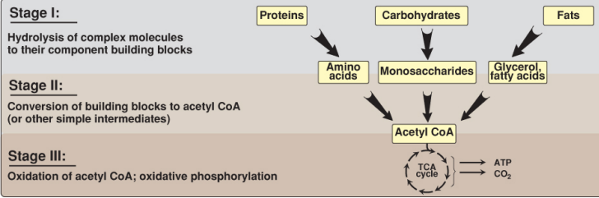
Catabolism
Core Knowledge
Three stages of catabolism
CoA = coenzyme A;
TCA = tricarboxylic Acid
CO2 = carbon dioxide.

Slide 8
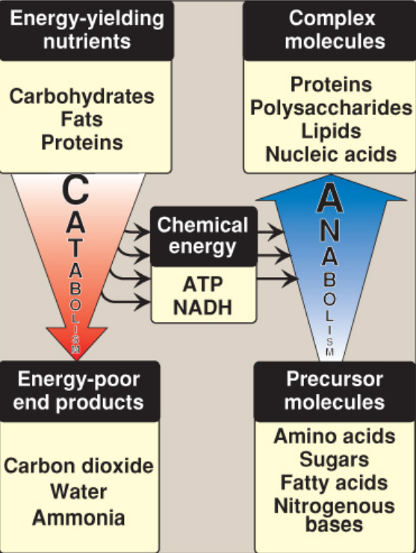
Anabolism
Core Knowledge
Anabolism is a divergent process in which a few biosynthetic precursors (such as amino acids) form a wide variety of polymeric, or complex products.
Anabolic reactions are endergonic, while Catabolic reactions generate energy and are exergonic.
Anabolic reactions often involve chemical reductant NADPH.

Slide 9
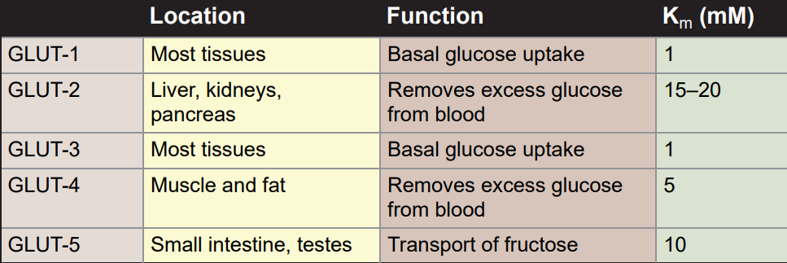
Glucose Transporters into Cells
Core Knowledge

Slide 10
Glucose Transport into Cells
Core Knowledge
Glucose cannot diffuse directly into cells but enters by one of two transport systems:
A sodium (Na+ )- and ATP-independent transport system or
A sodium (Na+ )- and ATP-dependent cotransport system.

Slide 11
Glucose Transport into Cells
Core Knowledge
A. Sodium- and ATP-independent transport system:
This passive system is mediated by a family of 14 glucose transporter (GLUT) isoforms found in cell membranes.
They are designated GLUT-1 to GLUT-14.
B. Sodium- and ATP-dependent cotransport of glucose:
This type of glucose cotransport with sodium occurs in the epithelial cells of the intestine, the renal tubules, and the choroid plexus that transports glucose against (up) its concentration gradient, from low extracellular concentrations to higher intracellular concentrations.

Slide 12
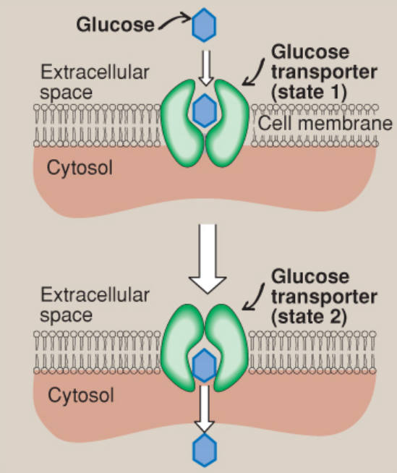
Glucose Transport into Cells
Core Knowledge
Schematic representation of the facilitated transport of glucose through a cell membrane.

Slide 13
Glycolysis
Core Knowledge
Glycolysis is at the hub of carbohydrate metabolism because virtually all sugars, whether from the diet or from catabolic reactions in the body, can be converted to glucose.
Pyruvate is the end product of glycolysis in cells with mitochondria and an adequate supply of O2.

Slide 14
Types of Glycolysis
Core Knowledge
This series of 10 reactions is called aerobic glycolysis because O2 is required to reoxidize the NADH formed during the oxidation of glyceraldehyde 3-phosphate.
Alternatively, pyruvate is reduced to lactate as NADH is oxidized to NAD+.
This conversion of glucose to lactate is called anaerobic glycolysis because it can occur without the participation of O2.

Slide 15
Hexokinase
Core Knowledge
Hexokinase have low Km and therefore high affinity for glucose, this permits the efficient phosphorylation and subsequent metabolism of glucose even when tissue concentrations of glucose are low.
In liver it is saturated under normal conditions and so acts at a constant rate to provide glucose-6-phosphate to meet the liver’s needs.

Slide 16
Glucokinase
Core Knowledge
It is present in liver parenchymal cell and beta cells of the pancreas.
Glucokinase functions as the glucose sensor, determining the threshold for insulin secretion.
In the liver ,the enzyme facilitates glucose phosphorylation durning hyperglycemia.

Slide 17
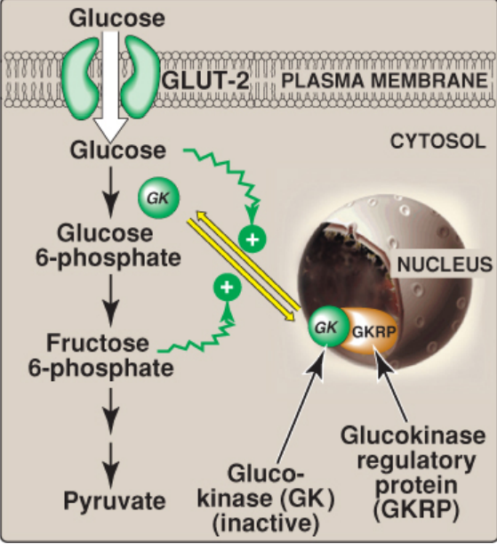
Kinetics of Glucokinase
Core Knowledge
Regulation of glucokinase activity by glucokinase regulatory protein. GLUT = glucose transporter.

Slide 18
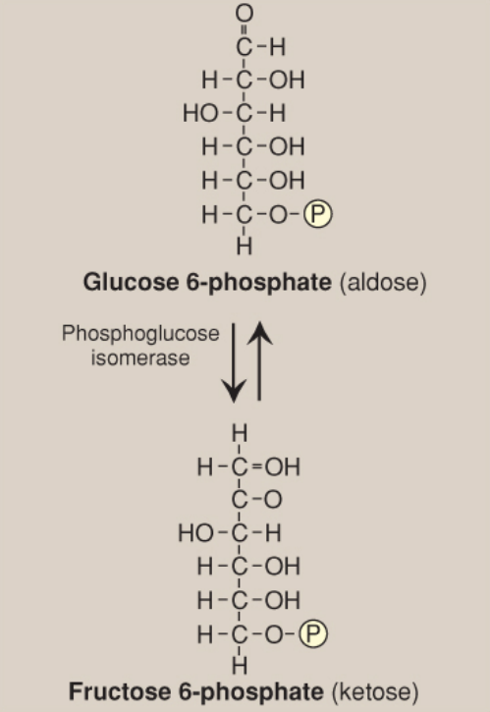
Reactions of Glycolysis
Core Knowledge
Aldose-ketose isomerization of glucose 6-phosphate to fructose 6- phosphate.

Slide 19
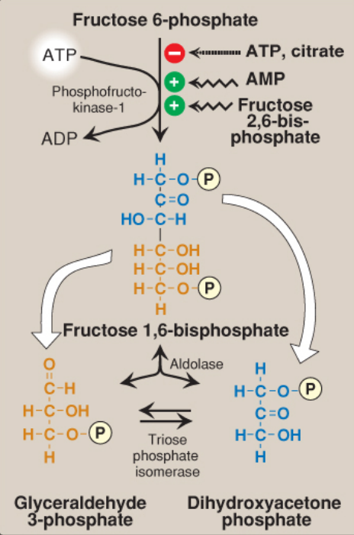
Reactions of Glycolysis
Core Knowledge
Energy-investment phase (continued): conversion of fructose 6-phosphate to triose phosphates.

Slide 20
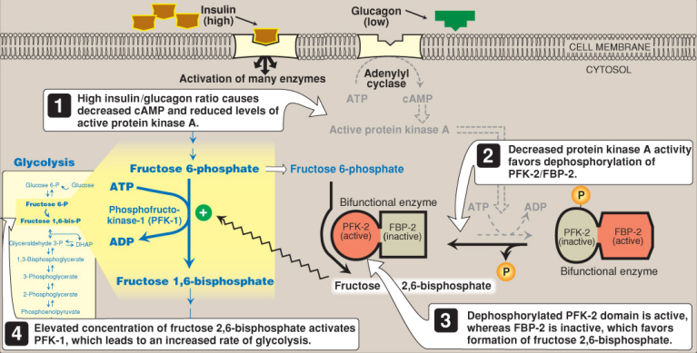
Insulin Effect on fructose 2,6-bisphosphate
Core Knowledge
Effect of elevated insulin concentration on the intracellular concentration of fructose 2,6-bisphosphate in the liver.

Slide 21
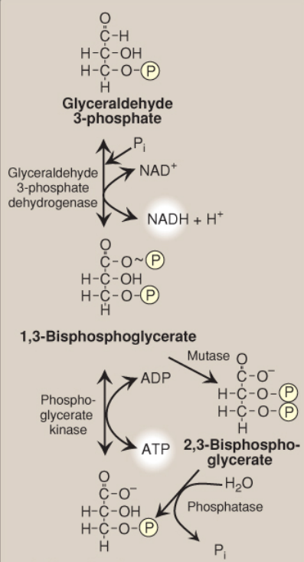
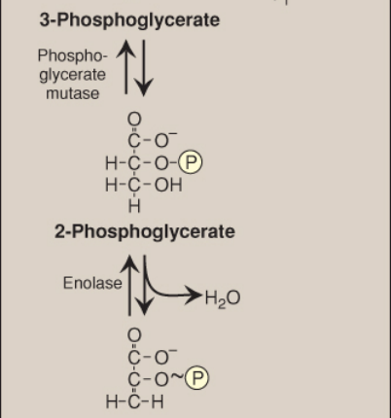

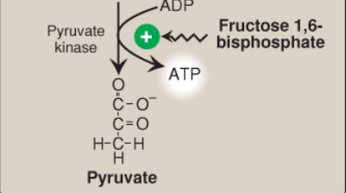
Core Knowledge
Energy-Generating Phase
conversion of glyceraldehyde 3- phosphate to pyruvate

Slide 22
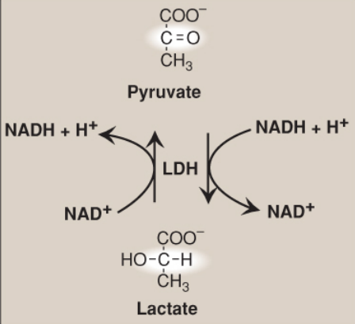
Pyruvate Reduction to Lactate
Core Knowledge
Interconversion of pyruvate and lactate by lactate dehydrogenase (LDH). NAD(H) = nicotinamide adenine dinucleotide.

Slide 23
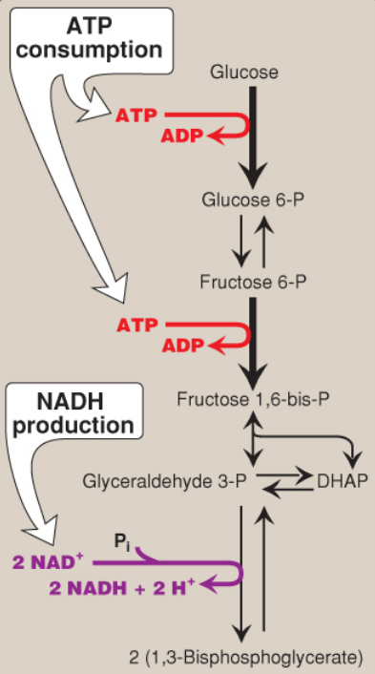
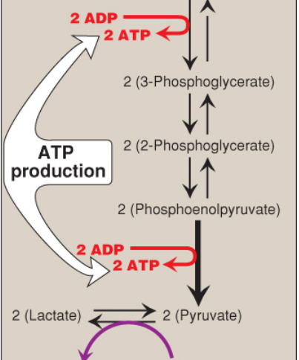
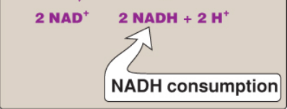
Summary of Glycolysis
Core Knowledge

Slide 24
Energy Yield from Anaerobic Glycolysis
Core Knowledge
A net of 2 molecules of ATP are generated for each molecule of glucose converted to 2 molecules of lactate
There is no net production or consumption of NADH

Slide 25
Energy Yield from Aerobic Glycolysis
Core Knowledge
The generation of ATP is the same as in anaerobic glycolysis that is a net gain of 2 ATP per molecule of glucose
2 molecules of NADH are also produced per molecule of glucose
Each NADH produces 3 ATP by passing through ETC

Slide 26
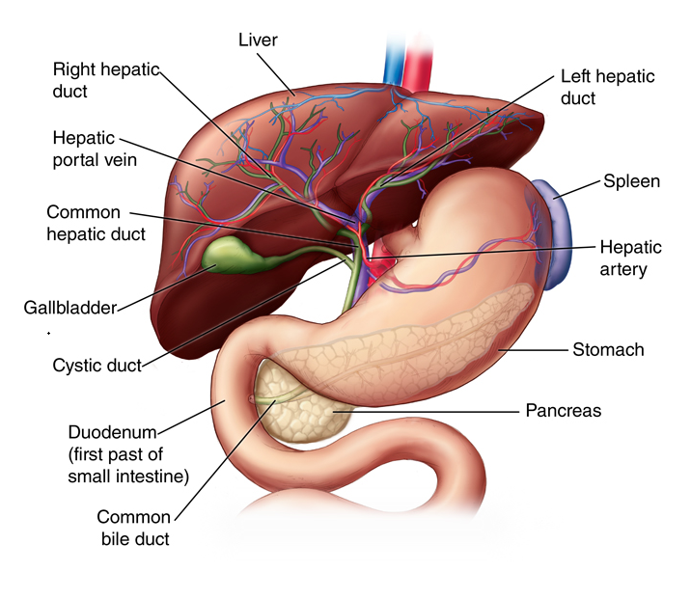
Horizontal Integration

Slide 27
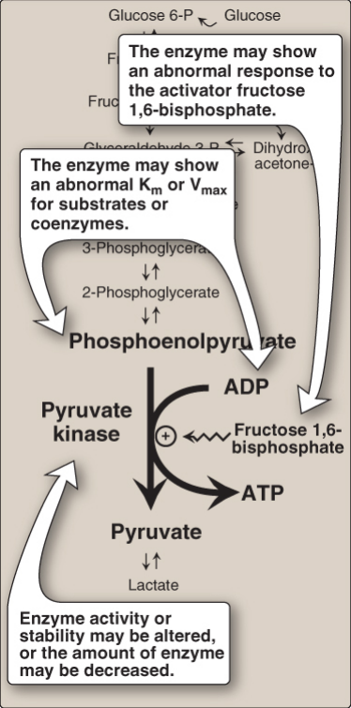
Vertical Integration
Pyruvate Kinase Deficiency
Alterations observed with various mutant forms of pyruvate kinase.

Slide 28
Spiral Integration
Family Medicine
Family Medicine plays important role in following manner:
Supportive care
Make appropriate tests to confirm diagnosis
Counsel the patient about the autosomal recessive disorder
Management of the blood transfusion depending upon the severity of disorder
Refer to Specialists for further management

Slide 29
Spiral Integration
Bioethics
Ethical Considerations
From an ethical standpoint, the scenario raises considerations regarding patient autonomy, informed consent, and confidentiality
The physician must ensure that patient fully understands her diagnosis, treatment options, and potential implications
Discuss the necessity of a healthy lifestyle & treatment plan. This requires clear communication and understanding of risks and benefits.
Additionally, the physician must respect patient’s privacy and confidentiality throughout the diagnostic and treatment process

Slide 30
Spiral Integration
Artificial Intelligence
Role of AI in Management
AI can potentially aid in enhancing diagnostic accuracy and efficiency.
AI-powered decision support systems can also help clinicians in selecting appropriate treatment modalities
AI-driven predictive models may help anticipate the risk of complications of the Disease in susceptible populations

Slide 31
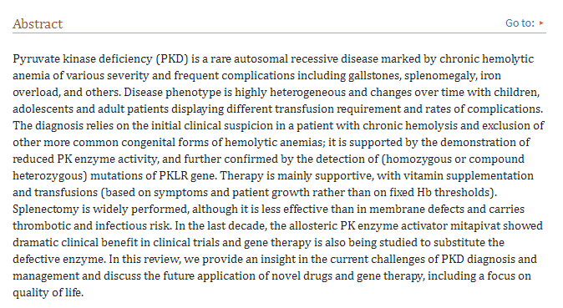
Spiral Integration
Research Article
Link:
https://www.ncbi.nlm.nih.gov/pmc/articles/PMC9444143/#:~:text=Pyruvate%20kinase%20deficiency%20(PKD)%20is%20a%20congenital
Journal Name:
PubMed Central
Title:
Pyruvate Kinase Deficiency: Current Challenges and Future Prospects
Author Name:
Bruno Fattizzo et al.

Slide 32
How To Access Digital Library
Steps to Access HEC Digital Library
Go to the website of HEC National Digital Library
On Home Page, click on the INSTITUTES
A page will appear showing the universities from Public and Private Sector and other Institutes which have access to HEC National Digital Library HNDL
Select your desired Institute
A page will appear showing the resources of the institution
Journals and Researches will appear
You can find a Journal by clicking on JOURNALS AND DATABASE and enter a keyword to search for your desired journal

Slide 33
Learning Resources
Text book of Biochemistry, Lippincott 8th edition, chapter no. 08 , page no. 100
Google scholar
Google images

Slide 34
THANK YOU

