Slide 2
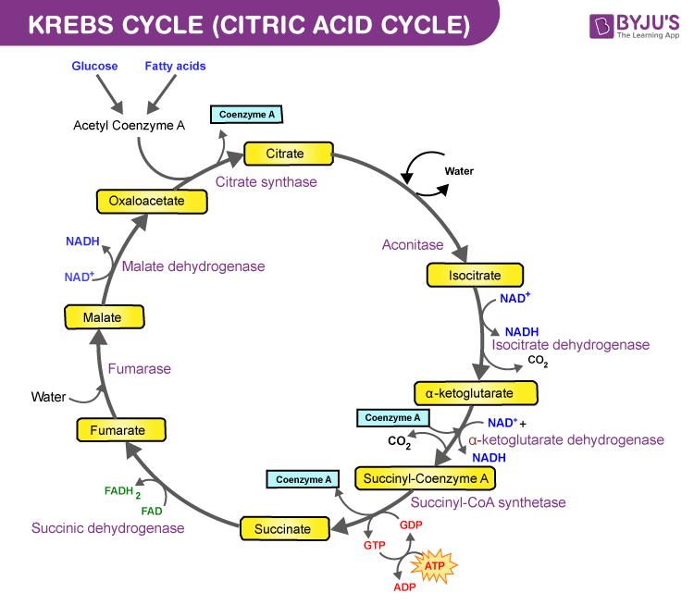
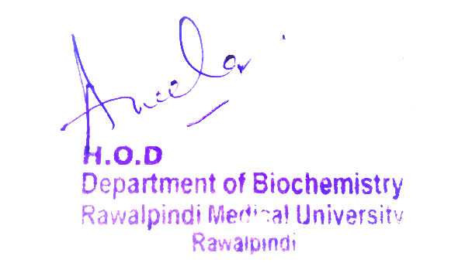
Gastrointestinal Tract (GIT) Module 2nd Year MBBS(LGIS) TCA CYCLE
Presenter: Dr. Uzma Zafar Date: 31-01-25
(APWMO)

Slide 3
Motto, Vision, Dream
To impart evidence based research oriented medical education
To provide best possible patient care
To inculcate the values of mutual respect and ethical practice of medicine
Wisdom
Truth
Service

Slide 4
Professor Umar Model of Integrated Lecture

Slide 5
Learning Objectives
At the end of this session students should be able to
1. Explain the reaction of TCA cycle and its regulation
2. Discuss energy yield in TCA cycle

Slide 6
Interactive Session
A 6-month-old infant is brought to the family physician by his parents due to poor feeding, lethargy, developmental delay, and episodic vomiting. The child has a history of failure to thrive and seizure-like episodes. On examination, the infant has hypotonia and signs of metabolic acidosis. Laboratory investigations reveal lactic acidosis, hyperammonemia, and hypoglycemia. Urine organic acid analysis shows elevated lactate, alanine, and ketone bodies. The infant is referred to a biochemical geneticist for confirmatory enzyme assays and genetic testing.

Slide 7
TCA Cycle
The Tricarboxylic Add (TCA) cycle, also known as the kerbs cycle or citric add cycle.
It is a fundamental metabolic pathway found in aerobic organisms, including humans.
It plays a central role in the breakdown of carbohydrates, fats, and proteins to generate energy in the form of ATP (adeno sine tri phosphate).

Slide 8
Steps of TCA Cycle

Slide 9
Citrate Synthesis

Slide 10
Citrate Isomerization & Oxidative Decarboxylation of Isocitrate

Slide 11
Oxidative decarboxylation of α-ketoglutarate

Slide 12
Succinyl CoA Cleavage

Slide 13
Succinate Oxidation

Slide 14
Fumarate Hydration

Slide 15
Malate Oxidation

Slide 16
Energy Produced by TCA Cycle

Slide 17
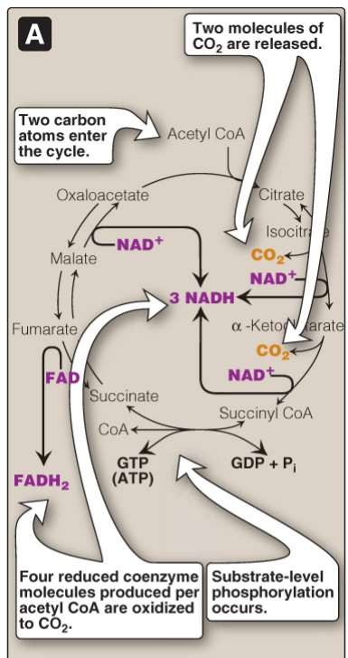
Cycle Regulation
Production of reduced Coenzymes, ATP & Co2 in TCA cycle

Slide 18
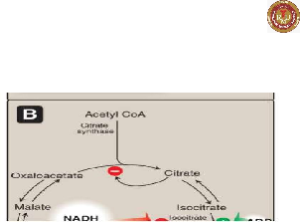
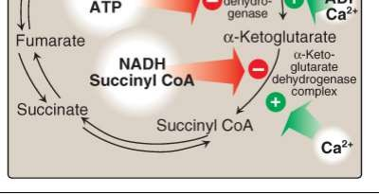
Core Knowledge
Cycle Regulation
Inhibitors & Activators of the cycle

Slide 19
Vertical Integration

Slide 20
Vertical Integration Leigh Syndrome
It is also known as subacute necrotizing encephalomyelopathy
It is a rare and severe neurological disorder that typically begins in infancy or early childhood.
Caused by defects in mitochondrial ATP production, primarily as a result of mutations in genes that encode proteins of the PDHC, or ATP synthase
Both nuclear and mitochondrial DNA affected

Slide 22
Spiral Integration Family Medicine
Family Medicine plays important role in following manner:
Diagnosis: Family physician plays a crucial role in recognizing the signs and symptoms such as developmental delays, muscle weakness, and neurological abnormalities.
Education: Family physicians educate patients and their families about Leigh syndrome, including its underlying genetic cause, clinical manifestations, prognosis, and available treatment options.
Multidisciplinary Care Coordination: Family physicians collaborate with a multidisciplinary team of health care professionals, including neurologists, genetic counselors, physical therapists, occupational therapists, and social workers, to provide comprehensive care for individuals with Leigh syndrome.
Community Support: Family physicians advocate for individuals with Leigh syndrome and their families within the healthcare system and the broader community.
Refer to Specialists: Family physicians refer to patient to the specialist for further treatment

Slide 23
Spiral Integration Artificial Intelligence
Artificial Intelligence plays role in following aspects:
AI algorithms can assist in the early detection of Leigh syndrome by analyzing medical imaging data such as MRI scans, aiding clinicians in making a timely diagnosis.
AI can help analyze genetic data to identify mutations associated with Leigh syndrome
AI-driven drug discovery platforms can identify potential therapies for Leigh syndrome. By analyzing vast amounts of biological data, including molecular pathways involved in the disease

Slide 24
Suggested Research Article
Links:
https://www.ncbi.nlm.nih.gov/ pmc/articles/PMC9871338/
Journal Name:
PubMed Central
Title:
Regulation and function of the mammalian
tricarboxylic acid cycle
Author Name:
Paige K. Arnold et al.

Slide 25
Spiral Integration
Bioethics
Genetic Testing and Counseling
Prenatal Diagnosis and Reproductive Choices
Treatment Decision-Making
Research Ethics
Access to Healthcare and Support Services

Slide 26
Learning Resources
Textbook of Biochemistry, Lippincott 8th edition, chapter no 09, page no 120
Google scholar
Google images

Slide 27
https://youtu.be/F6vQKrRjQcQ

