Slide 1
Forensic Psychiatry
Dr Filza ali Dr Gulzaib

Slide 3
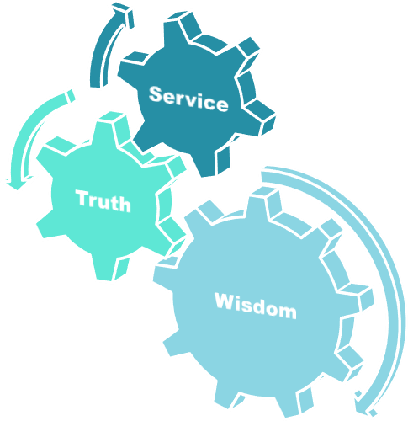
Motto of RMU

Slide 4
Vision of Rawalpindi Medical University The Dream/ Tomorrow
🞄 To impart evidence based research oriented
medical education
🞄 To provide best possible patient care
🞄 To inculcate the values of mutual respect and ethical practice of medicine

Slide 5
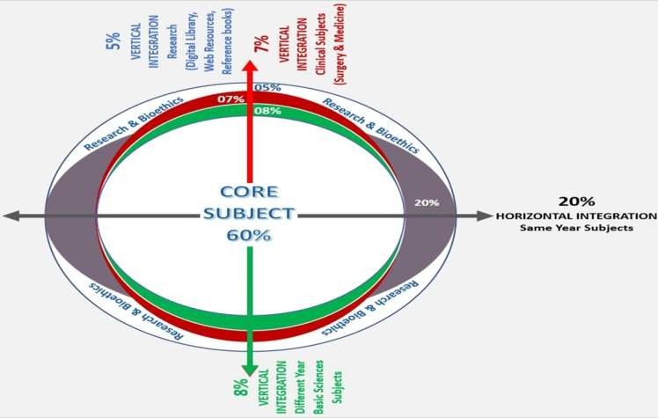
Prof Umar’s LGIS Model

Slide 6
SEQUENCE OF LGIS
Learning Objectives
Core concept 70 %
Horizontal integration related to Pathology and Pharmacology 15 %
Relevant clinical concepts and medico legal application of core knowledge / Vertical integration 10%
Research article relevant to the topic 3%
Ethics and family medicine 2%

Slide 7
🞄 Define Psychiatry, Forensic psychiatry, Insanity , Compos mentis
🞄 Define hallucination and enlist its types.
🞄 Define delusion and classify its types.
🞄 Briefly explain different mental disorders
🞄 State the medicolegal importance of both fit and unfit to trial and define plea of insanity
🞄 Distinguish between true and feigned insanity.
Learning Objectives

Slide 8
Psychiatry & Forensic Psychiatry
Core Concept
Psychiatry
🞄 It deals with study, diagnosis & treatment of mental
illness.
Forensic Psychiatry
🞄 It deals with application of Psychiatry in the
administration of justice.
🞄 Forensic psychiatry is the branch of psychiatry that
🞄 deals with issues arising in the interface between psychiatry and the law, and with the flow of mentally disordered offenders along a continuum of social systems

Slide 9
Core Concept
A state of emotional and psychological well- being in which an individual is able to use his or her cognitive and emotional
capabilities, function in society, and meet the
ordinary demands of everyday life.
A field comprising various professions, such as psychiatry and social work, that deals with the promotion of mental and psychological well-being and the prevention, diagnosis, or treatment of mental disorders.
Mental Health

Slide 10
Core Concept
oGood mental health is a sense of wellbeing, confidence and self-esteem.
oIt enables us to fully enjoy and appreciate
other people, day-to-day life and our environment.
Good mental health
When we are mentally healthy we can:
oform positive relationships
ouse our abilities to reach our potential
odeal with life’s challenges .

Slide 11
Core Concept
🞄 of sound mind, memory, and understanding
legally fit to conduct/defend proceedings
Examples of COMPOS MENTIS
🞄 went to court to prove that her grandmother was no longer compos mentis and needed a legal guardian
🞄 Not sound in mind
Compos Mentis
🞄 A person classed as unfit to conduct/defend legal proceedings

Slide 12
Core Concept
🞄 Insane---in a state of mind that
prevents normal perception, behavior, or social interaction; seriously mentally ill.
Insane & Insanity
🞄 Insanity, craziness or madness is a spectrum of behaviors characterized by certain abnormal mental or
behavioral patterns

Slide 13
Core Concept
Hereditary (Huntington chorea)
Environmental (faulty parental attitude & lack of mental hygiene )
iii.
Psychogenic (unsuccessfully repressed mental conflicts.
Causes of insanity
iv. Precipitating (frustration , financial worries, disappointment in sexual affairs, death of close relation.
v. Organic (head injury, atherosclerosis, senile
degeneration, myxedema, pernicious anemia.

Slide 14
Core Concept
🞄 Defined in the Criminal Code as a “disease of the mind”
🞄 Can include any mental abnormality which causes impairment
🞄 With the exception of voluntary intoxication or transient mental states such as hysteria or concussion
🞄 Consequently, personality disorders are eligible for this defence.
🞄 An individual with a personality disorder would be unable to appreciate the nature and quality of the act in the manner that the courts have ruled.
Mental disorder

Slide 15
Core Concept
🞄 It is false sense of perception without any external object or stimulus to produce it.
Types
→Visual (tiger)/flashes of light
→Auditory (voices)
→Olfactory (smell)
→Gustatory (sweet, Bitter taste)/food is being
tampered.
→Tactile/touch (rats or mice)
→Psycho motor (feeling of movement of some parts)
Hallucination & its Types:-

Slide 16
Core Concept
🞄 It is false/firm belief in something which is not a fact.
Types
→Infidelity (wife unfaithful) Othello syndrome,(the
dangerous state of morbid jealousy)
→Self Reproach (past failure)
Delusion & its Types:-
→Nihilistic (No world or no existence)
→Hypochondriac (unhealthy or disease)e.g, cancer
,depression of later life.
→Persecution (poison)he imagines that attempts of being killed by relatives.
→Grandeur or exaltation ( Feeling rich)
→Reference (stranger looking at him)
→Influence, believes that his thoughts/actions are being influenced to harm him.

Slide 17
Core Concept
Delirium
🞄 It is disturbance of consciousness in which
orientation is impaired.
Delirium & Illusion
Illusion
🞄 It is a false interpretation in the sense of an external object or stimulus which has a real existence; when a person sees a dog & mistaken it for tiger, a stick for a snake.

Slide 18
🞄 It is a sudden irresistible force compelling a person to the conscious performance of some action without motive or fore thought.
Core Concept
Impulse
Kleptomania (stealing of things from shop)
Pyromania (sets fire to things)
Mutilomania (mutilate animals or insects)
Dipsomania (alcoholic drinks )
Suicidal impulse
Homicidal impulse
Impulse

Slide 19
It is a single idea, thought or emotion which
Core Concept
Obsession
Obsession & Aphasia
is constantly entertained by a person.
Aphasia
🞄 Loss of ability to express meaning by use of speech or writing (motor) or under stand spoken or written languages (sensory)

Slide 20
🞄 Somnambulism, this is an abnormal mental condition & means walking during sleep in this condition mind is
Core Concept
partially active & so concentrated on one particular train of ideas that a somnambulist is capable of performing most remarkable & incredible work.
Somnambulism

Slide 21
Core Concept
This is half way between sleep & walking & is very often called sleep drunkenness.
This may be after epileptic fit from deep sleep,
Semi-
Somnolence or
Somnolentia
he may unconsciously commit some horrible & illegal deed owing to his mind being in a state of confusion especially he is having dream or nightmare at the time.
He is not criminally responsible for such a deed.

Slide 22
Borderline Personality Disorder
Core Concept
Tend to act without
considering consequences
Lack of Impulse control
Transient stress-related paranoid ideas or severe dissociative symptoms.

Slide 23
Psychopath (personality disorder)
Core Concept
🞄 Psycho path is a person who is neither insane nor mentally defective but fails to conforms to normal standards of behavior.
🞄 It is a persistent disorder or disability of mind which results in abnormally aggressive conduct on the part of person.

Slide 24
🞄 They are characterized
by withdrawal from reality, living in a world of fantasy.
Core Concept
Psychosis

Slide 25
🞄 Organic psychosis
Core Concept
🞄 Endocrine, metabolic systemic, intoxication childbirth, cerebral arteriosclerosis, epilepsy, tumor, senile dementia, alcoholic
intracranial infarction.
Classification:

Slide 26
Core Concept
🞄 Emotional or intellectual disorder but does not lose touch with reality.
🞄 It is a condition of nervous exhaustion due to physical or mental condition.
Types
Anxiety neurosis
Hysterical neurosis
Alcoholic neurosis
Obsessive compulsive
Depressive neurosis
Hypochondriacs neurosis
Unspecified neurosis
Neurosis

Slide 27
Core Concept
“Unfit to stand trial” is defined in the Criminal Code.
It means because of a mental disorder that
the accused person is unable to defend against the charge(s) he is facing or to tell their lawyer what they want to do with their case.
If a judge has reasonable grounds to believe that an accused is suffering from some mental problem , he will likely order a fitness assessment.
An accused who is not “unfit to stand trial” is usually referred to in court as “fit to stand trial” or simply as “fit.”
The law assumes that every accused person is “fit”, unless it is determined by a judge, after a fitness hearing that the accused is “unfit to stand trial.”
Fitness to Stand Trial

Slide 28
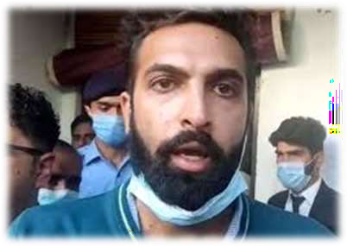
Core Concept
To be found Unfit to Stand Trial, the
individual must, on account of mental disorder, be unable to conduct their defense at any
stage of the proceedings before a verdict is rendered or to instruct counsel to do so.
In forensic psychiatry it is called “insanity
plea”, particularly in the case of murder.
Unfitness to Stand Trial

Slide 29
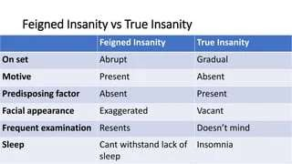
True and Feigned Insanity
Core Concept

Slide 30
Research
https://www.ncbi.nlm.nih.gov/pmc/articles/PMC28 00139/
https://www.researchgate.net/publication/2325467 28_Comparing_True_and_False_Confessions_Amo ng_Persons_With_Serious_Mental_Illness
https://www.researchgate.net/publication/3349798 82_The_mental_representation_of_true_and_fals e_intentions_a_comparison_of_schema- consistent_and_schema-inconsistent_tasks
https://www.thecut.com/2017/02/how-hard-is-it- to-fake-insanity.html
Research

Slide 31
Ethics
The Mental Healthcare Act 2017 explicitly talks about the rights of patients with mental illness and lays down the ethical and legal responsibilities of mental health professionals and the government.
Autonomy, non-maleficence, beneficence, and justice are ethical principles that guide mental health care. Having an intentional process of ethical deliberation is essential. Clinicians need to act in the best interests of the people, families, and communities they serve.
Biomedical Ethics

Slide 32
Family Medicine
Family physicians are on the front lines of mental
health treatment.
Although not all mental illness is intensely disruptive for the family, mental illness always has its impact. A family physician can be a catalyst for eventually getting the family to a counselor, to a psychiatrist, or into community support.
Never underestimate the power of a calm and compassionate family physician upon a family struggling with mental illness.
It may be the healing engagement of the family physician that becomes the family’s lifeline to find inner strengths and external avenues to survive.
🞄 https://www.ncbi.nlm.nih.gov/pmc/articles/PMC53 94372/
Family Medicine

Slide 33
How To Access Digital Library
Steps to Access HEC Digital Library
Go to the website of HEC National Digital Library.
On Home Page, click on the INSTITUTES.
A page will appear showing the universities from Public and Private Sector and other Institutes which have access to HEC National Digital Library HNDL.
Select your desired Institute.
5.A page will appear showing the resources of the institution
6. Journals and Researches will appear
7. You can find a Journal by clicking on JOURNALS AND DATABASE and enter a keyword to search for your desired journal.

Slide 34
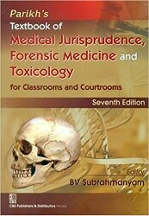
TEXT BOOKS & PRACTICAL NOTEBOOK:
Principles & Practice of Forensic Medicine.
by Nasib R. Awan
Parikh’s Textbook of Medical Jurisprudence,
Forensic Medicine & Toxicology.
Practical Manual Of Forensic Medicine
& Toxicology

